Slide 1
Mobility Tracking
Qiyin Fang, Adam Yu, Michael Zon

Slide 2
Targeted parameters
Location (GPS)
Time-stamped GPS coordinates
What time?

Slide 3
Sensing requirements
Track mobility
1000-2000 patients
Partitioned into cohorts
1 week out of 3 months continuously tracked
Next step
Ideally no configuration
Ideally no charging

Slide 4
Sensor types
Sensors
Data is stored locally
Retrieved after week
Timestamp, continuous
Sampling frequency tbd
Type 1: Bracelet sensor
Type 2: GPS
Device validation
Validate accuracy

Slide 5
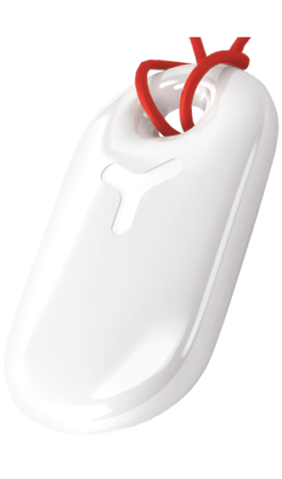
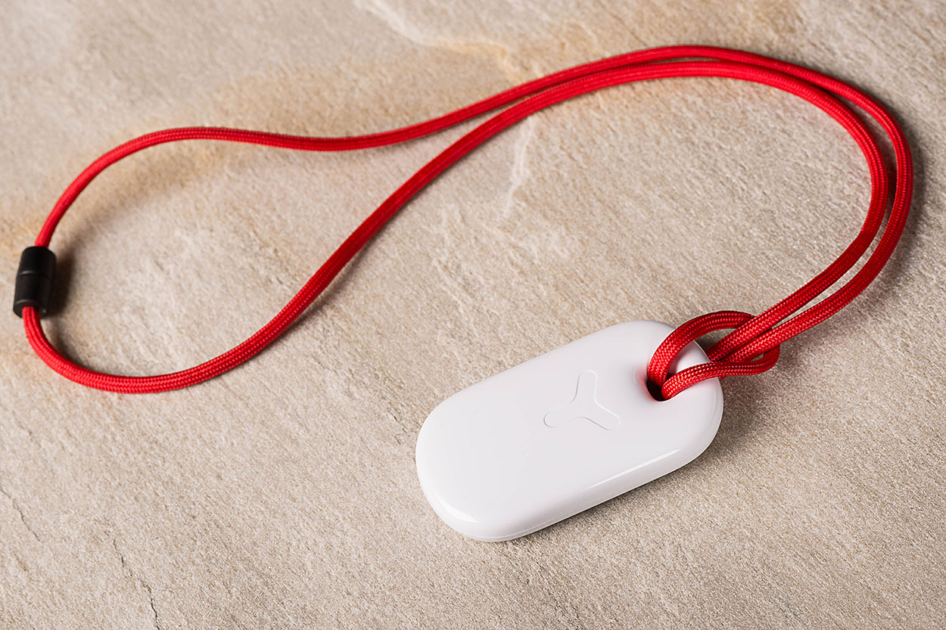
Type 1: GPS
Less than $100-150
Travel path
Speed
Distance
Battery life
•Accelerometer activated/deactivated
https://yepzon.com/product/yepzon/

Slide 6
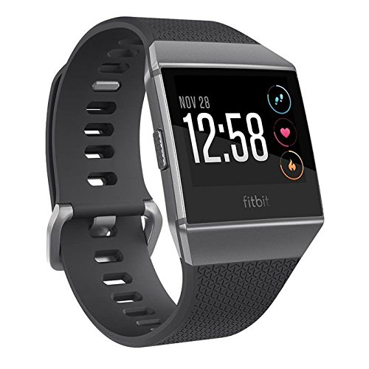
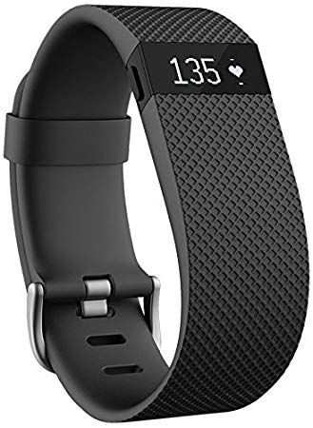
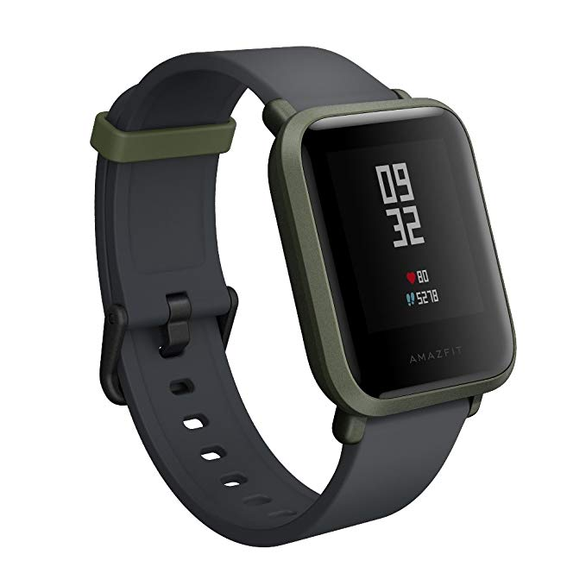
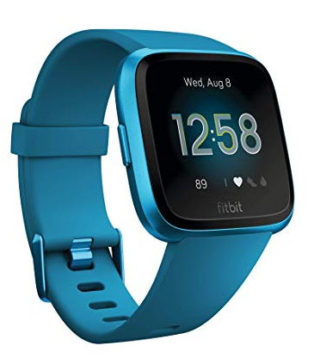
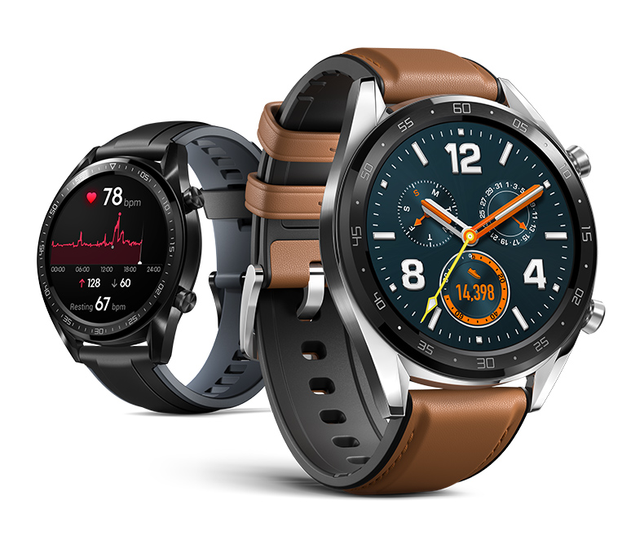
Type 2: wrist watch
$50-100
Data retrieval
Step count
Distance
Stairs (direction)
Heart rate
Sleep: start, stop
Blood pressure (optional)
Oxygenation (relatively easy)
Accelerator
Gyroscope
Every 3s

Slide 7
Fitbit Ionic Constraints
Battery life with custom software running for 8 days
Sensor sampling frequency >1/3 Hz
Sensors
Accelerometer
Global Positioning System (GPS)
Data Privacy
Ability to turn off communication capability of device
Data stored on device
5 MB storage
Enough for 7 days of continuous logging at 1/3 Hz
Direct retrieval of GPA and other identifying data
No first-party (by company of device) logging of data
Reproducibility of data
Ability to turn off screen and all user interfacing

Slide 8
Fitbit Ionic Objectives (in addition to Constraints)
Production at scale
Potential for automated data retrieval process
Potential for automated deployment of custom software to all devices
Sensor sampling frequency of 1 Hz
15 MB per sensor
Enough for 7 days of continuous logging at 1 Hz
Sensors
Hear rate (beats per minute)
Body presence (worn or not)
Barometer
Gyroscope
Orientation (quaternion)
Oxygenation

Slide 9
Fitbit Ionic Test Components
System with empty program
Barometer
Gyroscope
Accelerometer
Heart Rate
Orientation
Body Presence
Global Positioning System (GPS)
Writing to device

Slide 10
Fitbit Ionic Battery Test
Each component is individually tested
Each time point records elapsed charge from initially full charge
Sampling Times
3 hours
6 hours
12 hours

Slide 11
Huawei Watch GT
https://consumer.huawei.com/us/wearables/watch-gt/

