Slide 1


Deception Detection (CAUT)
Overview
Team-A:
Shreya Salgia, Hinal Desai, Levan Sulimanov

Slide 2
Table of contents
Introduction
Project Diagram
01
02
State of the Art
Dataset
03
04
Give brief goal
Show overall workflow
Mention past research
Describe train data

Slide 3
Introduction
Provide affordable and non-invasive deception detection tool for law enforcement and court personnel.

Slide 4
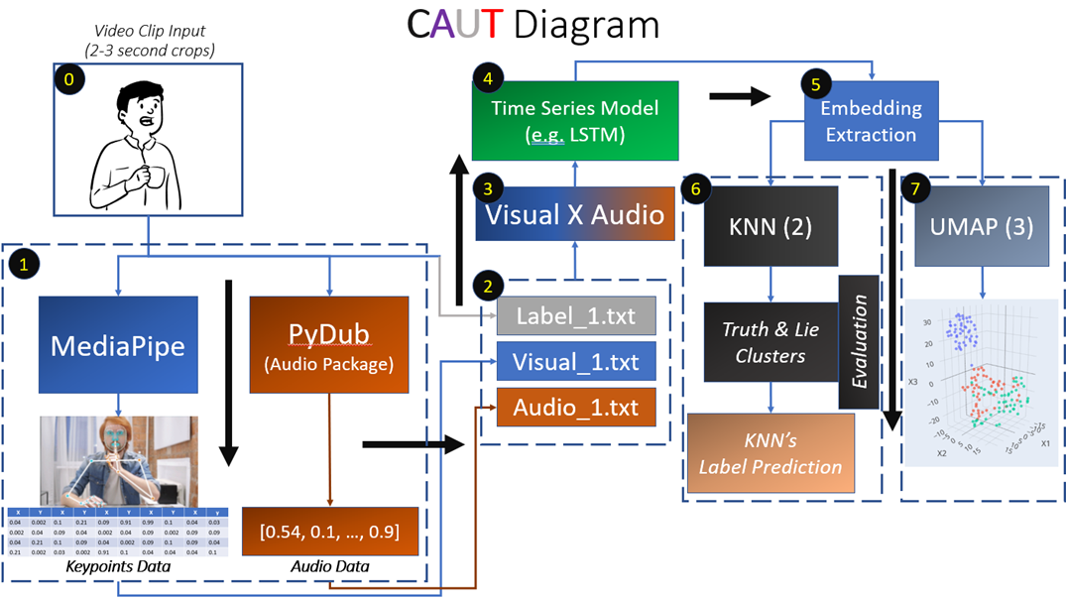
Proposed Solution
Diagram with main building blocks of our project pipeline.

Slide 5
State of Art
Frontiers
Detecting Human Emotion
Emotion Recognition and Deception Detection

Slide 6
Data Distribution
Lies
The total files including the audio and video (.mp4) files is 829.
-> Count of the files under the Truth label = 389
-> Count of the files under the Lie label = 400
Since the video files under each label are 60 each,
-> Count of the audio files under the Truth label = 329
-> Count of the audio files under the Lie label = 340
…

Slide 7
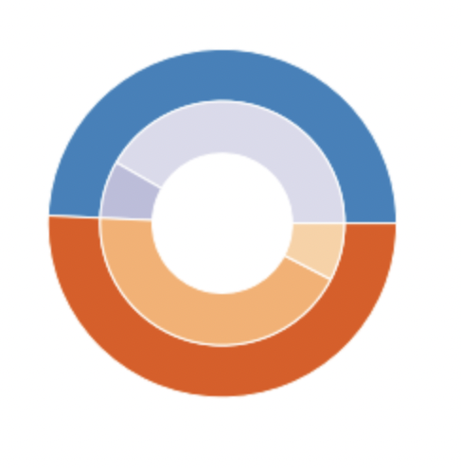
Truth : 389
Truth Audio : 329
Truth Video : 60
Lie
Video : 60
Lies : 400
Lie Audio : 340

Slide 8
Data Distribution
Each video will be divided into frames with 30 frames being generated per second, for a 3 second video.
As per the Mediapipe, each frame has 468 feature points that will be read.
Total_Features_Per_Video = 468*30FPS*3 = 42,120
Total_Features_Per_Video * 120 Videos ~= 5,054,400
…

Slide 9
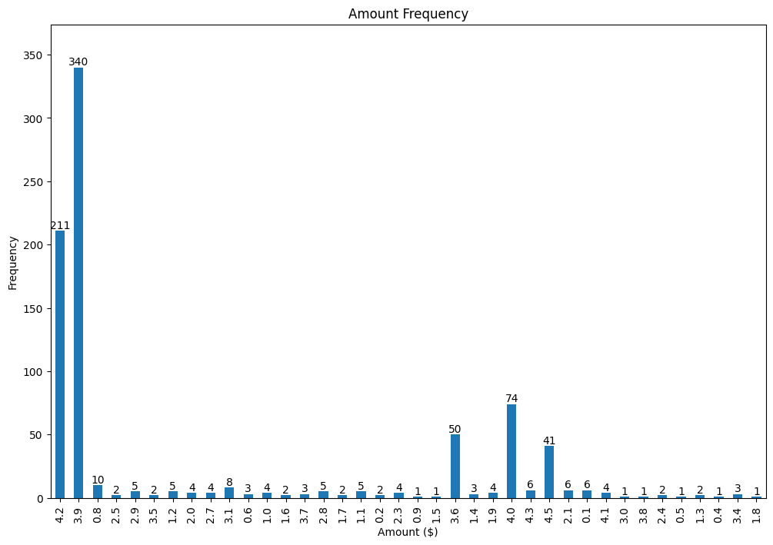
Data Duration
Each video contains 1-3 second court scene
Appropriate label provided per each video segment

Slide 10
Resources
Photos:
…
Projects:
Frontiers: https://www.frontiersin.org/articles/10.3389/fpsyg.2021.675097/full
Detecting Human Emotion: https://github.com/DetectingHumanEmotion/detecting-human-emotion-webapp
Emotion Recognition and Deception Detection: https://osf.io/crzne/download
Papers:
…
Data:
DARE: https://doubaibai.github.io/DARE/
Bag-of-Lies: http://iab-rubric.org/index.php/bag-of-lies

Slide 11
Thank you!
Question?

