Slide 1
Course Project
Levani Babukhadia

Slide 2
Setting up the environment
I used online cloud provider “codemagic.io”
MacOS in VM for free for 500 minutes
as I don’t have an actual machine
In-built necessary software

Slide 3
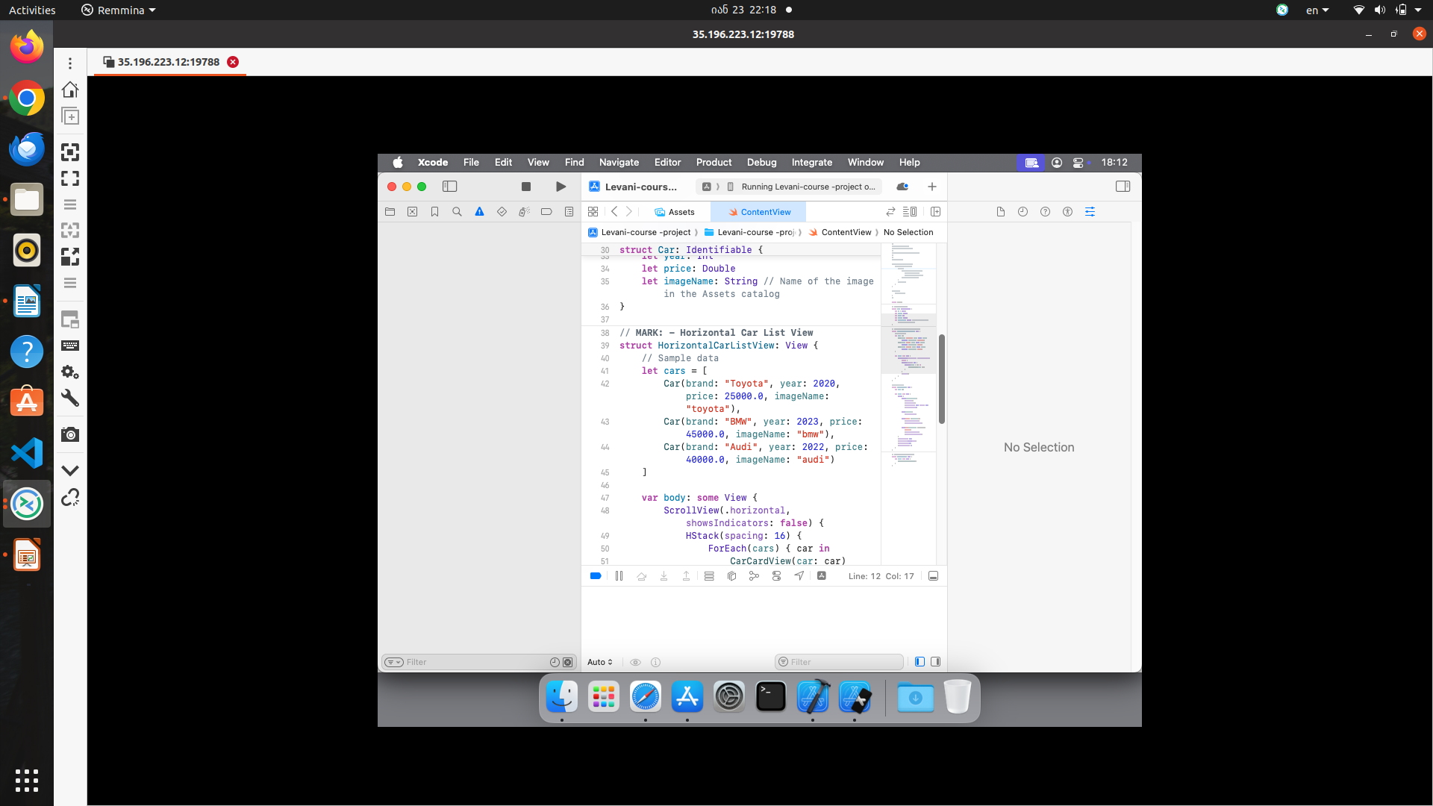
The Environment

Slide 4
Task
Creating a list of cars
The list should be dynamic
Cars should have some basic info
By dynamic I mean, capable of reacting to user’s input

Slide 5
How I solved the task
Creating a struct “car”
Creating “view”
Making the view “horizontal”

Slide 6
Final result
There are 3 cars aligned horizontally
Cars react to tapping; the list moves horizontally
There could be as many cars as one wishes
  Simple code modification is needed, and photoes

Slide 7
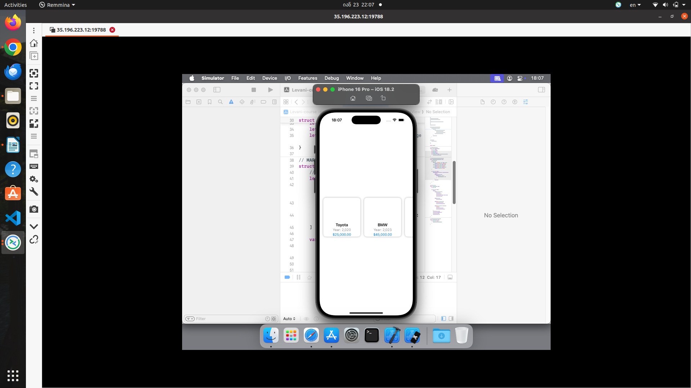
Final view

Slide 8
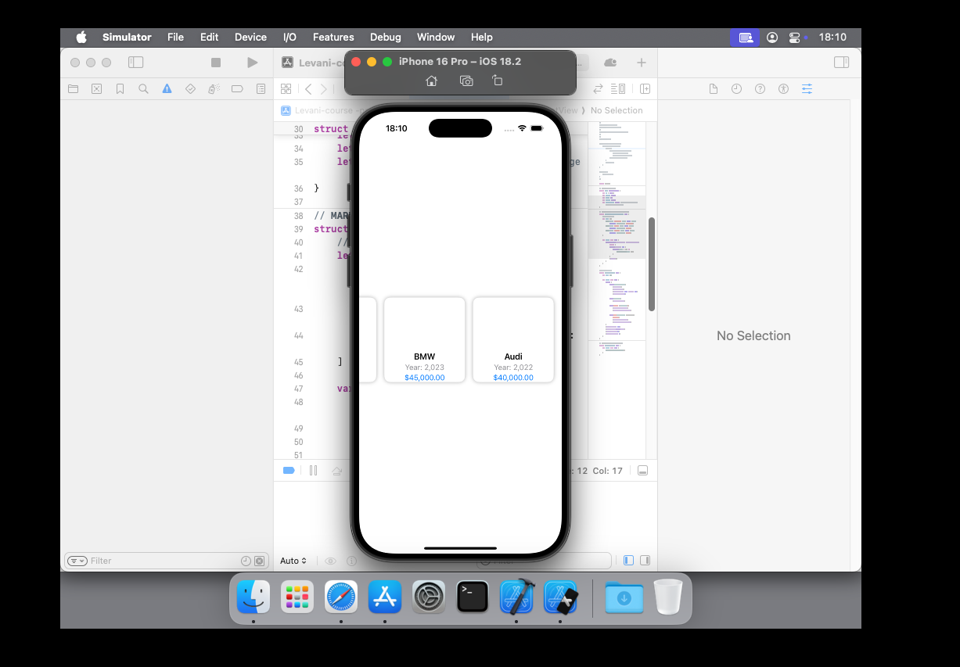
Horizontal movement

Slide 9
Final Words!
The whole project will be sent to the lecturer on email
The project is available on Github
Dear lecturer, thanks for the course!

