Slide 1
8.000 € a year she’s owed. Nobody told her.
Taxability
Claude Community Berlin · Impact Lab · October 2026
€
A single mom of a disabled child, her first German tax return · 5 o’Claude
Notes:
We’re 5 o’Claude, and this is Taxability. Open with the number and pause. 8.000 euros is how much one single mom of a disabled child in Germany can miss in her first year, during her tax return. It’s about two months of take-home pay for someone like Lisa. It isn’t fraud or a loophole: it’s money German law already gives her. She just doesn’t know it exists, because the tax app asks about her, not about her child. Illustrative estimate for Lisa’s case under 2026 rules.

Slide 2


One diagnosis, and Mom gets a second job
02 Meet the family
Lisa
Nurse, full-time
New in Germany
German at B1
Tina’s diagnosis
Autism, after months
Lisa, 35
Tina, 5
Therapies
About 6 h a week
Single mom, nurse
Autism
None
Family nearby
“I opened the tax return and just froze.”
Illustrative family, built from the situations parents described to us
Taxability
02
Notes:
Lisa is a composite persona. She’s 35, a nurse, new in Germany with German at B1, and raising five-year-old Tina alone. The Kita noticed Tina “acts differently” with change and noise; the doctor referred her; after months of waiting, the diagnosis was autism. Now it’s speech and occupational therapy, early intervention and a Kita helper, about six hours a week. Lisa is capable and organised, but she just landed in a system written in a language and logic she doesn’t know yet. Lisa is now Tina’s care manager and advocate, and the money side gets dropped. And tax season arrives right when she has the least capacity.

Slide 3
Doing it alone wastes her time and money
03 Doing it alone
35 h
1.300 €
150
of research, forms and translating, mostly at night
for a tax advisor and translator, if she pays instead
appointments a year to book and attend, about 6 h a week
Plus 12+ forms across five offices: Finanzamt (tax office), Familienkasse (child benefit), Versorgungsamt (disability ID), Pflegekasse (care insurance), Jugendamt (youth office) · Team estimates
Taxability
03
Notes:
Resources wasted. What does Lisa do today, with no automation? Three numbers. First, about 30 to 40 hours, a full work week, mostly at night: 10 to 15 hours finding out what she’s entitled to, 6 to 8 on the tax return, 4 to 6 each on the disability ID application, the care level application, and translating letters herself. Second, if she pays instead: a tax advisor at 300 to 800 euros and a translator at 200 to 500 euros, up to 1.300 euros, and most advisors still won’t file the disability or care applications. Third, about 150 appointments a year that Lisa has to book, reschedule and attend: roughly three therapy sessions a week over about 45 weeks, plus paediatrician visits, the specialist assessment, the care-level assessor and office appointments. That’s about six hours a week, or 300 hours a year, on top of a full-time job. And she has to deal with five offices and 12 or more forms in her first year: the tax return and its annexes plus the tax-class change for the Finanzamt, child benefit for the Familienkasse, the disability ID for the Versorgungsamt, the care level and relief-budget claims for the Pflegekasse, and early intervention and a Kita support worker for the Jugendamt or social office. None of them tells her about the others. These are our team’s estimates; we’ll validate them with parents.

Slide 4
More families need help every year, and each misses 104.000 € by age 18
04 The opportunity
+8%
+3%
1–2k
autism diagnoses a year
children with a severe disability a year
core families like Lisa’s
≈ 200.000 young people (0–24) today, ≈ 10.000 more a year (our estimate) · hkk 2013–2024
Each misses ≈ 8.000 € a year: 8–16 Mio. € a year in total, 104–208 Mio. € by age 18 (our estimate)
231.000 today, ≈ 6.000 more a year · Destatis 2025, Bundestag 19/1623
Taxability
04
Notes:
Three numbers. First, the group is growing: health insurer hkk’s data shows the share of young people up to 24 with an autism diagnosis went from 0.41 percent in 2013 to 1 percent in 2024, roughly 8 percent more every year. Applied to Germany’s roughly 20 million people aged 0 to 24, that’s about 200.000 young people with a diagnosis today, about 10.000 more each year. That’s our own extrapolation; no official national count exists, and it’s billing data from one insurer. Second, across all disabilities: 231.000 children under 18 had a severe-disability ID at the end of 2025, according to Destatis, up from 174.000 in 2015, roughly 3 percent or 6.000 more a year. Destatis says comparisons with earlier years are limited because of data clean-ups in Hesse and Saxony. Third, the money: we estimate 1.000 to 2.000 core families like Lisa’s. Each misses about 8.000 euros a year, so 8 to 16 million euros a year in total, and about 104.000 euros per family from age 5 to 18, or 104 to 208 million in total. Invested at an assumed 5 percent instead, it could be about 140.000 euros per family by age 18. Illustrative, not advice.

Slide 5
Her language, her situation, her next step
05 What makes it different
Her three biggest pains | Taxability | Tax apps | AI chatbots | Advice centres
“I can’t read the letters.” | Her language | DE/EN only | Generic | Partly
“What are we entitled to?” | Finds it all | Partly | No | Partly
“The paperwork never ends.” | Does it | Tax only | No | Partly
AI tax explainers already exist: WISO SteuerGPT, ChatGPT and Taxfix’s reported AI agent. None is built for Lisa.
Taxability
05
Notes:
Three things hurt parents like Lisa most, and here’s how the alternatives compare. One: she can’t read the letters. Tax apps run in German and English at best, chatbots translate but generically, advice centres help partly. Taxability explains every letter in her own language. Two: she doesn’t know what she’s entitled to. Tax apps cover part of it, chatbots don’t know her case. Taxability finds the single-parent relief, the disability lump sum and the care benefits, each with the law behind it. Three: the paperwork never ends. Tax apps only do the tax return, chatbots stop at explaining. Taxability fills in the forms, books appointments, and stores and translates documents. AI tax explainers already exist, WISO SteuerGPT, ChatGPT, and Taxfix is reported to be building an agent. None is built for Lisa. Don’t claim that no competitor exists.

Slide 6
We reach Lisa through people she already trusts
06 Go-to-market
01
02
03
Trusted advisers
When she files
Later
SPZ paediatric centres, Sputnik, MBE migration advice (922), EUTB (800+), VAMV
A link or promo code on the Taxfix result screen, like its N26 offer
Question cards inside Taxfix, once the pilot numbers prove it works
The partner pays, not the parent. We never hold her money. Planned routes, no commitments yet.
Taxability
06
Notes:
We reach Lisa through people she already trusts. First, the social-paediatric centres, the SPZ, where children like Tina get diagnosed: that’s the moment a family enters this maze. Then Sputnik, an organisation for kids with disabilities, where our domain expert Julia volunteers, so it’s our first warm contact, not a partnership. Then migration advice centres, disability counselling offices and single-parent associations: MBE had 922 migration advice centres in 2023, EUTB has over 800 disability advice offices, and VAMV is the single-parent association. Then we meet her inside Taxfix at the moment she files her return. Taxfix already works with partners through codes and links, like its N26 offer, so a link is the realistic first step; a built-in module comes later. The partner pays, not the parent, and we never hold her money: it goes straight to the account provider. These are planned routes, and we have no commitments yet. Don’t claim a partnership with Taxfix or any advice centre.

Slide 7
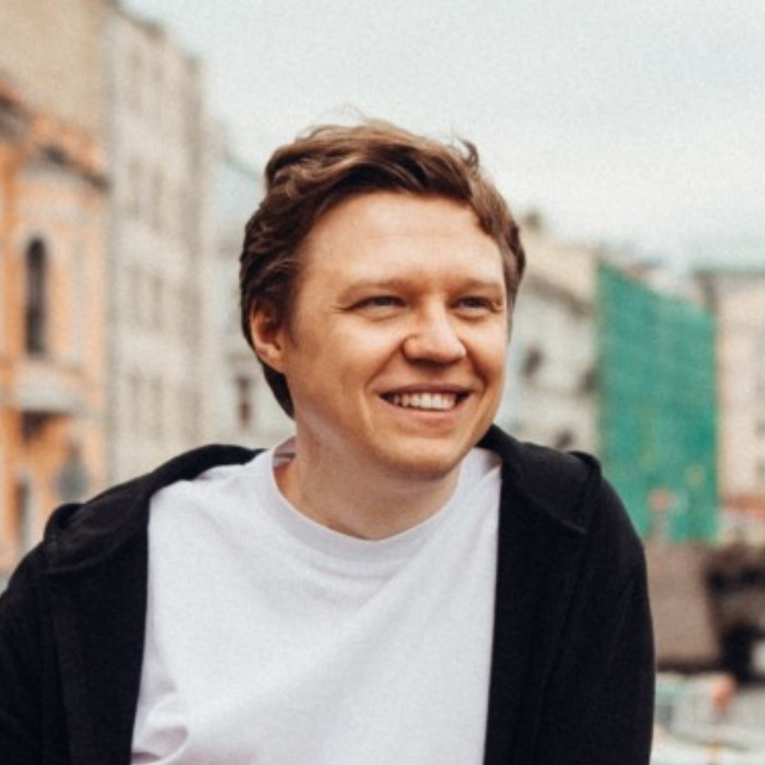
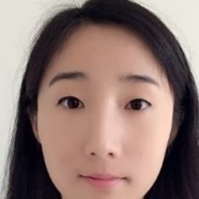

Builders, design and lived experience
07 The team · 5 o’Claude
Julia Armenat
Leonid (Leo) Kurdyukov
Vita Štefane
Ran (Vivian) Wei
Kim My Duyen Nguyen
Domain expert
Builder
Product & design
Builder
Founder
Volunteer at Sputnik, for kids with disabilities. Mom of an autistic son.
Senior PM in fintech. Shipped a first-to-market deposit product.
Product design partner for B2B startups: design, strategy, research.
Software engineer with 5+ years of experience.
Builds lasting bridges between brands, people and cultures.
Taxability
07
Notes:
Introduce each person in one sentence, and lead with lived experience: Julia is our domain expert, a volunteer at Sputnik, an organisation for kids with disabilities, and the mom of an autistic son. That’s our unfair advantage for trust.

Slide 8
Let’s build a future for kids with special needs, now
Taxability
How
Next
Thank you
Give parents their time and money back
Pilot with 100 families
Julia Armenat · 5 o’Claude
Notes:
End on the future: let’s build a future for kids with special needs, now, by giving parents their time and money back. Lisa shouldn’t need a tax degree to help Tina. Every hour Lisa doesn’t spend on forms is an hour with Tina. Every euro she finds goes to therapy or into Tina’s fund. Next, a pilot with 100 families. Thank you.

