Slide 1
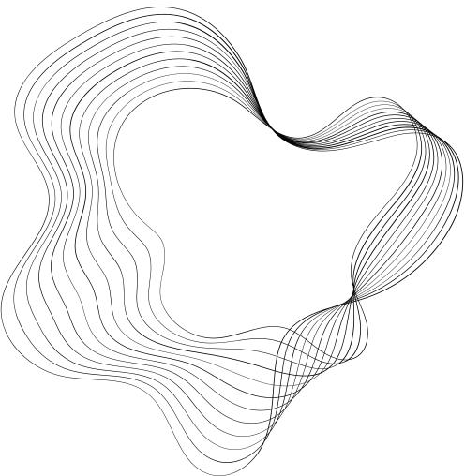

ANIMATIONS IN CSS
BY S.BHARATH REDDY

Slide 2
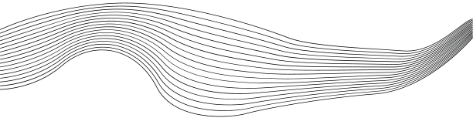
CONTENT
01
@KEYFRAMES
02
ANIMATION-NAME & ANIMATION-DURATION
03
ANIMATION-DELAY
04
ANIMATION-PLAY-STATE
05
ANIMATION-ITERATION-COUNT
06
ANIMATION-DIRECTION
07
ANIMATION-TIMING-FUNCTION
08
ANIMATION-FILL-MODE
09
ANIMATION SHORT-HAND PROPERTY

Slide 3
@KEYFRAMES
DEFINES CHANGES IN STYLES USING “FROM” AND “TO”
RESPONSIBLE FOR THE MOTION AND IMPLEMENTS OTHER ANIMATIONS
@keyframes example {
from {background-color: red;}
to {background-color: yellow;}
}
@KEYFRAMES MYFIRST {
0% {BACKGROUND-COLOR:RED; LEFT:0PX; TOP:0PX;}
25% {BACKGROUND-COLOR:YELLOW; LEFT:200PX; TOP:0PX;}
50% {BACKGROUND-COLOR:BLUE; LEFT:200PX; TOP:200PX;}
75% {BACKGROUND-COLOR:GREEN; LEFT:0PX; TOP:200PX;}
100% {BACKGROUND-COLOR:RED; LEFT:0PX; TOP:0PX;}

Slide 4
ANIMATION-NAME
DEFINES THE ANIMATION NAME
ANIMATION-DURATION
DEFINES THE DURATION OF AN ANIMATION
DIV {
width: 100px;
height: 100px;
animation-name: example;
animation-duration: 4s;
}
https://developer.mozilla.org/en-US/docs/Web/CSS/animation-duration

Slide 5
ANIMATION-DELAY
THE ANIMATION-DELAY PROPERTY SPECIFIES A DELAY FOR THE START OF AN ANIMATION.
DIV {
width: 100px;
height: 100px;
position: relative;
background-color: red;
animation-name: example;
animation-duration: 4s;
animation-delay: 2s;
}
https://developer.mozilla.org/en-US/docs/Web/CSS/animation-delay

Slide 6
ANIMATION-PLAY-STATE
THE ANIMATION-PLAY-STATE CSS PROPERTY SETS WHETHER AN ANIMATION IS RUNNING OR PAUSED.
.BOX {
WIDTH: 100PX;
HEIGHT: 100PX;
ANIMATION-NAME: ROTATE;
ANIMATION-DURATION: 0.7S;
ANIMATION-ITERATION-COUNT: INFINITE;
ANIMATION-PLAY-STATE: PAUSED;
}
.BOX:HOVER {
ANIMATION-PLAY-STATE: RUNNING;
}
https://developer.mozilla.org/en-US/docs/Web/CSS/animation-play-state

Slide 7
ANIMATION-ITERATION-COUNT
THE ANIMATION-ITERATION-COUNT PROPERTY SPECIFIES THE NUMBER OF TIMES AN ANIMATION SHOULD RUN.
THE VALUE CAN BE GIVEN AS “INFINITE” FOR AN ENDLESS LOOP
DIV {
width: 100px;
height: 100px;
animation-name: example;
animation-duration: 4s;
ANIMATION-ITERATION-COUNT: 3;
}
https://developer.mozilla.org/en-US/docs/Web/CSS/animation-iteration-count

Slide 8
ANIMATION-DIRECTION
IT SPECIFIES WHETHER AN ANIMATION SHOULD BE PLAYED FORWARDS, BACKWARDS OR IN ALTERNATE CYCLES.
THE ANIMATION-DIRECTION PROPERTY CAN HAVE THE FOLLOWING VALUES :
NORMAL - THE ANIMATION IS PLAYED AS NORMAL (FORWARDS). THIS IS DEFAULT
REVERSE - PLAYED IN REVERSE DIRECTION (BACKWARDS)
ALTERNATE - PLAYED FORWARDS FIRST, THEN BACKWARDS
ALTERNATE-REVERSE - PLAYED BACKWARDS FIRST, THEN FORWARDS
https://developer.mozilla.org/en-US/docs/Web/CSS/animation-direction

Slide 9
ANIMATION-TIMING-FUNCTION
THE ANIMATION-TIMING-FUNCTION PROPERTY SPECIFIES THE SPEED CURVE OF THE ANIMATION.
THE ANIMATION-DIRECTION PROPERTY CAN HAVE THE FOLLOWING VALUES :
LINEAR- Specifies an animation with the same speed from start to end
EASE- Specifies an animation with a slow start, then fast, then end slowly (this is default)
EASE-IN- Specifies an animation with a slow start
EASE-OUT - Specifies an animation with a slow end
EASE-IN-OUT - Specifies an animation with a slow start and end
https://www.w3schools.com/css/tryit.asp?filename=trycss3_animation_speed

Slide 10
ANIMATION-FILL-MODE
CSS ANIMATIONS DO NOT AFFECT AN ELEMENT BEFORE THE FIRST KEYFRAME IS PLAYED OR AFTER THE LAST KEYFRAME IS PLAYED.
THE ANIMATION-FILL-MODE PROPERTY CAN OVERRIDE THIS BEHAVIOR.
THE ANIMATION-FILL-MODE PROPERTY SPECIFIES A STYLE FOR THE TARGET ELEMENT WHEN THE ANIMATION IS NOT PLAYING (BEFORE IT STARTS, AFTER IT ENDS, OR BOTH).
THE ANIMATION-FILL-MODE PROPERTY CAN HAVE THE FOLLOWING VALUES:
NONE - DEFAULT VALUE
FORWARDS
BACKWARDS
BOTH

Slide 11
ANIMATION SHORTHAND PROPERTY
DIV {
animation-name: example;
animation-duration: 5s;
animation-timing-function: linear;
animation-delay: 2s;
animation-iteration-count: infinite;
animation-direction: alternate;
}
DIV {
animation: example 5s linear 2s infinite alternate;
}

