Slide 1
Introduction to WAI-ARIA
Presented by Qiang Wan
Notes:
Today I will introduct war-aria11111111111

Slide 2
Overview
What is ARIA? Why do we need it?
How do we use it?
Roles
Keyboard Access
Live Region

Slide 3
Web Accessibility Initiative – Accessible Rich Internet Applications
Defines a way to make Web content and Web applications more accessible to people with disabilities
This specification provides an ontology of roles, states, and properties that define accessible user interface elements and can be used to improve the accessibility and interoperability of web content and applications. These semantics are designed to allow an author to properly convey user interface behaviors and structural information to assistive technologies in document-level markup

Slide 4
Why do we need ARIA?
Problem: Assistive Technologies
Can’t interact with concurrent techs
ARIA to the rescue!
Semantic meaning
Dynamic content updates
etc.

Slide 5
Roles in ARIA
Landmark roles
Widget and Element Roles

Slide 6
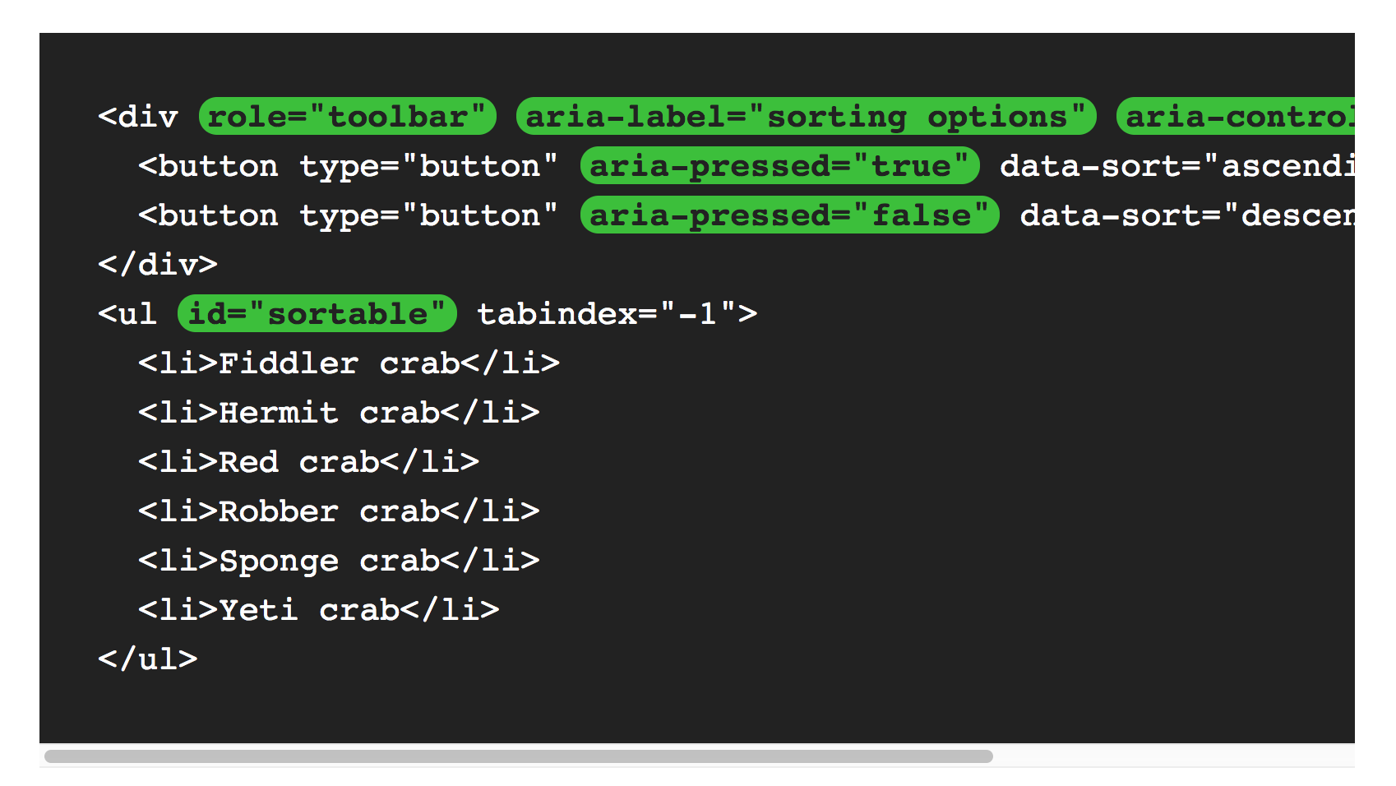
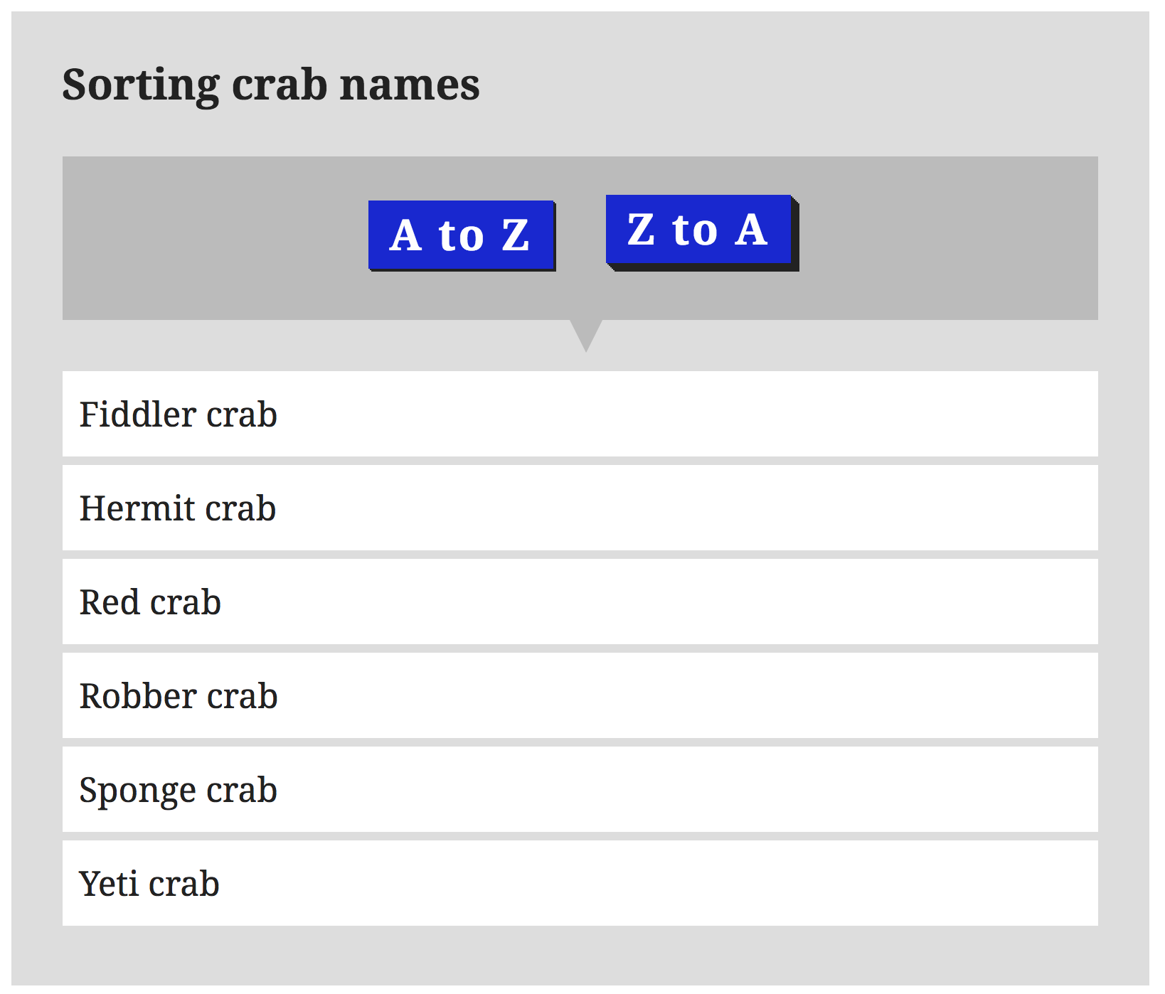
Role example

Slide 7
Keyboard Access
HTML’ tabindex
<div id="progaccess" tabindex="-1"> ... </div>
One tab stop per section

Slide 8
Live Region
allow elements in the document to be announced if there are changes, without the user losing focus on their current activity
<ul aria-live="polite">

Slide 9
Something Else
Browsers:
Firefox, Opera, IE8
ARIA vs HTML 5
ARIA: <div role=“navigation”>
HTML5: <nav>
Many ARIA roles have no HTML5 equivalent, such as application, banner

Slide 10
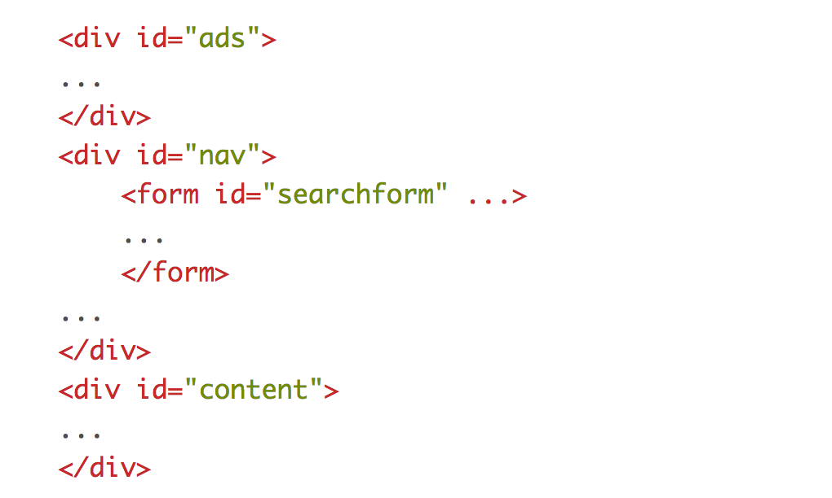
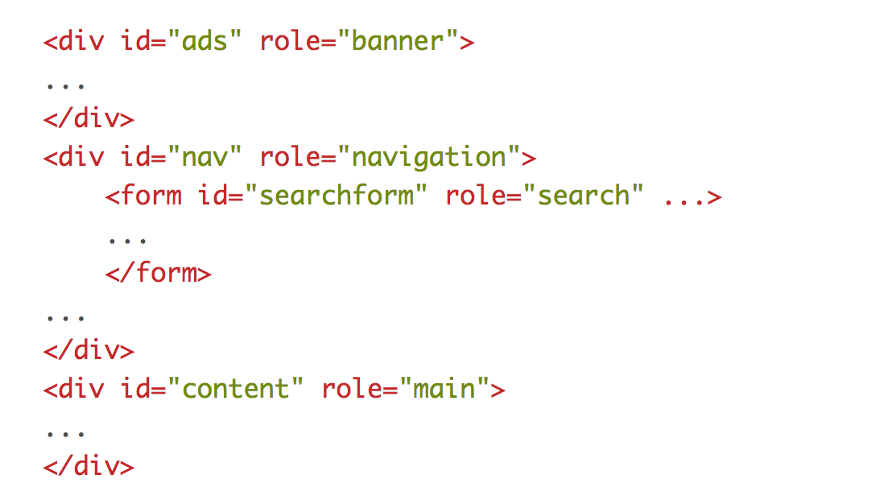
Use it Now!(HTML)

Slide 11
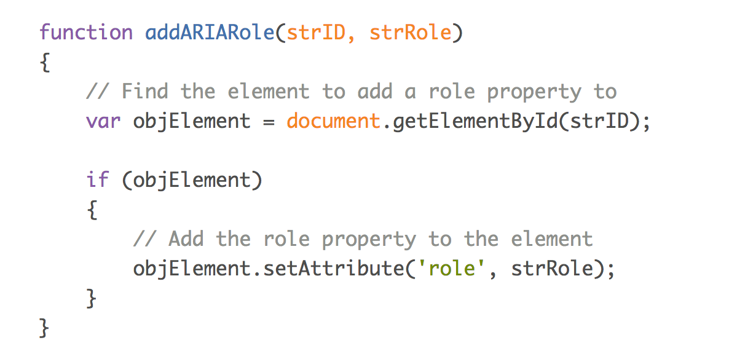
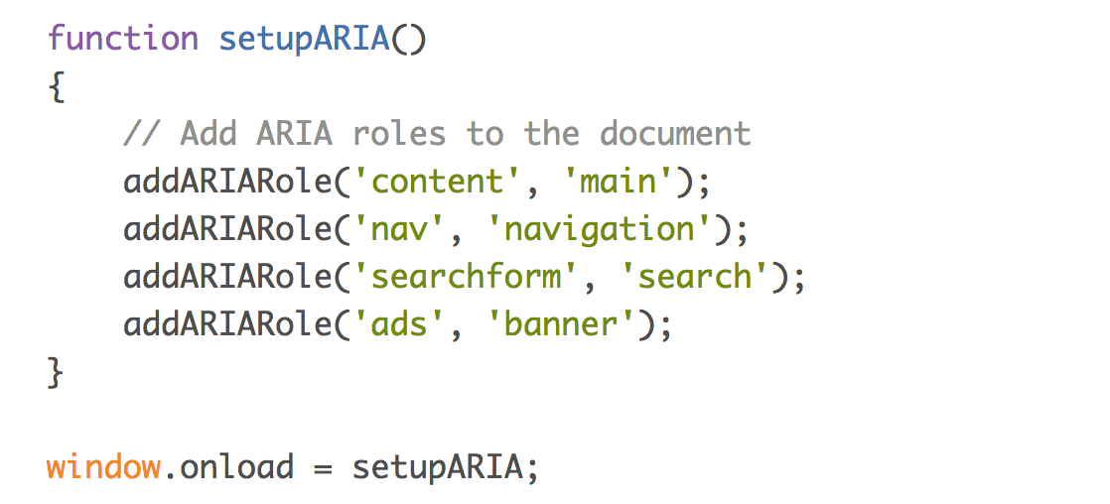
Use it Now! (JavaSrcipt)

Slide 12
Summary
Problem
Role, state, and properties of widgets and updated content on HTML pages are not conveyed correctly to assistive technologies
ARIA
Allowing developers to describe widgets in detail, define document structure, and define regions of the page that will change

Slide 13
Q&A
THANK YOU FOR LISTENING!

