Slide 1
https://docs.google.com/presentation/d/1M81uIcrc5L2PPXwpJF8sJgrFhAfzbBUbwG8_mUtUQAE/edit?usp=sharing
Notes:
Link to the website prototype

Slide 2
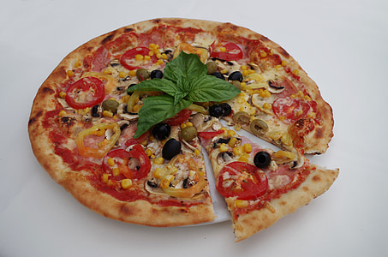
Book a Pizza
Check Delivery
"Love is like pizza, it has all the toppings you choose.”
Notes:
This is the home page. Navigate to booking and delivery sections using buttons

Slide 3
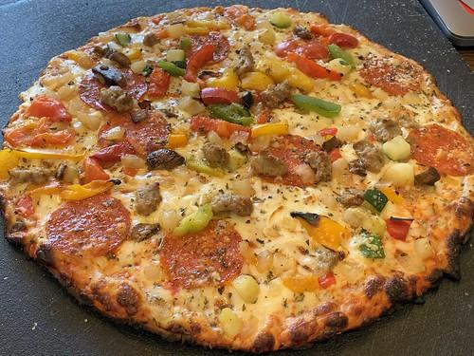
You are hungry and what you are waiting for ??
Book Pizza
Notes:
This is the booking pizza sub page. Use left and right arrows for seeing images on slider.

Slide 4
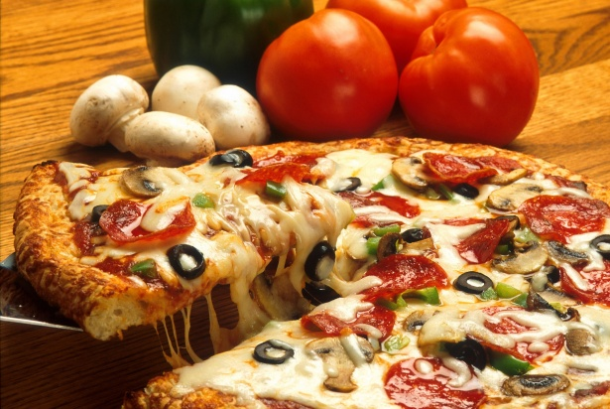
You are hungry and what you are waiting for ??
Book Pizza
Notes:
This is the second image on the slider, scroll through images using arrow buttons.

Slide 5

You are hungry and what you are waiting for ??
Book Pizza
Notes:
This is the third image. If you want to book pizza, then click on “Book Pizza” button.

Slide 6
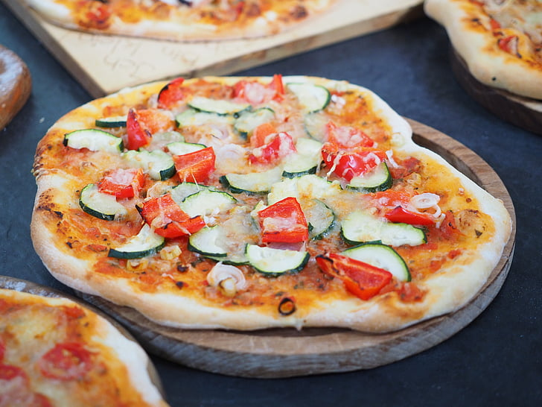

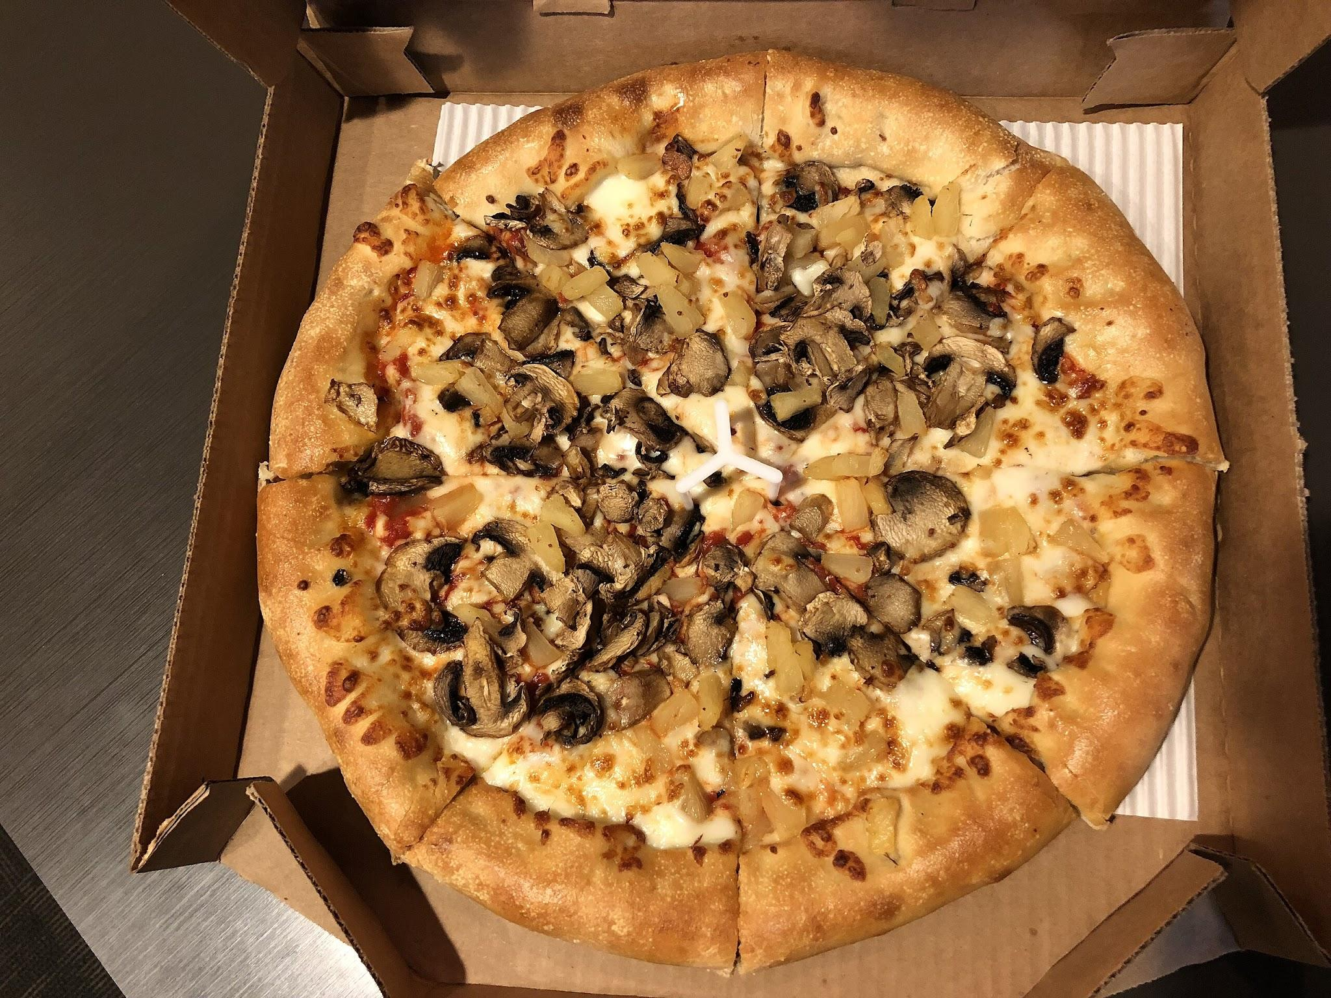
Select your pizza crust
Flatbread
Gluten Free
Stuffed Bread
Notes:
First to start, select any crust of your choice to proceed with customizing pizza.

Slide 7
Select your pizza crust
Flatbread
Gluten Free
Stuffed Bread
Notes:
Selecting flatbread crust for pizza.

Slide 8
Select your pizza crust
Flatbread
Gluten Free
Stuffed Bread
Notes:
Selecting Gluten Free crust

Slide 9
Select your pizza crust
Flatbread
Gluten Free
Stuffed Bread
Notes:
Selecting Stuffed bread as pizza crust.

Slide 10
Please select your pizza crust to continue !!!!!
Select Crust
Notes:
If you will not select any crust, this message pop ups.

Slide 11
You can only select one crust for Pizza!!!
Select Crust
Notes:
If you try to go with multiple crusts then you will get this pop up.

Slide 12
Select your Sauce
Alfredo Sauce
Garlic Sauce
Notes:
Select your desired sauce for pizza using checkboxes (You can select multiple)

Slide 13
Select your Sauce
Alfredo Sauce
Garlic Sauce
Notes:
Selecting Alfredo sauce

Slide 14
Select your Sauce
Alfredo Sauce
Garlic Sauce
Notes:
Selecting Garlic sauce.

Slide 15
Select your Sauce
Alfredo Sauce
Garlic Sauce
Notes:
Selecting both Alfredo and Garlic sauce.

Slide 16
Please select atleast one sauce to proceed
Select Sauce
Notes:
If you will not select even one sauce, you will get this message.

Slide 17
Select your toppings
Corn
Paneer
Ginger garlic
Notes:
You can select vegetarian toppings of your preference. Note that you can select multiple toppings for your pizza.

Slide 18
Select your toppings
Corn
Paneer
Ginger garlic
Notes:
Selecting Corn toppings.

Slide 19
Select your toppings
Corn
Paneer
Ginger garlic
Notes:
Selecting Paneer toppings.

Slide 20
Select your toppings
Corn
Paneer
Ginger garlic
Notes:
Selecting Ginger-Garlic toppings.

Slide 21
Select your toppings
Corn
Paneer
Ginger garlic
Notes:
Selecting Corn and Paneer toppings.

Slide 22
Select your toppings
Corn
Paneer
Ginger garlic
Notes:
Selecting Corn and Ginger-Garlic toppings.

Slide 23
Select your toppings
Corn
Paneer
Ginger garlic
Notes:
Selecting Paneer and Ginger-Garlic toppings

Slide 24
Select your toppings
Corn
Paneer
Ginger garlic
Notes:
Selecting all three toppings.

Slide 25
Please select atleast one topping to continue !!!
Select Toppings
Notes:
If you did not select atleast one topping then you will get this message.

Slide 26
Select your toppings
Fish
Shrimp
Mutton
Notes:
You can select any toppings of your choice from the non-vegetarian items.

Slide 27
Select your toppings
Fish
Shrimp
Mutton
Notes:
Selecting Fish toppings for pizza.

Slide 28
Select your toppings
Fish
Shrimp
Mutton
Notes:
Selecting Shrimp (Prawns) toppings for pizza.

Slide 29
Select your toppings
Fish
Shrimp
Mutton
Notes:
Selecting Mutton (Goat) toppings for pizza.

Slide 30
Select your toppings
Fish
Shrimp
Mutton
Notes:
Selecting Fish and Shrimp toppings for pizza.

Slide 31
Select your toppings
Fish
Shrimp
Mutton
Notes:
Selecting Fish and Mutton toppings for pizza.

Slide 32
Select your toppings
Fish
Shrimp
Mutton
Notes:
Selecting Mutton and Shrimp toppings for pizza.

Slide 33
Select your toppings
Fish
Shrimp
Mutton
Notes:
Selecting all three toppings for pizza.

Slide 34
Your pizza is ready
Order
Head to check out
Book Pizza
Choose again
Notes:
Your pizza responses are saves. You can select them again or head to checkout.

Slide 35
Order Placed !!!
Select Mode
Pickup Delivery
Notes:
Select your preferred mode of getting pizza either pickup or delivery.

Slide 36
Order Placed !!!
Select Mode
Pickup Delivery
Notes:
Selecting pickup mode.

Slide 37
Order Placed !!!
Select Mode
Pickup Delivery
Notes:
Selecting delivery mode.

Slide 38
Select any one of the mode to continue
Select mode
Notes:
If you did not opt for any mode then you will get this alert message.

Slide 39
You cannot select both pickup and delivery !!
Select any one mode to continue
Select mode
Notes:
If try to pick both modes then this alert message pops up.

Slide 40
Pickup
You can pick up at our branch within two hours. If you do not pick up your order within 2 hours, You have to order again.
Our Branch Address: 4463 School House Cmns,
Harrisburg,
North Carolina, 28075
Notes:
If you selected pickup, this screen with pickup address is displayed.

Slide 41
Do you want to confirm Pickup ?
Action Confirmation Window
Yes
No
Notes:
Confirm your choice.

Slide 42
We are waiting for you
Pick Up Placed Successfully
Home
Notes:
Pickup acknowledgement is displayed. Clicking on Home will take you to homepage.

Slide 43
Delivery
Address
Steps to enter address:
Click on ‘Address’ button.
Select your address on Google Maps.
Click on save and save it to delivery address.
Order will be delivered to your saved address.
Notes:
If you opt for delivery then this screen is displayed.

Slide 44
Action Confirmation Window
Are you sure that address is correct ?
Yes
No
Notes:
Confirm your choice.

Slide 45
You will get your order within 20 minutes
For any assistance, call: 7237222301
Delivery Placed Successfully
Home
Notes:
Delivery acknowledgement for your reference with number for additional assistance. Clicking on Home will take you to homepage.

