Slide 1
Performance Analysis of MIMO-OFDM for Various Modulation Techniques over Different Fading Channels
UTHIRA MOHAN
HARSHAVARDAN TIRUPUR VENUGOPAL

Slide 2
ABSTRACT

Slide 3
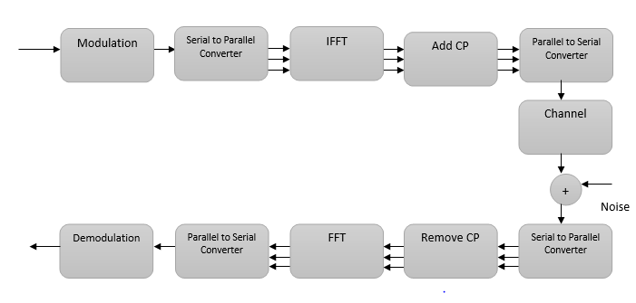
OFDM

Slide 4
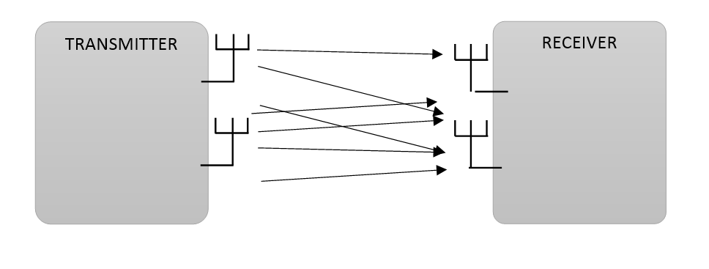
MIMO

Slide 5
MIMO-OFDM
IN
OUT
MODULATION
MIMO-OFDM
MODULATOR
CHANNEL
DEMODULATION
MIMO-OFDM
DEMODULATOR

Slide 6
CHANNELS
AWGN
RAYLEIGH
RICIAN

Slide 7
AWGN
TRANSMITTED SIGNAL
s(t)
RECEIVED SIGNAL
r(t)=s(t)+n(t)
n(t)

Slide 8
RAYLEIGH
TRANSMITTED SIGNAL
s(t)
RECEIVED SIGNAL
r(t)=s(t)+n(t)
Fading
n(t)

Slide 9
RICIAN
TRANSMITTED SIGNAL
s(t)
RECEIVED SIGNAL
r(t)=s(t)+n(t)
Fading
n(t)

Slide 10
MODULATION
BPSK
QPSK
M-PSK
D-PSK
DBPSK
DQPSK
QAM

Slide 11
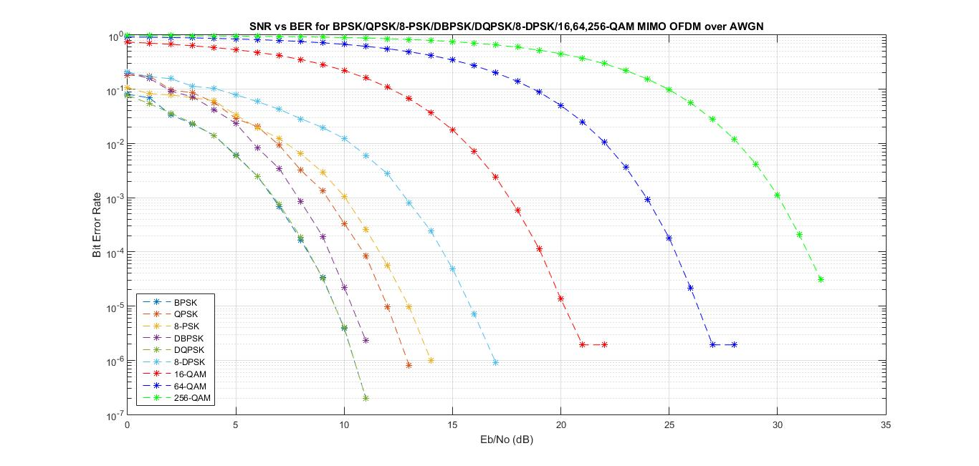
COMPARISON ON AWGN

Slide 12
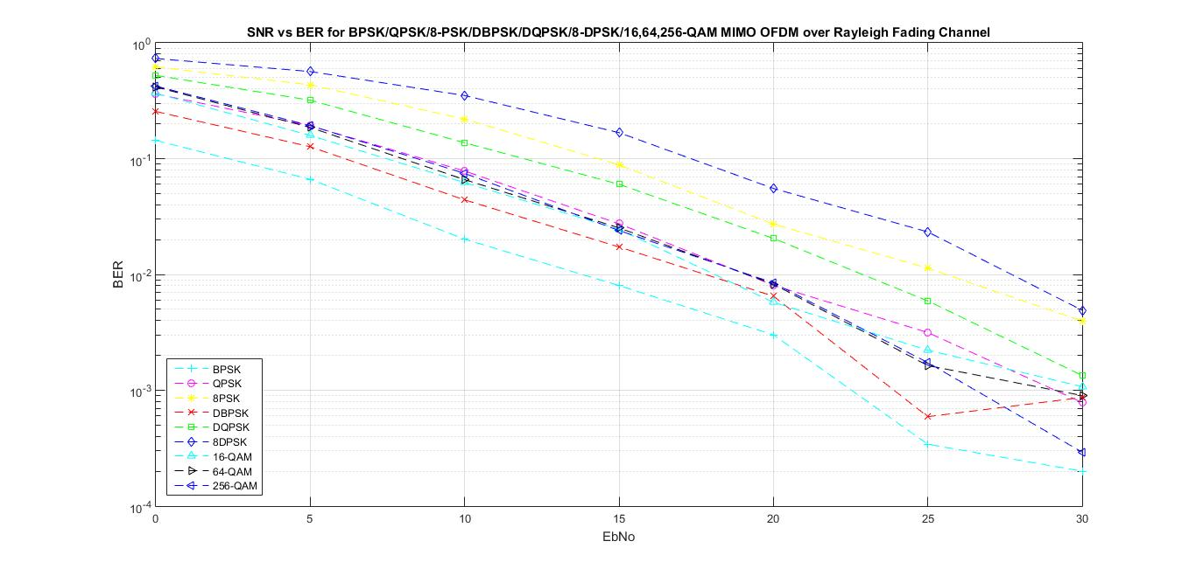
COMPARISON ON RAYLEIGH

Slide 13
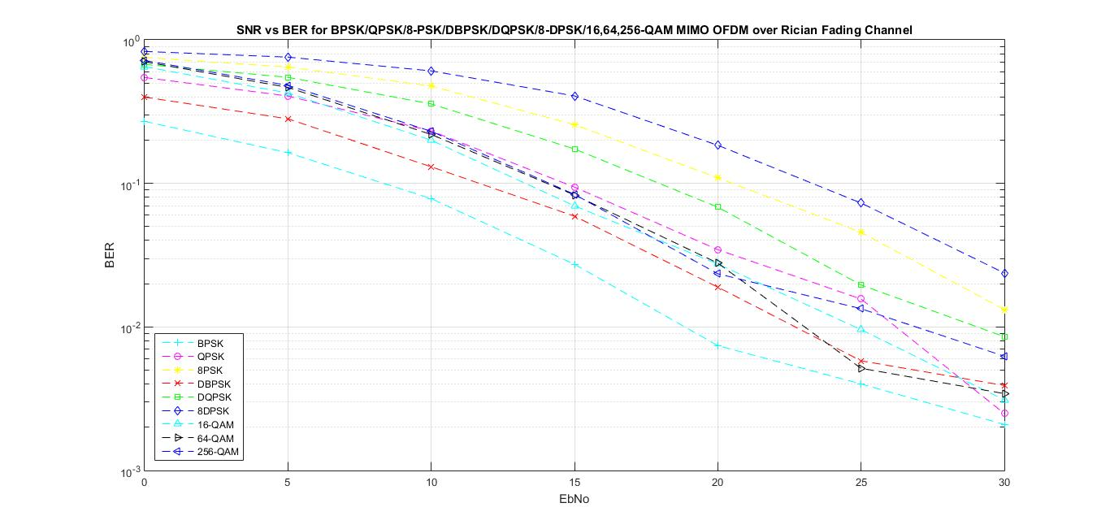
COMPARISON ON RICIAN

Slide 14
CONCLUSION

Slide 15
REFERENCES
Salvo Rossi, P., "On Throughput of MIMO-OFDM Systems with Joint Iterative Channel Estimation and Multiuser Detection under Different Multiple Access Schemes," in Communications Letters, IEEE , vol.15, no.8, pp.831-833, August 2011.
Mirnia, S.E.; Zarei, A.; Emami, S.D.; Harun, S.W.; Arof, H.; Ahmad, H.; Shalaby, H.M.H., "Proposal and performance evaluation of an efficient RZ-DQPSK modulation scheme in all-optical OFDM transmission systems," in Optical Communications and Networking, IEEE/OSA Journal of , vol.5, no.9, pp.932-944, Sept. 2013
Vipin Kumar, Parveen Dhyani ,“Design and Performance Analysis of MIMO-OFDM System using QPSK Modulation Scheme under AWGN Channel”, in International Journal of Electronics and Computer Science Engineering
http://www.mathworks.com/help/comm/ref/comm.awgnchannel-class.html
https://en.wikipedia.org/wiki/Phase-shift_keying

