Slide 1

Outdoors Captstone
Levi Costello, Howard Rolleston

Slide 2
Discussion Layout
-What is our Outdoors Website
-Achieving our Goal
-How we planned it out.
-Our Application and flow
-Demo
-Challenges
-Future?

Slide 3

What is the Outdoors Website
- Create a web application similar to various ecommerce websites such as Amazon.com.
- Make a simple and basic ecommerce website that implements the minimalist features.
-

Slide 4




Achieving Our Goal
In this project we achieved our goal using the following:
Angular
Java
SpringBoot
JWT
OAUTH
MySql

Slide 5
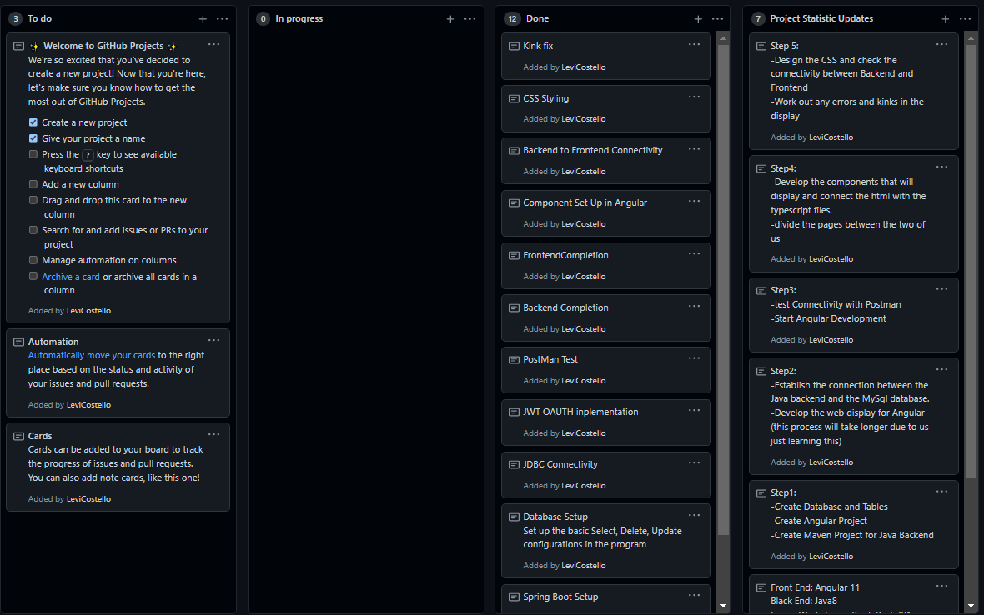
How We Planned It Out
The Following Steps:
Project setup and planning
Database development
Backend Development
Frontend Development
Styling/Error Fix

Slide 6
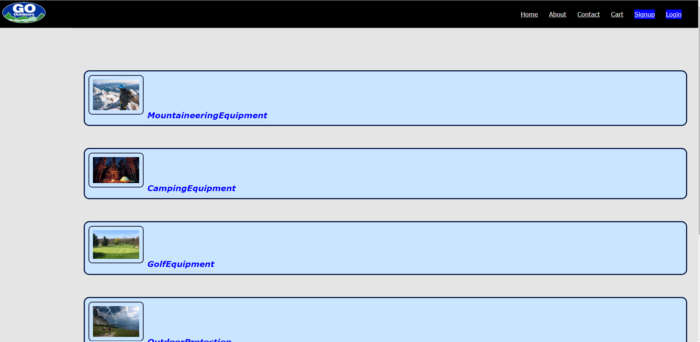
Home

Slide 7
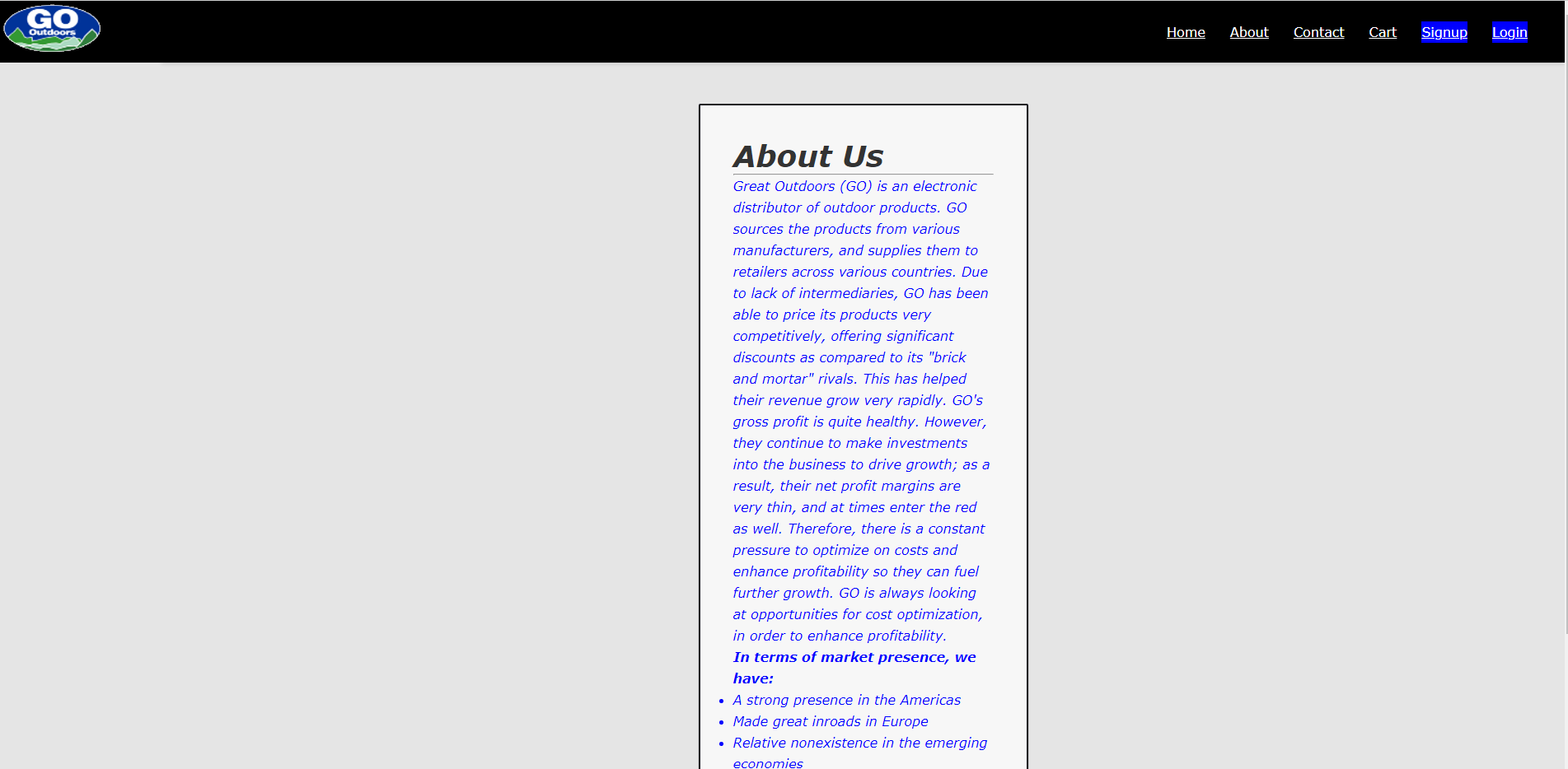
About Us

Slide 8
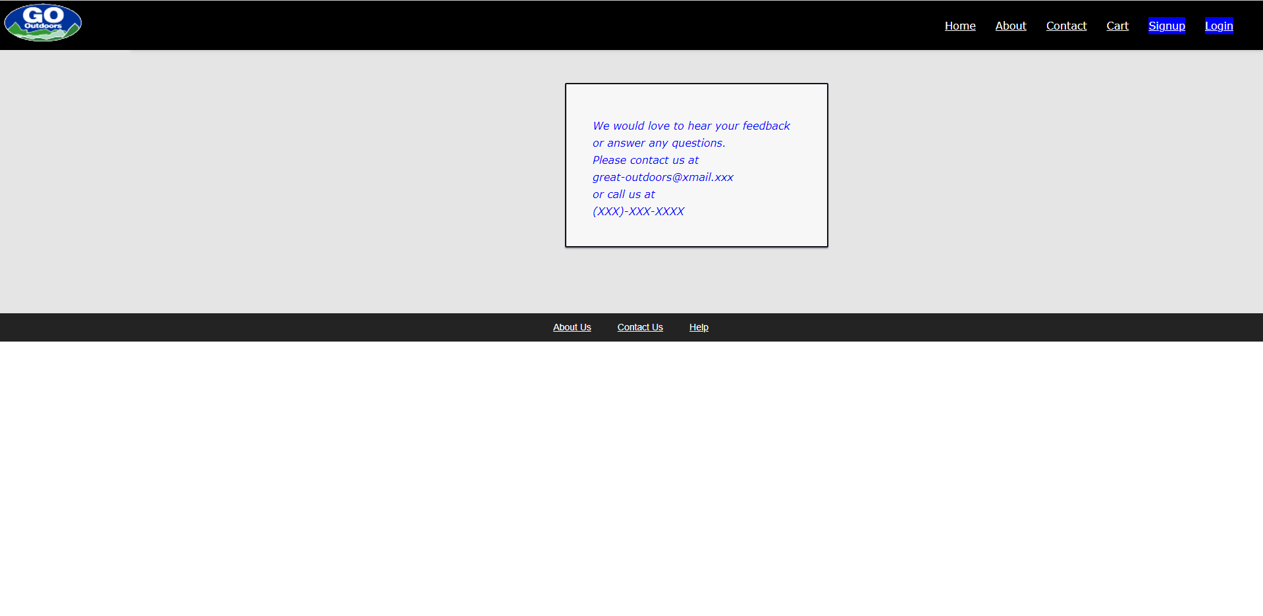
Contact Us

Slide 9
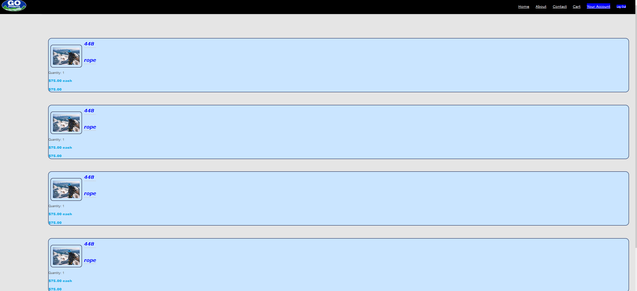
Cart

Slide 10
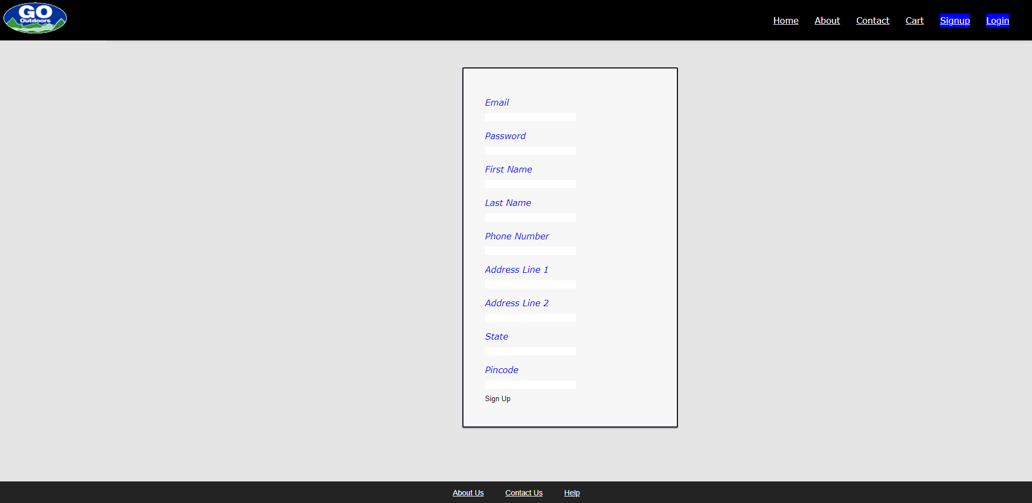
Sign Up

Slide 11
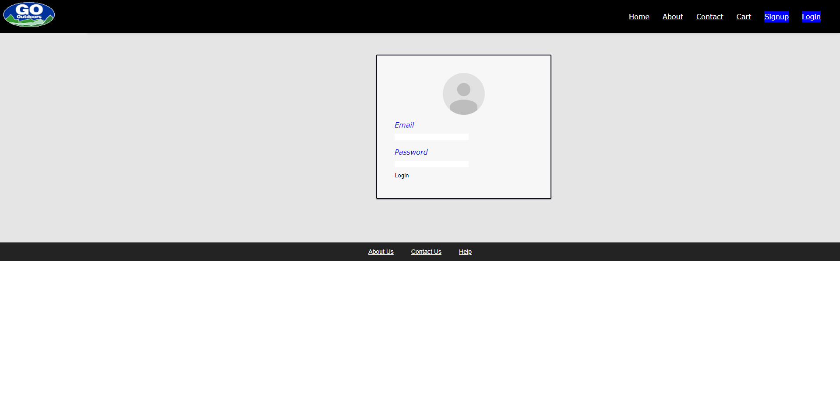
Login

Slide 12
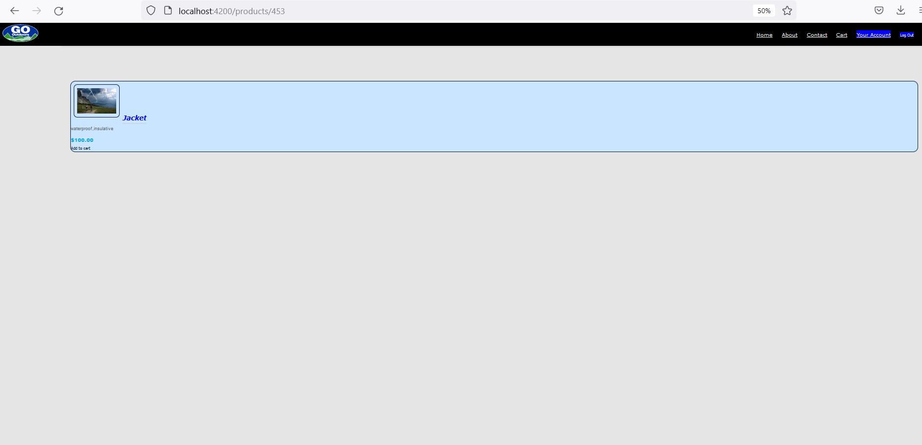
Product Page

Slide 13
DEMO

Slide 14
Moving Forward
We plan to add order functionality so that a user could actually order and item and “receive it”
Create user roles so that we can designate admin, employee, shipments, etc.
And more

Slide 15
THANK YOU

