Slide 1

Yatrik
Travel Recommendation System
An ML-powered travel planner that recommends tourist destinations and generates personalized day-wise itineraries — built with Flutter, FastAPI, and Scikit-learn.
FLUTTER
FASTAPI
MACHINE LEARNING
MAPBOX

Slide 2



The Problem with Manual Trip Planning
Time-Consuming Research
Travelers juggle multiple websites to compare attractions, check routes, and estimate visit durations — a tedious process, especially in unfamiliar cities.
No Personalization
Existing platforms show popular spots without considering individual interests like nature, history, temples, or food — one-size-fits-all recommendations.
Hidden Gems Stay Hidden
Regional destinations in places like Chhattisgarh receive limited visibility, leaving travelers unaware of beautiful, lesser-known locations.

Slide 3
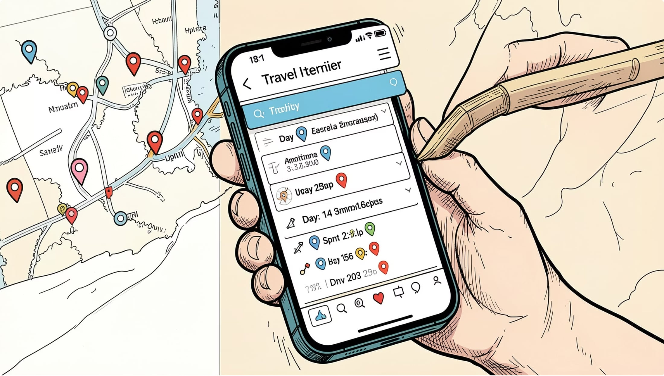

How Yatrik Solves It
Yatrik combines an intelligent recommendation engine with a polished mobile app. Users enter their destination, trip duration, and travel interests — and Yatrik handles the rest.
Select city, state & travel days
Choose interests: nature, history, temples & more
ML model filters & ranks tourist spots
Day-wise itinerary generated automatically
View all locations on an interactive Mapbox map

Slide 4
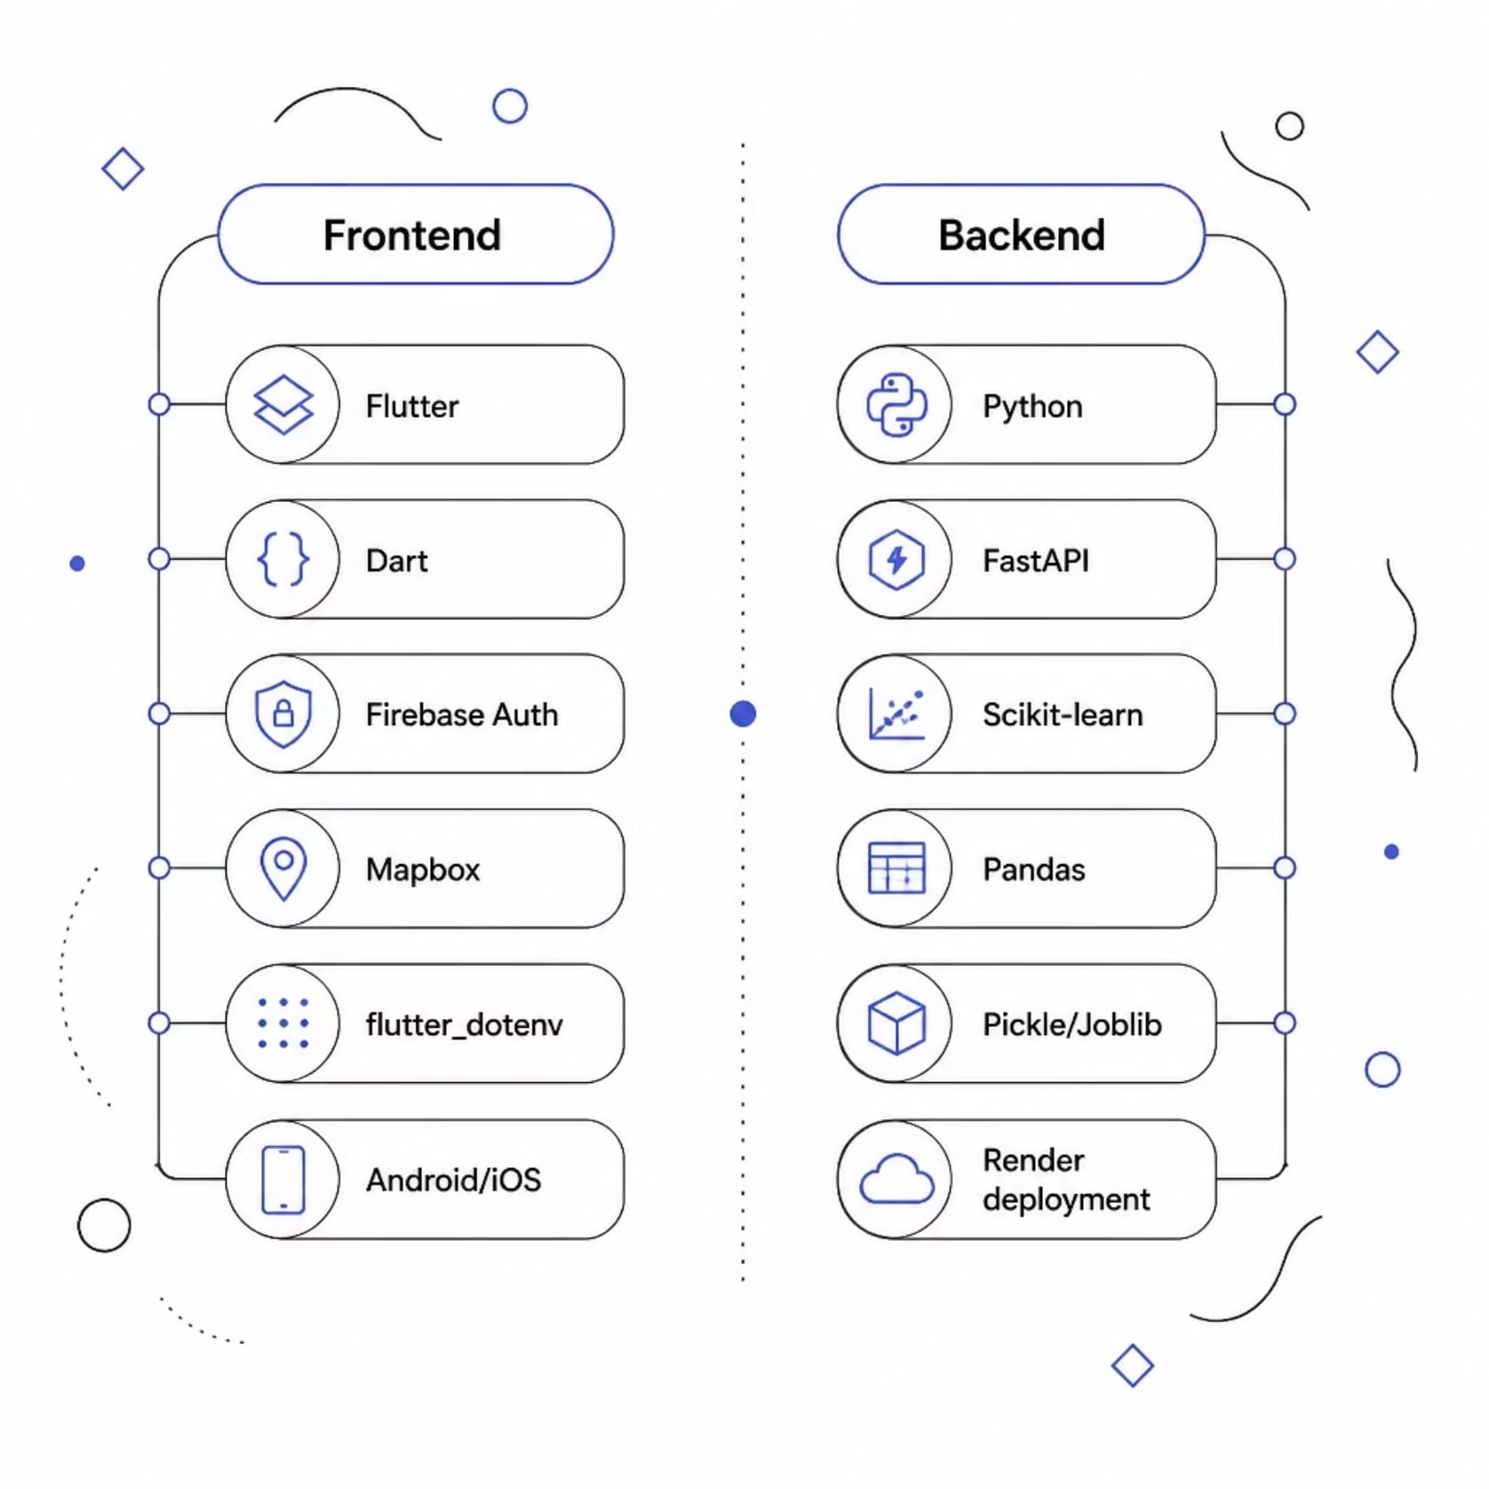
Technology Stack
Yatrik follows a modern client-server architecture — Flutter for a cross-platform frontend, FastAPI for a high-performance backend, and Scikit-learn for ML-powered recommendations.
Frontend — Flutter
Single codebase for Android & iOS with Firebase Google Sign-In, Mapbox maps, and a responsive Material Design UI.
Backend — FastAPI
Lightweight Python framework handling API requests, ML model inference, itinerary generation, and JSON responses — deployed on Render.

Slide 5
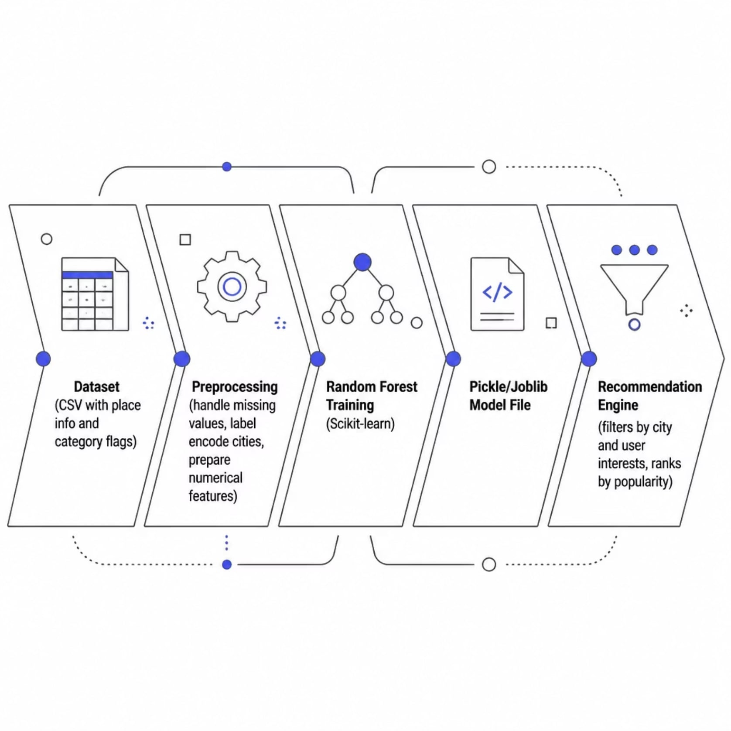

Machine Learning Model
Random Forest Classifier
The recommendation engine uses a Random Forest Classifier from Scikit-learn — chosen for its efficiency on structured tabular data and stable classification results.
Tourist destinations can belong to multiple categories simultaneously, so the model supports multi-interest filtering across nature, history, temples, wildlife, and more.
Dataset features include: Place Name, City, State, Lat/Lng, Ideal Hours, Popularity Score, and 8 category flags (Museum, Nature, History, Temple, Wildlife, Beach, Shopping, Foodie).

Slide 6

Recommendation Workflow
Enter Preferences
Send Request
Load Model & Data
Generate Itinerary
From input to itinerary in seconds — the backend processes user preferences, applies the trained Random Forest model, ranks destinations by popularity and relevance, and distributes them across travel days based on ideal visiting hours.

Slide 7
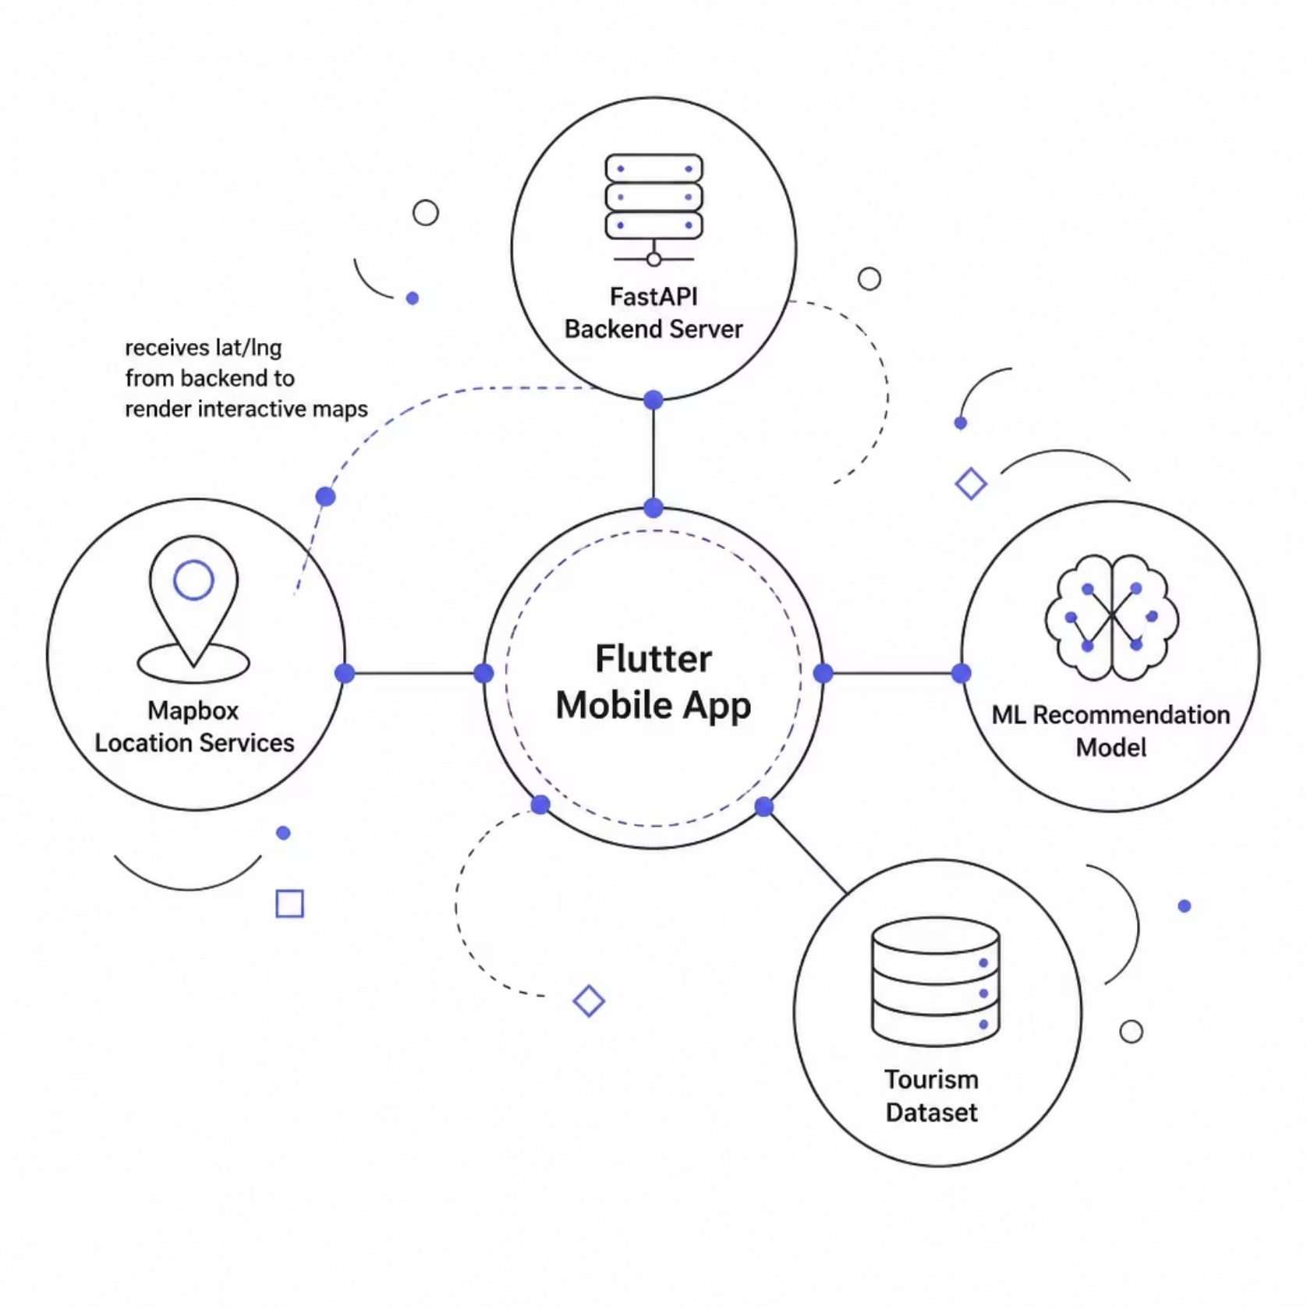
System Architecture
Yatrik's architecture connects five core components through clean REST API boundaries, enabling modular development and future scalability.
Flutter App
FastAPI Server
ML Model
Tourism Dataset
User input, UI, map display
Request handling, validation
Random Forest inference
CSV place data
Mapbox
Location visualization

Slide 8
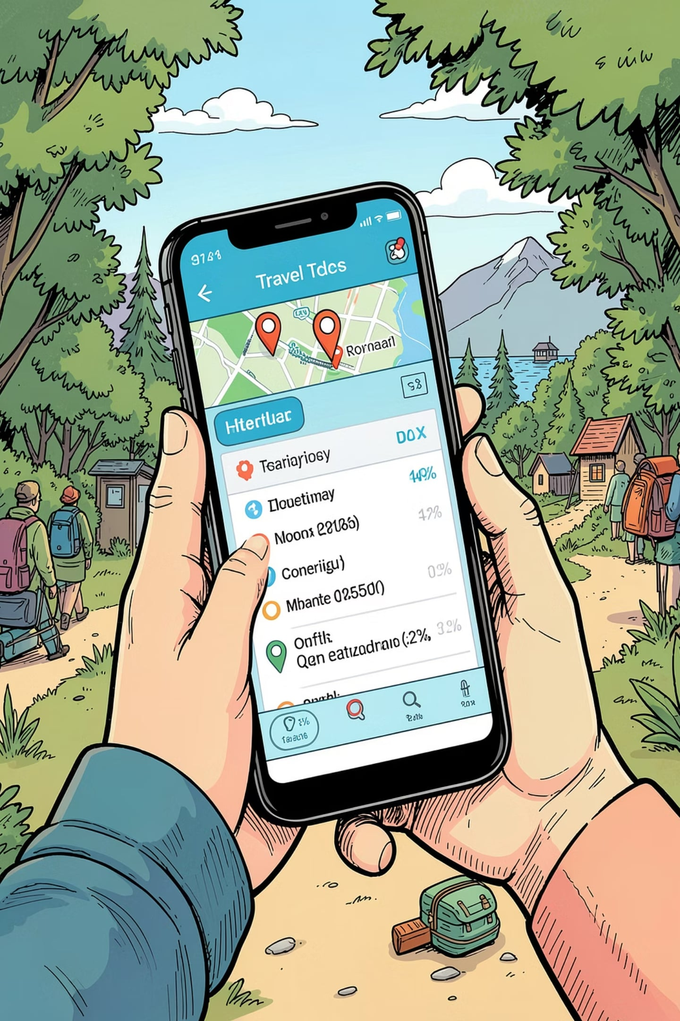




Key Features
Personalized Recommendations
ML-powered destination suggestions tailored to your interests — nature, history, temples, wildlife, and more.
Auto Day-Wise Itinerary
Destinations automatically distributed across travel days based on ideal visiting hours and popularity.
Interactive Mapbox Maps
Visualize your full trip plan with map markers showing exact lat/lng coordinates for every stop.
Trip Sharing
Share your generated itinerary with friends and family directly from the app.

Slide 9
Results & API Reference
✅ Verified Working
Sample Request
All major modules — Flutter frontend, FastAPI backend, ML model, and Mapbox integration — work seamlessly together to generate personalized travel plans.
{
"City": "Raipur",
"State": "Chhattisgarh",
"Days": 4,
"Is_Nature": 1,
"Is_History": 1,
"Is_Temple": 0
}
Sample Response
{
"success": true,
"spots_found": 20,
"itinerary": [
{
"day": 1,
"place_name": "Nandanvan Zoo",
"lat": 21.21,
"lng": 81.65,
"categories": ["Wildlife"]
}
]
}
Backend Status
Recommendations
GET / — health check
POST /recommend — returns itinerary JSON

Slide 10






What's Next for Yatrik
Currently focused on Chhattisgarh tourism, Yatrik's architecture is built to scale. The roadmap transforms it into a complete AI-powered travel platform.
AI Travel Assistant
Hotels & Dining
Conversational planning via OpenAI APIs
Recommendations + budget estimation
Multilingual Support
Smart Routing
Regional languages across India
Weather & traffic-aware optimization
Cloud & Offline
Community Features
Cloud DB + offline itinerary access
User ratings, reviews & saved history

