Slide 1


Deep Sky Project Finance
X

Slide 2
Market
Offtake Contracts
 | Contract | Benefits
Company A | Purchase 1.5 million carbon removal credits over 10 years at $450 per credit. | Stronger case for lenders Lock in predictable revenue Credible anchor buyer Less exposure to volatile VCM.
Frontier | Annual purchase of $30M over 10 years (60,000 carbon removal credits at $500 per credit) | Technological advancement fund Aligns deliveries with production Buyer Diversification
Federal Organization | Purchase up to 200,000 carbon removal credits per year for 15 years for $300 per credit with an escalation factor of 2.2% per year. | Long-term revenue protection A credible financing partner Alignment with public priorities Contract of Difference
Buyers expect DAC prices to fall: In a survey cited by BMO, buyers viewed US272–458 per tonne as an acceptable range for 2030 DAC credits.
Notes:
Company A has offered to purchase 1.5 million carbon removal credits over 10 years at $450 per credit. Deep Sky would begin delivering credits as each phase becomes operational, with the annual allocation to Company A increasing alongside production. Payments would therefore grow through the buildout rather than fund construction upfront. Once Phase 3 reaches full production, the agreement would provide a predictable revenue stream backed by a credible anchor buyer.
Company A resembles Microsoft because both are large corporate buyers pursuing a carbon-negative-by-2030 goal and willing to sign long-term agreements for durable carbon removal. Microsoft has used advance purchase commitments to help scale emerging removal projects, which is similar to the role Company A’s 10-year offtake could play for Deep Sky. A buyer like that offers more than revenue: its purchasing experience and reputation could give lenders confidence that there is a serious market for the credits.
The demand for DAC credits is far ahead of delivery: as of today only 8% of contracted tonnes of Carbon credits has been delivered across the market. This is a market-wide figure, not Microsoft’s delivery rate. For a buyer like Microsoft, securing a long-term offtake now can lock in a predictable price before more projects come online and competition for verified credits grows. It also reserves future supply and helps finance new capacity. The remaining risk is delivery, so Microsoft would still need confidence in Deep Sky’s construction milestones, production ramp-up, and verification process.
The Organization is a $15 billion public investment fund with the aim of accelerating emissions reductions and deployment of clean technologies. The offer from the Federal Organization is to purchase up to 200,000 carbon credits per year for 15 years for $300 per credit with an escalation factor of 2.2% per year.
Long-term revenue protection: The price floor limits Deep Sky’s exposure to falling carbon credit prices while preserving the opportunity to sell credits at higher market prices.
A credible financing partner: Federal backing and a 15-year term could give lenders and investors greater confidence in the project’s future cash flows.
Alignment with public priorities: Supporting Deep Sky One would demonstrate a tangible commitment to scaling Canadian direct air capture and could help attract other public and private capital.
Contract of Difference – we don’t have to deliver
A project finance structure allows stakeholders to appropriately share risks (through equity and debt investments) on the future success of the Project while the corporate sponsor can avoid dilution and loss of control that is commonly associated with corporate financing.
We have confidence in the market growth of carbon removal credits; accordingly we are allocating our production surplus (after delivering to company A, Frontier and Federal organization) to the VCM and forecasted increase in demand for the Compliance market.
This approach of combination of offtakes ensures we are minimizing our risks to the evolving carbon market but also maintaining confidence the supply will outprice the demand and we have credits loeft over to meet that increased demand.

Slide 3
Project
From Financing to Verified Tonnes
1
A financeable revenue plan: Company A commits to buying credits as production ramps up. The federal price floor protects a separate volume against low market prices. Together, they help lenders forecast revenue, provided the contracts have realistic delivery terms.
Robust capital structure: Equity, debt, eligible grants and tax credits must cover the build and a contingency.
2
3
A credible path to deliver
Secure permits and power (feedstock)
Build and Commission each phase
Measure and verify removals before issuing credits.
Notes:
For Deep Sky to succeed beyond its first facility, we focused on three factors.
First, it needs a financeable revenue plan. Committed buyers give lenders confidence in future cash flow. Company A’s fixed-price contract and the federal price floor also reduce exposure to weak demand or falling credit prices.
Second, it needs a capital structure that can fund construction while leaving enough cash for operations and future facilities. We used a weighted average cost of capital approach to assess how different debt levels affect project value. We also accounted for the risk that costs exceed contracted revenue by looking at operating efficiencies, grants, and tax credits.
Third, Deep Sky needs a credible path to delivery. Construction could run late or over budget, so our plan includes contingency funding and an experienced construction partner. The plant may produce fewer credits than expected, so we use conservative delivery commitments and allow time to ramp up. Finally, securing permits and feedstock, agreeing on a certification method early, and independently verifying removals are essential: buyers can only receive credits that Deep Sky can prove it has delivered.

Slide 4
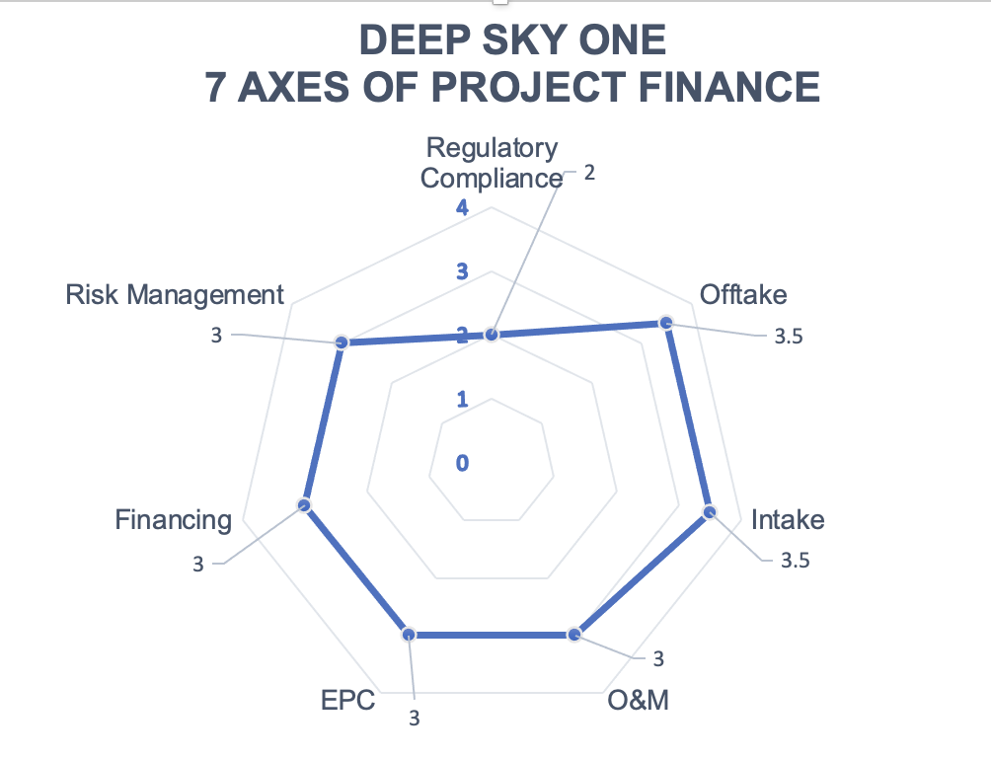
Company
Long-term Positioning (7 Axes Framework)
Securing long-term offtakes:
Committed buyers:
Demonstrate demand.
Provide more predictable cash flow.
Strengthen the case for financing Deep Sky One and future facilities.
Managing
risks:
Exposure to volatile market and falling price:
Off-take agreements.
Latest announcement by Fed. Gov. on international markets.
Federal floor of CCM.
Failure to deliver to buyers:
Phased DAC credit deliveries align buyer commitments with the production ramp-up.
Notes:
Construction costs more or takes longer than planned - > Set aside contingency funding (Grant money) and use an experienced construction partner.
The plant produces fewer verified credits than promised -> Commit to conservative delivery volumes and allow a ramp-up period.
Credit prices fall or demand is weak -> Combine Company A’s fixed-price sale with the federal price floor.
Costs exceed contracted prices -> Reduce operating costs and confirm that grants and tax credits close the funding gap.
Credits cannot be verified or sold -> agree on the certification method early and use independent verification.
Turning to our Financial Axis, our primary challenge is solving the first-of-a-kind dilemma: in Year 1, our operating cash flow is just $1.8 million, exposing the project to four distinct structural risks.
First, Solvency Timing: Traditional project debt would cause immediate Year-1 default. We mitigate this by phasing debt on a de-risking ladder—capping early leverage at just 15% until technical uptime is proven.
Second, The Working Capital Gap: Canada's CCUS tax credit covers 54% of our CapEx, but the cash rebate only clears 12 to 18 months post-commissioning. We neutralize this liquidity gap using a self-liquidating commercial bridge facility.
Third, The Cash-Flow Squeeze: Demanding fixed cash dividends from catalytic capital drains debt service. By restructuring public funds into a 3% cash, Payment-in-Kind convertible preferred instrument, we protect cash flow and unlock over $100 million in senior borrowing capacity.
Finally, Merchant Carbon Volatility: We shield lenders by bifurcating debt—underwriting senior bonds strictly against investment-grade offtakes from buyers like Microsoft, while backstopping open-market volume with a $300 sovereign price floor.
Together, these structural tools eliminate technical default risk and make the project fully bankable

Slide 5
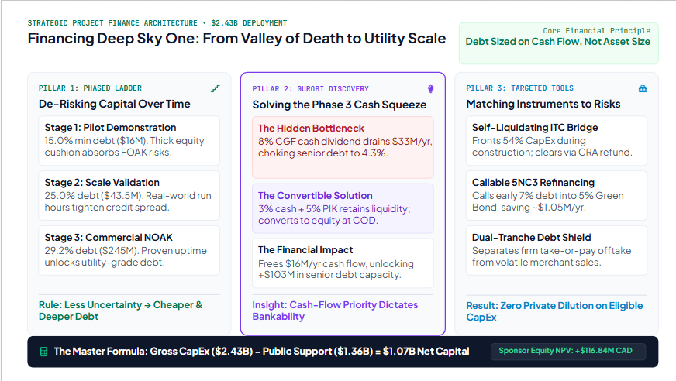
Financial
Capital Stack Structure
Notes:
[0:00 – 0:50] The Core Question & The Gurobi Approach
Good morning, judges. The easiest way to understand our financing strategy is to stop asking, "How do we borrow $2.4 billion?" and instead ask:
"How do we build a multi-billion-dollar infrastructure project when Day 1 produces almost no operational cash, the technology is unproven at commercial scale, and commercial lenders refuse to take engineering risk?"
In project finance, banks do not lend based on how green or valuable an asset might be on paper. They ask one question: “How much predictable cash flow is available to service our loan, and how wide is our safety cushion?” That safety cushion is the Debt Service Coverage Ratio (DSCR). If you load up on conventional senior debt from Day 1, early cash flows cannot even cover the interest payments, causing immediate default.
To solve this, we didn't use a static spreadsheet. We formulated a dynamic optimization model in Gurobi that treated capital structure as an evolving de-risking ladder. Our objective maximized long-term shareholder value while mathematically enforcing strict lender DSCR coverage covenants across every single operational year.
[0:50 – 1:55] The Financing Ladder: Three Stages of De-Risking
Instead of a single financing close, think of Deep Sky One as three distinct companies evolving over time:
Stage 1: The Demonstration Pilot. This stage is about pure risk absorption. Because banks will not touch unproven capture equipment, senior debt is kept to a strict minimum. We fund this stage using government tax credits, non-repayable grants, catalytic public capital, and sponsor equity. Sponsoring equity acts as the first-loss cushion—if unexpected hiccups occur, equity takes the hit so lenders stay protected.
Stage 2: Scale Validation. As real-world operating data validates capture rates and sorbent durability, engineering uncertainty drops. Because the bank's risk is lower, our borrowing capacity expands and our interest rates begin to step down.
Stage 3: Commercial NOAK Infrastructure. By the time multi-train commercial operations are proven, Deep Sky One no longer looks like early-stage climate tech. It behaves like a contracted utility asset. With risk largely eliminated, commercial lenders step in with substantial, low-cost senior debt, minimizing the need for expensive equity.
The governing rule is straightforward: less uncertainty leads to more debt, which yields a lower cost of capital.
[1:55 – 2:55] The CGF Discovery: Cash Flow Priority vs. Nominal Capital
The central financial discovery from our Gurobi optimization revealed that a project’s borrowing capacity is not determined by Assets minus Liabilities—it is determined by who holds a contractual claim on annual cash flow.
To bridge the funding gap, we brought in public catalytic capital from the Canada Growth Fund (CGF). When we initially modeled CGF as standard preferred equity demanding an 8% annual cash dividend, it created a severe cash squeeze. Paying that mandatory cash dividend drained the project's operational cash, leaving almost nothing to service bank loans. Senior lenders pulled back, and our model revealed that the project sponsor would have been forced to write an enormous, dilutive emergency equity check.
We resolved this by structuring CGF as a Subordinated Convertible Preferred Instrument with a Payment-in-Kind (PIK) feature:
Instead of draining cash, the project pays only a modest 3% cash distribution, while the remaining return is paid in kind—meaning it rolls into the investment balance rather than leaving the project's bank account.
Keeping that cash inside the project freed up critical debt-service capacity, unlocking over $100 million in additional commercial bank borrowing.
At commercial completion, this instrument converts into equity ownership, permanently wiping away a massive future loan refinancing cliff.
[2:55 – 3:45] Risk-Matched Instruments: Bridging, Calling, and Offtakes
Every remaining layer of our capital stack directly targets a specific project risk:
The Self-Liquidating ITC Bridge Loan: Canada’s clean economy tax credits reimburse over half our eligible CapEx, but the government refund check only clears after the plant is built and operational. Contractors need their money on Day 1. We use a dedicated commercial bridge loan to front construction costs, which automatically repays itself the moment the CRA tax refund arrives—funding over half the physical plant without diluting our equity.
Callable 5NC3 Bonds: Early construction debt charges high interest rates to reflect early-stage risk. We structured this debt with a call option. Once commercial operations prove the plant works, we exercise the option to retire those expensive early loans and refinance into a low-interest Green Bond—just like refinancing a mortgage after your credit score improves.
Offtake-Backed Dual Debt Tranches: We refuse to gamble debt service on volatile open-market carbon prices. We take binding, multi-year forward purchase agreements from blue-chip buyers like Microsoft to secure cheap senior bank debt, while isolating uncontracted merchant sales into a separate subordinated bucket backstopped by a sovereign price floor.
[3:45 – 4:00] Closing
By structuring our capital around cash-flow priority, risk transitions, and public policy, we transform a high-risk first-of-a-kind project into a bankable, utility-grade infrastructure asset.

Slide 6


