Slide 1

SpaceX Falcon 9 Project
IBM Data Science Professional
Certificate
https://github.com/Leviathan-404/SpaceX-Falcon-9-Project

Slide 2



OUTLINE
Executive Summary
Introduction
Methodology
Results
  Visualization – Charts
  Dashboard
Discussion
  Findings & Implications
Conclusion

Slide 3

EXECUTIVE SUMMARY
Analyzed rocket launch data using python
Used a downloaded dataset because the API was unavailable
Included a web-scraping notebook to show the alternative data-collection method
Cleaned and explored the data using pandas and numpy
Found that landing success varied by booster version and launch site
Future work could include newer data and predictive modeling

Slide 4

INTRODUCTION
This capstone project applies the end-to-end data science workflow to a real-world aerospace problem: predicting whether the SpaceX Falcon 9 first stage will land successfully.
Because first-stage reuse can significantly reduce launch costs, accurate landing predictions can support pricing and competitive bidding decisions.
The project uses data collection, wrangling, exploratory analysis, visualization, and machine learning to identify factors linked to successful landings.
The final model evaluation compares predictive performance and highlights insights that can help inform launch cost estimates.

Slide 5

CAPSTONE METHODOLOGY
Data collection: Scraped Falcon 9 and Falcon Heavy historical launch records from Wikipedia.
EDA + labeling: Explored landing outcomes and converted results into supervised learning labels: 1 = successful landing, 0 = unsuccessful landing.
SQL analysis: Used SQL queries to complete required analysis tasks and summarize launch patterns.
Feature engineering: Cleaned variables and prepared features for model training.
Interactive analytics: Built visual analysis with Folium maps and an interactive Dash app.
Machine learning: Created a pipeline to predict first-stage landing success using the prepared launch data.

Slide 6
DATA COLLECTION & WRANGLING
DATA PREPARATION PIPELINE
Source: Wikipedia page, List of Falcon 9 and Falcon Heavy launches.
Collection: Used requests, BeautifulSoup, and pandas to scrape and structure historical launch records after the SpaceX API was unavailable.
Fields captured: Included launch date, booster/version details, payload/orbit information, launch site, landing outcome, reuse indicators, landing pad, and location-related attributes.
Missing-value review: Identified missing attributes and calculated the percentage of missing values in each column.
Wrangling: Standardized landing outcomes, selected modeling features, and converted results into a binary target label: 1 = successful landing, 0 = unsuccessful landing.
FINAL OUTPUT
Cleaned Falcon 9 launch dataset prepared for:
• Exploratory data analysis
• SQL analysis
• Visual analytics
• Machine learning

Slide 7
SQL ANALYSIS OF LAUNCH RECORDS
SETUP
QUERY FOCUS
Tool environment
Jupyter Notebook SQL using %sql magic commands connected to a SQLite3 database.
Dataset
Cleaned Falcon 9 launch records prepared from the Wikipedia web-scraping and wrangling stage.
Purpose
Use SQL to summarize launch data, validate patterns, and prepare insights before visualization and machine learning.
Main analysis tasks
• Queried launch sites and mission records
• Compared payload mass across customers and boosters
• Reviewed booster versions and landing outcomes
• Counted successful vs. unsuccessful landings
• Used filters, grouping, averages, and date-based queries
Result
SQL helped uncover structured patterns that supported later EDA, Folium/Dash visual analytics, and model feature selection.

Slide 8
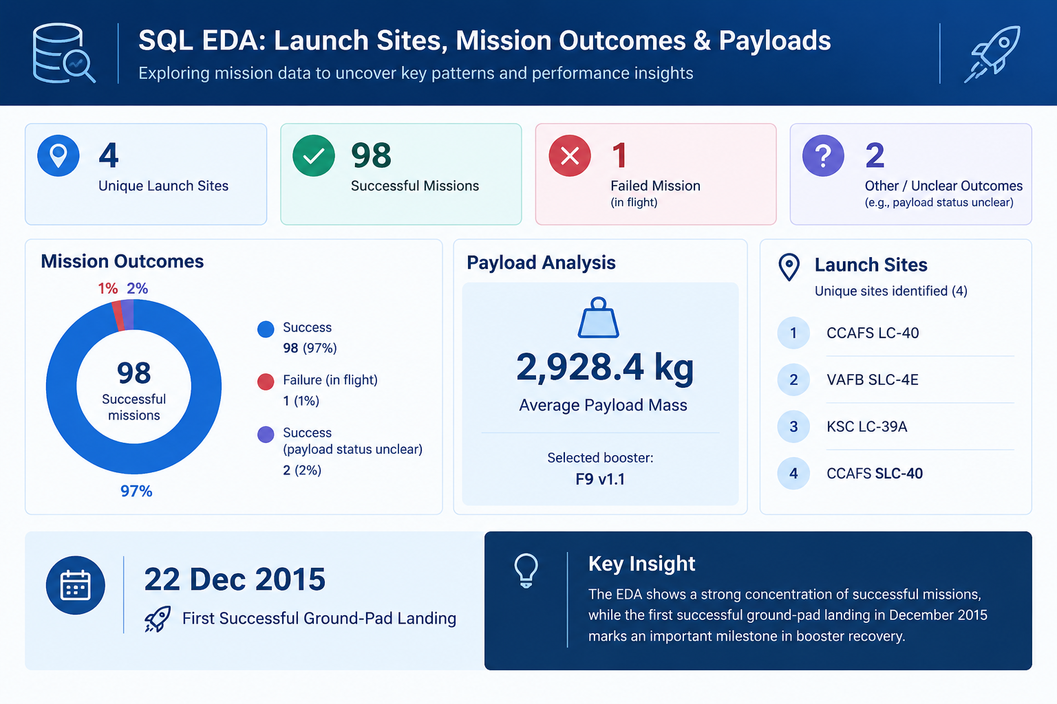

Slide 9
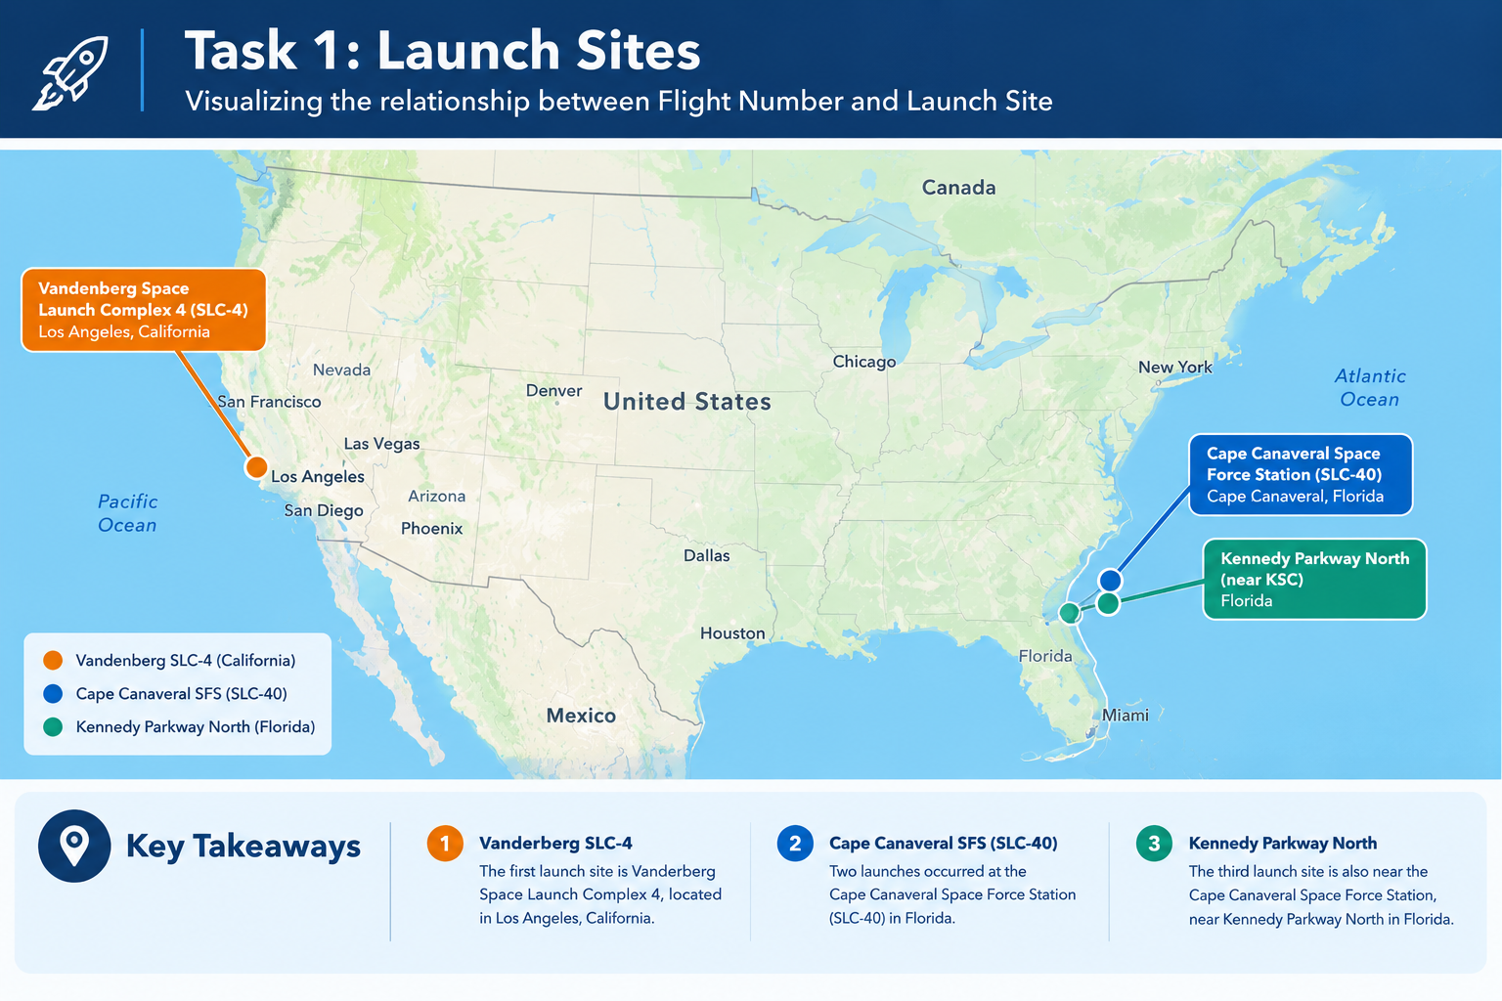

Slide 10
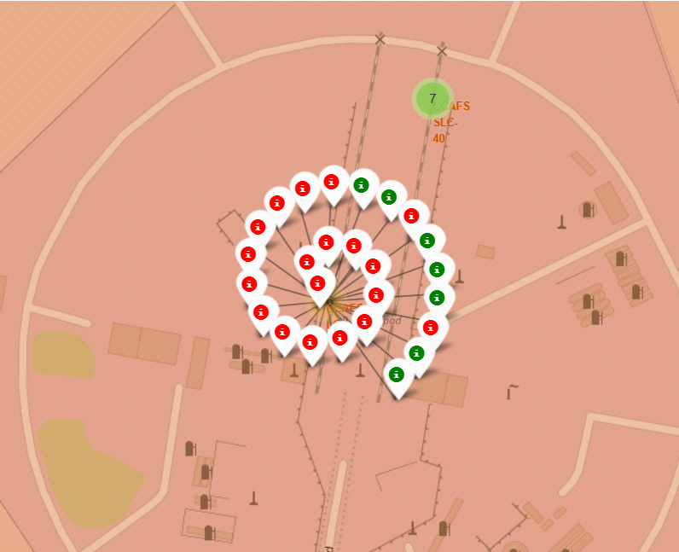
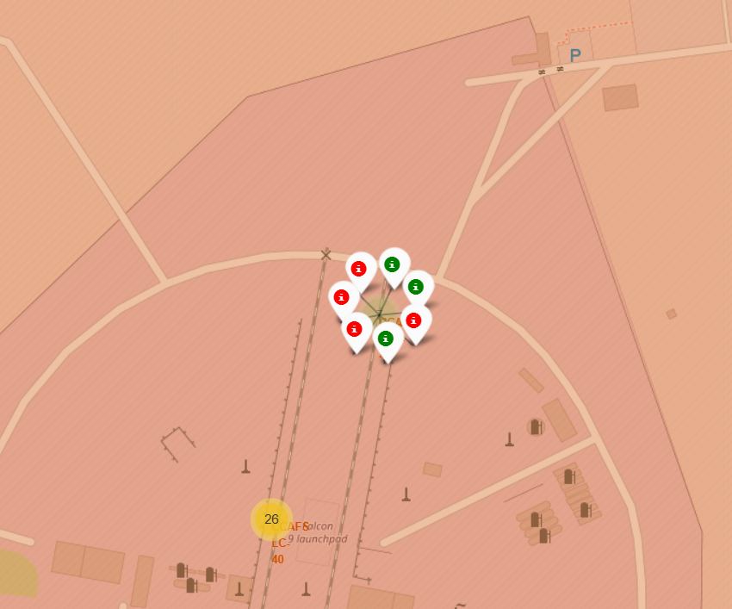
🚀
🚀
Task 2: Marked success/failed launches for CCFAS SLC-40
✦
Key Takeaways
1
Key Finding 1
2
Key Finding 2
The two Cape Canaveral-area launch sites show different success rates, with the second site recording a higher proportion of successful launches in this dataset.
CCAFS SLC-40 (left): Of the 26 recorded launches, 7 were successful, giving a success rate of approximately 26.9%.
Second launch site (right): Of 7 recorded launches, 3 were successful, giving a success rate of approximately 42.9%
EDITABLE TEMPLATE • Replace placeholders with your own data and findings

Slide 11
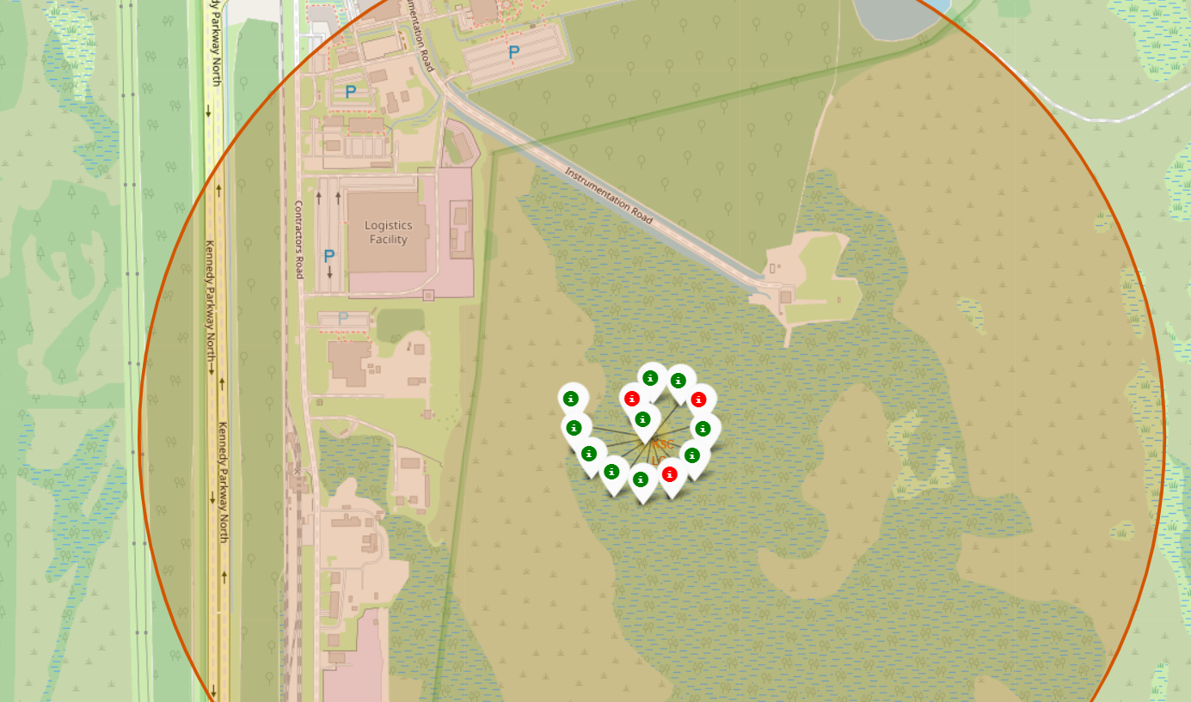
🚀
🚀
Task 2: Marked success/failed launches for KSC LC 39A
✦
Key Takeaways
Of the 13 launches recorded at KSC LC-39A, only 3 were unsuccessful, meaning 10 launches were successful. This corresponds to a 76.9% success rate, indicating a relatively high proportion of successful missions at this launch site within the dataset.
EDITABLE TEMPLATE • Replace placeholders with your own data and findings

Slide 12
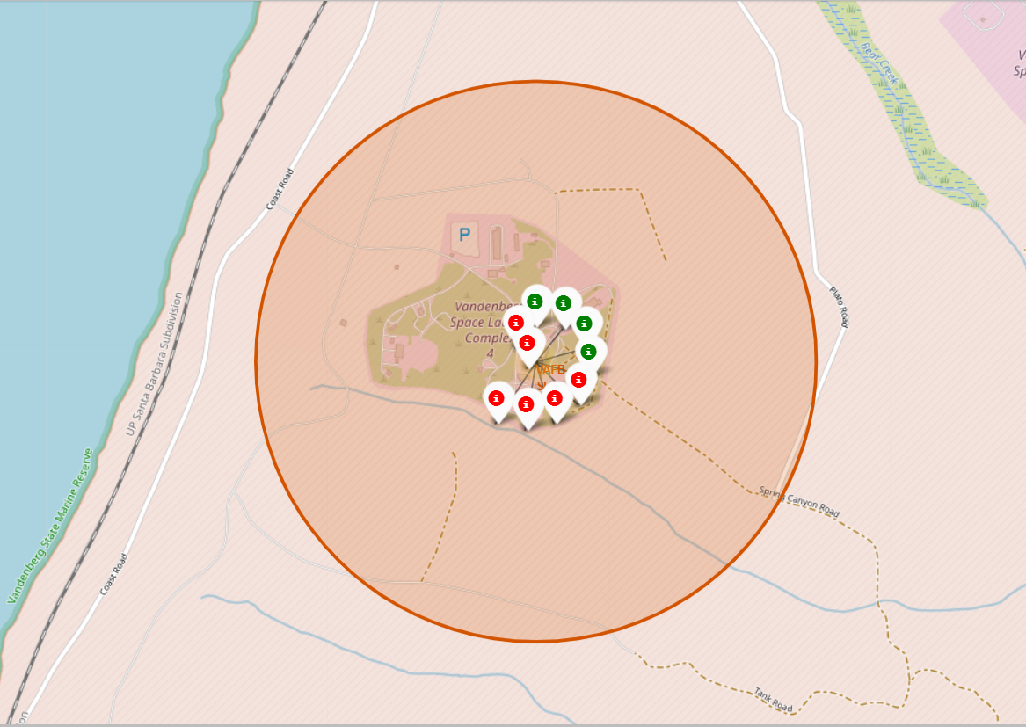
🚀
🚀
Task 2: Marked success/failed launches for KSC LC 39A
✦
Key Takeaways
Of the 10 launches recorded at VAFB SLC-4E in Los Angeles, 4 were successful, resulting in a 40% success rate. The data therefore shows that less than half of the launches at this site were successful within the dataset.
EDITABLE TEMPLATE • Replace placeholders with your own data and findings

Slide 13
Launch Success Analysis
Summary of launch performance by site, payload range, and Falcon 9 booster version
1
Largest share of successful launches
2
Highest launch success rate
KSC LC-39A — 41.7%
KSC LC-39A — 76.9%
KSC LC-39A accounted for the largest proportion of successful launches, followed by CCAFS LC-40 at 29.2%.
10 of 13 launches at KSC LC-39A were successful, producing the highest site-level success rate in the dataset.
3
Payload range with highest success
4
Payload range with lowest success
0–6,000 kg
5,000–9,000 kg
The displayed payload analysis indicates stronger successful-launch representation within the 0–6,000 kg range.
The displayed comparison shows comparatively weaker launch outcomes within the 5,000–9,000 kg range.
5 | Highest-performing booster version: FT — the strongest launch success performance among the displayed booster categories.
Source: SpaceX launch records dataset | Findings based on the interactive Dash dashboard

Slide 14
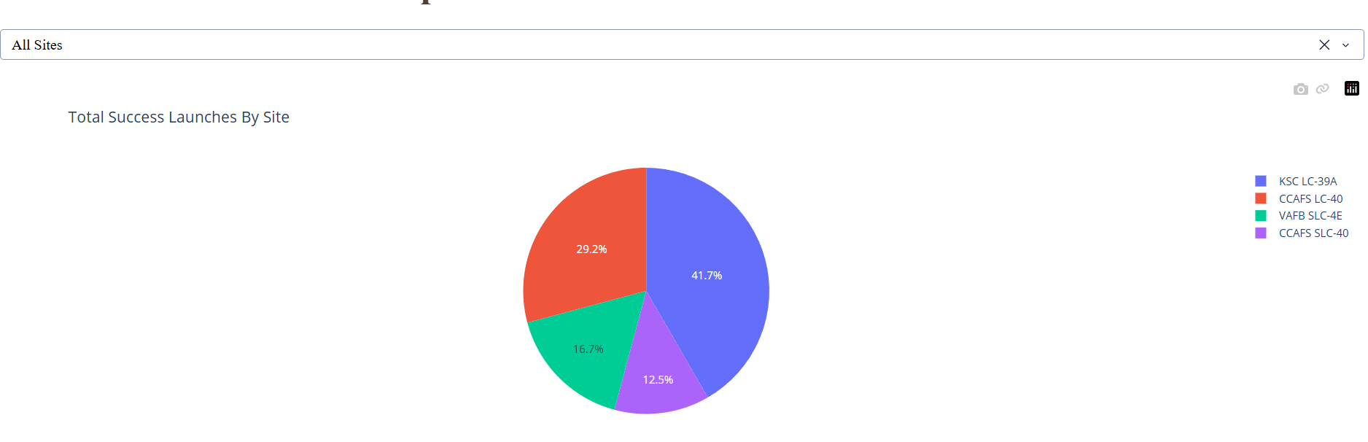
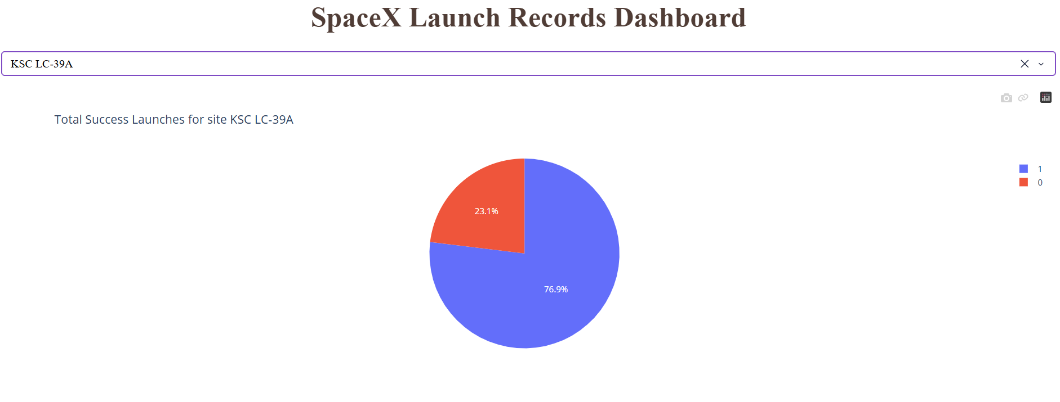
Supporting Charts: Launch Site Performance
Dashboard visualizations supporting the site-level findings
Successful launches by site
KSC LC-39A: 76.9% success rate
Interpretation
KSC LC-39A leads both in the share of successful launches and in overall launch success rate. The site contributed 41.7% of successful launches and achieved a 76.9% success rate, based on 10 successful launches out of 13 recorded missions.
Source: SpaceX launch records dataset | Findings based on the interactive Dash dashboard

Slide 15
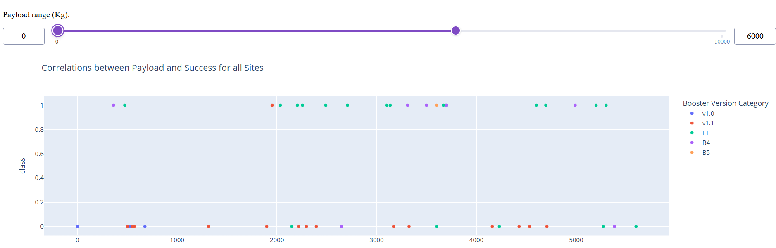
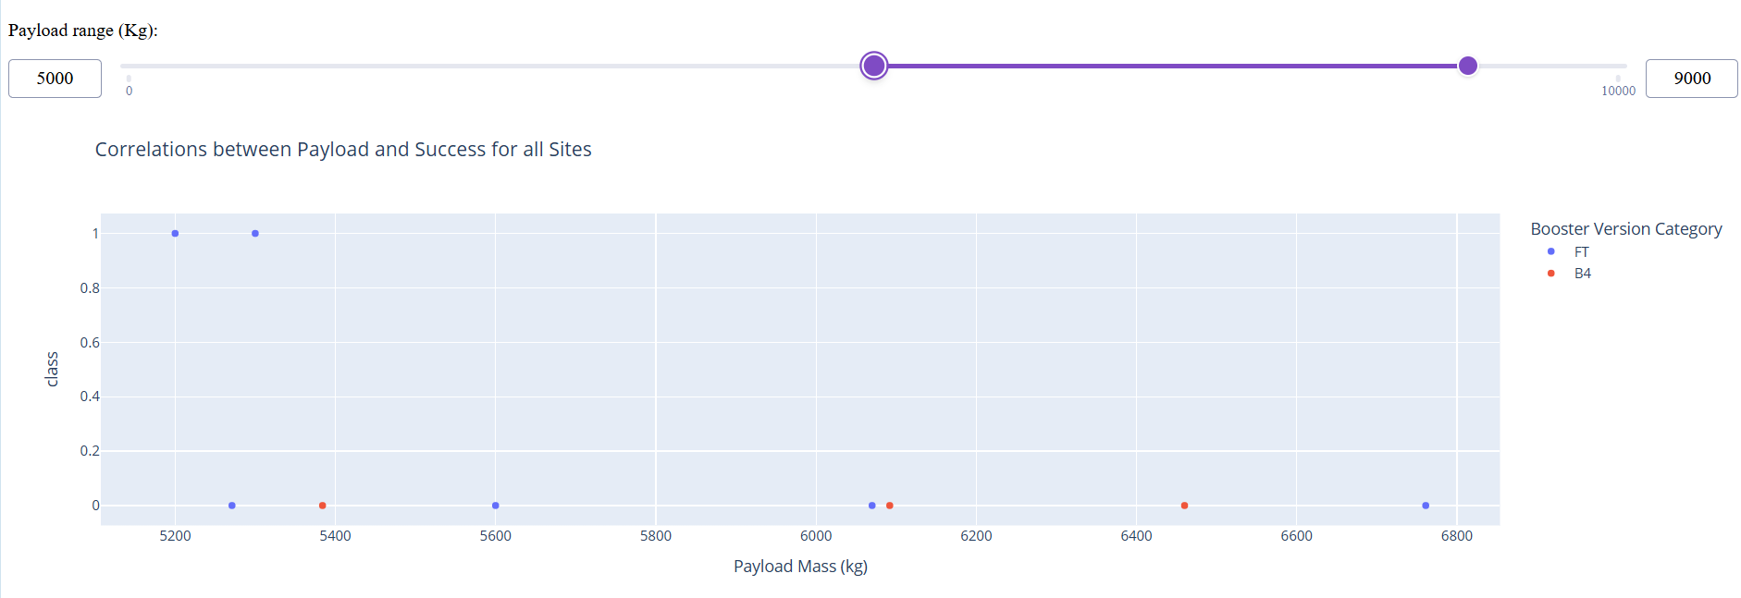
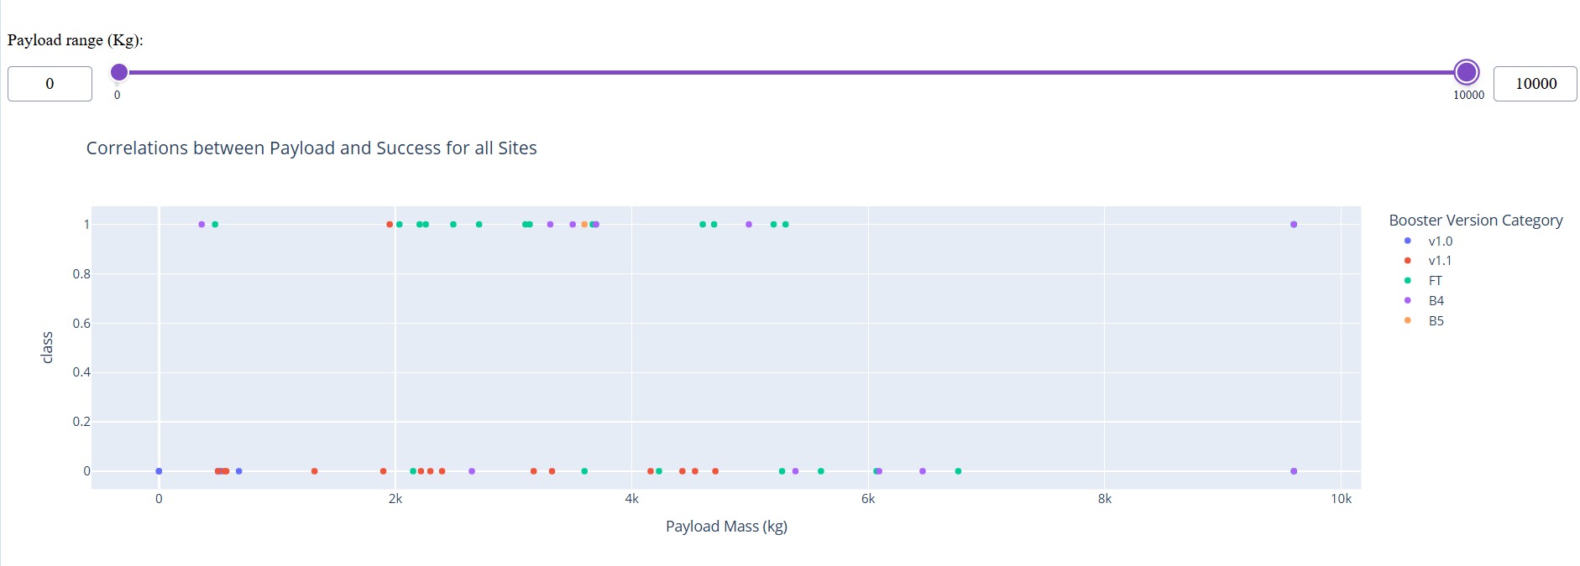
Supporting Charts: Payload and Booster Performance
Payload-range filters and booster-version outcomes from the Dash dashboard
0–6,000 kg range
5,000–9,000 kg range
Full payload distribution
Interpretation
The 0–6,000 kg payload range shows stronger successful-launch representation than the 5,000–9,000 kg range. Across the displayed booster categories, FT is identified as the highest-performing version in terms of launch success rate.
Source: SpaceX launch records dataset | Findings based on the interactive Dash dashboard

Slide 16
Exploratory Data Analysis and Visual Analytics
Investigating launch patterns, site performance, payload characteristics, and booster versions
Data Exploration
Visual Analysis
Performance Comparisons
• Examined launch records and relevant variables
• Reviewed launch sites, payload mass, orbit type, flight number, and booster version
• Identified patterns and differences across launch conditions
• Used charts and interactive dashboard filters
• Compared successful launches across sites
• Examined payload and orbit relationships with landing outcomes
• Calculated success counts and success rates
• Compared booster-version categories
• Investigated how launch characteristics relate to mission success
Key Findings from the Visual Analysis
Launch site
KSC LC-39A recorded the largest share of successful launches and the highest observed site success rate: 76.9%.
Booster version
The Full Thrust (FT) category showed the highest launch success rate among the evaluated booster versions.
Payload analysis
Interactive payload-range exploration was used to compare landing outcomes across different payload masses.
Analytical value
Visual analytics helped reveal differences that would be difficult to identify from raw records alone.
Source: SpaceX launch records dataset | EDA dashboard and visual analytics

Slide 17
Prediction Analysis Methodology
Machine-learning workflow used to predict Falcon 9 landing outcomes
1
2
3
4
5
Define the Target
Prepare the Data
Split the Dataset
Train Models
Evaluate Results
Use the landing outcome as the binary target:
0 = did not land
1 = landed
Select relevant launch features, clean the data, and prepare variables for modelling.
Separate the data into training and test sets to evaluate performance on unseen observations.
Develop and evaluate Logistic Regression, SVM, Decision Tree, and KNN classifiers.
Compare test accuracy and inspect confusion matrices to identify correct predictions and errors.
Models Evaluated
Evaluation Measures
• Logistic Regression
• Support Vector Machine (SVM)
• Decision Tree Classifier
• K-Nearest Neighbours (KNN)
• Test-set accuracy
• Confusion matrices
• Correct versus incorrect classifications
• Comparative assessment of model performance
Objective: identify models capable of reliably distinguishing successful from unsuccessful Falcon 9 landings.
Source: SpaceX launch records dataset | Machine-learning workflow

Slide 18
Prediction Analysis: Model Comparison
Evaluation of models predicting Falcon 9 landing outcomes
Logistic Regression
Support Vector Machine
Decision Tree
K-Nearest Neighbours
83.3%
83.3%
83.3%
61.1%
15 of 18 correct
15 of 18 correct
15 of 18 correct
11 of 18 correct
Model | Accuracy | Correct | Observation
Logistic Regression | 83.3% | 15/18 | Strong overall performance
SVM | 83.3% | 15/18 | Matched Logistic Regression
Decision Tree | 83.3% | 15/18 | Matched top accuracy
KNN | 61.1% | 11/18 | Lower predictive performance
Key Interpretation
Logistic Regression, SVM, and Decision Tree achieved identical test accuracies of 83.3%. KNN performed considerably worse at 61.1%. The three higher-performing models correctly classified 15 of 18 test cases.
Note: The SVM confusion matrix was not regenerated because its original training process required several hours.
Source: SpaceX launch records dataset | Model evaluation results

Slide 19
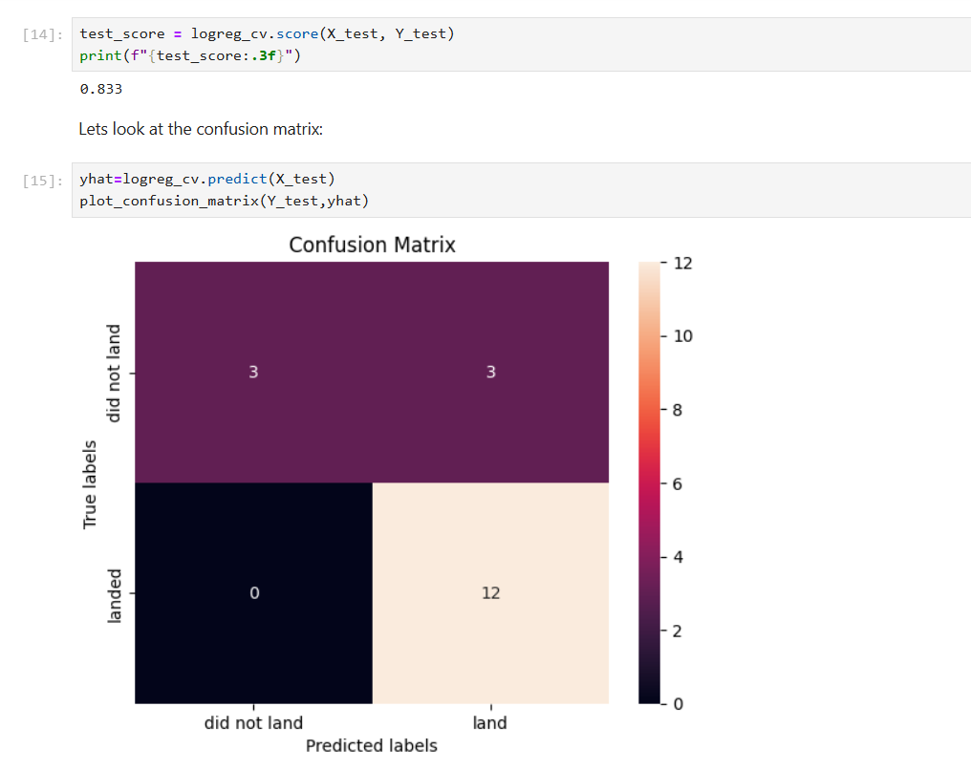
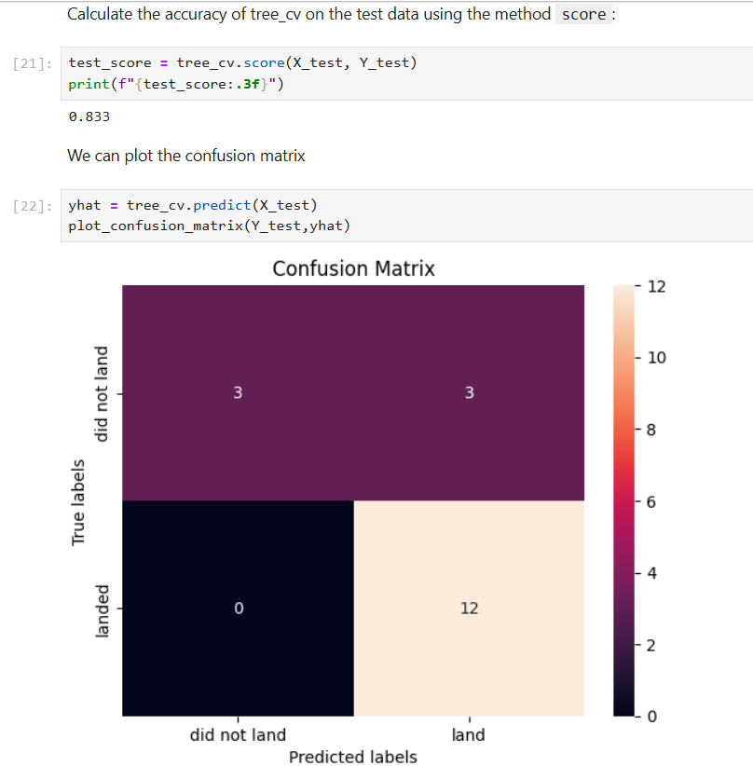
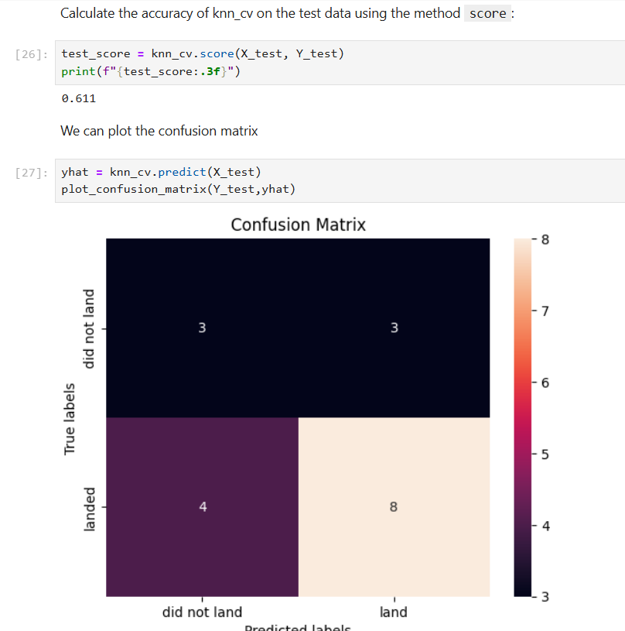
Prediction Analysis: Confusion Matrices
Detailed prediction outcomes for the evaluated classifiers
Logistic Regression — 83.3%
Decision Tree — 83.3%
KNN — 61.1%
Logistic Regression
Decision Tree
KNN
12 landings and 3 non-landings correctly predicted; 3 unsuccessful launches were classified as successful.
Produced the same confusion-matrix counts and accuracy as Logistic Regression.
Correctly predicted 8 landings and 3 non-landings; 4 successful launches were classified as unsuccessful.
Source: SpaceX launch records dataset | Confusion matrices generated in the course lab

Slide 20
Conclusion and Key Findings
Summary of the exploratory analysis, dashboard findings, and predictive modelling
The analysis shows that launch success varied by launch site, booster version, payload characteristics, and model choice.
Exploratory Analysis
Booster-Version Finding
Predictive Modelling
• KSC LC-39A recorded the largest share of successful launches.
• KSC LC-39A also showed the highest launch success rate at 76.9%.
• Payload ranges and booster categories provided additional insight into landing outcomes.
• The Falcon 9 Full Thrust (FT) booster category recorded the highest launch success rate among the evaluated versions.
• This highlights the importance of examining technology and vehicle-generation differences.
• Logistic Regression, SVM, and Decision Tree each achieved 83.3% test accuracy.
• KNN achieved 61.1% and performed less effectively on this test set.
• The strongest models correctly classified 15 of 18 test observations.
Overall takeaway: Site selection, vehicle configuration, payload characteristics, and model selection all contribute to understanding launch success.
Source: SpaceX launch records dataset | Exploratory analysis and machine-learning evaluation

Slide 21
Innovative Insights
Additional observations generated by combining visual analytics with predictive modelling
Launch success is not determined by a single factor; it reflects the interaction of site, payload, vehicle configuration, and operational history.
1
Site Selection as a Strategic Variable
2
Vehicle Evolution Matters
The variation in success rates across launch sites suggests that launch location can be treated as an important feature when analysing mission outcomes.
The strong performance associated with the FT booster category suggests that technological generation may provide useful predictive information.
3
Model Agreement Builds Confidence
4
Accuracy Alone Is Not Enough
Logistic Regression, SVM, and Decision Tree all achieved 83.3% accuracy, indicating consistent performance across different modelling approaches.
The confusion matrices show why model evaluation should include error patterns—not only overall accuracy—especially when missed or false success predictions have different implications.
Practical implication: combine descriptive analytics with predictive models to support more informed launch-planning decisions.
Source: SpaceX launch records dataset | Synthesized project insights

