Slide 1
Does Money Really Matter?

Slide 2
Agenda
Problem Statement
Methodology
Budget vs Revenue
Budget vs Audience
Genre vs Audience

Slide 3
Problem Statement
Production studios invest heavily into the production and marking of film projects but is there a correlation between budget and Return on Investment (ROI) to justify the upfront costs. Additionally, is there a correlation between budget and audience satisfaction. Does the genre play a significant factor in increased revenue?
This analysis looks to identify where limited funds should be allocated in order to get the biggest ROI as well as potentially a cult following.
The four main questions to be answered:
1) Does production budget correlate to a box office profit?
2) Does a higher production budget correlate to a higher audience score?
3) Does a higher audience score correlate to a higher box office profit?
4) Does movie genre have an effect on box office profit and audience score?

Slide 4
Methodology
Used the TMDB v11 dataset from Kaggle as base dataset
Filtered data to only include movies between 2019 and 2023
Filtered movies that had a budget of over $10 million and revenue of over $10 million
For genre analysis filtered movies that had a budget of over $1 million and revenue of over $1 million
Assumptions:
Studios spend an additional 50% of budget on marketing
Total budget = base budget + (base budget * 0.5)
Percent Profit = (Revenue – Total Budget) / Total Budget

Slide 5
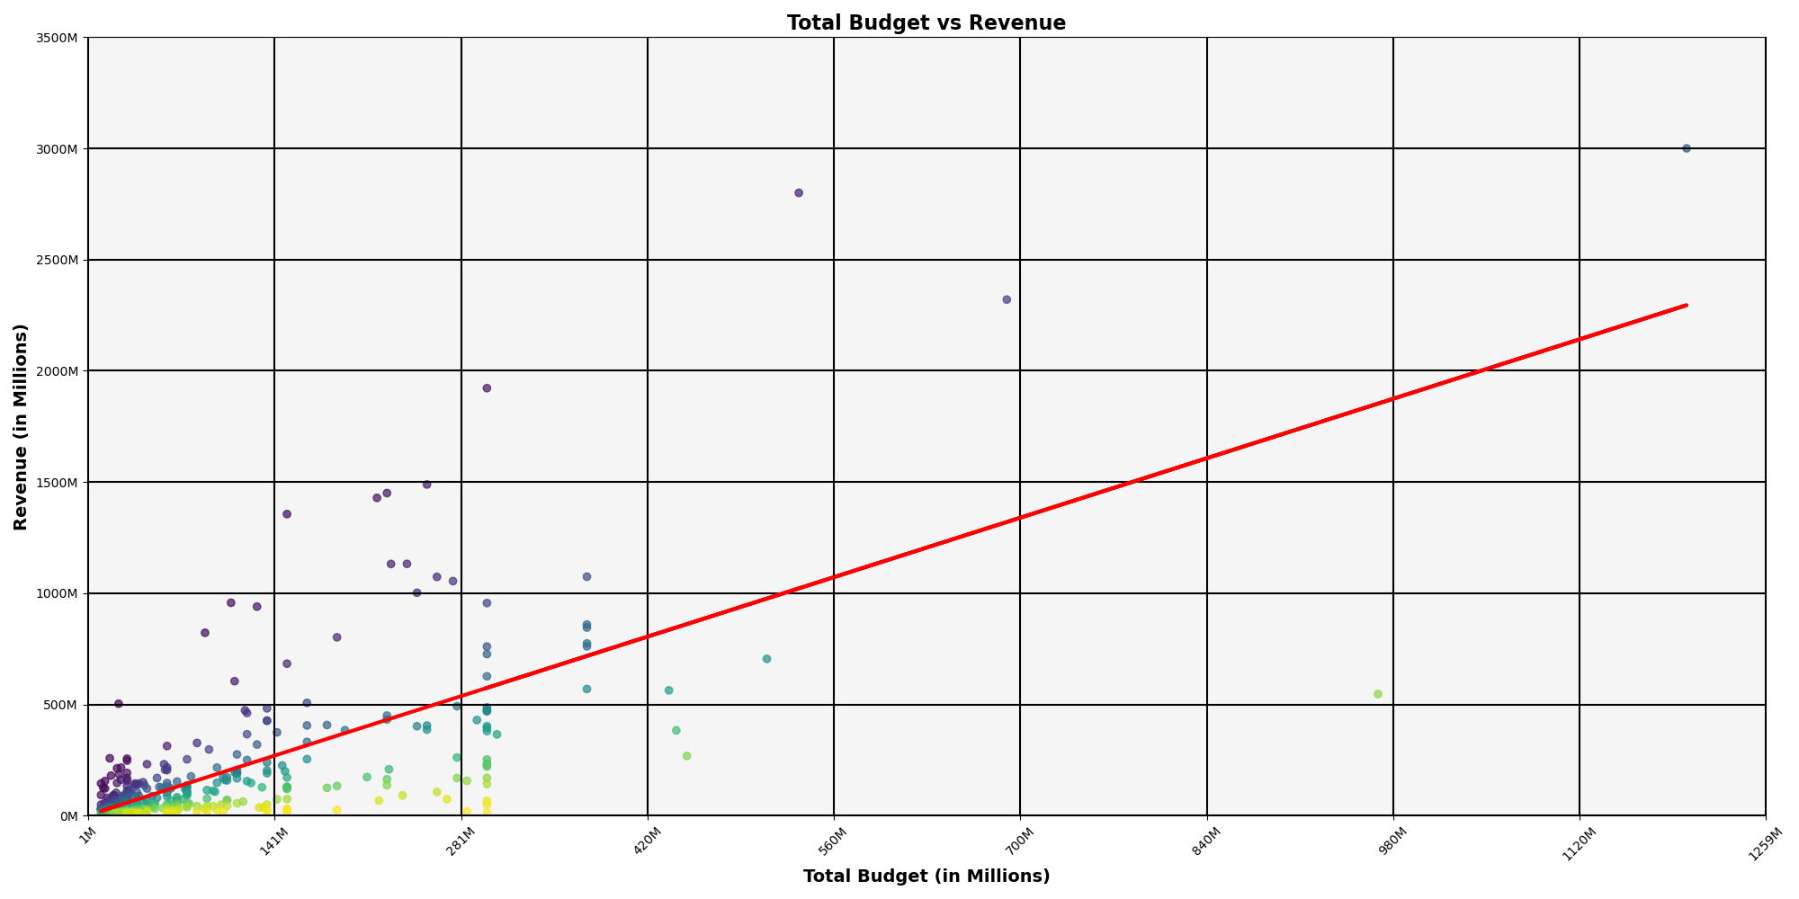
Budget vs. Revenue
Analysis goes here
The R-value is: 0.4843842278753481

Slide 6
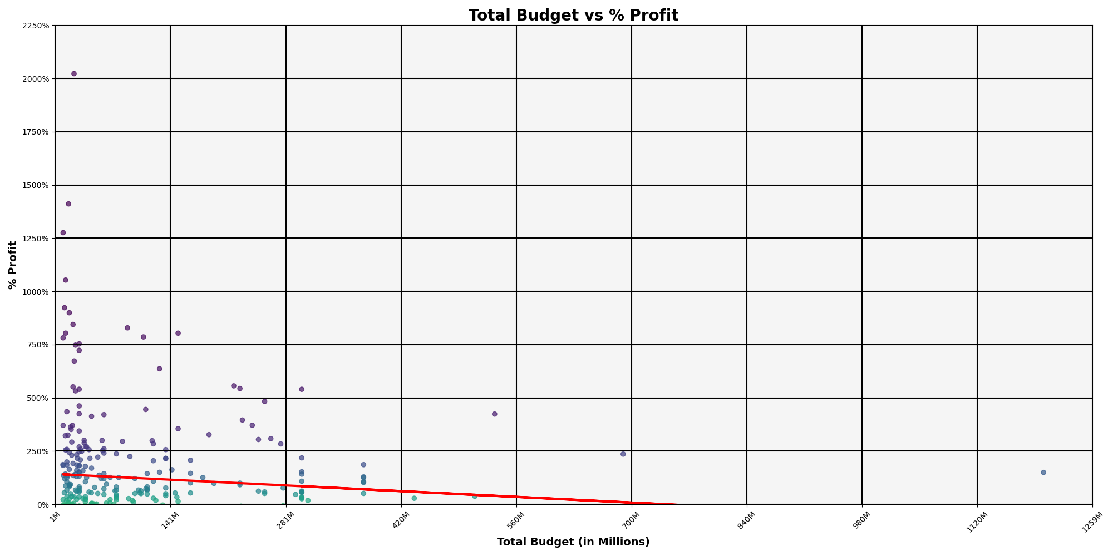
Budget vs. Profit %
Analysis goes here
The R-value is: 0.010746837895366696

Slide 7
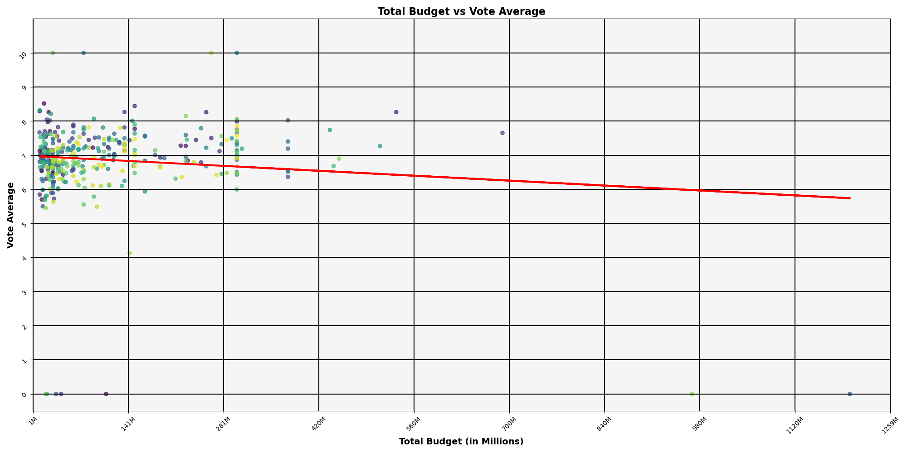
Budget vs Audience Score
Analysis goes here
The R-value is: 0.012800770639383029

Slide 8

% Profit vs Audience Score
Analysis goes here
The r-value is: 0.004712464594773485

Slide 9
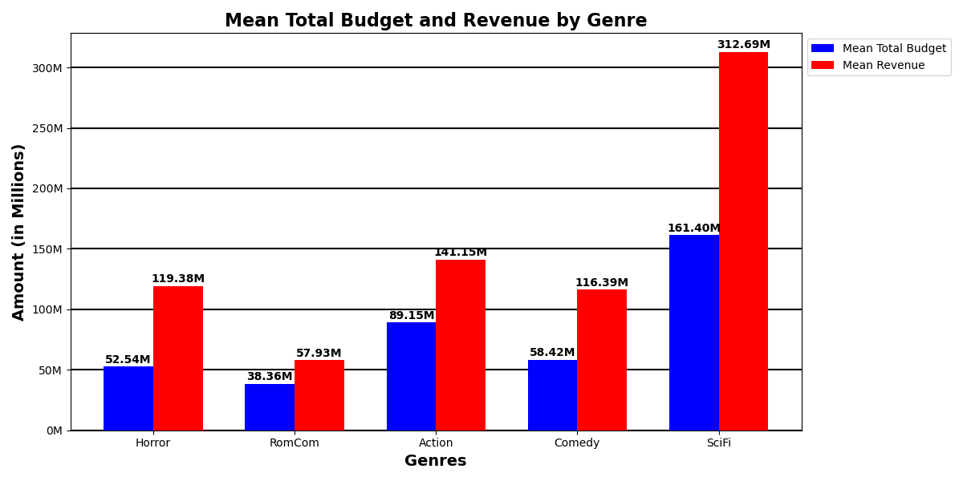
Budget vs. Revenue by Genre
Analysis goes here

Slide 10
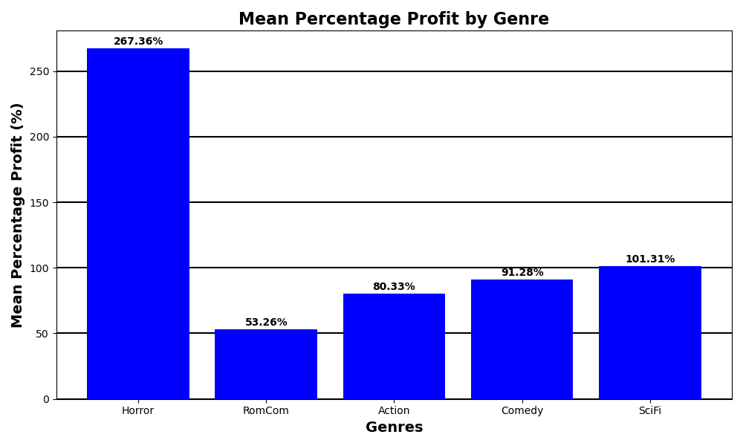
% Profit by Genre
Analysis goes here

Slide 11
Conclusion / Recommendations
Does production budget correlate to a box office profit?
2) Does a higher production budget correlate to a higher audience score?
3) Does a higher audience score correlate to a higher box office profit?
4) Does movie genre have an effect on box office profit and audience score?
Recommendations

Slide 12
Questions

