Slide 1
Does Money Really Matter?

Slide 2
Agenda
Problem Statement
Methodology
Budget vs Revenue
Budget vs Audience
Genre vs Audience

Slide 3
Problem Statement
Production studios invest heavily into the production and marking of film projects but is there a correlation between budget and Return on Investment (ROI) to justify the upfront costs. Additionally, is there a correlation between budget and audience satisfaction. Does the genre play a significant factor in increased revenue?
This analysis looks to identify where limited funds should be allocated in order to get the biggest ROI as well as potentially a cult following.

Slide 4
Methodology

Slide 5
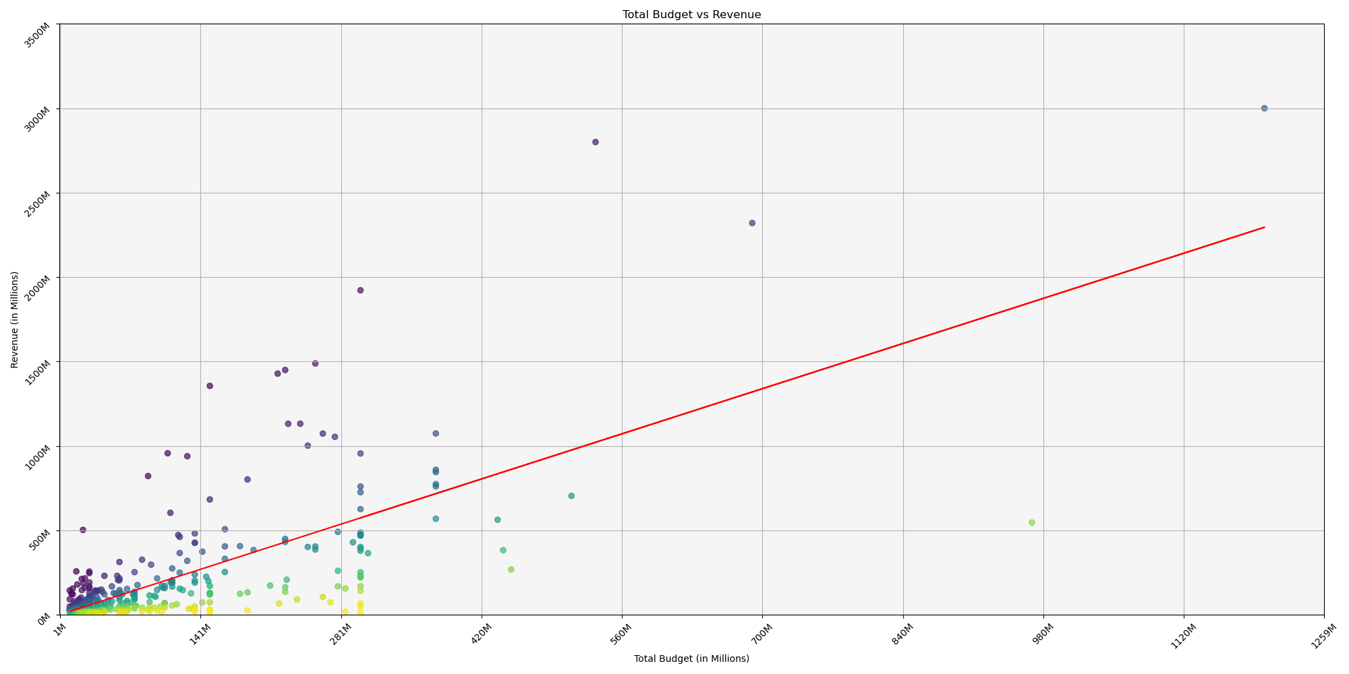
Budget vs. Revenue
The R-value is: 0.4843842278753481

Slide 6
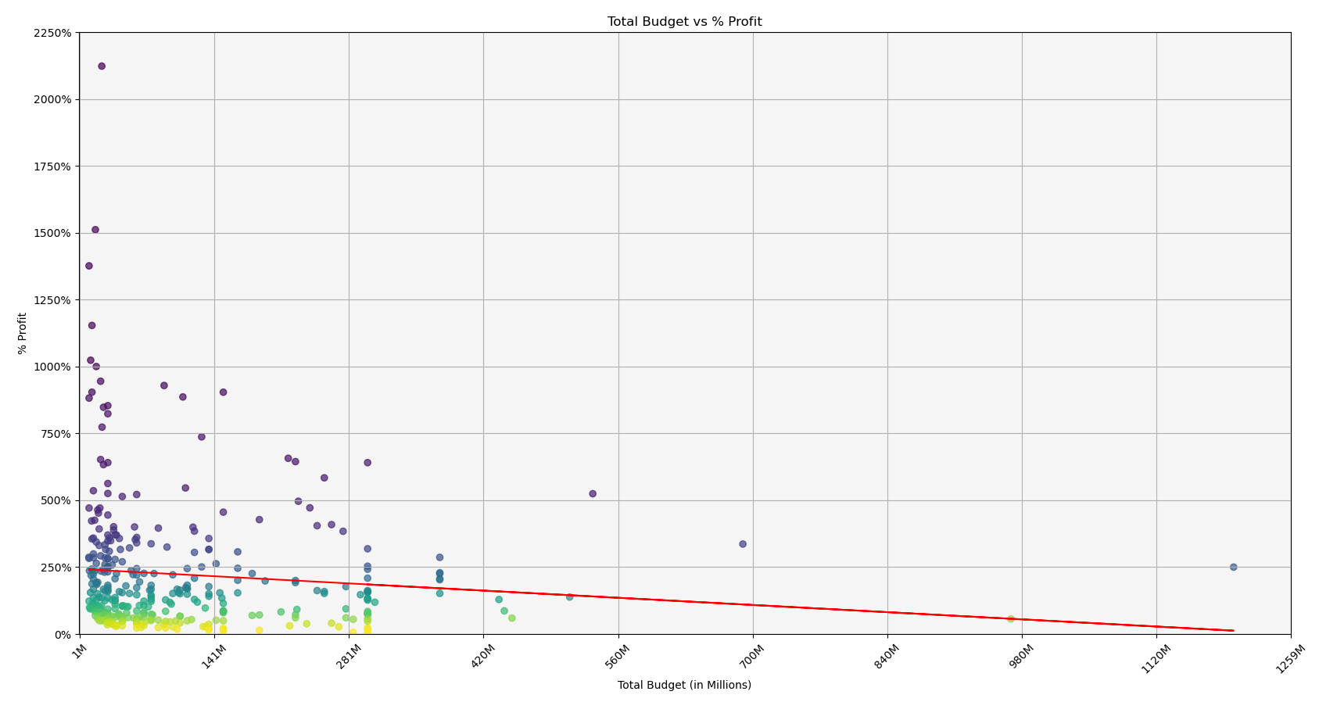
Budget vs. Profit %
The R-value is: 0.010746837895366696

Slide 7
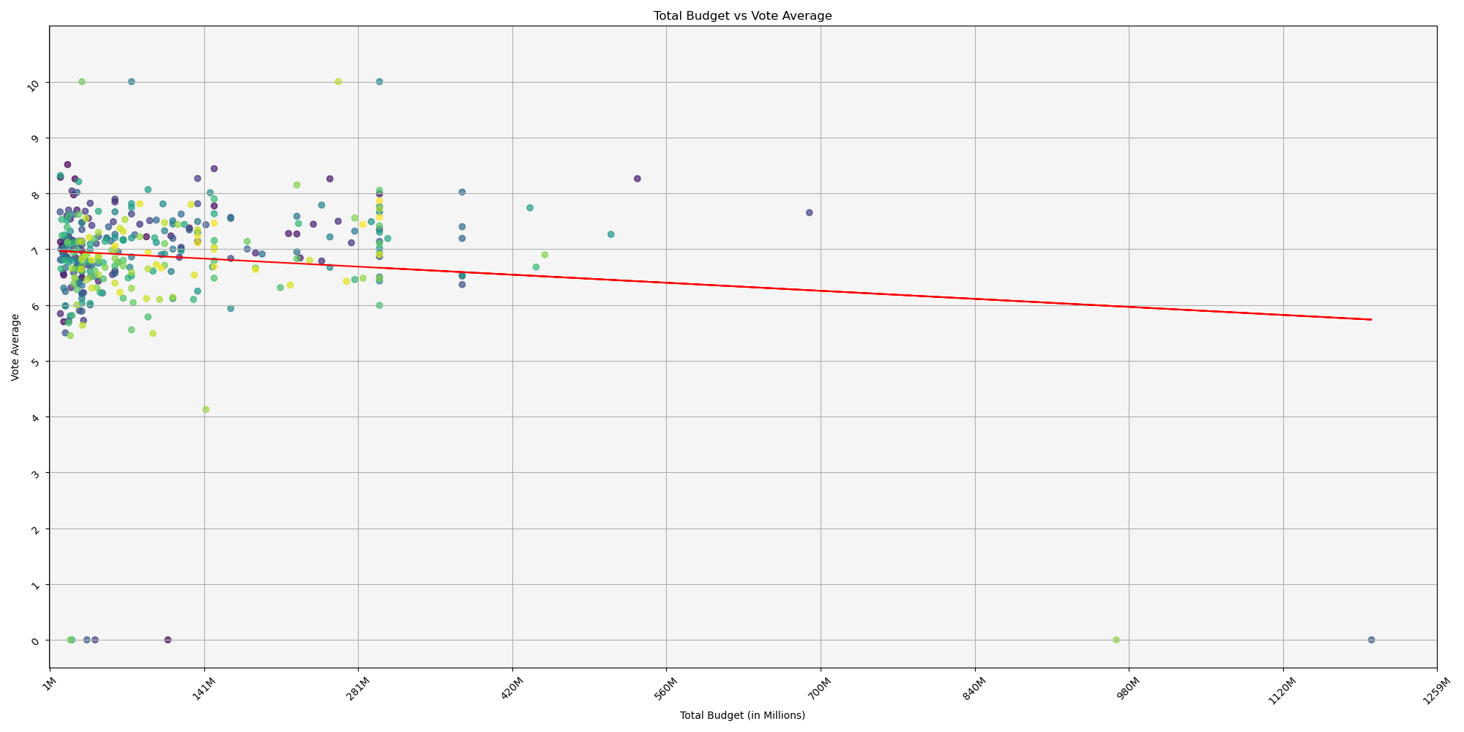
Budget vs Audience Score
The R-value is: 0.012800770639383029

Slide 8
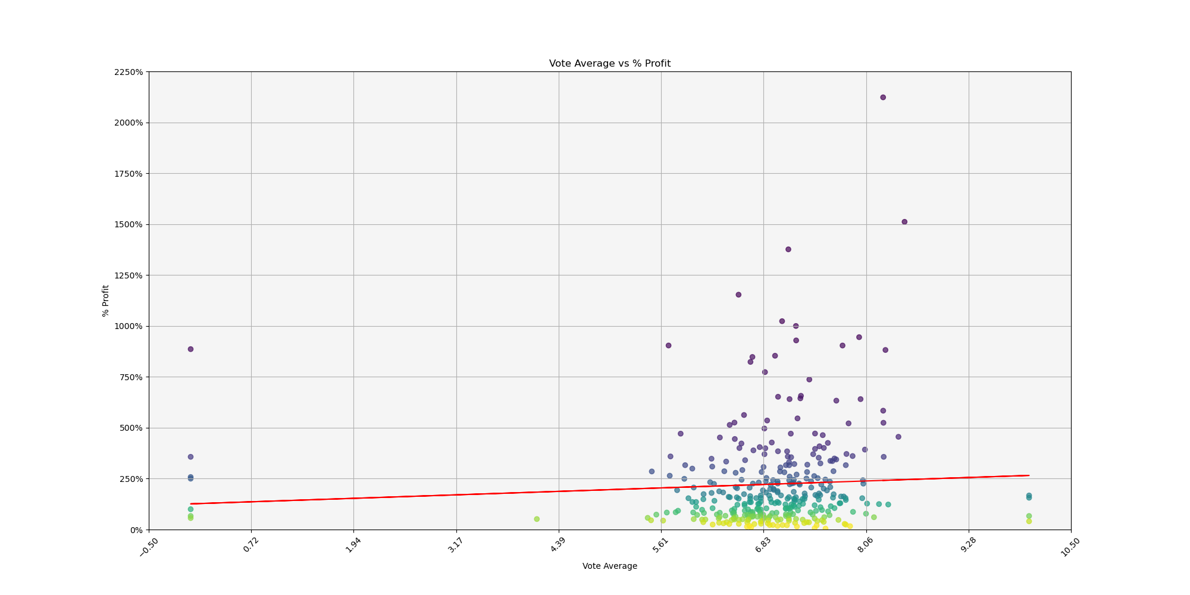
% Profit vs Audience Score
The r-value is: 0.004712464594773485

Slide 9
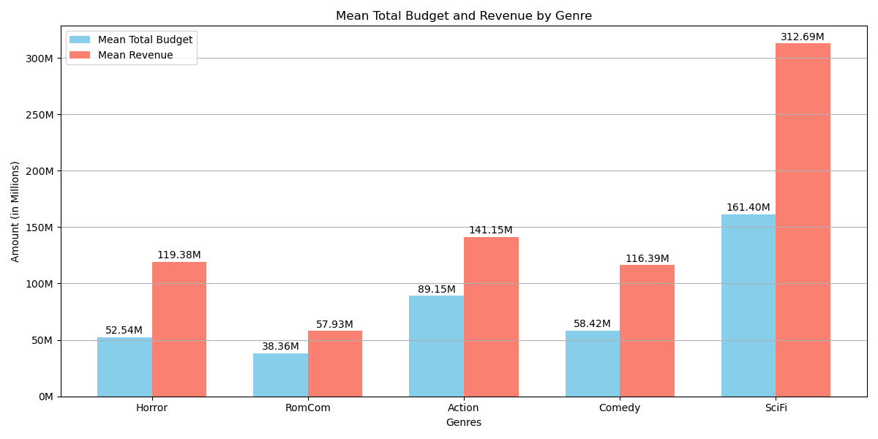
Budget vs. Revenue by Genre

Slide 10
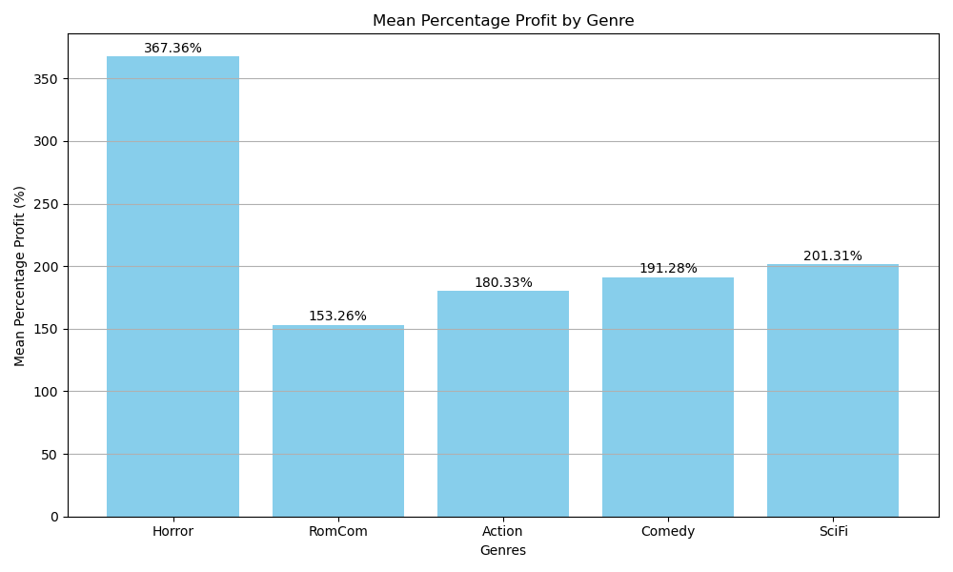
% Profit by Genre

Slide 11
Conclusion

Slide 12
Questions

