Slide 1
Does Money Really Matter?

Slide 2
Agenda
Problem Statement
Methodology
Budget vs Revenue
Budget vs Audience
Genre vs Audience
Conclusion/Recommendations
Questions

Slide 3
Problem Statement
Production studios invest heavily into the production and marking of film projects but is there a correlation between budget and Return on Investment (ROI) to justify the upfront costs. Additionally, is there a correlation between budget and audience satisfaction. Does the genre play a significant factor in increased revenue?
This analysis looks to identify where limited funds should be allocated in order to get the biggest ROI as well as potentially a cult following.
The four main questions to be answered:
1) Does production budget correlate to a box office profit?
2) Does a higher production budget correlate to a higher audience score?
3) Does a higher audience score correlate to a higher box office profit?
4) Does movie genre have an effect on box office profit?

Slide 4
Methodology
Used the TMDB v11 dataset from Kaggle as base dataset
Filtered data to only include movies between 2019 and 2023
Filtered movies that had a budget of over $10 million and revenue of over $10 million
For genre analysis filtered movies that had a budget of over $1 million and revenue of over $1 million
Analyzed Total Budget vs Revenue/% Profit, Total Budget/Audience Vote and % Profit vs Audience Score
For genre specific analyzed Budget vs. Revenue by Genre and % Profit vs by Genre
Several movies fell within multiple genre categories and were bucketed based off into individual genres
Performed Anova test on all five genres
Performed Two Sample T-Test on genre vs genre
Assumptions:
Studios spend an additional 50% of budget on marketing
Total budget = base budget + (base budget X 0.5)
Percent Profit = (Revenue – Total Budget) / Total Budget
There is a set budget of $200 Million
Notes:
Speak to what worked easy and what hurdles there we
The Movie Database (TMDB)

Slide 5
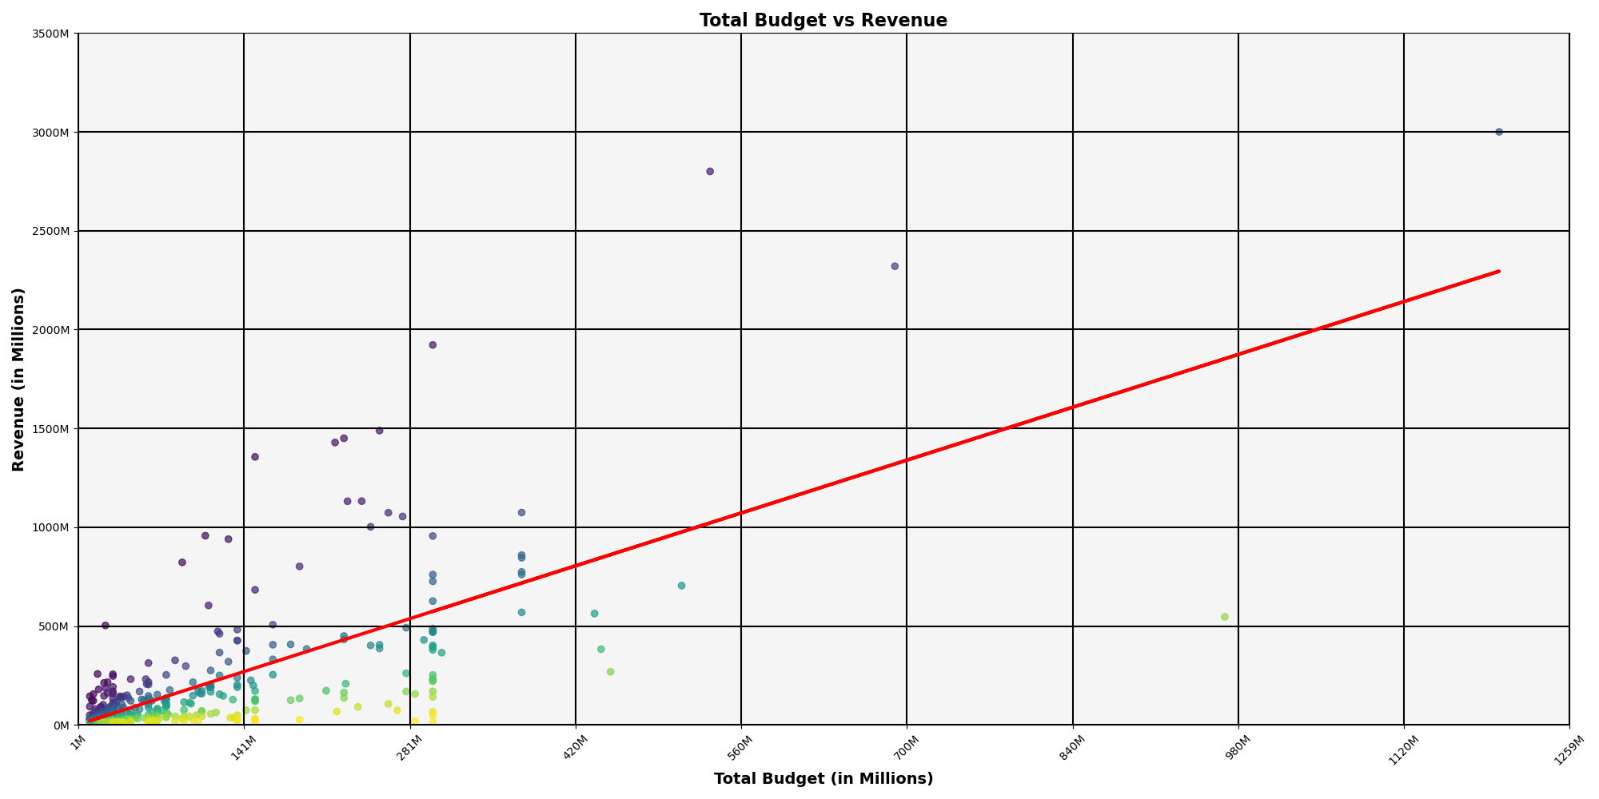
Does production budget correlate to a box office profit?
Statistical analysis indicates there is moderate likelihood of correlation between Total Budget and Revenue.
It appears that the more money studios invest into the movie the higher revenue
The R-value is: 0.4843842278753481

Slide 6
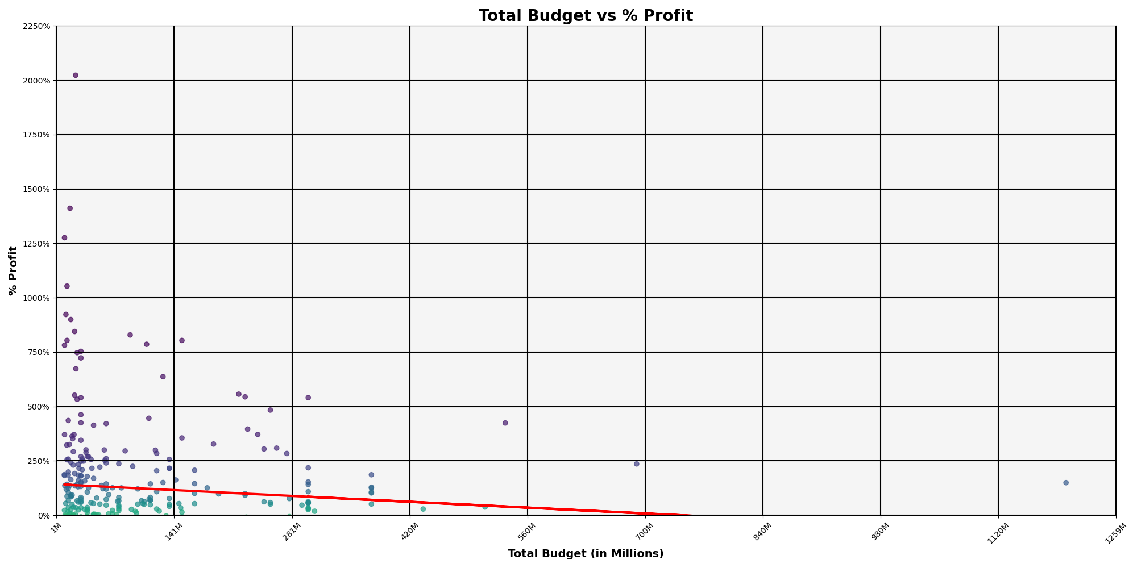
Does production budget correlate to a box office profit?
Statistical analysis indicates there no correlation between Total Budget and % Profit.
Smaller budget films typically have a higher percent profit on return as opposed to larger budget films
The R-value is: 0.010746837895366701

Slide 7
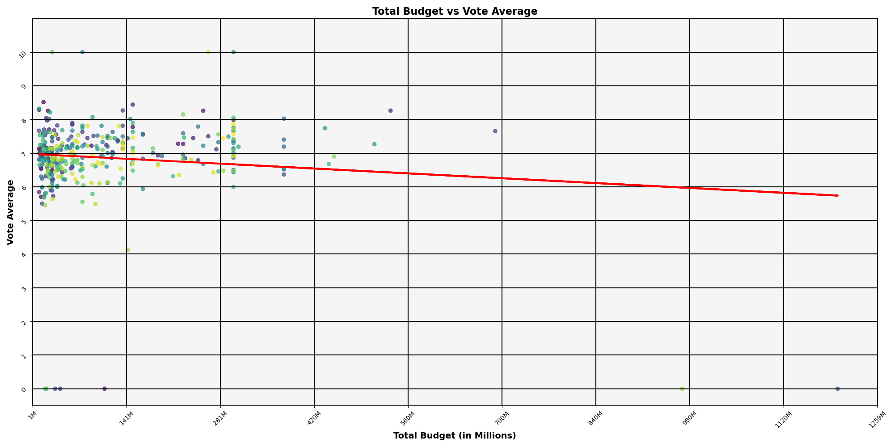
Does a higher production budget correlate to a higher audience score?
Statistical analysis indicates there no correlation between Total Budget and Voter Average.
It appears audiences have a vast acceptance of movies no matter the budget
Information could be used to inform future sequel planning
Less than 10 movies had 0 ratings
The R-value is: 0.012800770639383029

Slide 8
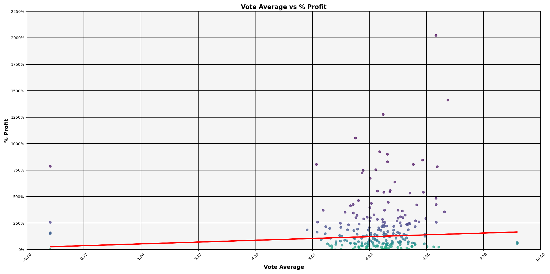
Does a higher audience score correlate to a higher box office profit?
Statistical analysis indicates there no correlation between Voter Average and % Profit.
Movies with a voter average between 5.5 and 8 saw a 500% profit
The R-value is: 0.004712464594773485

Slide 9
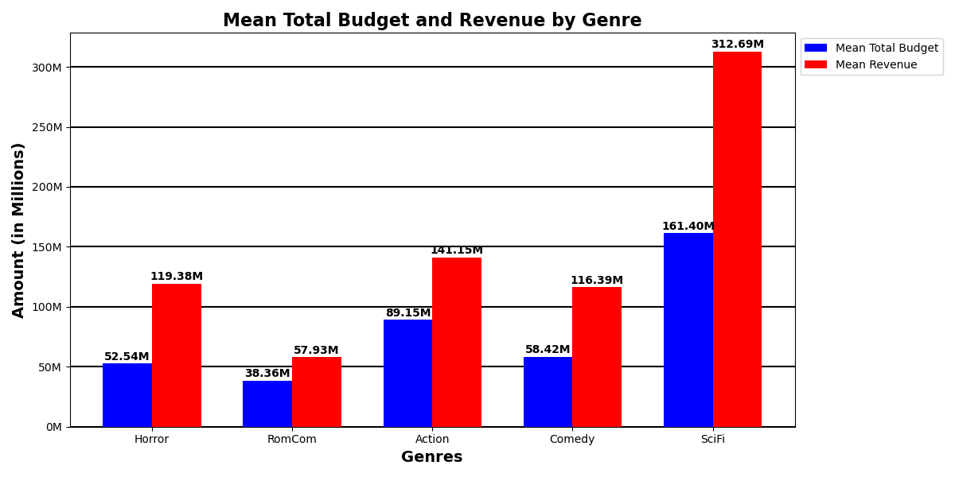
Does movie genre have an effect on box office profit?
On average Sci-Fi sees approximately $151.29 Million gross profit
The Horror saw the second highest ROI with $66.84 Million
RomComs typically have a lower ROI than any other genre ($19.57 Million)

Slide 10
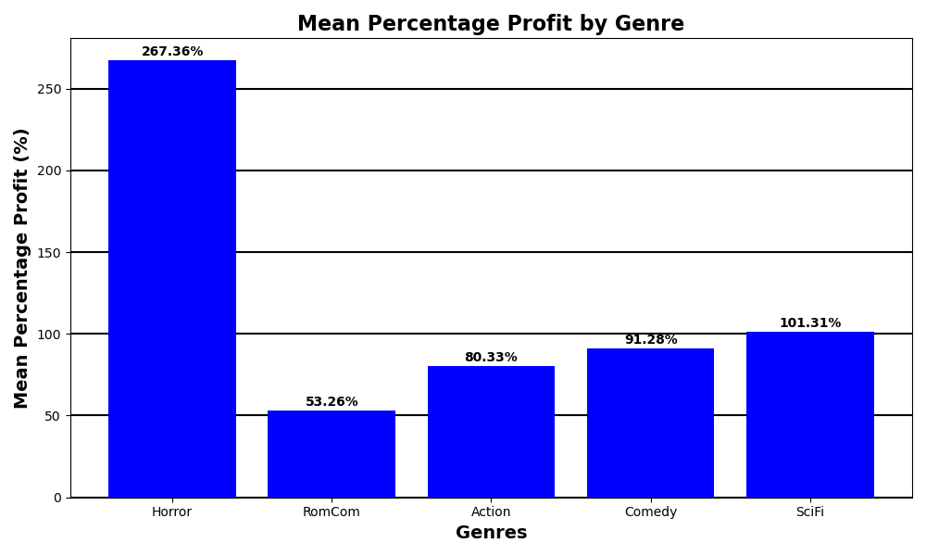
Does movie genre have an effect on box office profit?
Although Horror was second in ROI it has the higher percent profit of over 267%
Sci-Fi saw the second highest percent profit with over 101%
Romcom saw the least percent profit of 53%

Slide 11
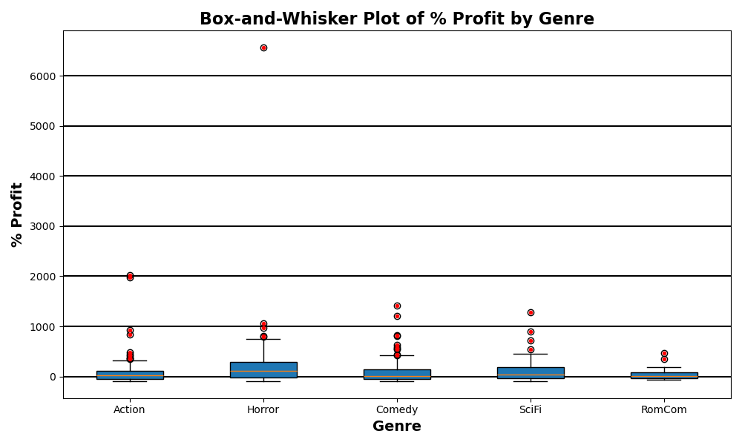
Statical Analysis of Genres
Two Sample T-Test
Fail to reject null hypothesis because there is no significant difference between the means for the following:
Action vs Sci-Fi
Action vs Comedy
Action vs RomCom
Sci-Fi vs Horror
Sci-Fi vs Comedy
Sci-Fi vs RomCom
Comedy vs Romcom
Reject null hypothesis and conclude that there is a significant difference be the means:
Action vs Horror
Comedy vs Horror
Horror vs Romcom
Anova test revealed that we can reject the null hypothesis and conclude that at least one of genre means is significantly different than the others
Notes:
Action/Sci-Fi: Because the p-value of 0.5419928655031908 is greater than or equal to the level of significance 0.05, we fail to reject the null hypothesis that there is no significant difference between the means.
Action/Horror: Because the p-value of 0.0320197770427886 is less than the level of significance 0.05, we reject the null hypothesis and conclude that there is a significant difference between the means.
Action/Comedy: Because the p-value of 0.7164631967004338 is greater than or equal to the level of significance 0.05, we fail to reject the null hypothesis that there is no significant difference between the means.
Action/Romcom: Because the p-value of 0.43568240524263513 is greater than or equal to the level of significance 0.05, we fail to reject the null hypothesis that there is no significant difference between the means.
Sci-Fi/Horror: Because the p-value of 0.05991806549135999 is greater than or equal to the level of significance 0.05, we fail to reject the null hypothesis that there is no significant difference between the means.
Sci-Fi/Comedy: Because the p-value of 0.7664193159250333 is greater than or equal to the level of significance 0.05, we fail to reject the null hypothesis that there is no significant difference between the means.
Sci-Fi/Romcom: Because the p-value of 0.20623285638678374 is greater than or equal to the level of significance 0.05, we fail to reject the null hypothesis that there is no significant difference between the means.
Comedy/Horror: Because the p-value of 0.04267365781352582 is less than the level of significance 0.05, we reject the null hypothesis and conclude that there is a significant difference between the means.
Comedy/Romcom: Because the p-value of 0.26635729090157445 is greater than or equal to the level of significance 0.05, we fail to reject the null hypothesis that there is no significant difference between the means.
Horror/Romcom: Because the p-value of 0.0159970411894357 is less than the level of significance 0.05, we reject the null hypothesis and conclude that there is a significant difference between the means.
Anova Test:
The F-statistic: 3.79 suggests that there is more variance between the genres than within the genres.
Because the P-value: 0.004773 is lower than the level of significance 0.05, we can reject the null hypothesis and conclude that at least one of genre means is significantly different than the others.

Slide 12
Conclusion / Recommendations
Does production budget correlate to a box office profit?
There was moderate positive correlation between total budget and revenue, which increases gross profit. There was no identifiable correlation between total budget and percent profit.
2) Does a higher production budget correlate to a higher audience score?
Analysis showed that audiences showed the same approval no matter the production cost.
3) Does a higher audience score correlate to a higher box office profit?
There was no correlation that would indicate that a higher audience score would equal a higher box office profit.
4) Does movie genre have an effect on box office profit?
Analysis did show that the genre of the movie did play a factor in the box office profit with audiences preferring Sci-Fi and Horror movies.
Recommendations:
1) Invest in four horror movies with a budget of $50 Million a piece with a potential gross profit of $460 Million. The Horror genera the highest percent profit when compared to the other genres with 267%.
2) Invest in one Sci-Fi movie with a budget of $161.40 Million and one low-budget horror film of $38 Million with a potential gross revenue of $331.84 Million ($312.69 Million from Sci-Fi and $10 Million from Horror).
3) Do not invest in RomCom sine they have a very low ROI.

Slide 13
Questions

