Slide 1
Exploring the Impact of Modifiable Risk Factors on Outcomes in the QUARTET USA Study: A Secondary Data Analysis
Minxing Huang
May 17, 2024
Notes:
Line spacing + Page numbers

Slide 2
Introduction

Slide 3
Hypertension
High prevalence and associated health risks
Contribute to approximately 13% of deaths worldwide
Leading cause of cardiovascular diseases, stroke, and premature mortality
Factors contributing to the development of hypertension
Tobacco use
Alcohol consumption
Caffeine consumption (?)
Understand the associations between these lifestyle habits and blood pressure → inform targeted interventions → reduce the burden of hypertension in hypertensive populations

Slide 4
QUARTET USA study
A double-blind randomized controlled trial conducted in federally qualiﬁed health centers (FQHC)
Examined whether initiating treatment with ultra-low-dose quadruple-combination therapy (LDQT) lowered blood pressure more effectively with fewer side effects
In this secondary data analysis, we examined the association between lifestyle factors — including smoking, alcohol intake, and caffeine intake — and blood pressure among individuals with hypertension.

Slide 5
Methods

Slide 6
Study Design
QUARTET USA study
Active comparator-controlled randomized trial assessing the efficacy and safety of an LDQT for hypertension
Eligibility requirements
Included participants with high blood pressure
Excluded participants with contraindication to candesartan, amlodipine, indapamide, or bisoprolol
Excluded participants having previous diagnosis of coronary artery disease, stroke, or heart failure
Those who met the eligibility requirements
Randomized 1:1 to either the LDQT arm or the active comparator arm
Returned to the clinic for follow-up visits at 6 weeks and 12 weeks

Slide 7
Study Variables
Outcomes
Systolic and diastolic blood pressure (SBP and DBP) measured at an in-person follow-up visit 12 weeks after randomization
Both variables treated as continuous in analyses
Predictors
Participants’ baseline daily smoking frequency, weekly alcohol intake, and weekly caffeine intake
All variables treated as continuous in analyses

Slide 8
Statistical Analysis
Descriptive statistics
Summarized participant demographical and lifestyle information, and baseline clinical outcomes overall and within the study arm
Pairwise associations among smoking, alcohol use, and caffeine use
Spearman’s correlation with 95% confidence intervals for correlation coefficient estimates
Examined the potential interaction effect between exposures
Primary analyses
Separate linear regression models fit for each outcome and risk factor
Adjusted for study arm and baseline measure of the outcome
Conducted 2-sided hypothesis tests for risk factors where alpha = 0.05
Did not adjust for multiple comparisons since these were exploratory data analyses
Residual diagnostics used to assess model fit

Slide 9
Results

Slide 10
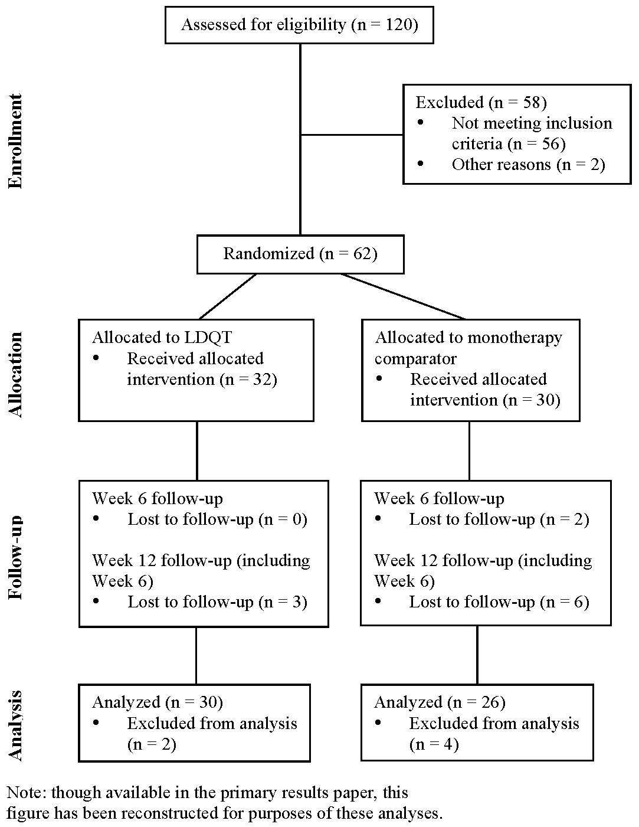
Figure 1. CONSORT Flowchart of Study Participants in the QUARTET USA Study

Slide 11
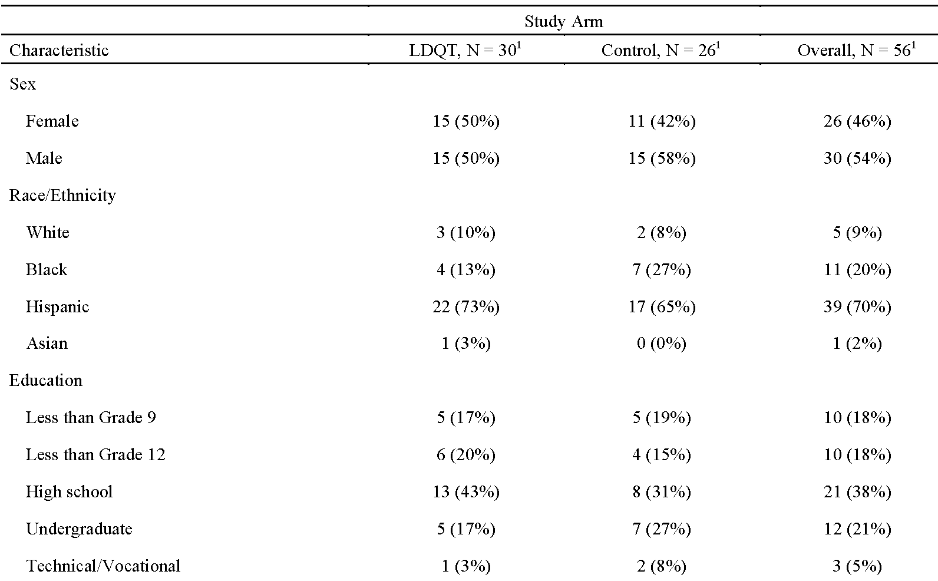
Table 1. Baseline Characteristics Overall and by Study Arm in the QUARTET USA Study (N = 56)

Slide 12
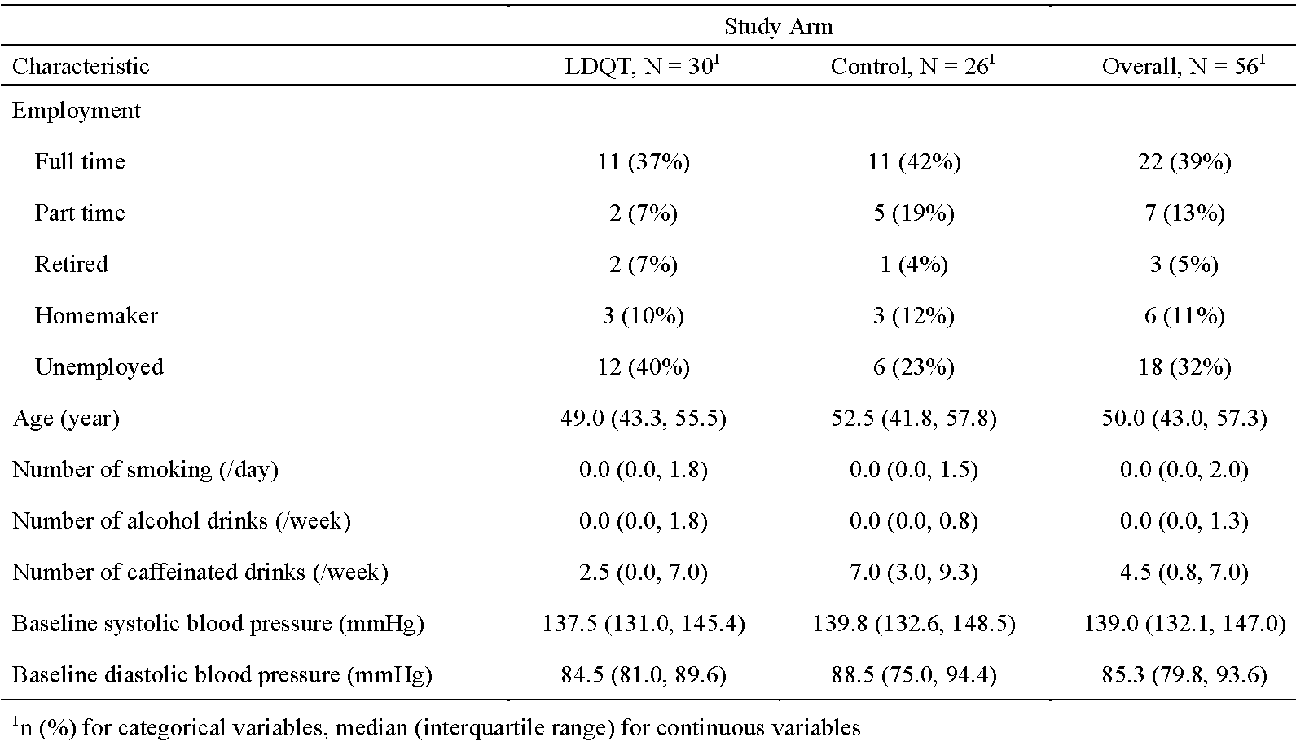
Table 1. Baseline Characteristics Overall and by Study Arm in the QUARTET USA Study (N = 56)

Slide 13
Correlation between Lifestyle Variables
Smoking versus alcohol
Spearman’s correlation coefficient = 0.19 (95% CI = [-0.08, 0.44])
Smoking versus caffeine
Spearman’s correlation coefficient = 0.25 (95% CI = [-0.02, 0.49])
Alcohol versus caffeine
Spearman’s correlation coefficient = -0.14 (95% CI = [-0.39, 0.14])

Slide 14
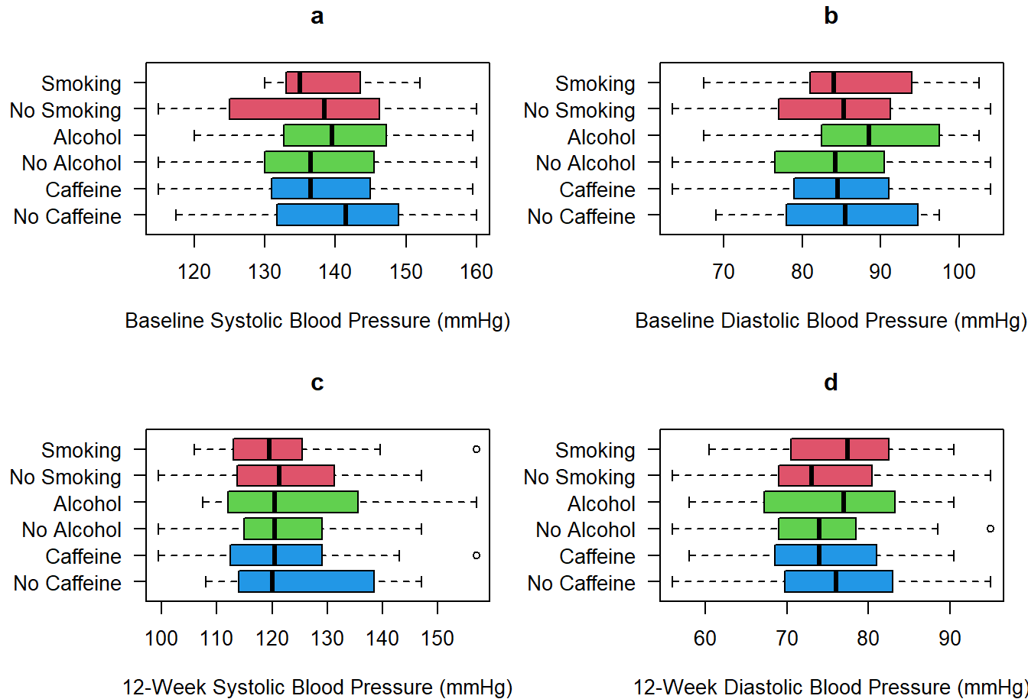
Figure 2. Boxplots of Binary Predictors and Blood Pressure in the QUARTET USA Study

Slide 15
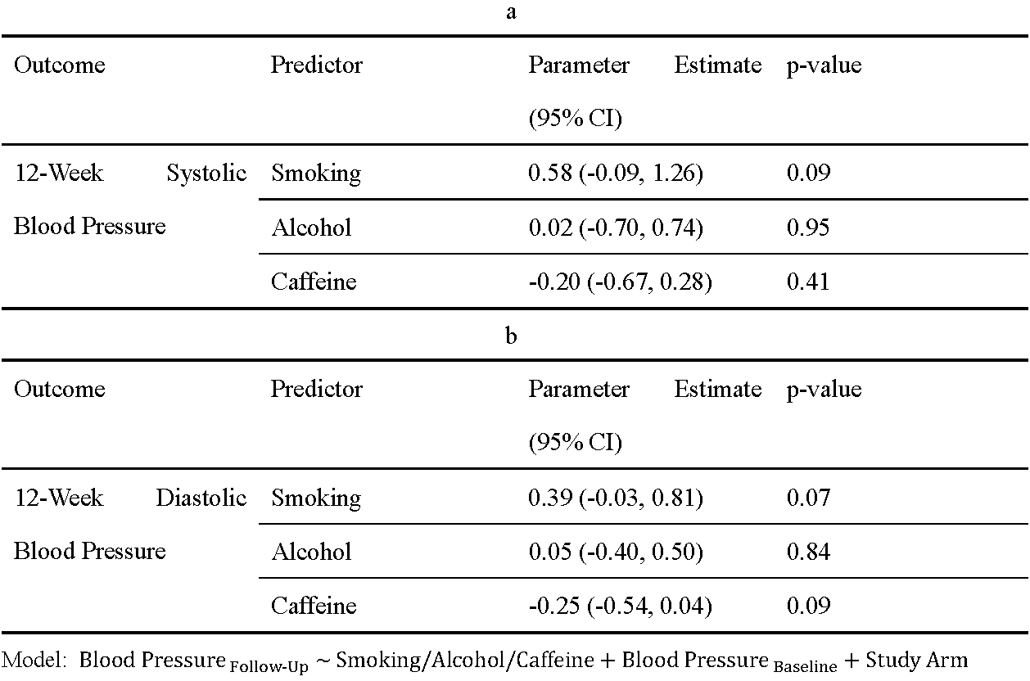
Table 2. Linear Regression Results in the QUARTET USA Study

Slide 16
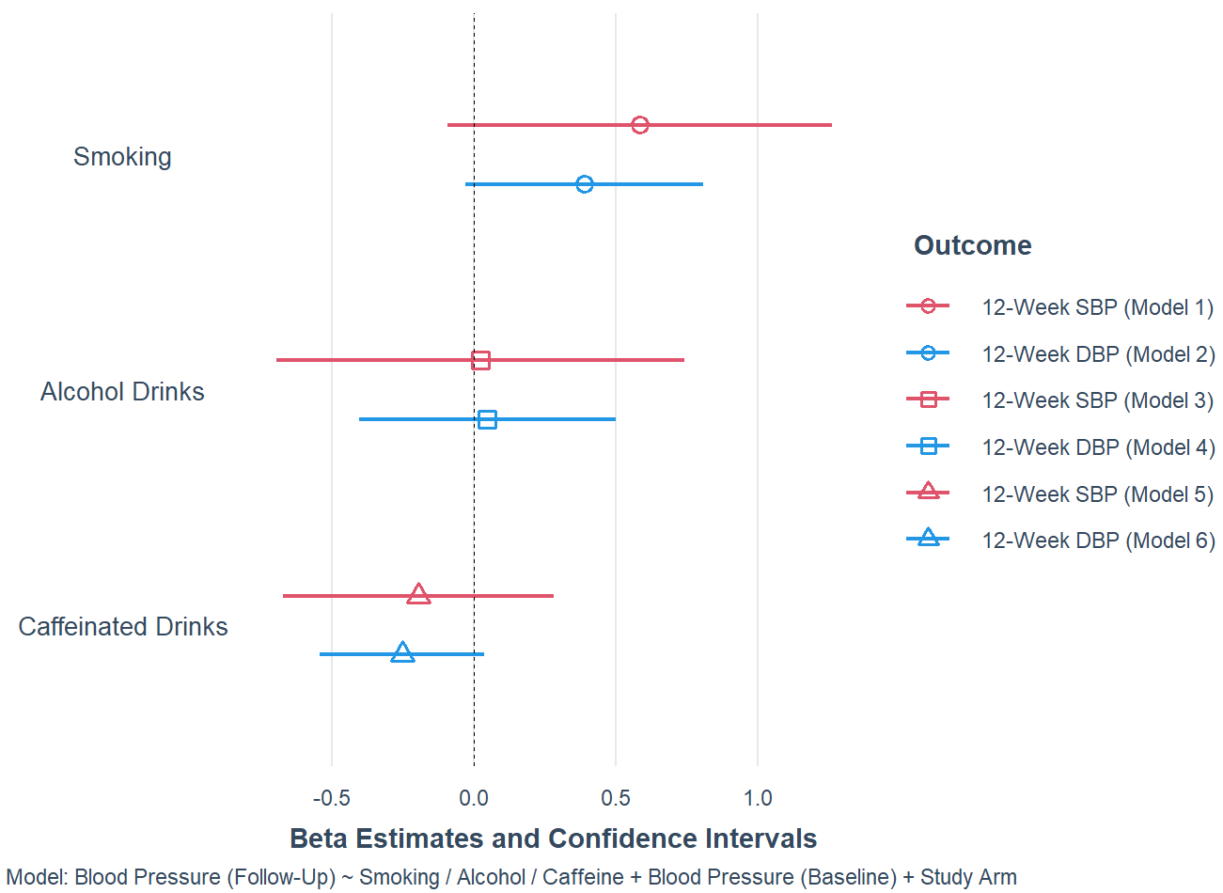
Figure 3. Linear Regression Results in the QUARTET USA Study

Slide 17
Discussion

Slide 18
Tobacco use positively associated with blood pressure
Aligned with previous research
Did not emerge as significant predictor of blood pressure over the 12-week follow-up period in our analysis
Alcohol consumption
Did not find statistically significant associations between follow-up blood pressure
Previous evidence suggested a potential link between excessive alcohol intake and hypertension
Caffeine consumption negatively associated with blood pressure
Did not reveal statistically significant associations between follow-up blood pressure
Concordant with previous findings

Slide 19
Limitations
Small sample size of this study could result in limited statistical power to detect subtle associations between lifestyle factors and follow-up blood pressure
Reliance on self-reported measures introduced the potential for recall bias
Implications
High prevalence of tobacco use, excessive alcohol consumption, and caffeine intake showed the need for comprehensive risk assessment in hypertensive populations
Clinicians should continue to emphasize the importance of lifestyle modifications to optimize blood pressure control

Slide 20
Reference
Hypertension. World Health Organization. Accessed April 18, 2024. https://www.who.int/health-topics/hypertension
High Blood Pressure Facts. Centers for Disease Control and Prevention. Updated March 17, 2023. Accessed April 18, 2024. https://www.cdc.gov/bloodpressure/risk_factors.htm
Mesas AE, Leon-Muñoz LM, Rodriguez-Artalejo F, Lopez-Garcia E. The effect of coffee on blood pressure and cardiovascular disease in hypertensive individuals: a systematic review and meta-analysis. The American Journal of Clinical Nutrition. 2011/10/01/ 2011;94(4):1113-1126. doi:10.3945/ajcn.111.016667
Baldridge AS, Huffman MD, Lazar D, et al. Efficacy and safety of a quadruple ultra-low-dose treatment for hypertension (QUARTET USA): Rationale and design for a randomized controlled trial. American Heart Journal. 2022/12/01/ 2022;254:183-193. doi:10.1016/j.ahj.2022.09.004
Huffman MD, Baldridge AS, Lazar D, et al. Efficacy and safety of a four-drug, quarter-dose treatment for hypertension: the QUARTET USA randomized trial. Hypertension Research. 2024/04/08 2024;doi:10.1038/s41440-024-01658-y
Notes:
Line spacing + Page numbers

