Slide 1
IPL 2024 Team Formation Analysis
Maximizing Chances of Winning Matches

Slide 2
Explain the importance of forming a competitive team for IPL 2024:-
Here are several key reasons illustrating the significance of building a competitive team:
Entertainment Value
Fan Engagement
Sponsorship and Endorsements
Franchise Profitability
Team Morale and Motivation
Brand Image
Development of Talent
Attracting Future Talent
Economic Impact
In summary forming a competitive team for IPL 2024 is not just about winning matches; it has a ripple effect on revenue, fan engagement, brand image, and the overall cricketing ecosystem. The benefits extend to franchises, players, sponsors, fans, and the broader cricketing community, making it a vital aspect of the IPL tournament.

Slide 3
INTRODUCING THE DATA:- (IPLdata.csv)
I have consolidated the data of each of the player from IPL'22
The data contains information like matches played, runs, wickets, catches, stumps, run-outs …..etc
Based on these data points we will try to create the best 11 from these set of players for the IPL'24
We can summarize our analysis in the following steps:-
1.Extraction and loading the data
2.Cleaning the data and removing the noise
3.Analyse the data based on different parameters
4.Visualizing the important statistical findings
5.Making the best team of 11

Slide 4

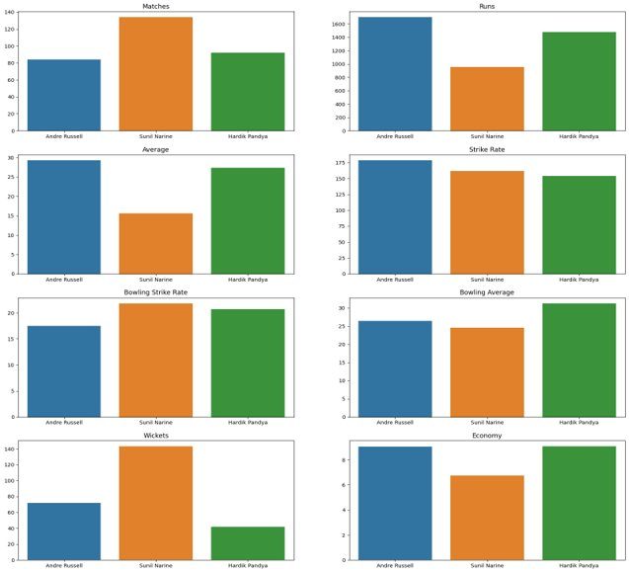
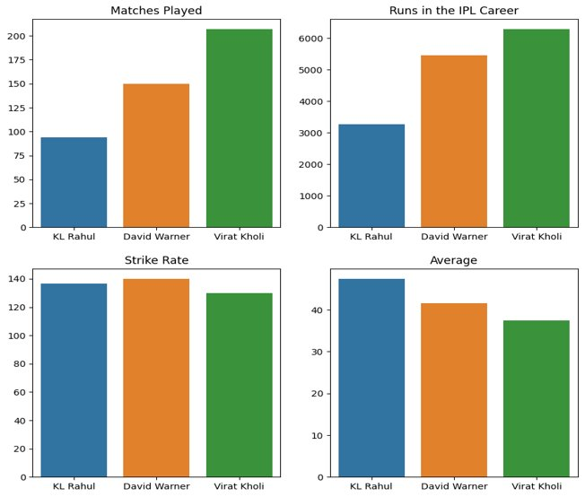
Highlights from EDA:-
BATTERS
ALLROUNDERS

Slide 5
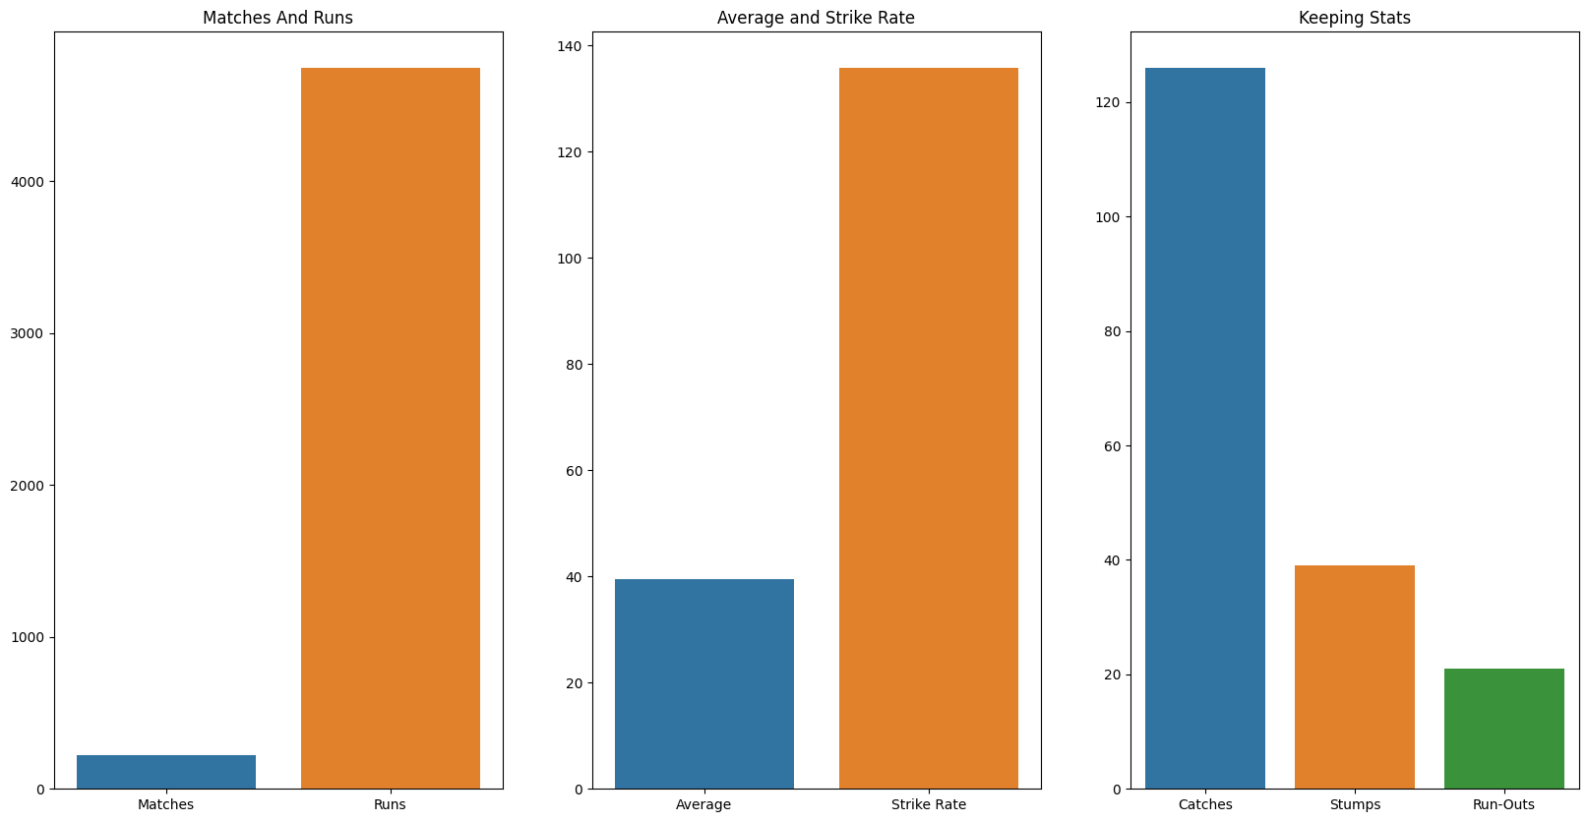
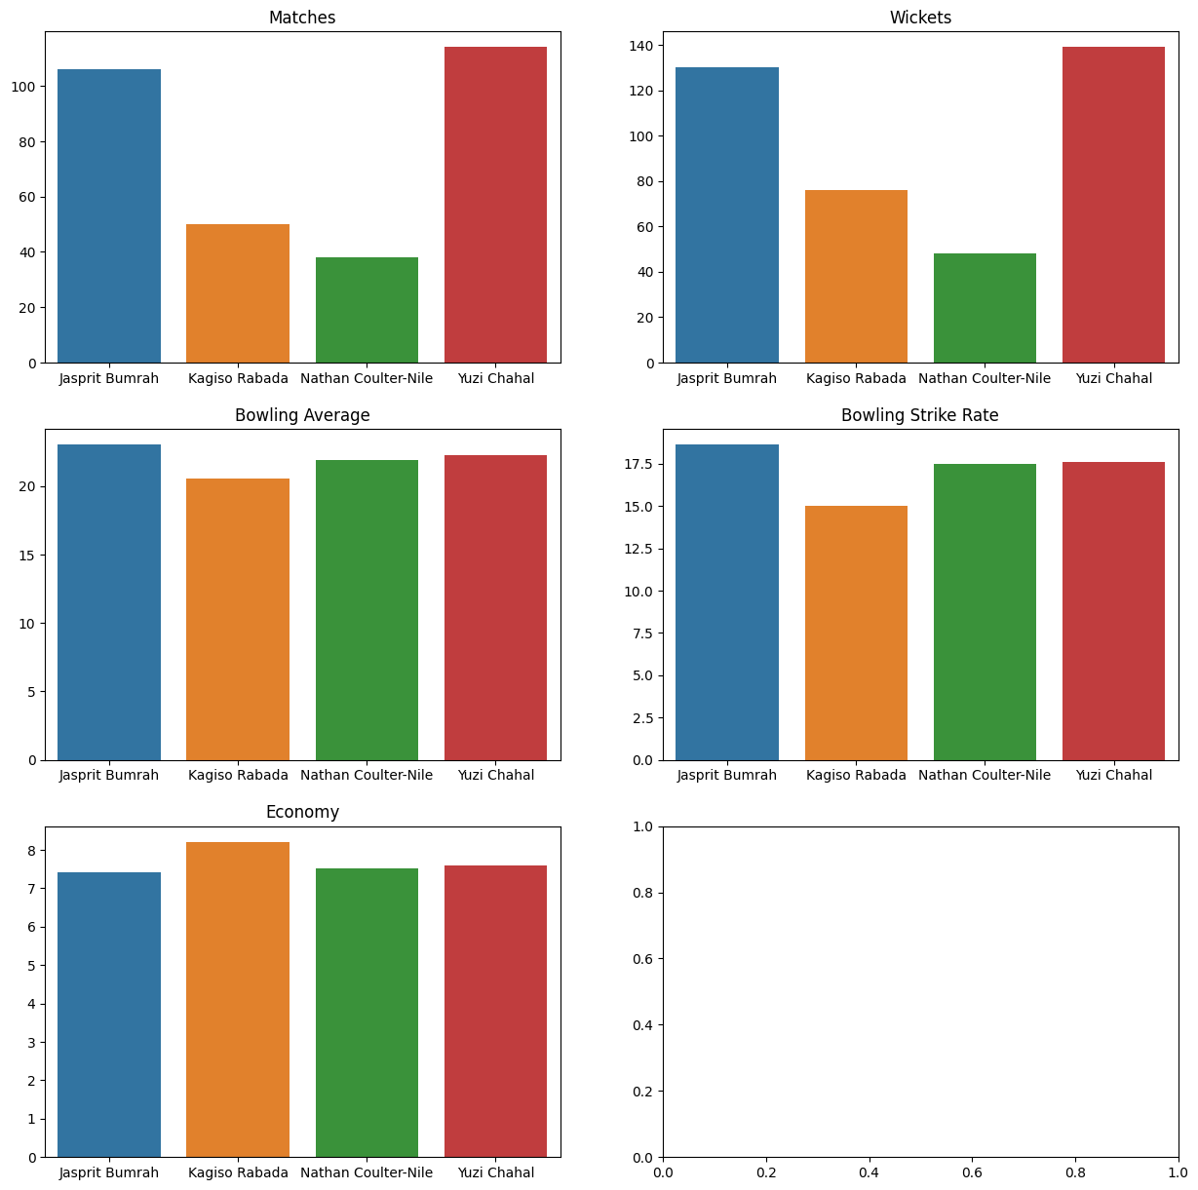
Highlights from EDA:-
BOWLERS
WICKET KEEPER

Slide 6
Explanation:-
SR.NO | PLAYER NAME | TEAM | NATIONALITY
1 | KL RAHUL | LUCKNOW | INDIAN
2 | DAVID WARNER | DELHI | INDIAN
3 | VIRAT KOHLI | BANGLORE | INDIAN
4 | ANDRE RUSSELL | KOLKATA | OVERSEAS
5 | SUNIL NARINE | KOLKATA | OVERSEAS
6 | HARDIK PANDYA | GUJARAT | INDIAN
7 | MS DHONI | CHENNAI | INDIAN
8 | YUZVENDRA CHAHAL | RAJASTHAN | INDIAN
9 | JASPRIT BUMRAH | MUMBAI | INDIAN
10 | NATHAN COULTER-NILE | RAJASTHAN | OVERSEAS
11 | KAGISO RABADA | PUNJAB | OVERSEAS
FORMING THE BEST 11 FOR IPL2024
Based on the analysis we will consider the ratio of the players in the best 11 as follows:
1. 3Batters
2. 3Allrounders
3. 4Bowlers and 2 Spin Options
4. 1Wicket Keeper

Slide 7
CONCLUSION AND FUTURE WORK:-
In conclusion, our analysis has provided valuable insights into forming a competitive IPL team for 2024.
Top-performing players have been identified across various categories: batsmen, bowlers, all-rounders, and a wicket-keeper.
A balanced team composition with a mix of power-hitters, effective bowlers, and agile fielders is essential for success in IPL 2024.
Implementing our recommendations will significantly boost the chances of winning matches in the upcoming IPL season.
Investing in star performers while nurturing emerging talent can lead to a competitive and marketable team.
Future Work and Recommendations:
Future work may involve real-time player performance tracking during IPL 2024 to make dynamic team adjustments. Periodic performance reviews are recommended to ensure the selected players continue to meet the team's evolving requirements.

