Slide 1



Sentiment Analysis on XRP Cryptocurrency
At the End of February 2021:
Progress and Outlook Sharing
February 2021

Slide 2

XDM
Super Data Manager
An elite boutique quantitative research-driven firm
Aim to discover investment opportunities hiding behind market factors
Ko Ho Wei Wang Shurong Zhong Yifeng Sun Yi Lyu Zongyu

Slide 3

RoadMap
What is our research approach?
Why we choose XRP?
The goal we would like to achieve
The importance of the goal
The sub-tasks we have done
What is our next step?

Slide 4
Sentiment Analysis
Sentiment analysis, also known as opinion mining, refers to the use
of NLP, text analysis to extract and identify subjective
information in source materials, in particular to predicting the
behavior and possible trend of stock markets

Slide 5

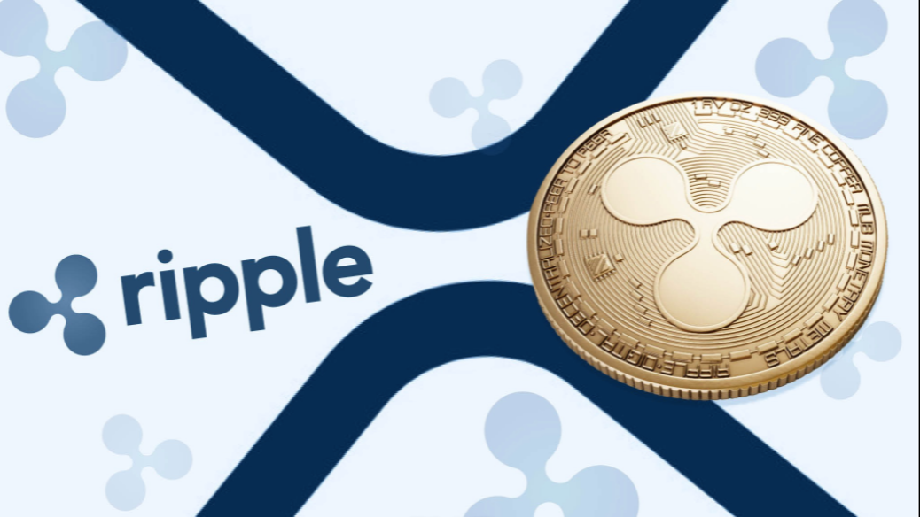

XRP
World Rank Fourth virtual currencies
Ranked by market cap, behind Bitcoin, Ethereum, and Tether

Slide 6

Research Target — XRP
Avoid irrelevant noise
Relative less data
High
Liquidity

Slide 7


Research Goal
Determine the volatility of XRP in accordance with the XRP discussion intensity in Twitter
Figure out the tweets impact from the users whose followers greater than 50k
Grade XRP related tweets, find out the relationship of popularity sentiment toward daily price movement

Slide 8


Extra Goal
Extend data source to other social media such as Reddit, Facebook, etc.
Conduct sentiment analysis to other targets such as Bitcoin, Tesla, etc.

Slide 9


Importance of sentiment analysis
XRP cryptocurrency
Daily volatility: 7.22%
Annualized: 114.68%
Determine
Predict
Determine investors’ opinions of a specific asset
…..
Sentiment may hint at future price action
…..
Sentiment impact secondary market volatility, trading volume, etc.
Forecast trend based on popularity opinion
…..
…..
Gain an overview of wider public opinion behind certain topics
Division could be a clue of high volatility
Price of XRP deeply dived in late December 2020 as public expected it to worsen

Slide 10


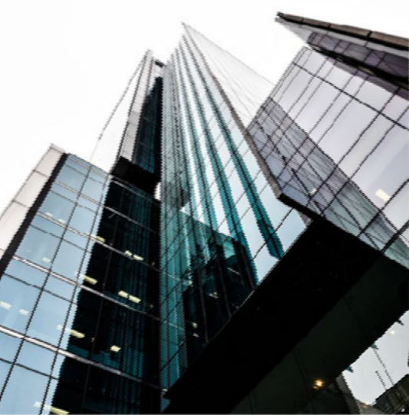
PROCESS
Business Risk
Through comprehensive proprietary research, only invest in those best enterprises which generate superior returns even market performs badly.
Market Risk
Diversification through global portfolio. Currently, we mostly focus on China, Hong Kong SAR and the United States.
4. Risk Management
Portfolio Risk
An actively managed equity fund should be fairly concentrated to a degree in order to generate absolute return.
By monitoring overlapping growth drivers and correlations between stocks, diversification risk can be controlled.
Rigorous attention paid to liquidity.
Macro Risk
Flexible position control regarding global macro risks.

Slide 11
Timeline
 | 1st week | 2nd week | 3rd week | 4th week
Brainstorm research topic
Data mining and processing
Sentiment analysis
Extract key product features
Preliminary result
Further application
Final report

