Slide 1



Sentiment Analysis on XRP Cryptocurrency
At the End of February 2021:
Progress and Outlook Sharing
February 2021

Slide 2

XDM
X Factor Determine Manager
An elite boutique quantitative research-driven firm
Aim to discover investment opportunities hiding behind market factors
Ko Ho Wei Wang Shurong Zeng Yifeng Sun Yi Lyu Zongyu

Slide 3

RoadMap
What is our research approach?
Why we choose XRP?
The goal we would like to achieve
The importance of the goal
The sub-tasks we have done
What is our next step?

Slide 4
Sentiment Analysis
Sentiment analysis, also known as opinion mining, refers to the use
of NLP, text analysis to extract and identify subjective
information in source materials, in particular to predicting the
behavior and possible trend of stock markets

Slide 5

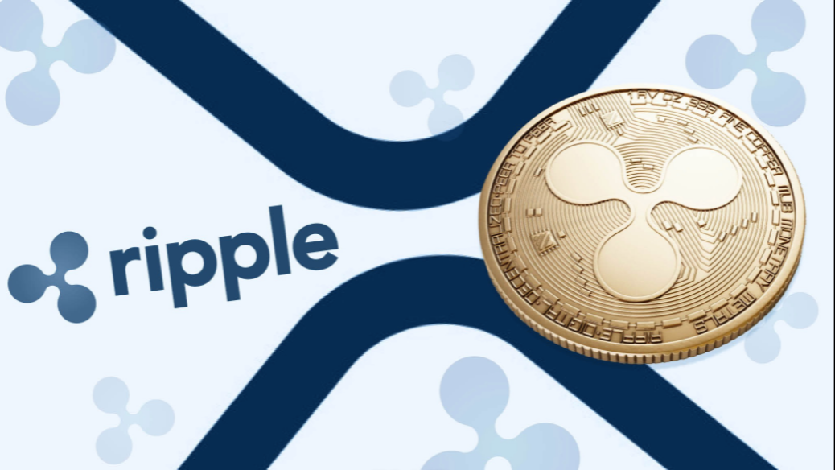

XRP
World Rank Fourth virtual currencies
Ranked by market cap, behind Bitcoin, Ethereum, and Tether

Slide 6

Research Target — XRP
Avoid irrelevant noise
Relative less data
High
Liquidity
?

Slide 7
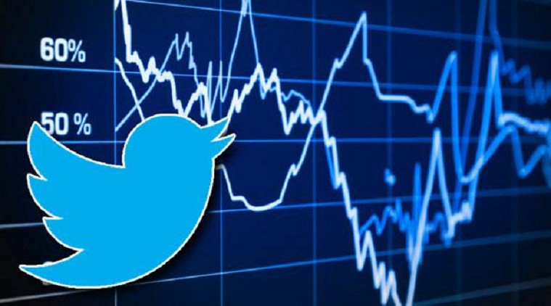

Research Goal
To determine the relationship between volatility of XRP and XRP related tweets
Figure out the impact magnitude in accordance with the discussion intensity in Twitter

Slide 8


Importance of sentiment analysis
XRP cryptocurrency
Daily volatility: 7.22%
Annualized: 114.68%
Determine
Predict
Determine investors’ opinions of a specific asset
…..
Sentiment may hint at future price action
…..
Sentiment impact secondary market volatility, trading volume, etc.
Forecast trend based on popularity opinion
…..
…..
Gain an overview of wider public opinion behind certain topics
Division could be a clue of high volatility
Price of XRP deeply dived in late December 2020 as public expected it to worsen

Slide 9



PROCESS
Business Risk
Through comprehensive proprietary research, only invest in those best enterprises which generate superior returns even market performs badly.
Market Risk
Diversification through global portfolio. Currently, we mostly focus on China, Hong Kong SAR and the United States.
4. Risk Management
Portfolio Risk
An actively managed equity fund should be fairly concentrated to a degree in order to generate absolute return.
By monitoring overlapping growth drivers and correlations between stocks, diversification risk can be controlled.
Rigorous attention paid to liquidity.
Macro Risk
Flexible position control regarding global macro risks.

Slide 10
process
Fidelity focuses on active style, disagrees with EMH, but increases focus on ETF recently
2013
Expanded its partnership with BlackRock
Launched 10 domestic sector ETFs sub-advised by BlackRock
2018
Launched international factor ETFs
with exposure to developed and
emerging markets
2015
Added Real Estate sector ETF
to its sector ETF group
2014
Launched 3 active Fixed Income ETFs:
Fidelity Total Bond (FBND)
Fidelity Limited Term Bond (FLTB)
Fidelity Corporate Bond (FCOR)
2020
Launched active equity ETFs
with potential to outperform in
a large cap equity ETF
2016
Launched 6 smart beta ETFs
Reduced expenses on 27 equity and
bond index funds & ETFs
2003
Launched its 1st ETF,
Fidelity Nasdaq Composite Index (ONEQ)
Source: “Fidelity: Embracing ETFs.” Rujing Meng, Jiayun Qian. The Asia Case Research Centre, The University of Hong Kong. (2019)

Slide 11
Timeline
 | 1st week | 2nd week | 3rd week | 4th week
Brainstorm research topic
Data mining and processing
Sentiment analysis
Extract key product features
Preliminary result
Further application
Final report

