Slide 1
Games at Babbel
Case study by Levan Kikozashvili

Slide 2
What is meant by activation? – let’s contemplate…
Activation usually means the conversion of users from just registered to the users who used the platform in any meaningful way (usually first session).
Based on the following graphs (see bellow) the activation would refer to the engagement of the user after their first session (similar to 2nd session retention).
Assumption: the users are automatically redirected to either review or lesson after registration (based on the second sankey)

Slide 3
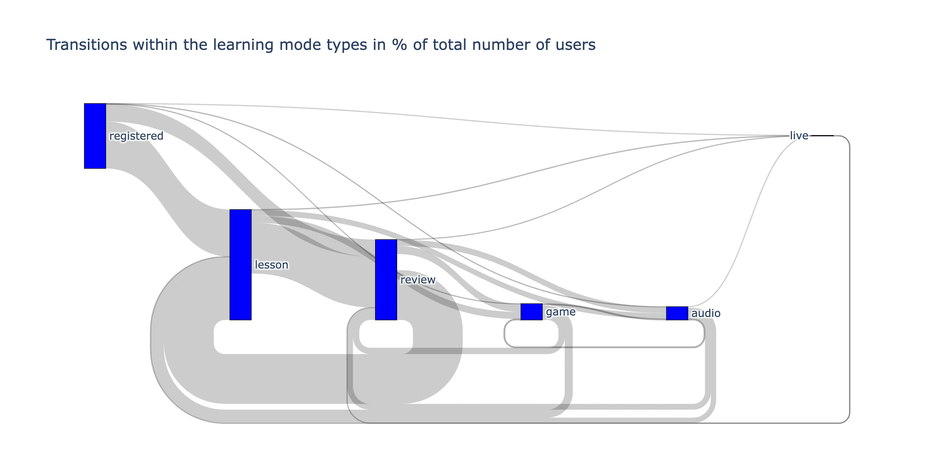
Question 2. – Learning activities interminglement for new users

Slide 4
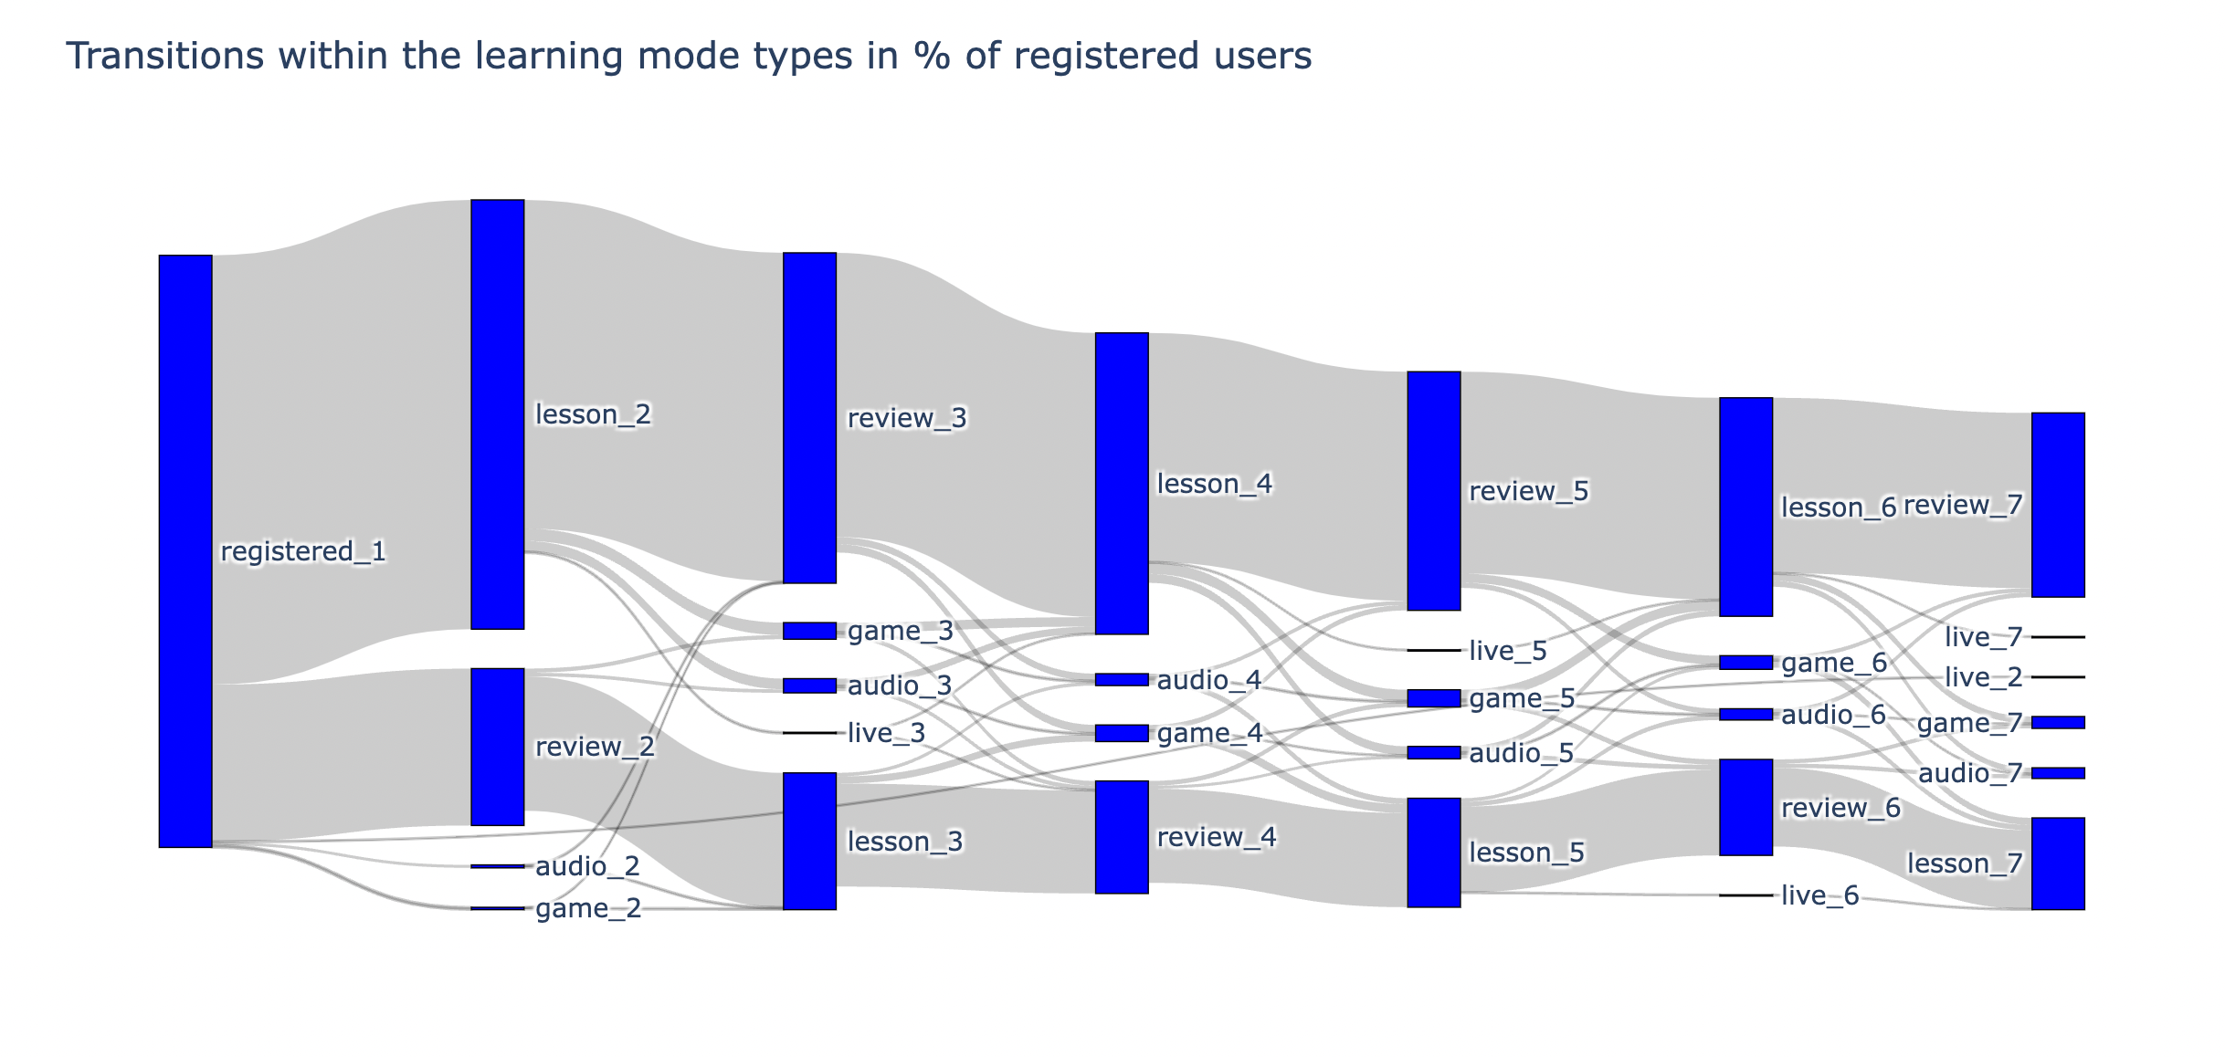
Question 2.1 – Learning activities interminglement – chronological dimension for new users (see the Jupyter notebook for more)

Slide 5
Question 1. Metrics to be considered
Given the team wants to maximize the activation of users in terms of game usage on early stages of their life on the platform we could measure the percent of gamers to total registered traffic – i.e. conversion rate to playing (for each cohort of newly registered users).
Conversion to games, as a first learning activity, second, etc. (see the Sankey diagram)
I would pose a broader question – why would we want to promote playing games on early stages (given the current structure of user experience) – maybe we should be assessing how the gaming factor influences the central KPIs: retention of the users and the conversion rate to sales of the premium subscription (or ARPU).

Slide 6
Question 3. Gaming and customer segmentation
Instead of intersecting the user categories with each other and finding the combination of features that give us the highest conversion to playing games – which is a rather hard to interpret approach, I trained a simple Logistic regression on an aggregated data set, that would predict if the user will/has play/ed games on the platform.
We trained the model on the following user features:
[ ‘other_learning_activity', 'age', 'motivation', 'subscription_type’, 'subscription_geo_area', 'learning_os', 'learning_language’, 'time_spent_sum_total', 'number_of_sessions_total']
Why we trained the model? We want the feature importance aspect of log reg!
Let’s observe what user segment-dimensions account best for the user’s inclinations to try out the gaming feature of babbel!

Slide 7
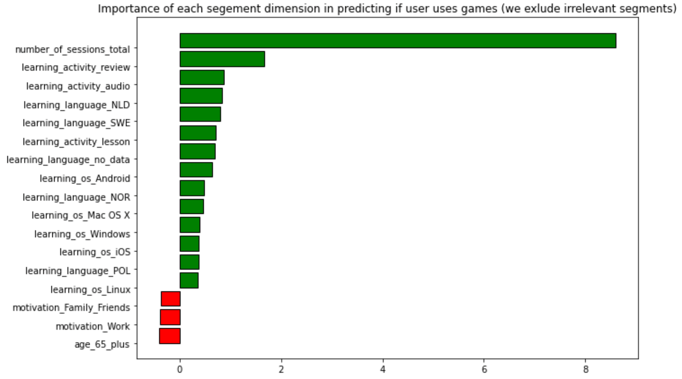
(see the Jupyter notebook for more)

Slide 8
Question 4. AB test design – new game and user activation boost
We have set the following postulates: activation of users lies in engagement of users on early stages of their life on platform
Having said that, we would want to observe 1. the conversion from registration to ”first session” (but given the given data - to the second session). 2. I would also suggest monitoring the retention rate of users given various exposures (with or without the new game).
The problem with randomized AB test, where the treatment group receives a new game, while the control does not, lies precisely in the way the game is pushed in the treatment group (if we naively redirect the users, regardless of their prior assumed interest in gaming [see the customer segmentation slide] we mess up the initial hypothesis of the test, since we integrate a new variable in the testing flow: the redirect and or a pop-up)
Hence, we would have an ABC test with two hypotheses

Slide 9
Question 4. ABC test design – new game and user activation boost
The primary question we should be: is the new game really boosting the conversion to the second session?
The secondary question: would the game suggestion mechanism (banner, pop-up for instance) drop the metrics in comparison to the current layout?
To answer the question, I believe, we should roll out the test on new users where:
in control group the users have a usual layout, where none of the pop-ups are integrated;
the treatment group is exposed to the pop-up after registration (0th session), where the new game is suggested to the users to be played (with possibility to reject the offer)
the control_placebo_game group is exposed to the pop-up after registration (0th session), , where an older, “placebo” game is suggested to the user to be solved (the choice of such game is a whole other question…) (with possibility to reject the offer)

Slide 10
Question 4. ABC test results analysis
We have gathered the results of ABC test and we can now (try) answer the following questions:
Is the new game better at activating users than the older one?
Is the pop-up or banner dropping our main (and or other metrics)?
Ideally, we would not want the way we integrated the new game to be “bad” (i.e. banner), dropping activation rate and or other KPIs, such as ARPU… but at the end of the test we would be able to differentiate the way of integration from the game performance as such!
Depending on the traffic size and team’s confidence in the feature, we could also experiment with different integration methods, thus increasing the number of groups in the experiment => decreasing the statistical sensitivity of the test, which is not ideal...
It would be interesting to observe the performance of the new game among the gamer and non-gaming segments that we outlined at the beginning.

Slide 11
Thanks for your undivided attention!

