Slide 1
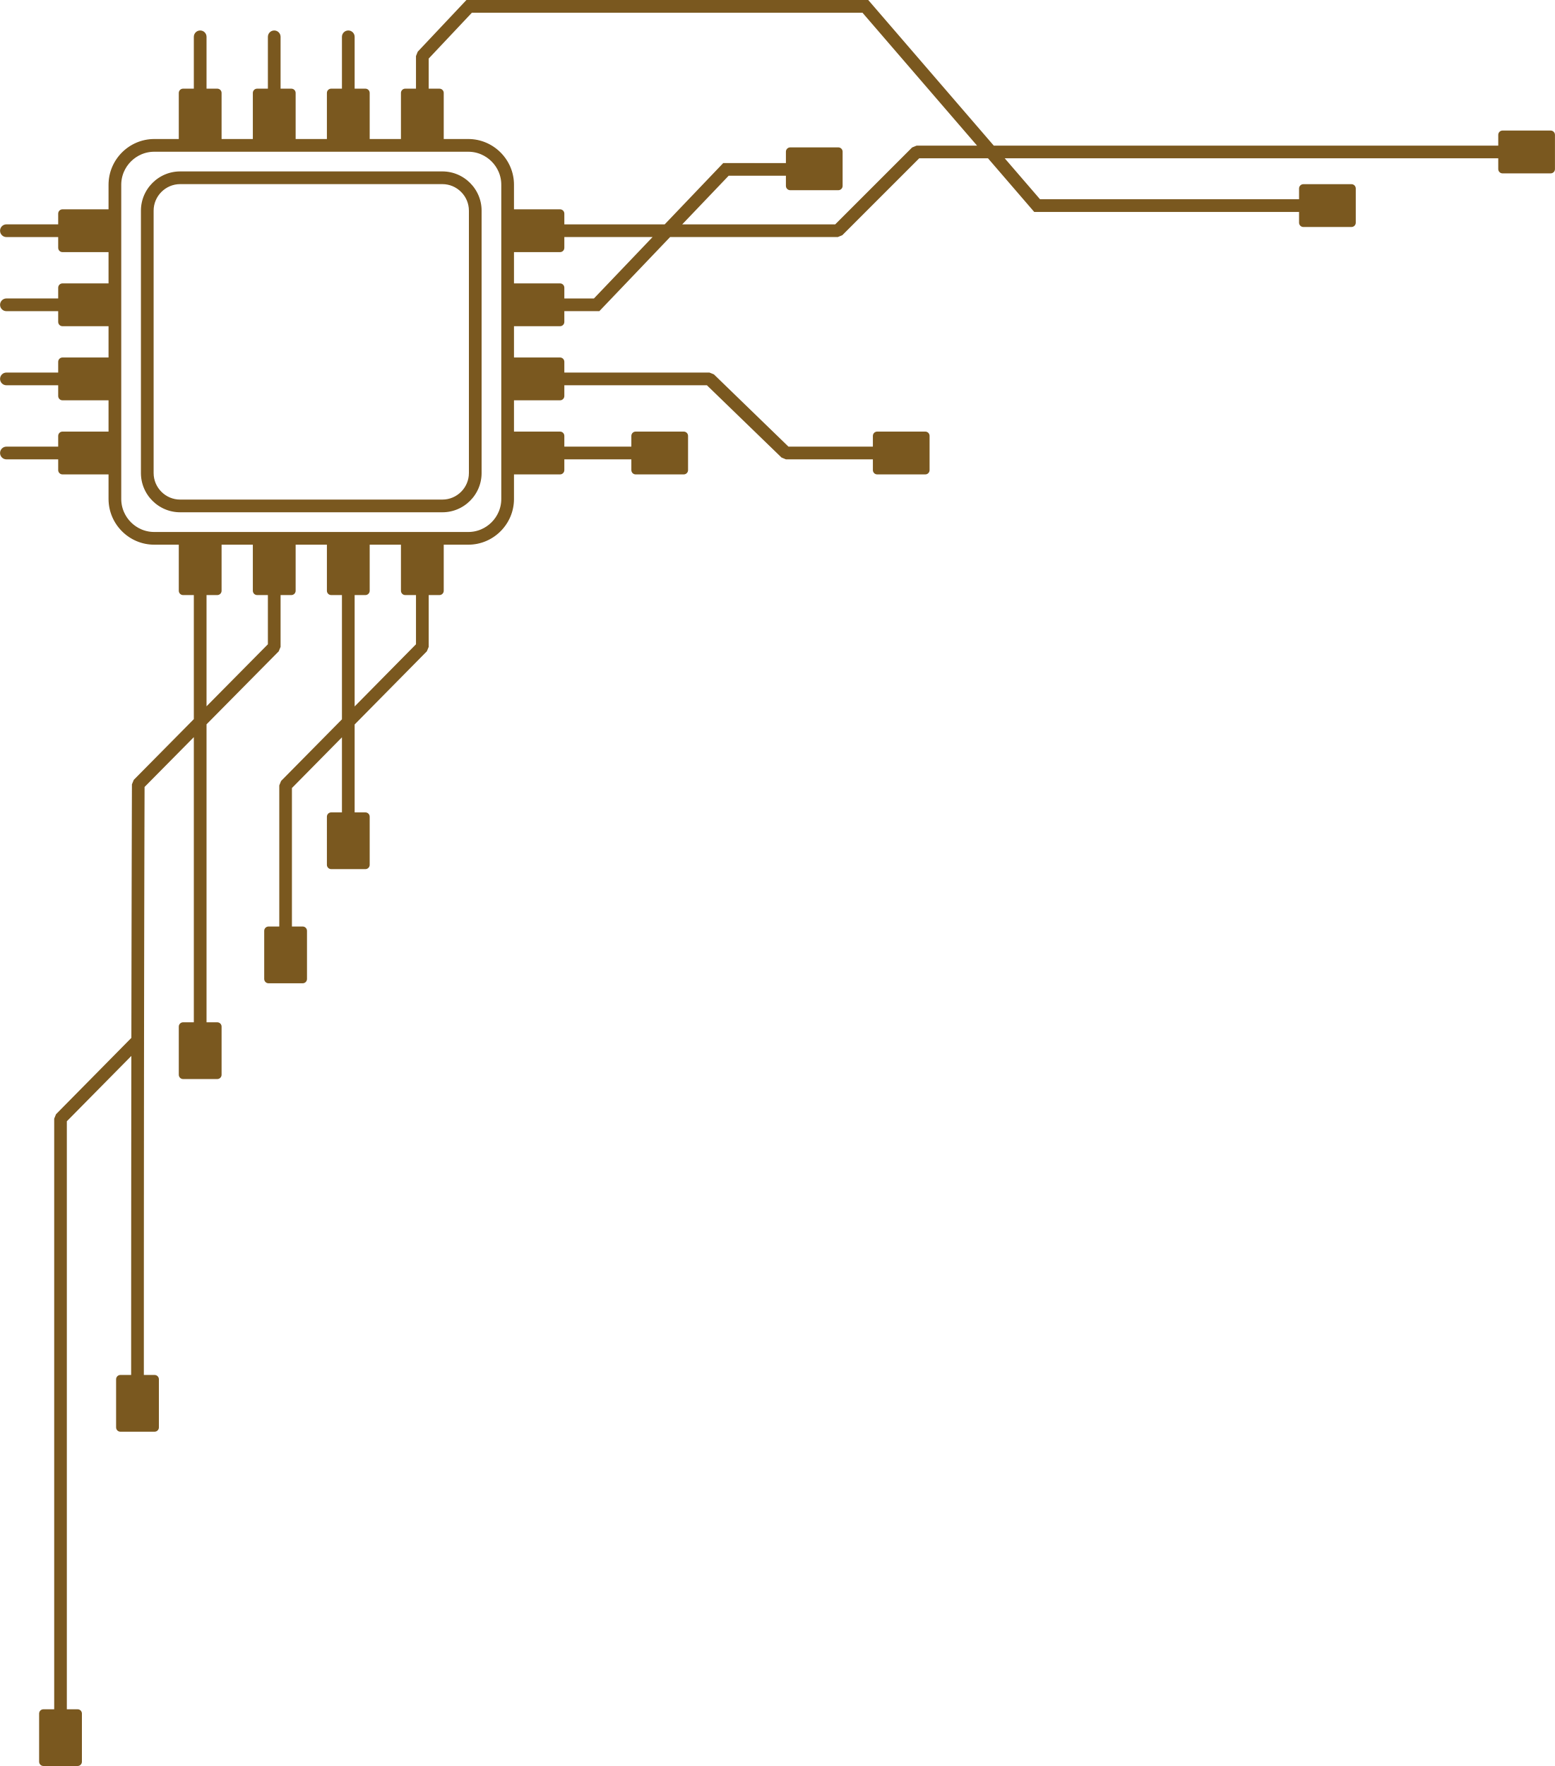


SmartWard360
AI-Powered Hospital Command Center
Team Binary Blood
Tanvir Shahadat Shuva
Jobayer Ahmed
MD Affan
Next Generation Clinical Decision Support
Nayeem Uddin
Abbas Uddin Chowdhury
1
Notes:
1

Slide 2





THE PROBLEM
Hospitals Are Overwhelmed, Fragmented, and Reactive
Scattered Data
Missed Alerts
Manual Pressure
Patient records live in siloed systems ,no unified clinical view
Critical warnings are delayed or lost in the noise
Clinicians rely on memory during high stakes decisions
Prescription Errors
Dangerous Handovers
Drug interactions go undetected without automated safety layers
Poor shift transitions cause life-threatening miscommunication
Notes:
2

Slide 3



WHY THIS MATTERS
The Human Cost of Systemic Failure
3rd
50%
2hrs
$1B+
Leading Cause of Death
Preventable
Lost Per Shift
Annual Cost
Medical errors rank among the top preventable causes of mortality globally
Adverse drug events could be avoided with proper safety systems
Average clinician time wasted on manual documentation daily
Healthcare systems spend billions on error remediation and inefficiency
Notes:
4

Slide 4
THE SOLUTION
One Platform.
Complete Intelligence.
Transforming hospitals from reactive silos into proactive, AI-driven environments.
Notes:
5

Slide 5





HOW IT WORKS
Six Pillars of Intelligent Care
Command Center
AI Clinical Notes
Rx Safety Checker
Unified real-time view of all patients and beds across the entire hospital
Auto-generated SOAP notes and discharge summaries ,saving hours every shift
Instant detection of dangerous drug interactions before they reach the patient
Smart Bed Monitoring
Sample Tracking
Ambulance Sync
IoT-enabled movement and vitals alerts keeping patients safe around the clock
Real-time lab workflow from collection to result, no more lost samples
GPS + live ECG streaming to the hospital before the patient even arrives
Notes:
6

Slide 6
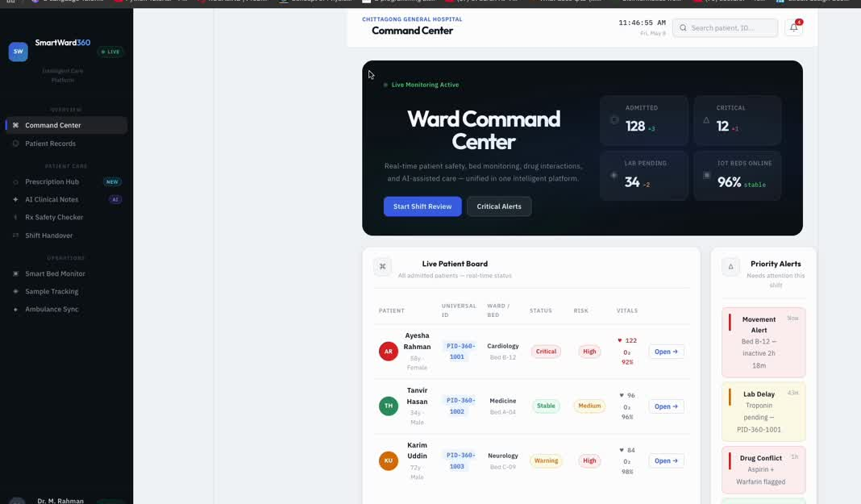
LIVE DEMO

Slide 7












LIVE DEMO
Let’s See It in Action
01
2
3
4
Select Patient
Trigger Alert
Generate Note
Check Rx Safety
Open dashboard, choose patient, view live vitals instantly.
Activate clinical alert – AI risk score appears in real time.
One click generates a complete AI-powered SOAP clinical note.
Scan prescription – dangerous interactions flagged immediately.

Slide 8



WHAT MAKES US DIFFERENT
Not Another Fragmented Tool
All-in-One Platform
Real-Time + AI
Patient Safety First
Monitoring, AI, safety, and operations — unified in a single interface that works the way hospitals work.
Live data fused with intelligent clinical analysis — not historical snapshots, but decisions in the moment.
Built-in safety layers woven into every workflow, not bolted on as an afterthought.
Workflow-Native
Universal Identity
Designed for actual hospital operations, not a theoretical ideal — it fits how clinicians actually work.
Works seamlessly across institutions with shared patient records — continuity of care wherever it's needed.
Notes:
9

Slide 9

VISION & CLOSE
A Connected, Intelligent Healthcare Ecosystem
Safer Hospitals
Dramatically reduce preventable medical errors
Faster Decisions
AI-powered insights at the point of care
National Scale
Scalable architecture ready for system-wide deployment
SmartWard360 is not just software , it's a life-saving system.
Notes:
10

Slide 10
Thank You

