Slide 1
Introducing
Camel is an integration framework
The Camel project was started in early 2007
Camel’s focus is on simplifying integration

Slide 2
What is Camel?
At the core of the Camel framework is a routing engine, or routing engine builder
Camel makes no assumptions about the type of data you need to process
Camel offers higher-level abstractions using the same API regardless of the protocol or data type the systems are using

Slide 3
Why use Camel?
■ Routing and mediation engine
■ Enterprise integration patterns (EIPs)
■ Domain-specific language (DSL)
■ Extensive component library
■ Payload-agnostic router
■ Modular and pluggable architecture
■ POJO model
■ Easy configuration
■ Automatic type converters
■ Lightweight core
■ Test kit
■ Vibrant community

Slide 4
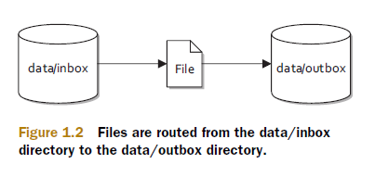
Your first Camel ride
Our problem

Slide 5
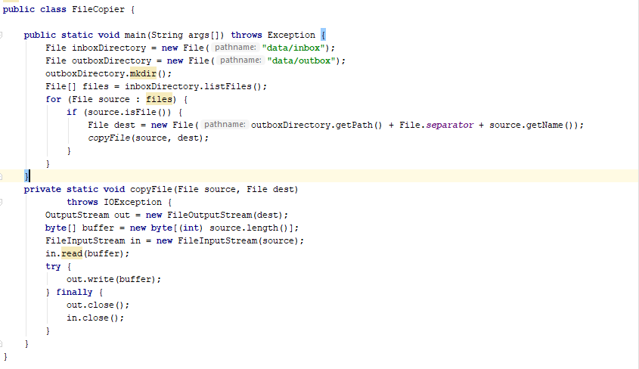
Routing files from one folder to another in plain Java

Slide 6
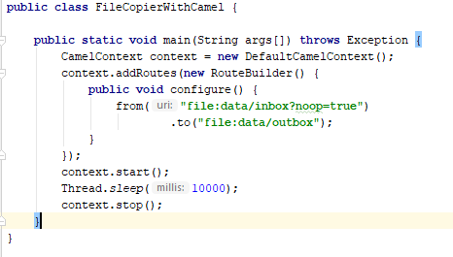
Routing files from one folder to another with Apache Camel

Slide 7
Camel’s message model
In Camel, there are two abstractions for modeling messages
org.apache.camel.Message — The fundamental entity containing the data being carried and routed in Camel
org.apache.camel.Exchange—The Camel abstraction for an exchange of messages. This exchange of messages has an “in” message and as a reply, an “out” message

Slide 8

org.apache.camel.Message
Messages are the entities used by systems to communicate with each other when using messaging channels. Messages flow in one direction from a sender to a receiver.

Slide 9
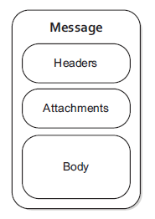
org.apache.camel.Message
Messages have a body (a payload),
headers, and optional attachments
and they are uniquely identified with
an identifier of type java.lang.String

Slide 10
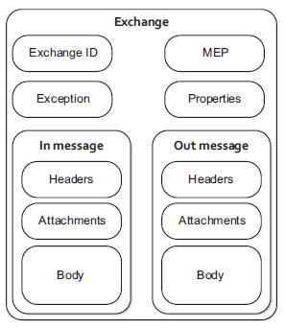
org.apache.camel.Exchange
An exchange in Camel is the
message’s container during routing
Exchange ID—A unique ID that identifies the exchange.
MEP—A pattern that denotes whether you’re using the
InOnly or InOut messaging style.
Exception—If an error occurs at any time during routing.
Properties—Similar to message headers, but they last for
the duration of the entire exchange.
In message—This is the input message, which is mandatory.
Out message—This is an optional message that only exists
if the MEP is InOut.

