Slide 1
CrowdFilm
ACA 2019 Python Project

Slide 2
Theory of Everything (The Idea)
All-in-one application for movie seekers
Movie listing based on chosen criteria
In-app search option for movies and people
Individual Movie & Person pages
Dedicated Oscars page

Slide 3

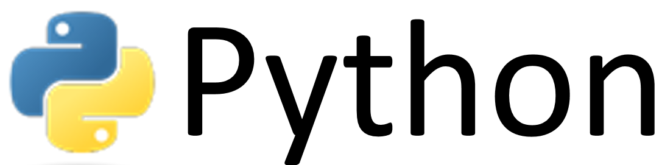



Matrix (Structure)
INTERNET
DB
WEB SCRAPPER
WEB
APPLICATION

Slide 4

Web Scrapper

Slide 5
Imitation Game (Scrapping problems)
Dynamic websites (JavaScript execution)
Blocking
Captchas
…and many other problems

Slide 6

Hidden Figures (The Solution)

Slide 7
The “victim”
All movies released from 1937
Filmmakers
Production companies
Ratings of movies and actors/actress

Slide 8
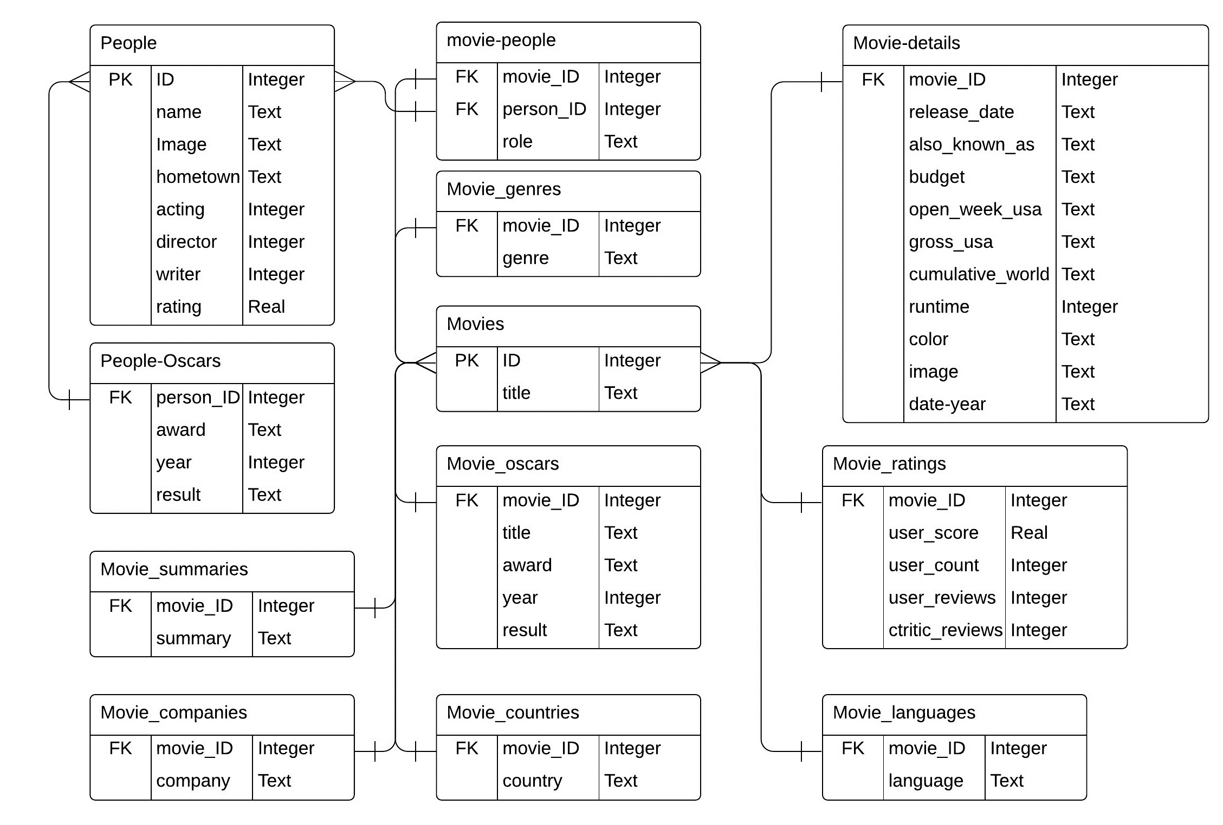
Digital Fortress (Database Diagram)

Slide 9
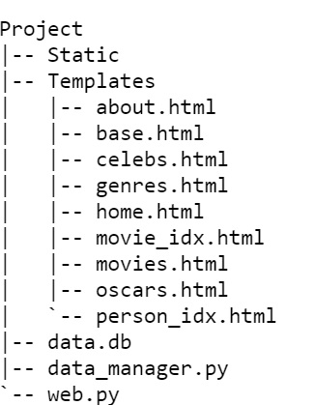
Project Structure
Powered by

Slide 10
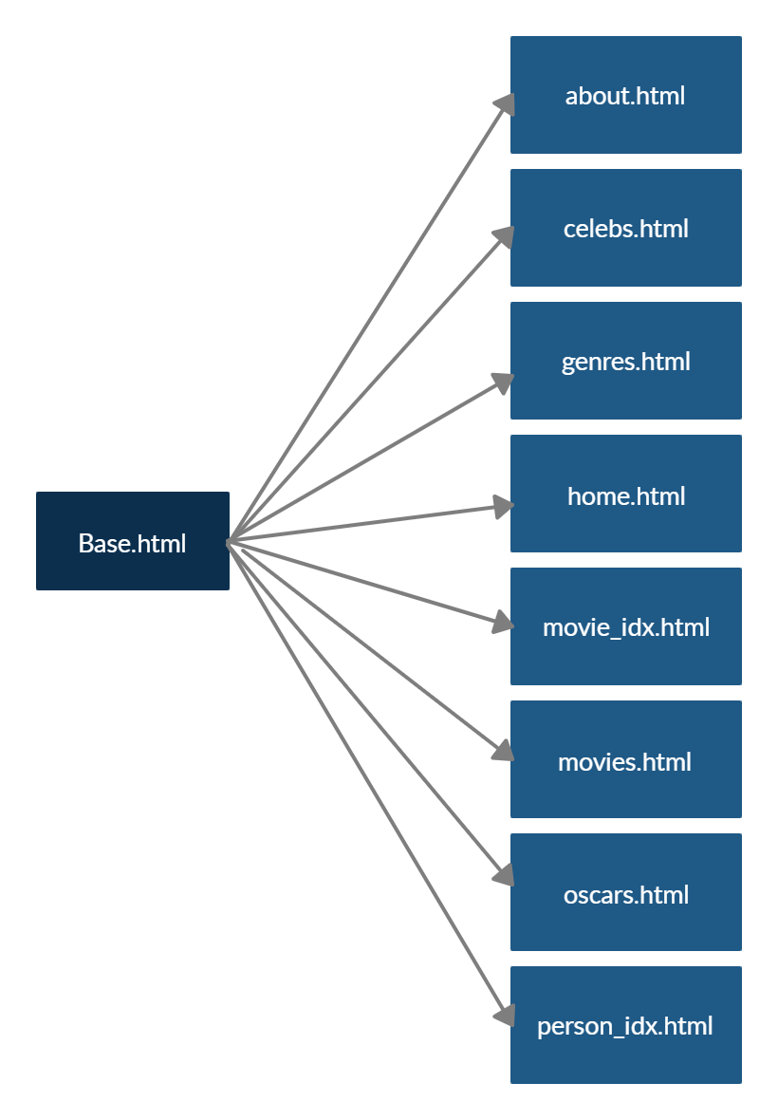
Template Hierarchy

Slide 11
Web Application Structure
Movies
Search option by given keyword
Ordering option by chosen criteria
Direct navigation to a individual movie page
Celebs
Search option by a given keyword
Direct navigation to a individual person page
Genres
Dropdown access for few genres
Oscars
Listing of Oscar Awards ordered by years
Powered by

Slide 12

Home Page

Slide 13
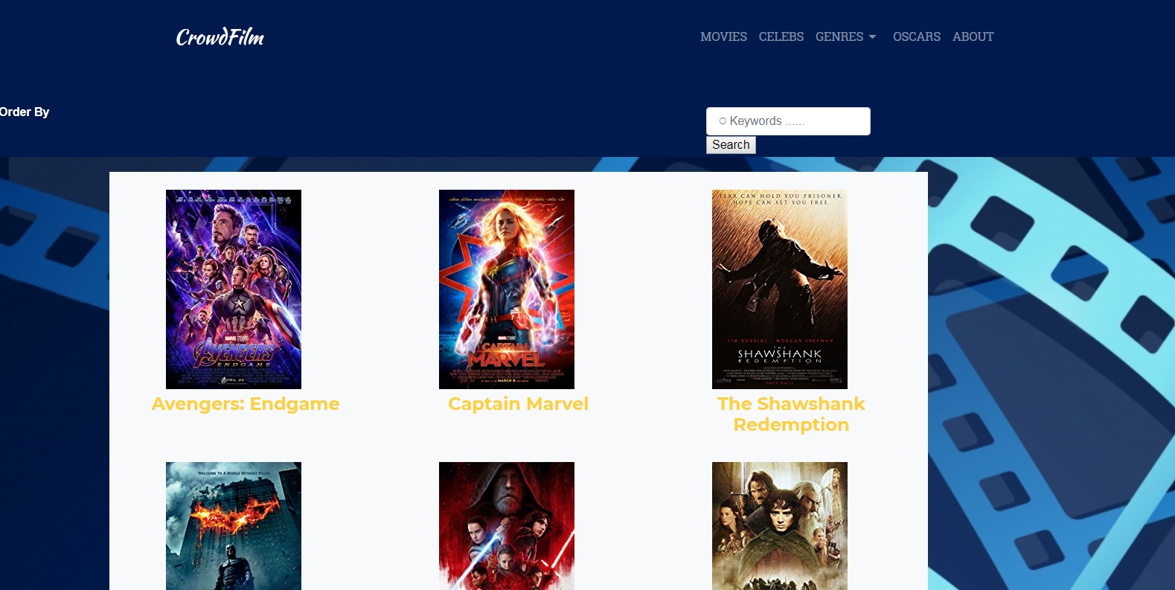
Movies

Slide 14
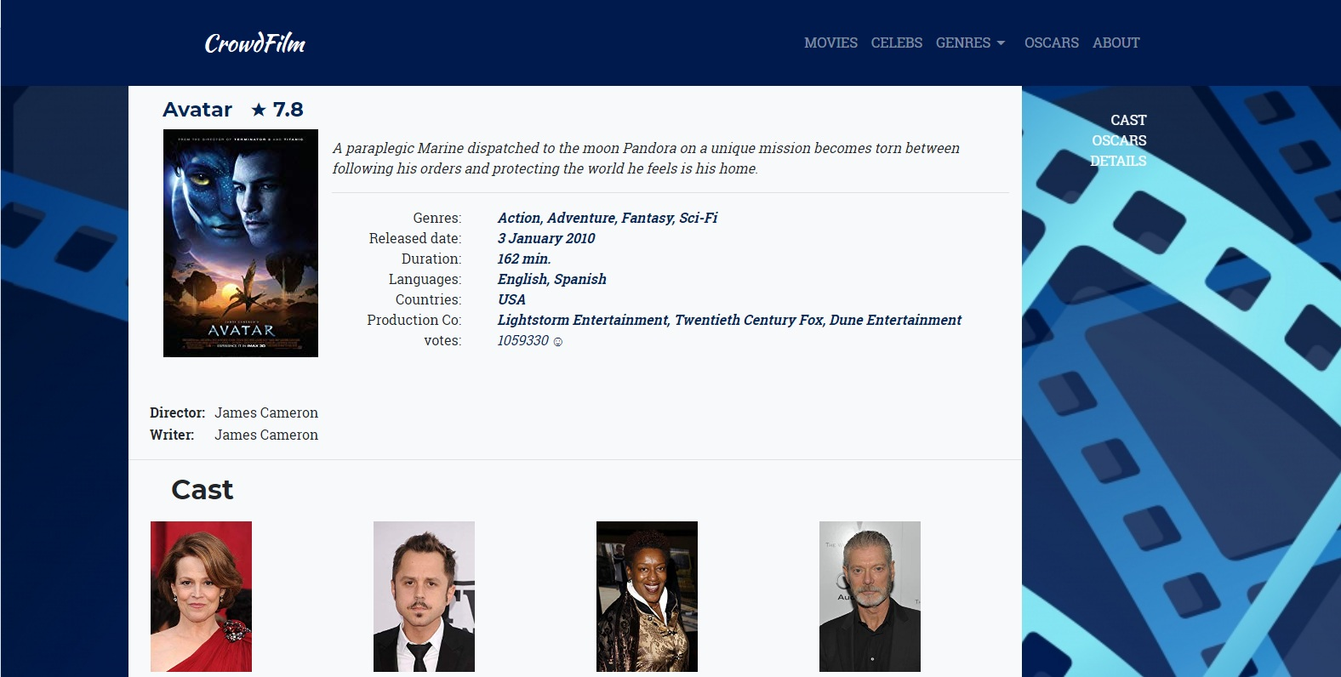
Movie page

Slide 15
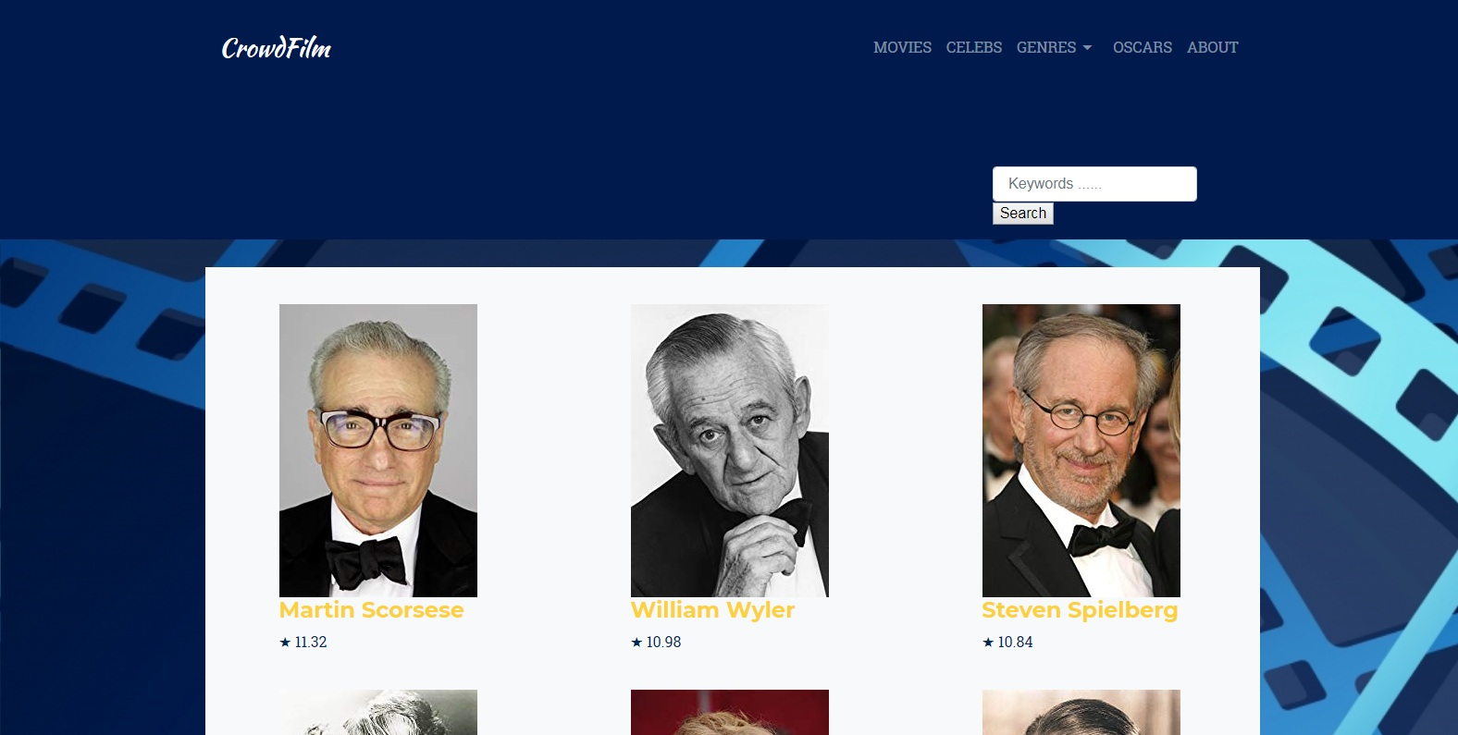
Celebs

Slide 16

Person page

Slide 17
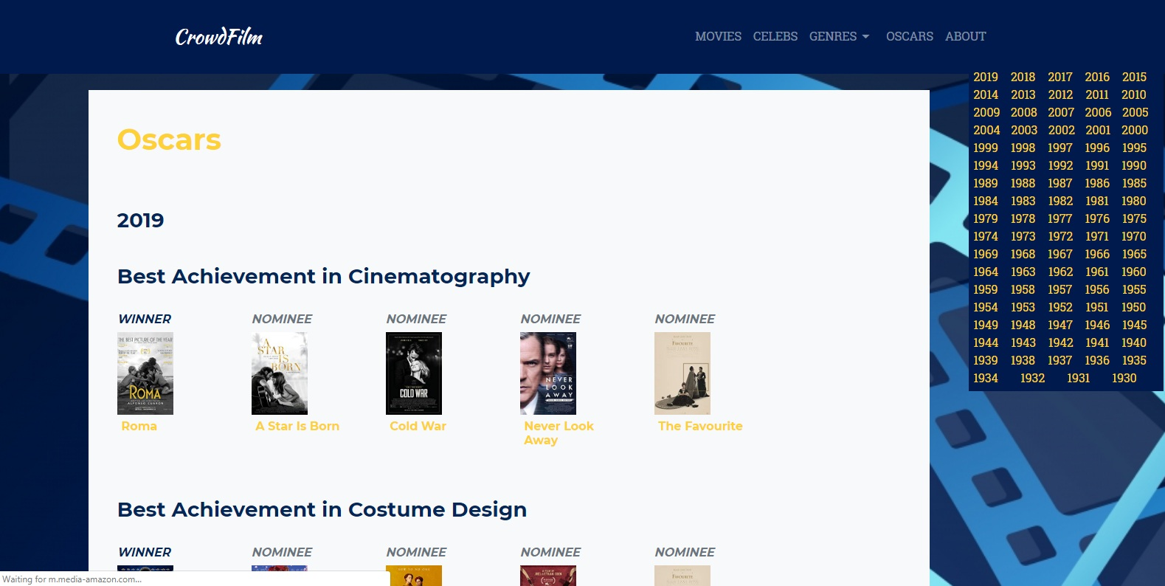
Oscars

Slide 18
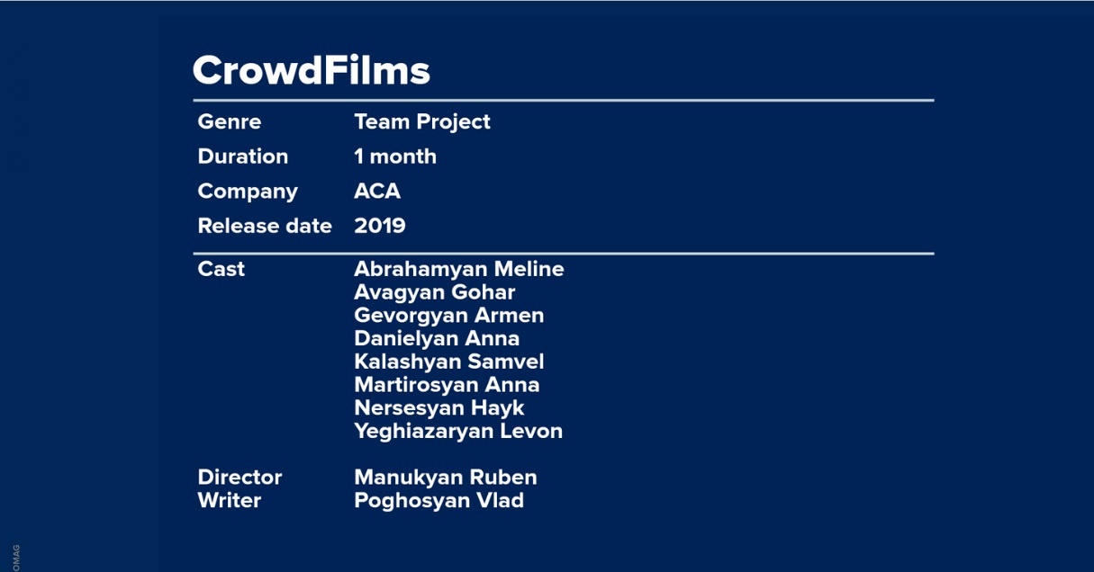
Our Team

Slide 19
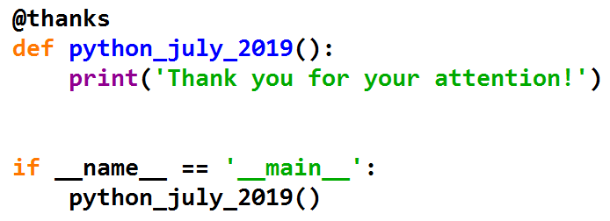
That’s it!

