Slide 1
Info Retrival Project presentation
Made by: Tzahi Kats 205888886 Iftah Levy 209383306

Slide 2
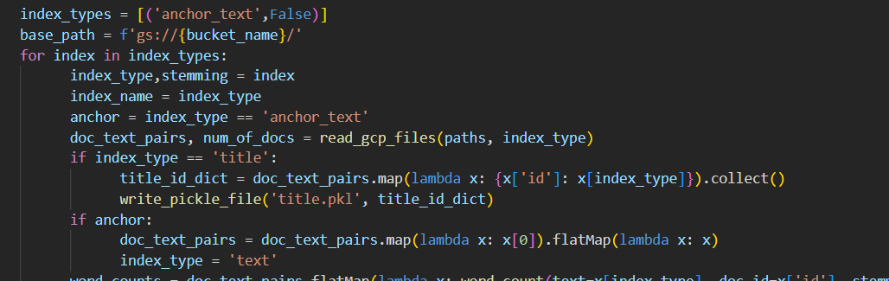
Step 1: Creating indexs
The first thing we did was create 3 separate indexes: for Titles, Anchor links and Body. we used these indexes for experimenting and for further development.
Initial version of Indexing code

Slide 3
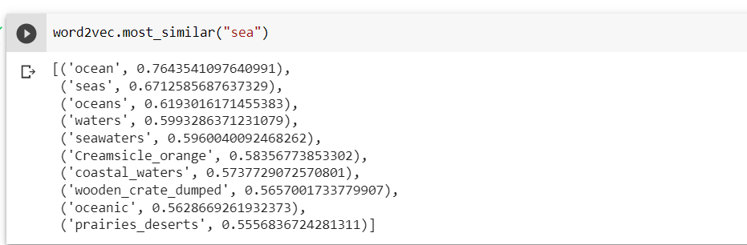
Step 2: experimentation:
After making initial Indexes we set on researching various components that could be used to improve the search engine or indexes. We researched PyDictionary, Word2Vec, Stemmer, removal of rare word to name a few.
An Example of experimentation on word2vec

Slide 4
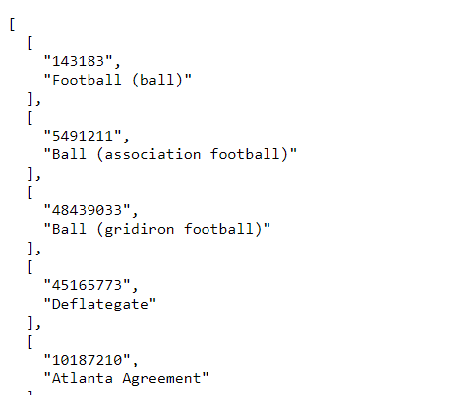
Step 3: finishing and testing
Lastly, we implemented the last of the Search functions and ran it on our Indexes. As we kept testing various weights and inclusions, we slowly improved the code to make it more efficient and streamlined
An Example of a result we tested by hand:

