Slide 1




What is Woomy-Arras Offline?
Woomy-Arras Offline is a community-driven offline version of the popular browser-based tank battle game Woomy-Arras.io. It lets players enjoy the game without relying on online servers.
Core Gameplay
Key Features
Active Development
Control a tank, destroy enemies and shapes, level up through class trees, and unlock unique tank abilities.
Multiple game modes, tank customization, and strategic combat make each run feel different.
The project is actively maintained and continues to evolve through community
contributions.
Technical Insight:
This project is a browser-based JavaScript canvas game that packages both the client and an adapted server/game-simulation runtime into the same web page. It is not built on Unity, Godot, Phaser, React, or a modern frontend framework. It is essentially a custom engine written in JavaScript, using:
HTML/CSS for the page/menu shell.
Canvas 2D for rendering the game.
Plain JavaScript for the client, renderer, input handling, entity drawing, mockup handling, and game UI.
A Node-style game server runtime adapted to run in the browser using custom polyfills for require, module.exports, global, process, and WebSocket behavior.
A WebSocket-like protocol between client and server.
The game is basically a single page offline browser app where the server simulation is loaded into the same browser tab and connected to the client through an in-memory WebSocket polyfill.

Slide 2
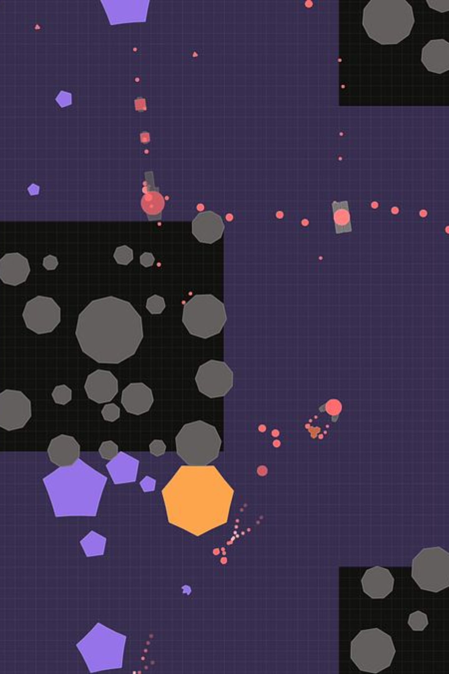








My Contributions
Game Modes
Re-added Growth FFA
Added Growth hybrid modes: Growth 4TDM, Growth Siege, Growth Maze FFA, Growth 2TDM, Growth 4TDM Maze, Growth Solo vs Team, and many more
Modes designed for experimentation while maintaining original Arras feel
Testing & Development Tools
Improved Beta Testing Panel with score editing and skill point editing and many more features
Added World Edit options: change total bot count, change total polygon count, +7 new features
Admin/Developer Commands (Dev Token Required): I, U, H, Q, (+), (-), V, and many more
Boss spawn button for any map
Tank Additions & Combat Updates
Added Countless new tank upgrades and entire new branch classes
Balanced old tanks fire power
Backend Rework
Javascript Optimization
Tank Balances
Better Collision Detection System
Oversight fixes and major Debugging

Slide 3
Game Mechanics
and many more features…

Slide 4
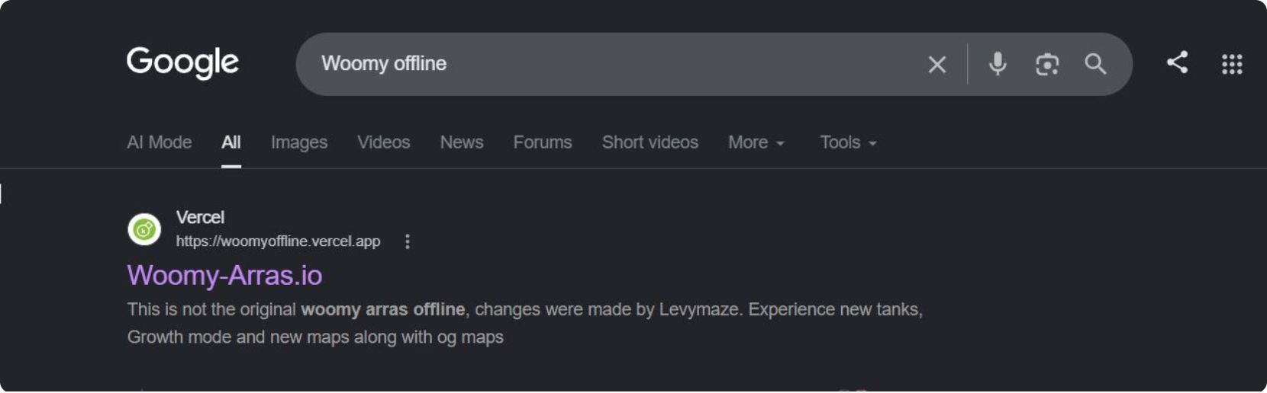
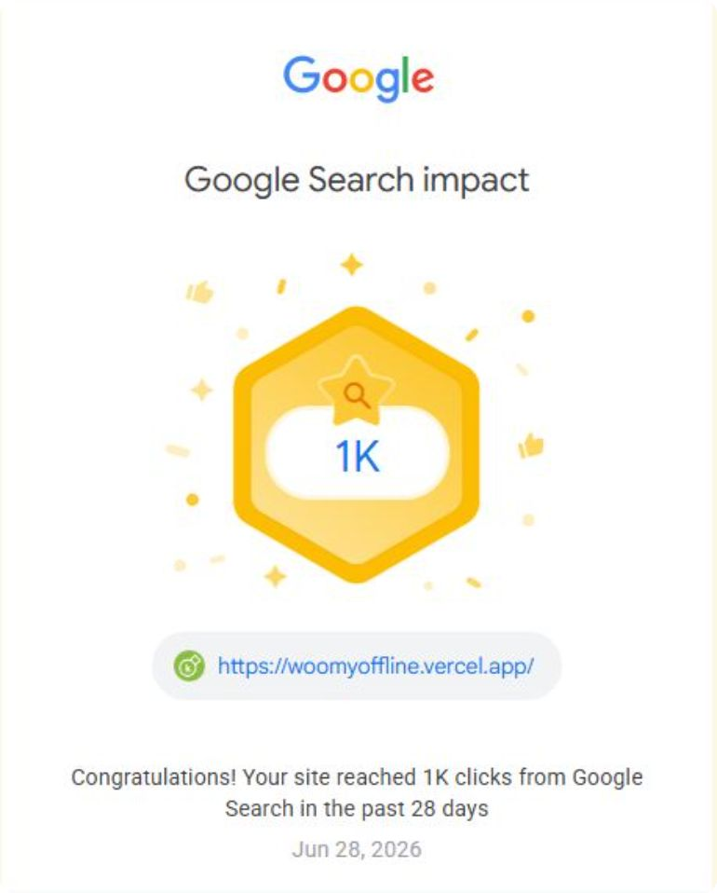
Achievements
#1 on Search Results Since May 2026
1k Monthly visits since June 2026

Slide 5
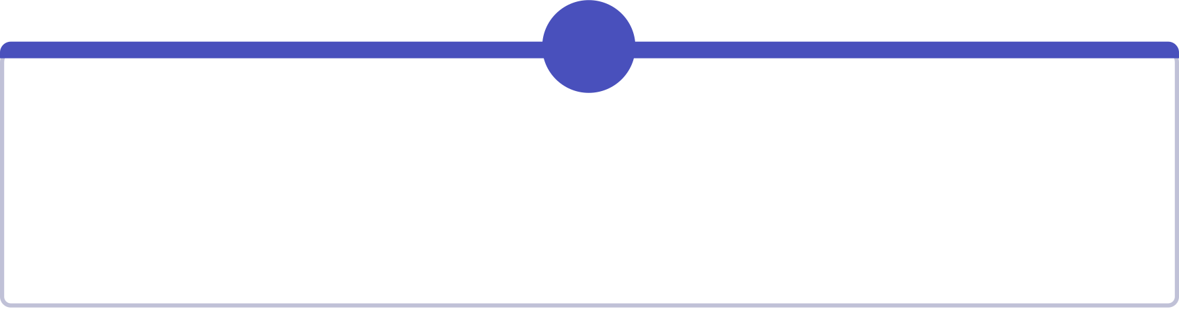


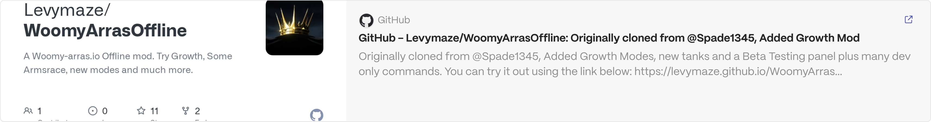
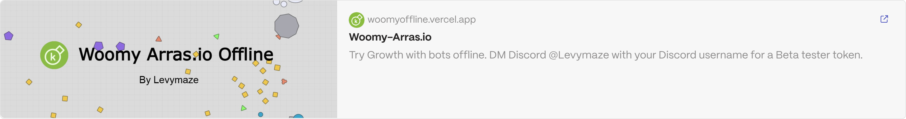
The Future Continues
Woomy-Arras Offline continues to be worked on, expect more changes soon.
Ongoing Evolution
Community-Powered
Expect continuous improvements, new features, and exciting content as the project steadily advances.
Your ideas, feedback, and contributions are essential to shaping the game's direction and success.
Thank you for being a part of this incredible community. The best is yet to come!

