Slide 1

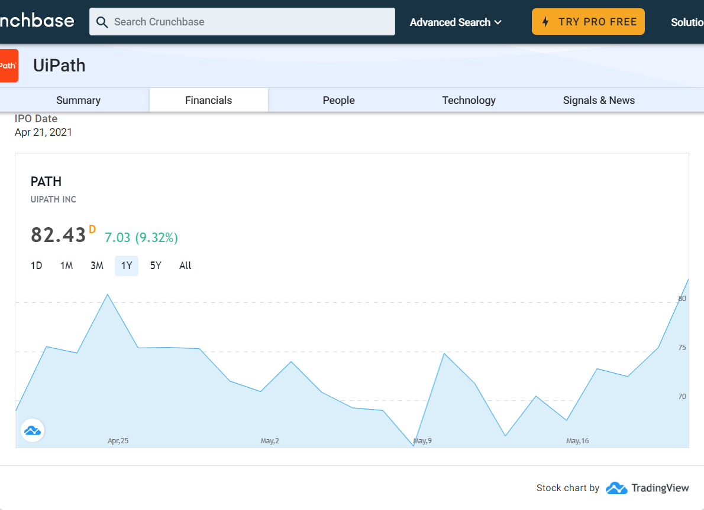
UiPath Overview
Company Background: UiPath is a software company developing robotic process automation and artificial intelligence software.
Latest Company News:
UiPath builds AI-driven task mining engine into its RPA platform - https://siliconangle.com/2021/05/19/uipath-builds-ai-driven-task-mining-engine-rpa-platform/
UiPath launches enhanced task mining and other updates - http://ow.ly/592H102K02H
UiPath Expands Robotic Process Automation (RPA) Training - https://www.channele2e.com/business/digital-transformation/uipath-automation-school/
Industries: | Artificial IntelligenceDeveloper ToolsEnterprise SoftwareMachine LearningRobotics
Date Founded: | 2005
Executives | Andra Ciorici, Daniel Dines, Manish Bharti, Marius Tirca
Headquarters: | New York, New York, United States
Stock Symbol: | NYSE:PATH
Latest Investment: | UiPath is funded by 27 investors. Alkeon Capital and Tiger Global Management are the most recent investors.
Latest Acquisition: | Cloud Elements

