Slide 1

NCRM April 2024 – Intro to python for data analysis: Session 4 – part 1: Debugging
Lewys Brace
l.brace@exeter.ac.uk

Slide 2
Debugging

Slide 3
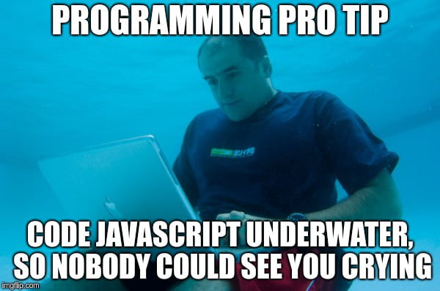
Debugging
Debugging is in fundamental aspect of coding, and you will probably spend more time debugging than actually writing code.
EVERYONE has to debug, it is nothing to be ashamed of.
In fact, you should be particularly concerned if you do write a programme that does not display any obvious errors, as it likely means that you are just unaware of them.
There are a number of debugging programmes available to coders. However, debugging the most common issues that you’ll encounter when developing programmes can be done by following a few key principles.
However, always remember that sometimes fixing a bug can create new bugs.

Slide 4

Print everything
When debugging, the most important function at your disposal is the print() command. Every coder uses this as a debugging tool, regardless of their amount of experience.
You should have some sense as to what every line of code you have written does. If not, print those lines out. You will then be able to see how the values of variables are changing as the programme runs through.
Even if you think you know what each line does, it is still recommended that you print out certain lines as often this can aid you in realising errors that you may have overlooked.

Slide 5
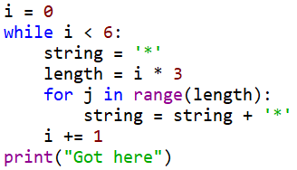



Print examples
Did this chunk of code run?
I want the value of variable to be 10 upon completion of the for loop. Did the for loop work correctly?
No.
Yes, it did.

Slide 6
Run your code when you make changes
Do not sit down and code for a hour or so without running the code you are writing. Chances are, you will never get to the bottom of all of the errors that your programme reports when it runs.
Instead, you should run your script every few minutes. It is not possible to run your code too many times.
Remember, the more code you write or edit between test runs, the more places you are going to have to go back an investigate when your code hits an error.

Slide 7
Read your error messages
Do not be disheartened when you get an error message. More often than not, you’ll realise what the error is as soon as you read the message; i.e. the for loop doesn’t work on a list because the list is empty.
This is particularly the case with Python, which provides you with error messages in ‘clear English’ compared to the cryptic messages given by offered by other languages.
At the very least, the error message will let you know which lines is experiencing the error. However, this may not be the line causing the error. Still, this offers a good starting point for your bug search.

Slide 8
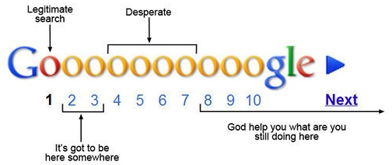
Google the error message
If you cannot work out the cause of an error message, google the error code and description.
This can sometimes be a bit of a hit-or-miss, depending on the nature of the error.
If your error is fairly specific, then there will nearly always be a webpage where someone has already asked for help with an error that is either identical or very similar to the one you are experiencing; stackoverflow.com is the most common page you’ll come across in this scenario.

Slide 9
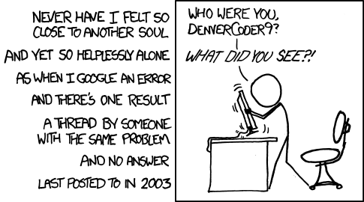
Do make sure that you read the description of the problem carefully to ensure that the problem is the same as the one you are dealing with. Then read the first two or three replies to see if page contains a workable solution.

Slide 10
Comment out code
You can often comment out bits of code that are not related to the chunk of code that contains the error.
This will obviously make the code run faster and might make it easier to isolate the error.

Slide 11
Binary searches
This method draws upon a lot of the methods we have already covered.
Here, you want to break the code into chunks; normally two chunks, hence this method’s name.
You then isolate which chunk of code the error is in.
After which, you take the chunk of code in question, and divide that up, and work out which of these new chunks contains the error.
So on until you’ve isolate the cause of the error.

Slide 12
Walk away
If you have been trying to fix an error for a prolonged period of time, 30 minutes or so, get up and walk away from the screen and do something else for a while.
Often the answer to your issue will present itself upon your return to the computer, as if by magic.

Slide 13
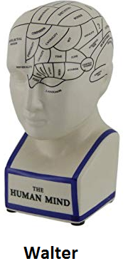
Phrase your problem as a question
Many software developers have been trained to phrase their problem as a question.
The idea here is that phrasing your issue in this manner often helps you to realise the cause of the problem.
This often works!

Slide 14
Ask someone
If all else fails, do not hesitate to ask a colleague or friend who is a coder and maybe familiar with the language for help.
They may not even need to be a specialist, sometimes a fresh pair of eyes belonging to someone who is not invested in the project is more efficient at helping you work out your issue than spending hours trying to solve the issue on your own or getting lost the internet trying to find a solution.

Slide 15
Any questions?

