Slide 1

NCRM April 2024 – Intro to python for Data Analysis: Session 6: Data cleaning
Lewys Brace
l.brace@exeter.ac.uk

Slide 2
Recap
So far on this course, we have learned the basics of coding, including:
- The Python syntax
- Data types
- Coding architectures ;i.e. for lops and while loops
- Importable modules
It is important to lean these things so that we can do data science.
However, before we move on to the next part of the course where we learn how to use these tools to do data science, it is worth exploring why we do it.

Slide 3
Data science, statistics, and data analytics

Slide 4
Data science and statistics
As covered in session 1, we refer to this as social data science or computational social science, and can more formally be defined as:
An interdisciplinary field that combines scientific methods, statistical techniques, and computational methods such as the use of algorithms and machine learning (often referred to as artificial intelligence) and processes in order to gain actionable insights from large, sometimes unstructured and “noisy”, data.
As this definition shows, data science is about more than “just” statistics.
However, statistics does make up a large part of data science, so it is worth taking a look at some of its underlying concepts.

Slide 5
Statistics vs Probability
It is perhaps easiest to understand the nature of statistics by looking at an important difference between it and the related area of probability.
Probability says “I've got a data generating process” (i.e., throwing two dice and adding the result), “now tell me what sorts of outcomes I can expect from this data generating process”.
Statistics is the inverse. Statistics says “I have some outcomes” (i.e., data), “Now what can I infer about the process that generated them?”.

Slide 6
The Nature of the Beast
All forms of statistical analysis are based upon an inferential move that gets a lot of mileage in statistics, one that is based on the following logic:
1. It argues that, if the world were a certain way, what sort of outcomes would we expect to see?
2. We then compare the predicted outcome in that hypothetical world to the outcome we’ve actually seen in the real world.
3. We then reason that the real-world result either is or isn’t close enough to the hypothetical one to make us suspect that the hypothetical world’s data-generating process is actually a good description of the real one.
Once you “get” that inferential strategy, all of statistics starts to make a lot more sense.

Slide 7
Things to Remember
Remember that some of statistics is convention: i.e. why are we so interested in the squared differences from the mean?
Not everything is exact, there's often more than one way to do things.
The statistical tests we favour might have been different if we'd had a different history of statistical development.
There's a pragmatic rather than a pure spirit about statistical thinking.

Slide 8
Data Analytics
This “pragmatic over purest” thinking led to the notion of data analytics, the idea of applying statistical techniques for practical purposes, in a range of domains; including business and science.
As Tukey stated:
“Procedures for analysing data, techniques for interpreting the results of such procedures, ways of planning the gathering of data to make its analysis easier, more precise or more accurate, and all the machinery and results of (mathematical) statistics which apply to analysing data.”
- John Tukey (1961).

Slide 9
Data science
Technological advancements have increasingly impacted our daily lives, and have resulted in an ever-increasing data-rich social world, which combined with increases in computational power of machines used for analysis, has led to the emergence of data science.
Data science now follows similar principles to data analytics, but builds on top of it by including the use of computational methods, such as algorithms, and having more of a focus on domain-specific knowledge; i.e. security, politics, behavioural science, etc.
Data science is therefore multifaceted, and can be described as a science, a research paradigm, a research method, a discipline, a workflow, and a profession.
It uses techniques and theories drawn from many fields within the context of mathematics, statistics, computer science, information science, and domain knowledge.
A data scientist is therefore a professional who combines computational methods with statistical knowledge and domain-specific understanding to create gain insights from data.

Slide 10
In doing this, the data scientist/computational social scientist follows a number of stages in their workflow.
Specifically, the data science workflow involves data collection, inspecting, cleaning, transforming, and modelling data with the aim of discovering useful information.
These steps are iterative in the sense that feedback from later phases may result in additional work in earlier phases.
Perhaps paradoxically, we’re going to start here by looking at the last stage; communication.
This is because data science has a focus on domain-specific knowledge, so thinking about your data and analysis within that domain-specific context, and how you would convey your results to your intended audience is useful during the course of your analysis.

Slide 11
Spyder IDE

Slide 12

The Spyder IDE
Up until now on this course we have been using Jupyter notebooks to learn how to code in Python.
Jupyter notebooks are for learning how to code.
However, it is equally important to learn how to use other Integrated Development Environments (IDE) as these are often computationally more efficient when running complicated code or working with large datasets.
While you can edit your code in a text editor (i.e. Sublime Text, Notepad++) and run the code in the terminal, for the remainder of this course, we will be using the Spyder IDE that was installed onto your system when you installed the Anaconda distribution of Python.
Spyder offers a user-friendly GUI with which to work and is great for developing and running Python code.
You can open Spyder by clicking on the Spyder Icon (top right of this slide) in the Anaconda Navigator.

Slide 13
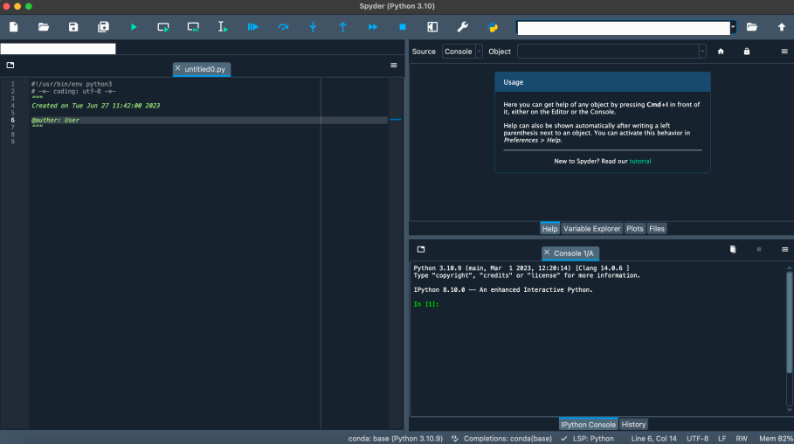
Once Spyder has opened, you'll be greeted with the window below This is the Spyder IDE.
You can type your code in the text editor box on the left and get your output printed to the screen on the bottom right-hand side box.
You then run your code by clicking the green play button at the top of the window or by pressing F5.

Slide 14
Principles of Data cleaning

Slide 15
Raw data
Data scientists/computational social scientists work with data to extract useful knowledge and actionable insights.
When data scientist first acquire data, it is often in its raw form, which is known as primary or source data, and is messy and in need of cleaning.
Data science analysis methods are only as good as the data fed in.
So if you use data that has irregular and inconsistent values, then you’re going to produce outputs that are irregular and inconsistent.
This is where data cleaning comes in.

Slide 16
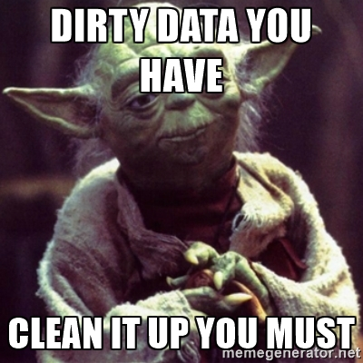
Data cleaning removes incorrect, corrupted, garbage, incorrectly formatted, duplicate, or incomplete data within a dataset.
Proper data cleaning can make or break your project.
Indeed, it is commonly said that data scientists spend 90% of their time cleaning and manipulating data, and only 10% of their time actually analysing it.
There are no hidden tricks and secrets to uncover, or any ‘hard and fast’ rules for data cleaning because the processes may vary from one dataset to another.
However, there are a number of steps that an analyst can follow in order to ensure that their data is useable.

Slide 17
1. Remove unwanted observations
The first step to data cleaning is removing unwanted observations from your dataset. This includes duplicate and irrelevant observations

Slide 18

Duplicate observations
Duplicate observations most frequently arise during data collection, such as when you:
Combine datasets from multiple places
Scrape data
Receive data from clients/other departments

Slide 19

Irrelevant observations
Irrelevant observations are those that don’t actually fit the specific problem that you’re trying to solve.
If you were building a model for single-family homes only, for example, you wouldn't want observations for blocks of flats in there.
This is also a great time to review your charts from Exploratory Analysis. You can look at the distribution charts for categorical features to see if there are any classes that shouldn’t be there.

Slide 20
2. Fix Structural Errors
Structural errors are those that arise during measurement, data transfer, or other types of "poor housekeeping”.
Include issues such as typos or inconsistent capitalization.
If working with a large data set, check the top 20 rows, bottom 20 rows, and a random 20 rows from somewhere in between:
1. Does what you’re looking at make sense? 2. Does the data match the column label?
3. Does the data abide by the appropriate rules for its field? i.e. if my name was in a field, it should say “Lewys“, not “L3wys”, and phones numbers should be the correct number of numerical digits.
4. Is there logic to the data issues you are finding; i.e. (01632) 960050 -> 01632 960050.

Slide 21
If dealing with categorical features, it is easy to check for such areas using some form of plot.
1. Easy changes are fine to make; i.e. “L3wys” -> “Lewys”.
2. Avoid making amendments, such as “Mert” -> “Bert”, unless you have prior knowledge.
If working with numerical features, compute some summary statistics. Do these make sense? i.e. if looking at data for low income families, it’s unlikely that the annual wage for an individual will be ~>£1,000,000.

Slide 22

3. Filter Unwanted Outliers
Outliers can cause problems with certain types of models
In general, if you have a legitimate reason to remove an outlier, it will help your model’s performance.
However, outliers are innocent until proven guilty. You should never remove an outlier just because it’s a "big number." That big number could be very informative for your model.

Slide 23
4. Handle Missing Data
You cannot simply ignore missing values in your dataset. You must handle them in some way for the very practical reason that most missing values could negatively impact your analysis.
Look at the missing (or ‘null’ values) values. How many are there? Is this number acceptable? Is there a pattern as to where these missing values appear; if so, there could be an issue with data collection or transfer.
There are two common ways in which to deal with missing values, and neither of them are good:
Dropping observations
Inputting missing values.

Slide 24
Dropping observations
Dropping observations that have missing values is sub-optimal for the obvious reason that, when you drop observations, you drop information.
Indeed, the fact that the value was missing may be informative in itself.
In the real world, you also often have to make predictions on new data even if some of the features are missing.

Slide 25
Inputting
Inputting missing values is sub-optimal because the value was originally missing, but then filled in by the analyst.
This leads to the loss of information, no matter how sophisticated your imputation method is.
A number of sophisticated methods for dealing with this issue.
The issue with all these methods is that, when you input values you’re not adding any real information. You’re just reinforcing the patterns already provided by other features.
Again, however, ‘missingness’ is almost always informative in itself.

Slide 26
Dealing with missing values
In short, you should always tell your algorithm that a value was missing because missingness is informative.
So, how does an analyst dealing with missing data?

Slide 27
Missing categorical data
The best way to handle missing data for categorical features is to simply label them as ‘Missing’, by assigning some form of dummy code.
You’re essentially adding a new class for the feature.
This also gets around the technical requirement of analysis software for needing no missing values.

Slide 28
Missing numeric data
For missing numeric data, you should flag and fill the values:
1. Flag the observation with an indicator variable of missingness.
2. Then, fill the original missing value with just to meet the technical requirement of no missing values.
By using this technique of flagging and filling, you are essentially allowing for the estimate of the optimal constant for missingness, instead of just filling it in with the mean.

Slide 29
Communicate with the source
Sometimes an ‘error’ in the data is merely the result of a decision made upon data collection or input.
Do not be afraid to contact the data source to ask questions, it is always better to check such details than risk pressing ahead with analysis on a false assumption.

Slide 30
There are other approaches to data cleaning
A lot of work has been done, and many clever mathematical methods have been devised in order to deal with data cleaning issues.
This is just MY method. There are others.
The method you use will very much be dependent upon the data set you are working with.

Slide 31
Use the correct tools
Use Excel if:
You have fewer than 1 million records.
You need to do a job quickly and easily.
There is a logical pattern to cleaning the data and it’s easy enough to clean using Excel functions.
The logical pattern to cleaning the data is hard to define, and you need to clean the data manually.
Use a scripting language (i.e. Python or R) if:
You need to document your process
You plan on doing the job on a repeated basis
There is a logical pattern to cleaning the data, but it is hard to implement with excel functions.
This also depends on what tool you’re most comfortable with!

Slide 32
Data cleaning with pandas and NumPy

Slide 33
Exercise 1
Q1.1: Go to the session 8 sub-section of the module’s ELE page and download the Books.csv file.
Q1.2: Save this file to a location on your system that you will remember.
Q1.3: Load the Books.csv into your Spyder IDE. Remember, you need to import NumPy and Pandas.
Q1.4: Print the variable of the dataset to the screen.
Q1.5: Save the variable names to a list variable.
Notes:
var1

Slide 34
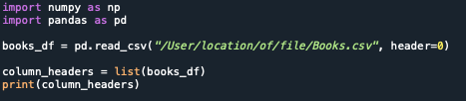

Slide 35
Step 1: Looking at the dataset
You now know what the name of the variables in your dataset are.
We now need to take a glimpse of the data to understand a understand how the values are structured based on the column they are in, to give us a rough idea of any inconsistencies.
How should you do this?
Notes:
var1

Slide 36
Exercise 2
Q2.1: Print the first 10 rows of data.
Q2.2: Take a look at each column in your dataset, and note any issues that you think might need correcting.
Remember: You can print out specific columns to the screen.
Notes:
var1

Slide 37
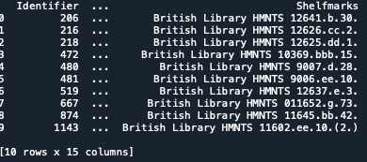

Slide 38
Looking at the variables shows us that there are columns containing data that are useful to a library, but not to our analysis.
As such, we can drop them.
Dropping unnecessary columns is useful when dealing with large datasets as it helps to save on memory.
To do this, we use the .drop() method, which can take several optional arguments.
In the example below, we pass in the inplace parameter as True and the axis parameter as 1. This tells Pandas that we want the changes to be made directly in our object and that it should look for the values to be dropped in the columns of the object.

Slide 39

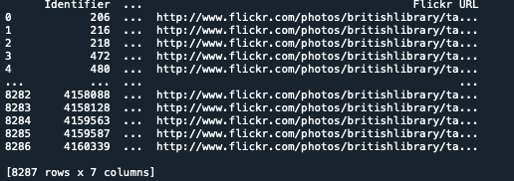

Slide 40
Setting an index
Looking at the columns names, we see there is one entitled “Identifier”
If this is a set of unique values, it would make a good index.
So, let’s check if it is a unique set of values, and if it is, set it as the row index for our dataframe.
Notes:
var1

Slide 41
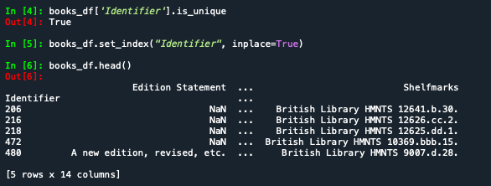

Slide 42
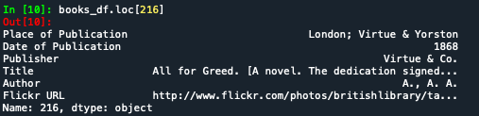
We can access each record in a straightforward way with loc[].
Although loc[] may not have all that intuitive of a name, it allows us to do label-based indexing, which is the labeling of a row or record without regard to its position.
In other words, 216 is the second label of the index. To access it by position, we could use df.iloc[1], which does position-based indexing.

Slide 43
Step 2: Cleaning specific columns
So far, we have removed unnecessary columns and changed the index of our dataframe to something more sensible.
We know want to clean specific columns and get them into a uniform format to get a better understanding of the dataset and enforce consistency.
In particular, we will be cleaning “Date of Publication” and “Place of Publication” variables.
Notes:
var1

Slide 44

Upon inspection, all of the data types are currently either the object dtype or float
The dtype data type is roughly analogous to str in native Python.
It encapsulates any field that can’t be neatly fit as numerical or categorical data.
This therefore makes sense that so many variables in our data are of this type since we’re working with data that is initially a bunch of messy strings
Notes:
var1

Slide 45
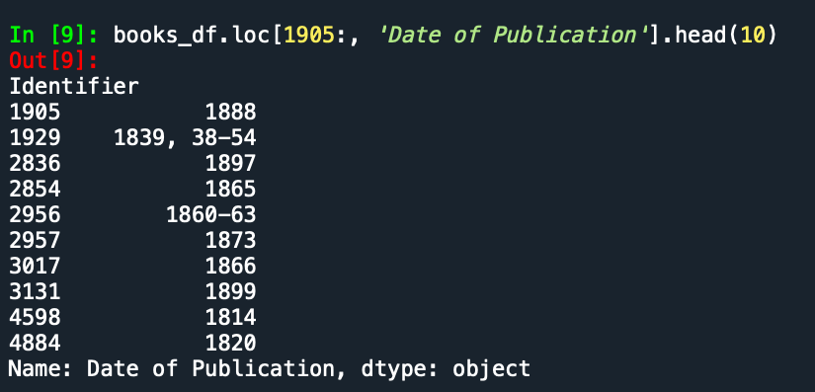
One field where it makes sense to enforce a numeric value is the date of publication so that we can do calculations down the road.
From looking at the below, what do we need to fix?
1. Remove the extra dates in square brackets, wherever present: 1879 [1878]
2. Convert date ranges to their “start date”, wherever present: 1860-63; 1839, 38-54
3. Completely remove the dates we are not certain about and replace them with NumPy’s NaN: [1897?]
4. Convert the string nan to NumPy’s NaN value
Notes:
var1

Slide 46

Regex
Looking at the patterns of issues in this particular dataset, we can make use of something called a regular expression to fix these issues.
A regular expression (regex) is a pattern that the regular expression attempts to match to the input text.
For example, the regex below is meant to find any four digits at the beginning of a string, which suffices for our case.
The regex is in the form of a raw string (meaning that a backslash is no longer an escape character), which is standard practice with regular expressions.
The \d represents any digit, and {4} repeats this rule four times. The ^ character matches the start of a string, and the parentheses denote a capturing group, which signals to Python that we want to extract that part of the regex. (We want ^ to avoid cases where [ starts off the string.)
Notes:
Pvar1

Slide 47
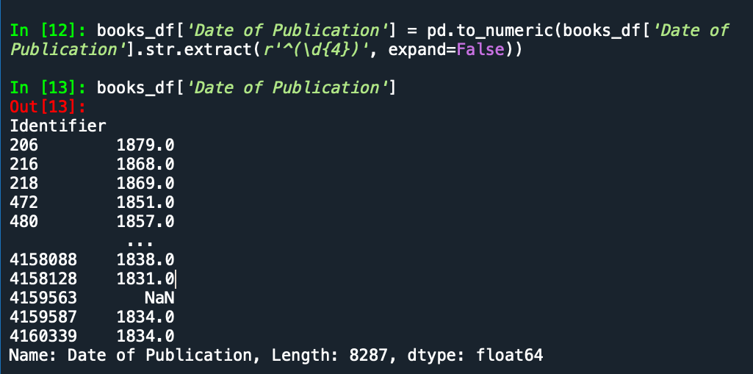
We can use this regex to update the “Date of Publication” variable by using nested methods.
We first use .str.extract() to convert each of the row values in “Date of Publication” to a string object and then only extract the row values that are matched to the regex.
We then use pd.to_numeric() to convert convert these strings to numeric type, which will also convert any non-matched strings to NaNs.
This new column of floats and NaNs is then assigned to the “Date of Publication” variable, which overwrites the original with our new cleaned version.
Notes:
r1

Slide 48
A quick check shows that about 1 in every 10 values are missing from the “Date of Publication” column.
This is a small price to pay to gain the ability to do computations with the remaining, valid, values.
Notes:
r1

Slide 49
Step 3: Cleaning columns of strings
We just used .str to help clean the “Date of Publication” variable.
This attribute is a way to access string operations in Pandas that largely mimic the in-built Python string operations covered in previous sessions; i.e. .lower(), .replace(), etc.
Let’s take a look at the “Place of Publication” variable.
Notes:
var1

Slide 50

We’re going to combine .str with NumPy’s .where() method to clean this variable.
The .where() method takes a number of arguments.
The first (condition) is either an array-like object or a Boolean mask.
The second (then) is the value to be used if condition evaluates to True
The third (else) is the value to be used otherwise.
The .where() method takes each element in the object used for condition, checks whether that particular element evaluates to True in the context of the condition, and returns an ndarray containing then or else, depending on which applies.
Notes:
var1

Slide 51

It can be nested into a compound if-then statement, allowing us to compute values based on multiple conditions.

Slide 52
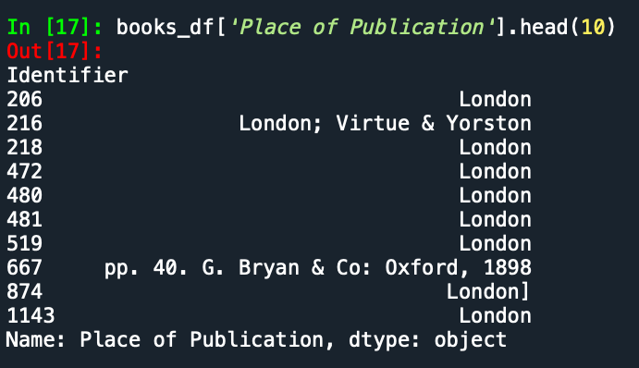
We’ll be making use of these two functions to clean “Place of Publication” since this column has string objects.

Slide 53
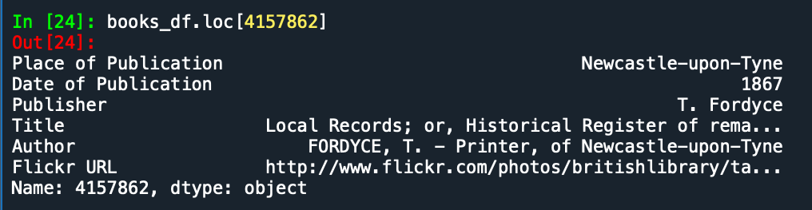
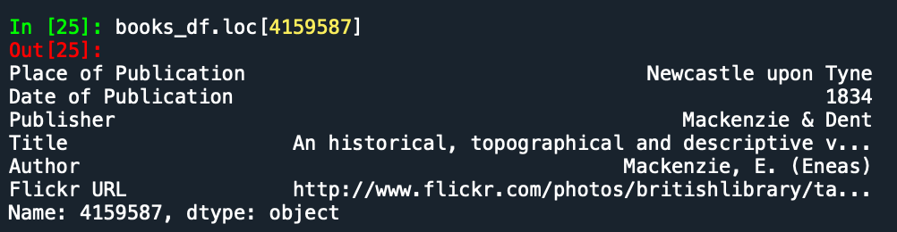
In some rows, the place of publication is surrounded by other unnecessary information.
If we were to look at more values, we would see that this is the case for only some rows that have their place of publication as ‘London’ or ‘Oxford’.
These two books were published in the same place, but one has hyphens in the name of the place while the other does not.

Slide 54
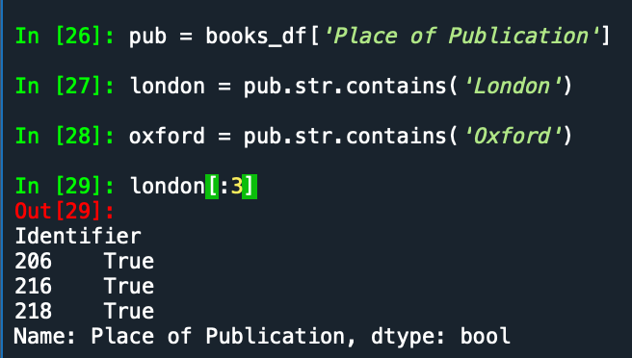
To clean this column in one sweep, we can use str.contains() to get a Boolean mask.
We then combine with np.where() to clean the column.

Slide 55
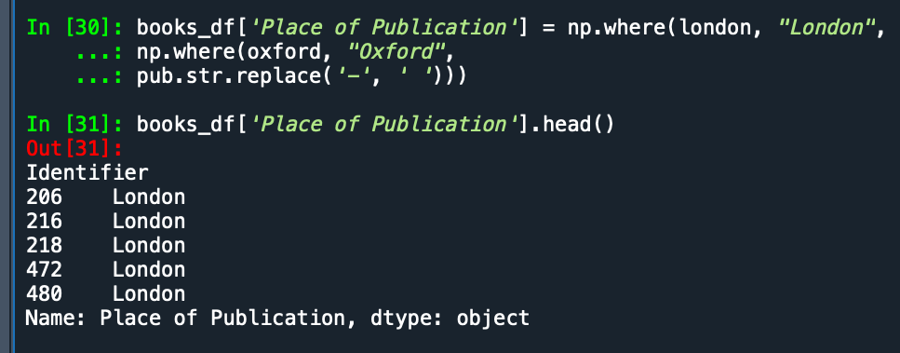
We then combine with np.where() to clean the column.
This method is called in a nested structure, with condition being a series of Booleans obtained with str.contains(). The contains() method works similarly to the in-built in keyword used to find the occurrence of an entity in an iterable (or substring in a string).
The replacement to be used is a string representing our desired place of publication. We also replace hyphens with a space with str.replace() and reassign to the column in our dataframe.

Slide 56
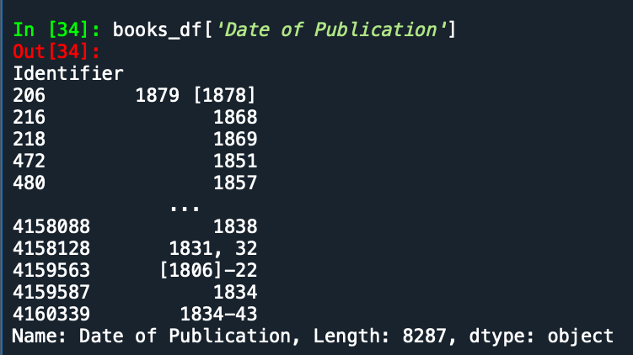
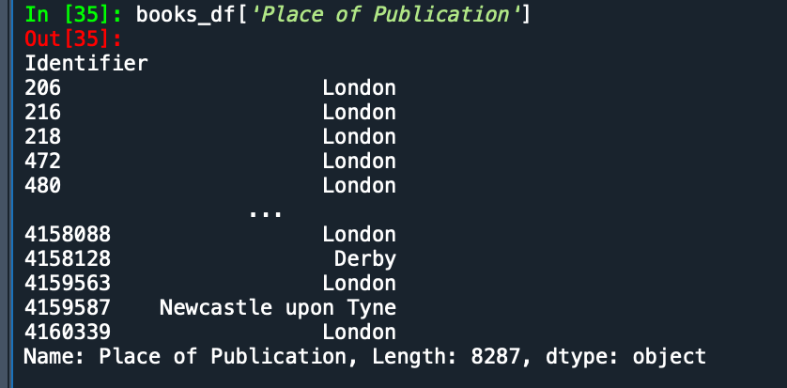
Let’s take a look at the top five rows of our cleaned data.
Although there is more dirty data in this dataset, we will discuss only these two columns for now.

Slide 57
Any questions?

