Slide 1

NCRM April 2024 – Intro to python for Data Analysis: Session 7 – part 1: Introduction to data visualisation with Python
Lewys Brace
l.brace@exeter.ac.uk

Slide 2
We discussed before how social data scientists/computational social scientists following the following workflow.
Today, perhaps paradoxically, we’re going to look at the last stage; communication.
We’re doing this for two reasons:
1. Visualising your dataset can be a good way of understanding the nature of the data you are working with.
2. Data science has a focus on domain-specific knowledge, so thinking about your data and analysis within that domain-specific context, and how you would convey your results to your intended audience is useful during the course of your analysis.

Slide 3

Rules for storytelling
“You gotta keep in mind what’s interesting to you as an audience, not what’s fun to do as a writer [or data scientist/computational social scientist]. They can be very different”.
“Putting it on paper lets you start fixing it. If it stays in your head, a perfect idea, you’ll never share it with anyone”.
“What’s the essence of your story? Most economical telling of it? If you know that, you can build out from there”.
- Emma Coats, former story artist for Pixar

Slide 4
Communicating your analysis
It can be difficult to explain the nature and results of analytical tests to audiences.
Data analysts are notorious for being poor communicators; leads to analysis not being used properly.
Good analysts tell a story.
In contrast, those analysts who rather the data ‘speak for themselves’ do not tend to be very effective.

Slide 5
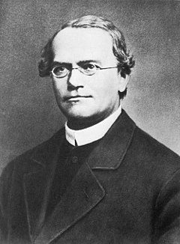
The importance of communicating: A bad historical example.
“My scientific studies have afforded me great gratification; and I am convinced that it will not be long before the whole world acknowledges the results of my work.”
- Gregor Mendel, shortly before his death in 1884.

Slide 6
He successfully demonstrated that the inheritance of genetic information from one generation to the next follows particular laws.
However, the significance of Mendel’s work was not realised until the start of the 20th century, when the independent re-discovery of these laws laid the foundations of the field of genetics.
Why did it take so long for the importance of Mendel’s work to be recognised?
Notes:
1.

Slide 7
This was largely due to the fact that the complex and detailed work Mendel produced was not understood, even by influential people in the same field, due to the way in which he attempted to convey his findings.
Mendel died without knowing how much his findings would change history,
It would be 30 years before the rest of the scientific community caught up with his work.

Slide 8
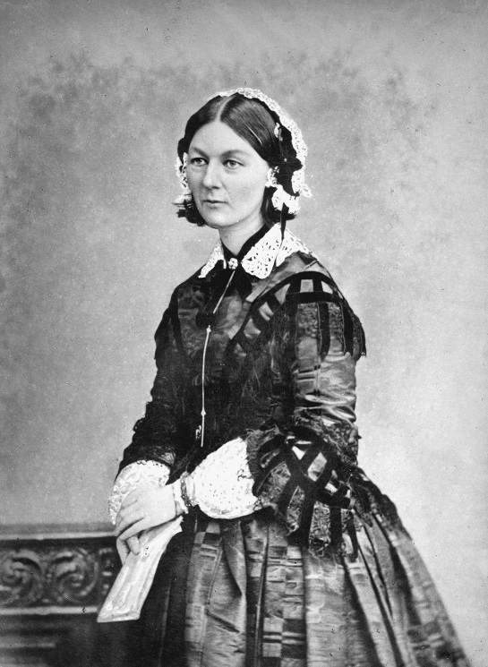
The importance of communicating: A good historical example.
In October 1854, during the Crimean War, Nightingale and a number of other nurses were sent to a British military hospital in Turkey.
She found that most of the deaths at the hospital were the result of epidemic, endemic, and contagious diseases, and not the original wounds for which individuals were admitted.
By February 1855, the mortality rate in the hospital was 43%.
Florence Nightingale: founder of professional nursing and stats pioneer

Slide 9
In addition to her campaign of improving basic sanitation at the hospital, Nightingale believed that statistics could help solve the problem.
She realised that the presentation of data was very important because people did not find numerical tables interesting.
She therefore designed diagrams to dramatise the number of deaths that were occurring as a result of the unsanitary conditions.
At the time, such diagrams were relatively novel.

Slide 10
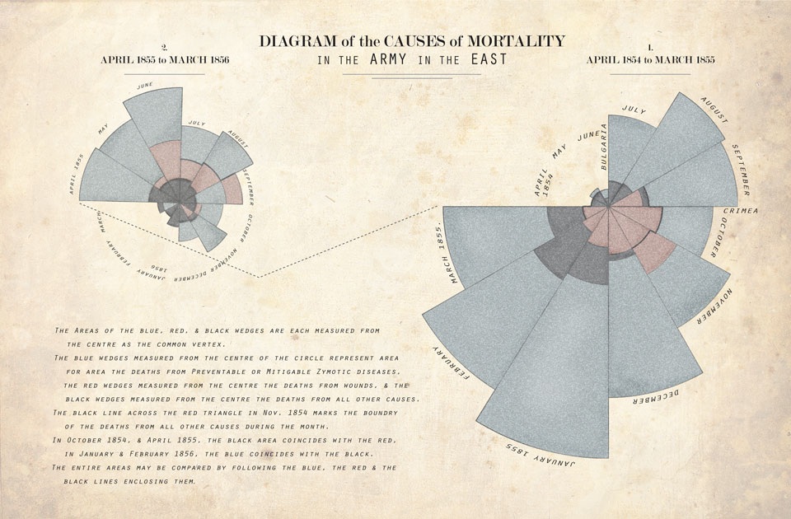

Slide 11
These diagrams were used to present the data, and convey the conditions of the hospital, to parliament.
Eventually, death rates were sharply reduced, as shown in the data Nightingale systematically collected.

Slide 12
The art of conveying an analysis
We thus see that, if you don’t want your analytical results to be ignored, you need to be able to present your results in an concise, informative, and engaging manner.
The essence of analytical communication is describing the problem and the story behind it, the model, the data employed, and the relationships among the variables in the analysis.
When the relationships among variables are identified, the meaning of the relationships should be interpreted, stated, and presented relevant to the problem.

Slide 13
The more effective analysts are those who can tell a story with data. Regardless of the details of the analysis method and the means of getting it across, the elements of good analytical stories are similar.
They have a strong narrative, typically driven by the business problem or objective.
Such narratives present findings in terms that the audience can understand. If the audience is highly quantitative and technical, then statistical or mathematical terms, even an occasional equation, can be used.
Good stories conclude with actions to take and the predicted consequences of those actions.

Slide 14
Understanding your data
While suitable graphs are a great way to allow you to convey the results of your analysis in your reports or presentations, they are also an excellent tool for exploratory data analysis (EDA).

Slide 15
Exploratory data analysis (EDA)
Exploring your data is the a crucial step in data analysis. It involves:
Organising the data set
Plotting aspects of the data set
Maybe producing some numerical summaries; central tendency and spread, etc.
“Exploratory data analysis can never be the whole story, but nothing else can serve as the foundation stone.” - John Tukey.

Slide 16
Graphs for EDA
EDA should always be carried out prior to any formal statistical analysis.
EDA allows you to check your data for:
To ensure you have meaningful data.
Detect errors that were made during data entry.
To detect patterns in the data that may go undetected by the statistical analysis that you use.
To ensure that the assumptions of your data are met.
To interpret the departures from the assumptions.
To detect unusual values, which are known as ‘outliers’.
Graphing is the most important part of this exploration.

Slide 17
Graphical data exploration
Graphing data is one of the most important parts of data analysis, and is the first thing you should do after cleaning your data.
Graphing data offers a number of functions:
It allows your to explore your data, by allowing you to easily identify unusual values and often aiding in the decision of what kind of analysis to subject the data to.
Enables you to ensure that your chosen model is a realistic fit to the data.
Allows you to communicate the nature of your data by summarising numerical information.

Slide 18
How to present data
Graphs should, among other things:
Show the data.
Induce the reader to think about the data being presented, rather than focusing on the graph itself; i.e. what colour the bars are, etc.
Avoid distorting the data.
Present many numbers with minimal ink.
Make large data sets, if that’s what you’re working with, coherent.
Encourage the reader to compare different pieces of data.
Reveal data.

Slide 19
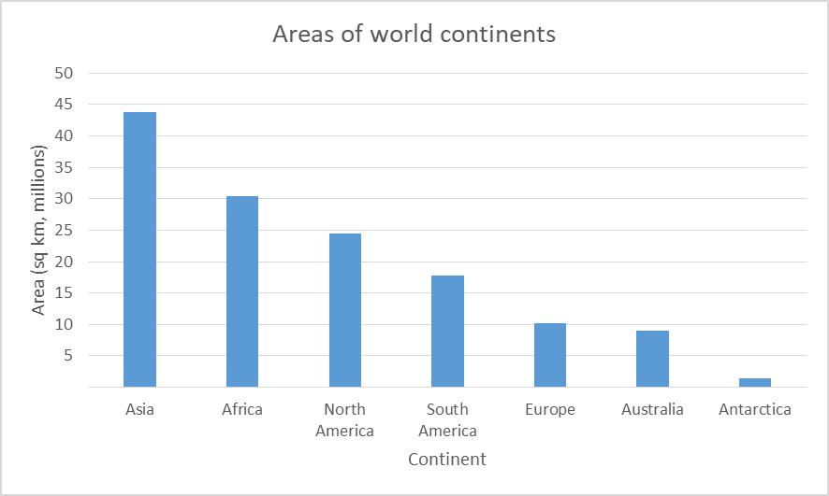
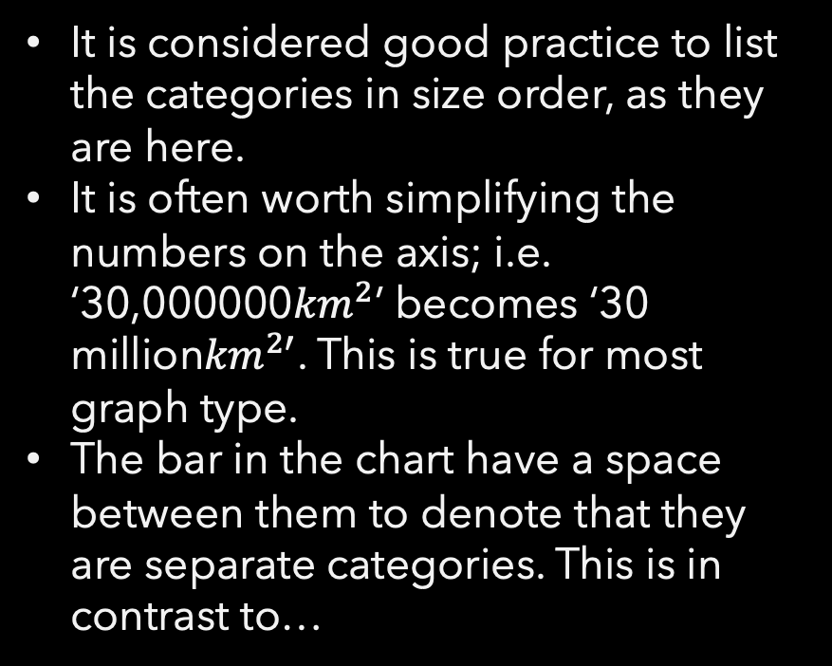
Bar charts
One of the most common graph types that you’ll see in newspapers and magazines.
It provides an instant picture of the relative sizes of different categories.
It is considered good practice to list the categories in size order, as they are here.
It is often worth simplifying the numbers on the axis; i.e. ‘30,000000${km}^{2}$’ becomes ‘30 million${km}^{2′}$. This is true for most graph type.
The bar in the chart have a space between them to denote that they are separate categories. This is in contrast to…

Slide 20
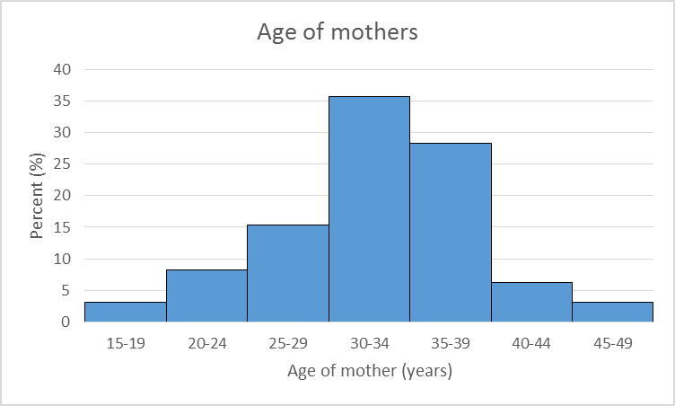
Histograms
Here, all of the bars are touching, indicating that horizontal axis represents a continuous number scale.
Often is to summarise a distribution.

Slide 21
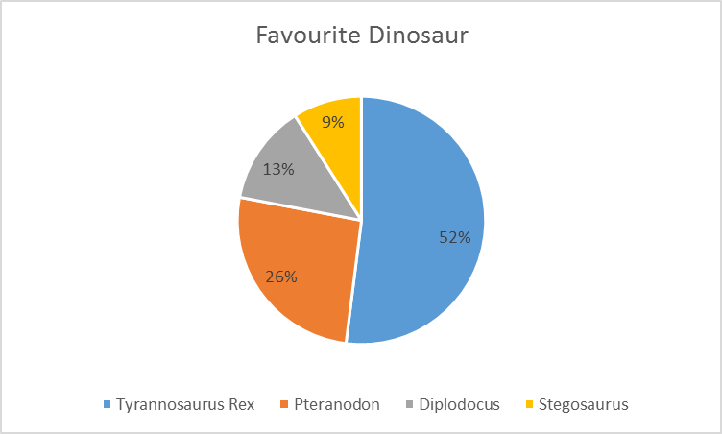

Pie charts
Frowned upon.
They are valid if you have a complete set, the component parts of which add up to 100% of the ‘pie’
To calculate the amount of the pie that a Pteranodon, which constitutes 26%:
$$360∗\frac{26}{100}=93.6$$ Pteranodon pie section = 93.6$°$

Slide 22
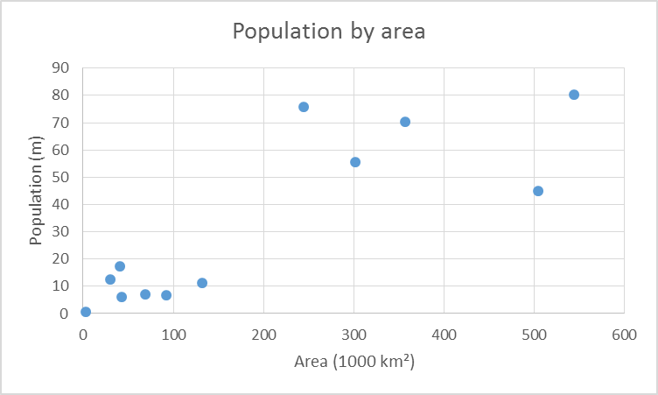
Scatter plots
Scatter plots are a useful way in which to represent paired data, data that consists of two distinct characteristics being measured for each of the sample items, in such a way that you can easily visualise the relationship between the two measures.

Slide 23
Choosing the correct graph
Two things to consider when deciding which graph to use:
The type of data being represented.
The type of statistical judgement which you hope the graph will help you to make.

Slide 24
Types of data
Categorical (entities are divided into distinct categories):
Binary variable (There are only two categories (i.e. dead or alive).
Nominal variable: There are more than two categories (i.e. whether someone is an omnivore, vegetarian, vegan, or fruitarian).
Ordinal variable: -The same as a nominal variable, but the categories have a logical order (i.e. whether a student got a fail, pass, merit, or distinction in an exam).
Continuous (entities get a distinct score):
Interval variable: Equal intervals on the variable represent equal differences in the property being measured (i.e. the difference between 6 and 8 is equivalent to the difference between 13 and 15).
Ration variable: The same as an interval variable, but the ratios of scores on the scale must also make sense (i.e. a score of 16 on an anxiety scale means that the person is, in reality, twice as anxious as someone scoring 8).

Slide 25
Discrete and continuous data
Discrete:
Investigation | Typical items of data
Types of wildflower | Bluebell, marigold, meadow-sweet
Household size | 1 person, 2 people, 3 people, 4 people
Environmental problems | Oil spills, acid rain, dog fouling
Vehicle colour | Red, green, blue
Continuous:
Investigation | Typical items of data
Babies’ birth weight | 3120g, 3760g, 2700g
Temperature survey | 18.6◦c, 21.4◦c, 19.0◦c
Survey of commuting times | 23 mins, 11 mins, 70 mins

Slide 26
Class test
Data item | Type of data: D or C?
M27
1929
1.2-1.5m
4.5-6.8kg
Three buds
One quarter
Discrete
Continuous
Continuous
Continuous
Discrete
Continuous

Slide 27
So, which graph?
Three types of statistical judgements:
- Summarising
- Comparing
- Inter-relating
Notes:
There are three types of statistical judgment, summarising, comparing, and inter-relating, and the kind of judgement you are making will be fundamental in helping you to decide on what kind of graph you should draw.

Slide 28
Let’s code
Open up the Spyder IDE, ready for the practical exercises.

