Slide 1

NCRM April 2024 – Intro to Python for data analysis: Session 9: Bivariate analysis and relationships
Lewys Brace
l.brace@exeter.ac.uk

Slide 2
Welcome to term 2!

Slide 3
Term 1 recap
Last term, we learned :
1. How to code in Python.
2. Coding architecture and principles.
3. How to use major Python packages (i.e. matplotlib, Pandas, NumPy) for CSS.
4. How to clean data.
5. Basics of data visualisation.
6. Descriptive statistics (i.e. measures of central tendency).

Slide 4
Term 2 outline
This term, we’re going to build upon these skills by first looking at:
1. Bi- and multi-variate data.
2. Relationships between variables.
3. CSS research ethics.
4. The internet as a data source
5. Text data analysis
6. Networks

Slide 5
Bivariate data and relationships between variables

Slide 6
Recap of data types
Categorical (entities are divided into distinct categories):
Binary variable (There are only two categories (i.e. dead or alive).
Nominal variable: There are more than two categories (i.e. whether someone is an omnivore, vegetarian, vegan, or fruitarian).
Ordinal variable: -The same as a nominal variable, but the categories have a logical order (i.e. whether a student got a fail, pass, merit, or distinction in an exam).
Continuous (entities get a distinct score):
Interval variable: Equal intervals on the variable represent equal differences in the property being measured (i.e. the difference between 6 and 8 is equivalent to the difference between 13 and 15).
Ration variable: The same as an interval variable, but the ratios of scores on the scale must also make sense (i.e. a score of 16 on an anxiety scale means that the person is, in reality, twice as anxious as someone scoring 8).

Slide 7
Discrete and continuous data
Discrete:
Investigation | Typical items of data
Types of wildflower | Bluebell, marigold, meadow-sweet
Household size | 1 person, 2 people, 3 people, 4 people
Environmental problems | Oil spills, acid rain, dog fouling
Vehicle colour | Red, green, blue
Continuous:
Investigation | Typical items of data
Babies’ birth weight | 3120g, 3760g, 2700g
Temperature survey | 18.6◦c, 21.4◦c, 19.0◦c
Survey of commuting times | 23 mins, 11 mins, 70 mins

Slide 8
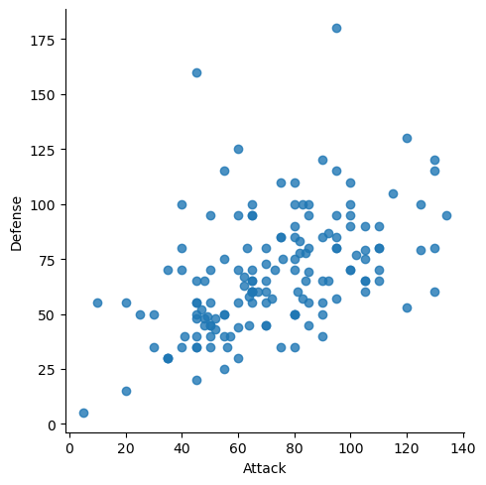
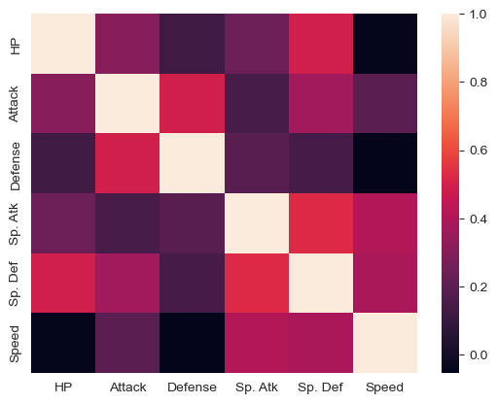
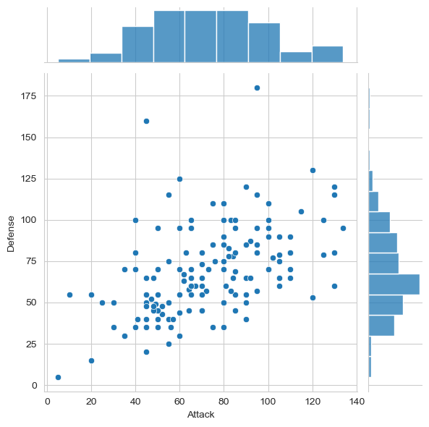
Univariate
We spent most of last term looking at ways of characterising the distribution of a single variable; i.e. distribution of Pokemon attack power.
This is known as univariate analysis because we are working with one variable.
However, in the last session, we produced the following graphs:

Slide 9
Bivariate
The graphs on the left and the right feature two variables being examined together.
This is known as bivariate analysis as we are examining two variables and their potential relationship.
The middle graph is an example of multi-variate analysis as it feature more than two variables.

Slide 10
The relationship between variables
You might want to know:
- To what extent the change in a patient’s blood pressure is linked to the dosage level of a drug they’ve been given.
- To what degree the number of plant species in an ecosystem is related to the number of animal species.
- Whether a national craze of playing with a yo-yo is linked to a drought.

Slide 11
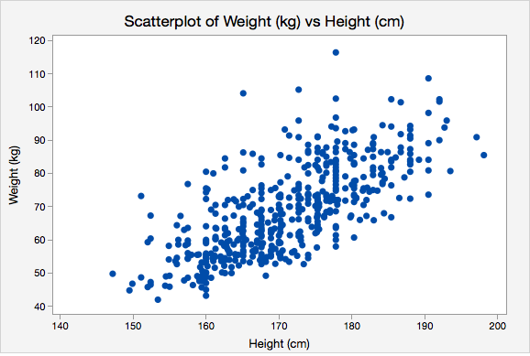
We assume that for each case, we have at least two real-valued variables; i.e. both height (cm) and weight (kg) recorded for a group of people.
The standard way of displaying this is by the use of scatterplots.

Slide 12
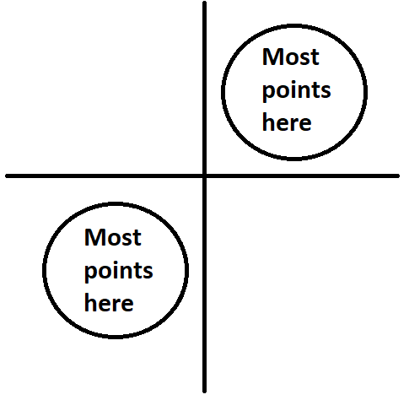
The basic story
A positive relationship

Slide 13
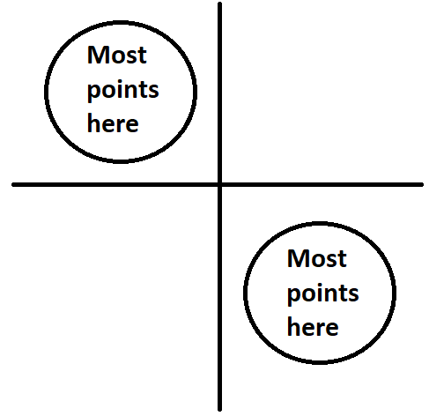
A negative relationship

Slide 14

No relationship
Points everywhere

Slide 15
Exercise 1
Q1.1: Open Spyder IDE.
Q1.2: Download the the UK_terrorism_GDP_dataset.csv from the session 12 sub-section of the module’s ELE page.
Q1.3: Create a scatterplot of the two variables in the dataset. What do you see? What kind of relationship exists between the two variables.

Slide 16
Measuring relationships?
It would be useful to have a quantitative measure of the extent to which one variable changes when another one does.
Another way of putting it: “when we know the value of variable A, how much information do we have about the value of variable B?”

Slide 17
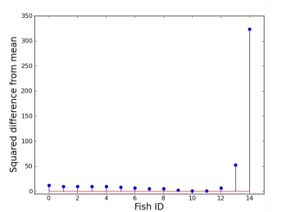
Recap of the one-variable case
Perhaps we can borrow some ideas about the way we characterised variation in the single-variable case
With one variable, we start out calculating the mean, which is also the expectation of the distribution.
Then find the sum of all the squared deviations from the mean.
This gives us a measure of the total variation; which will be higher for bigger samples.

Slide 18
The variance
We divide this total by the sample size, N. - or N-1 if we are using our sample to estimate the value for a wider population.
To get the variance.
The variance is a good measure of how much variation exists in the sample; normalised by sample size.
It has the nice property of being additive.
The only problem is that the variance is a measure in units squared. We therefore take the square root to get…

Slide 19
The standard deviation
This is another measure of the ‘average spread’ of the distribution.
It is now a measured in the original units.
The sample standard deviation (division by N-1) is a good estimate for the population standard deviation.
With a good estimate of the population SD, we can reason about the standard deviation of the distribution of the sample means.
That’s a number that gets smaller as the sample sizes get bigger.
To calculate this from the sample standard deviation, we divide through by the square root of sample size, N, to get…

Slide 20
The standard error
This measures the precision of our estimation of the true population mean.
Plus or minus 1.96 standard errors from the sample mean should capture the true population mean 95% of the time.
The standard error is itself the standard deviation of the distribution of the sample means.

Slide 21
Variation in one variable
So, these four measures all describe aspects of the variation in a single variable: - Sum of squared deviations
- Variance
- Standard deviation
- Standard error
Can we adapt them for thinking about the way in which two variables might vary together?

Slide 22
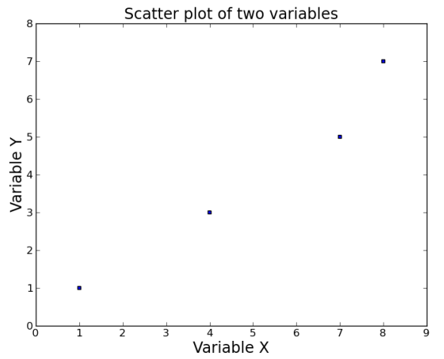
Two variable example
Consider a small sample of four records with two variables recorded, X and Y.
Let’s work with the following values:
(1,1), (4,3), (7,5), (8,7)
X and Y could be anything.
Let’s say X is hours spent fishing and Y is number of fish caught.

Slide 23
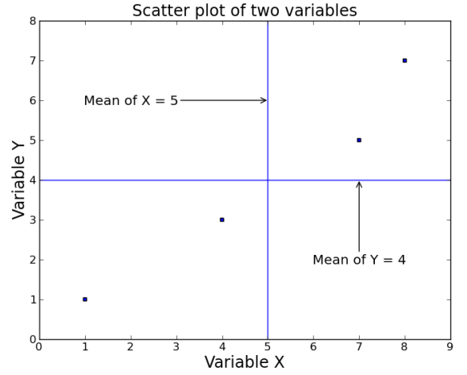
We can see if there’s a positive relationship, but how should we quantify it?
We can start by calculating the mean for each variable: - Mean of X = 5. - Mean of Y = 4.

Slide 24
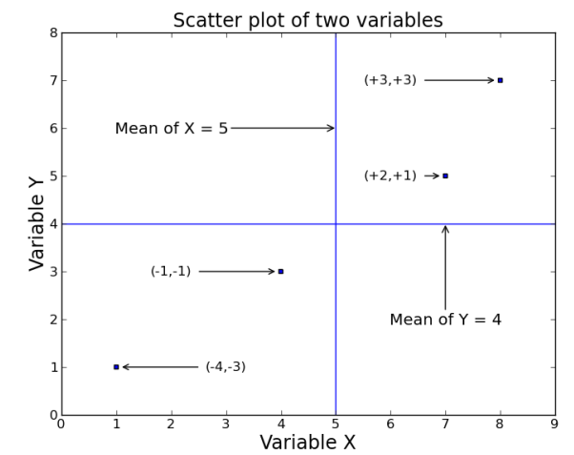
In the one-variable case, the next step would be to find the deviations from the mean and then square them.
However, in the two-variable case, we first need to connect the variables.
We do this my multiplying each X-deviation by its associated Y-deviation and taking the sum of those values.

Slide 25
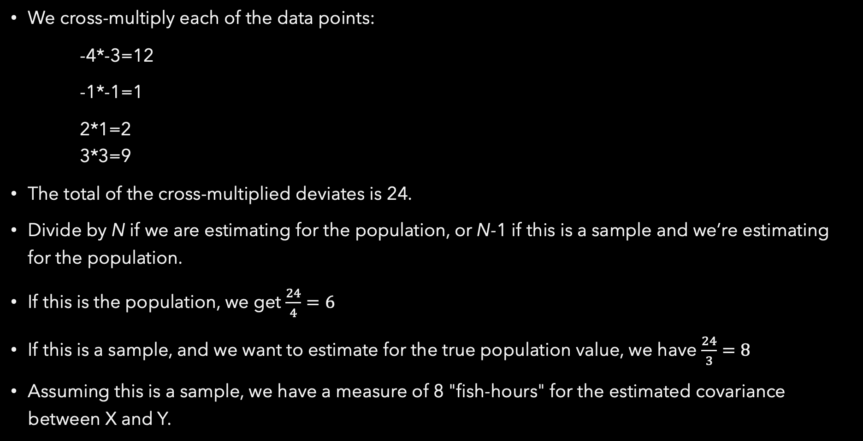
Calculating covariance
We cross-multiply each of the data points:
-4*-3=12
-1*-1=1
2*1=2 3*3=9
The total of the cross-multiplied deviates is 24.
Divide by N if we are estimating for the population, or N-1 if this is a sample and we’re estimating for the population.
If this is the population, we get $\frac{24}{4}=6$
If this is a sample, and we want to estimate for the true population value, we have $\frac{24}{3}=8$
Assuming this is a sample, we have a measure of 8 "fish-hours" for the estimated covariance between X and Y.

Slide 26
Note that if lower values of X had gone with higher values of Y and vice-versa, we would have got a negative number.
If big values of X and Y were randomly scattered, covariance would be close to zero.
As a note on the relationship with variance, if we calculated the covariance of X with itself, we’d get the variance of X.

Slide 27
Interpreting covariance.
Covariance has some of the properties we want; positive, negative, and absent relationships can be recognised.
But ‘fish hours’ is difficult to interpret. Can we scale it in some way?
Well, the standard deviation of X is in hours, and the standard deviation of Y is in fish…

Slide 28
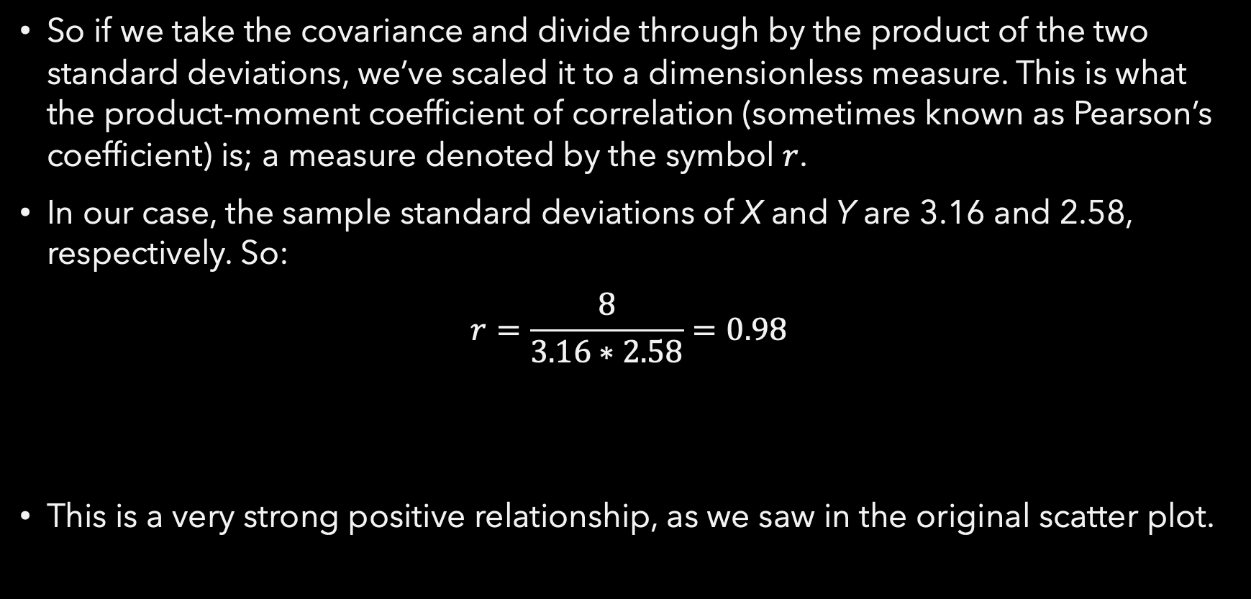

Correlation coefficient - $r$
So if we take the covariance and divide through by the product of the two standard deviations, we’ve scaled it to a dimensionless measure. This is what the product-moment coefficient of correlation (sometimes known as Pearson’s coefficient) is; a measure denoted by the symbol $r$.
In our case, the sample standard deviations of X and Y are 3.16 and 2.58, respectively. So:
$$r=\frac{8}{3.16∗2.58}=0.98$$
This is a very strong positive relationship, as we saw in the original scatter plot.

Slide 29

The formula has been devised to ensure that the value of $r$ will always lie in the in the range -1 to 1. For example:
$r$ = -1 means a perfect negative correlation
$r$ = 1 means a perfect positive correlation
$r$ = 0 means that there is zero correlation
$r$ = -0.84 means a strong negative correlation
$r$ = 0.15 means a weak positive correlation
And so on…
Notes:
1. Again, the maths behind how to calculate the correlation coefficient is beyond the scope of this course, and at any rate, all statistical calculators and data analytics software will have in-built functions that calculate it for you. It is therefore more important to understand what the correlation coefficient is and how to read the output of the calcualtion

Slide 30
0.0 - 0.3: Weak relationship; may be an artefact of the data set and in fact there is no relationship at all.
0.3 - 0.6: Moderate relationship; you might be on to something, or you might not.
0.6 - 0.9: Strong relationship; you can be confident that these two variables are connected in some way.
0.9 - 1.0: Very strong relationship; variables are almost measuring the same thing.

Slide 31

In other words…
The strength of a correlation will be indicated by how far from zero the value of $r$ lies; with whether it is a positive or negative value indicating whether is it a positive or negative relationship.

Slide 32
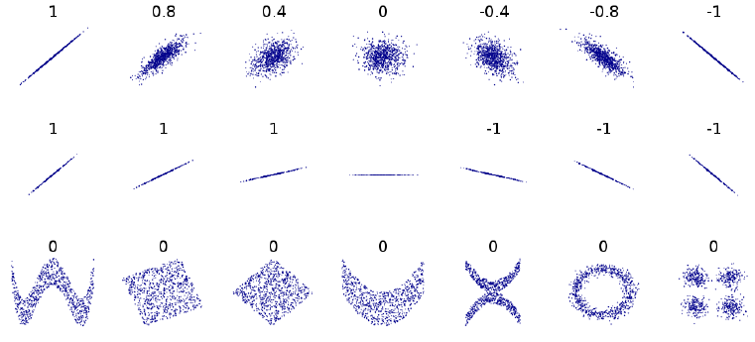

Important things to remember
In general, the smaller the batch size, the larger the value of $r$ has to be in order to provide evidence of significant correlation.
$r$ only measures linear relationships:

Slide 33
Correlation is NOT causation!
- Just because X and Y are correlated does not mean that X causes Y.
- They could both be cause by some other factor, Z.
- Or Y may cause X.
It is also important to remember that low correlations may be the result of sampling noise, with no causal linkage being present.

Slide 34
Range effects
Two variables can be strongly related across the whole of their range, but with no strong relationship in a limited subset of that range.
For example, consider the relationship between price and top speed in cars; a broadly positive relationship. However, if we only look at expensive cars, the two values may be uncorrelated.

Slide 35
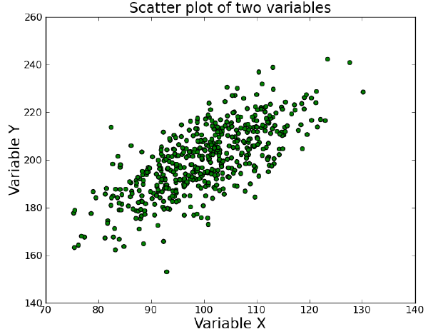
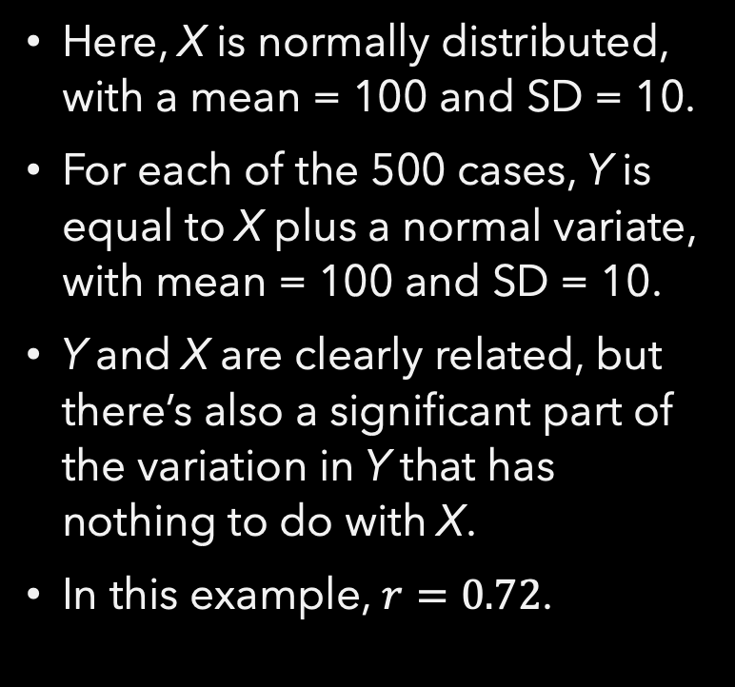
An example
Here, X is normally distributed, with a mean = 100 and SD = 10.
For each of the 500 cases, Y is equal to X plus a normal variate, with mean = 100 and SD = 10.
Y and X are clearly related, but there’s also a significant part of the variation in Y that has nothing to do with X.
In this example, $r=0.72$.

Slide 36
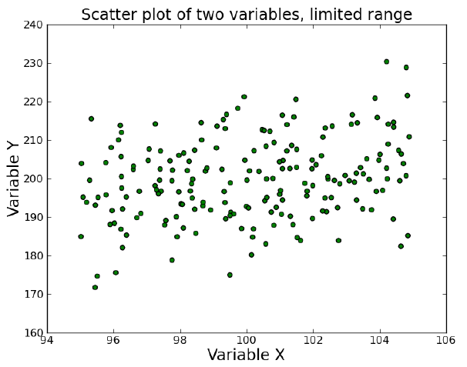
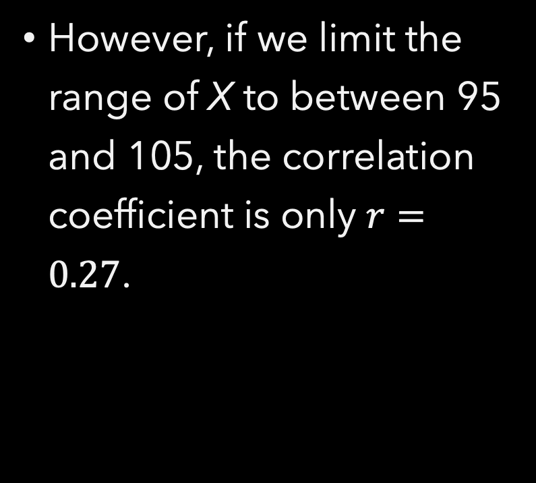
However, if we limit the range of X to between 95 and 105, the correlation coefficient is only $r=0.27$.

Slide 37
Information about Y from X
If I know the correlation between two things, what does knowing one thing tell me about the value of the other?
Consider the X, Y example. X was a random variable and Y was equal to X plus another random variable from the same distribution.
The correlation worked out at about 0.7. Why?

Slide 38
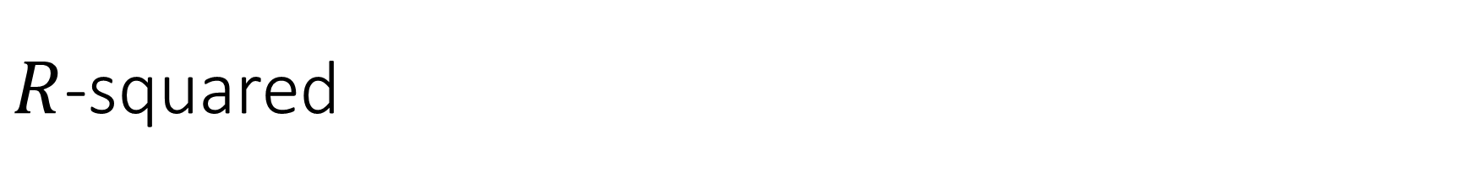
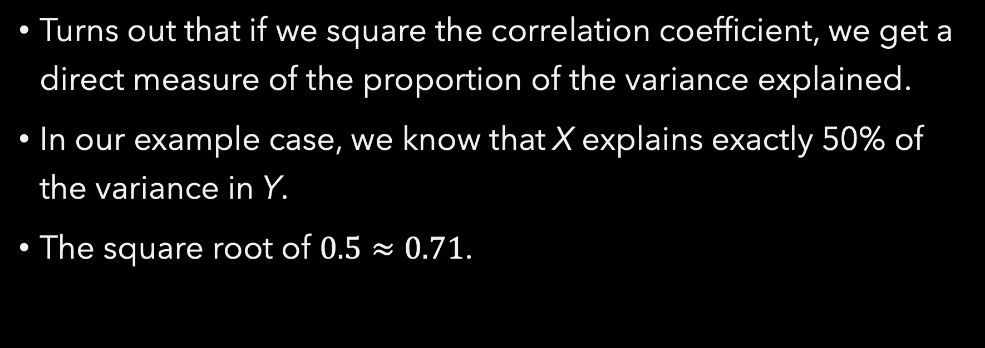
$R$-squared
Turns out that if we square the correlation coefficient, we get a direct measure of the proportion of the variance explained.
In our example case, we know that X explains exactly 50% of the variance in Y.
The square root of $0.5≈0.71$.

Slide 39
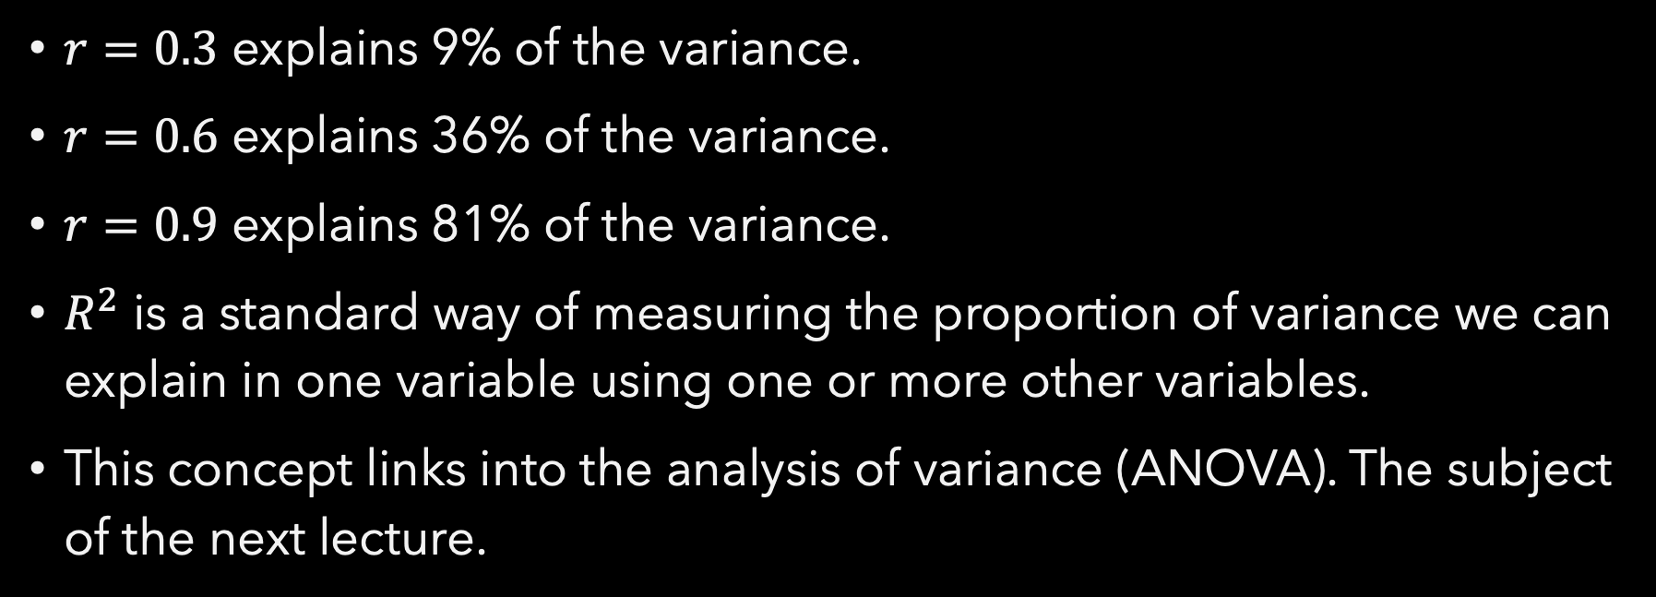
$r=0.3$ explains 9% of the variance.
$r=0.6$ explains 36% of the variance.
$r=0.9$ explains 81% of the variance.
$R^{2}$ is a standard way of measuring the proportion of variance we can explain in one variable using one or more other variables.
This concept links into the analysis of variance (ANOVA). The subject of the next lecture.

Slide 40
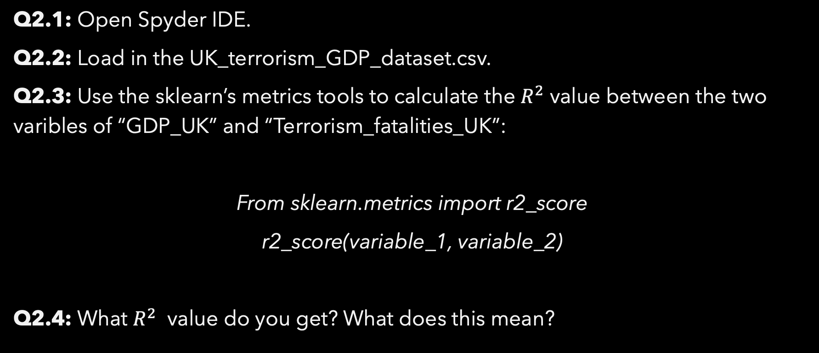
Exercise 2
Q2.1: Open Spyder IDE.
Q2.2: Load in the UK_terrorism_GDP_dataset.csv.
Q2.3: Use the sklearn’s metrics tools to calculate the $R^{2}$ value between the two varibles of “GDP_UK” and “Terrorism_fatalities_UK”:
From sklearn.metrics import r2_score
r2_score(variable_1, variable_2)
Q2.4: What $R^{2}$ value do you get? What does this mean?

Slide 41
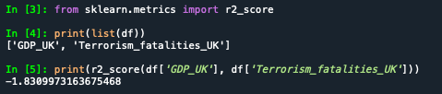
Sklearn is a module with many great tools for data analysis and machine learning, and is a module you’ll use a lot as you advance through your course.

Slide 42
End of Session 12

