Slide 1

HONOURS THESIS PRESENTATION
Multi-Page Visually Rich Document Understanding
A Survey of System Design and an Empirical Attribution of Failure
Lewei Xu
Supervisors: Dr Yihao Ding · Dr Daochang Liu
Department of Computer Science and Software Engineering
School of Physics, Mathematics and Computing · October 2026
Notes:
Hello everyone, my name is Lewei, and my thesis looks at multi-page document understanding.

Slide 2
Thesis Overview
Chapter 1 · Introduction
Four chapters, three research questions, two papers.
CHAPTER | QUESTION | PUBLICATION
1 Introduction & Background | Why are long documents hard, and why a fixed compute budget? | Thesis chapter
2 Survey | RQ1 How are multi-page systems designed? | Managing Evidence at Document Scale: A Survey of MP-VRDU EMNLP 2026, Main Conference
3 Empirical study | RQ2 Where and why do these systems fail? | Locating Failure in MP-VRDU: An Empirical Attribution Submitted to NAACL
4 Method & Conclusion | RQ3 Can the findings build a competitive system under a fixed budget? | Thesis chapter: training-free proof of concept
Notes:
The thesis has four chapters. Chapter 2 is our survey, accepted at the EMNLP 2026 main conference. Chapter 3 is our empirical study, currently under review. Chapter 4 turns the findings into a simple working system.

Slide 3
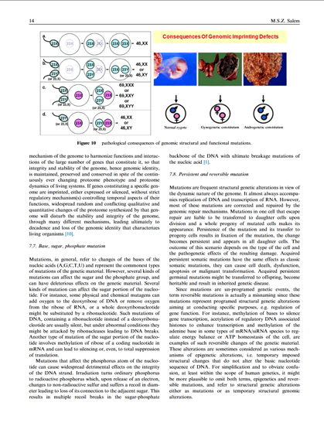
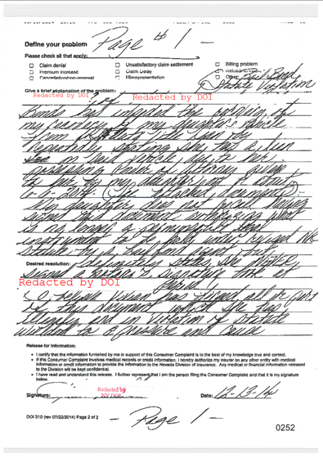
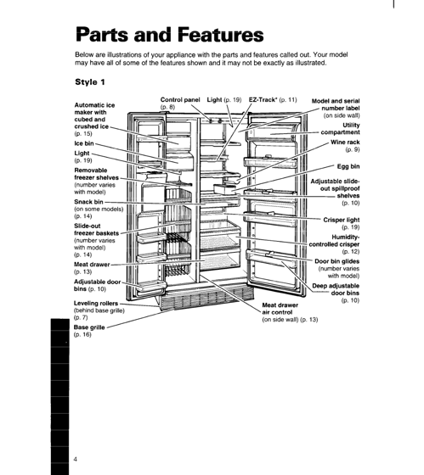
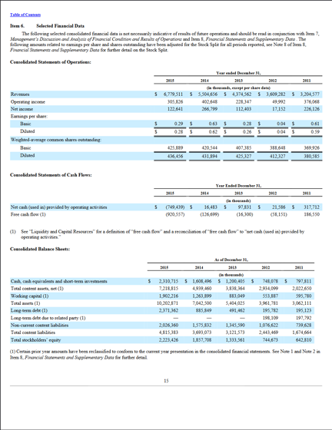
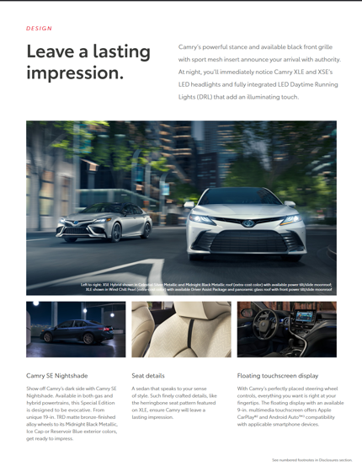
Multi-Page Visually Rich Documents
Chapter 1 · Introduction
Meaning lives in text, visuals and layout, and often runs across pages.
Research paper
Signed form, handwritten
Technical manual
Financial report
Brochure
Long
Exceeds the model’s context window
Sparse
Evidence is buried among many pages
Structured
Links cross pages: “see Table 3”
Notes:
Documents carry meaning through text, visual content and layout. Multi-page documents add another layer: one answer may need a figure, a table and a passage several pages apart.

Slide 4
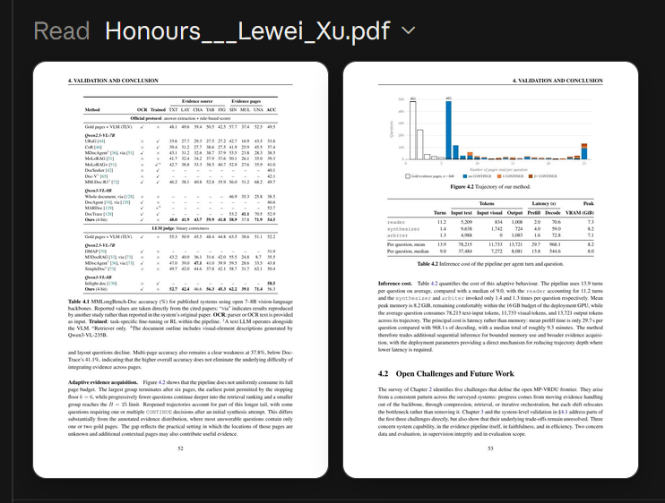
Why a Fixed Compute Budget?
Chapter 1 · Introduction
Real deployments need local, open-weight models under a fixed compute budget.
IN INDUSTRY
Privacy: medical, legal and financial records stay in-house
Cost: API fees become prohibitive at millions of documents
Specialisation: domain documents need an adapted model
Which pages to read, at what resolution, and how many times?
LLM assistants plan, locate and inspect pages before answering.
Notes:
Consumer assistants like Claude can read my 100-page thesis by planning, locating and inspecting pages. In industry, privacy, cost and specialisation push organisations to run open-weight models locally, so accuracy and efficiency both matter.

Slide 5
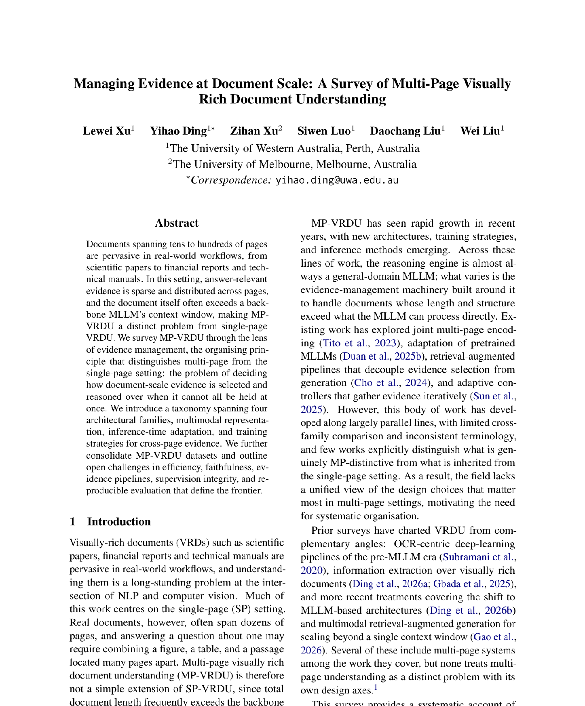

Survey: Managing Evidence at Document Scale
Chapter 2 · Survey · EMNLP 2026 Main
First-Authored and Accepted at the EMNLP 2026 Main Conference, Budapest.
RESEARCH GAP
Multi-page systems grew along parallel lines, with inconsistent terminology and little cross-family comparison.
CONTRIBUTIONS
The first survey to treat MP-VRDU as a distinct problem
A taxonomy of 46 systems, organised by evidence management
47 datasets consolidated; five open challenges
Notes:
The first part of the thesis is our survey, accepted at the EMNLP 2026 main conference. Multi-page systems grew along parallel lines with inconsistent terminology. We bring them together through evidence management.

Slide 6
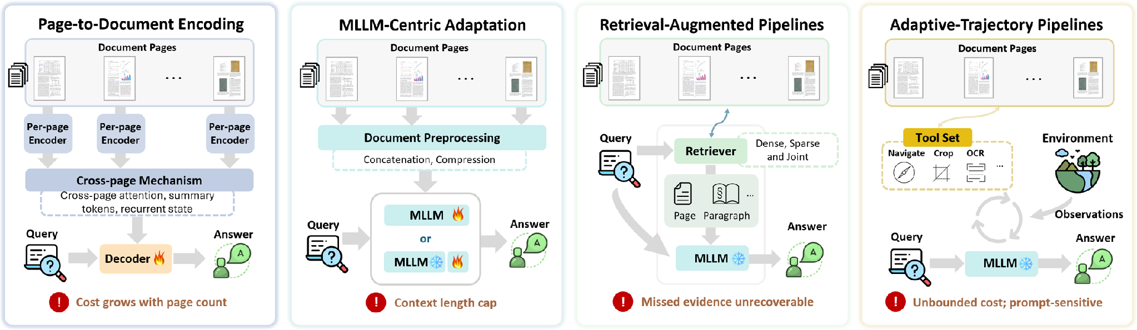
Four Architectural Families
Chapter 2 · Survey · EMNLP 2026 Main
Each family fixes the previous bottleneck and relocates it rather than removing it.
e.g. Hi-VT5, GRAM
e.g. DocSLM, Docopilot
e.g. M3DocRAG, MoLoRAG
e.g. SimpleDoc, DocAgent
Models: trained end to end, purpose-built components
Pipelines: modular, interchangeable backbones
Notes:
Page-to-document encoding models encode each page and connect them; cost grows with page count. MLLM-centric models feed all pages into a pretrained model; they are capped by the context window. Retrieval-augmented pipelines retrieve first; missed evidence cannot be recovered. Adaptive-trajectory pipelines let a controller choose each step; cost is hard to bound.

Slide 7
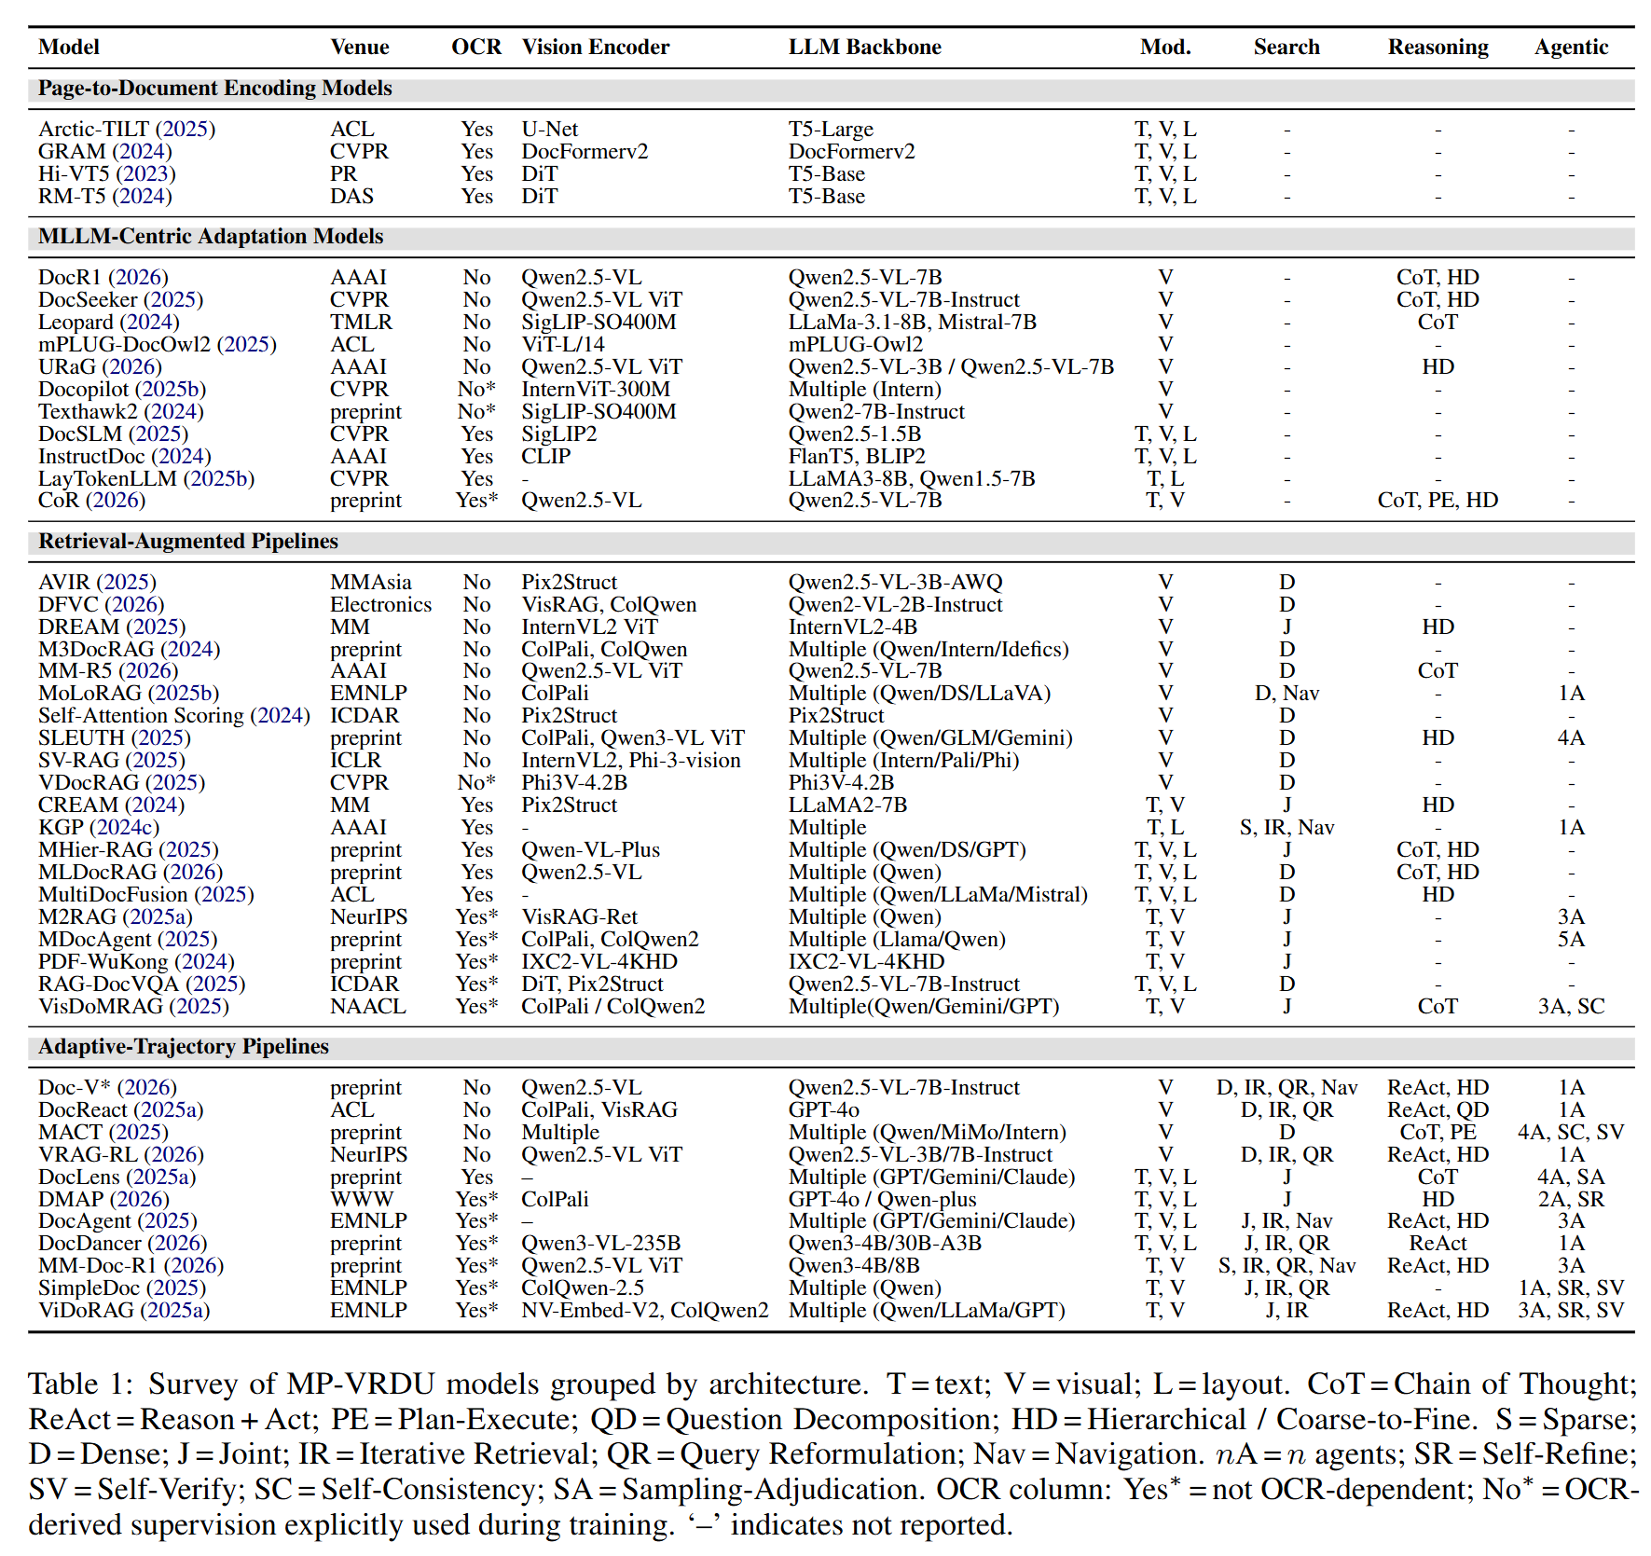
Surveyed Systems at a Glance
Chapter 2 · Survey · EMNLP 2026 Main
The survey’s main table: every system, grouped by family.
Models vs pipelines
Pipelines are tested with several interchangeable backbones.
Modalities
Encoding models use text, vision and layout; MLLM-centric models are mostly vision only.
Search
Appears only once retrieval is separated from answering.
Notes:
This is the main table of the survey. Three things are worth noticing: pipelines are tested with several backbones, encoding models use text, vision and layout while MLLM-centric models are mostly vision only, and search only appears once retrieval is separated from answering.

Slide 8
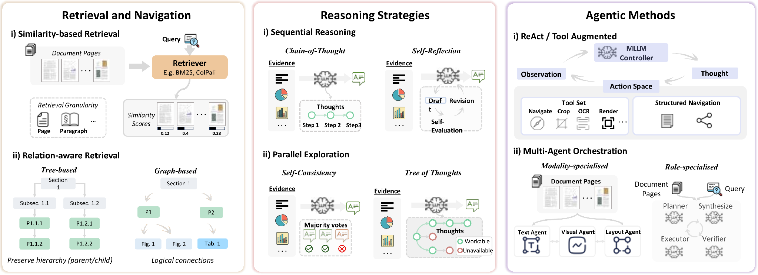
Inference-Time Strategies
Chapter 2 · Survey · EMNLP 2026 Main
Reshape the pipeline around a frozen MLLM: select, reason over, or acquire evidence.
Relation-aware retrieval finds links similarity misses
A chain cannot recover what retrieval missed
Lifts the recall ceiling; cost is hard to bound
Notes:
Inference-time strategies keep the backbone frozen. Retrieval selects evidence, reasoning strategies work over what was assembled, and agentic methods acquire more evidence during inference.

Slide 9
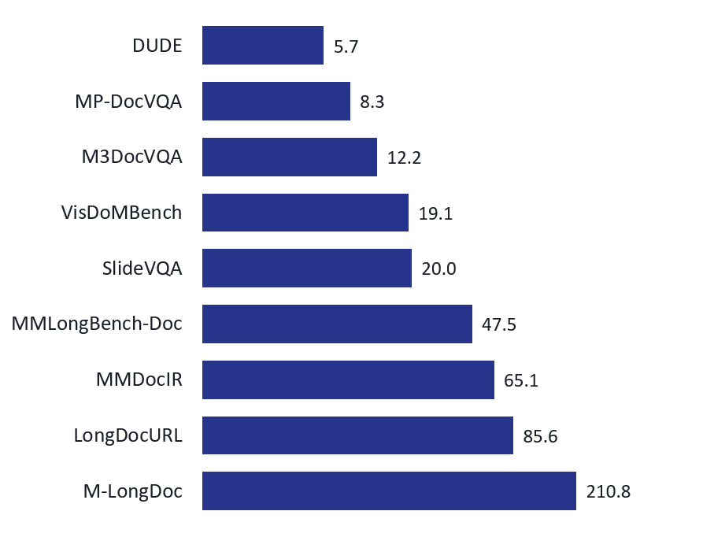
Training Strategies & Datasets
Chapter 2 · Survey · EMNLP 2026 Main
Pretraining is rare; fine-tuning carries the weight, with RL layered on top.
TRAINING
BENCHMARKS: AVERAGE PAGES PER DOCUMENT
Retrieval: alignment, cross-page fusion, logical relevance
Reasoning: trace imitation, then reward-driven GRPO
Agentic: trajectory distillation, then RL
Cross-cutting: PEFT / LoRA, single- to multi-page curricula
Fine-tuning data is mostly LVLM-synthesised; 16 of 19 papers that fine-tune on MP-DocVQA also evaluate on it.
Notes:
Training internalises the inference-time decisions. Retrievers learn alignment, cross-page fusion or logical relevance; reasoners move from trace imitation to GRPO; agents from distillation to RL. Benchmarks keep getting longer.

Slide 10
Open Challenges
Chapter 2 · Survey · EMNLP 2026 Main
Each design relocates the bottleneck rather than removing it.
Evidence pipeline
High-resolution reading vs document-scale aggregation
Faithfulness
Few systems abstain or ground answers in evidence
Efficiency
Latency and token cost are rarely reported
Contamination
Training and test sets share source PDFs
Evaluation
Answer-only scores, mostly English VQA
Missing: an end-to-end account of where systems fail → Chapter 3
Notes:
Five challenges remain. The last one leads to the second paper: nobody had located, end to end, where these systems actually fail.

Slide 11
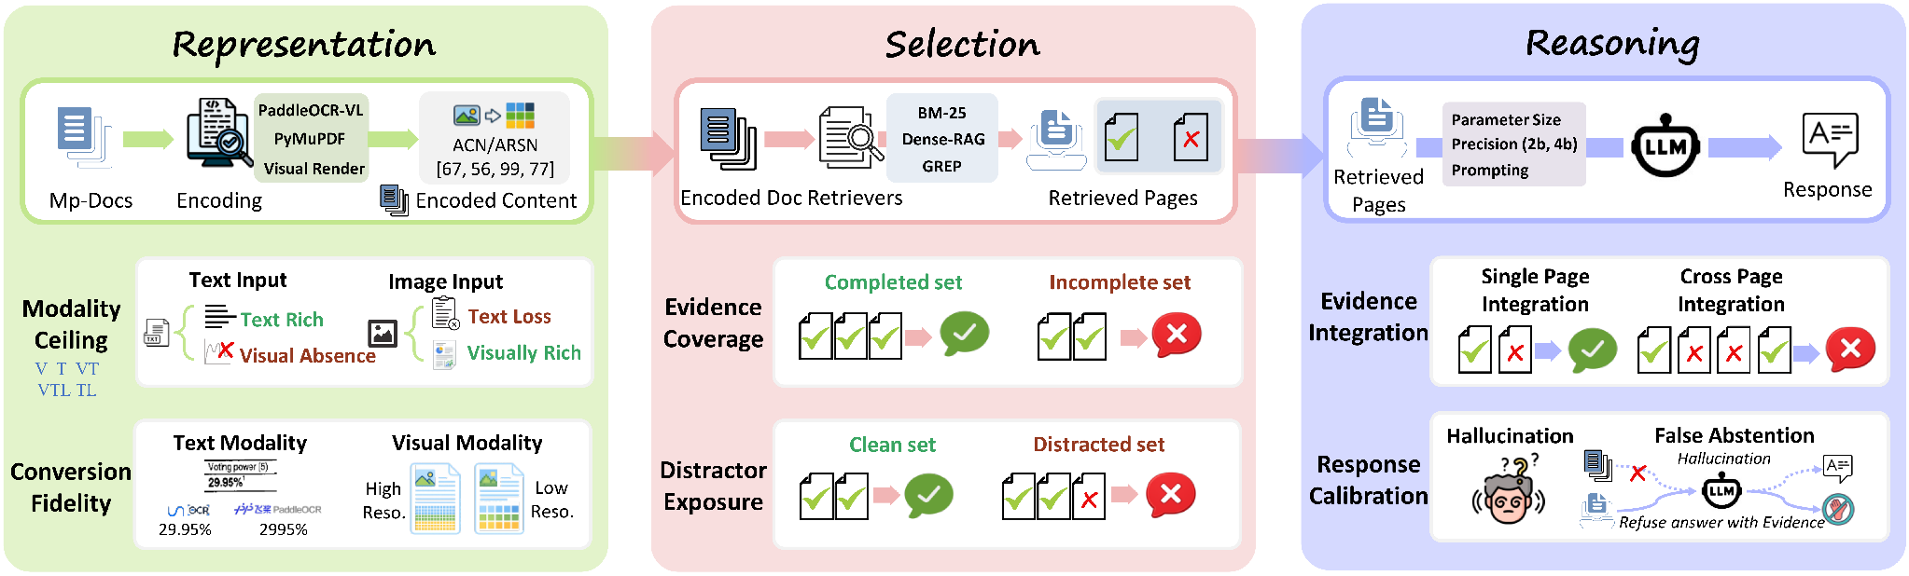
Empirical Study: Locating Failure in MP-VRDU
Chapter 3 · Empirical study · Under review
Under review. Failures at different stages produce the same wrong answer.
RESEARCH GAP
CONTRIBUTIONS
Prior studies show where accuracy drops, not why; design claims conflict.
Three architecture-independent failure loci
Controlled interventions: 2 datasets × multiple model families
Guidance for local deployment
Notes:
The second paper is under review. Prior work shows where accuracy drops but not why, and design claims conflict. We locate failure at three architecture-independent loci, each with two mechanisms.

Slide 12
Methodology: Attribution by Construction
Chapter 3 · Empirical study · Under review
Change one stage, hold the other two fixed.
Encode Representation
Retrieve Selection
Answer Reasoning
T · TL · TLV · V
3 parsers · 3 resolutions
Gold pages, or
drop one · add k distractors
Qwen3-VL 2B → 32B
4 prompt modes
T embedded text · TL parser text · V page image · TLV parser text + image (default)
DATA
MODELS
EVALUATION
MMLongBench-Doc: 135 documents with evidence pages, sources, answerability. LongDocURL: 396 born-digital documents.
Qwen3-VL (Alibaba) and Gemma-3 (Google), developed independently
Gemini-2.5-Flash judge: 98.3% agreement with a human annotator
Notes:
One deliberately simple pipeline: encode, retrieve, answer in one pass. Each experiment changes one stage. Gold pages let us take retrieval out of the picture.

Slide 13
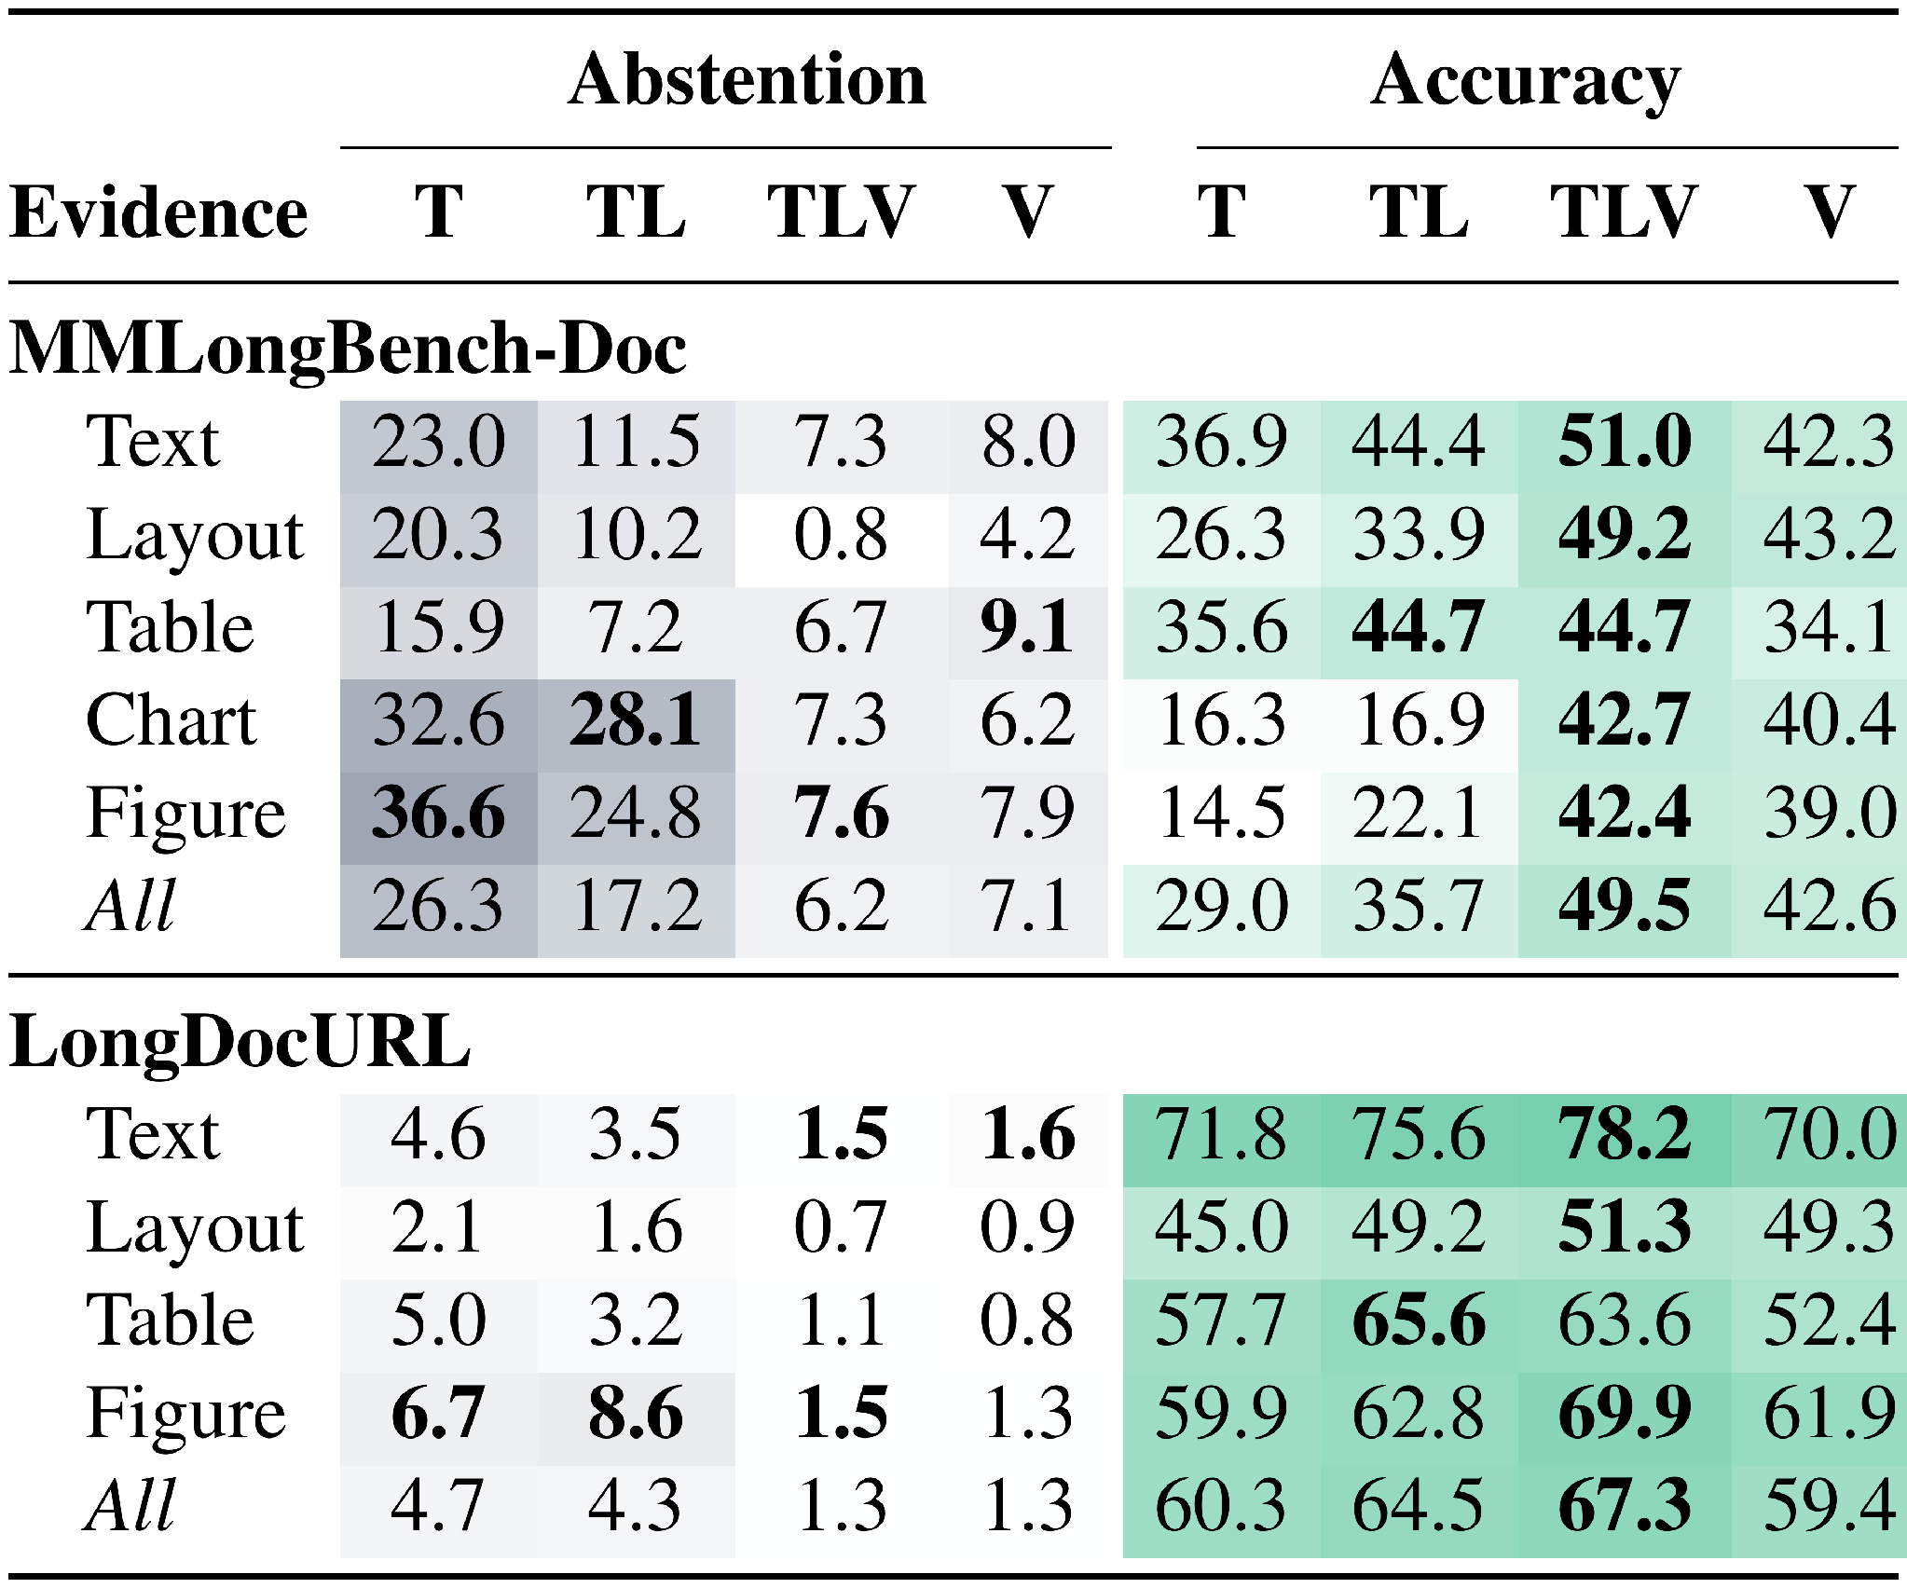
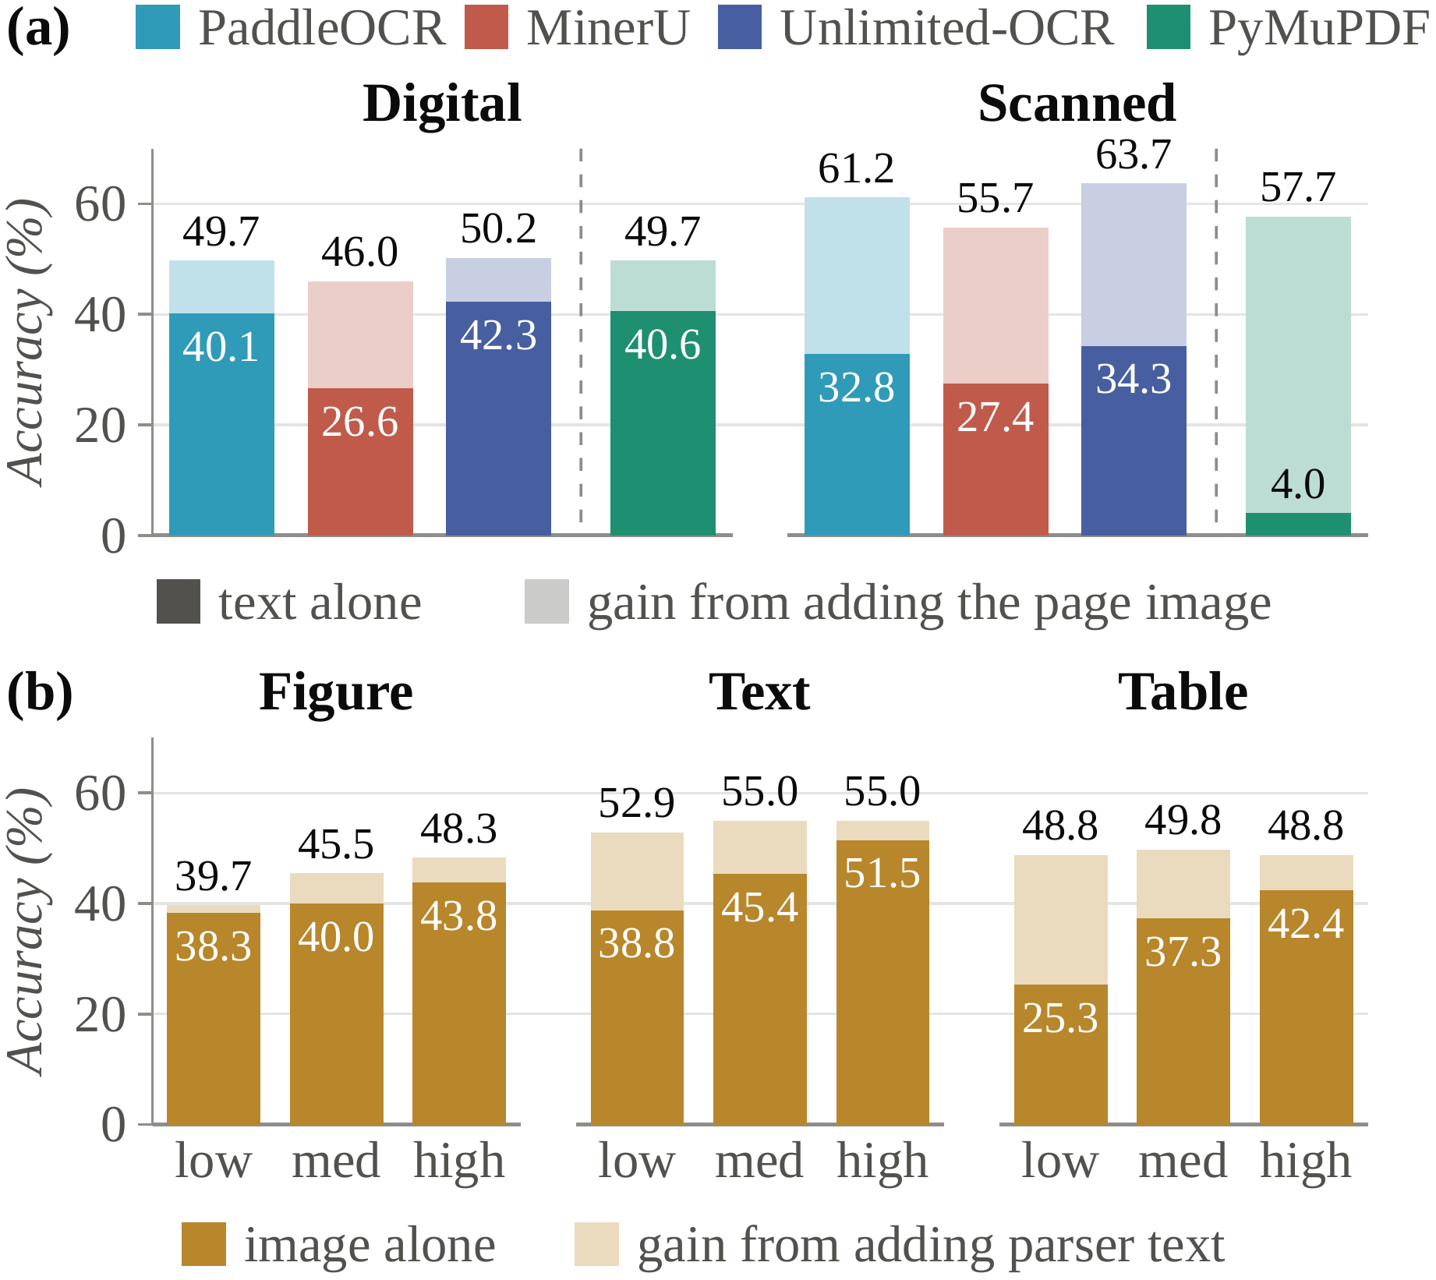
Finding 1 · Representation
Chapter 3 · Empirical study · Under review
Text and vision are complementary: neither alone is enough.
Conversion fidelity: accuracy by parser and resolution
Chart refusal: 32.6% → 7.3% with page images
Parser spread: 15.7 → 4.2 pts once the image is added
Modality ceiling: refusal and accuracy by evidence type
Notes:
Text-only input refuses chart and figure questions far more often. Adding page images brings refusal under 10 percent, but images alone trail text plus images, 42.6 against 49.5. Adding the image also makes accuracy much less sensitive to the parser.

Slide 14
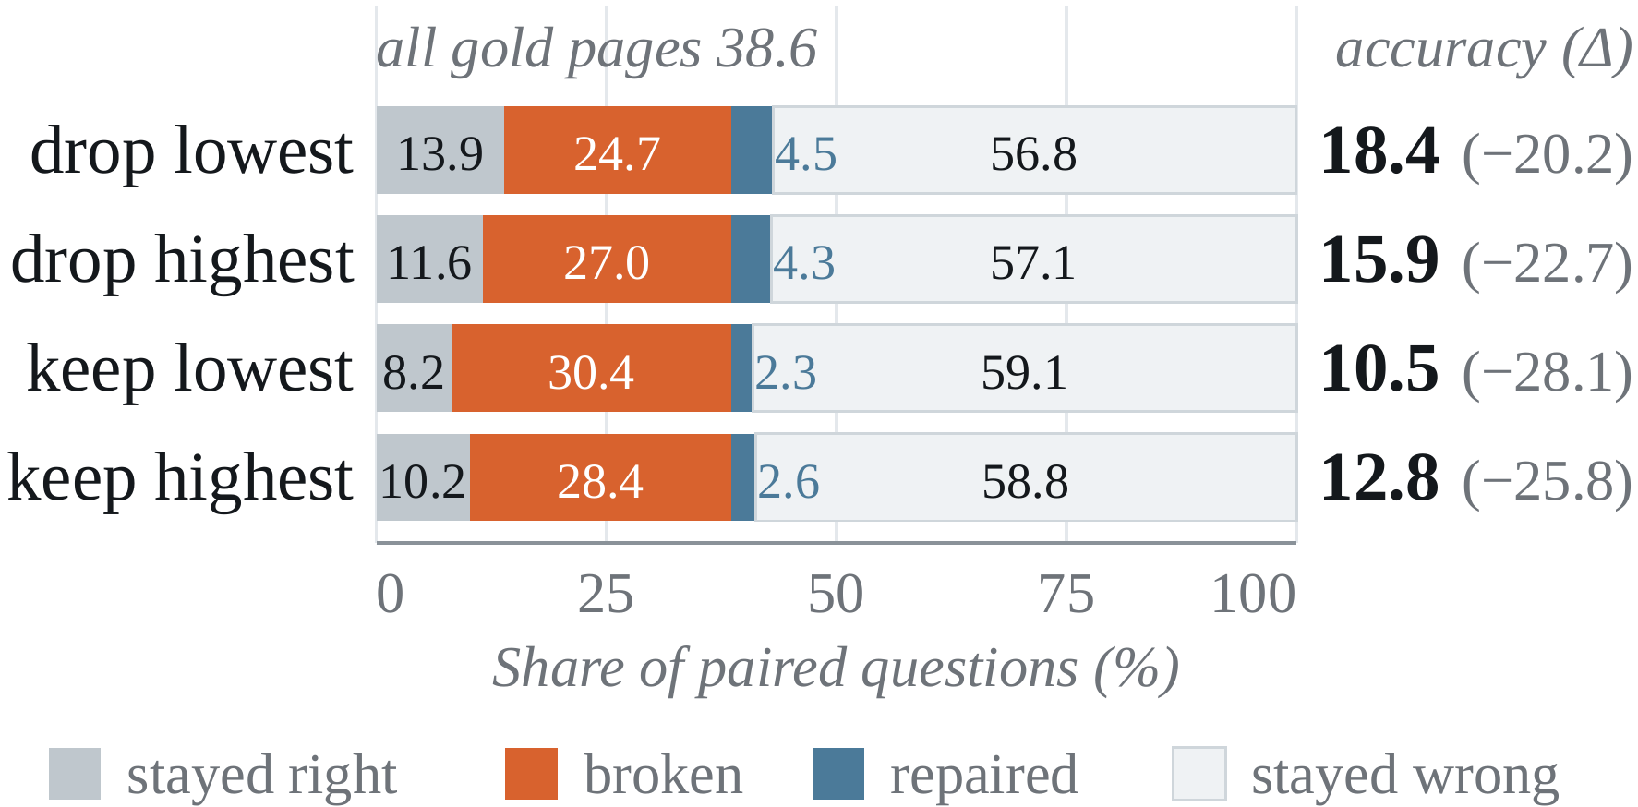
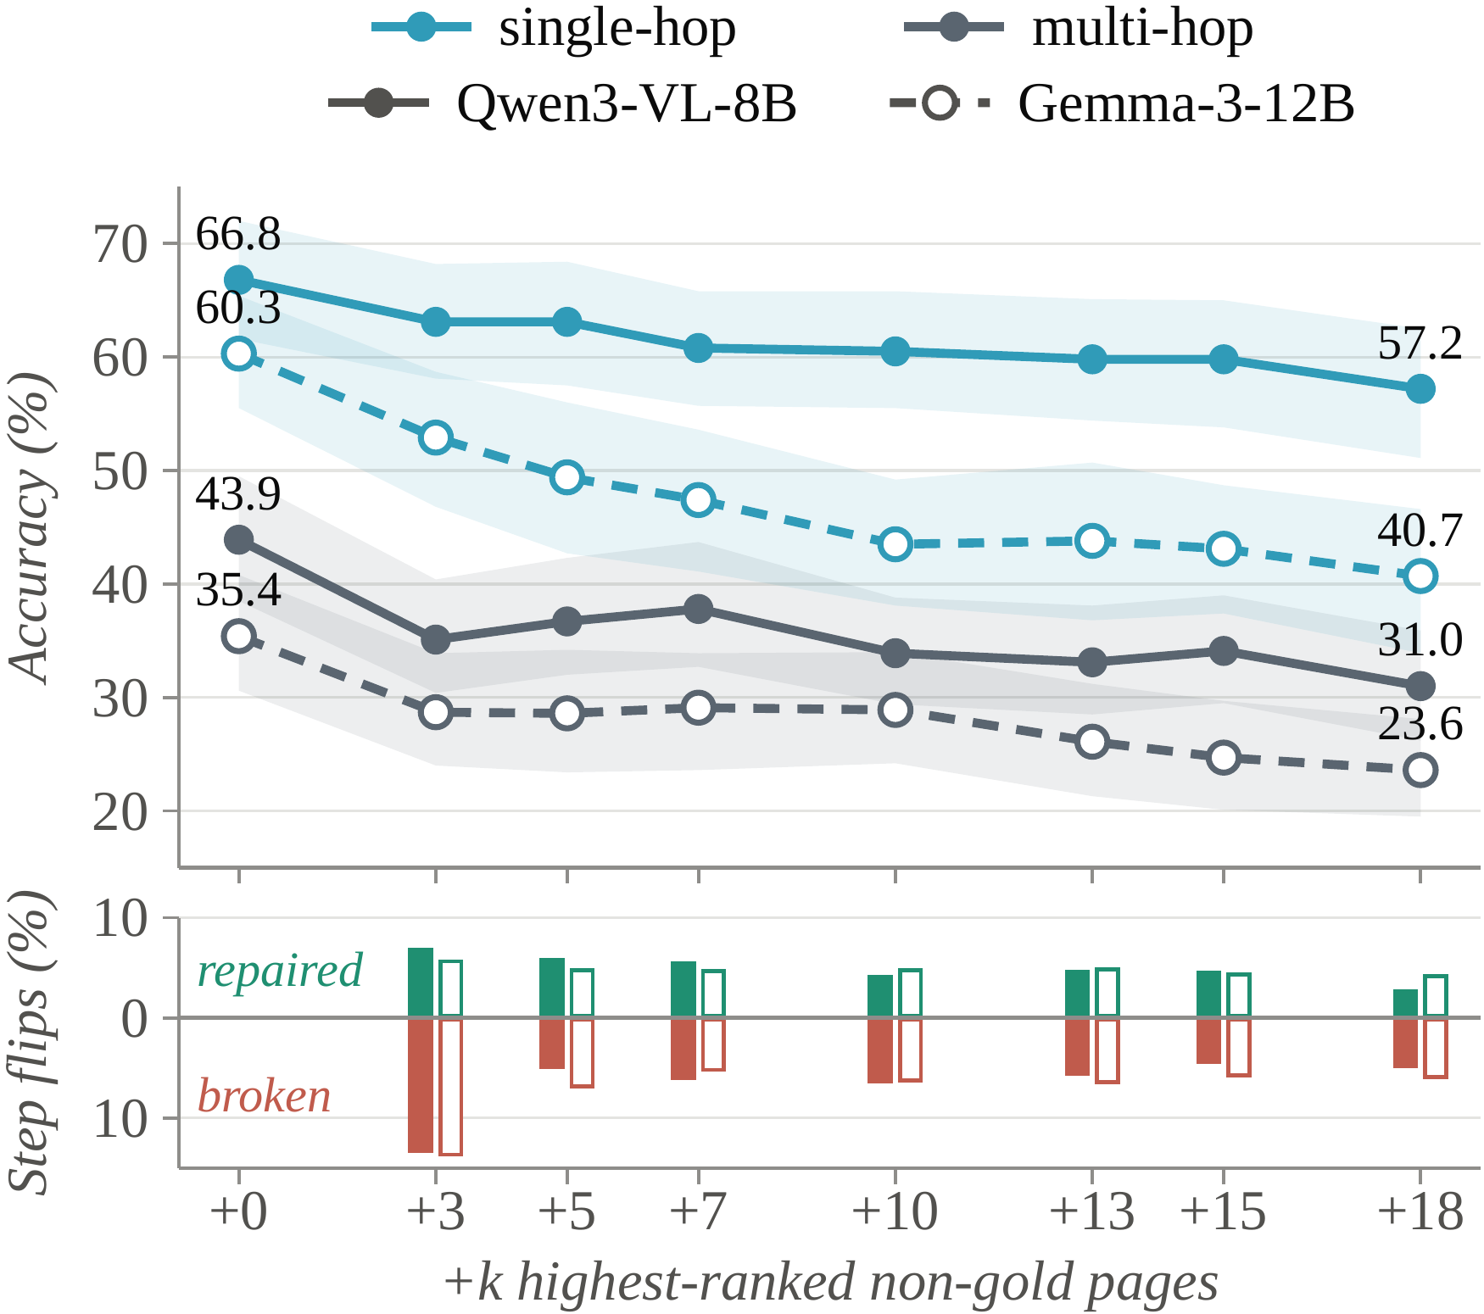
Finding 2 · Selection
Chapter 3 · Empirical study · Under review
Select evidence as a set, not page by page.
Evidence coverage: removing one gold page
All gold pages 38.6% → drop one 18.4%
Retrieval rank does not predict which page is safe to lose
Distractor exposure: +3 pages, multi-hop 43.9% → 35.1%
Notes:
Removing just one of the gold pages roughly halves accuracy, and the retriever rank does not tell us which page is safe to lose. Keeping every gold page but adding three distractors drops multi-hop accuracy from 43.9 to 35.1.

Slide 15
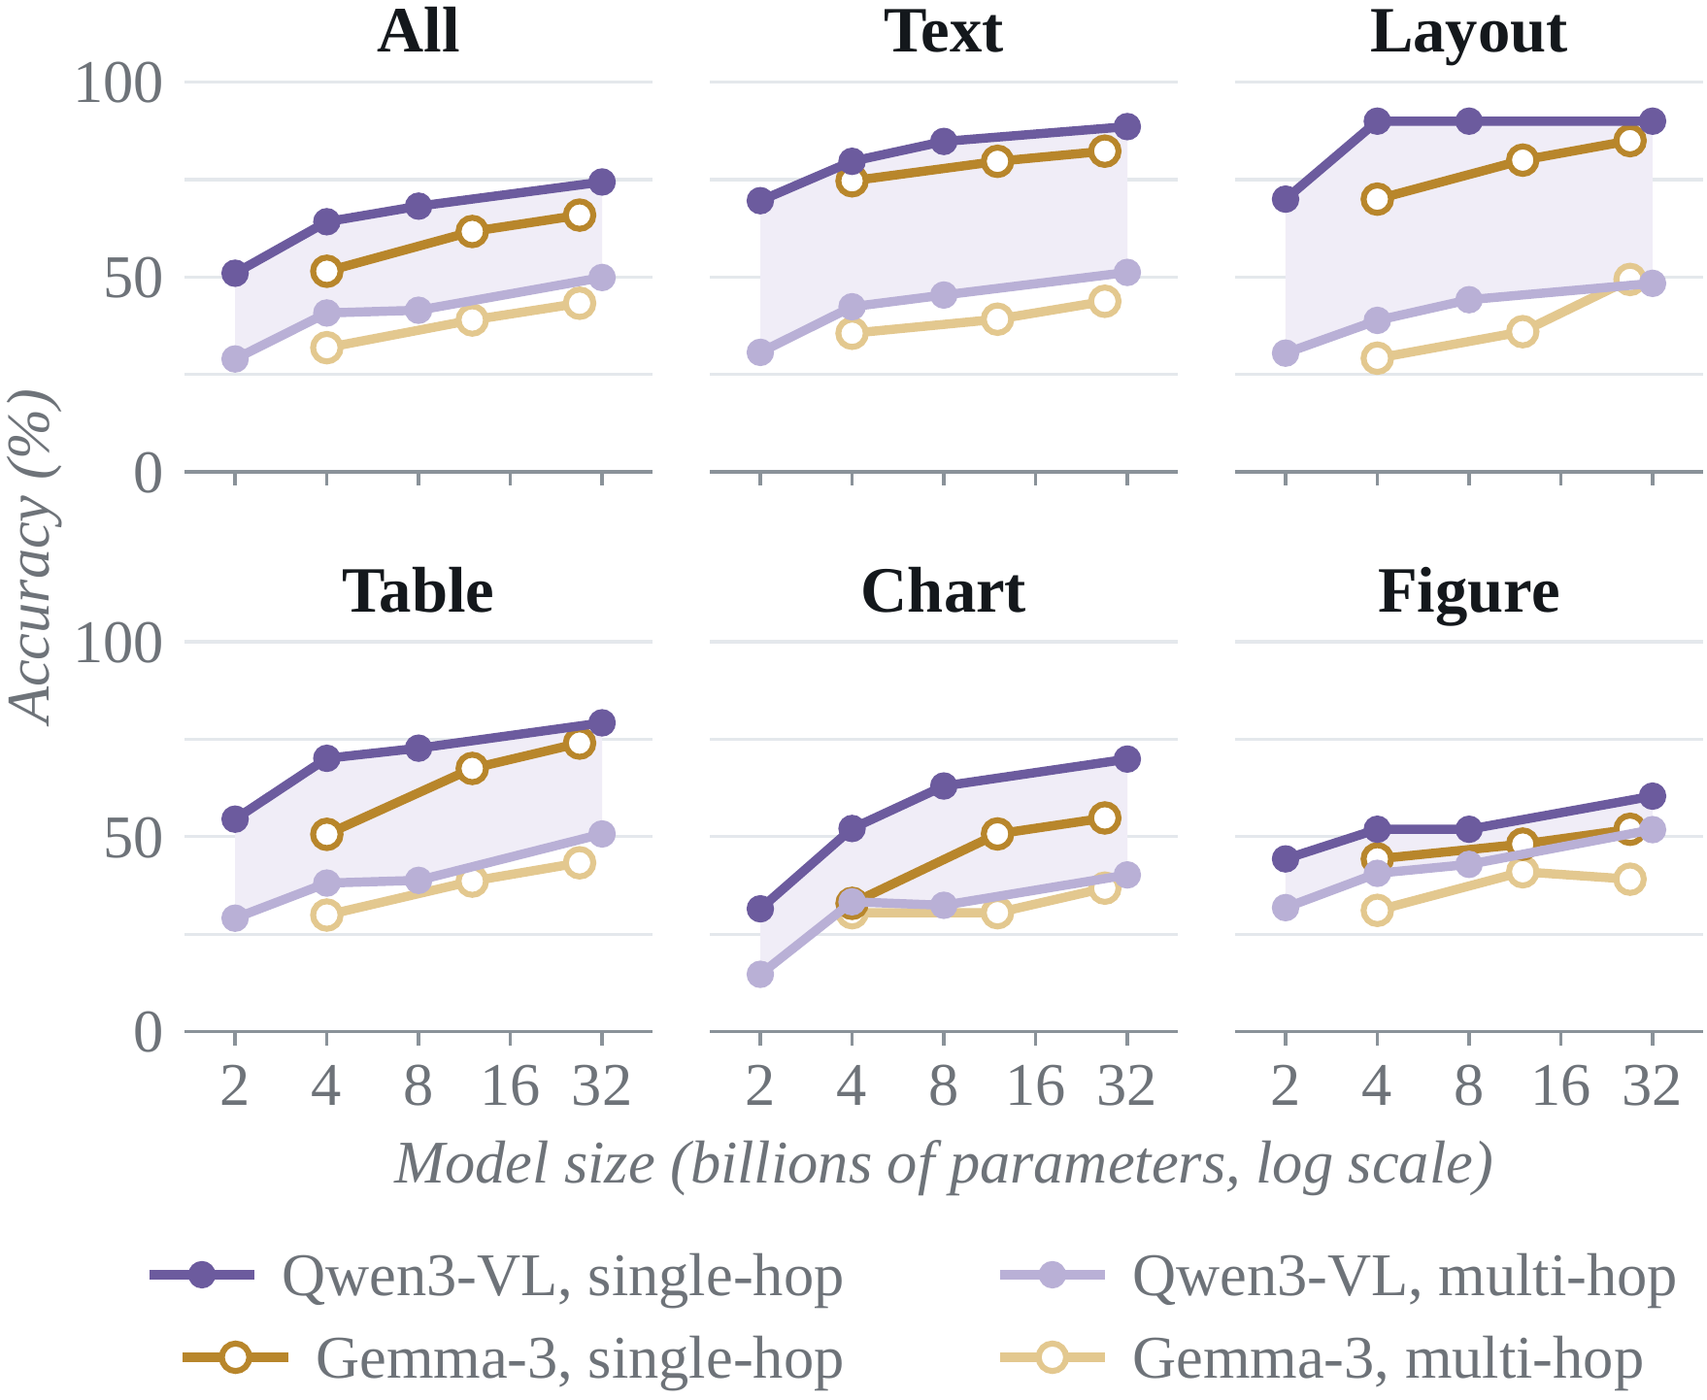
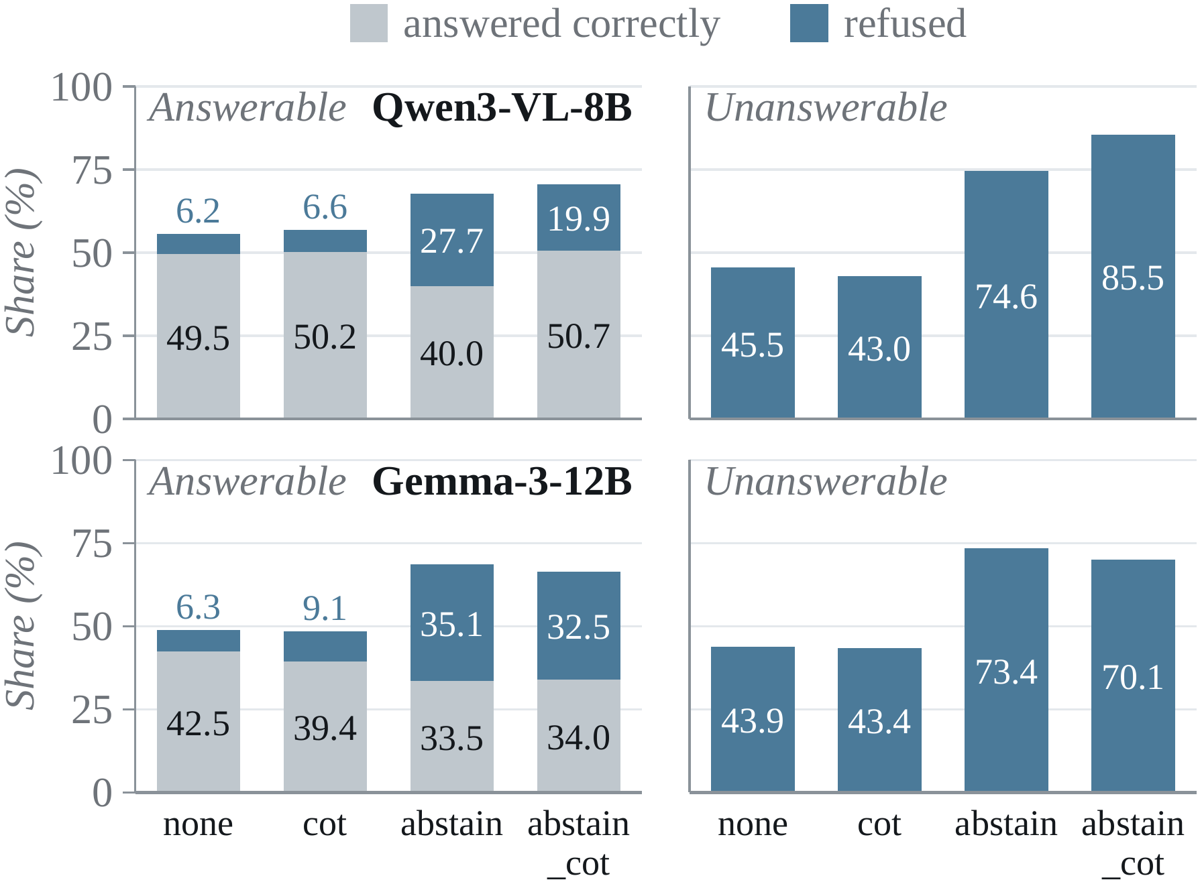
Finding 3 · Reasoning
Chapter 3 · Empirical study · Under review
Scale helps everything, but does not close the multi-hop gap.
Response calibration: abstain prompt, false refusal 6.2% → 27.7%
Evidence integration: multi-hop 29.0% → 49.9%, gap persists
Notes:
From 2B to 32B, multi-hop accuracy rises from 29 to almost 50 percent, but single-hop rises as much, so the gap stays. An abstain instruction raises correct refusal but also false refusal, from 6.2 to 27.7 percent; reasoning first recovers part of it.

Slide 16
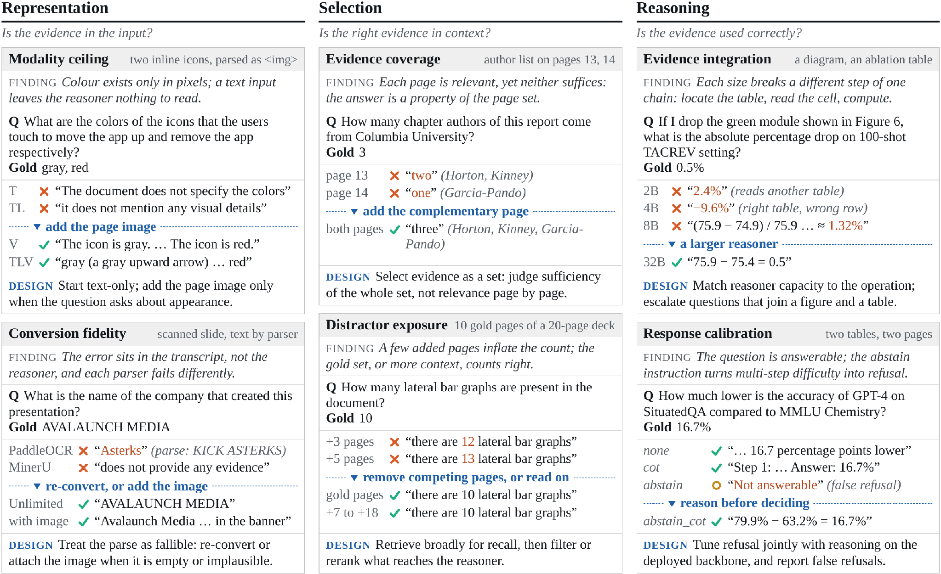
From Real Failures to Design
Chapter 3 · Empirical study · Under review
Six mechanisms on real questions, each with a design implication.
DESIGN
Representation
Add the page image when appearance matters or the text is unreliable
Selection
Retrieve broadly, then filter as a set
Reasoning
Reason before refusing; match model size to the task
Notes:
Each column shows real questions from MMLongBench-Doc: the finding, what the model answered, and the design implication. For example, colour exists only in pixels, an author list split over two pages needs both pages, and each model size breaks a different step of one reasoning chain.

Slide 17
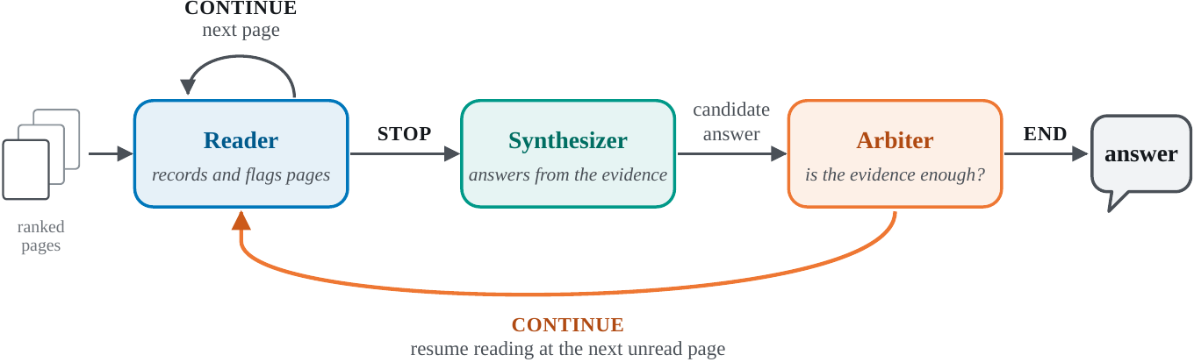
From Findings to a Simple Method
Chapter 4 · Method & conclusion
One model, three roles, each grounded in a finding.
Representation
Reader sees every page as text + image
Selection
Read broadly, pass on compact records
Reasoning
A separate arbiter judges sufficiency
Notes:
The reader goes through pages in ranked order, reading text and image together. The synthesizer answers from flagged pages and short records. The arbiter cannot answer; it accepts or sends the reader back for more pages.

Slide 18
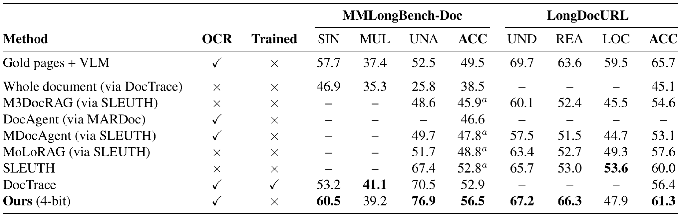
Simple Method: Results
Chapter 4 · Method & conclusion
Best among Qwen3-VL-8B systems, training-free and at 4-bit.
56.5% MMLongBench-Doc · 61.3% LongDocURL
Trade-off: ~10.8 min per question; multi-page still trails DocTrace (39.2 vs 41.1)
Notes:
All systems use the same 8B backbone. Ours reaches 56.5 on MMLongBench-Doc and 61.3 on LongDocURL without training. It still trails DocTrace on multi-page questions, and the cost is time: about eleven minutes per question in about eight gigabytes of memory.

Slide 19
Conclusion
Chapter 4 · Method & conclusion
RQ1
Multi-page understanding is evidence management, in four families EMNLP 2026 Main
RQ2
Failures sit at representation, selection or reasoning, each with its own fix Under review
RQ3
A training-free system built on these findings is competitive under a fixed budget
Future work: structure-aware retrieval · calibrated abstention · cost as a first-class metric
Thank you · Questions?
Notes:
To conclude: the survey organises the field, the empirical study locates failures, and a simple system built on those findings is competitive. Thank you, I am happy to take questions.

Slide 20
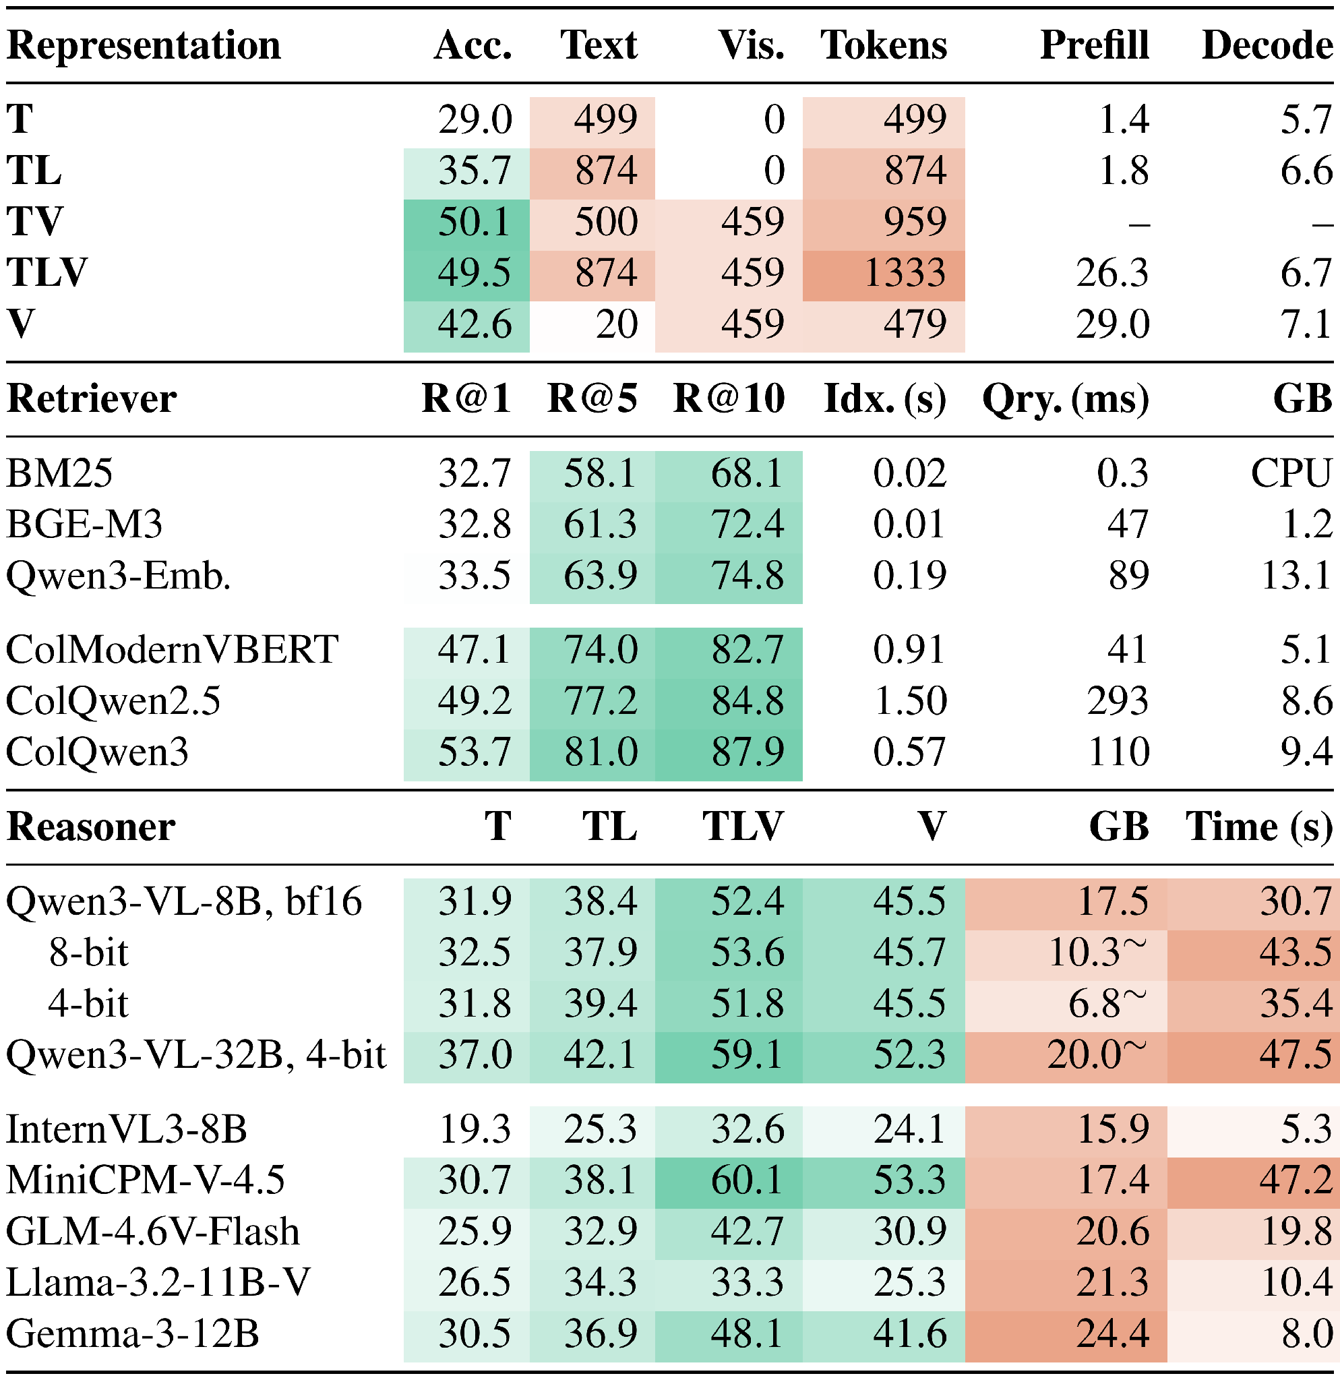
Backup · Deployment: Accuracy and Cost
Backup
Every representation, retriever and reasoner choice has a cost side.
Representation: text + image matches parser text + image with fewer tokens; images cost 26.3 s vs 1.8 s prefill
Retriever: ColQwen3 R@5 81.0% vs BM25 58.1%, but needs a GPU
Reasoner: 4-bit saves memory, not time

Slide 21
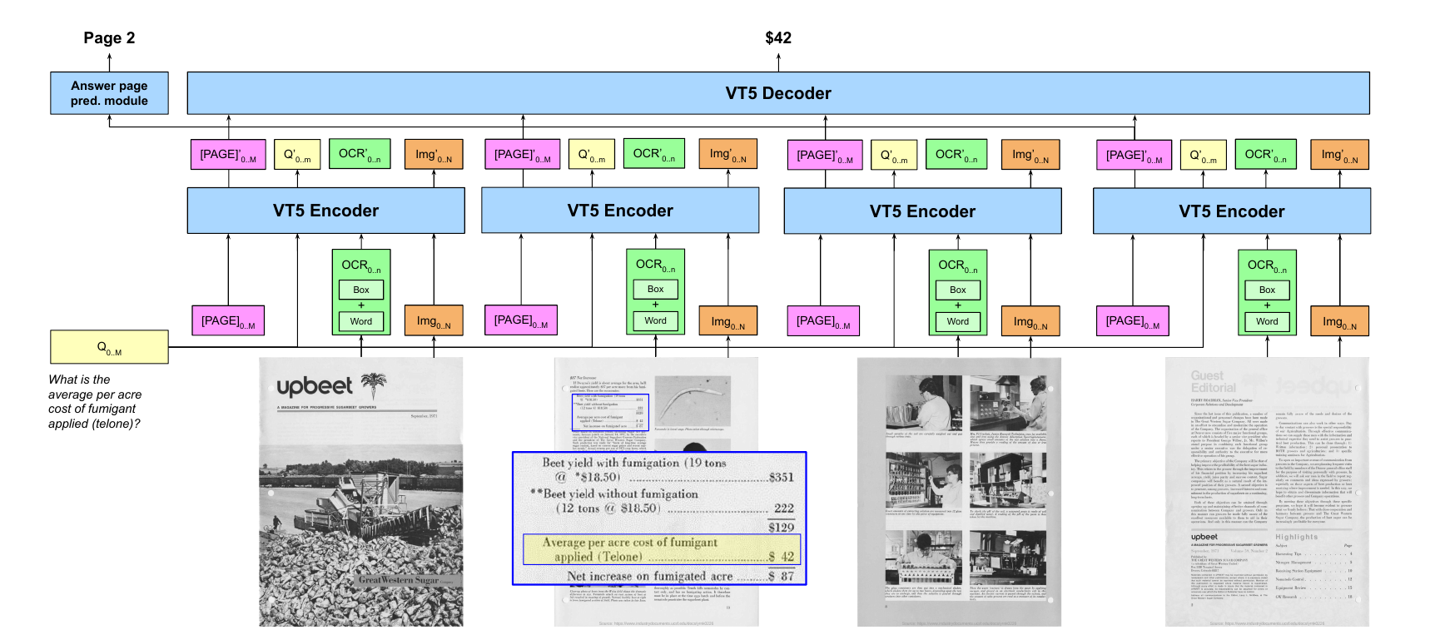
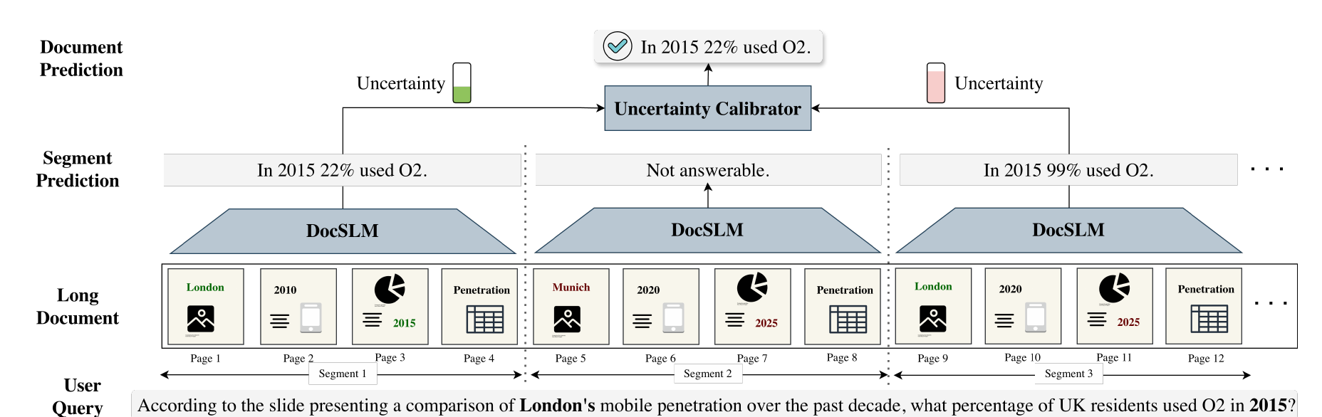
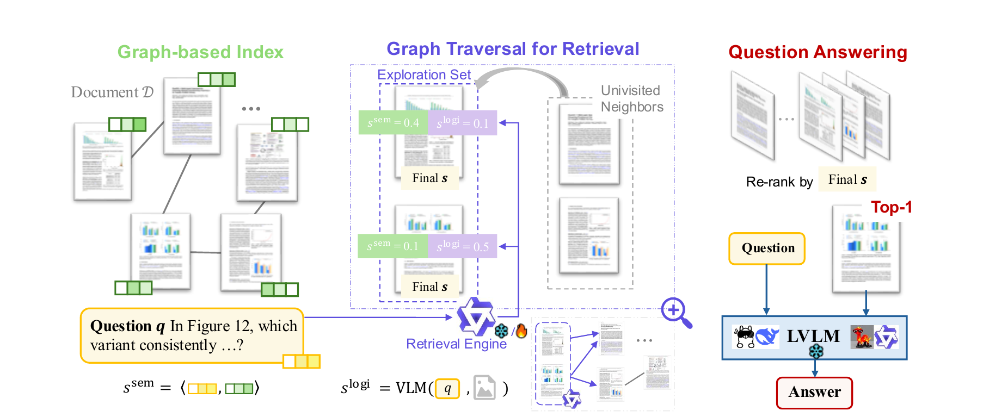
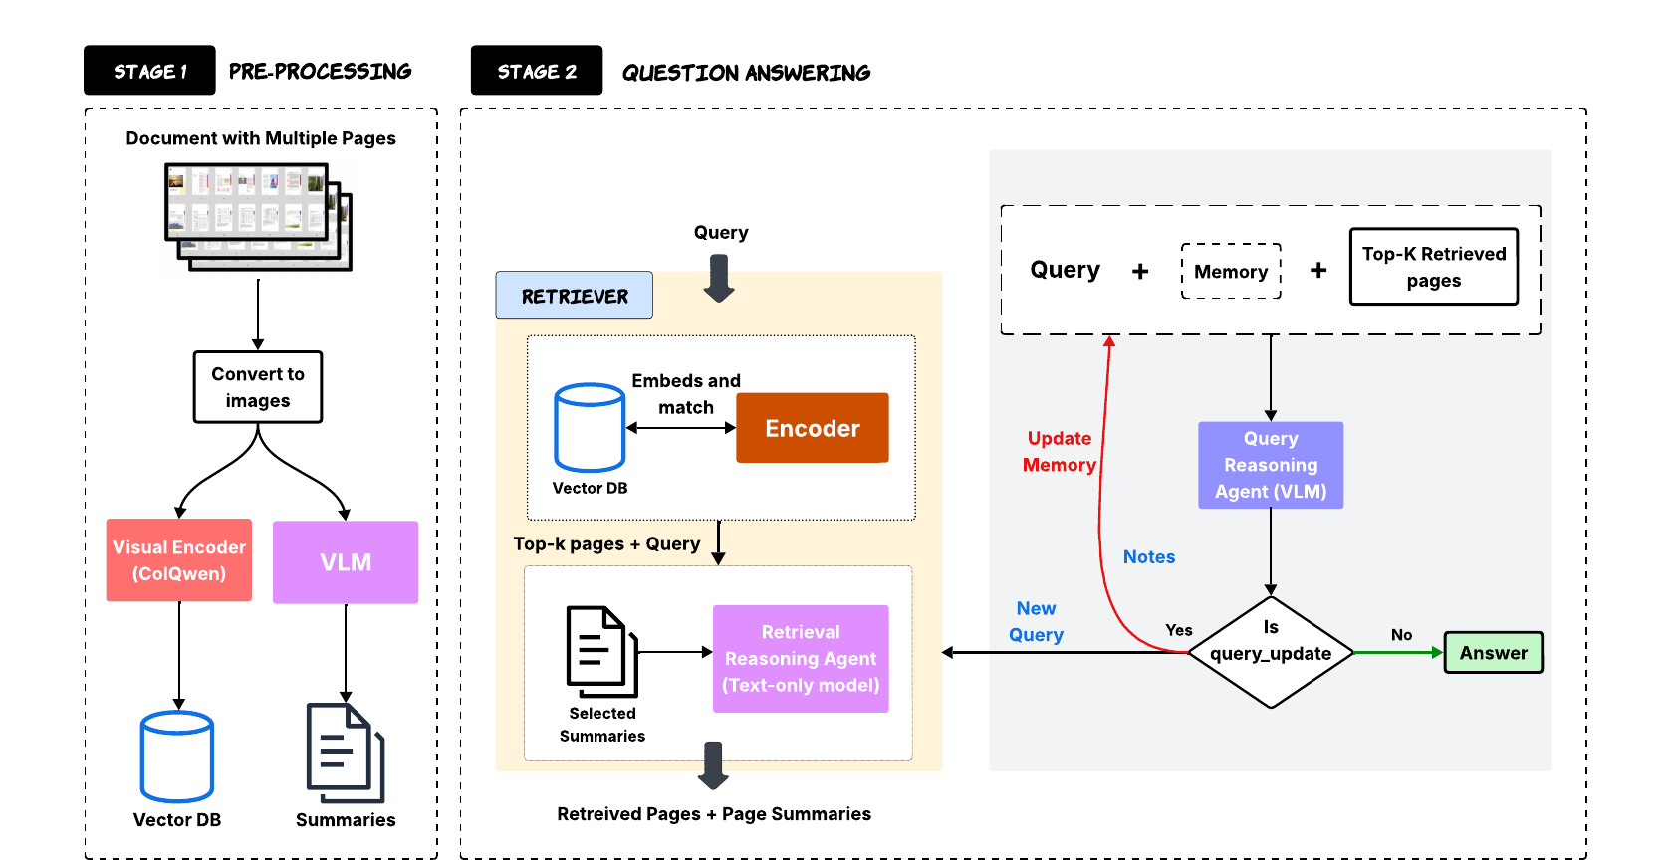
Backup · Representative Frameworks
Backup
One representative system per architectural family.
Hi-VT5 Tito et al., Pattern Recognition 2023
DocSLM Hannan et al., CVPR 2026 Findings
MoLoRAG Wu et al., EMNLP 2025
SimpleDoc Jain et al., EMNLP 2025

