Slide 1

HONOURS THESIS PRESENTATION
Multi-Page Visually Rich Document Understanding
A Survey of System Design and an Empirical Attribution of Failure
Lewei Xu
Supervisors: Dr Yihao Ding · Dr Daochang Liu
Department of Computer Science and Software Engineering
School of Physics, Mathematics and Computing · October 2026
Notes:
Hello everyone, my name is Lewei, and I’ve been working on multi-page visually rich document understanding, or just long document understanding, for my honours project this year.

Slide 2
Seminar/Thesis Overview
Chapter 1 · Introduction
Four chapters, three research questions, two papers.
CHAPTER | QUESTION | PUBLICATION
1 Introduction & Background | Why are long documents hard, and why a fixed compute budget? | Thesis chapter
2 Survey | RQ1 How are multi-page systems designed? | Managing Evidence at Document Scale: A Survey of MP-VRDU EMNLP 2026, Main Conference
3 Empirical study | RQ2 Where and why do these systems fail? | Locating Failure in MP-VRDU: An Empirical Attribution Submitted to NAACL
4 Method & Conclusion | RQ3 Can the findings build a competitive system under a fixed budget? | Thesis chapter: training-free proof of concept
Notes:
First, I’ll go through some background.
Then I’ll go cover the 2 papers completed this year.
The first is survey of the long document understanding field.
The second paper is an empirical study on designing and deploying long document understanding systems.
If we have time, I’ll go over this proof of concept method for long document understanding that uses the findings of empirical study.

Slide 3
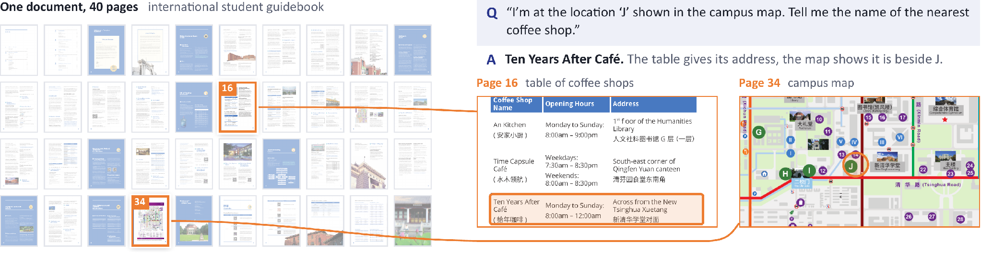
What is MP-VRDU?
Chapter 1 · Introduction
Meaning lives in text, visuals and layout, and often runs across pages.
A question from MMLongBench-Doc: the answer needs the table on page 16 and the map on page 34.
Long
Exceeds the model’s context window
Sparse
Evidence is buried among many pages
Structured
Links cross pages: “see Table 3”
Notes:
So, what do we mean by a visually rich document?
Documents carry meaning through text, visual elements like charts and figures, and how these are laid out on a page.
A multi-page document simply has two or more pages, but its meaning can be spread across those pages and connected between them.
Although when we say multi-page, we generally mean longer documents from 50 or hundreds of pages.
For the purposes of this seminar, the definition of document understanding is just answering an arbitrarily specific natural language question over a long visually rich document.
Here is an example of relatively easy question now, but was very difficult even just a year ago.
Long document understanding is difficult due to two main reasons
First is the sheer volume of information, both textual, visual and structural, is often too much for even long context vision language models to read in full, and even if you can, reasoning over so much information is very difficult.
Second is that answer relevant evidence can be scattered across the document, and you need to combine and reason over this evidence to successfully answer a question.

Slide 4
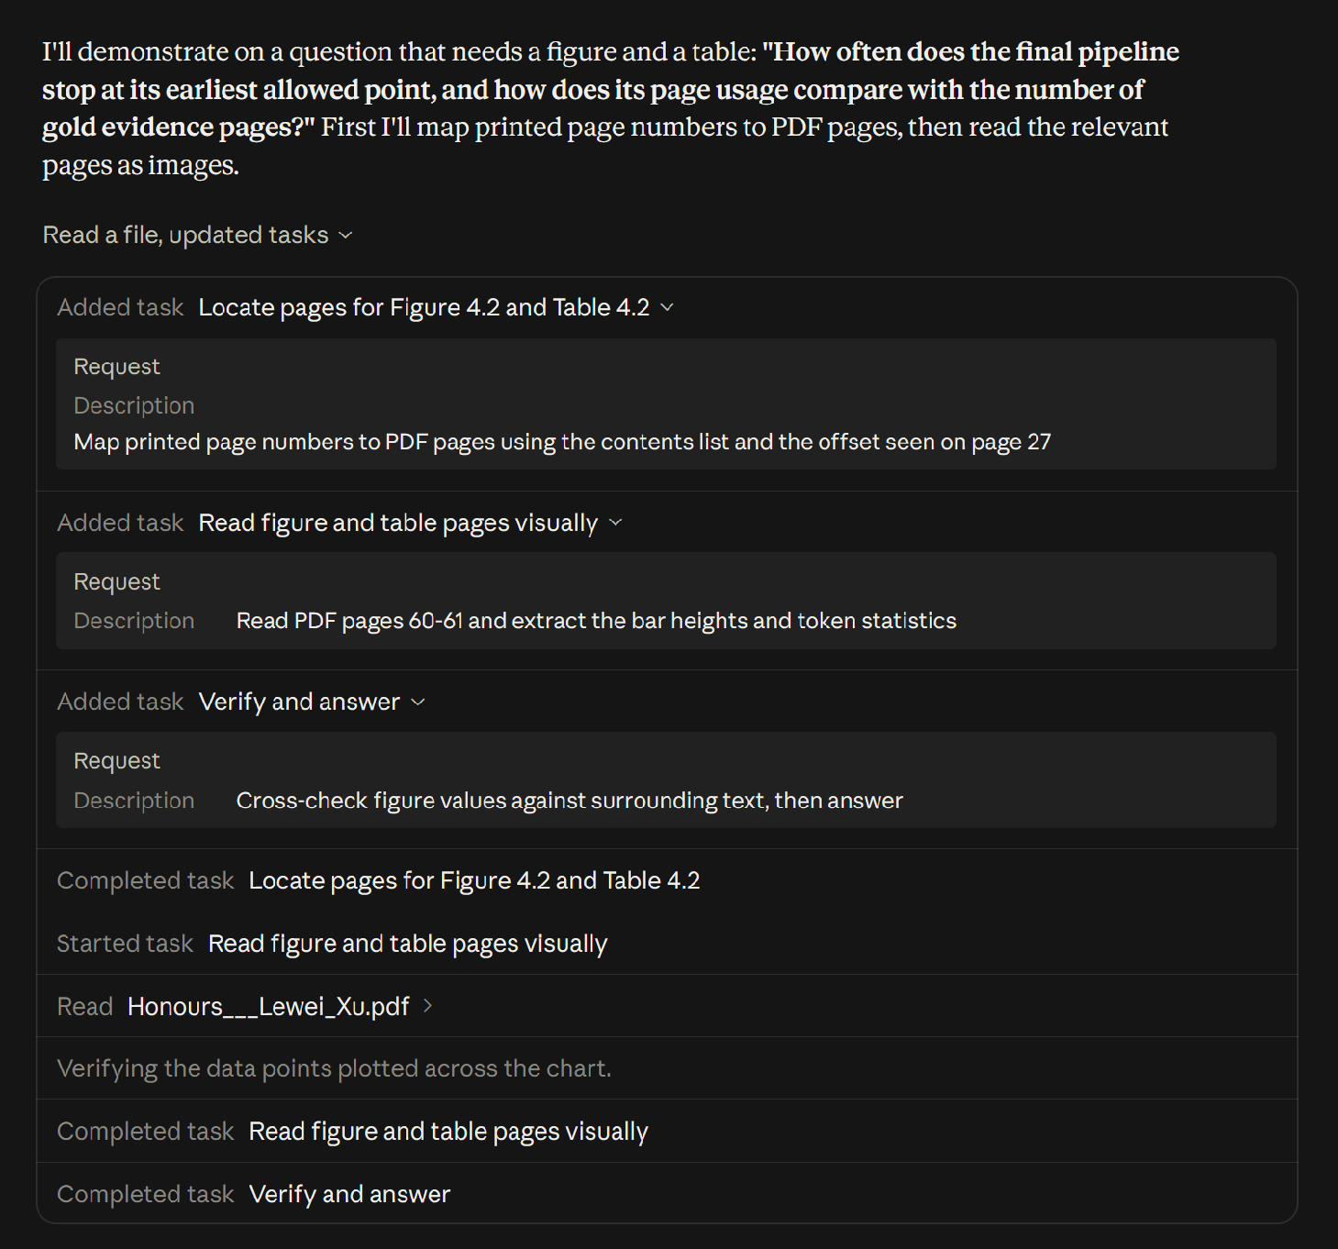
MP-VRDU in Real World Applications
Chapter 1 · Introduction
Real deployments need local, open-weight models under a fixed compute budget.
IN INDUSTRY
Thousands to millions of documents
Privacy: medical, legal and financial records stay in-house
Cost: API fees become prohibitive at millions of documents
Specialisation: domain documents need an adapted model
In any case, you need to build your own document understanding pipeline, either by running local VLMs, or via third party API
LLM assistants plan, locate and inspect pages before answering.
Notes:
We can already see document understanding research being applied in the language model assistants we use.
Here’s an example of me uploading my thesis which is close to 100 pages, and claude is able to answer questions very accurately.
But these assistants are just one application of document understanding.
In industry, you might have one or a few specific tasks to perform over thousands or millions of documents.
One major concern is privacy. For example, medical and legal documents cannot be sent to a third-party service due to data-residency requirements.
Another is cost. Even without privacy concerns, processing that volume through a commercial API can be very expensive.
Another case is specialist document types may need specialized pipelines to process them, or maybe even additional training on the language model.
Nor is uploading documents one by one to a LLM assistant feasible, and you might need structured output for automatic downstream processing
As a result, real deployments need to implement their own document understanding pipeline either using API calls to closed source models, or by running local vision language models.

Slide 5

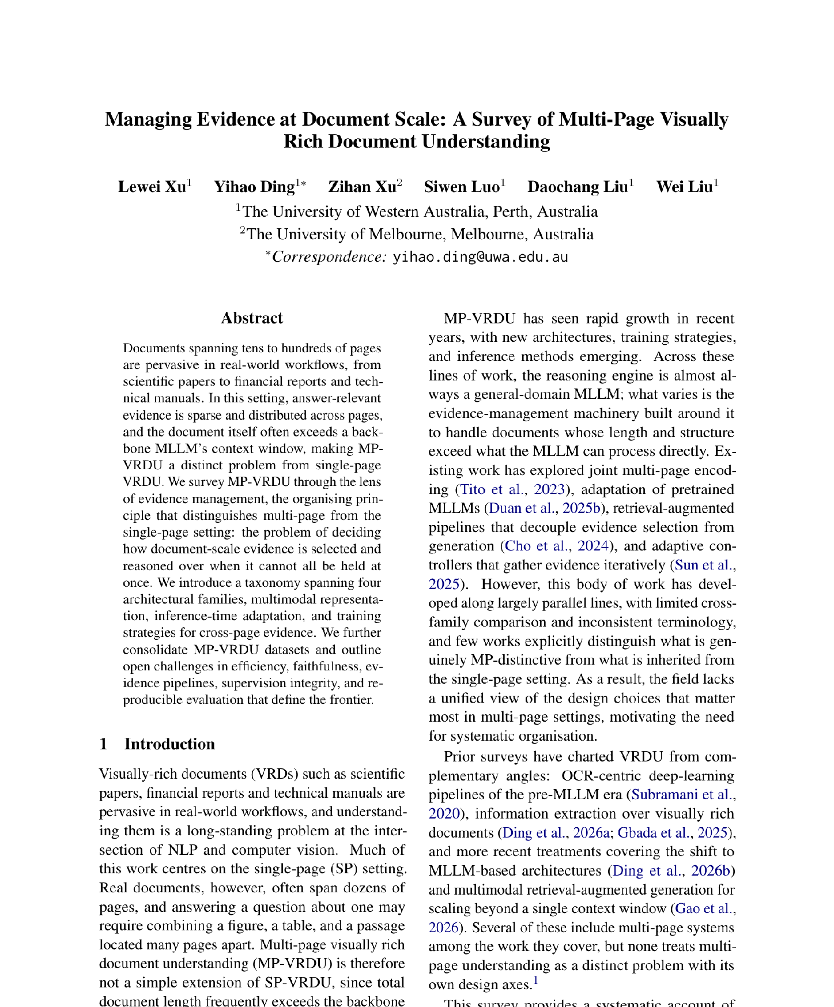
Managing Evidence at Document Scale: A Survey of Multi-Page Visually Rich Document Understanding
Chapter 2 · Survey \
First-Authored and Accepted at the EMNLP 2026 Main Conference, Budapest.
RESEARCH GAP
Multi-page systems grew along parallel lines, with inconsistent terminology and little cross-family comparison.
CONTRIBUTIONS
The first survey to treat MP-VRDU as a distinct problem
We survey 46 systems, organised by evidence management, spanning 4 architectural families, multi-page multimodal representation, inference-time adaptation, and training strategies.
47 datasets consolidated; five open challenges
Notes:
That brings us to the survey paper completed earlier this year.
This is the first survey to treat the multi-page setting as a distinct problem.
And has been accepted into a top tier conference for natural language processing.
I’m a bit conscious of time so i’ll mainly talk about the 4 architectural families, and mostly skip everything else

Slide 6
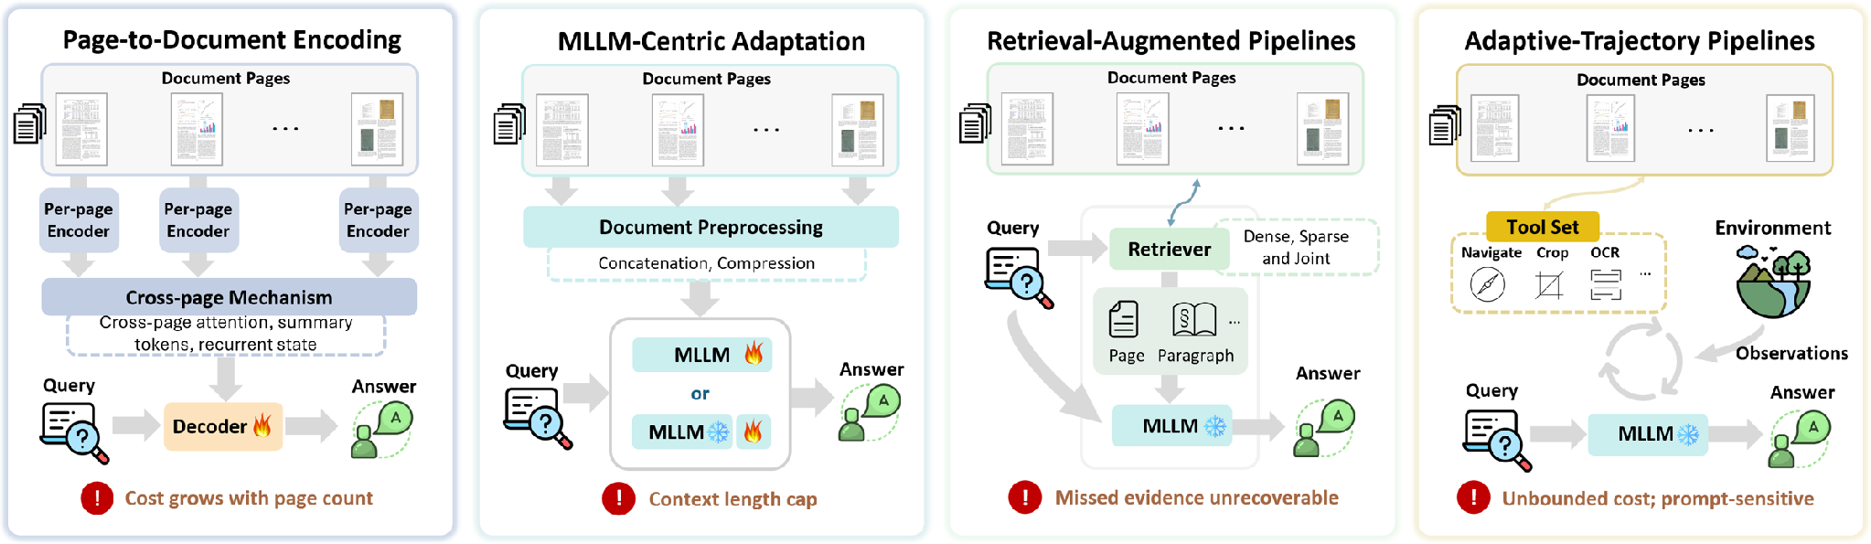
Four Architectural Families
Chapter 2 · Survey
Each family fixes the previous bottleneck and relocates it rather than removing it.
Late 2023 to mid 2024
Early 2024 to late 2025
Early 2024 to mid 2026
Early 2025 to mid 2026
e.g. Hi-VT5, GRAM
e.g. DocSLM, Docopilot
e.g. M3DocRAG, MoLoRAG
e.g. SimpleDoc, DocAgent
Notes:
These architectural families can also be considered different approaches to long document understanding.
The first family is page-to-document encoding models, an early approach that extends single-page architectures to the multi-page setting.
Each page is encoded separately into a compact representation. Those representations are connected through a cross-page mechanism, such as attention, and passed to a decoder to generate the final answer.
The limitation is that pages contain different amounts of information. Giving each page a fixed representation budget can lose fine-grained detail during encoding.
The second family addresses this by removing the per page encoding step, and instead adapts a pretrained multimodal large language model to process the document natively within its context window.
Adaptation can involve continued pretraining on document tasks or fine-tuning. Some systems also compress the representations to fit longer documents.
But performance can still degrade as documents get longer, and some documents cannot fit at all.
This motivates retrieval-augmented pipelines. Instead of fitting the whole document into the model, we retrieve relevant evidence and pass a smaller evidence set to a vision-language model.
Retrieval can be sophisticated, but the workflow is fixed in advance. Evidence missed during retrieval cannot be recovered by the answering stage.
Finally, adaptive-trajectory pipelines follow an agentic approach. The language model decides what evidence to collect, how to collect it, and when it has enough to answer.
But those repeated calls can become expensive, and make the total time and compute cost harder to bound.
The dates show roughly when each family is active in the papers we surveyed. Each one fixes the bottleneck of the one before, and moves it somewhere else.
We call the first two families models, because they are trained end to end. We call the last two pipelines, because their components are interchangeable.

Slide 7
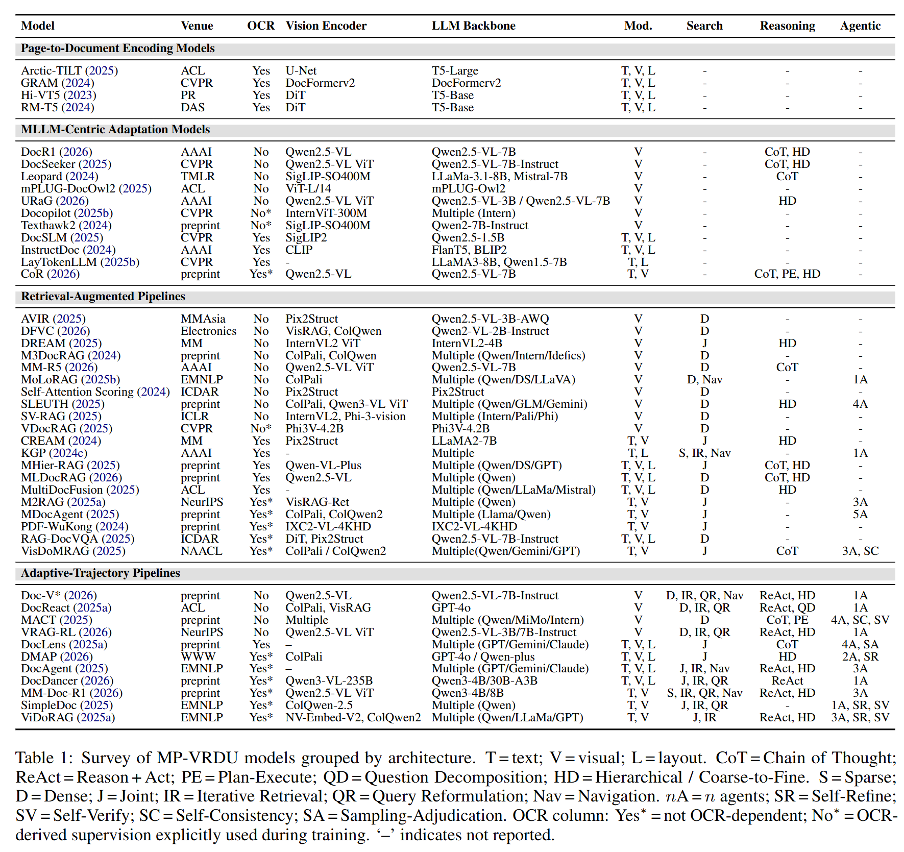
Surveyed Systems Main Table
Chapter 2 · Survey
Models vs pipelines
Models are trained end-to-end with purpose built components
Pipelines usually use a frozen LVLM backbone with interchangeable components/backbones.
Modalities
Encoding models use text, vision and layout; MLLM-centric models are mostly vision only.
Search
Appears only once retrieval is separated from answering.
Notes:
This is the main table of the survey, with the systems and papers we surveyed grouped by architectural family.
There are three things I want to point out
First, with the first 2 architectural families, we call them “models” because they’re generally trained end to end with purpose build components
The last 2 families we call them “pipelines” because they generally use a frozen vision language backbone sometimes with some fine tuning.
Their components are usually interchangeable, especially the vision language backbone, so as these language models get stronger, the pipelines also benefit from these improvements
Second, the modalities. Some systems use vision only, treating document understanding as a pure computer vision problem.
Others combine vision with text and layout information. The text may be embedded in the document or extracted by a parser.
This distinction will be important in the next part of the seminar.
Third, search. It only appears once retrieval is separated from answering, in the two pipeline families.

Slide 8
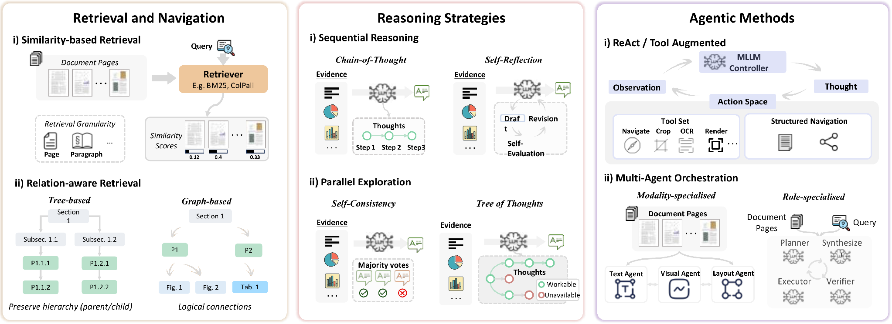
Inference-Time Strategies
Chapter 2 · Survey
Training free strategies to improve document understanding performance. Retrieval and Agentic methods are used for Retrieval Augmented and Adaptive Trajectory Pipelines; Reasoning strategies can be applied to any LVLM.
Relation-aware retrieval finds links similarity misses
A chain cannot recover what retrieval missed
Lifts the recall ceiling; cost is hard to bound
Notes:
Various training free strategies can be used to improve document understanding performance
Retrieval and navigation techniques such as similarity based and relation aware retrieval
And agentic methods such as reason + act with tool calls and multi-agent orchestration
These are used only in retrieval augmented and adaptive trajectory pipelines
Reasoning strategies such as cot, reflexion, sc, tot can be applied to all reasoning backbones.

Slide 9
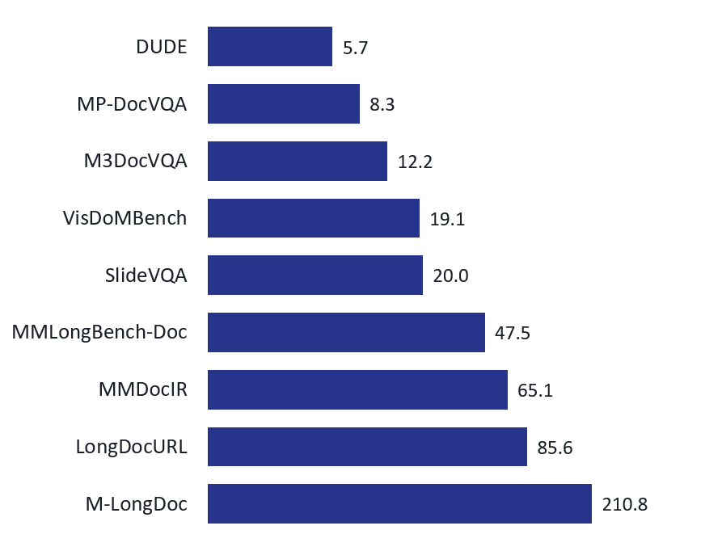
Training Strategies & Datasets
Chapter 2 · Survey
Pretraining is rare; fine-tuning carries the weight, with RL layered on top.
TRAINING
BENCHMARKS: AVERAGE PAGES PER DOCUMENT
Retrieval: alignment, cross-page fusion, logical relevance
Reasoning: trace imitation, then reward-driven GRPO
Agentic: trajectory distillation, then RL
Cross-cutting: PEFT / LoRA, single- to multi-page curricula
Fine-tuning data is mostly LVLM-synthesised; 16 of 19 papers that fine-tune on MP-DocVQA also evaluate on it.
Notes:
Pretraining is rare for long document understanding due to scarcity of data
We see a lot of fine tuning techniques applied across retrieval, reasoning and agentic behaviour
Document length in benchmarks are also getting increasingly longer as document understanding systems get better

Slide 10
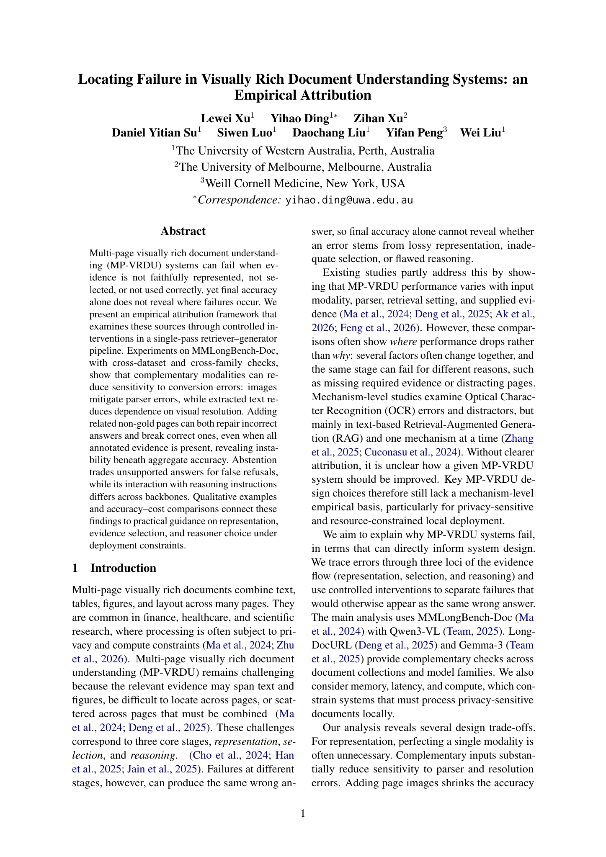
Locating Failure in Document Understanding
Chapter 3 · Empirical study
An Empirical Attribution · Under review
RESEARCH GAP
A wrong answer does not tell us whether evidence was lost, missed, or misused.
CONTRIBUTIONS
Three failure loci: representation, selection, reasoning.
Controlled interventions across two datasets and two model families.
Deployment guidance from accuracy and cost.
Notes:
The survey maps how systems manage evidence. This second paper asks where those systems fail.
A final wrong answer hides three different causes. The relevant information may be lost while encoding a page, a needed page may be omitted during selection, or the model may fail to use evidence it has received.
We separate these into representation, selection and reasoning. We test each through controlled interventions, then check whether the findings transfer across MMLongBench-Doc, LongDocURL, Qwen3-VL and Gemma-3.

Slide 11
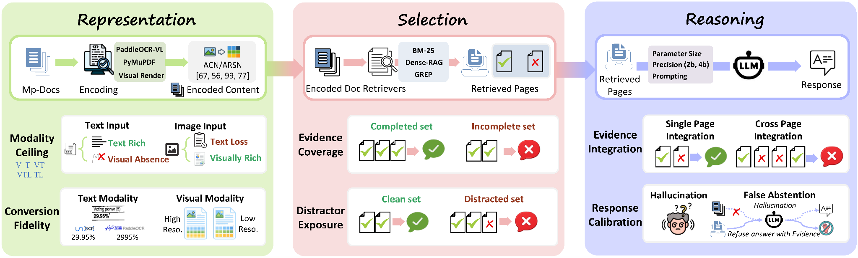
Attribution by Construction
Chapter 3 · Empirical study · Under review
Change one stage while holding the other two fixed.
REPRESENTATION
SELECTION
REASONING
T · TL · TLV · V
Parsers and image resolution
Gold pages as control
Drop evidence or add distractors
Qwen3-VL and Gemma-3
Model scale and prompt modes
MMLongBench-Doc + LongDocURL · Accuracy judge for correctness; rubric judge for refusal
Notes:
The framework is also our experimental setup. Every document question-answering system has to represent pages, choose what reaches the model and reason over that evidence.
We use one encode, retrieve and answer pipeline. For representation we vary embedded text, parser text and page images, including parser and resolution choices. For selection we start with annotated gold pages, then omit required pages or add non-gold pages. For reasoning we vary the backbone and its instructions.
Each comparison changes one stage while the others stay fixed. MMLongBench-Doc supplies evidence-page and evidence-source annotations; LongDocURL checks whether the patterns transfer to born-digital documents. Correctness and refusal come from their respective judges.

Slide 12
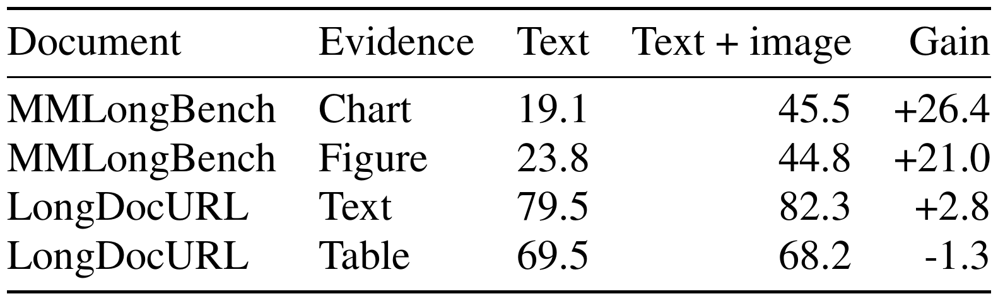
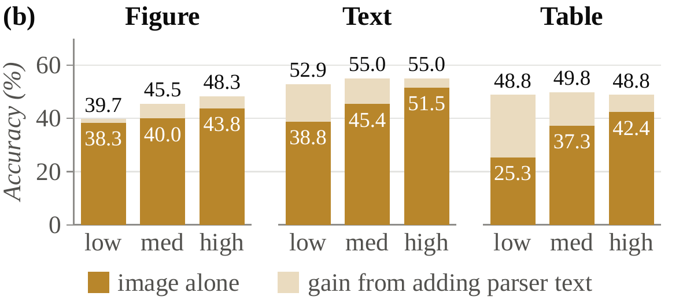
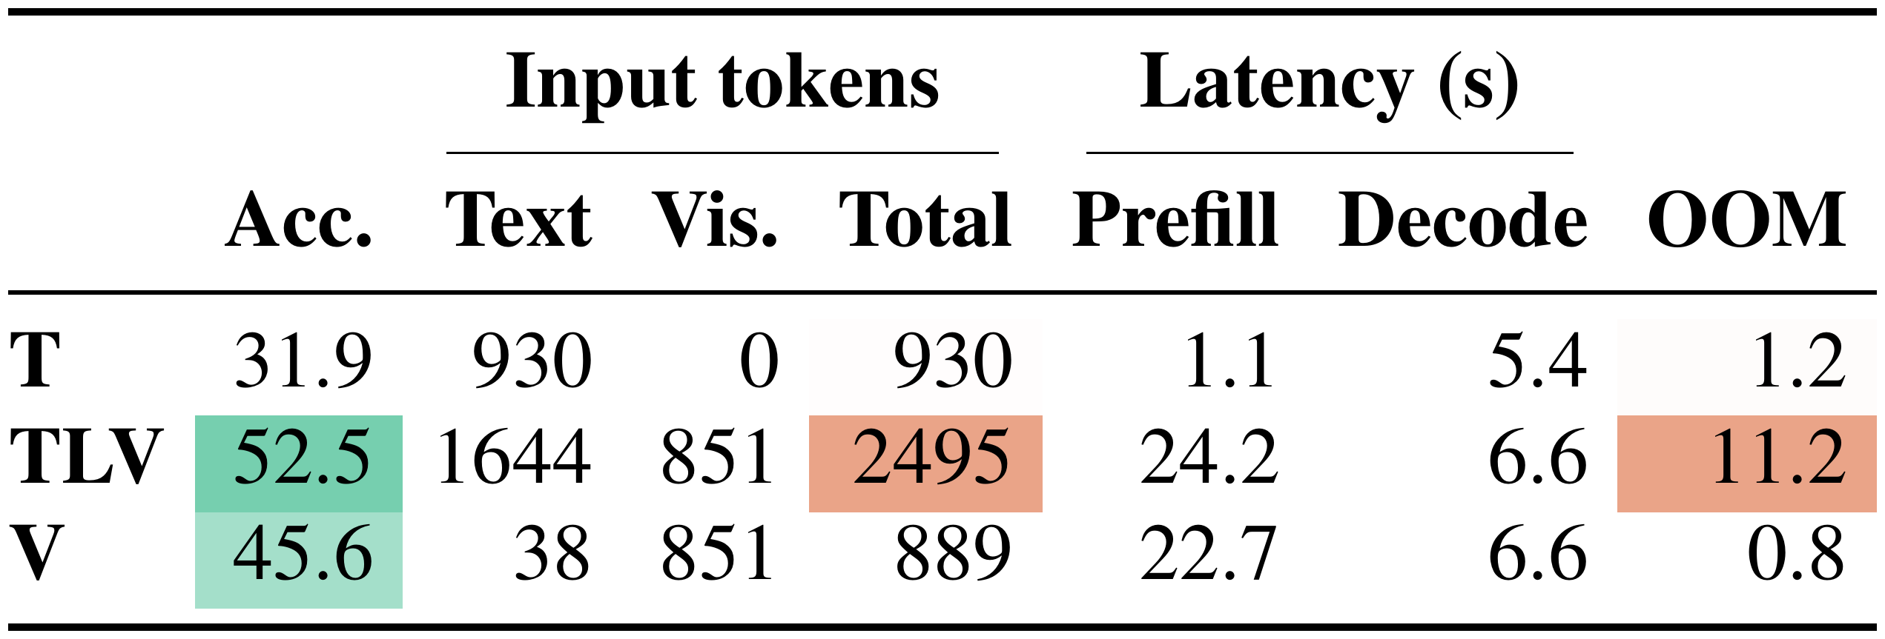
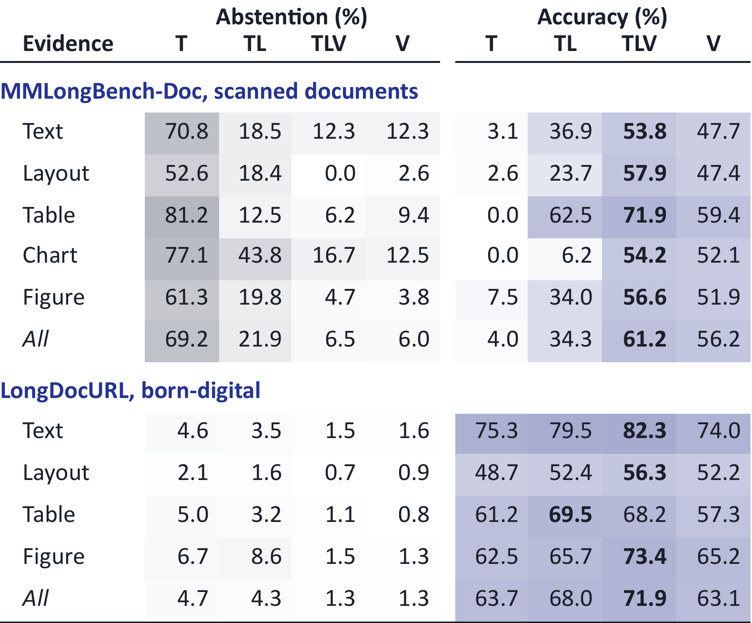
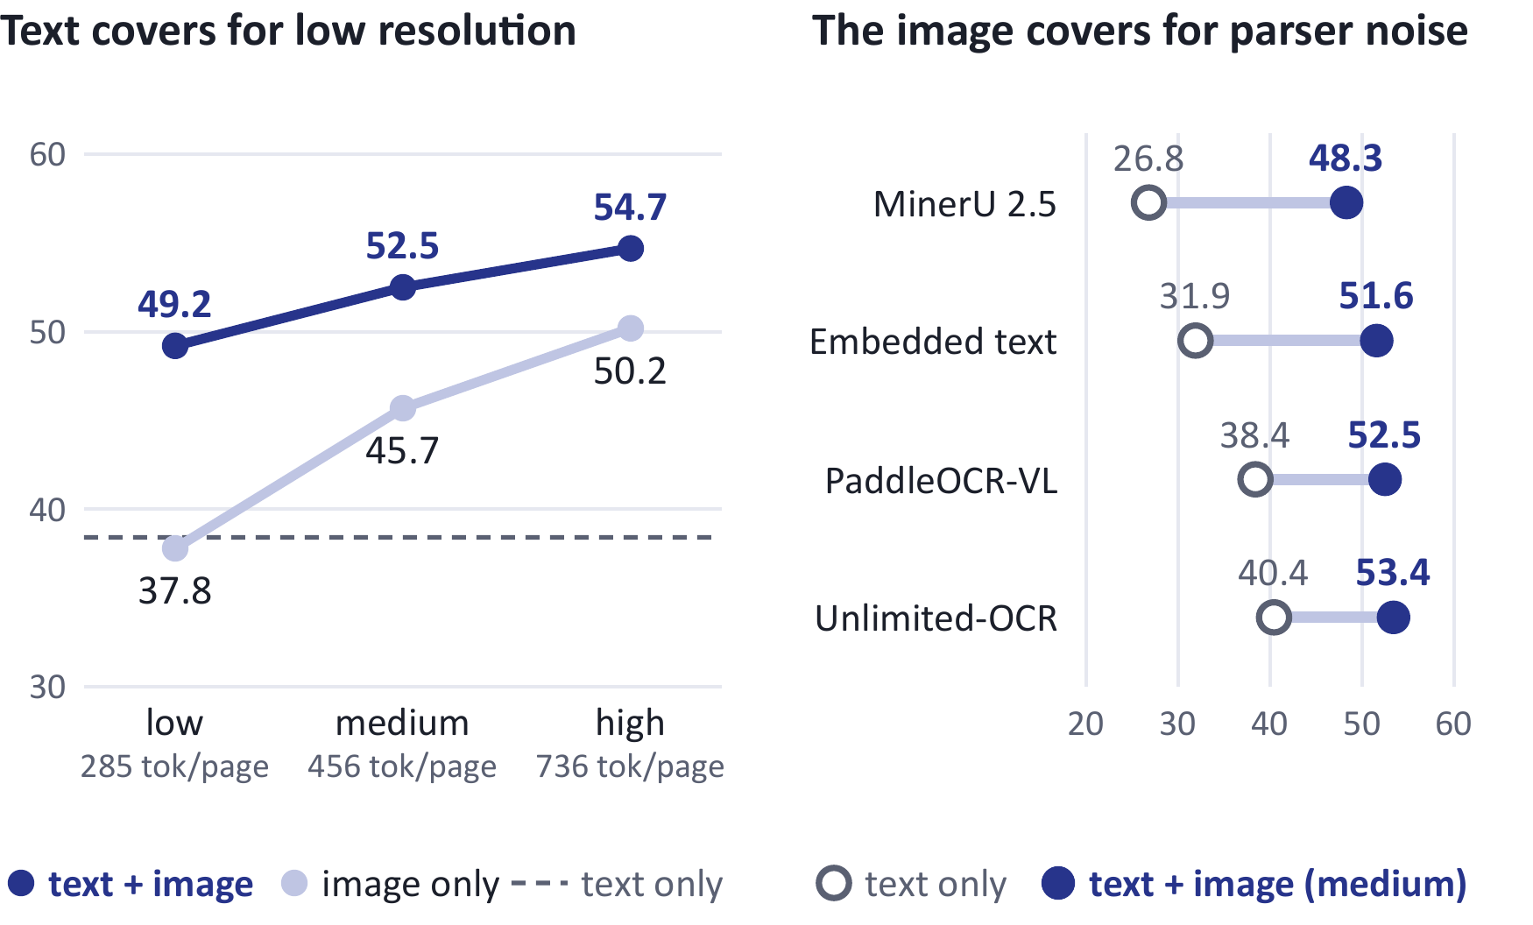
Finding 1 · Representation
Chapter 3 · Empirical study · Under review
Use vision where the task needs it; text helps low-resolution vision recover detail.
Accuracy by evidence type (%)
Low-resolution image + parser text
Cost of vision on two V100s
49.2% at low resolution vs 54.7% at high resolution
That keeps 90% of the high-resolution accuracy on the same 847 questions.
T embedded text · TL parser text · TLV parser text + image · V image only
Notes:
Vision is valuable when the answer depends on appearance. On MMLongBench-Doc chart questions, parser text reaches 19.1 percent accuracy and text with the page image reaches 45.5 percent. Figure questions show a similar gain. On born-digital LongDocURL, adding the image to parser text gives only 2.8 points on text questions and is slightly worse on table questions.
Vision also costs time. On two 16 GB V100s, an image-only input takes 22.7 seconds to prefill against 1.1 seconds for embedded text, about 21 times as long, even though both have about 900 input tokens. Text with images takes 24.2 seconds and has 11.2 percent out-of-memory failures, against 1.2 percent for text.
We can often render the image cheaply. Parser text plus a low-resolution image reaches 49.2 percent accuracy, compared with 54.7 percent at high resolution, on the same 847 questions. That keeps 90 percent of the high-resolution result. Text compensates especially on text and table questions; visual detail remains more important for charts and figures.

Slide 13
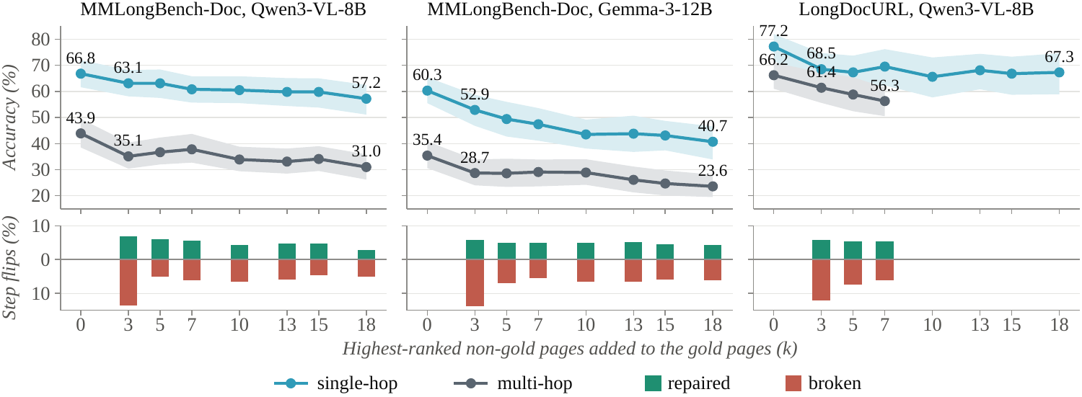
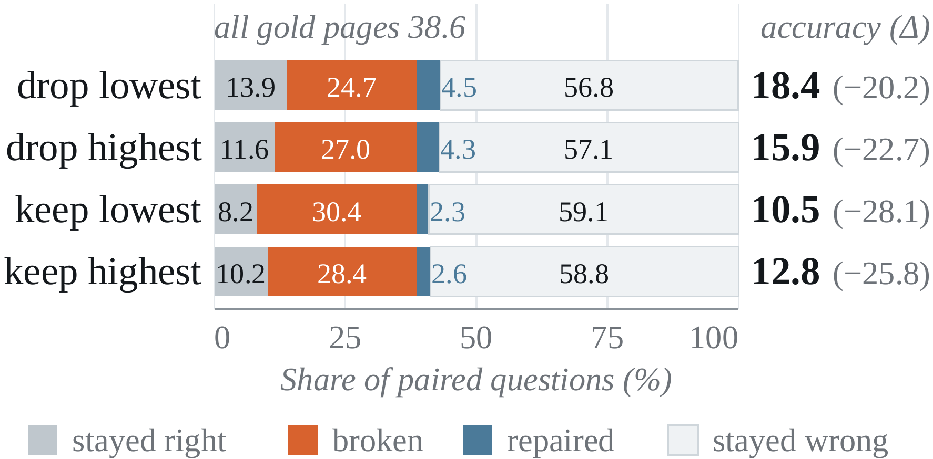
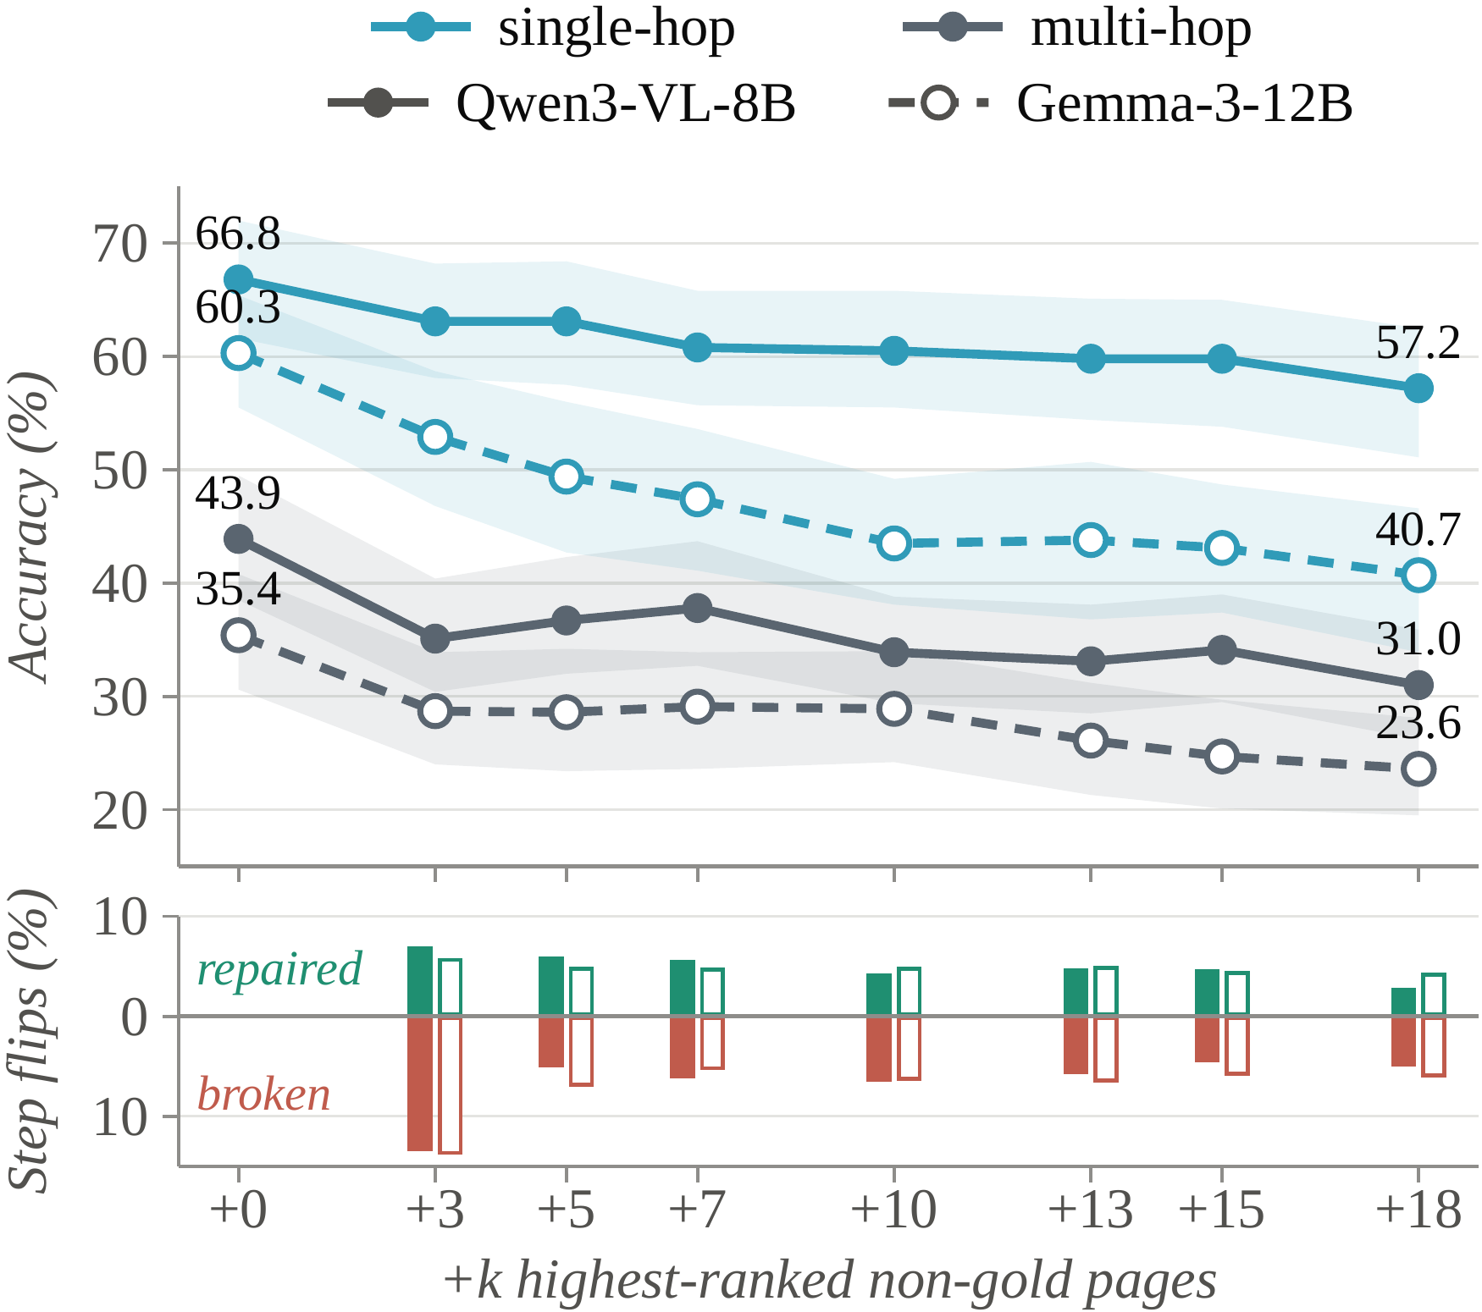
Finding 2 · Selection
Chapter 3 · Empirical study · Under review
All required pages stay in context, yet extra pages change the answer.
+3 pages: Qwen3-VL multi-hop accuracy 43.9% → 35.1%
13.3% broken · 7.0% repaired (+3)
Notes:
The distractor experiment keeps every annotated gold page in the context. We then add the highest-ranked non-gold pages, so evidence coverage stays complete.
The top row tracks accuracy. With Qwen3-VL-8B, multi-hop accuracy falls from 43.9 to 35.1 percent after just three extra pages, a drop of 8.8 points. Gemma-3 shows the same early decline. The bottom row tracks paired answer flips: at plus three, 13.3 percent of Qwen3-VL answers break while 7.0 percent are repaired.
The repairs matter. Added context can provide useful clues even when it is not annotated as gold. But the larger broken share means the net effect is harmful, particularly for multi-hop questions. Selection must control distractor exposure as well as evidence coverage.

Slide 14
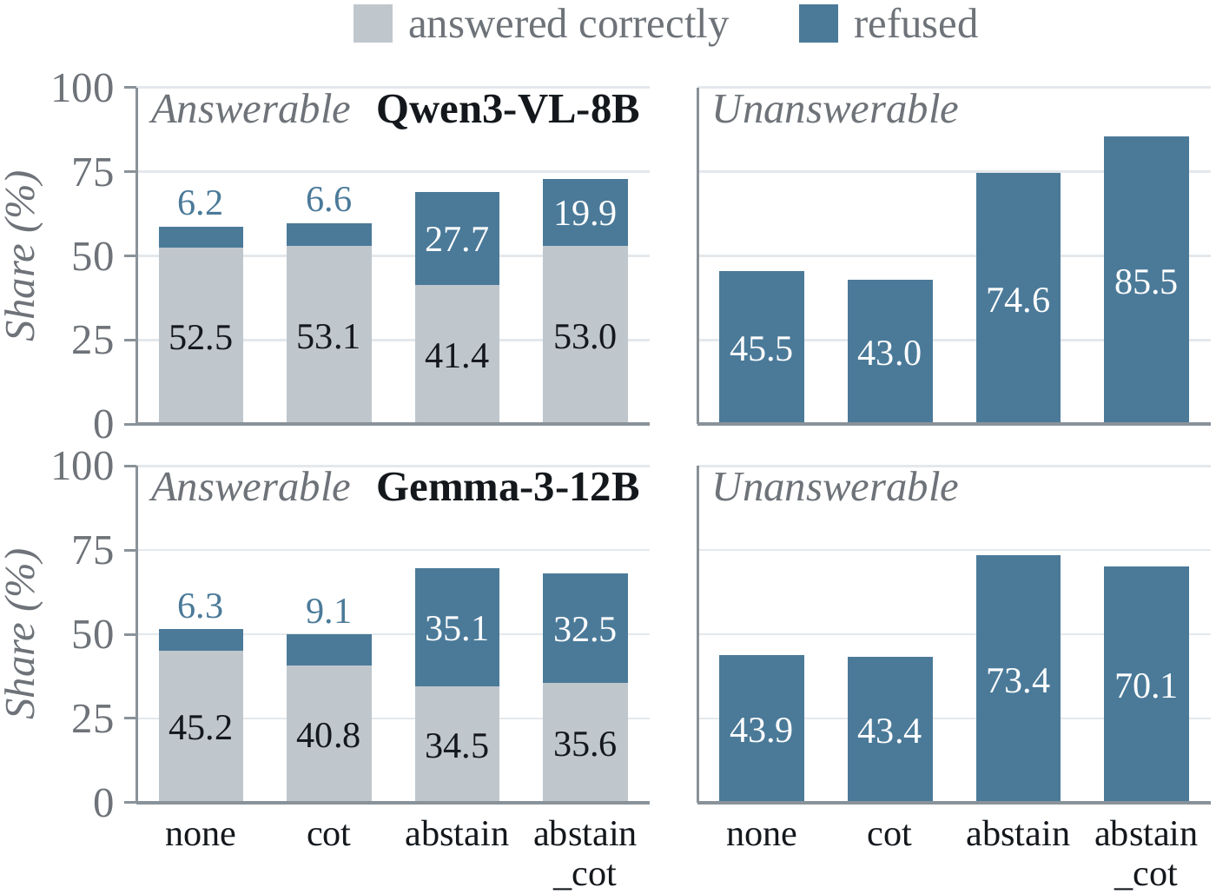
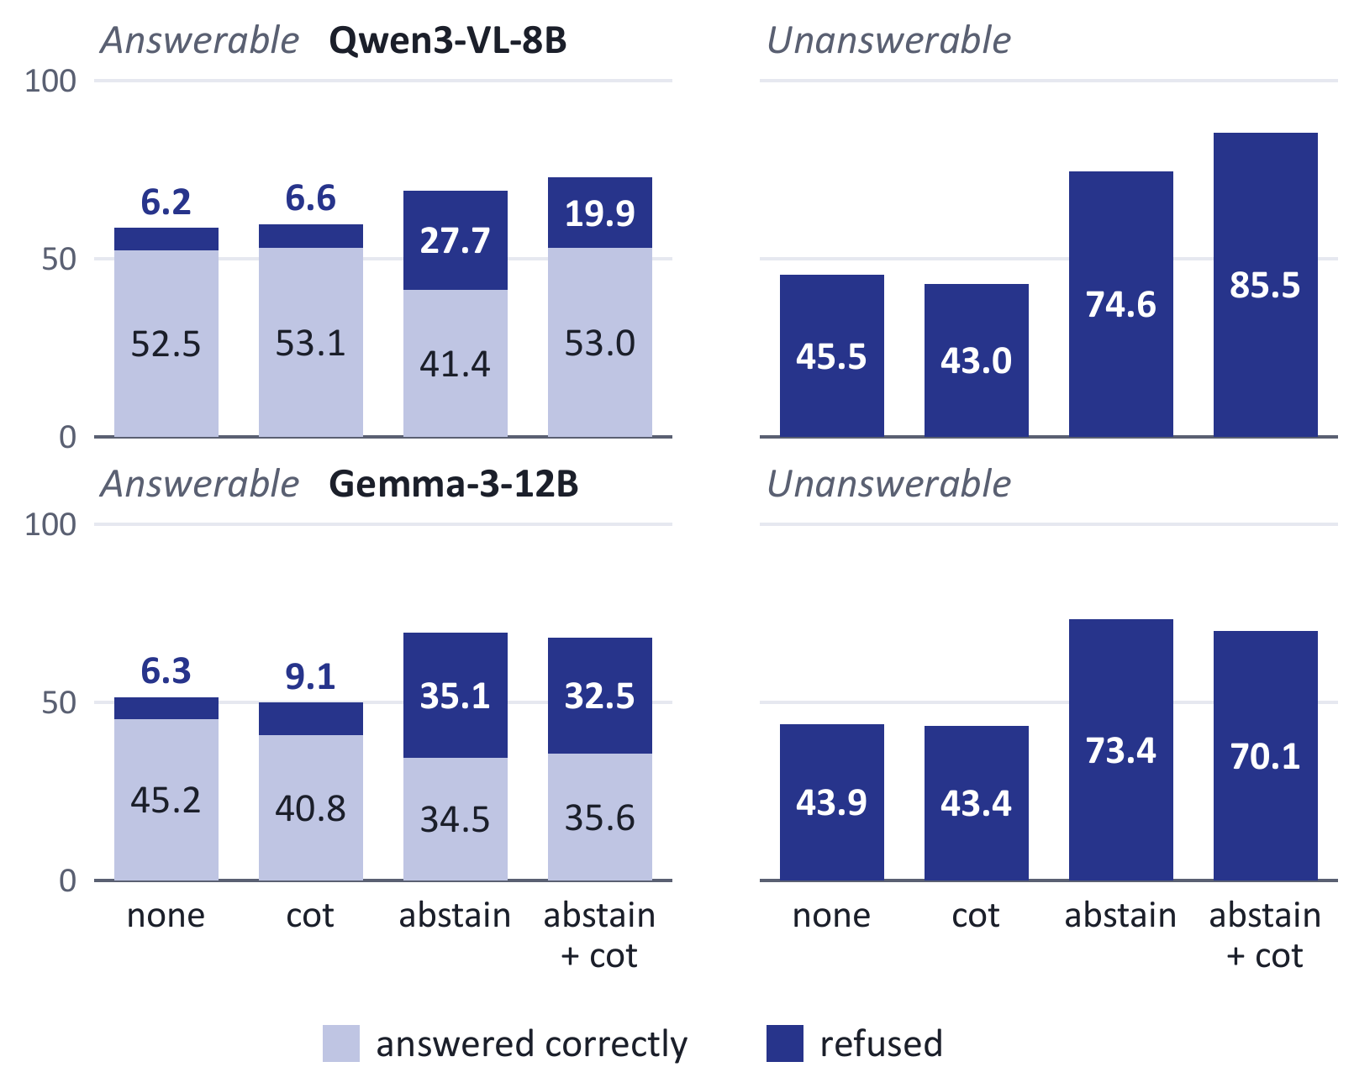
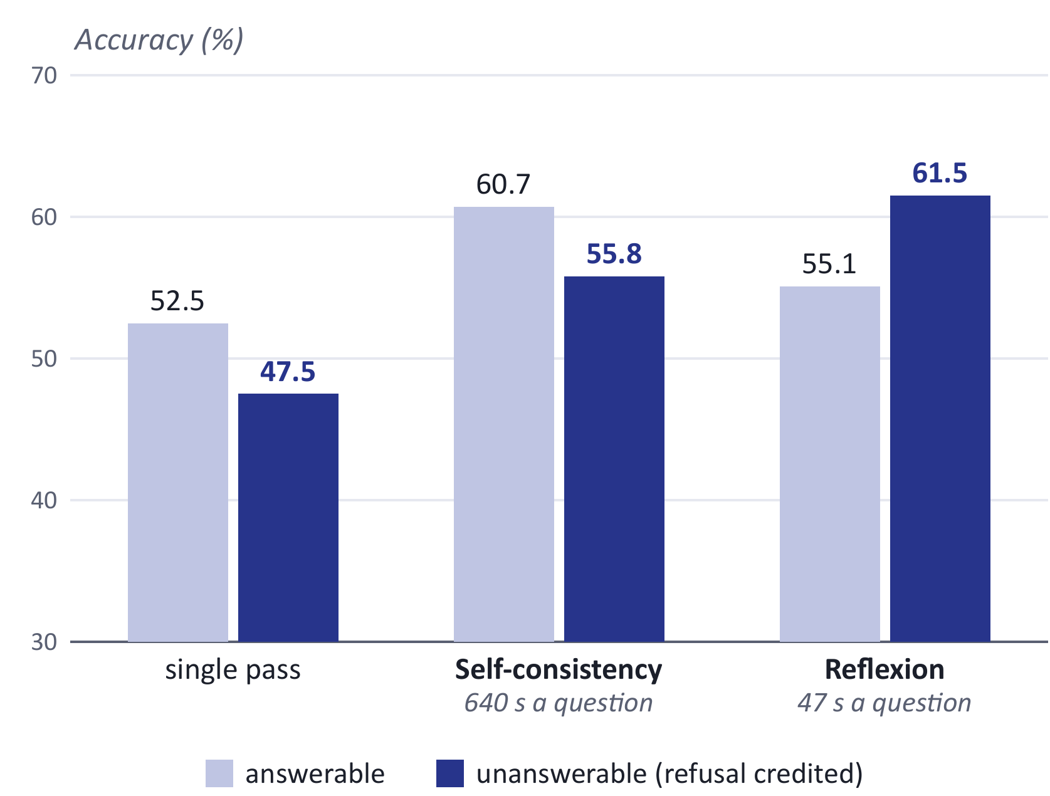
Finding 3 · Reasoning
Chapter 3 · Empirical study · Under review
Prompts move the accuracy and refusal trade-off.
Qwen3-VL-8B
Explicit abstention raises correct refusal on unanswerable questions:
45.5% → 74.6%
It also raises false refusal on answerable questions:
6.2% → 27.7%
Reasoning before abstaining recovers answerable accuracy to 53.0%.
Notes:
The third failure point is reasoning over evidence the model already has. A fluent answer can rest on a premise the document does not support.
This figure compares four prompt modes. For Qwen3-VL-8B, telling the model it may abstain raises correct refusal on unanswerable questions from 45.5 to 74.6 percent. It also increases false refusal on answerable questions from 6.2 to 27.7 percent, and answerable accuracy drops from 52.5 to 41.4 percent.
Adding a reasoning step before the abstention decision brings answerable accuracy back to 53.0 percent and raises correct unanswerable refusal to 85.5 percent for Qwen3-VL. Gemma-3 does not get the same benefit. The final strategy comparison needs rubric-judged refusal rates and a clear account of its unmatched precision and prompt settings.

Slide 15
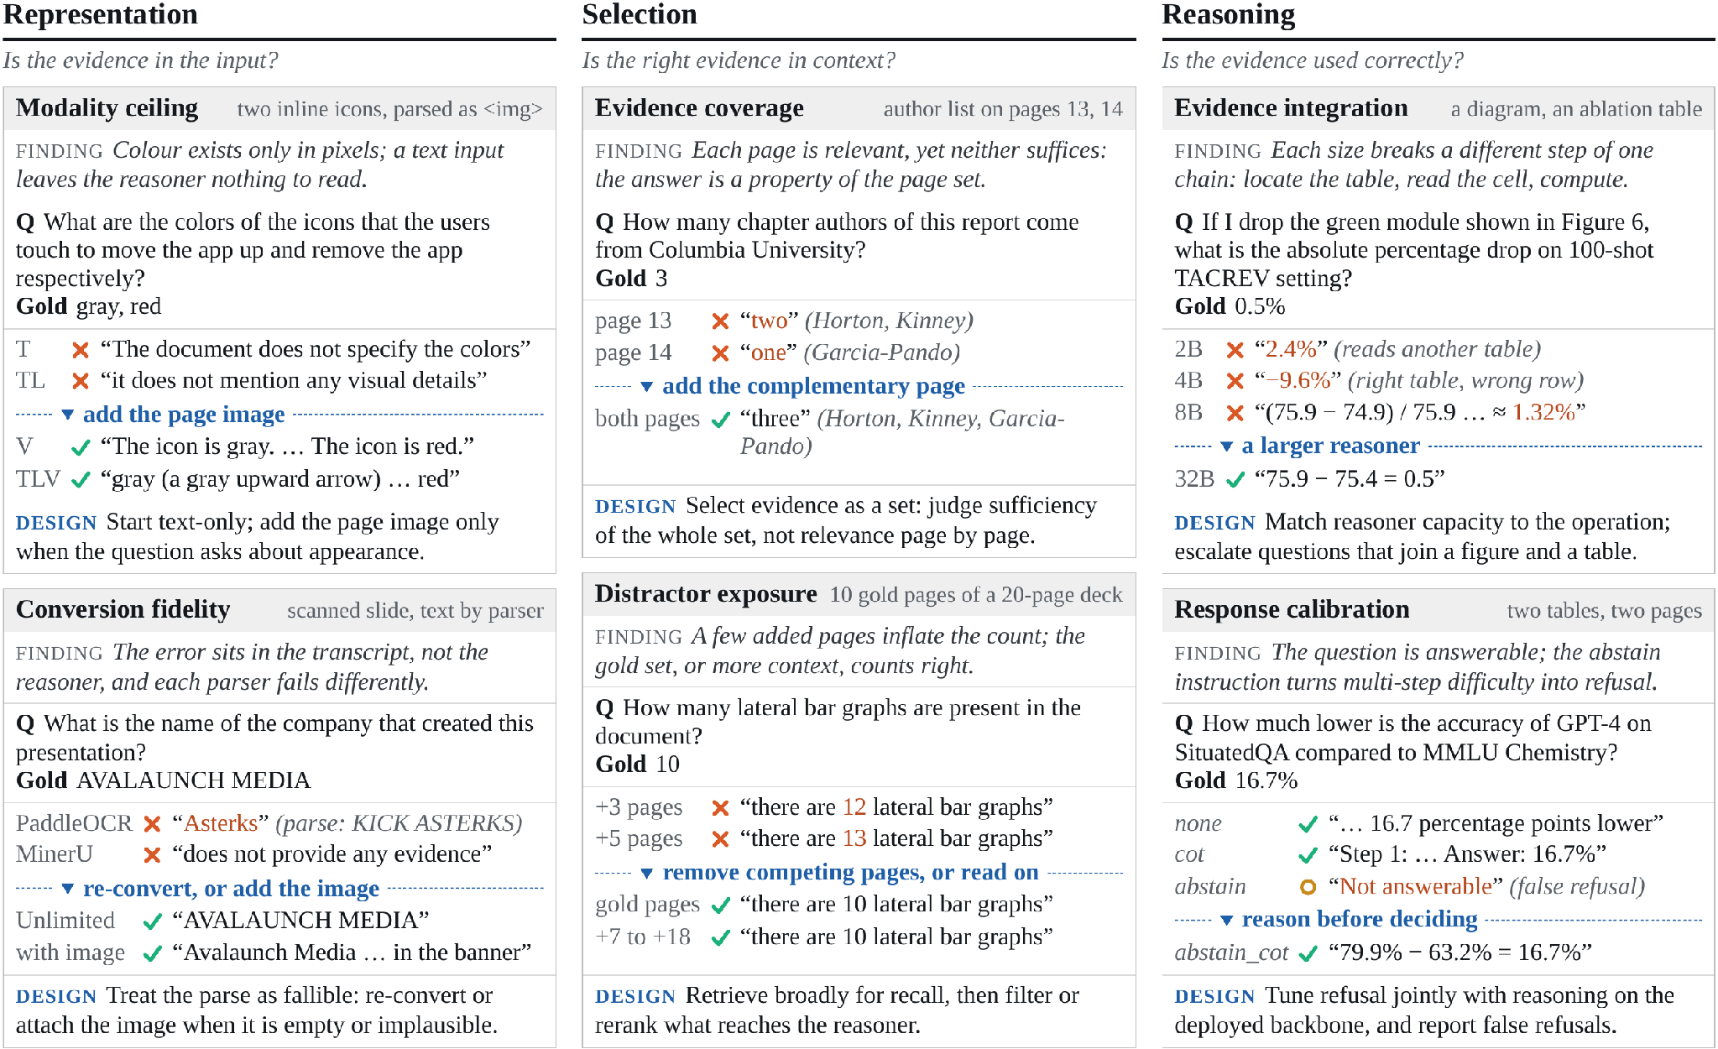
Qualitative Analysis
Chapter 3 · Empirical study · Under review
Six mechanisms on qualitative examples, each with a design implication.
DESIGN
Representation
Add the page image when appearance matters or the text is unreliable
Selection
Retrieve broadly, then filter as a set
Reasoning
Reason before refusing; match model size to the task
Notes:
The paper also checks individual questions to show what each failure looks like. Representation can hide an icon colour or corrupt a table during parsing. Selection can omit a required page or bury it among competing pages. Reasoning can accept a false premise or refuse despite sufficient evidence.
The design responses follow the same three stages: add the image when appearance matters or text is unreliable; retrieve broadly, then filter the evidence as a set; and calibrate the reasoner against the evidence it actually received.

Slide 16
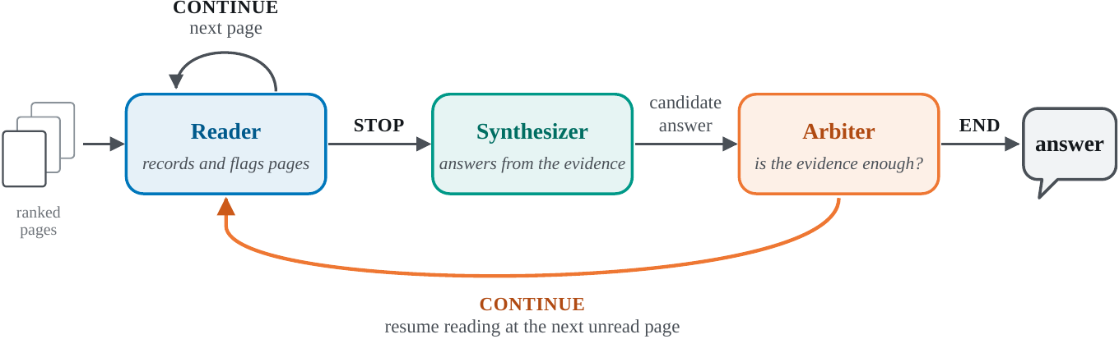
From Findings to a Simple Method
Chapter 4 · Method & conclusion
One model, three roles, each grounded in a finding.
Representation
Reader sees every page as text + image
Selection
Read broadly, pass on compact records
Reasoning
A separate arbiter judges sufficiency
Notes:
To check the findings, we put them into one small system. It is one model playing three roles.
The reader goes through the pages in ranked order. For each page it sees both the text and the image, writes down any evidence it finds, and flags pages that may hold the answer.
The synthesizer answers from the flagged pages in full and the short records of everything else.
The arbiter cannot write an answer. It either accepts, or names a missing fact and sends the reader back for more pages.
Each choice follows from a finding. Text and image together, for representation. Read broadly but pass on short records, for selection. And a separate step that judges whether the evidence is enough, for reasoning.

Slide 17
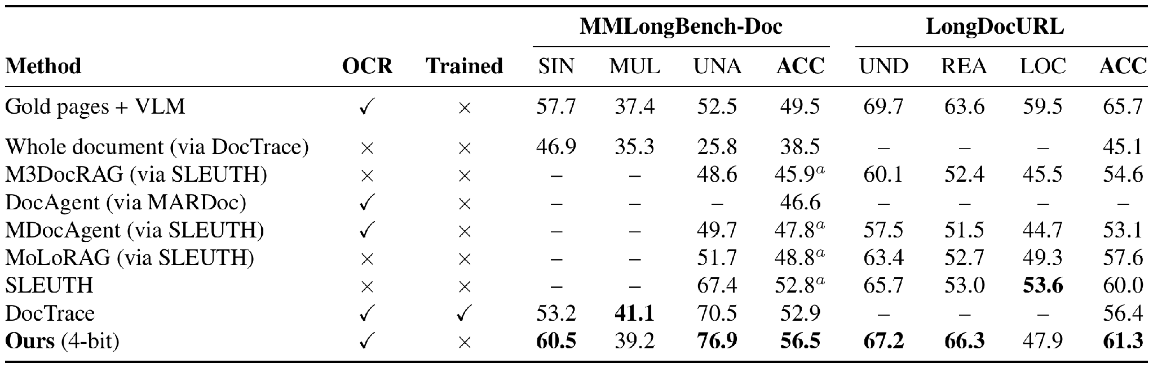
Simple Method: Results
Chapter 4 · Method & conclusion
Best among Qwen3-VL-8B systems, training-free and at 4-bit.
56.5% MMLongBench-Doc · 61.3% LongDocURL
Trade-off: ~10.8 min per question; multi-page still trails DocTrace (39.2 vs 41.1)
Notes:
All systems in this table use the same model with eight billion parameters.
Ours reaches 56.5 percent on MMLongBench-Doc and 61.3 percent on LongDocURL, the highest in the table, without any training and with the model stored at four-bit precision.
It is still behind the trained system DocTrace on questions that need several pages, 39.2 against 41.1.
The cost is time: about eleven minutes per question on average.

Slide 18
Conclusion
Chapter 4 · Method & conclusion
RQ1
Multi-page understanding is evidence management, in four families EMNLP 2026 Main
RQ2
Failures sit at representation, selection or reasoning, each with its own fix Under review
RQ3
A training-free system built on these findings is competitive under a fixed budget
Future work: structure-aware retrieval · calibrated abstention · cost as a first-class metric
Thank you · Questions?
Notes:
To conclude, back to the three research questions.
The survey organises the field. Understanding multi-page documents is a problem of evidence management, and four families of architecture handle it in different ways.
The empirical study locates the failures. They sit at representation, at selection, or at reasoning, and each one needs a different fix.
And a training-free system built on those findings is competitive under a fixed compute budget.
Thank you. I am happy to take questions.

Slide 19
Open Challenges
Chapter 2 · Survey · EMNLP 2026 Main
Each design relocates the bottleneck rather than removing it.
Evidence pipeline
High-resolution reading vs document-scale aggregation
Faithfulness
Few systems abstain or ground answers in evidence
Efficiency
Latency and token cost are rarely reported
Contamination
Training and test sets share source PDFs
Evaluation
Answer-only scores, mostly English VQA
Missing: an end-to-end account of where systems fail → Chapter 3
Notes:
The survey ends with five open challenges, and the one missing piece that motivates our second paper: an end-to-end account of where systems fail.

Slide 20
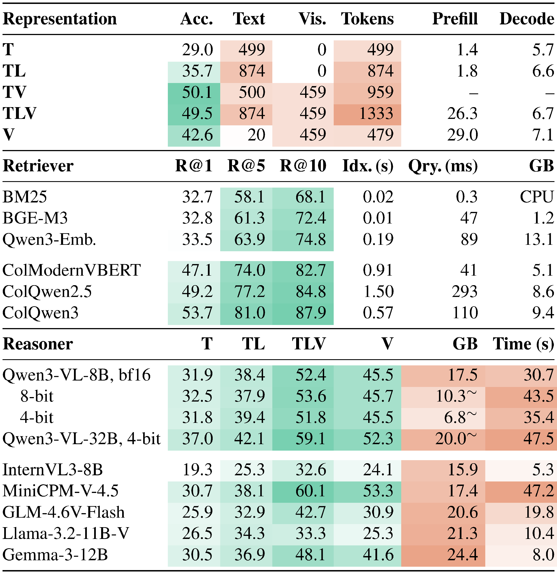
Backup · Deployment: Accuracy and Cost
Backup
Every representation, retriever and reasoner choice has a cost side.
Representation: text + image matches parser text + image with fewer tokens; images cost 26.3 s vs 1.8 s prefill
Retriever: ColQwen3 R@5 81.0% vs BM25 58.1%, but needs a GPU
Reasoner: 4-bit saves memory, not time
Notes:
For questions: the accuracy and cost of each representation, retriever and reasoner choice.

Slide 21
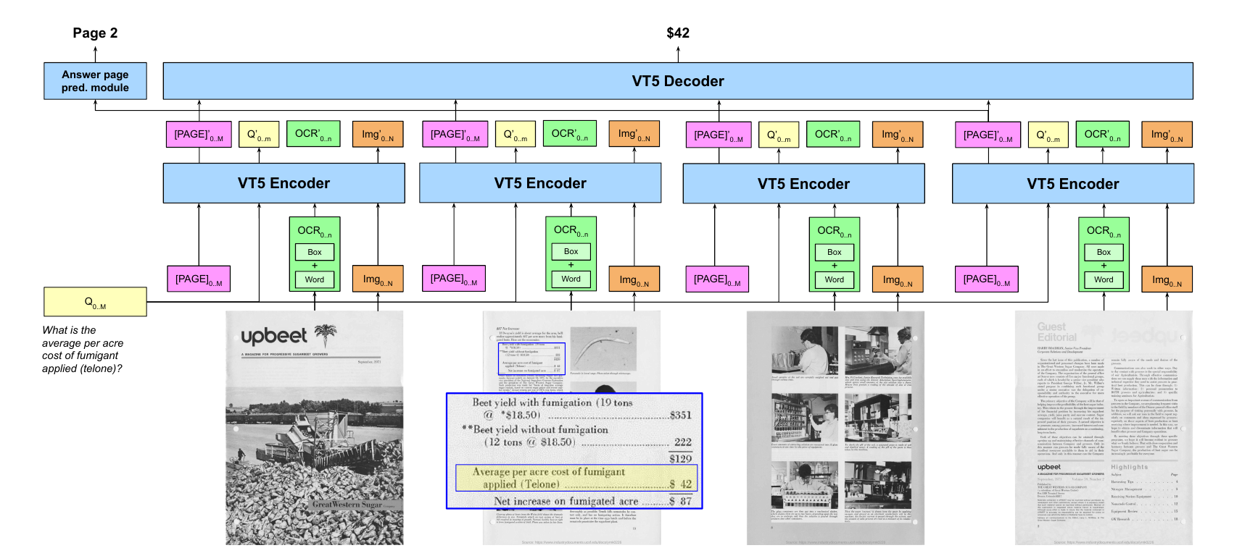
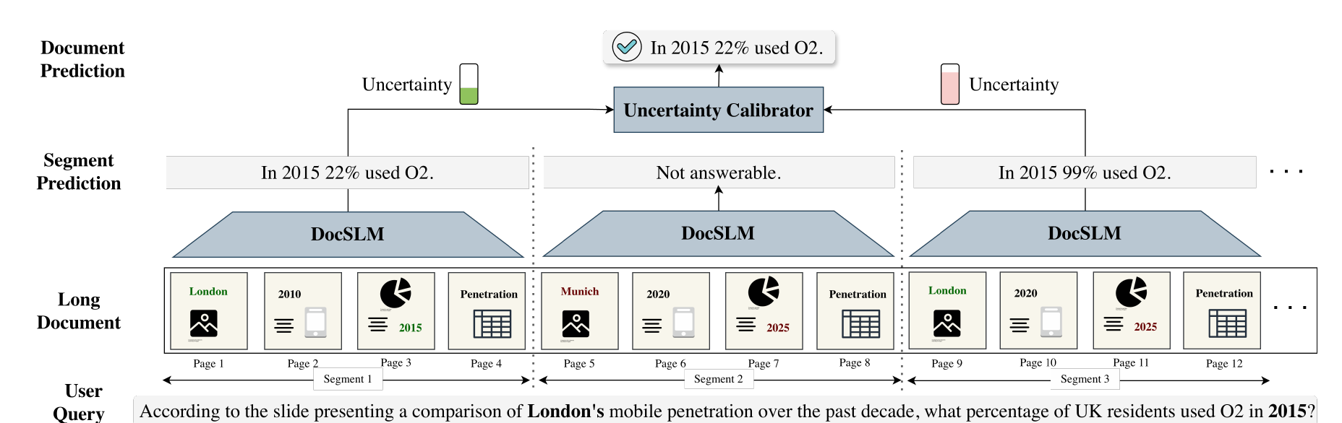
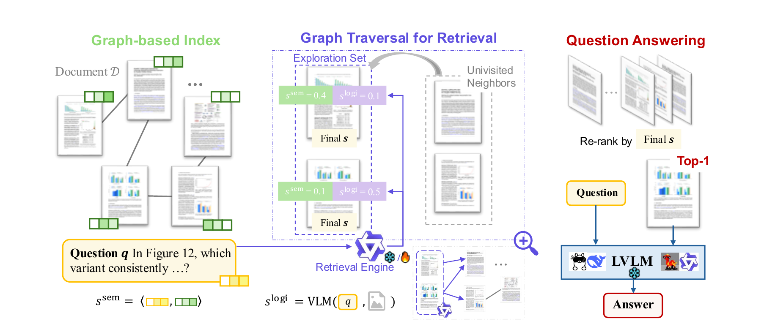
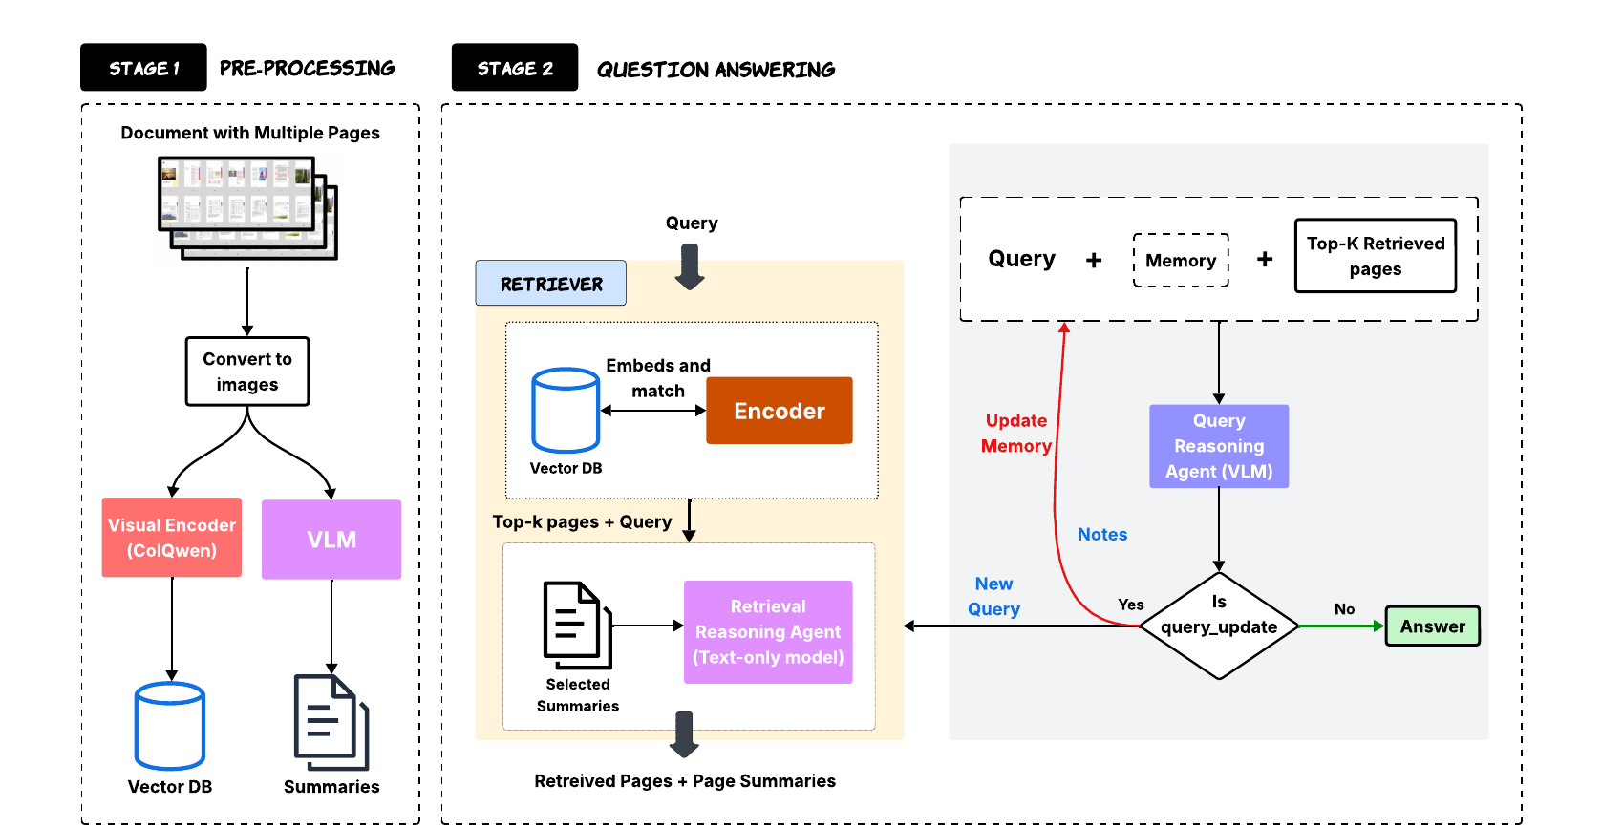
Backup · Representative Frameworks
Backup
One representative system per architectural family.
Hi-VT5 Tito et al., Pattern Recognition 2023
DocSLM Hannan et al., CVPR 2026 Findings
MoLoRAG Wu et al., EMNLP 2025
SimpleDoc Jain et al., EMNLP 2025
Notes:
For questions: one example system from each of the four families.

