Slide 1

HONOURS THESIS PRESENTATION
Multi-Page Visually Rich Document Understanding
A Survey of System Design and an Empirical Attribution of Failure
Lewei Xu
Supervisors: Dr Yihao Ding · Dr Daochang Liu
Department of Computer Science and Software Engineering
School of Physics, Mathematics and Computing · October 2026
Notes:
Hello everyone, my name is Lewei, and I’ve been working on multi-page visually rich document understanding, or just long document understanding, for my honours project this year.

Slide 2
Seminar/Thesis Overview
Chapter 1 · Introduction
Four chapters, three research questions, two papers.
CHAPTER | QUESTION | PUBLICATION
1 Introduction & Background | Why are long documents hard, and why a fixed compute budget? | Thesis chapter
2 Survey | RQ1 How are multi-page systems designed? | Managing Evidence at Document Scale: A Survey of MP-VRDU EMNLP 2026, Main Conference
3 Empirical study | RQ2 Where and why do these systems fail? | Locating Failure in MP-VRDU: An Empirical Attribution Submitted to NAACL
4 Method & Conclusion | RQ3 Can the findings build a competitive system under a fixed budget? | Thesis chapter: training-free proof of concept
Notes:
First, I’ll go through some background.
Then I’ll go cover the 2 papers completed this year.
The first is survey of the long document understanding field.
The second paper is an empirical study on designing and deploying long document understanding systems.
If we have time, I’ll go over this proof of concept method for long document understanding that uses the findings of empirical study.

Slide 3
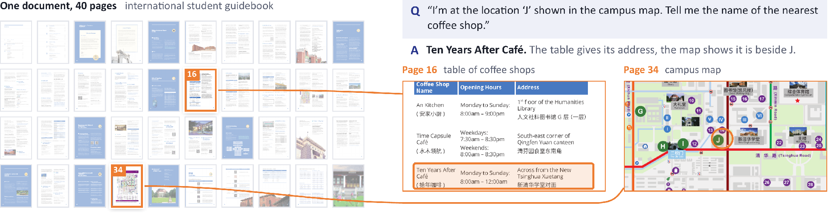
What is MP-VRDU?
Chapter 1 · Introduction
Meaning lives in text, visuals and layout, and often runs across pages.
A question from MMLongBench-Doc: the answer needs the table on page 16 and the map on page 34.
Long
Exceeds the model’s context window
Sparse
Evidence is buried among many pages
Structured
Links cross pages: “see Table 3”
Notes:
So, what do we mean by a visually rich document?
Documents carry meaning through text, visual elements like charts and figures, and how these are laid out on a page.
A multi-page document simply has two or more pages, but its meaning can be spread across those pages and connected between them.
Although when we say multi-page, we generally mean longer documents from 50 or hundreds of pages.
For the purposes of this seminar, the definition of document understanding is just answering an arbitrarily specific natural language question over a long visually rich document.
Here is an example of relatively easy question now, but was very difficult even just a year ago.
Long document understanding is difficult due to two main reasons
First is the sheer volume of information, both textual, visual and structural, is often too much for even long context vision language models to read in full, and even if you can, reasoning over so much information is very difficult.
Second is that answer relevant evidence can be scattered across the document, and you need to combine and reason over this evidence to successfully answer a question.

Slide 4
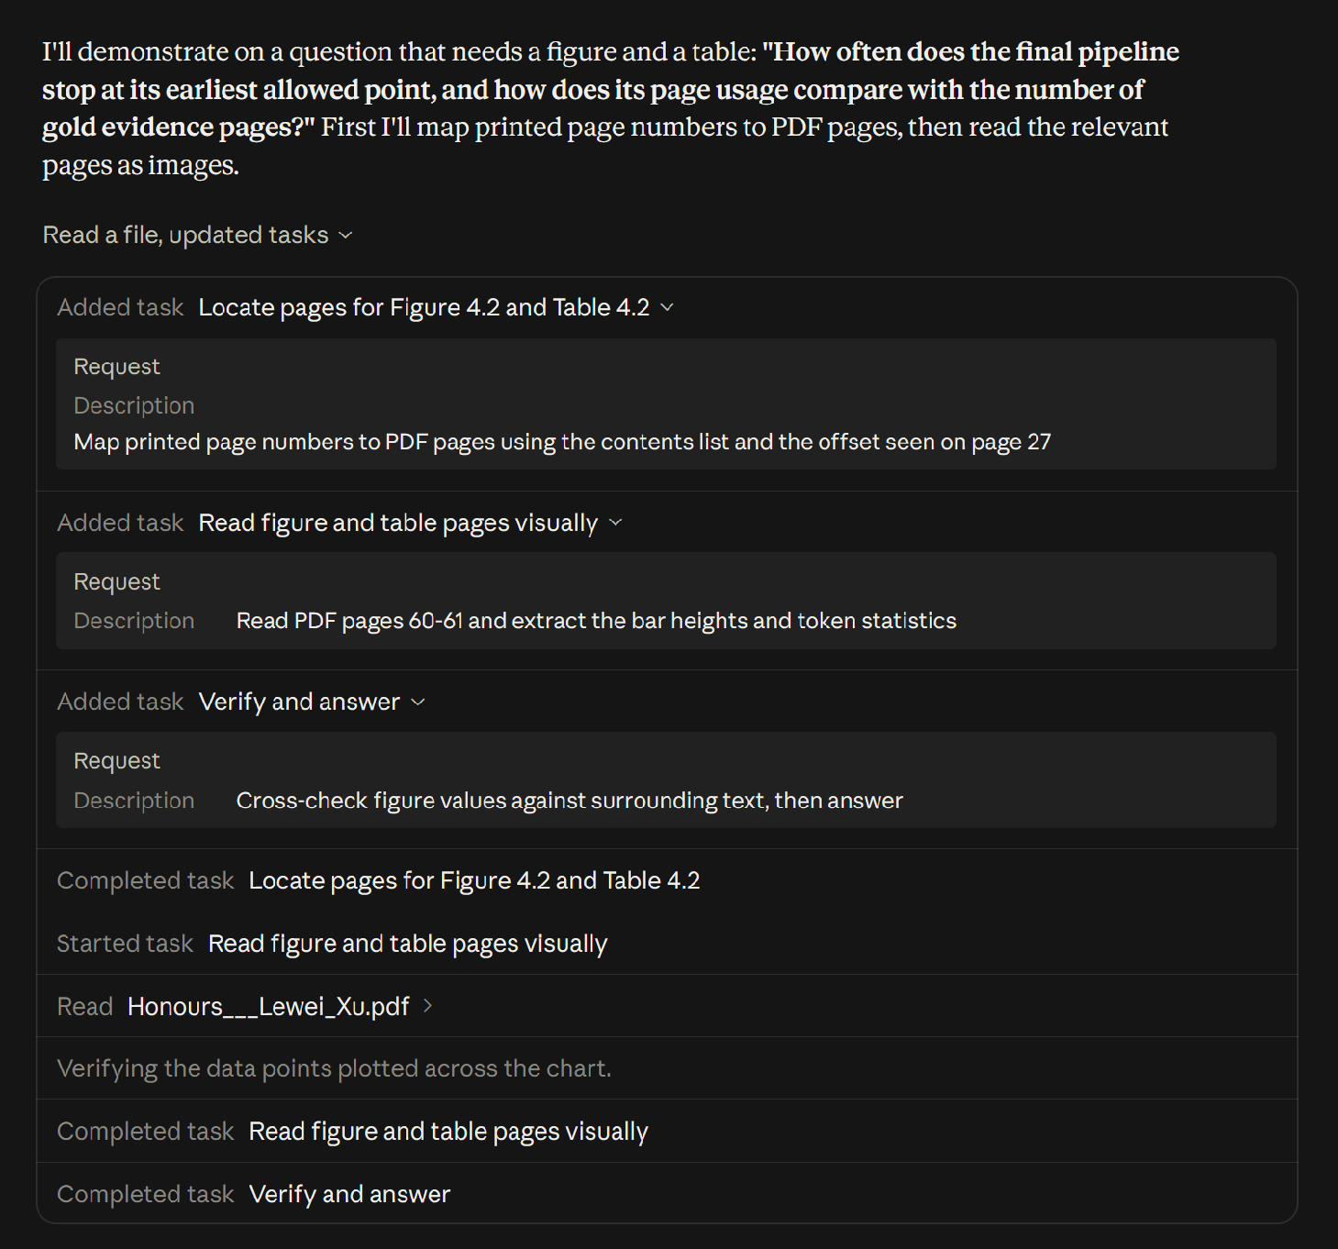
MP-VRDU in Real World Applications
Chapter 1 · Introduction
Real deployments need local, open-weight models under a fixed compute budget.
IN INDUSTRY
Thousands to millions of documents
Privacy: medical, legal and financial records stay in-house
Cost: API fees become prohibitive at millions of documents
Specialisation: domain documents need an adapted model
In any case, you need to build your own document understanding pipeline, either by running local VLMs, or via third party API
LLM assistants plan, locate and inspect pages before answering.
Notes:
We can already see document understanding research being applied in the language model assistants we use.
Here’s an example of me uploading my thesis which is close to 100 pages, and claude is able to answer questions very accurately.
But these assistants are just one application of document understanding.
In industry, you might have one or a few specific tasks to perform over thousands or millions of documents.
One major concern is privacy. For example, medical and legal documents cannot be sent to a third-party service due to data-residency requirements.
Another is cost. Even without privacy concerns, processing that volume through a commercial API can be very expensive.
Another case is specialist document types may need specialized pipelines to process them, or maybe even additional training on the language model.
Nor is uploading documents one by one to a LLM assistant feasible, and you might need structured output for automatic downstream processing
As a result, real deployments need to implement their own document understanding pipeline either using API calls to closed source models, or by running local vision language models.

Slide 5

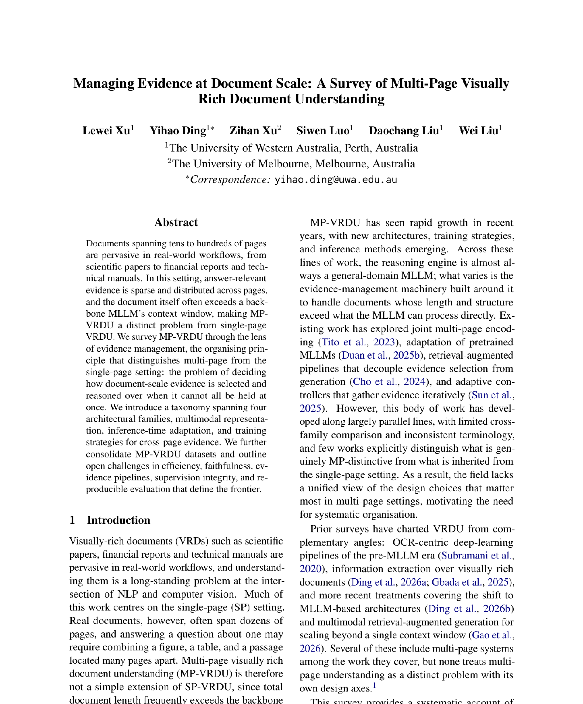
Managing Evidence at Document Scale: A Survey of Multi-Page Visually Rich Document Understanding
Chapter 2 · Survey \
First-Authored and Accepted at the EMNLP 2026 Main Conference, Budapest.
RESEARCH GAP
Multi-page systems grew along parallel lines, with inconsistent terminology and little cross-family comparison.
CONTRIBUTIONS
The first survey to treat MP-VRDU as a distinct problem
We survey 46 systems, organised by evidence management, spanning 4 architectural families, multi-page multimodal representation, inference-time adaptation, and training strategies.
47 datasets consolidated; five open challenges
Notes:
That brings us to the survey paper completed earlier this year.
This is the first survey to treat the multi-page setting as a distinct problem.
And has been accepted into a top tier conference for natural language processing.
I’m a bit conscious of time so i’ll mainly talk about the 4 architectural families, and mostly skip everything else

Slide 6
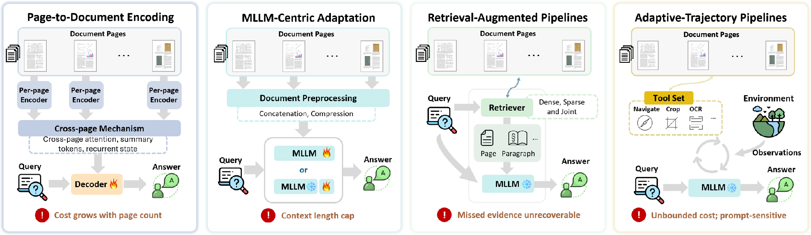
Four Architectural Families
Chapter 2 · Survey
Each family fixes the previous bottleneck and relocates it rather than removing it.
Late 2023 to mid 2024
Early 2024 to late 2025
Early 2024 to mid 2026
Early 2025 to mid 2026
e.g. Hi-VT5, GRAM
e.g. DocSLM, Docopilot
e.g. M3DocRAG, MoLoRAG
e.g. SimpleDoc, DocAgent
Notes:
These architectural families can also be considered different approaches to long document understanding.
The first family is page-to-document encoding models, an early approach that extends single-page architectures to the multi-page setting.
Each page is encoded separately into a compact representation. Those representations are connected through a cross-page mechanism, such as attention, and passed to a decoder to generate the final answer.
The limitation is that pages contain different amounts of information. Giving each page a fixed representation budget can lose fine-grained detail during encoding.
The second family addresses this by removing the per page encoding step, and instead adapts a pretrained multimodal large language model to process the document natively within its context window.
Adaptation can involve continued pretraining on document tasks or fine-tuning. Some systems also compress the representations to fit longer documents.
But performance can still degrade as documents get longer, and some documents cannot fit at all.
This motivates retrieval-augmented pipelines. Instead of fitting the whole document into the model, we retrieve relevant evidence and pass a smaller evidence set to a vision-language model.
Retrieval can be sophisticated, but the workflow is fixed in advance. Evidence missed during retrieval cannot be recovered by the answering stage.
Finally, adaptive-trajectory pipelines follow an agentic approach. The language model decides what evidence to collect, how to collect it, and when it has enough to answer.
But those repeated calls can become expensive, and make the total time and compute cost harder to bound.
The dates show roughly when each family is active in the papers we surveyed. Each one fixes the bottleneck of the one before, and moves it somewhere else.
We call the first two families models, because they are trained end to end. We call the last two pipelines, because their components are interchangeable.

Slide 7
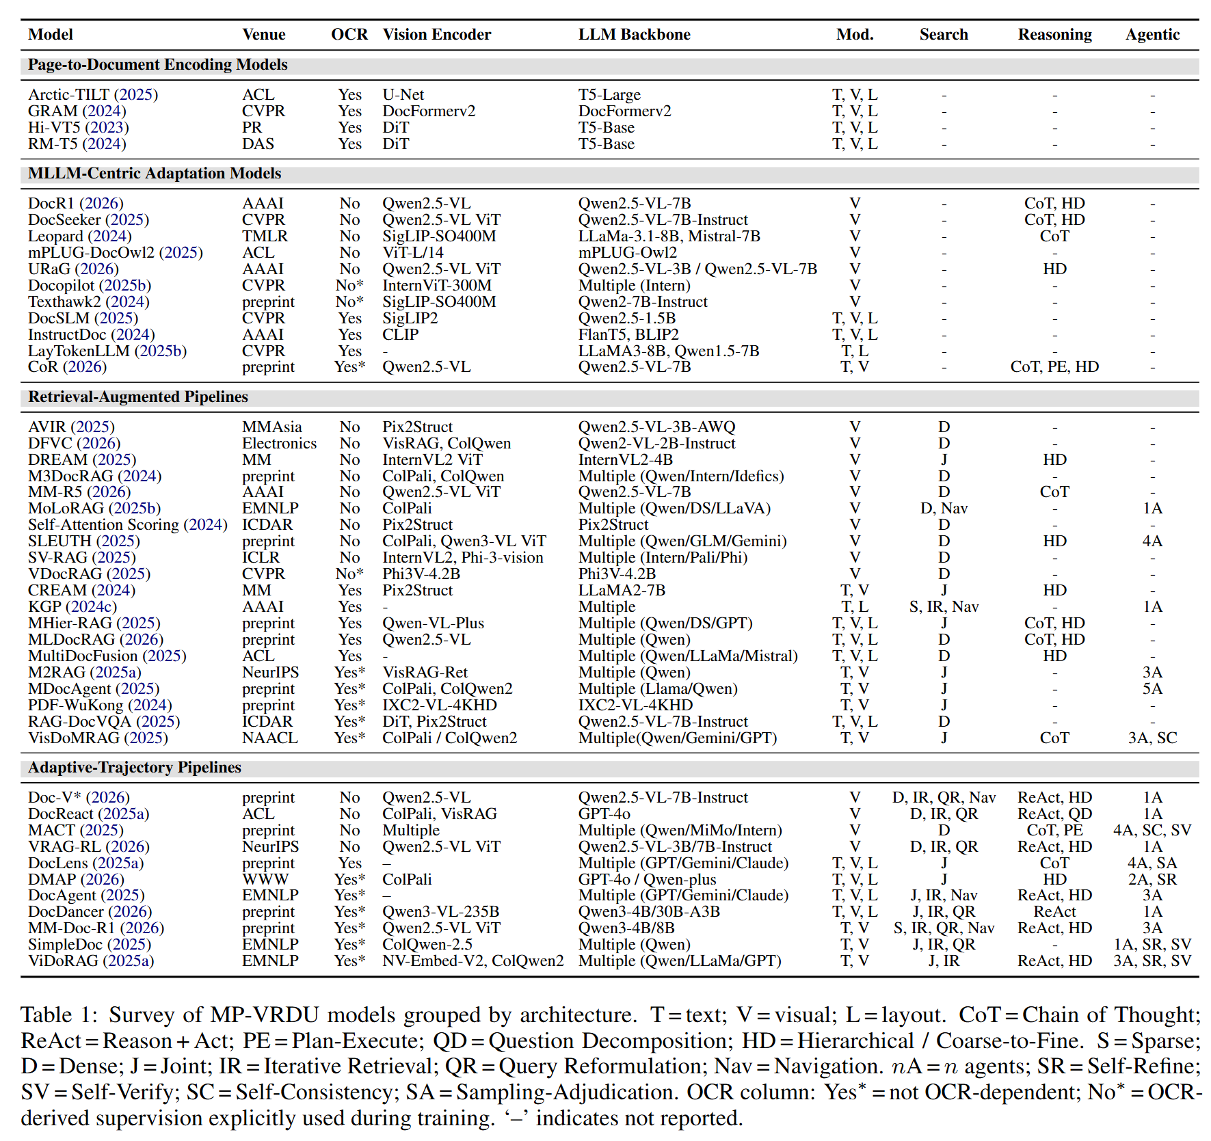
Surveyed Systems Main Table
Chapter 2 · Survey
Models vs pipelines
Models are trained end-to-end with purpose built components
Pipelines usually use a frozen LVLM backbone with interchangeable components/backbones.
Modalities
Encoding models use text, vision and layout; MLLM-centric models are mostly vision only.
Search
Appears only once retrieval is separated from answering.
Notes:
This is the main table of the survey, with the systems and papers we surveyed grouped by architectural family.
There are three things I want to point out
First, with the first 2 architectural families, we call them “models” because they’re generally trained end to end with purpose build components
The last 2 families we call them “pipelines” because they generally use a frozen vision language backbone sometimes with some fine tuning.
Their components are usually interchangeable, especially the vision language backbone, so as these language models get stronger, the pipelines also benefit from these improvements
Second, the modalities. Some systems use vision only, treating document understanding as a pure computer vision problem.
Others combine vision with text and layout information. The text may be embedded in the document or extracted by a parser.
This distinction will be important in the next part of the seminar.
Third, search. It only appears once retrieval is separated from answering, in the two pipeline families.

Slide 8
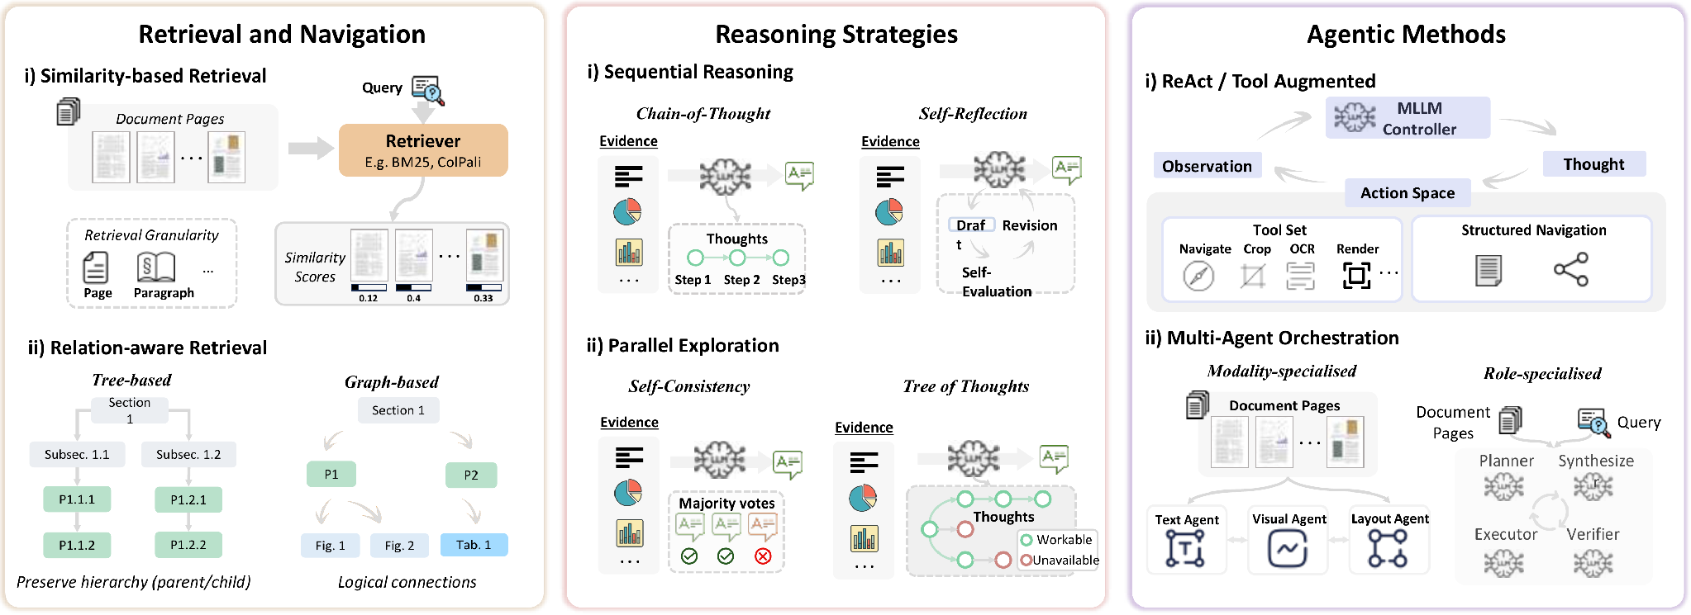
Inference-Time Strategies
Chapter 2 · Survey
Training free strategies to improve document understanding performance. Retrieval and Agentic methods are used for Retrieval Augmented and Adaptive Trajectory Pipelines; Reasoning strategies can be applied to any LVLM.
Relation-aware retrieval finds links similarity misses
A chain cannot recover what retrieval missed
Lifts the recall ceiling; cost is hard to bound
Notes:
Various training free strategies can be used to improve document understanding performance
Retrieval and navigation techniques such as similarity based and relation aware retrieval
And agentic methods such as reason + act with tool calls and multi-agent orchestration
These are used only in retrieval augmented and adaptive trajectory pipelines
Reasoning strategies such as cot, reflexion, sc, tot can be applied to all reasoning backbones.

Slide 9
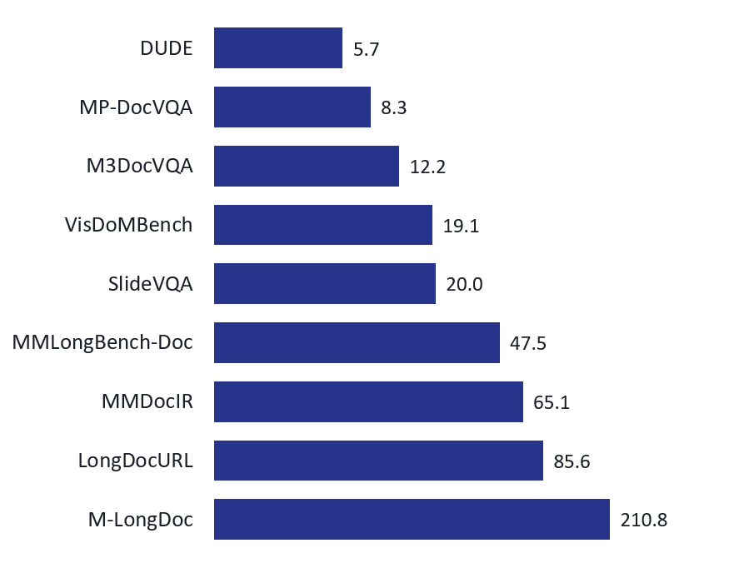
Training Strategies & Datasets
Chapter 2 · Survey
Pretraining is rare; fine-tuning carries the weight, with RL layered on top.
TRAINING
BENCHMARKS: AVERAGE PAGES PER DOCUMENT
Retrieval: alignment, cross-page fusion, logical relevance
Reasoning: trace imitation, then reward-driven GRPO
Agentic: trajectory distillation, then RL
Cross-cutting: PEFT / LoRA, single- to multi-page curricula
Fine-tuning data is mostly LVLM-synthesised; 16 of 19 papers that fine-tune on MP-DocVQA also evaluate on it.
Notes:
Pretraining is rare for long document understanding due to scarcity of data
We see a lot of fine tuning techniques applied across retrieval, reasoning and agentic behaviour
Document length in benchmarks are also getting increasingly longer as document understanding systems get better

Slide 10
Locating Failure in Multi-Page Visually Rich Document Understanding: An Empirical Attribution
Chapter 3 · Empirical study
RESEARCH GAP
CONTRIBUTIONS
Prior diagnostic studies are rarely applied to the document understanding domain
Method papers chase higher performance rather than informing design and deployment decision
Three architecture-independent failure loci
Controlled empirical attribution: 2 datasets × multiple model families
Guidance for local deployment
Under review. Failures at different stages produce the same wrong answer.
Notes:
That brings us to the empirical study for long document understanding
The goal of

Slide 11
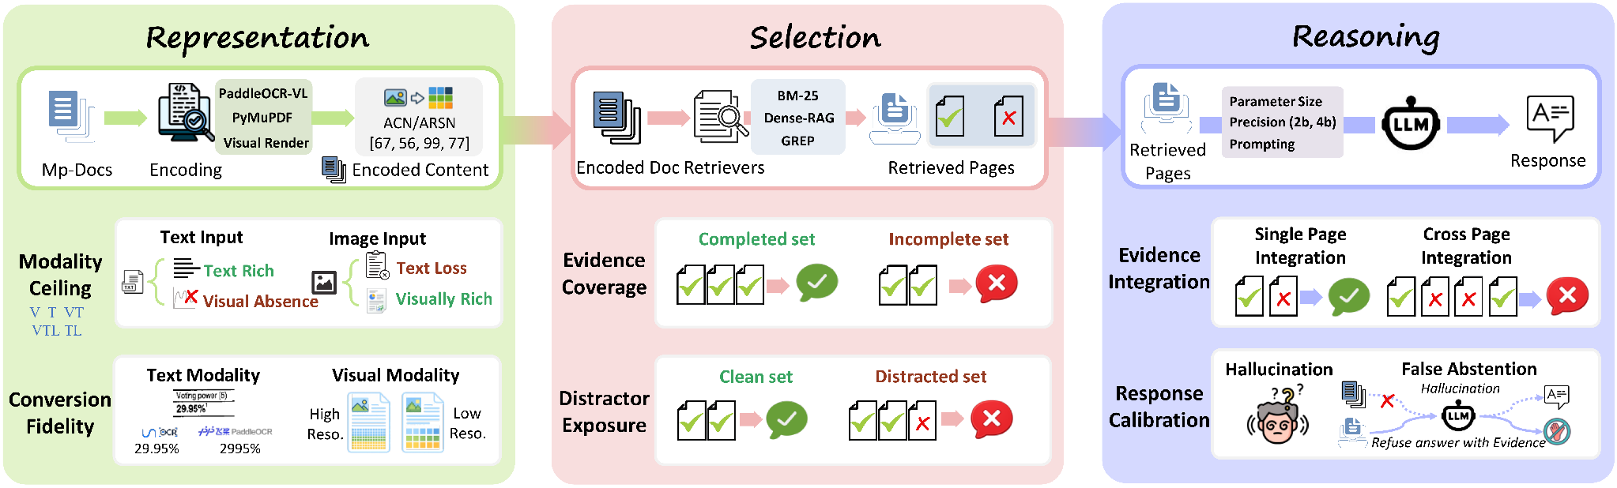
Attribution Framework

Slide 12
Methodology: Attribution by Construction
Chapter 3 · Empirical study · Under review
Change one stage, hold the other two fixed.
Encode Representation
Retrieve Selection
Answer Reasoning
T · TL · TLV · V
3 parsers · 3 resolutions
Gold pages, or
drop one · add k distractors
Qwen3-VL 2B → 32B
4 prompt modes
Self-consistency · Reflexion
T embedded text · TL parser text · V page image · TLV parser text + image (default)
DATA
MODELS
EVALUATION
MMLongBench-Doc: 135 documents with evidence pages, sources, answerability. LongDocURL: 396 born-digital documents.
Qwen3-VL (Alibaba) and Gemma-3 (Google), developed independently
Gemini-2.5-Flash judge: 98.3% agreement with a human annotator
Notes:
We use a simple encode, retrieve and answer pipeline, and each experiment changes one stage while holding the other two fixed.
For representation, we vary the modality, the parser and the image resolution.
For selection, we give the model the annotated gold pages, which bypasses retrieval, and then remove a page or add distractor pages.
For reasoning, we vary the model size and the prompt, and we also try two strategies that spend more computation: self-consistency and Reflexion.
The main benchmark is MMLongBench-Doc, with 135 documents and annotations for evidence pages, evidence type and answerability.
Two model families and a second document collection provide checks on transfer.

Slide 13
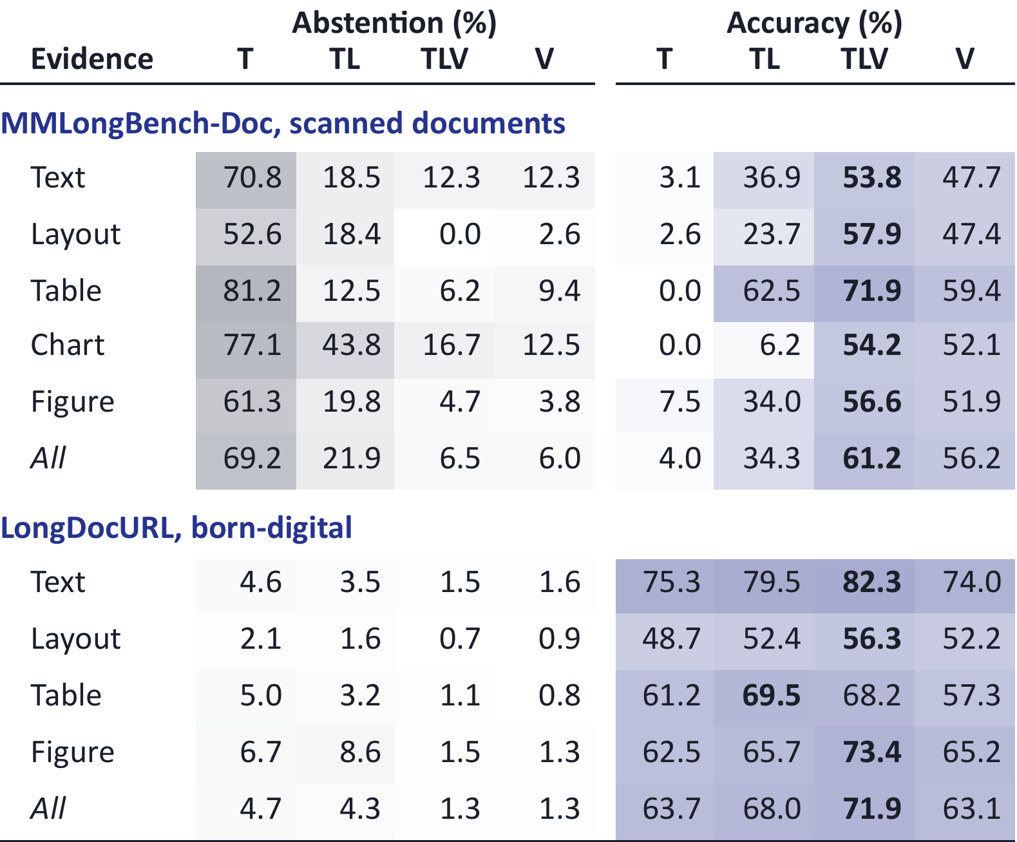
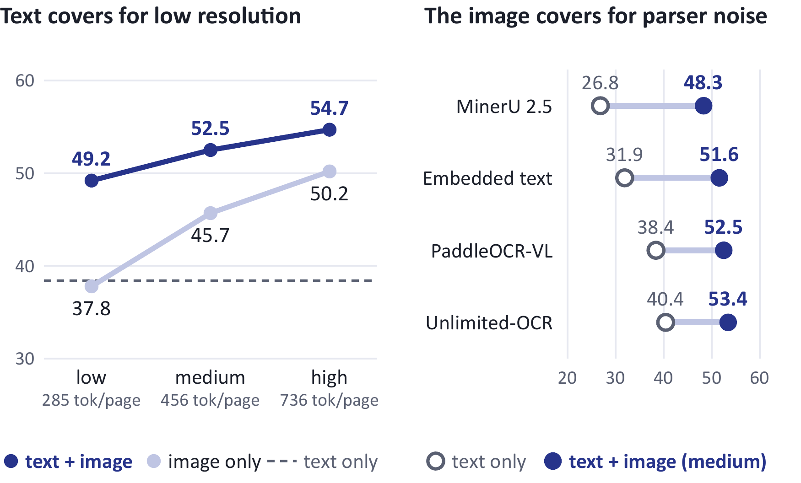
Finding 1 · Representation
Chapter 3 · Empirical study · Under review
Text and vision are complementary: neither alone is enough.
Qwen3-VL-8B on MMLongBench-Doc, 847 answerable questions, gold pages
Text 38.4%, low-res image 37.8%, together 49.2%
Parser spread: 13.6 → 5.1 pts once the image is added
T embedded text · TL parser text · TLV parser text + image · V page image
Notes:
The first finding is about representation: text and vision are complementary, and neither alone is enough.
The table shows how often the model declines to answer, and how often it is right, for each type of evidence and each representation.
On scanned documents, the text embedded in the file is nearly useless. The model declines about 70 percent of questions. A parser recovers much of that, and adding the page image does best on every evidence type.
On born-digital documents, in the lower half, text alone is already close, and the image adds only a few points.
So how much of each you need depends heavily on the document type and the task. There is no one size fits all.
The figure on the right shows why combining them works. Parser text alone answers 38 percent, a low-resolution image alone 38 percent, and together 49 percent. Text covers for low resolution.
And the image covers for parser noise. Text only, the four text sources are 14 points apart. With the image added, they are 5 points apart.

Slide 14
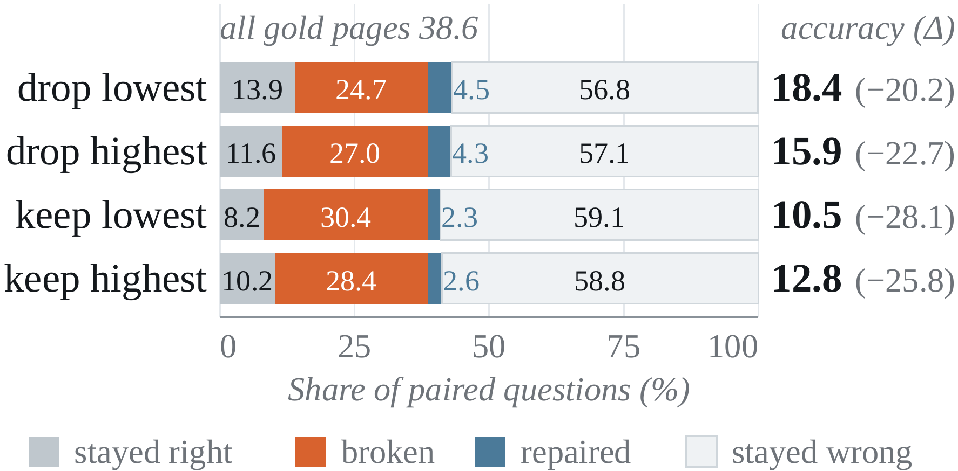
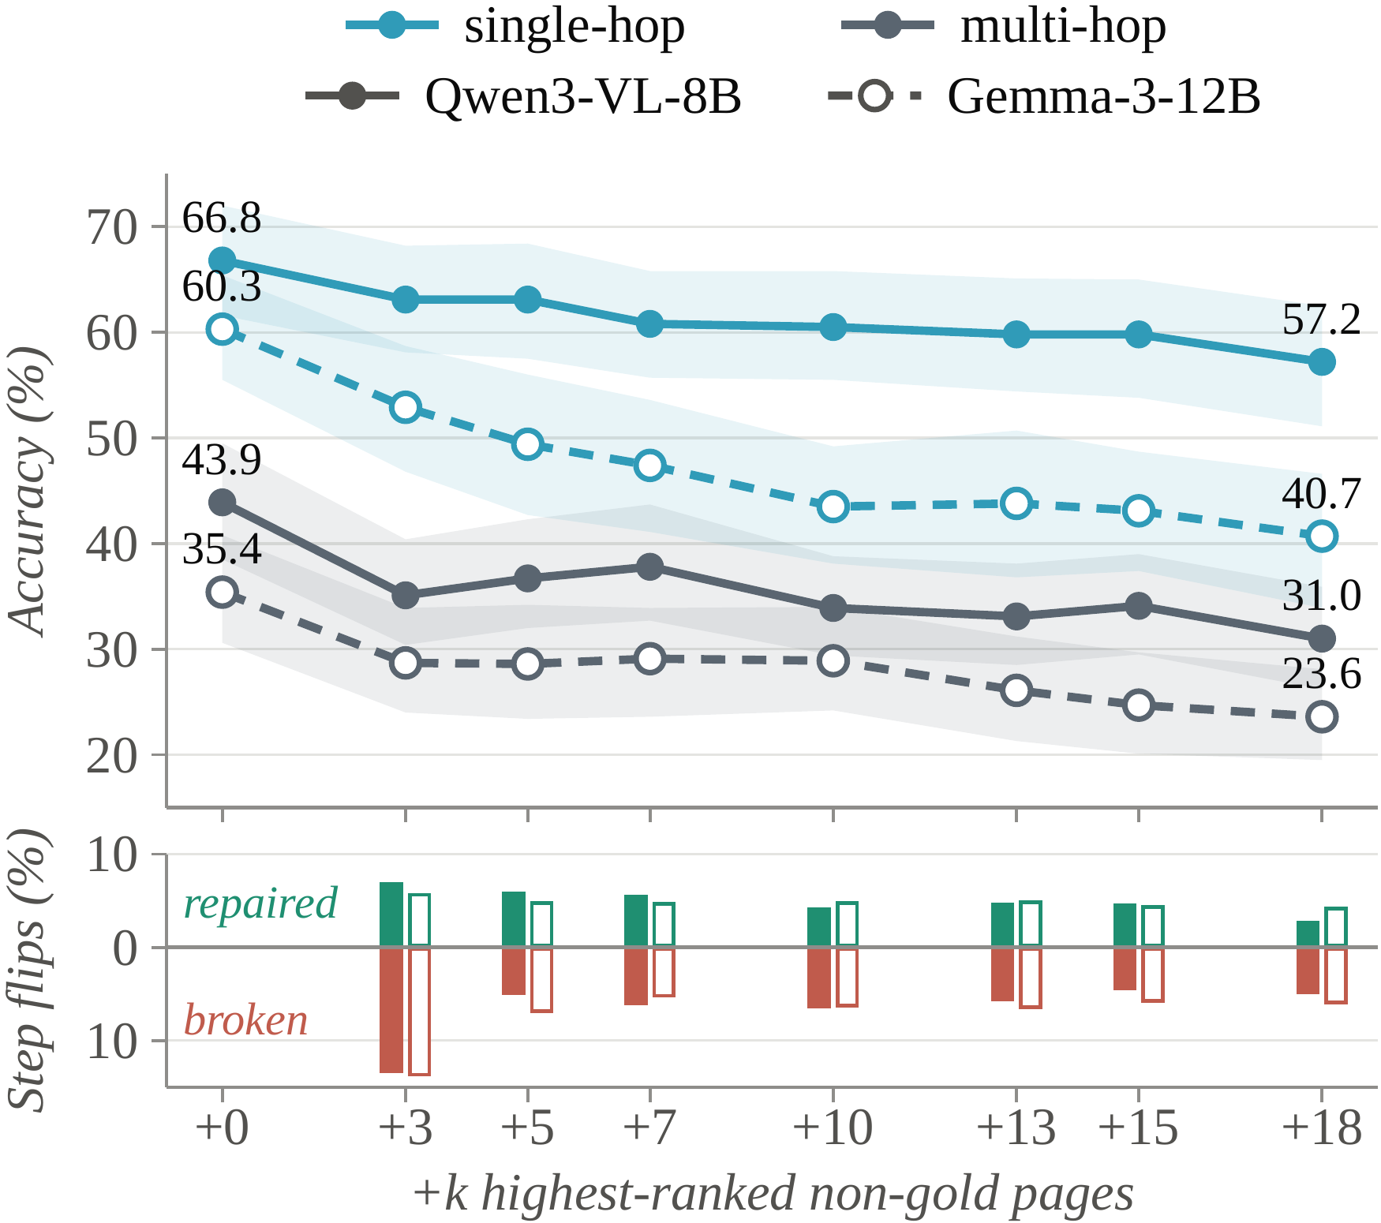
Finding 2 · Selection
Chapter 3 · Empirical study · Under review
Select evidence as a set, not page by page.
Evidence coverage: removing one gold page
All gold pages 38.6% → drop one 18.4%
Retrieval rank does not predict which page is safe to lose
Distractor exposure: flips against the gold-pages answer (Qwen3-VL-8B)
+3 pages: 7.0% flip to correct, but 13.3% break
Each later step: about 5% flip each way
Extra context repairs some answers while burying others
Distractor exposure: +3 pages, multi-hop 43.9% → 35.1%
Notes:
The second finding is about selection: evidence has to be selected as a set, not page by page.
If we retrieve too little, required evidence is simply missing. Removing one gold page halves accuracy, from 38.6 to 18.4 percent, and the retrieval rank does not tell us which page is safe to lose.
If we retrieve too much, the reasoner struggles to find and combine the evidence. On the right, every gold page is present, and accuracy still falls as we add more pages, most sharply for multi-hop questions.
But the extra pages do not only hurt. With three added pages, 7 percent of questions flip from wrong to correct, while 13 percent break.
After that first step, about 5 percent of answers flip in each direction every time we add more pages.
So extra context repairs some answers while burying others, and there is no clear signal for when to stop.
We need enough evidence to establish the answer, not just enough to generate one.

Slide 15
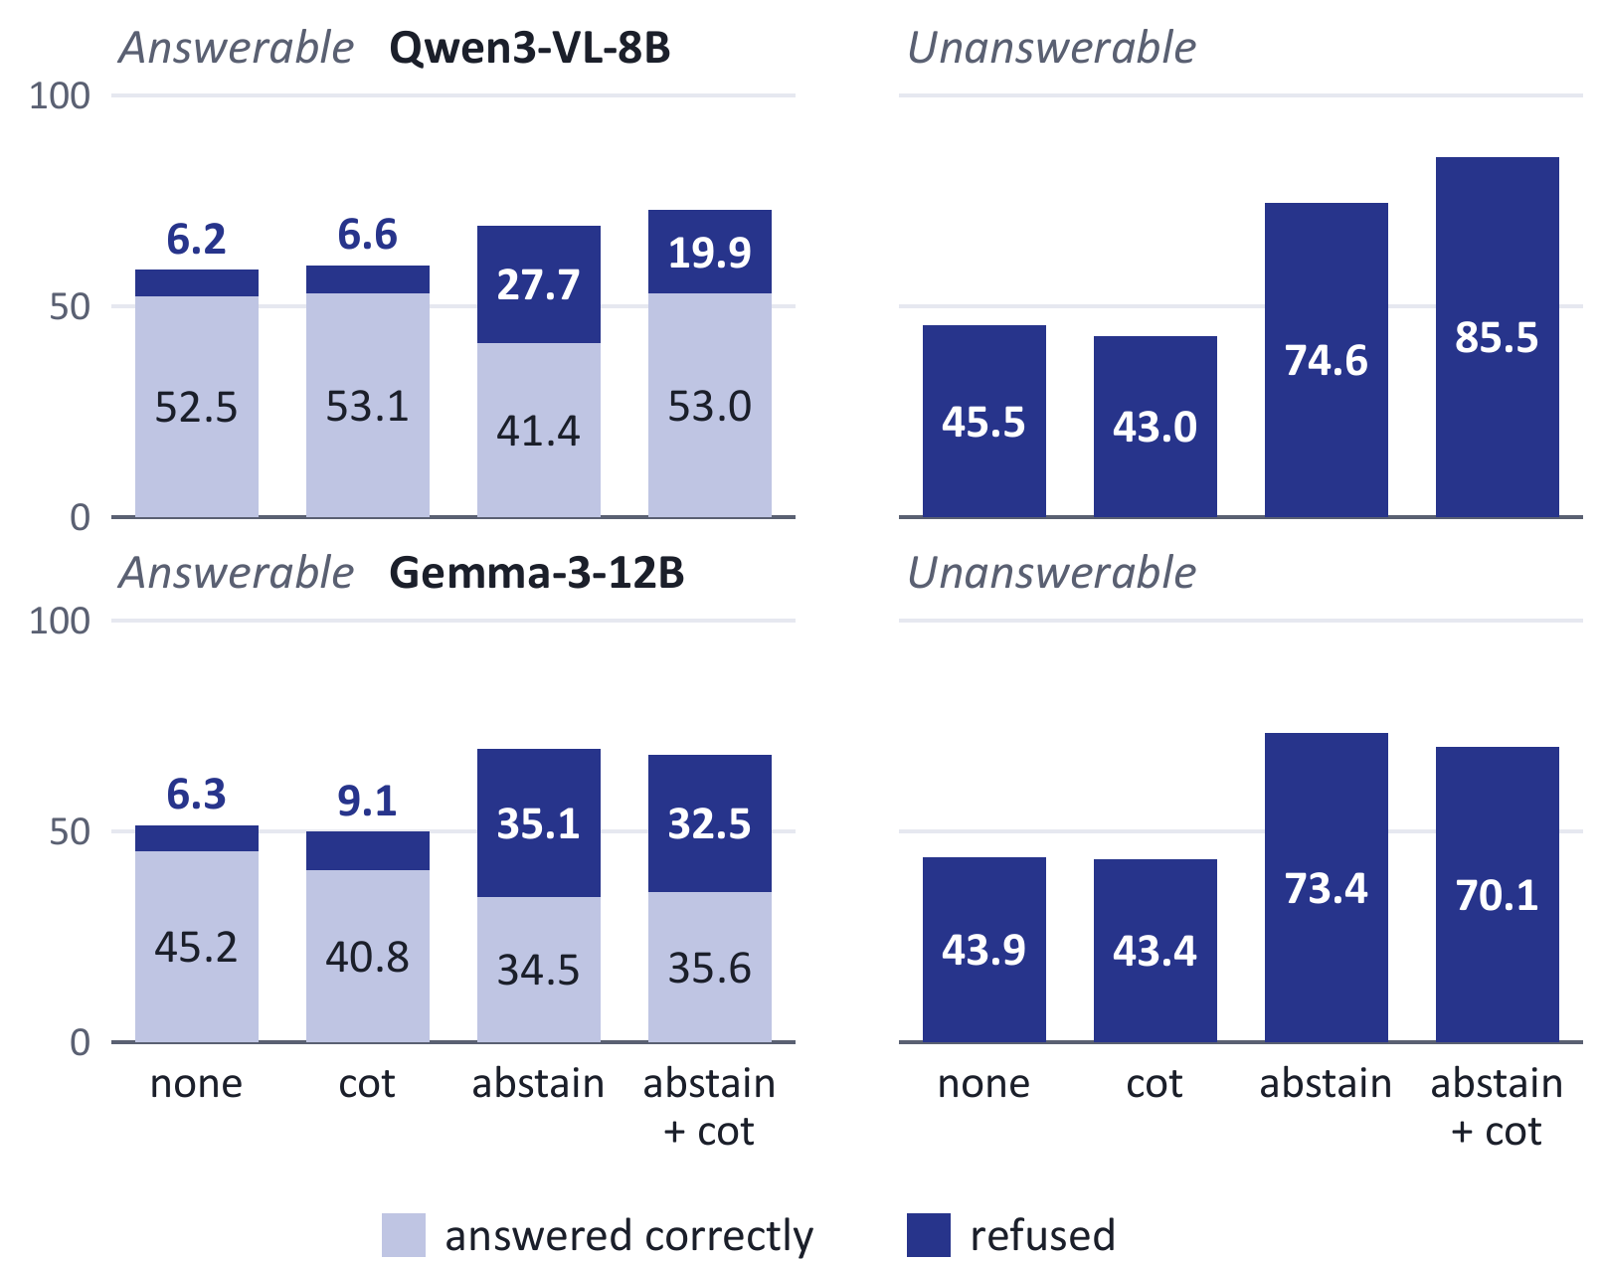
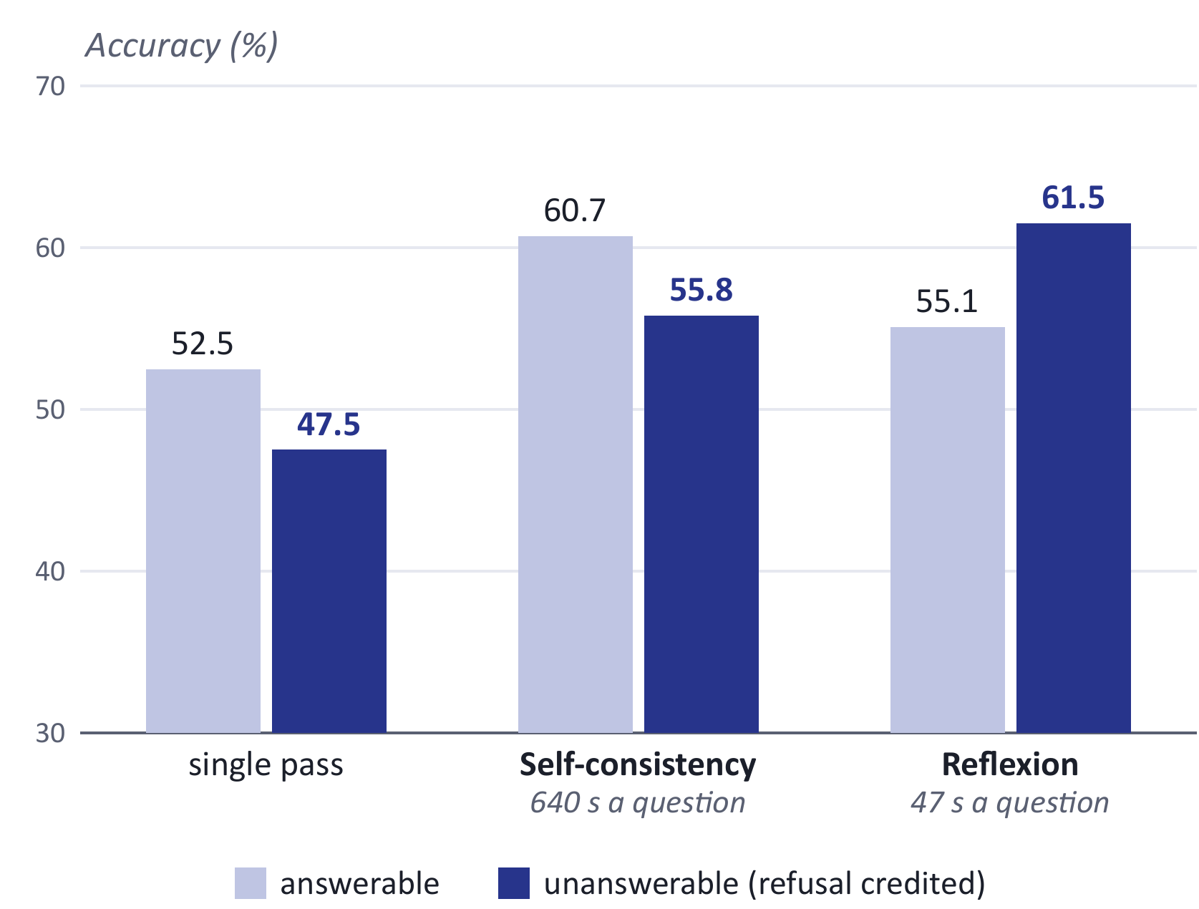
Finding 3 · Reasoning
Chapter 3 · Empirical study · Under review
Prompts move the refusal trade-off; more computation helps, at a price.
Abstain prompt, Qwen3-VL-8B: refusal 45.5% → 74.6%, false refusal 6.2% → 27.7%. Gemma-3-12B moves the same way.
More computation: +8 answerable at 640 s, +14 unanswerable at 47 s. Preliminary: self-consistency on 773 of 847.
Notes:
The third finding is about reasoning.
A question can contain a premise the document does not support. With no instruction, the model refuses only 45 percent of unanswerable questions and answers the rest fluently.
Prompts change this behaviour. If we explicitly allow the model to say not answerable, it correctly refuses far more unanswerable questions, from 45.5 percent to 74.6 percent.
But it also refuses more answerable ones, from 6.2 percent to 27.7 percent. Asking it to reason first wins most of that accuracy back.
The second model family, Gemma-3 in the lower row, moves the same way.
We can also spend more computation on reasoning. Self-consistency samples many reasoning paths and takes a vote. It adds about 8 points on answerable questions, at about 640 seconds a question.
Reflexion lets the model retry after checking its own answer. It adds about 14 points on unanswerable questions, at about 47 seconds.
These last numbers are preliminary, so I read them as a direction: more computation helps, at a price.

Slide 16
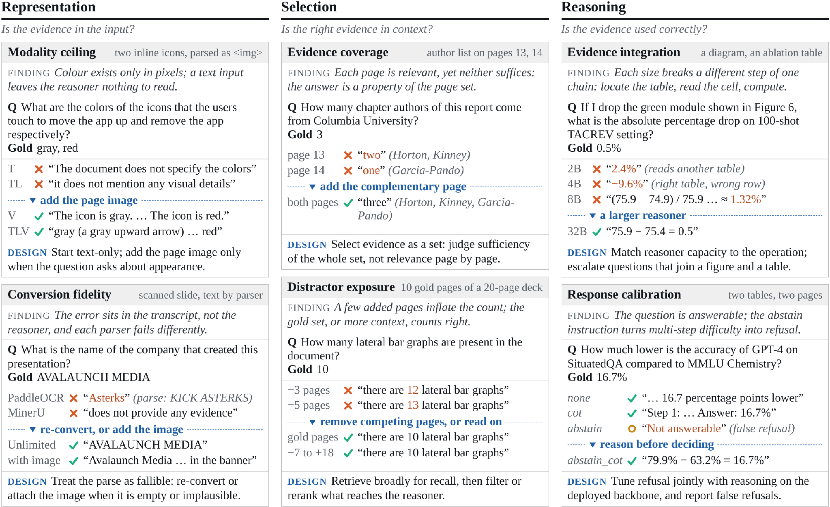
Qualitative Analysis
Chapter 3 · Empirical study · Under review
Six mechanisms on qualitative examples, each with a design implication.
DESIGN
Representation
Add the page image when appearance matters or the text is unreliable
Selection
Retrieve broadly, then filter as a set
Reasoning
Reason before refusing; match model size to the task
Notes:
Six mechanisms on real questions, two per failure point, each with the design choice it suggests.

Slide 17
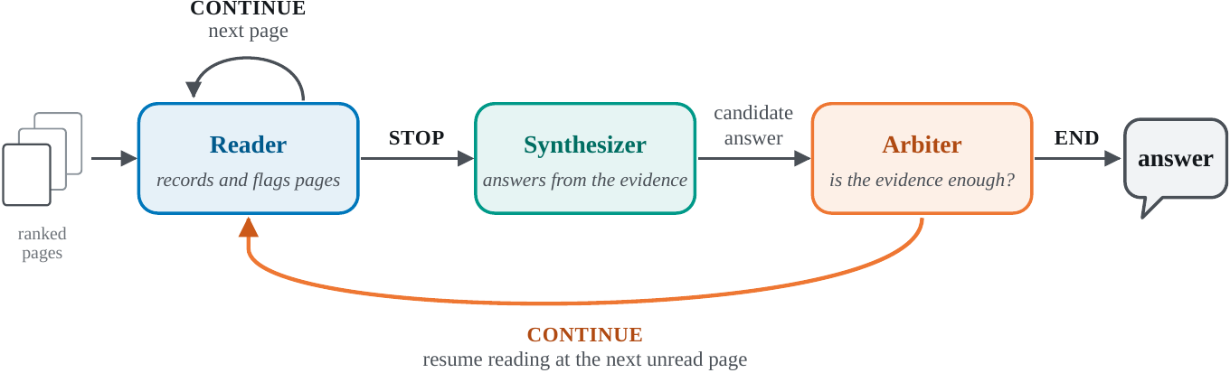
From Findings to a Simple Method
Chapter 4 · Method & conclusion
One model, three roles, each grounded in a finding.
Representation
Reader sees every page as text + image
Selection
Read broadly, pass on compact records
Reasoning
A separate arbiter judges sufficiency
Notes:
To check the findings, we put them into one small system. It is one model playing three roles.
The reader goes through the pages in ranked order. For each page it sees both the text and the image, writes down any evidence it finds, and flags pages that may hold the answer.
The synthesizer answers from the flagged pages in full and the short records of everything else.
The arbiter cannot write an answer. It either accepts, or names a missing fact and sends the reader back for more pages.
Each choice follows from a finding. Text and image together, for representation. Read broadly but pass on short records, for selection. And a separate step that judges whether the evidence is enough, for reasoning.

Slide 18
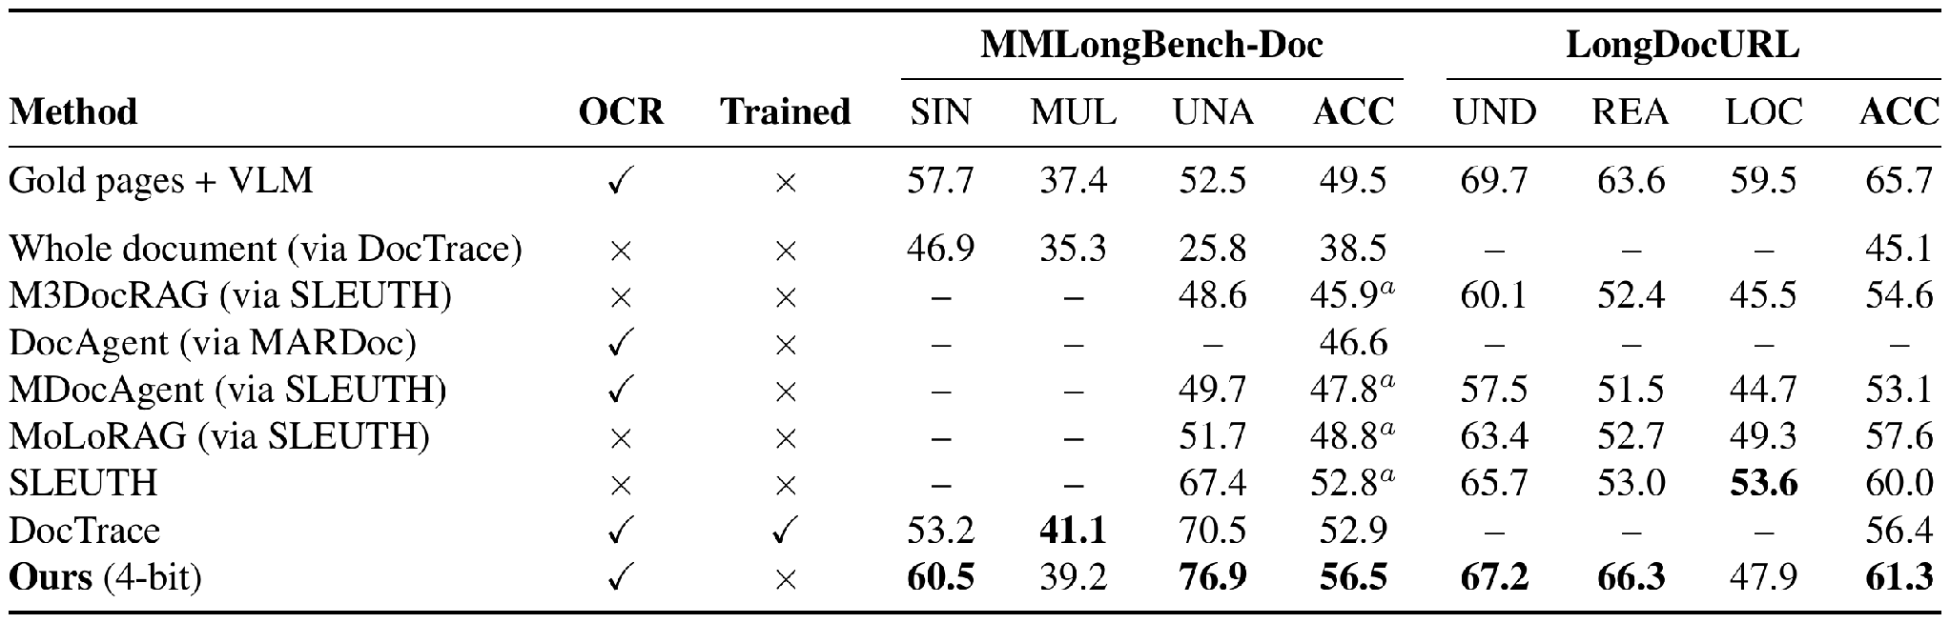
Simple Method: Results
Chapter 4 · Method & conclusion
Best among Qwen3-VL-8B systems, training-free and at 4-bit.
56.5% MMLongBench-Doc · 61.3% LongDocURL
Trade-off: ~10.8 min per question; multi-page still trails DocTrace (39.2 vs 41.1)
Notes:
All systems in this table use the same model with eight billion parameters.
Ours reaches 56.5 percent on MMLongBench-Doc and 61.3 percent on LongDocURL, the highest in the table, without any training and with the model stored at four-bit precision.
It is still behind the trained system DocTrace on questions that need several pages, 39.2 against 41.1.
The cost is time: about eleven minutes per question on average.

Slide 19
Conclusion
Chapter 4 · Method & conclusion
RQ1
Multi-page understanding is evidence management, in four families EMNLP 2026 Main
RQ2
Failures sit at representation, selection or reasoning, each with its own fix Under review
RQ3
A training-free system built on these findings is competitive under a fixed budget
Future work: structure-aware retrieval · calibrated abstention · cost as a first-class metric
Thank you · Questions?
Notes:
To conclude, back to the three research questions.
The survey organises the field. Understanding multi-page documents is a problem of evidence management, and four families of architecture handle it in different ways.
The empirical study locates the failures. They sit at representation, at selection, or at reasoning, and each one needs a different fix.
And a training-free system built on those findings is competitive under a fixed compute budget.
Thank you. I am happy to take questions.

Slide 20
Open Challenges
Chapter 2 · Survey · EMNLP 2026 Main
Each design relocates the bottleneck rather than removing it.
Evidence pipeline
High-resolution reading vs document-scale aggregation
Faithfulness
Few systems abstain or ground answers in evidence
Efficiency
Latency and token cost are rarely reported
Contamination
Training and test sets share source PDFs
Evaluation
Answer-only scores, mostly English VQA
Missing: an end-to-end account of where systems fail → Chapter 3
Notes:
The survey ends with five open challenges, and the one missing piece that motivates our second paper: an end-to-end account of where systems fail.

Slide 21
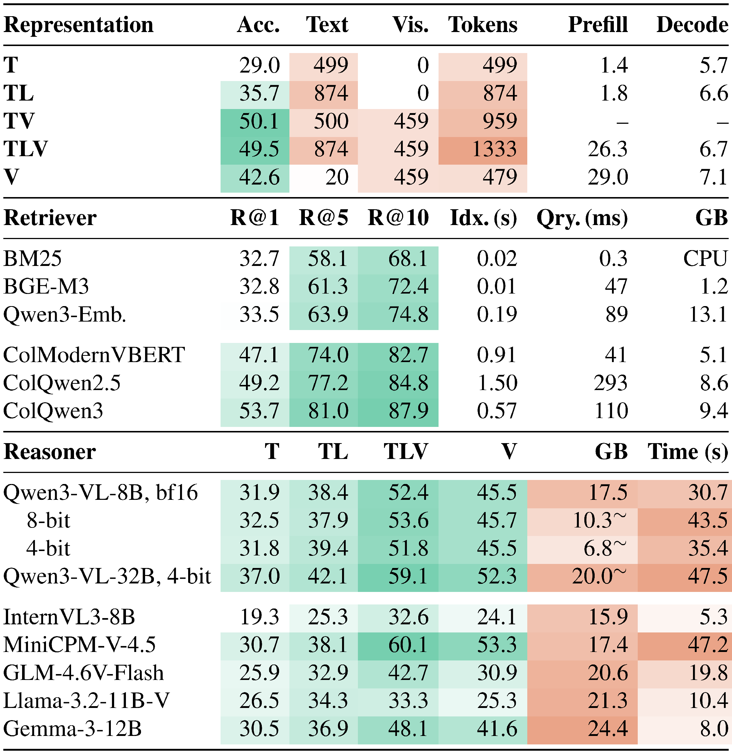
Backup · Deployment: Accuracy and Cost
Backup
Every representation, retriever and reasoner choice has a cost side.
Representation: text + image matches parser text + image with fewer tokens; images cost 26.3 s vs 1.8 s prefill
Retriever: ColQwen3 R@5 81.0% vs BM25 58.1%, but needs a GPU
Reasoner: 4-bit saves memory, not time
Notes:
For questions: the accuracy and cost of each representation, retriever and reasoner choice.

Slide 22
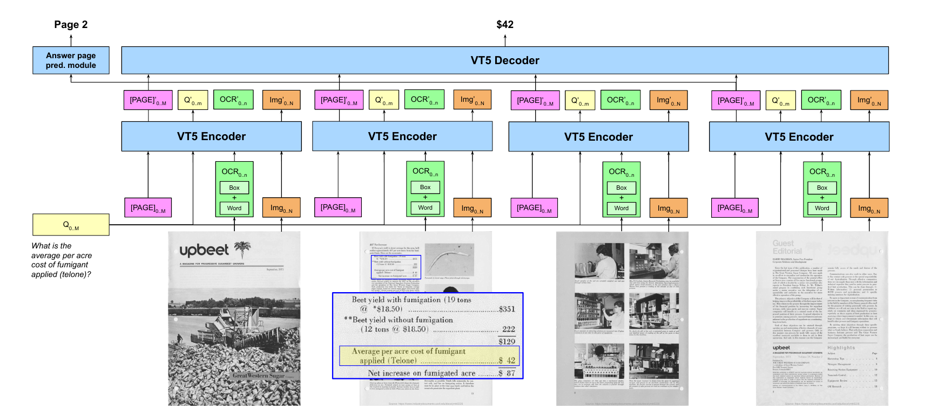
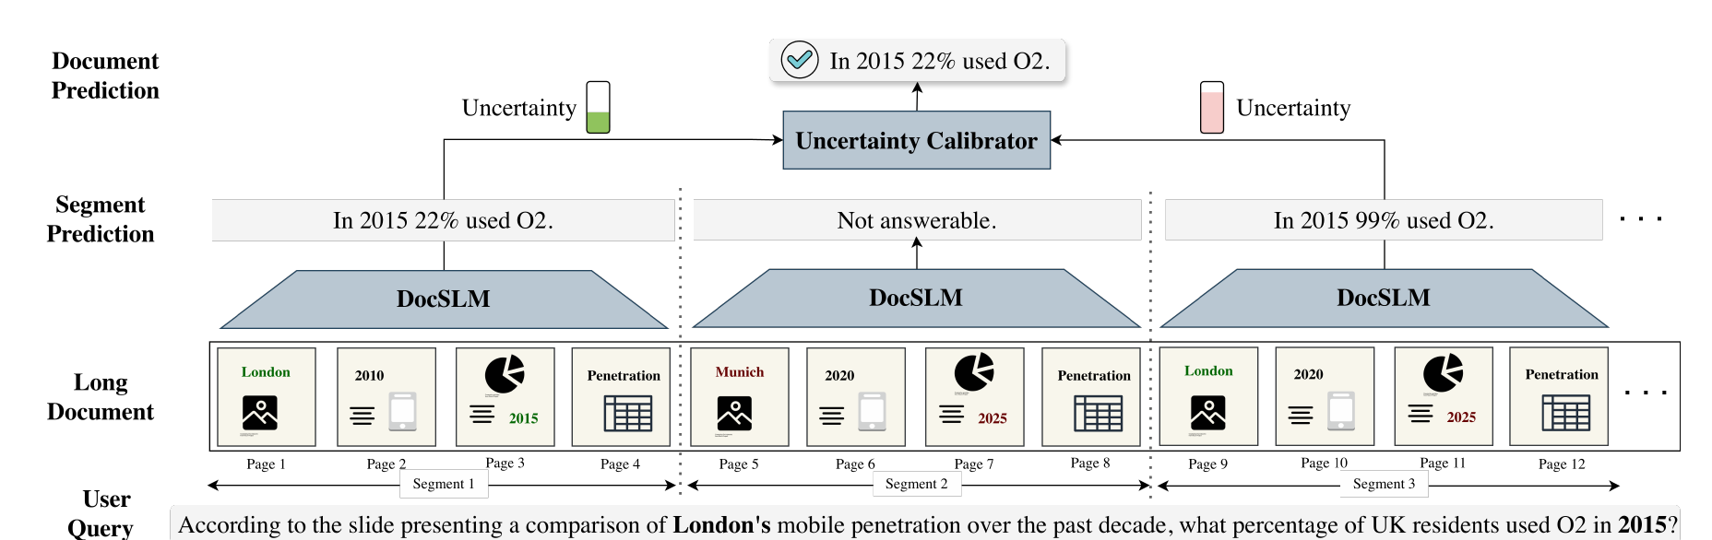
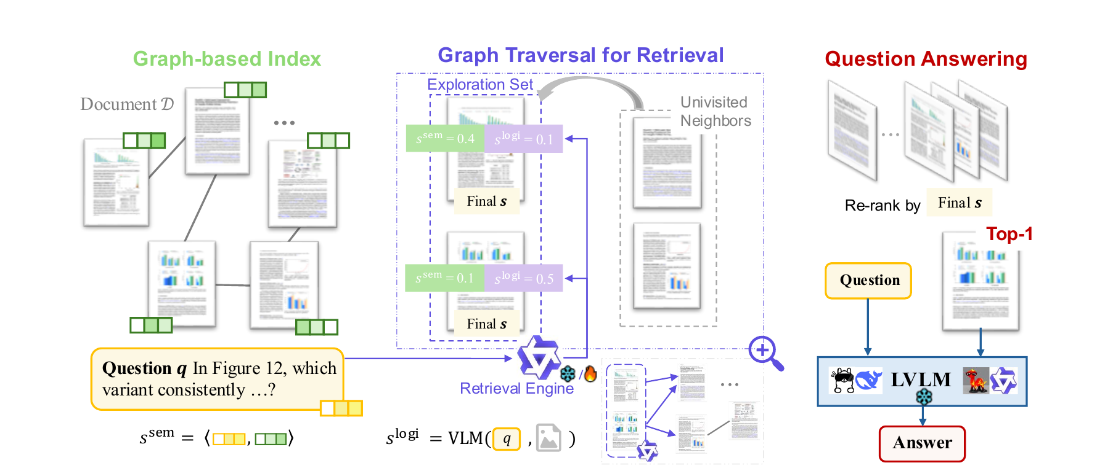
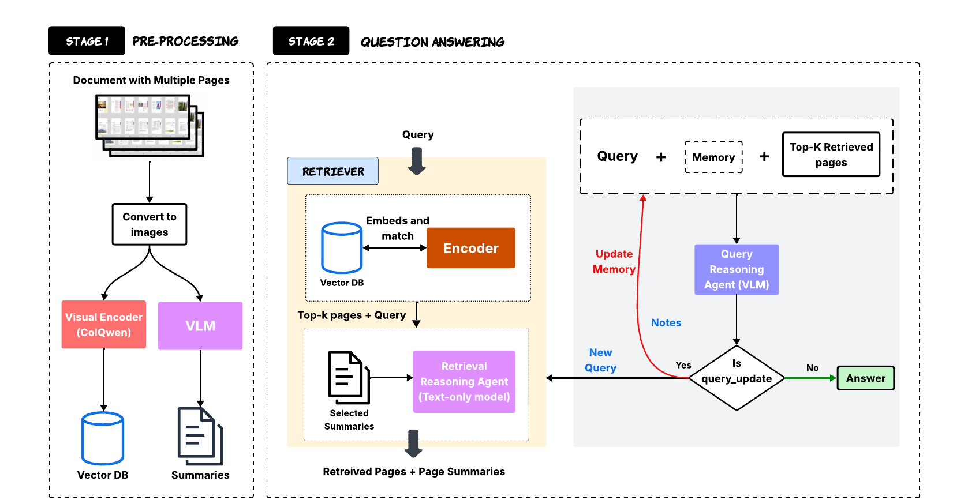
Backup · Representative Frameworks
Backup
One representative system per architectural family.
Hi-VT5 Tito et al., Pattern Recognition 2023
DocSLM Hannan et al., CVPR 2026 Findings
MoLoRAG Wu et al., EMNLP 2025
SimpleDoc Jain et al., EMNLP 2025
Notes:
For questions: one example system from each of the four families.

