Slide 1

HONOURS THESIS PRESENTATION
Multi-Page Visually Rich Document Understanding
A Survey of System Design and an Empirical Attribution of Failure
Lewei Xu
Supervisors: Dr Yihao Ding · Dr Daochang Liu
Department of Computer Science and Software Engineering
School of Physics, Mathematics and Computing · October 2026
Notes:
Hello everyone, my name is Lewei, and I’ve been working on multi-page visually rich document understanding, or just long document understanding, for my honours project this year.

Slide 2
Seminar/Thesis Overview
Chapter 1 · Introduction
Four chapters, three research questions, two papers.
CHAPTER | QUESTION | PUBLICATION
1 Introduction & Background | Why are long documents hard, and why a fixed compute budget? | Thesis chapter
2 Survey | RQ1 How are multi-page systems designed? | Managing Evidence at Document Scale: A Survey of MP-VRDU EMNLP 2026, Main Conference
3 Empirical study | RQ2 Where and why do these systems fail? | Locating Failure in MP-VRDU: An Empirical Attribution Submitted to NAACL
4 Method & Conclusion | RQ3 Can the findings build a competitive system under a fixed budget? | Thesis chapter: training-free proof of concept
Notes:
First, I’ll go through some background.
Then I’ll go cover the 2 papers completed this year.
The first is survey of the long document understanding field.
The second paper is an empirical study on designing and deploying long document understanding systems.
If we have time, I’ll go over this proof of concept method for long document understanding that uses the findings of empirical study.

Slide 3
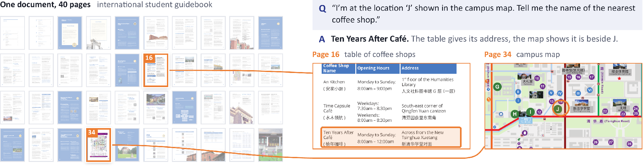
What is MP-VRDU?
Chapter 1 · Introduction
Meaning lives in text, visuals and layout, and often runs across pages.
A question from MMLongBench-Doc: the answer needs the table on page 16 and the map on page 34.
Long
Exceeds the model’s context window
Sparse
Evidence is buried among many pages
Structured
Links cross pages: “see Table 3”
Notes:
So, what do we mean by a visually rich document?
Documents carry meaning through text, visual elements like charts and figures, and how these are laid out on a page.
A multi-page document simply has two or more pages, but its meaning can be spread across those pages and connected between them.
Although when we say multi-page, we generally mean longer documents from 50 or hundreds of pages.
For the purposes of this seminar, the definition of document understanding is just answering an arbitrarily specific natural language question over a long visually rich document.
Here is an example of relatively easy question now, but was very difficult even just a year ago.
Long document understanding is difficult due to two main reasons
First is the sheer volume of information, both textual, visual and structural, is often too much for even long context vision language models to read in full, and even if you can, reasoning over so much information is very difficult.
Second is that answer relevant evidence can be scattered across the document, and you need to combine and reason over this evidence to successfully answer a question.

Slide 4
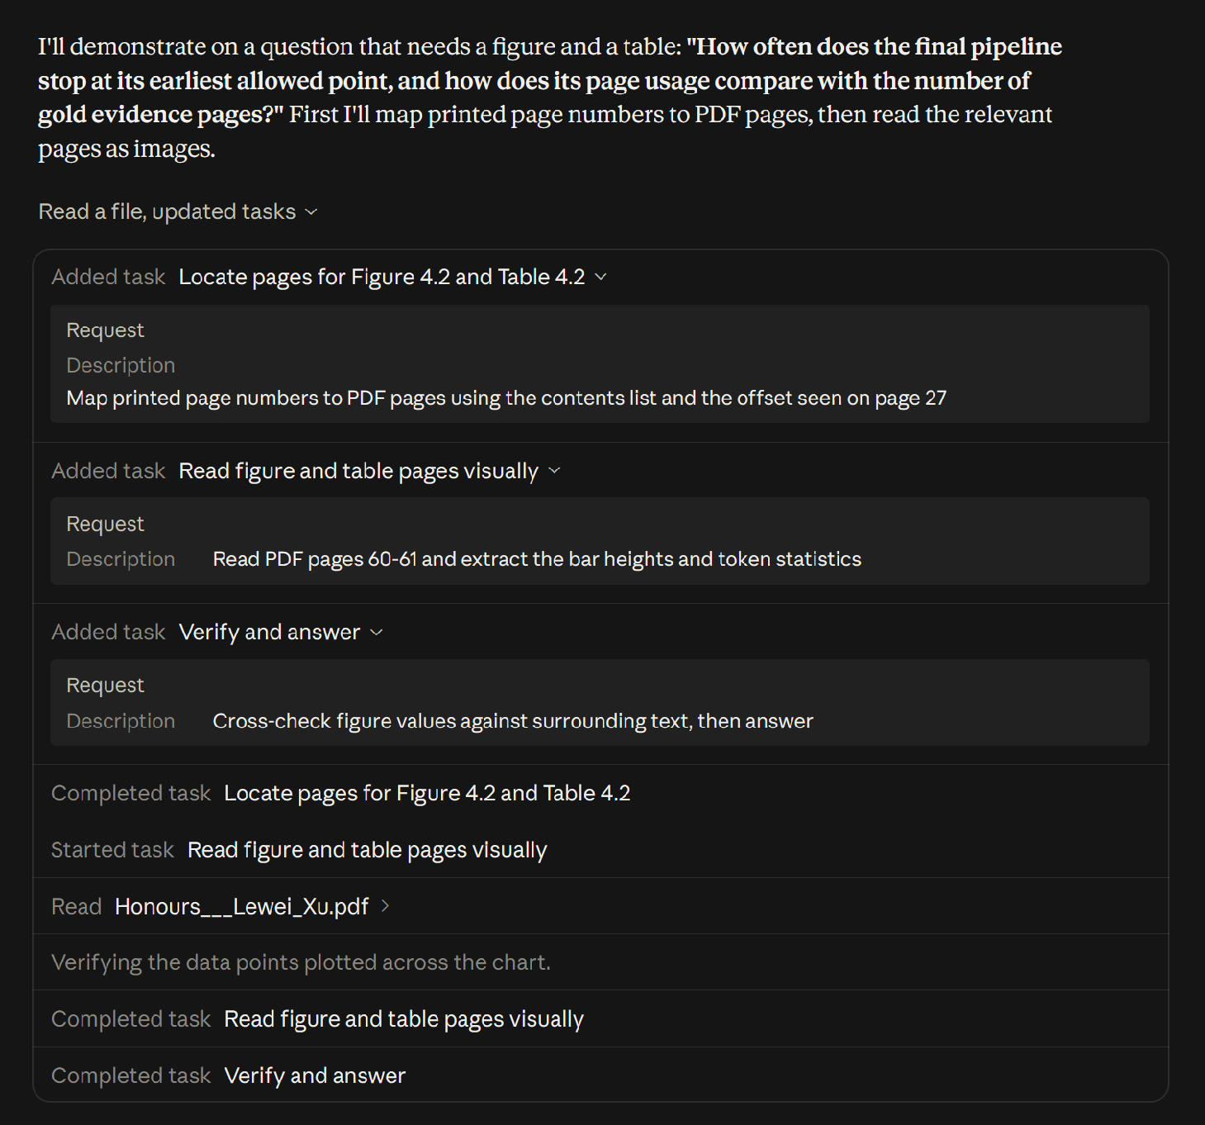
MP-VRDU in Real World Applications
Chapter 1 · Introduction
Real deployments need local, open-weight models under a fixed compute budget.
IN INDUSTRY
Thousands to millions of documents
Privacy: medical, legal and financial records stay in-house
Cost: API fees become prohibitive at millions of documents
Specialisation: domain documents need an adapted model
In any case, you need to build your own document understanding pipeline, either by running local VLMs, or via third party API
LLM assistants plan, locate and inspect pages before answering.
Notes:
We can already see document understanding research being applied in the language model assistants we use.
Here’s an example of me uploading my thesis which is close to 100 pages, and claude is able to answer questions very accurately.
But these assistants are just one application of document understanding.
In industry, you might have one or a few specific tasks to perform over thousands or millions of documents.
One major concern is privacy. For example, medical and legal documents cannot be sent to a third-party service due to data-residency requirements.
Another is cost. Even without privacy concerns, processing that volume through a commercial API can be very expensive.
Another case is specialist document types may need specialized pipelines to process them, or maybe even additional training on the language model.
Nor is uploading documents one by one to a LLM assistant feasible, and you might need structured output for automatic downstream processing
As a result, real deployments need to implement their own document understanding pipeline either using API calls to closed source models, or by running local vision language models.

Slide 5

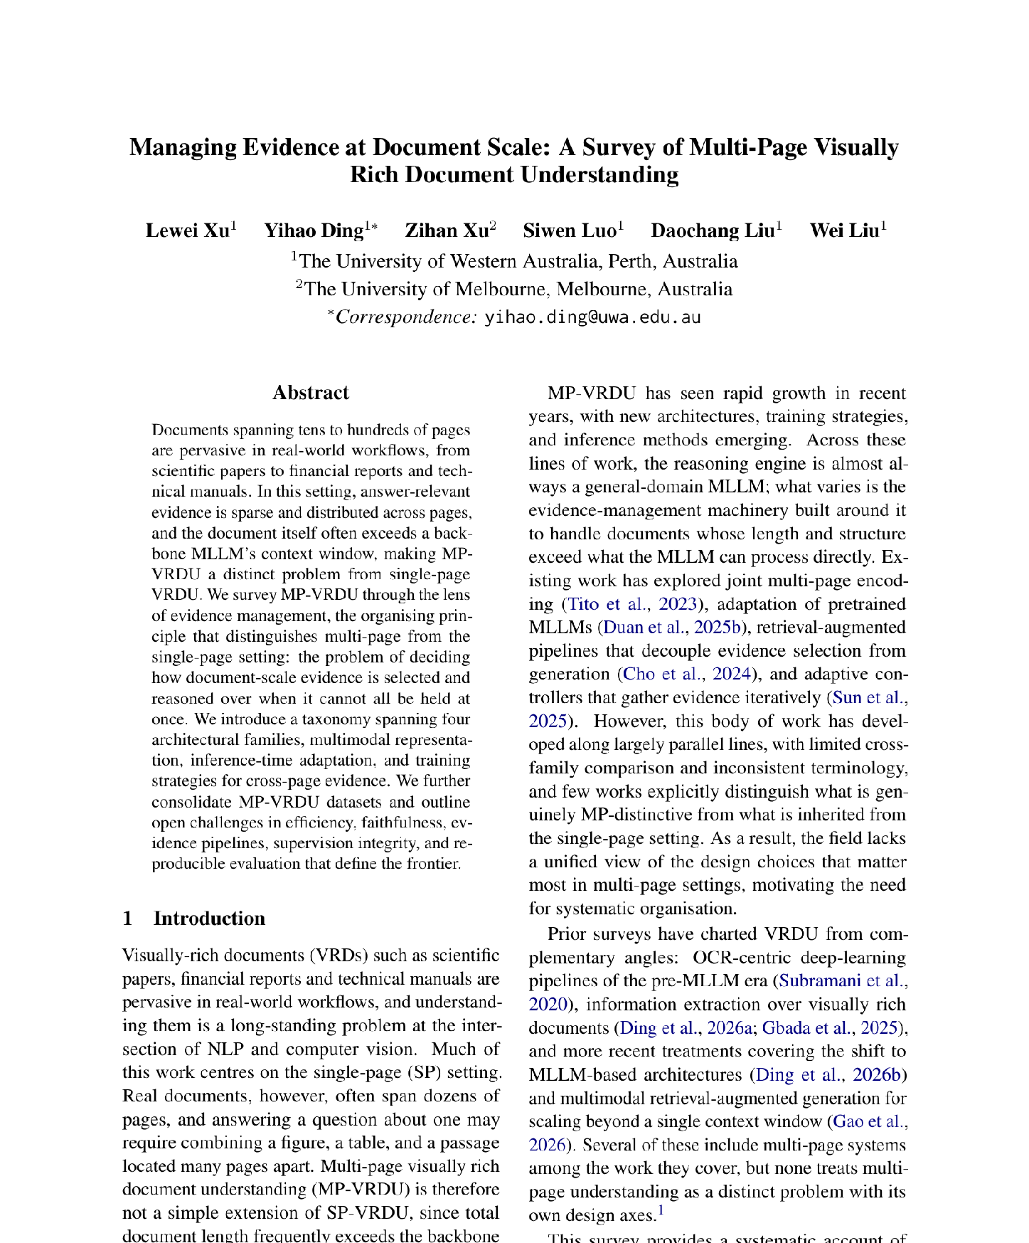
Managing Evidence at Document Scale: A Survey of Multi-Page Visually Rich Document Understanding
Chapter 2 · Survey \
First-Authored and Accepted at the EMNLP 2026 Main Conference, Budapest.
RESEARCH GAP
Multi-page systems grew along parallel lines, with inconsistent terminology and little cross-family comparison.
CONTRIBUTIONS
The first survey to treat MP-VRDU as a distinct problem
We survey 46 systems, organised by evidence management, spanning 4 architectural families, multi-page multimodal representation, inference-time adaptation, and training strategies.
47 datasets consolidated; five open challenges
Notes:
That brings us to the survey paper completed earlier this year.
This is the first survey to treat the multi-page setting as a distinct problem.
And has been accepted into a top tier conference for natural language processing.
I’m a bit conscious of time so i’ll mainly talk about the 4 architectural families, and mostly skip everything else

Slide 6
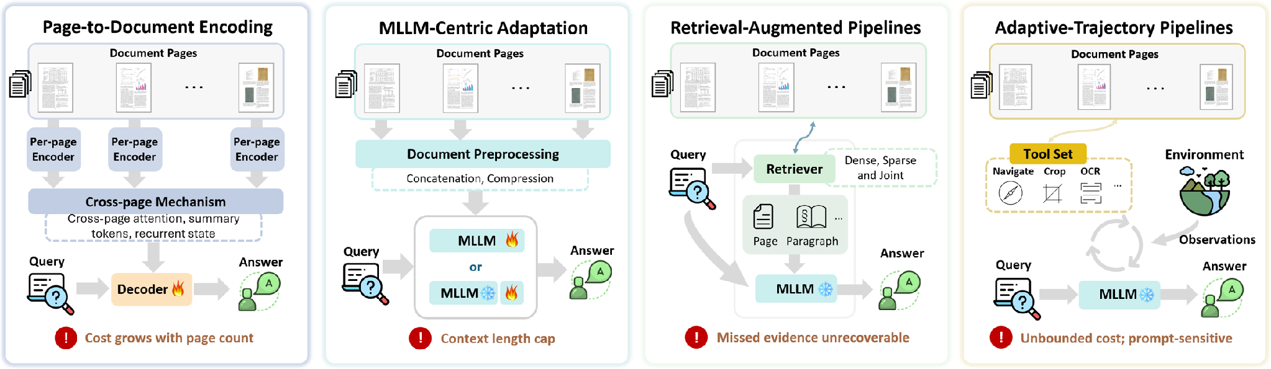
Four Architectural Families
Chapter 2 · Survey
Each family fixes the previous bottleneck and relocates it rather than removing it.
Late 2023 to mid 2024
Early 2024 to late 2025
Early 2024 to mid 2026
Early 2025 to mid 2026
e.g. Hi-VT5, GRAM
e.g. DocSLM, Docopilot
e.g. M3DocRAG, MoLoRAG
e.g. SimpleDoc, DocAgent
Notes:
These architectural families can also be considered different approaches to long document understanding.
The first family is page-to-document encoding models, an early approach that extends single-page architectures to the multi-page setting.
Each page is encoded separately into a compact representation. Those representations are connected through a cross-page mechanism, such as attention, and passed to a decoder to generate the final answer.
The limitation is that pages contain different amounts of information. Giving each page a fixed representation budget can lose fine-grained detail during encoding.
The second family addresses this by removing the per page encoding step, and instead adapts a pretrained multimodal large language model to process the document natively within its context window.
Adaptation can involve continued pretraining on document tasks or fine-tuning. Some systems also compress the representations to fit longer documents.
But performance can still degrade as documents get longer, and some documents cannot fit at all.
This motivates retrieval-augmented pipelines. Instead of fitting the whole document into the model, we retrieve relevant evidence and pass a smaller evidence set to a vision-language model.
Retrieval can be sophisticated, but the workflow is fixed in advance. Evidence missed during retrieval cannot be recovered by the answering stage.
Finally, adaptive-trajectory pipelines follow an agentic approach. The language model decides what evidence to collect, how to collect it, and when it has enough to answer.
But those repeated calls can become expensive, and make the total time and compute cost harder to bound.
The dates show roughly when each family is active in the papers we surveyed. Each one fixes the bottleneck of the one before, and moves it somewhere else.
We call the first two families models, because they are trained end to end. We call the last two pipelines, because their components are interchangeable.

Slide 7
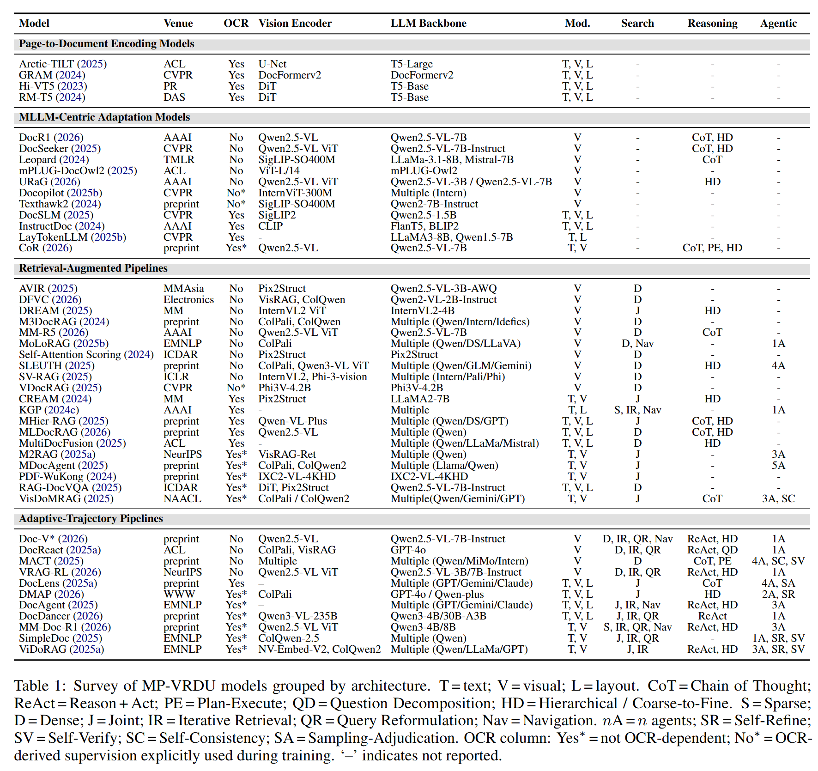
Surveyed Systems Main Table
Chapter 2 · Survey
Models vs pipelines
Models are trained end-to-end with purpose built components
Pipelines usually use a frozen LVLM backbone with interchangeable components/backbones.
Modalities
Encoding models use text, vision and layout; MLLM-centric models are mostly vision only.
Search
Appears only once retrieval is separated from answering.
Notes:
This is the main table of the survey, with the systems and papers we surveyed grouped by architectural family.
There are three things I want to point out
First, with the first 2 architectural families, we call them “models” because they’re generally trained end to end with purpose build components
The last 2 families we call them “pipelines” because they generally use a frozen vision language backbone sometimes with some fine tuning.
Their components are usually interchangeable, especially the vision language backbone, so as these language models get stronger, the pipelines also benefit from these improvements
Second, the modalities. Some systems use vision only, treating document understanding as a pure computer vision problem.
Others combine vision with text and layout information. The text may be embedded in the document or extracted by a parser.
This distinction will be important in the next part of the seminar.
Third, search. It only appears once retrieval is separated from answering, in the two pipeline families.

Slide 8
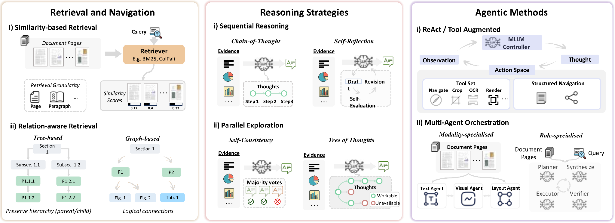
Inference-Time Strategies
Chapter 2 · Survey
Training free strategies to improve document understanding performance. Retrieval and Agentic methods are used for Retrieval Augmented and Adaptive Trajectory Pipelines; Reasoning strategies can be applied to any LVLM.
Relation-aware retrieval finds links similarity misses
A chain cannot recover what retrieval missed
Lifts the recall ceiling; cost is hard to bound
Notes:
Various training free strategies can be used to improve document understanding performance
Retrieval and navigation techniques such as similarity based and relation aware retrieval
And agentic methods such as reason + act with tool calls and multi-agent orchestration
These are used only in retrieval augmented and adaptive trajectory pipelines
Reasoning strategies such as cot, reflexion, sc, tot can be applied to all reasoning backbones.

Slide 9
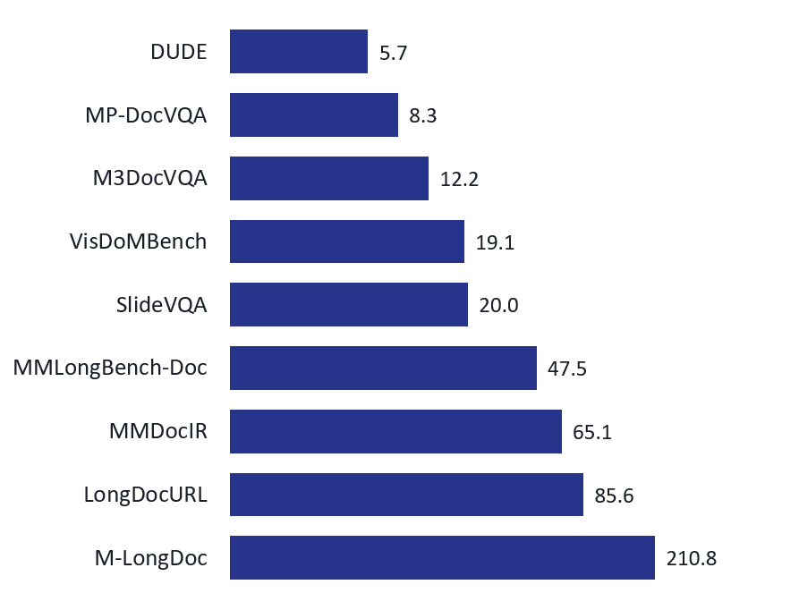
Training Strategies & Datasets
Chapter 2 · Survey
Pretraining is rare; fine-tuning carries the weight, with RL layered on top.
TRAINING
BENCHMARKS: AVERAGE PAGES PER DOCUMENT
Retrieval: alignment, cross-page fusion, logical relevance
Reasoning: trace imitation, then reward-driven GRPO
Agentic: trajectory distillation, then RL
Cross-cutting: PEFT / LoRA, single- to multi-page curricula
Fine-tuning data is mostly LVLM-synthesised; 16 of 19 papers that fine-tune on MP-DocVQA also evaluate on it.
Notes:
Pretraining is rare for long document understanding due to scarcity of data
We see a lot of fine tuning techniques applied across retrieval, reasoning and agentic behaviour
Document length in benchmarks are also getting increasingly longer as document understanding systems get better

Slide 10
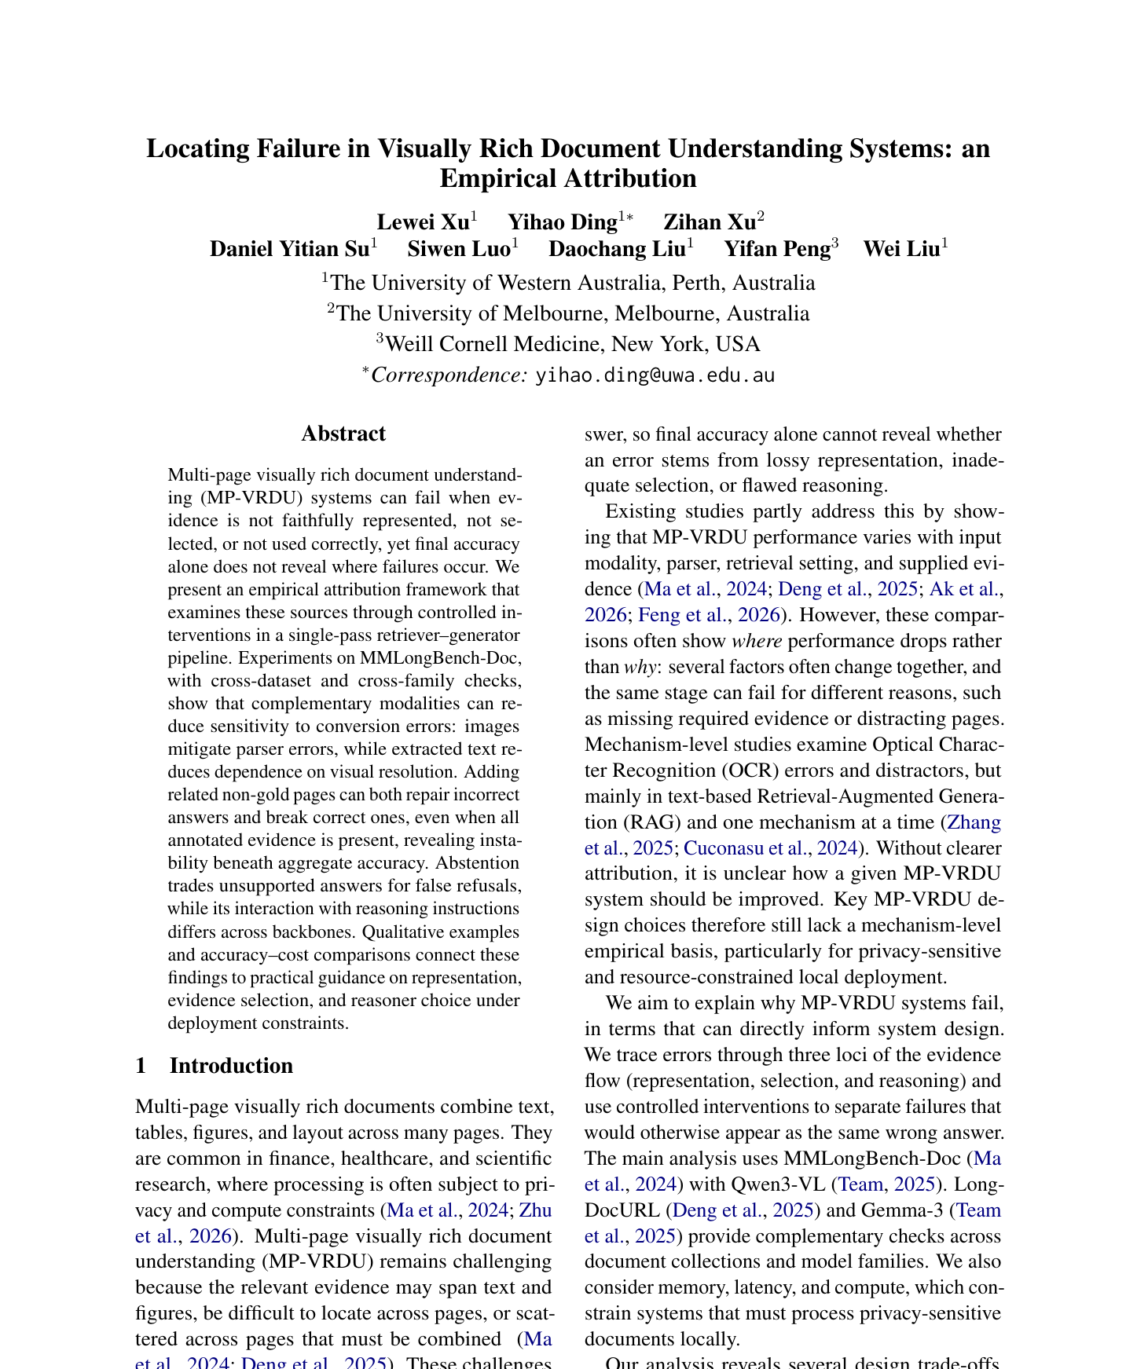
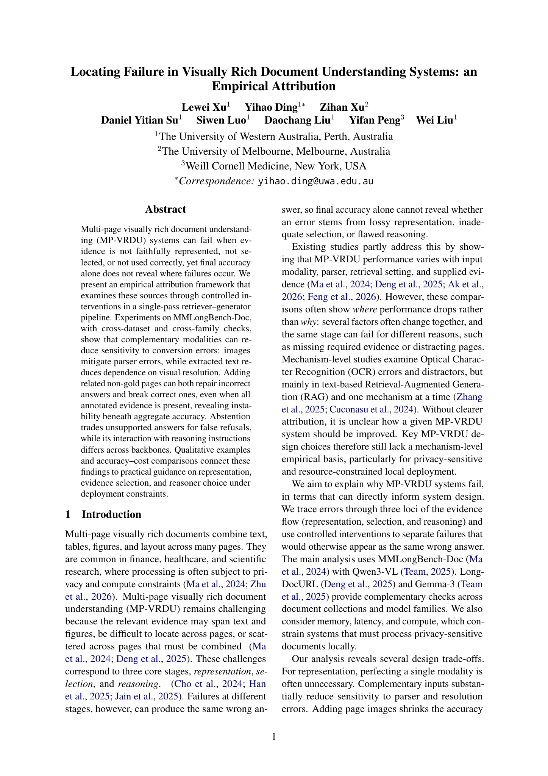
Locating Failure in Multi-Page Document Understanding
Chapter 3 · Empirical study
UNDER REVIEW
First-authored empirical study, under review
RESEARCH GAP
A final wrong answer hides where evidence fails: encoding, selection, or reasoning.
CONTRIBUTIONS
Three architecture-independent failure loci
Controlled interventions across two benchmarks and two model families
Deployment guidance from accuracy and cost
Notes:
The survey in Chapter 2 maps how systems manage evidence. This empirical paper asks where the evidence pipeline fails.
A final wrong answer does not reveal whether a page was encoded poorly, the needed evidence was not selected, or the model failed to reason over evidence it received.
We isolate representation, selection and reasoning with controlled interventions on MMLongBench-Doc and LongDocURL, using Qwen3-VL and Gemma-3 backbones. The study is under review.

Slide 11
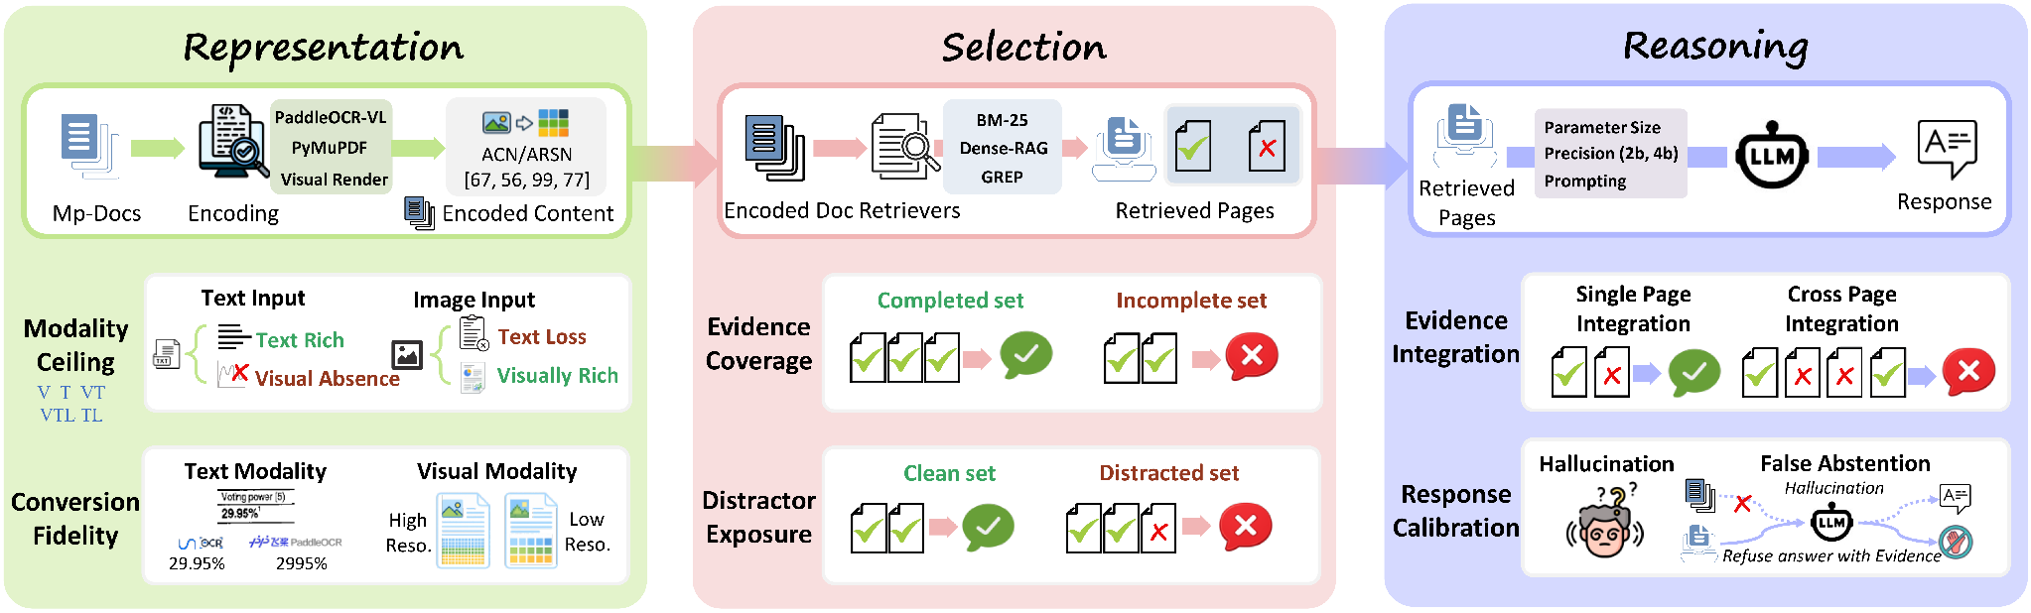
Attribution by Construction
Chapter 3 · Empirical study · Under review
Change one stage while holding the other two fixed.
REPRESENTATION
SELECTION
REASONING
T · TL · TLV · V
Parsers and image resolution
Gold pages as control
Drop evidence or add distractors
Qwen3-VL and Gemma-3
Model scale and prompt modes
MMLongBench-Doc + LongDocURL · Accuracy judge for correctness; rubric judge for refusal
Notes:
The framework is also our experimental setup. Every document question-answering system has to represent pages, choose what reaches the model and reason over that evidence.
We use one encode, retrieve and answer pipeline. For representation we vary embedded text, parser text and page images, including parser and resolution choices. For selection we start with annotated gold pages, then omit required pages or add non-gold pages. For reasoning we vary the backbone and its instructions.
Each comparison changes one stage while the others stay fixed. MMLongBench-Doc supplies evidence-page and evidence-source annotations; LongDocURL checks whether the patterns transfer to born-digital documents. Correctness and refusal come from their respective judges.

Slide 12
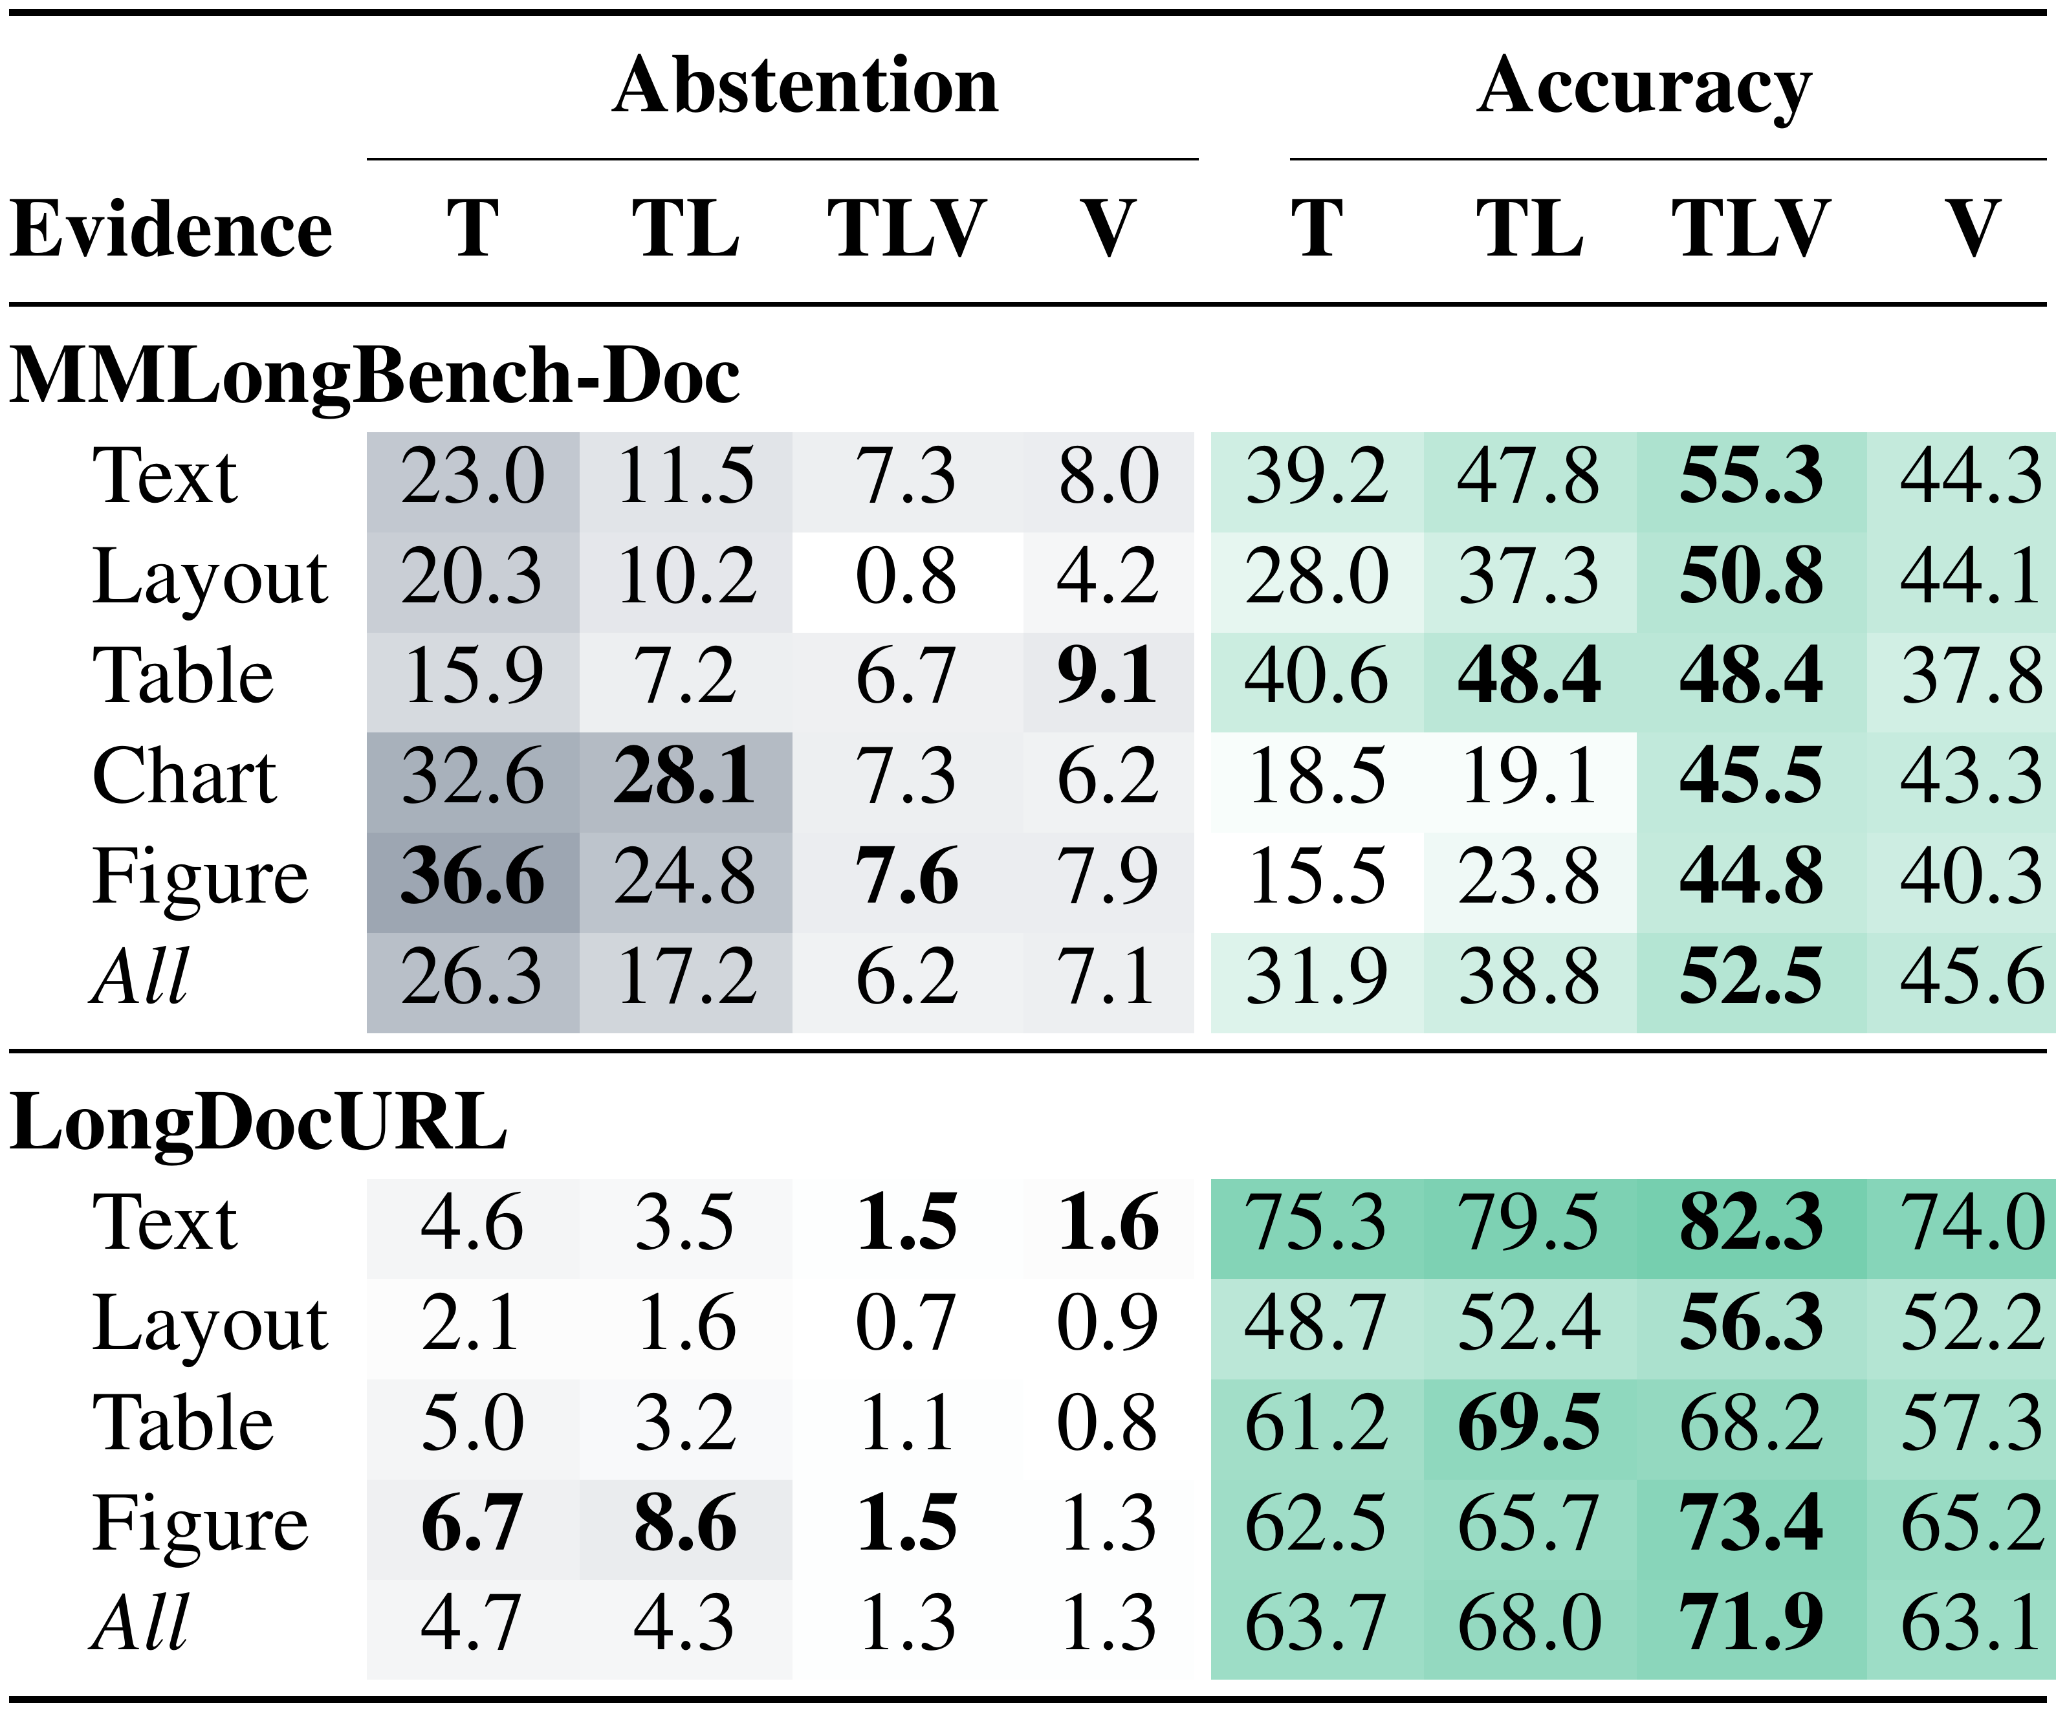
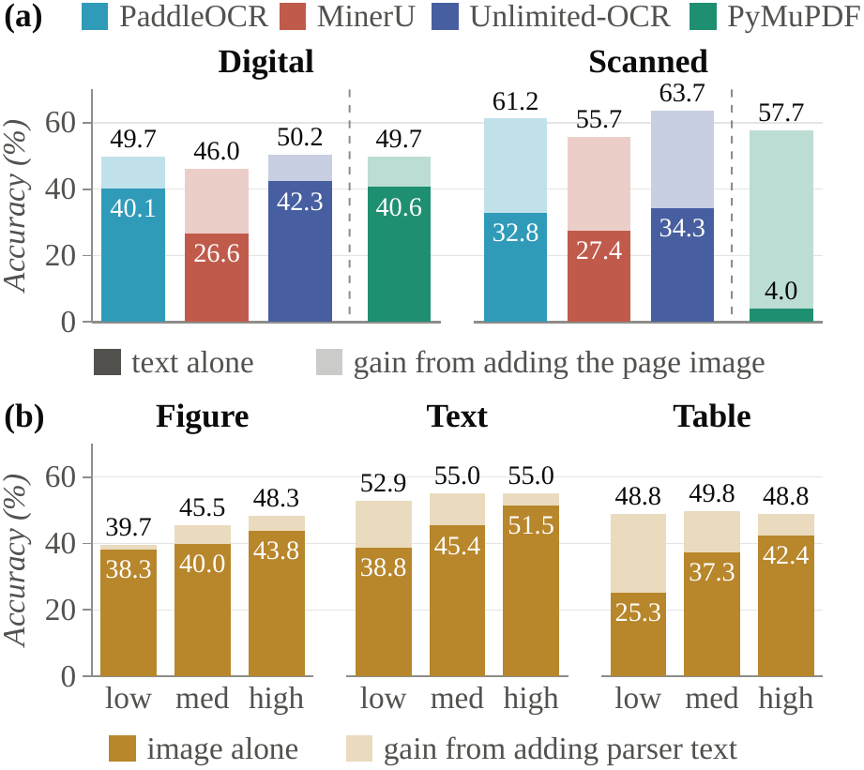
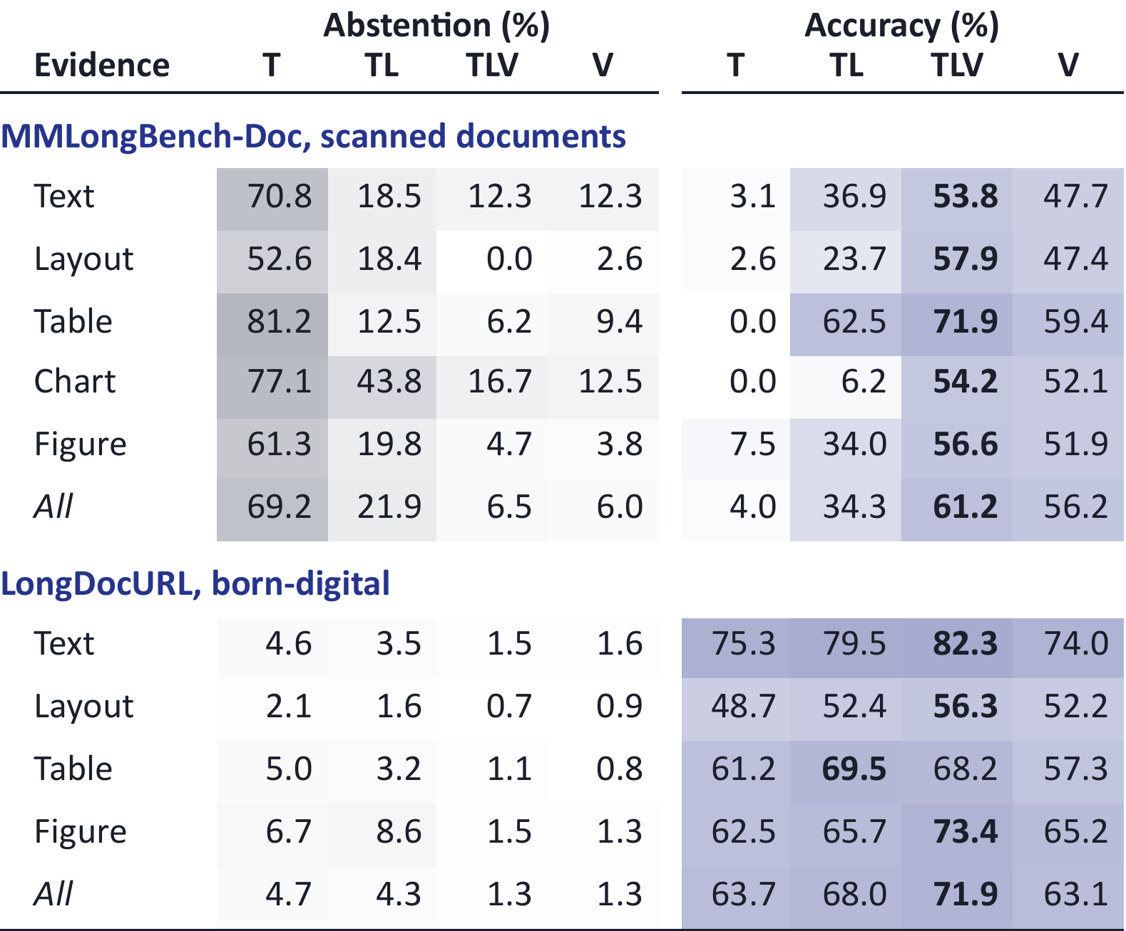
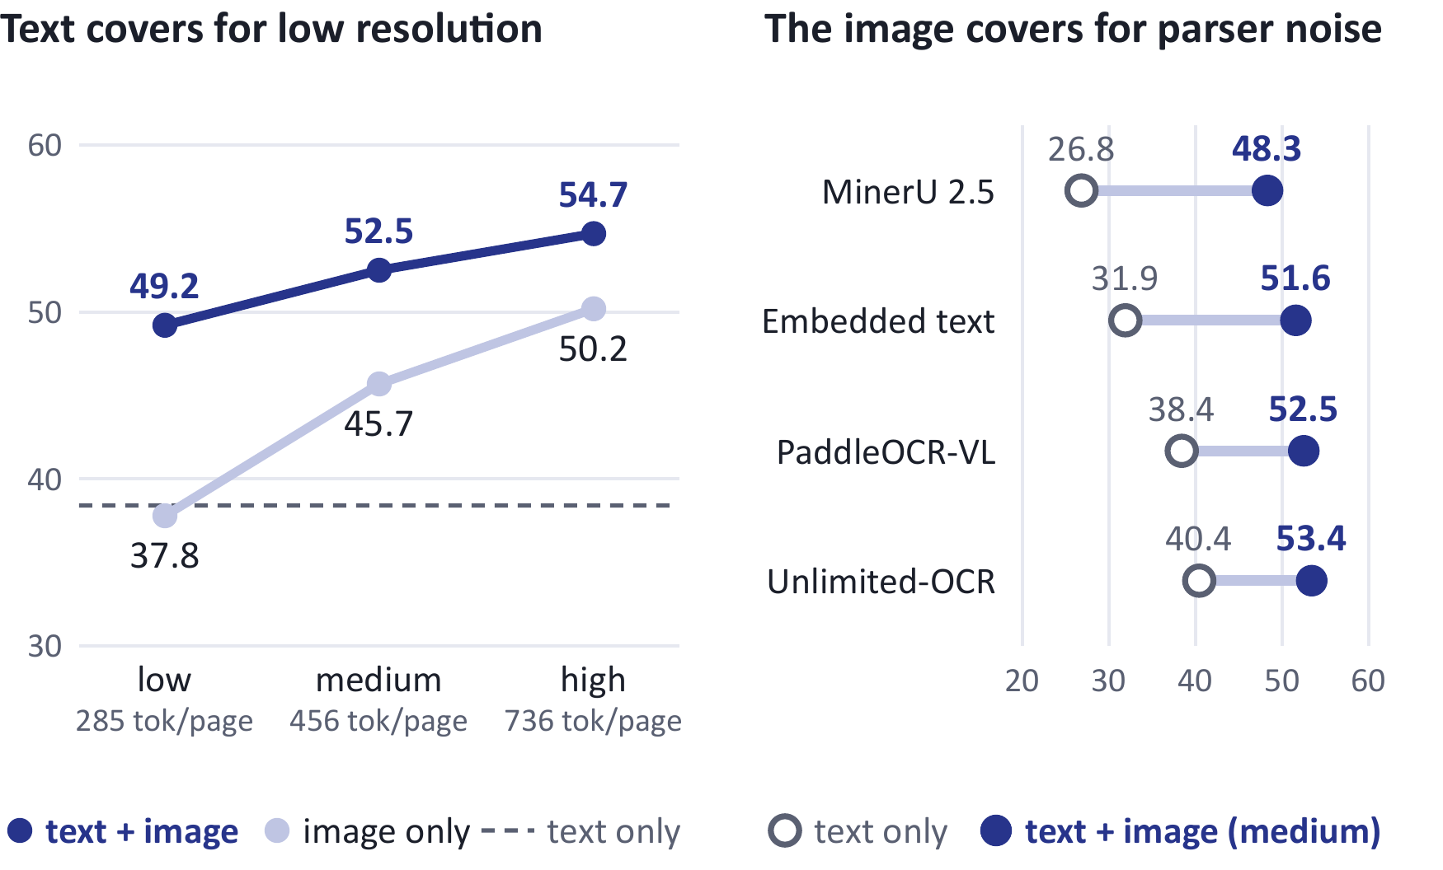
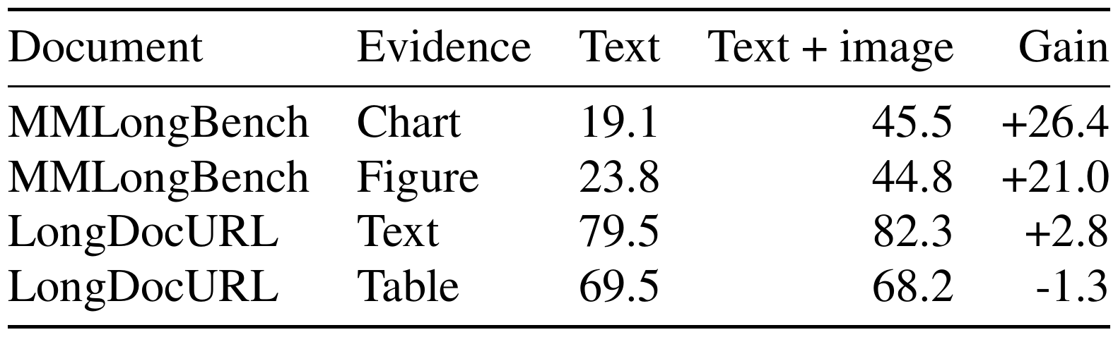
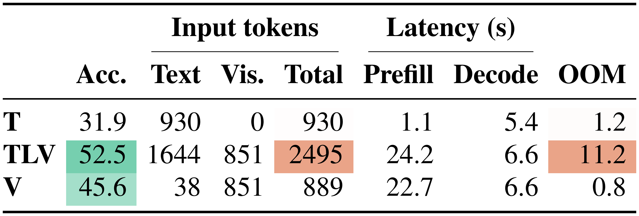
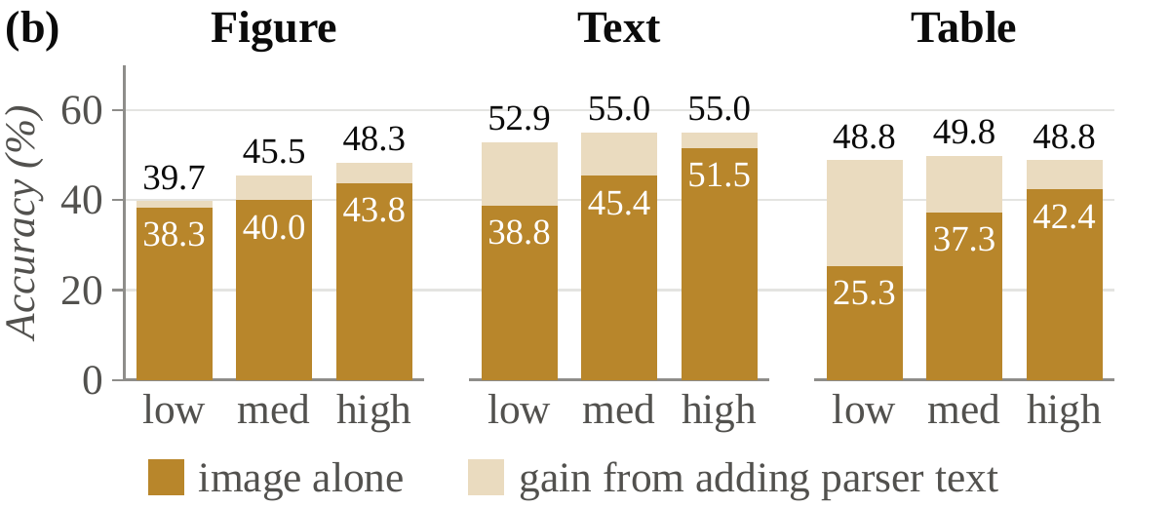
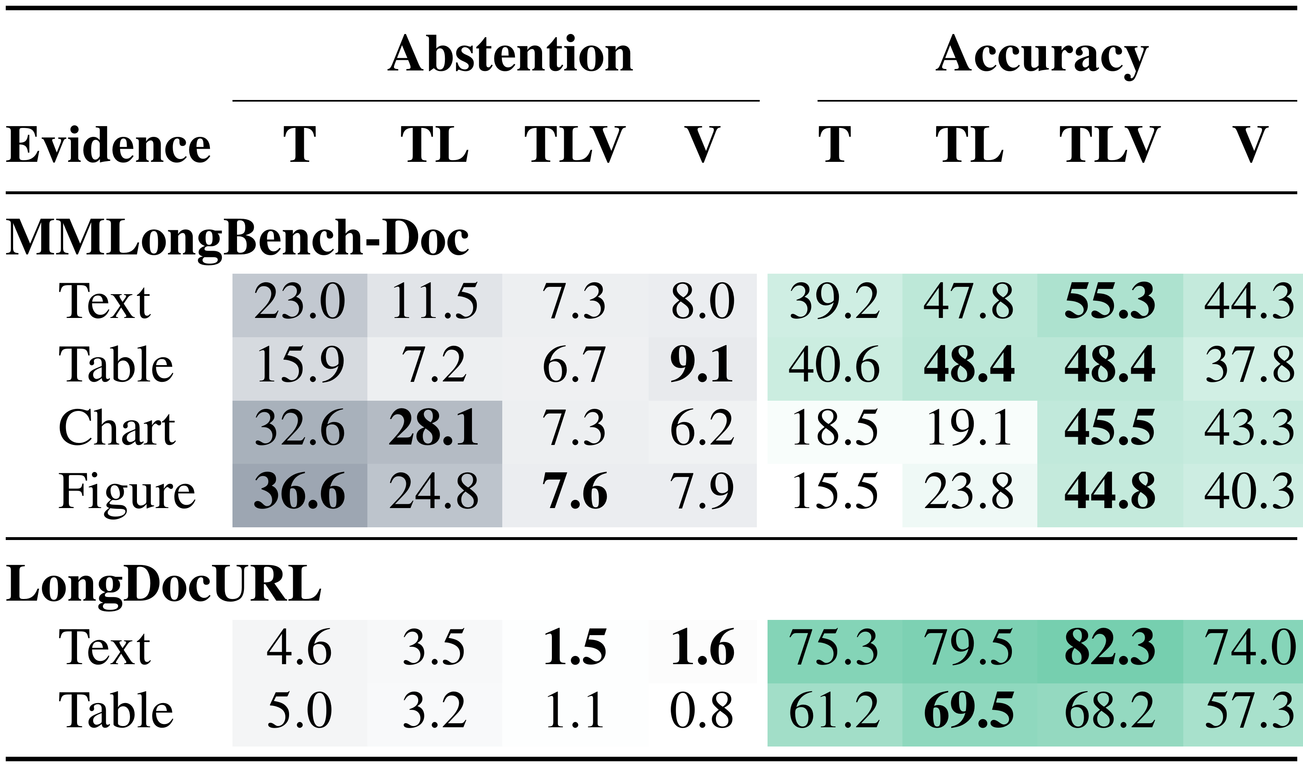
Finding 1 · Representation
Chapter 3 · Empirical study · Under review
Vision is task-dependent; text helps recover detail at low image resolution.
Vision adds 26.4 points on charts, but little on born-digital text and tables; image prefill costs about 21× text.
Text + low-res images: 49.2% accuracy, retaining 90% of the high-res result (54.7%).
Notes:
The left visual is the full Table 1, including both datasets, every evidence-source row and all four representations. T is embedded text, TL parser text, TLV parser text with the page image, and V image only. Accuracy and abstention are separate judged outcomes.
The modality ceiling depends on the task and the document. For MMLongBench-Doc charts, parser text scores 19.1 percent and text with the image reaches 45.5 percent. Figures rise from 23.8 to 44.8 percent. Born-digital LongDocURL text gains only 2.8 points, and tables move from 69.5 to 68.2 percent.
The right visual is the complete conversion-fidelity figure from the paper. Its first panel shows how page images compensate for different parsers on digital and scanned documents. The second panel shows how text compensates for low-resolution images, especially for text and table questions.
At low resolution, text plus images reaches 49.2 percent overall on the same 847 answerable questions, 90 percent of the high-resolution result of 54.7 percent. Vision has a cost: image-only prefill takes 22.7 seconds against 1.1 seconds for embedded text on two 16 GB V100s, roughly 21 times as long.

Slide 13
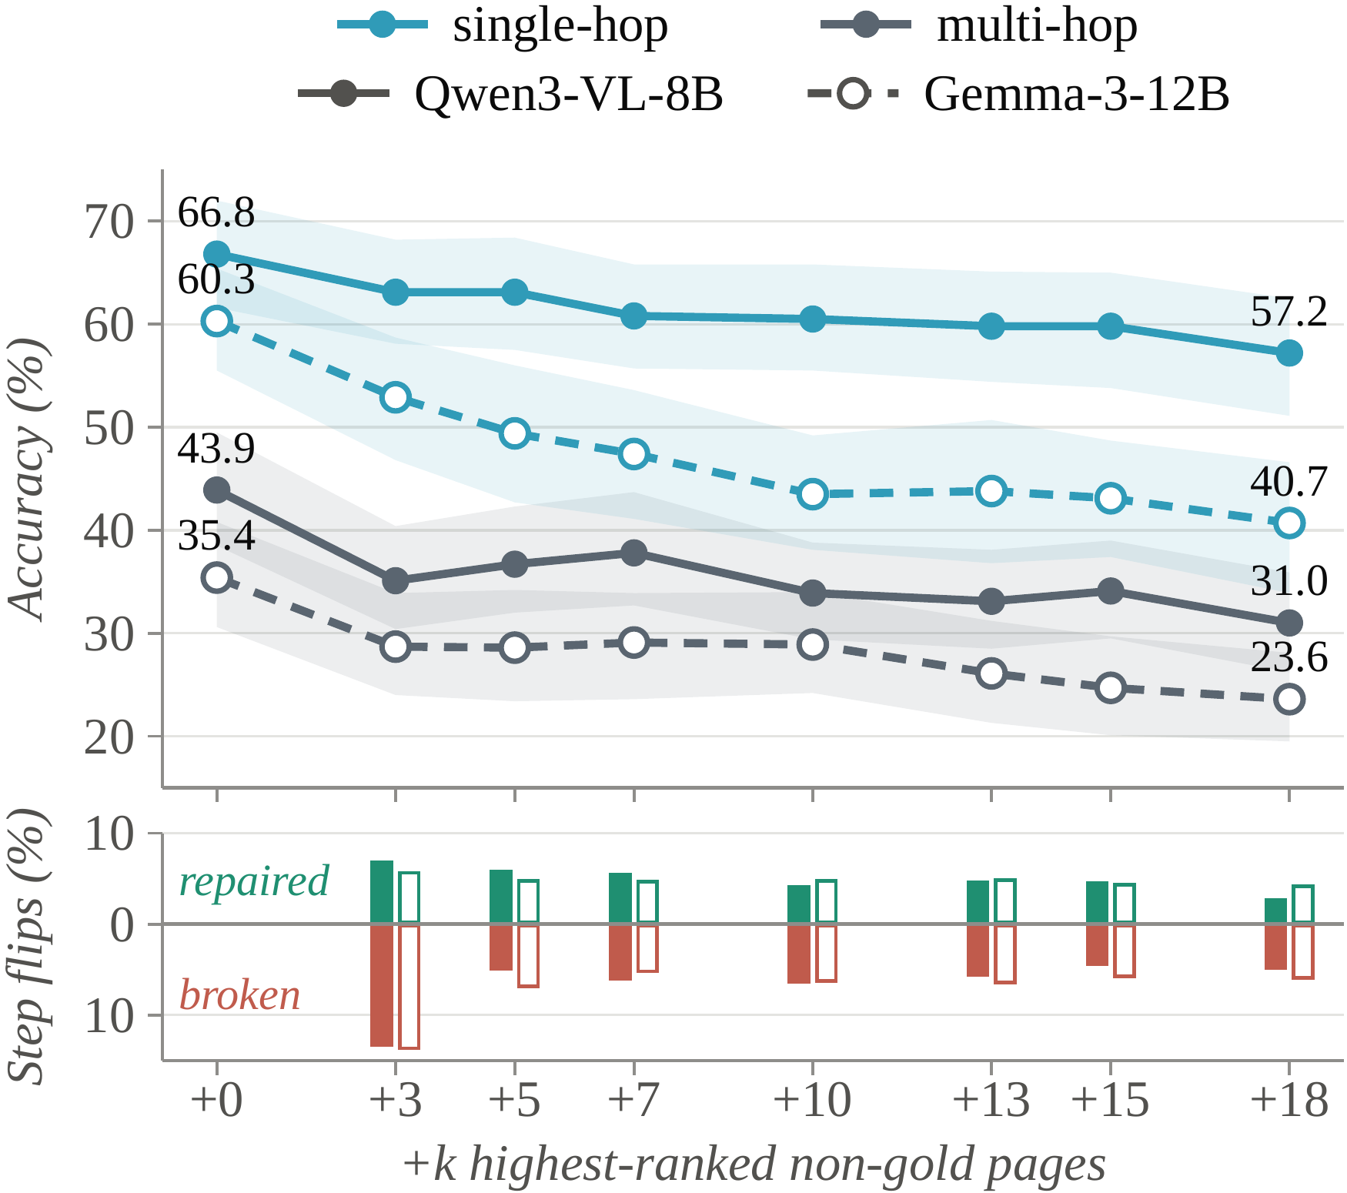
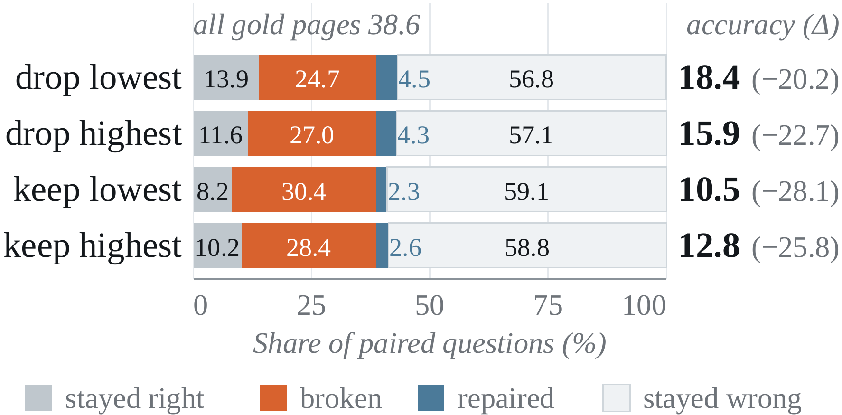
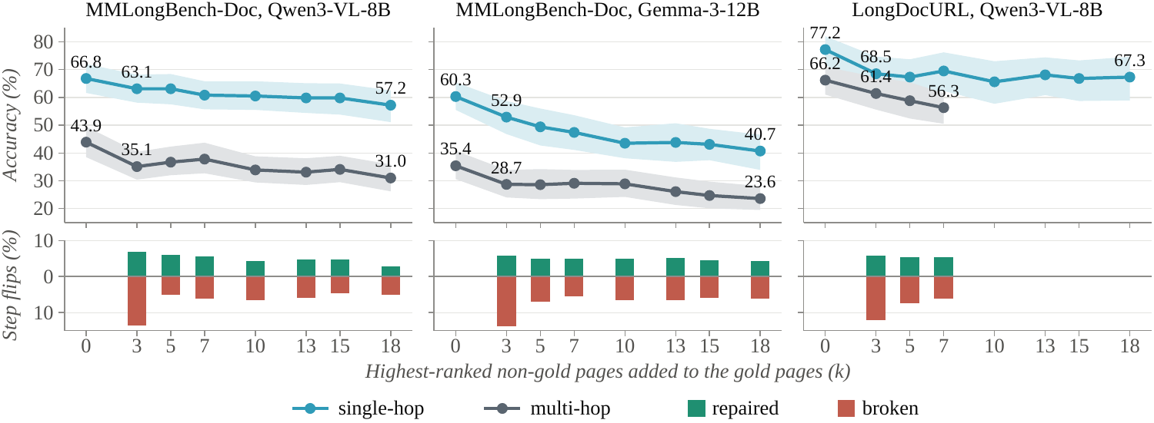
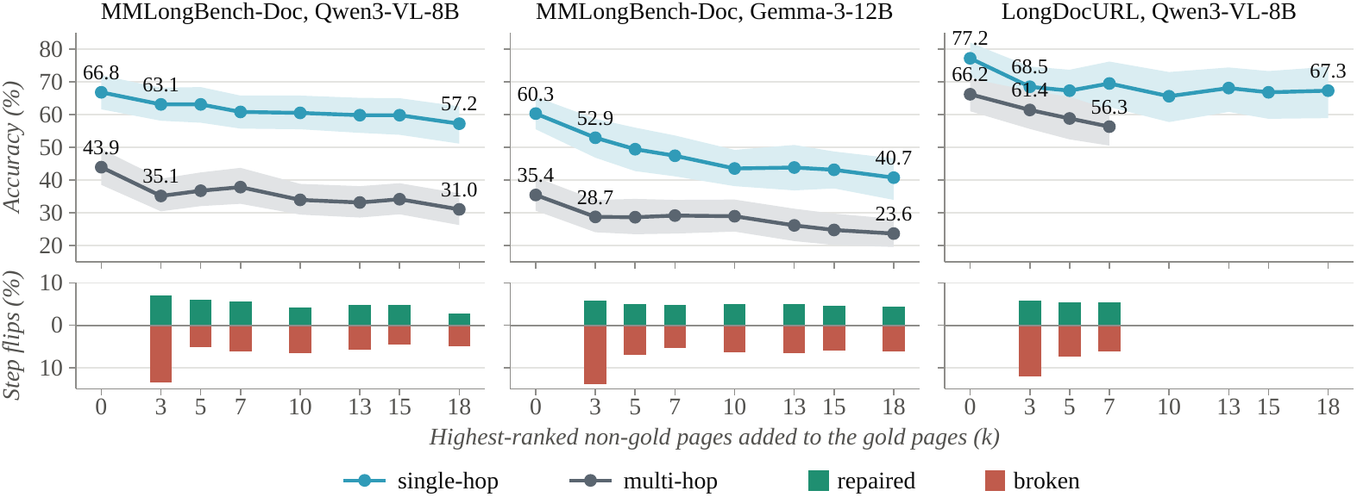
Finding 2 · Selection
Chapter 3 · Empirical study · Under review
Complete evidence coverage does not protect an answer from distractors.
ADD k NON-GOLD PAGES
All gold pages remain. The added pages are the highest-ranked non-gold pages.
+3 pages cuts multi-hop accuracy: Qwen3 43.9 → 35.1%; Gemma-3 35.4 → 28.7%.
At +3, 13.3% of Qwen3 answers break and 7.0% repair. Further additions keep flipping answers.
Selection must control distractor exposure as well as retain evidence.
Notes:
This is distractor_exposure_merged.pdf, the unified MMLongBench-Doc plot. Colour separates single-hop from multi-hop questions. Solid lines and filled markers are Qwen3-VL-8B; dashed lines and open markers are Gemma-3-12B. The lower panel uses filled and outline bars for the two models.
Every gold page remains in context. We add the top k retrieved non-gold pages, so evidence recall is fixed. At plus three, multi-hop accuracy falls from 43.9 to 35.1 percent for Qwen3 and from 35.4 to 28.7 percent for Gemma-3.
The lower panel reports paired verdict flips at each addition step. At plus three, 13.3 percent of Qwen3 answers break and 7.0 percent repair. Non-gold context can supply useful clues, but more answers are derailed than repaired. Later steps keep producing flips, while multi-hop accuracy remains below the gold-only baseline. This makes distractor exposure a separate selection problem from missing evidence.

Slide 14
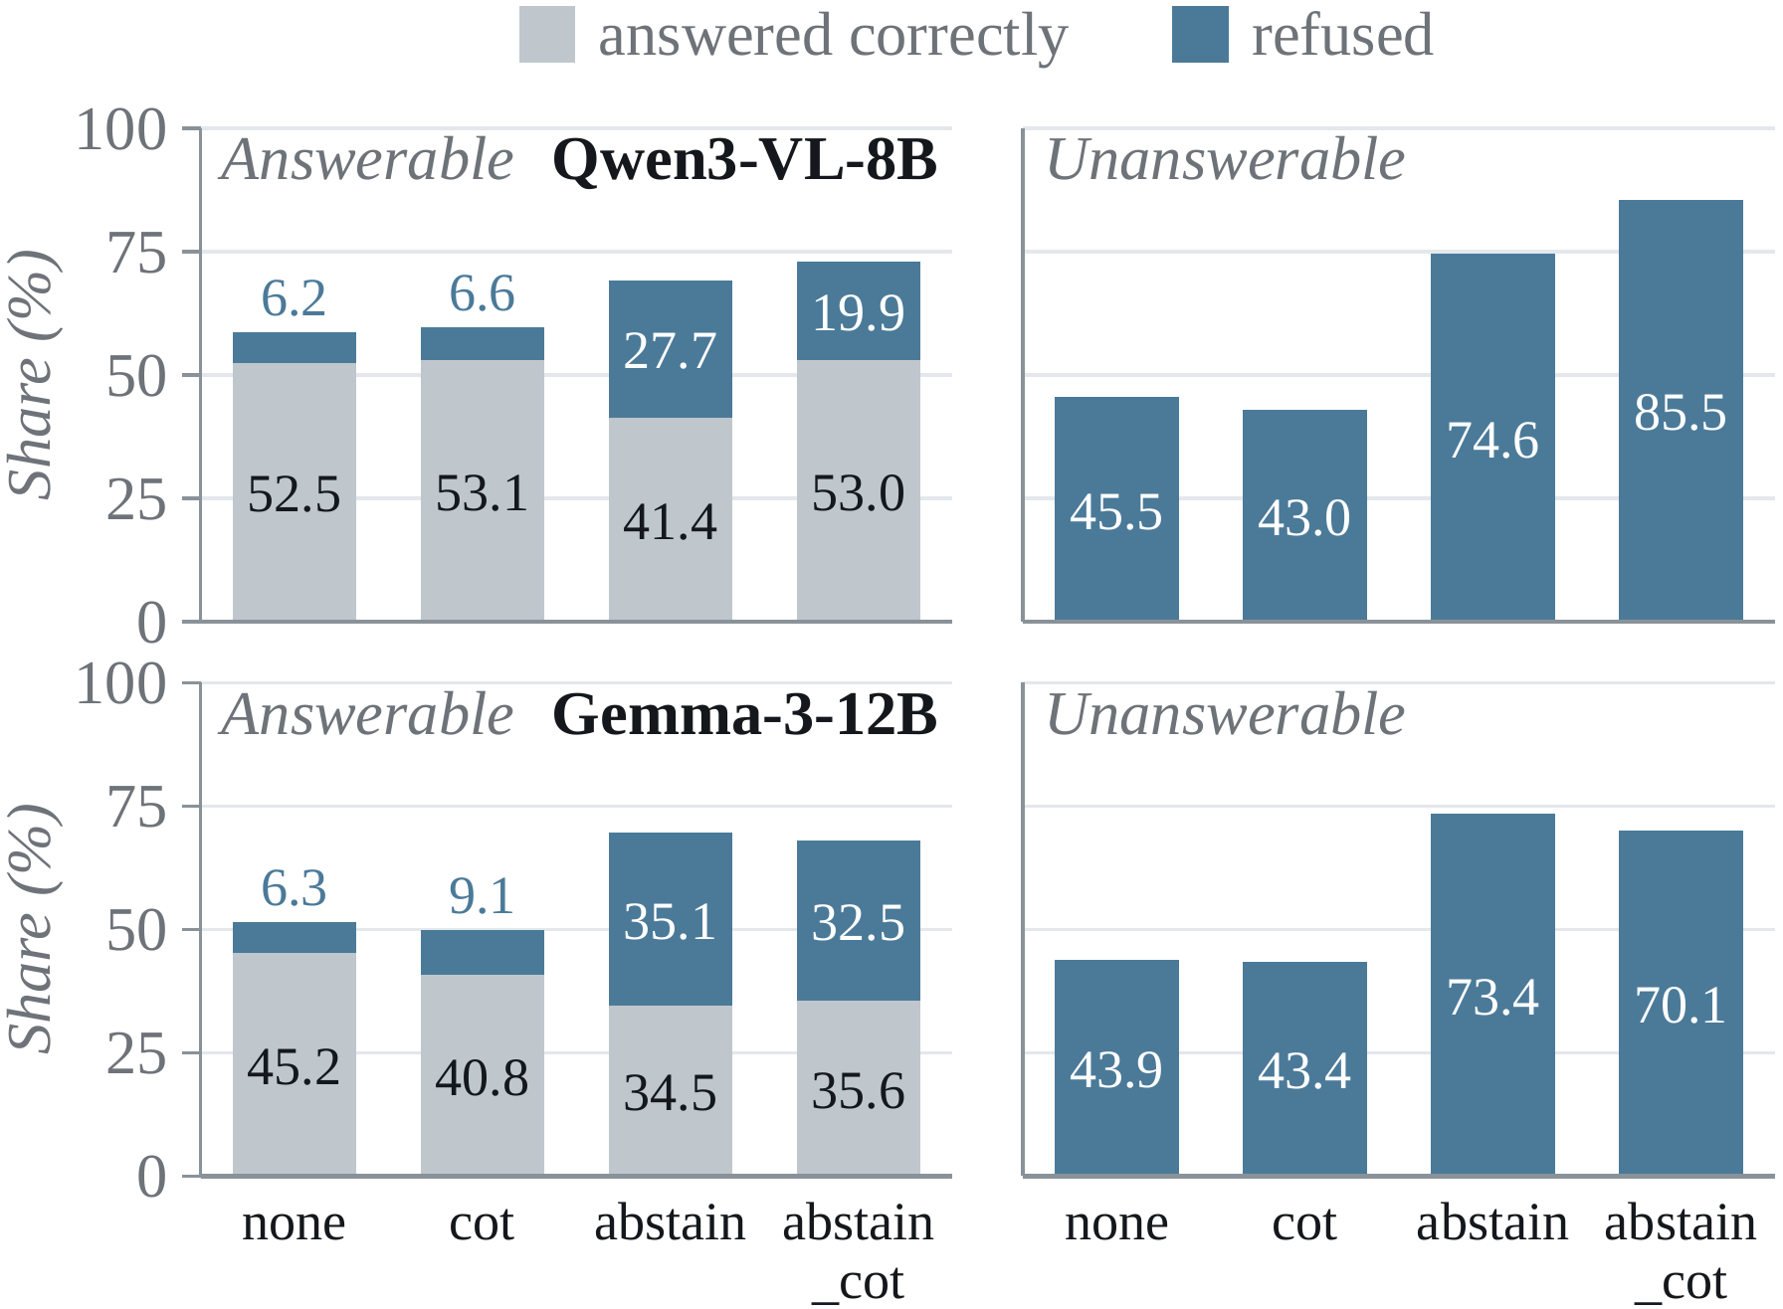
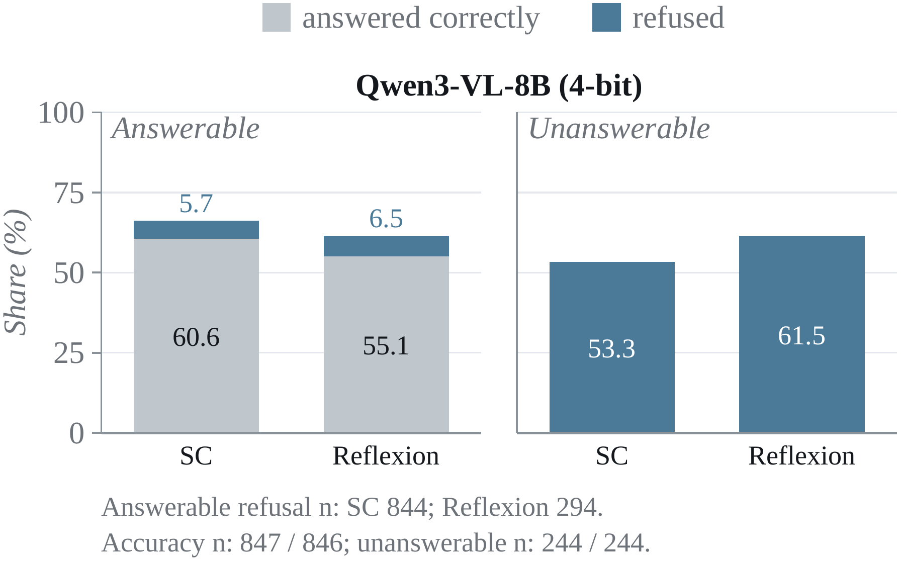
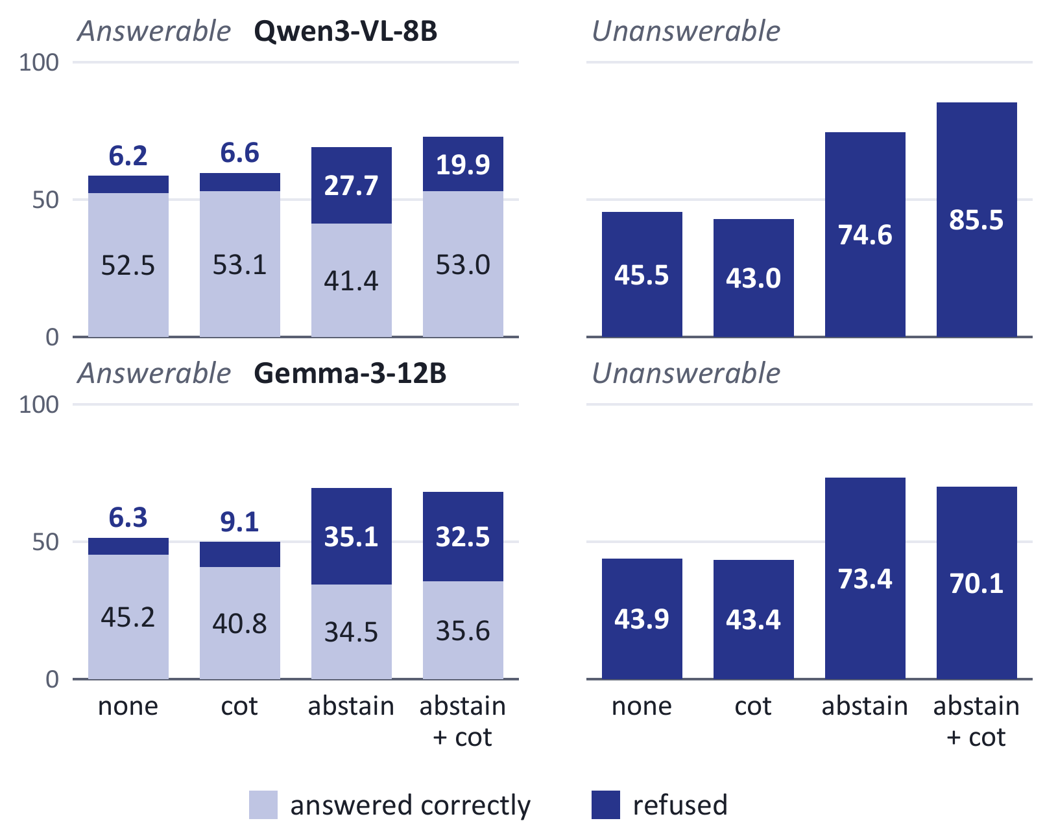
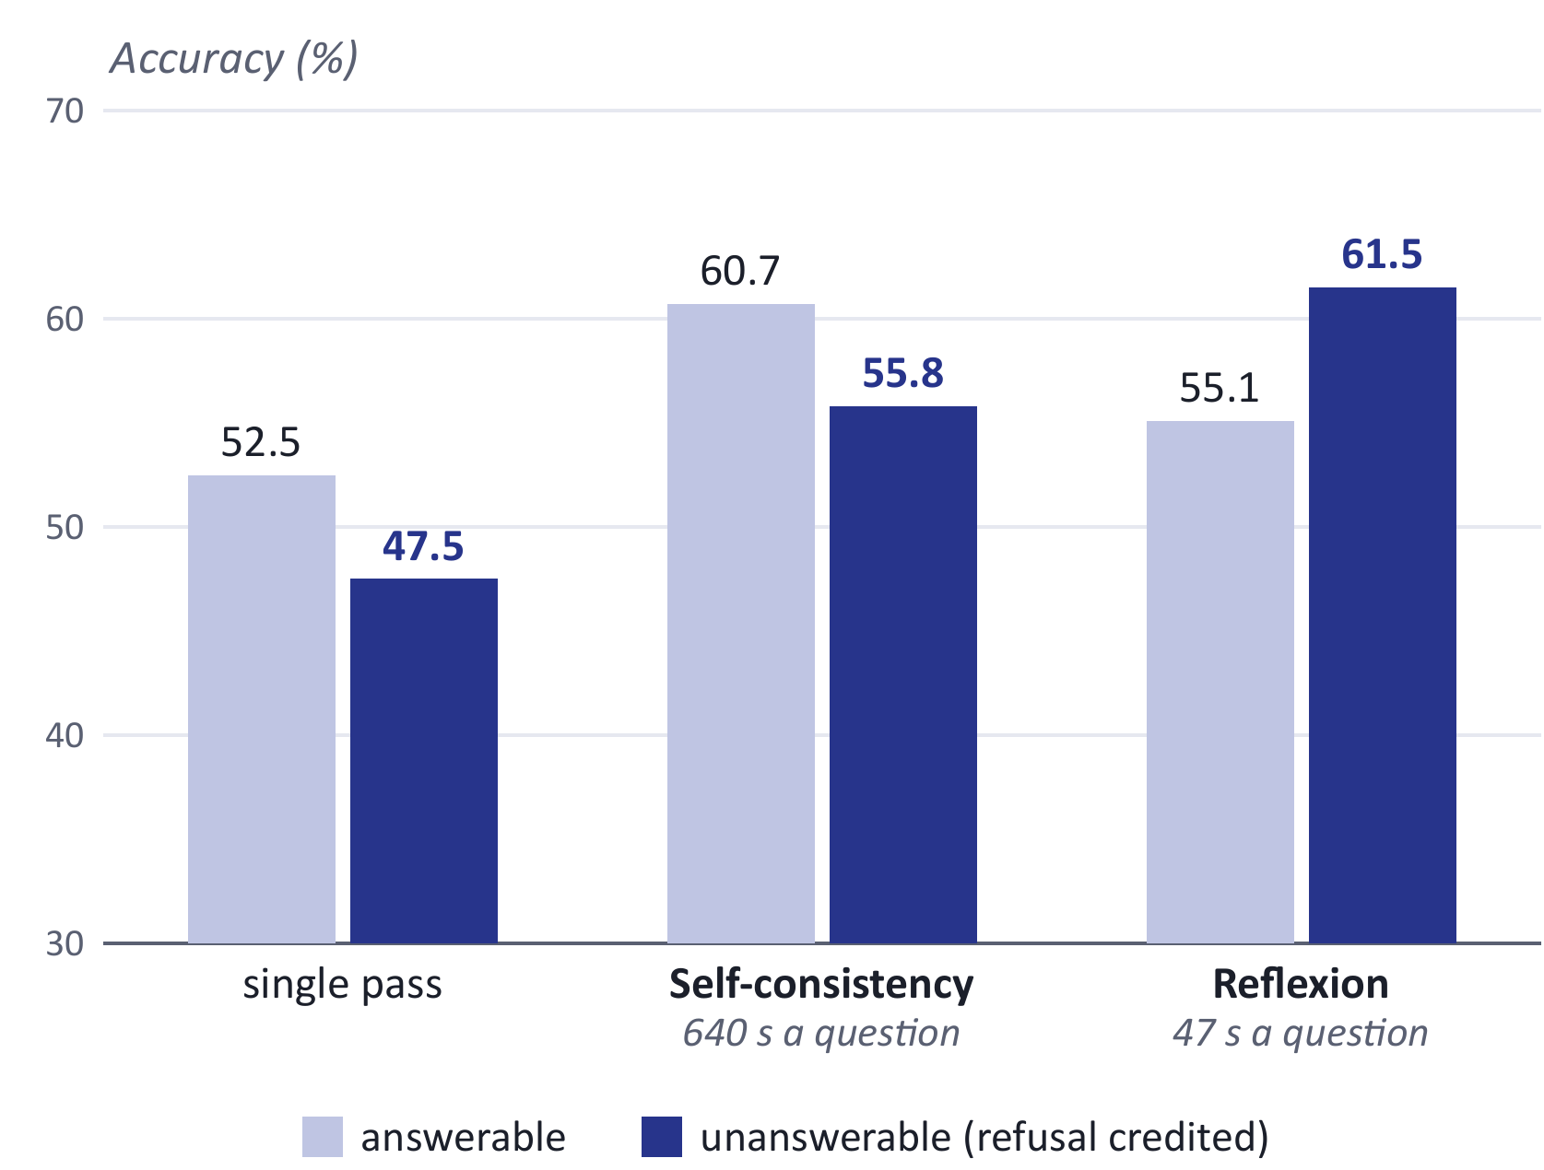
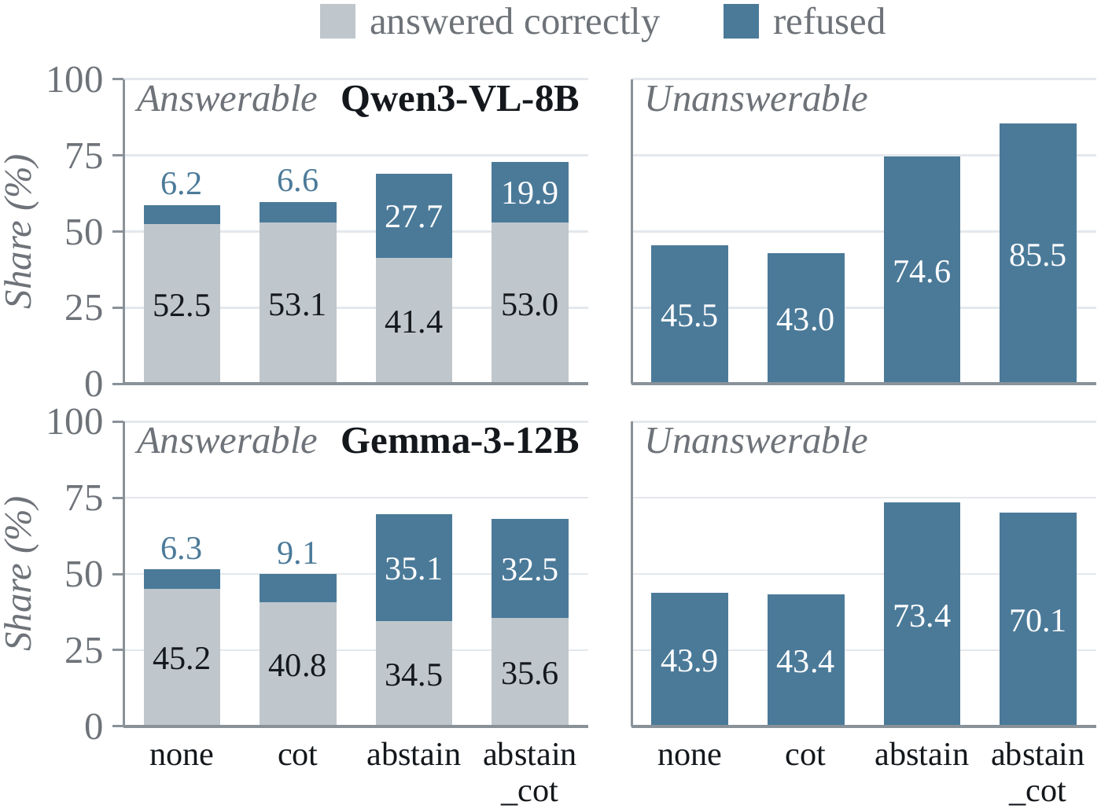
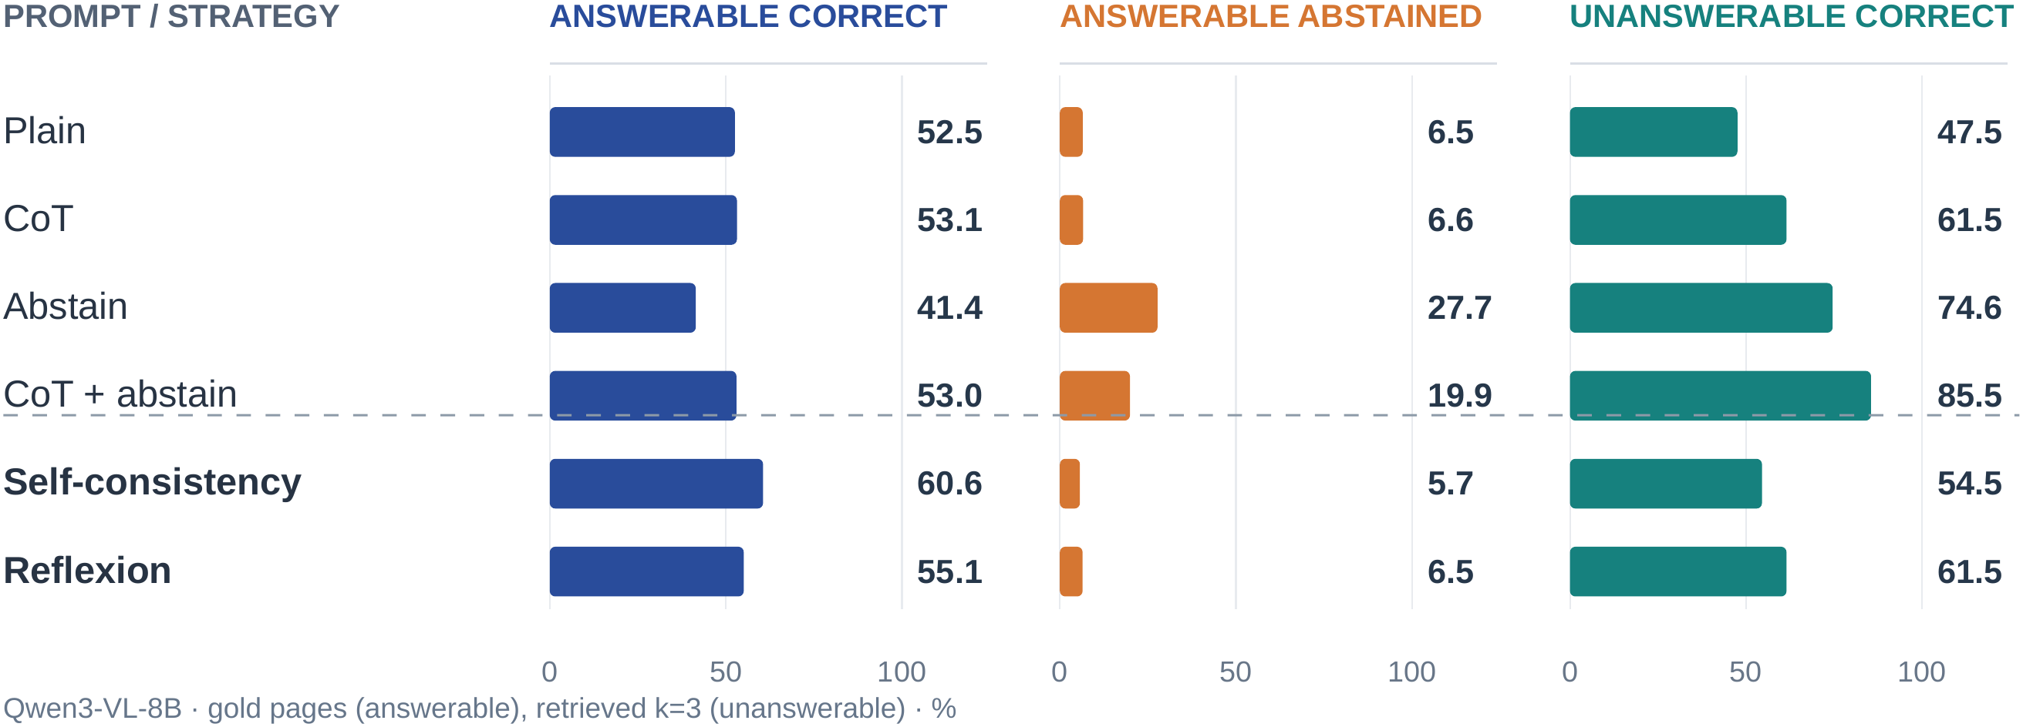
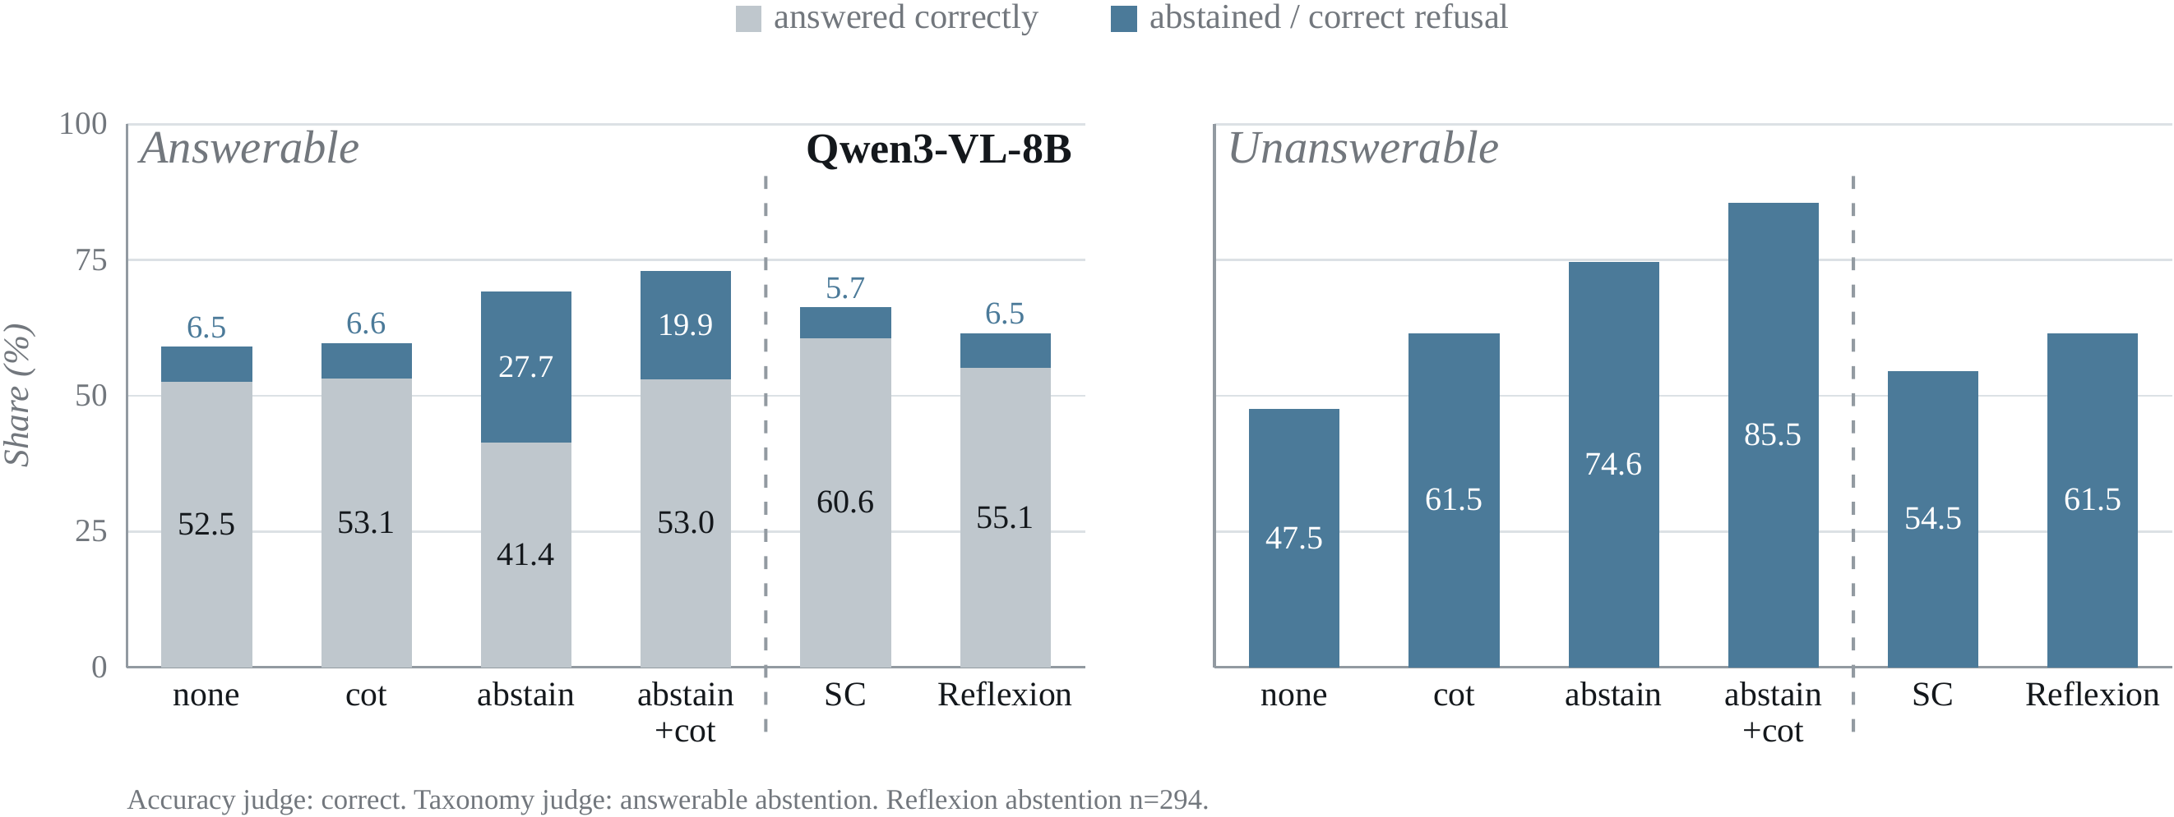
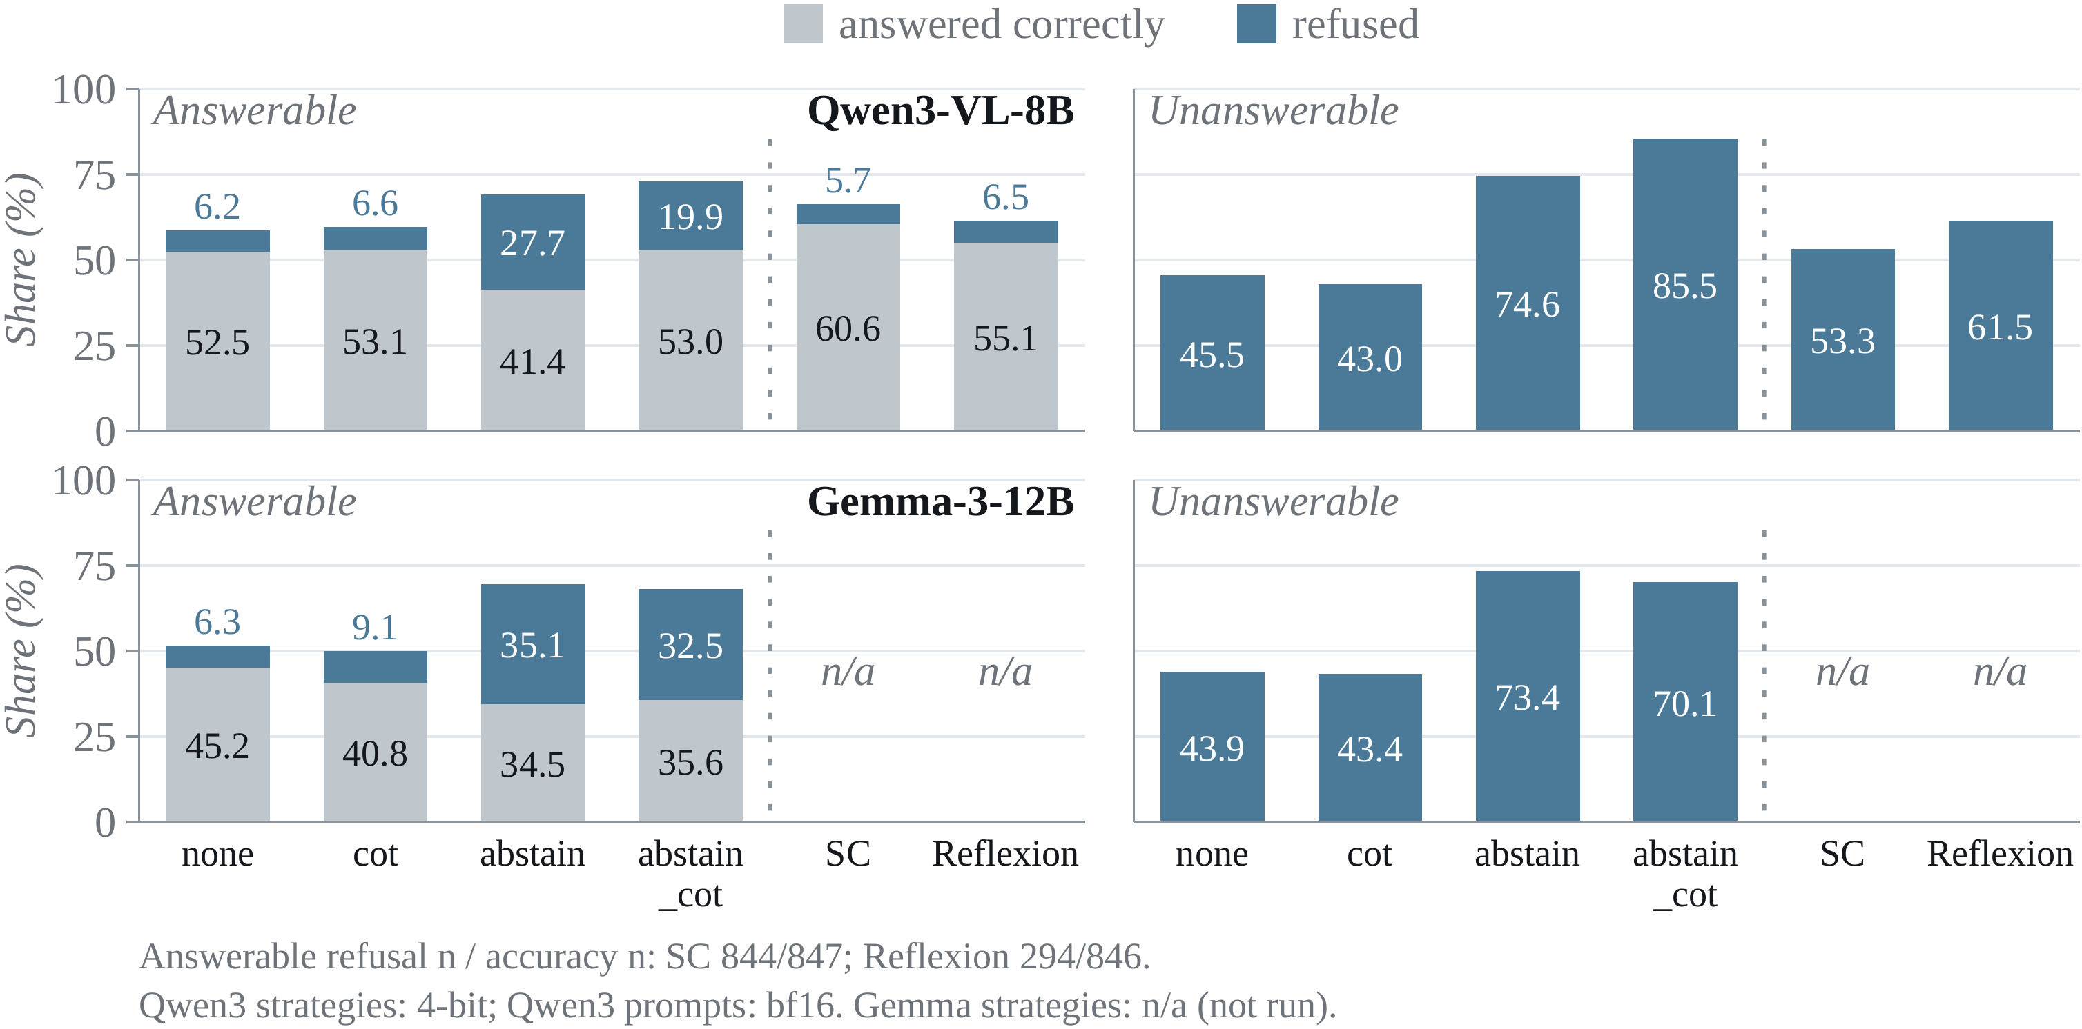
Finding 3 · Reasoning
Chapter 3 · Empirical study · Under review
Prompting moves the refusal trade-off; additional inference gives selective gains.
Answerable accuracy: 60.6% with SC and 55.1% with Reflexion, vs 52.5% plain.
Abstain raises correct refusal, but costs 11.1 points of answerable accuracy for Qwen3.
Reflexion correctly refuses 61.5%, vs 45.5% plain.
Notes:
The left figure is the original prompt_calibration.png: four prompt modes for Qwen3 and Gemma-3. The separate right figure compares only self-consistency and Reflexion on Qwen3-VL-8B at 4-bit.
Both figures use the same outcome definitions. Grey answerable segments are correctness from the accuracy judge. Blue answerable segments are refusal from the taxonomy judge. On unanswerable questions, blue is the refusal credited by the taxonomy judge.
For Qwen3, the abstain instruction raises correct unanswerable refusal from 45.5 to 74.6 percent and answerable refusal from 6.2 to 27.7 percent, but reduces answerable accuracy from 52.5 to 41.4 percent. Combining CoT with abstention recovers answerable accuracy to 53.0 percent and reaches 85.5 percent correct refusal. Gemma does not show that recovery.
Self-consistency reaches 60.6 percent answerable accuracy, about eight points above plain prompting; Reflexion reaches 55.1 percent, about 2.6 points above it. Their correct unanswerable refusal rates are 53.3 and 61.5 percent. Reflexion is 16 points above the plain 45.5 percent baseline on this taxonomy-judged measure.
These are observed comparisons: Qwen3 strategy runs use 4-bit precision and different prompts, while the original Qwen3 prompt modes use bf16. Gemma prompt modes use 4-bit. Reflexion answerable refusal is provisional at 294 rubric-judged cases; self-consistency has 844. The figure prints these counts.

Slide 15
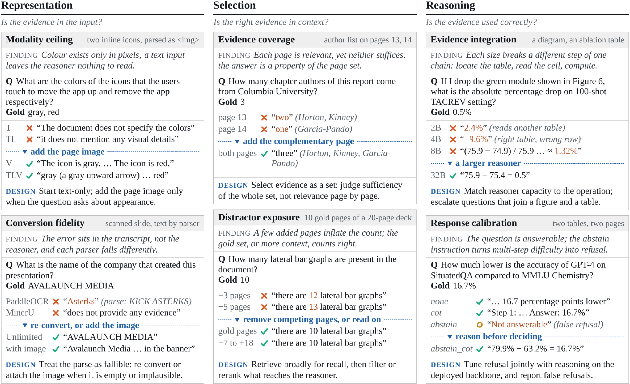
Qualitative Analysis
Chapter 3 · Empirical study · Under review
Six mechanisms on qualitative examples, each with a design implication.
DESIGN
Representation
Add the page image when appearance matters or the text is unreliable
Selection
Retrieve broadly, then filter as a set
Reasoning
Reason before refusing; match model size to the task
Notes:
The paper also checks individual questions to show what each failure looks like. Representation can hide an icon colour or corrupt a table during parsing. Selection can omit a required page or bury it among competing pages. Reasoning can accept a false premise or refuse despite sufficient evidence.
The design responses follow the same three stages: add the image when appearance matters or text is unreliable; retrieve broadly, then filter the evidence as a set; and calibrate the reasoner against the evidence it actually received.

Slide 16
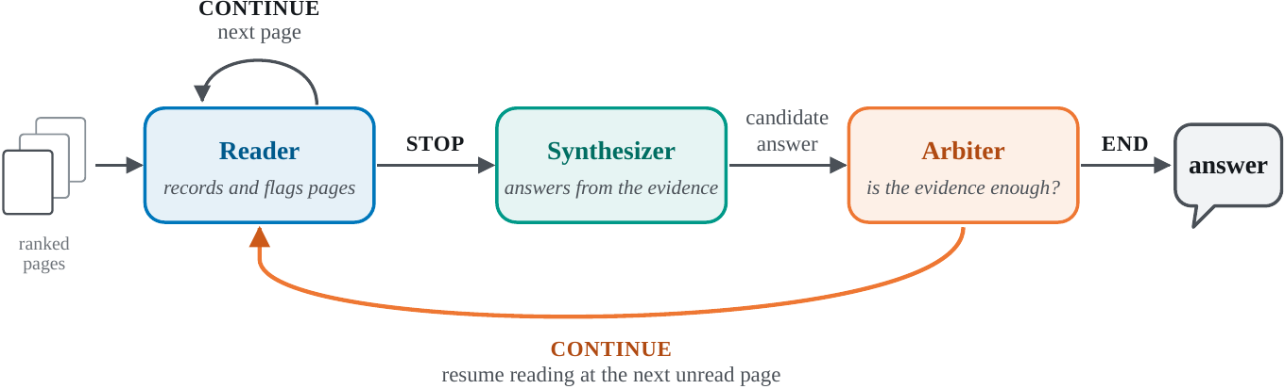
From Findings to a Simple Method
Chapter 4 · Method & conclusion
One model, three roles, each grounded in a finding.
Representation
Reader sees every page as text + image
Selection
Read broadly, pass on compact records
Reasoning
A separate arbiter judges sufficiency
Notes:
To check the findings, we put them into one small system. It is one model playing three roles.
The reader goes through the pages in ranked order. For each page it sees both the text and the image, writes down any evidence it finds, and flags pages that may hold the answer.
The synthesizer answers from the flagged pages in full and the short records of everything else.
The arbiter cannot write an answer. It either accepts, or names a missing fact and sends the reader back for more pages.
Each choice follows from a finding. Text and image together, for representation. Read broadly but pass on short records, for selection. And a separate step that judges whether the evidence is enough, for reasoning.

Slide 17
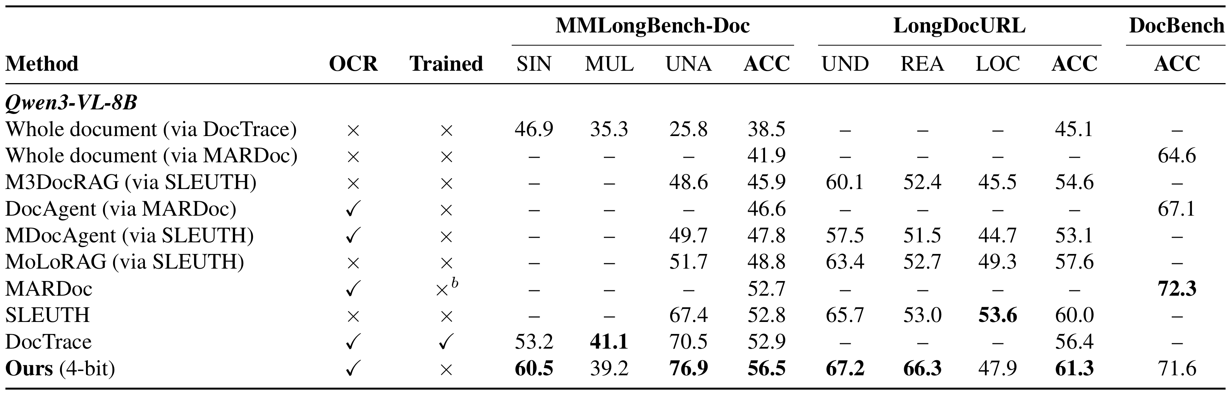
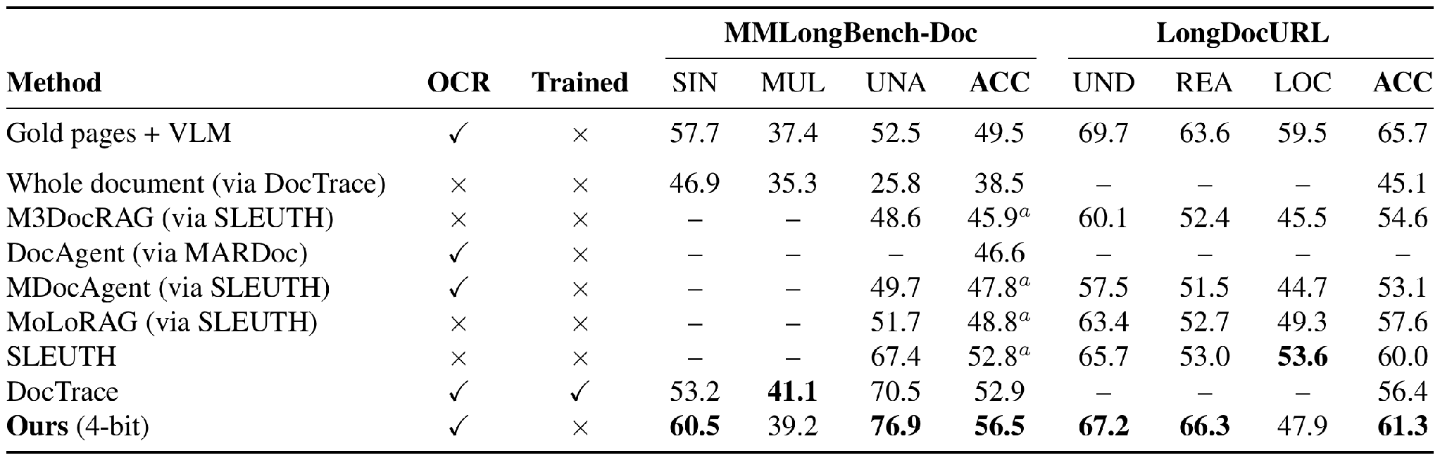
Simple Method: Results
Chapter 4 · Method & conclusion
Qwen3-VL-8B comparisons across three document benchmarks.
Ours: 56.5% MMLongBench-Doc · 61.3% LongDocURL · 71.6% DocBench
DocBench is a provisional 762/1,065 result; MARDoc reports 72.3%. Multi-page: 39.2 vs DocTrace 41.1%.
Notes:
This is the Qwen3-VL-8B section of the updated LaTeX comparison table, including DocBench. Ours uses one model at 4-bit without task-specific training.
The method scores 56.5 percent on MMLongBench-Doc and 61.3 percent on LongDocURL under their official protocols. In DocBench the current 762 of 1,065 completed questions score 71.6 percent. MARDoc reports 72.3 percent there, so do not describe ours as best in that column.
Our multi-page score is 39.2 percent, below DocTrace at 41.1 percent. DocBench evaluations in the source table also use a different evaluator for ours and the MARDoc results, so that column is a reported comparison with a protocol caveat.

Slide 18
Conclusion
Chapter 4 · Method & conclusion
RQ1
Multi-page understanding is evidence management, in four families EMNLP 2026 Main
RQ2
Failures sit at representation, selection or reasoning, each with its own fix Under review
RQ3
A training-free system built on these findings is competitive under a fixed budget
Future work: structure-aware retrieval · calibrated abstention · cost as a first-class metric
Thank you · Questions?
Notes:
To conclude, back to the three research questions.
The survey organises the field. Understanding multi-page documents is a problem of evidence management, and four families of architecture handle it in different ways.
The empirical study locates the failures. They sit at representation, at selection, or at reasoning, and each one needs a different fix.
And a training-free system built on those findings is competitive under a fixed compute budget.
Thank you. I am happy to take questions.

Slide 19
Open Challenges
Chapter 2 · Survey · EMNLP 2026 Main
Each design relocates the bottleneck rather than removing it.
Evidence pipeline
High-resolution reading vs document-scale aggregation
Faithfulness
Few systems abstain or ground answers in evidence
Efficiency
Latency and token cost are rarely reported
Contamination
Training and test sets share source PDFs
Evaluation
Answer-only scores, mostly English VQA
Missing: an end-to-end account of where systems fail → Chapter 3
Notes:
The survey ends with five open challenges, and the one missing piece that motivates our second paper: an end-to-end account of where systems fail.

Slide 20
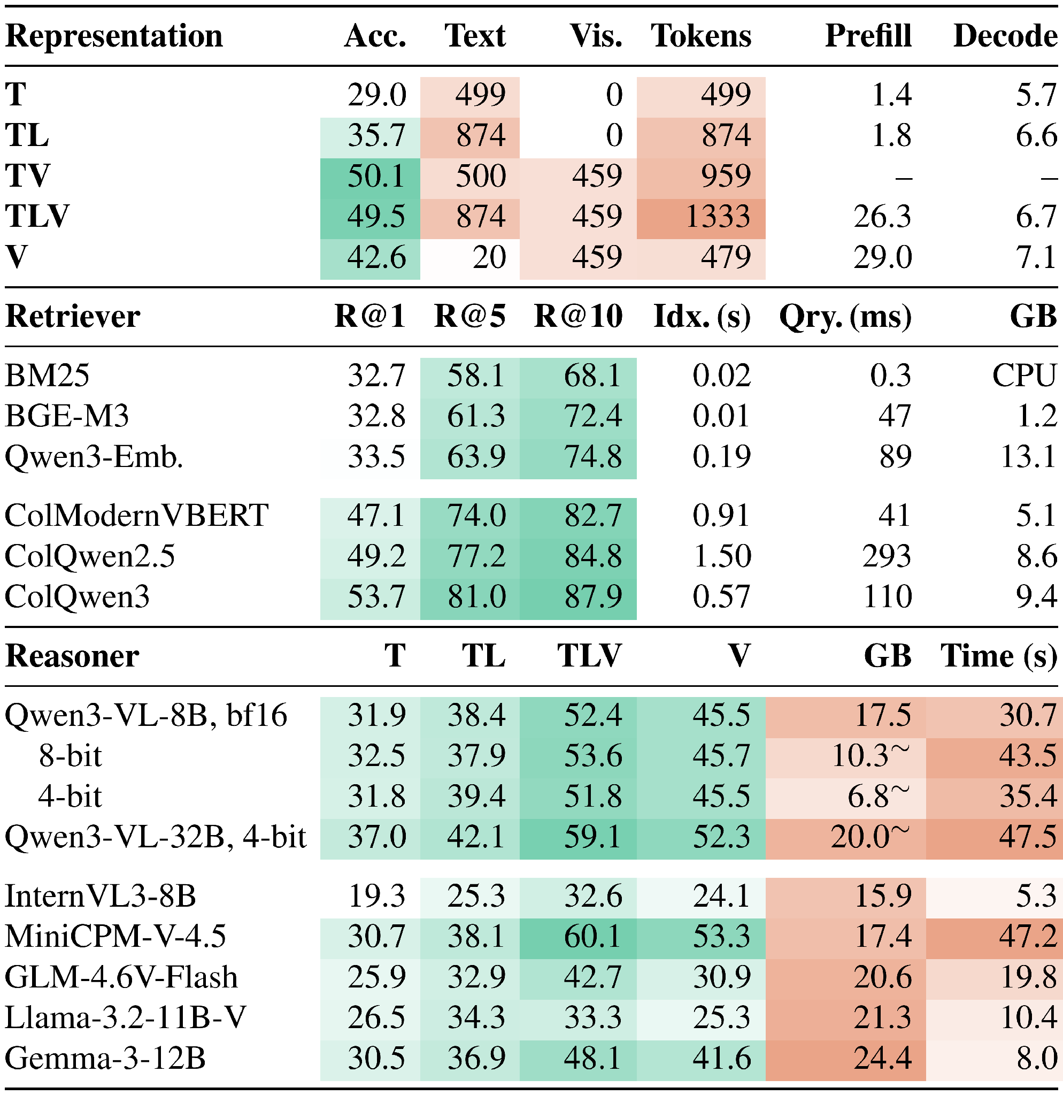
Backup · Deployment: Accuracy and Cost
Backup
Every representation, retriever and reasoner choice has a cost side.
Representation: text + image matches parser text + image with fewer tokens; images cost 26.3 s vs 1.8 s prefill
Retriever: ColQwen3 R@5 81.0% vs BM25 58.1%, but needs a GPU
Reasoner: 4-bit saves memory, not time
Notes:
For questions: the accuracy and cost of each representation, retriever and reasoner choice.

Slide 21
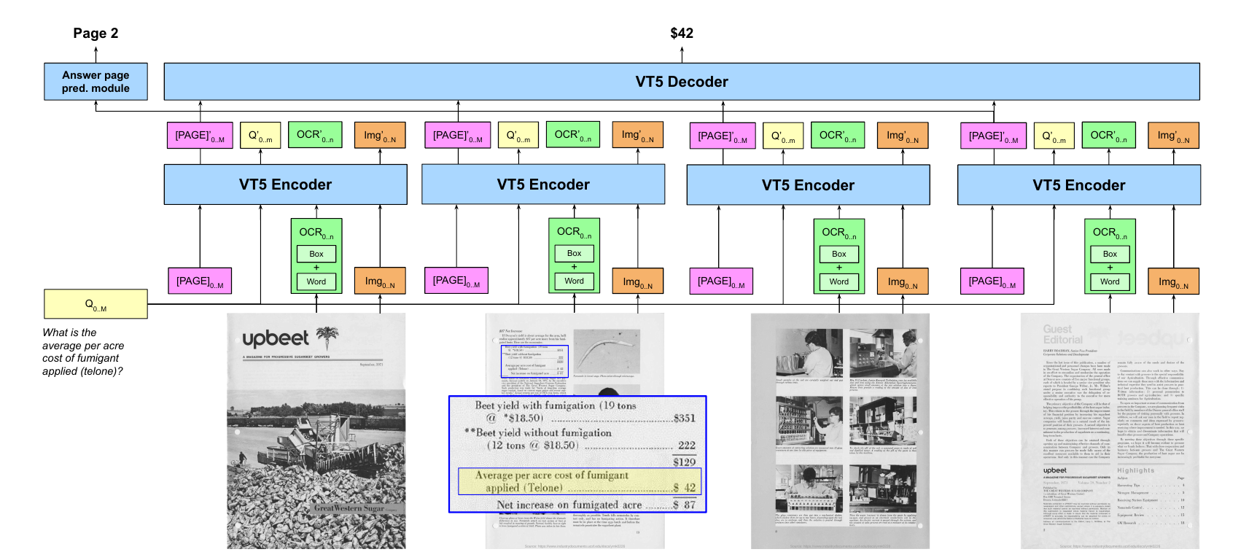
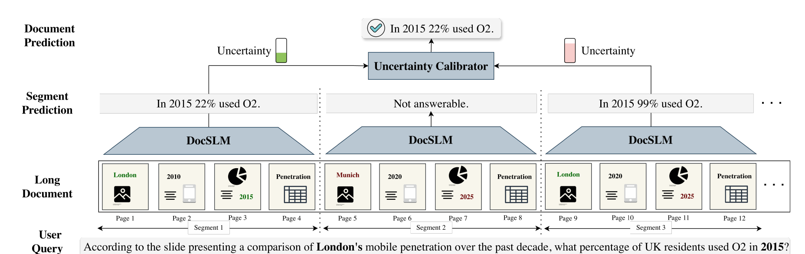
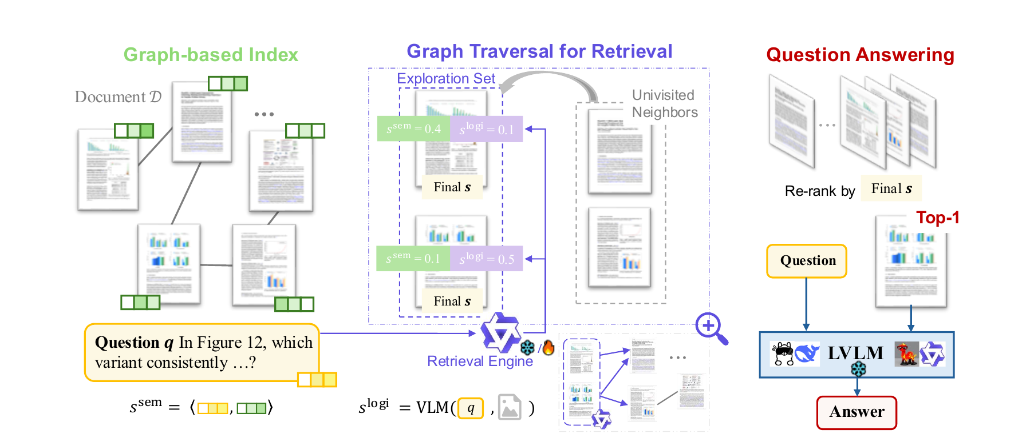
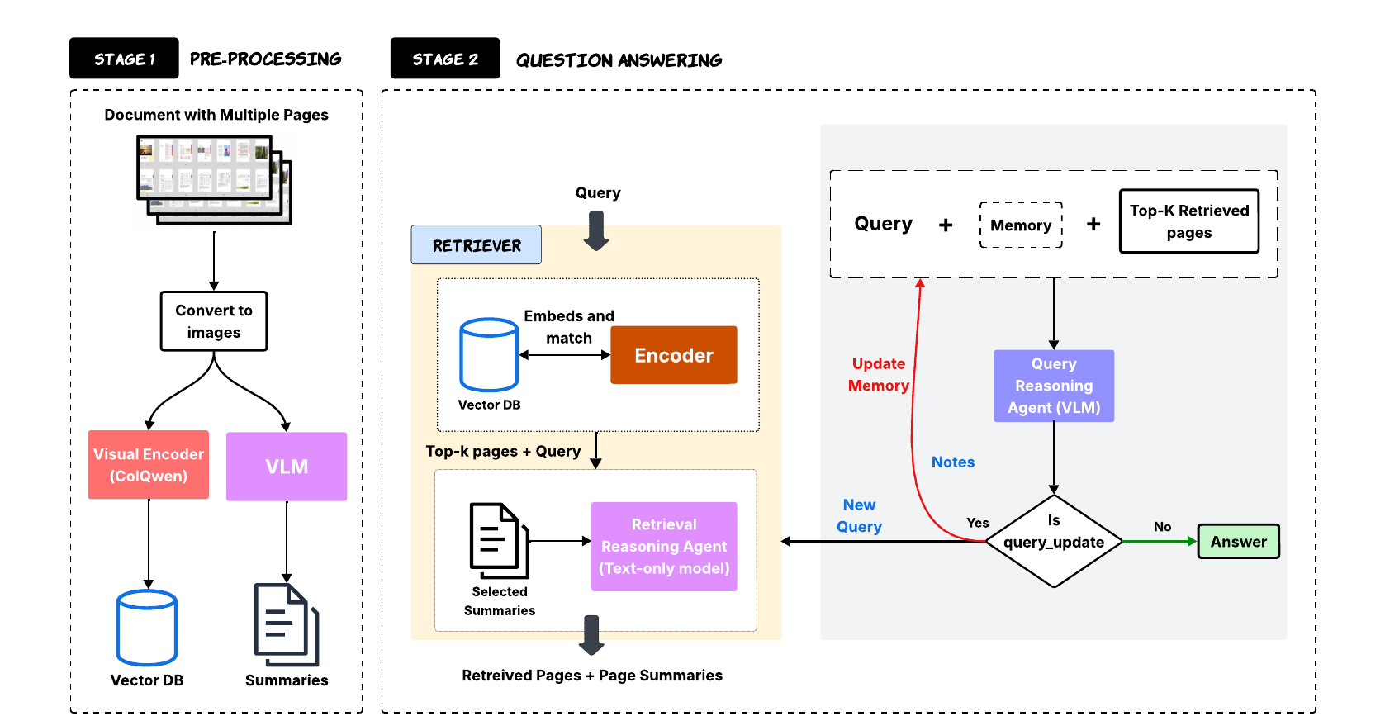
Backup · Representative Frameworks
Backup
One representative system per architectural family.
Hi-VT5 Tito et al., Pattern Recognition 2023
DocSLM Hannan et al., CVPR 2026 Findings
MoLoRAG Wu et al., EMNLP 2025
SimpleDoc Jain et al., EMNLP 2025
Notes:
For questions: one example system from each of the four families.

