Slide 1

Web Development II - Final Project
Driven Auto Rental
Team members:
Lewis – Miral

Slide 2
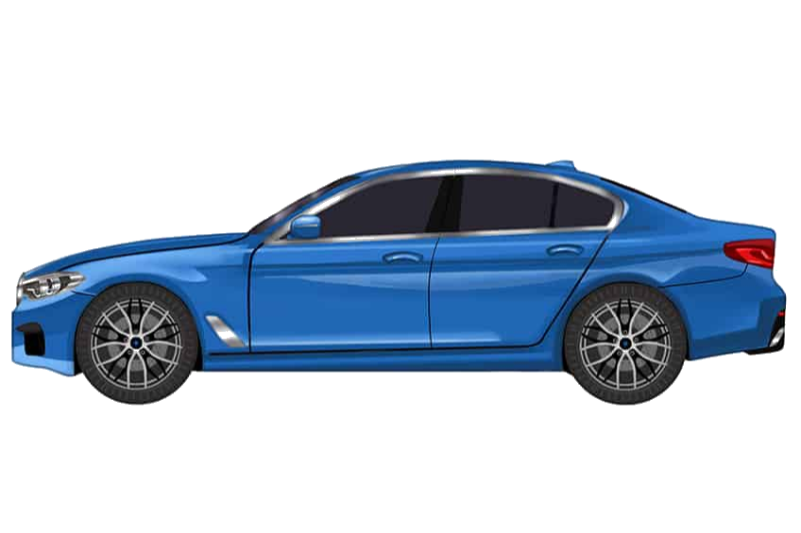
Background of the project - I
Objective:
Auto Rental System
(Book any type of vehicle for your everyday needs)
User and admin functionalities
Strict date keeping to prevent any overlapping reservations
Including:
Admin Dashboard
Admin Pages
Account Creation and Retrieval
Search
Booking & Checkout
Review Page
User Profile Page

Slide 3

Background of the project - II
Other priorities:
User friendly
Users can register with profile picture upload, search for cars, add extras, and confirm reservations.
Admins can view details of vehicles, users, bookings, reviews in searchable and sortable format.
Social Network Possibilities
Users can leave reviews and ratings, which are posted for others to see.
Users are in *friendly* competition for limited vehicle timeslots.

Slide 4





Technologies Implemented
React
React-Table
React date-range
HTML / CSS w/ React-Bootstrap
JavaScript
Git - GitHub - GitHubDesktop
Frontend: (mostly) Lewis
Backend: (mostly) Miral
MySQL (Azure)
NodeJS
Windows 10 Virtual Machine (Azure - For Hosting)
Blob storage (Azure – for Image storage)
Postman and Insomnia (For API Testing)

Slide 5
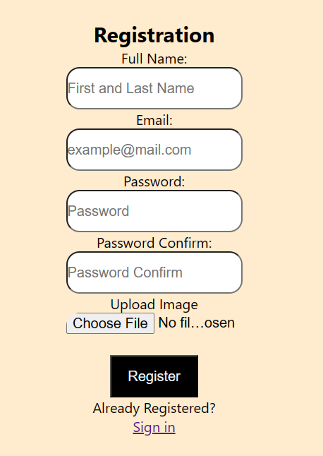
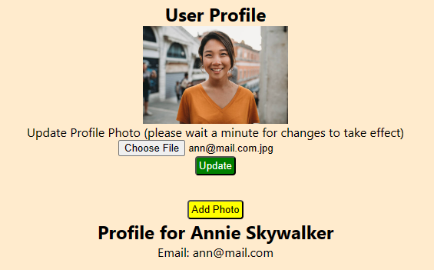
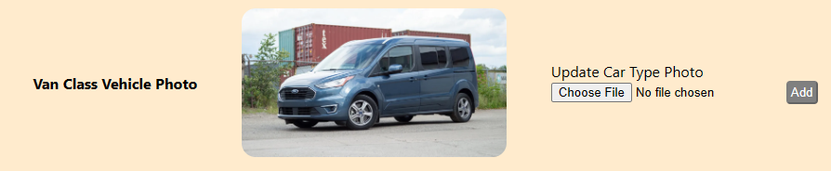
Solution Overview
Azure hosting (blob and virtual machine) combined with a reactive interface.

Slide 6
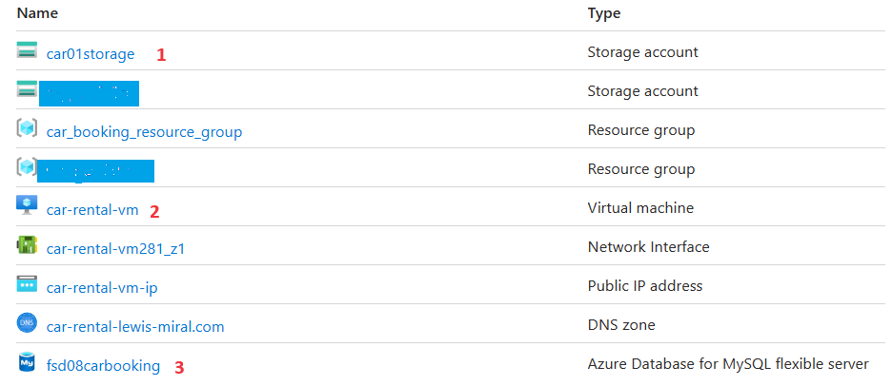
More on Cloud Solutions (Azure)
Blob storage
Virtual Machine hosting of the full stack
MySQL.

Slide 7
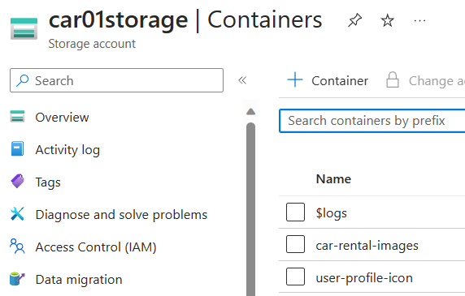
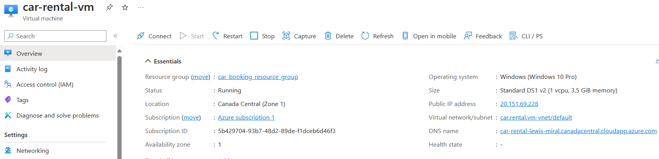
More on Cloud Solutions (Azure)
Snapshots
Blob Storage Configuration
Virtual Machine Configuration

Slide 8
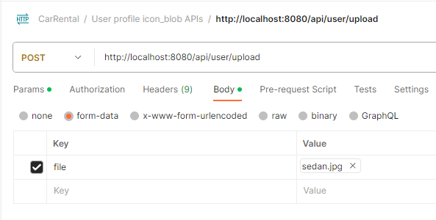
Challenges and Solutions
Blob storage
How to move files to and from cloud storage?
Initially faced difficulty with what APIs to use and how to connect with React.
(Postman was very helpful in this project.)

Slide 9
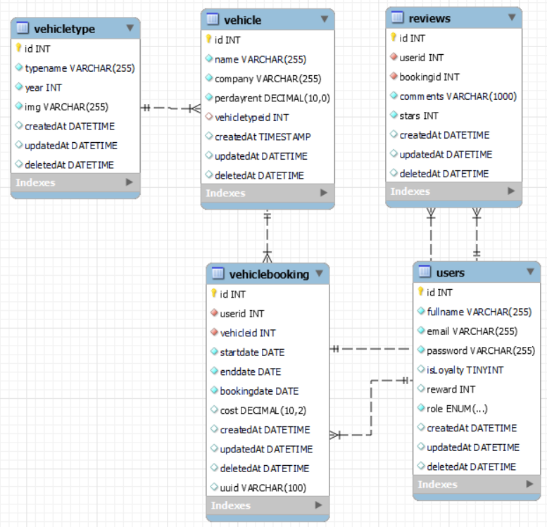


Challenges and Solutions
Database:
For soft delete, we implemented deletedAt (DATE) field. So when we delete any row, we populate date and we get all data where deletedAt is null.
This is called creating "paranoid" tables
Must be careful in all cases – debugging cases like soft deleted reviews and bookings showing on client.
Remember delete cascade
One booking can have multiple reviews

Slide 10
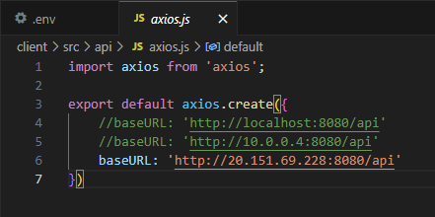
Challenges and Solutions
Client connection with Server project.
Project was working fine on local PC, but backend was not working from cloud hosted VM.
We changed axios baseURL to cloud IP to resolve the issue.

Slide 11
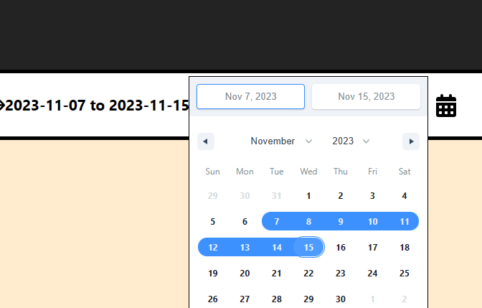
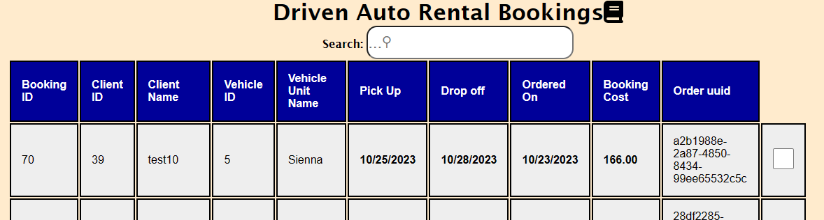
Solution Overview
React Calendar implementation supported by robust database queries. React-table npm package

Slide 12
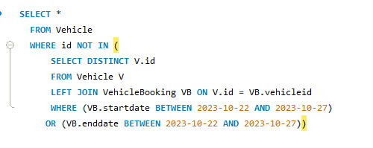
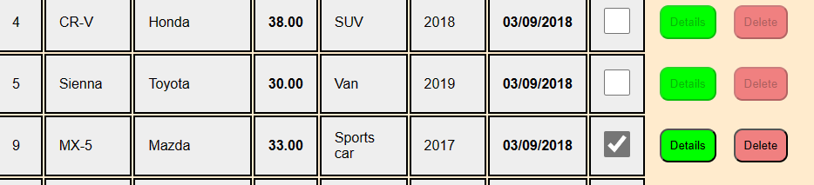
Solution Overview
React Calendar implementation supported by robust database queries. React table offered solutions and its own challenges.
React-table offered solutions and its own challenges.

Slide 13

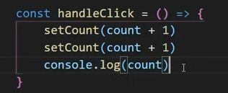
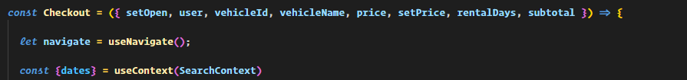
Challenges and Solutions
State Management in React:
State is perhaps the main ‘topic’ of React, and difficult to think about as your app scales up.
Two solutions and their challenges:
count = 0
Prop Drilling:
-We pass properties from a parent component to a child component.
Output?
-Easy to implement solution, but can get non-DRY very fast.
-Props can only be passed DOWN, though you can send setters down
-potential anti-pattern?

Slide 14
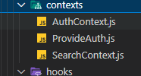
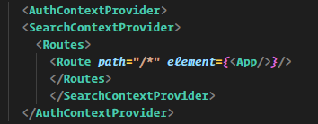

Challenges and Solutions
Using the useContext hook:
Can greatly improve DRY compliance
Fairly Easy to implement
Found it very tough to debug
Other answers…?

Slide 15



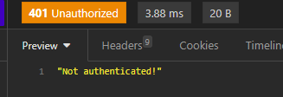

Challenge of Authentication
Local Storage
Apart from challenge of implementing Auth in itself: (JWT)
Trade-offs of verifying through different http request properties: cookies, headers, localStorage and so on.
Cookies: server-side authentication, localStorage strictly client. Cookies not available to javascript, security tradeoff
Cookies
Challenge of unit testing with authentication grows as your app gets bigger, especially if you rely on API testing tools like postman, insomnia.

Slide 16
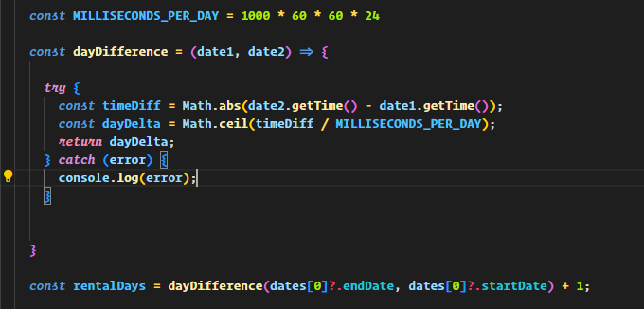
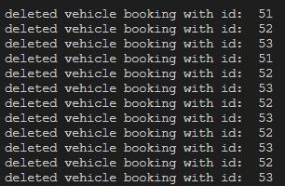
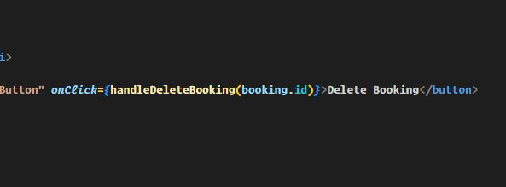
What We Learned
Micro level lessons:
Working with dates in programming is tricky – date-fns library
IIFEs can carry a lot of consequences especially wih React hooks

Slide 17
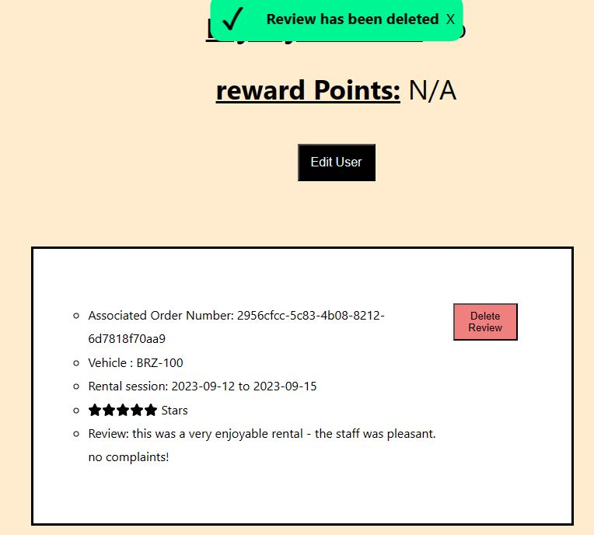
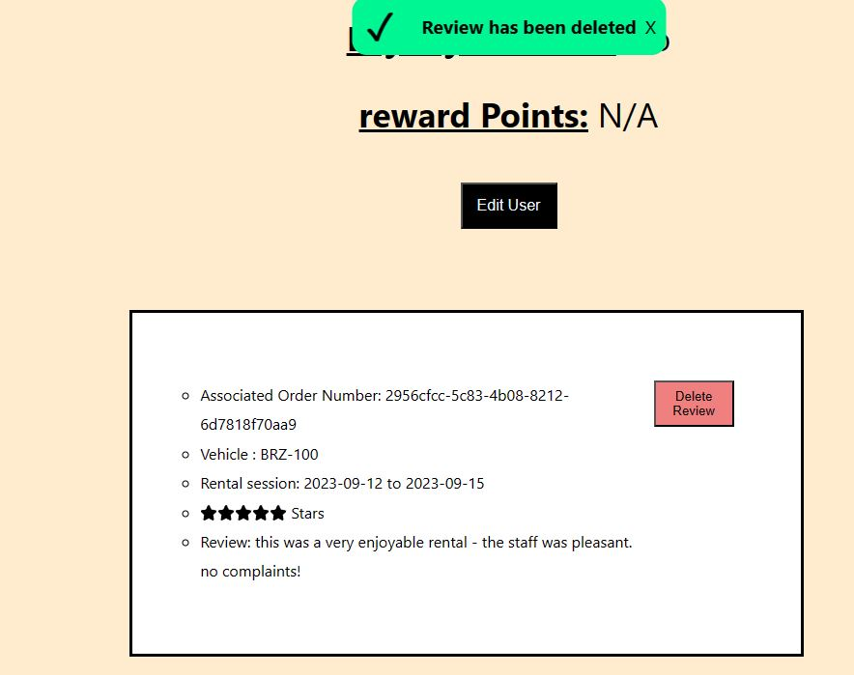

What We Learned
Micro level lessons continued:
React useEffect dependencies – how to update client views, keep pace with server

Slide 18

What We Learned
What a learned from a more macro perspective
Convention over configuration ? Opinionatedness?
A great deal about the ‘full stack’ from api call to the database -> client view
The difficulties and rewards of hosting
Difficulty of migrating a backend from one DB language to another
How to manage a React application’s state vis a vis the back end
How to think about React application broader architecture
e.g., Routables and components

Slide 19
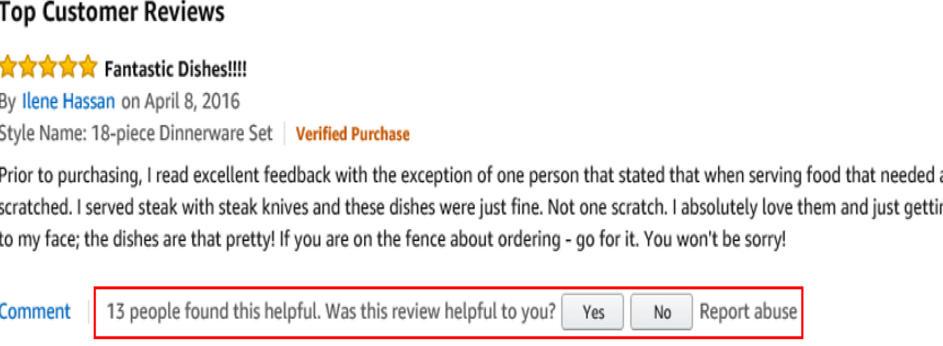

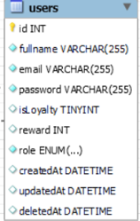
Future work
To implement next time:
More interaction between users
Things like rating a review useful
Giving a weight to user’s ratings depending on conditions
We had a loyalty system that we were not able to implement in time
Further individuate client views
(Visitor pattern?)
(Conditional rendering?)
Data analysis and charts

Slide 20
Summary
We planned and implemented an Auto Rental System using React, Nodejs
React date-range, React-bootstrap, React-table
Allowed for user authorization and authentication via localStorage and JWT
Allowed for users to book, review, and rate vehicles on a shared timeline
Data persisted in Azure hosted MySQL
Reusable components for navbars, dashboards, checkouts
Enabled both users and admins to upload files, stored on Azure blob
Enabled administrators to have full range of functionalities
Notify all users of the status of their operations via flash messages
Application hosted on virtual machine (Azure Windows 10)
Thank you for your attention!
Lewis and Miral

