Slide 1

How Workright delivers the right jobs proof of concept for a user-friendly jobs platform
Dustin, Jing, Lewis

Slide 2


The problem
LinkedIn? Indeed? Monster?
Modern apps and the job search?
Opportunity for a low-friction model

Slide 3
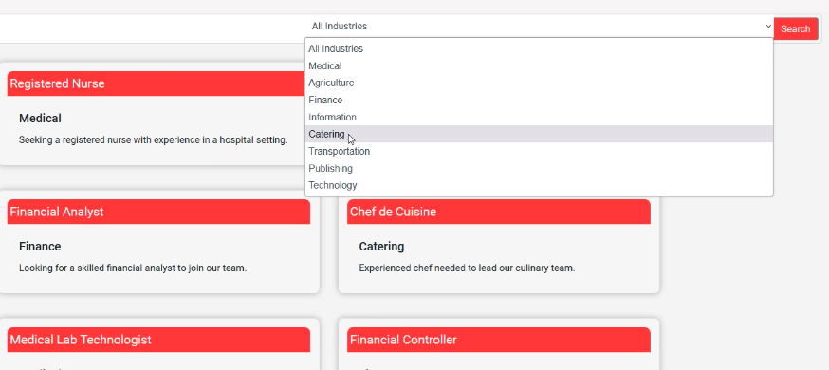
The workRight solution
Simplifying the job search process
Proximity is the key
Employers get directly involved; no middlemen

Slide 4
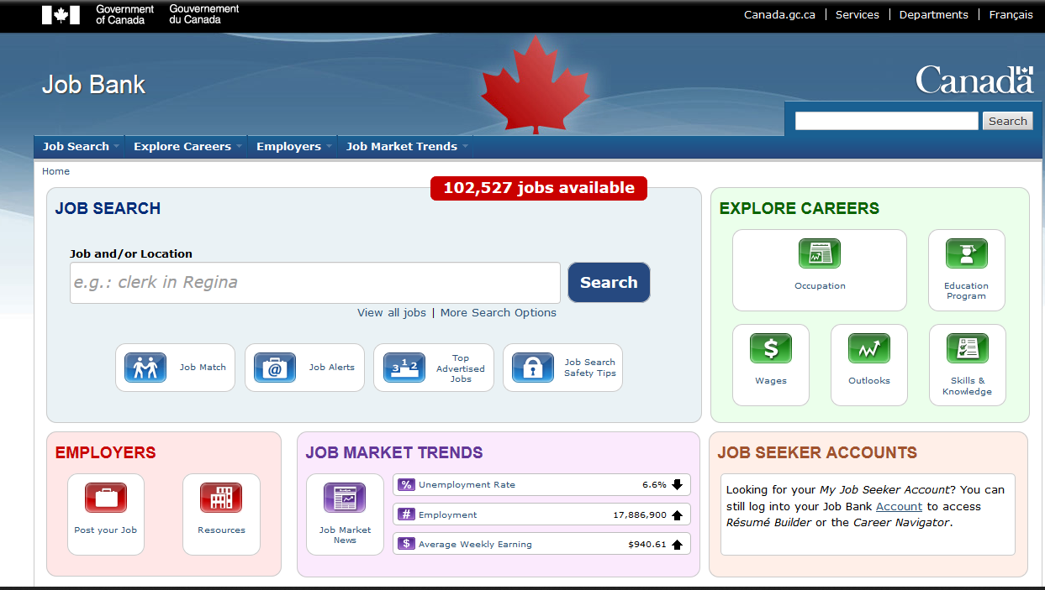
Let’s trade first impressions
Compare with Job Bank Canada, JobIllico, and others
Busy-ness on home pages especially a deterrent
The user interface itself a source of “decision fatigue” ON TOP of the job search
6/13/2023

Slide 5
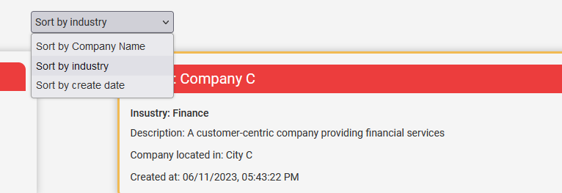
Implementing a smoother user experience
Minimalist registration
Companies and positions accessible within two clicks
Easy, lightweight search tools
Preventing user attrition
6/13/2023

Slide 6
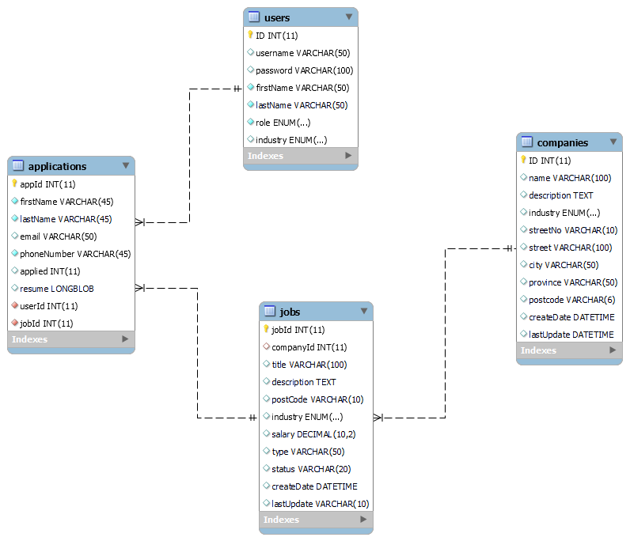
Database Structure
Users table holds job seekers and employers data
Jobs table for active postings
Company information as an addendum to job postings

Slide 7
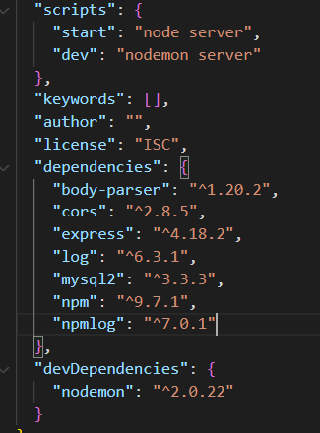
Node Js Technologies
nodemon allowed for rapid debugging “npm run dev” development script
jQuery, very simply easy to use in manipulating DOM for front-end validation
log.info available through npmlog

Slide 8

A multiplicity of Roles
Primary users are job-seekers, but there are also employer roles in the WorkRight app
Challenge of database queries and permissions across different role

Slide 9
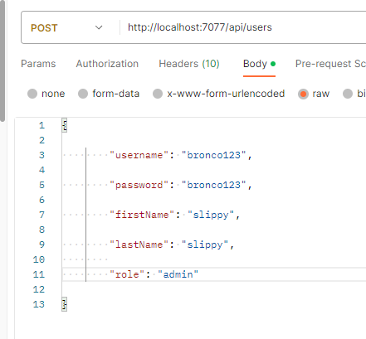
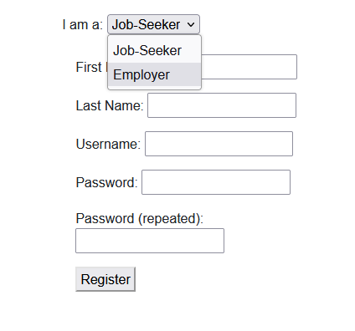
Building a ship a sea
Authentication can be tough to implement after the fact
With multiple roles, many moving parts
Avoiding code duplication while not cutting any corners

Slide 10
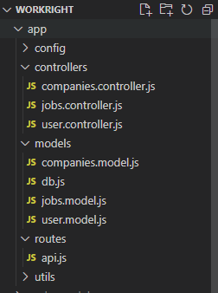
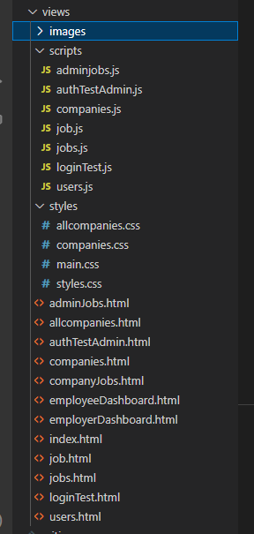
Difficulty:
Multiple controllers, multiple models
Almost 20 static pages
How to organize project development efficiently + realistically?

Slide 11
Building toward a uX
Job-seekers enjoy a pleasant, low mental overhead search
Employers enticed to create accounts
Administrators empowered to facilitate
Rock steady server-side

Slide 12
Challenge pages
The jobs table is huge, on
With multiple roles, many moving parts
Avoiding code duplication while not cutting any corners

Slide 13




Summary
An expansive project touching many important aspects of full-stack development and its challenges.

Slide 14

Thank you
-Lewis
-Dustin
-Jing

