Slide 1

Web Scraping (With Rrrrrruby)

Slide 2
What is it?
Basically: doing all the stuff you can normally do with a browser and your mouse and keyboard (and more) but with ruby script instead.

Slide 3

Example Scrape
Things we are using:
-Good ol’ ruby
-Net:HTTP (https://docs.ruby-lang.org/en/2.0.0/Net/HTTP.html)

Slide 4
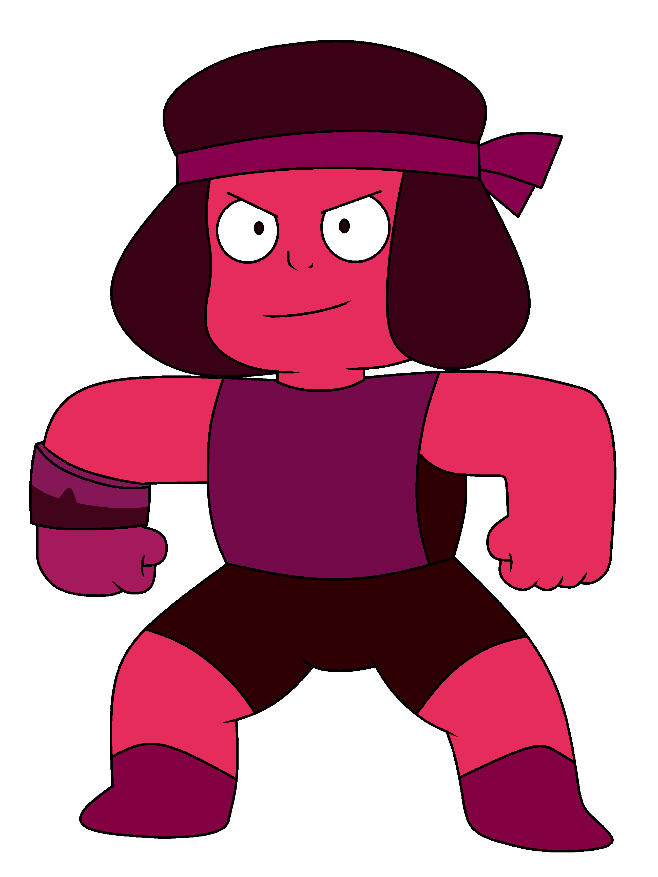


What just happened?
Request (though Net:HTTP)
Wikipedia
Roro Melb
Response (HTML text)

Slide 5
But why?
- Data Mining: Reddit scraping, Wall Street Journal Scraping, Real-estate Websites
- Profit: Auction Sniping
- Trolling: @arguetron
- Really, Really awesome data mining: Google

Slide 6
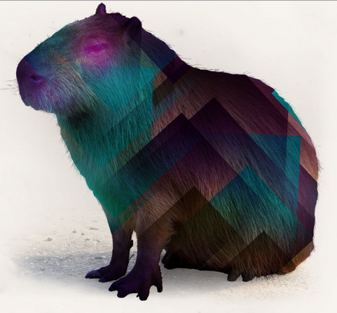




Example Scrape 2
Technology:

Slide 7

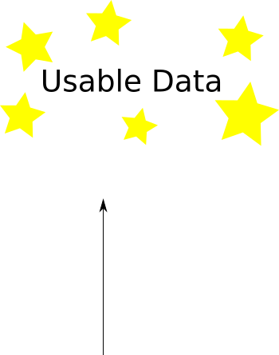
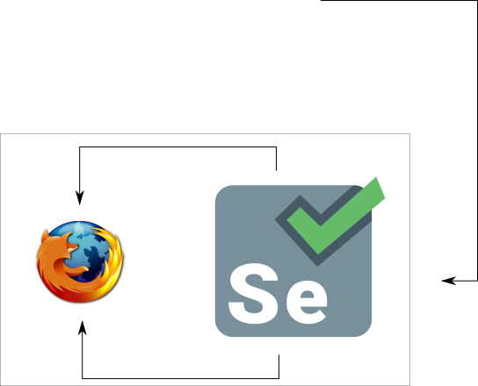
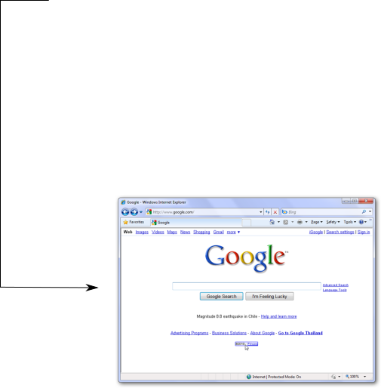
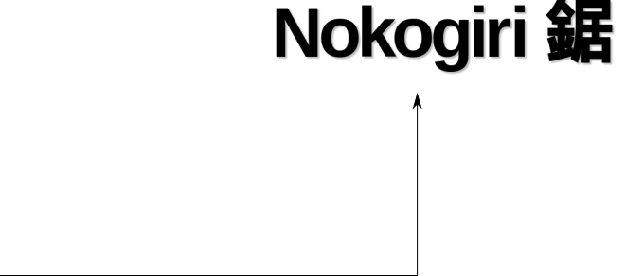
Watir/Nokogiri workflow

Slide 8
Scarping vs Normal
Its Sloooooooooooow
It’s buggy
- subject to website issues
- someone else wrote most of the code (probably still are)
It’s sequential

Slide 9
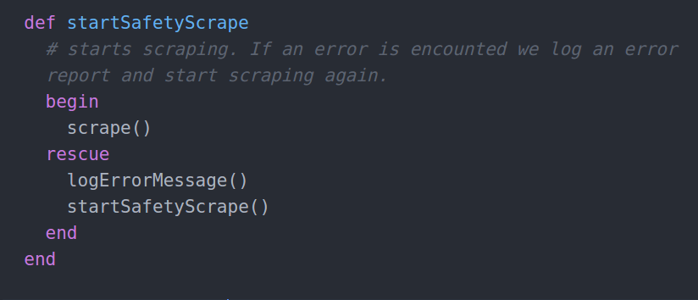
Bonus Section: Advice (double points for staying awake)
Expect errors:

Slide 10
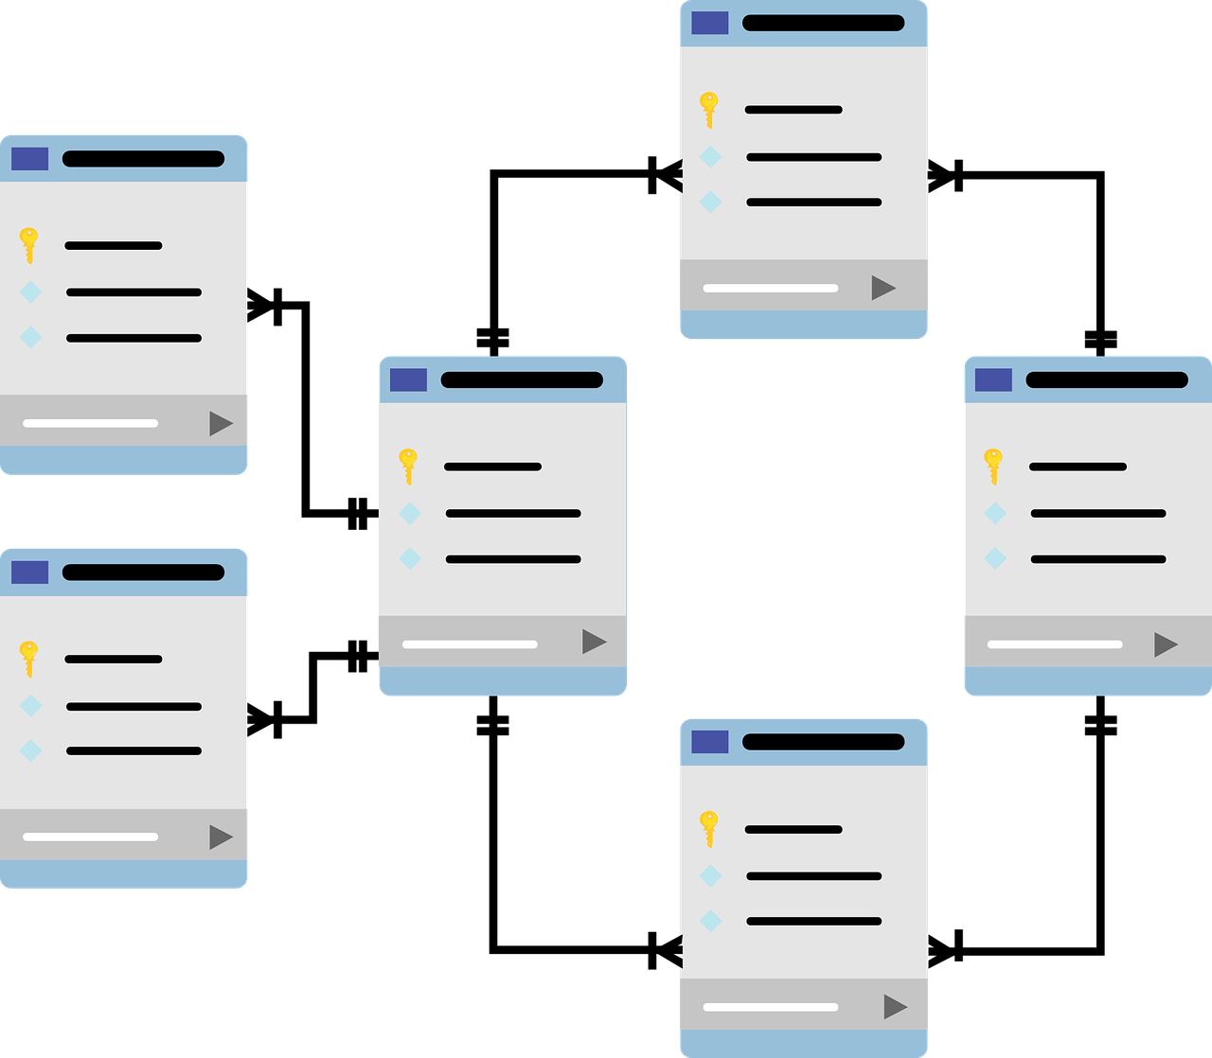
Advice: Work out Data Storage First

Slide 11
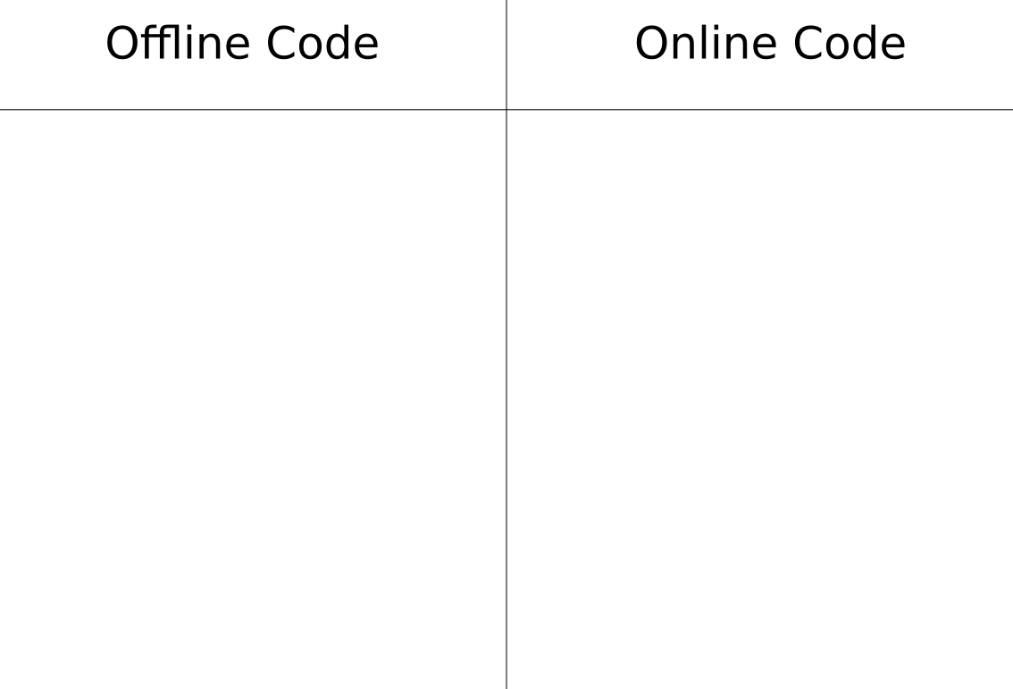
Advice: “Offline” and “Online” code
- consistent
- subject to the cruel whims of the Internet
- can run however you like
- can only ever run in a weird sequence
- not agonizingly slow
- agonizingly slow
- knock yourself out
- running it too often gets you banned

Slide 12
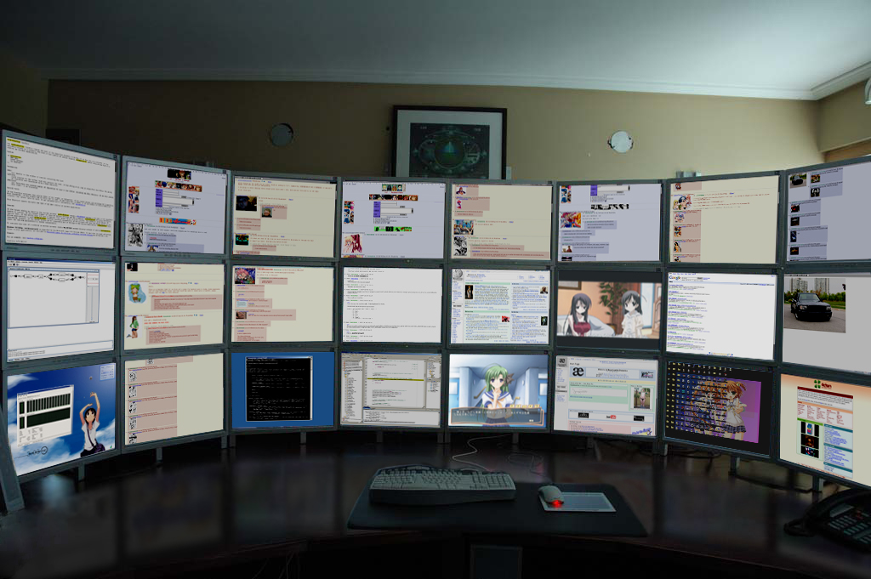
Advice: Have >= 2 monitors

Slide 13
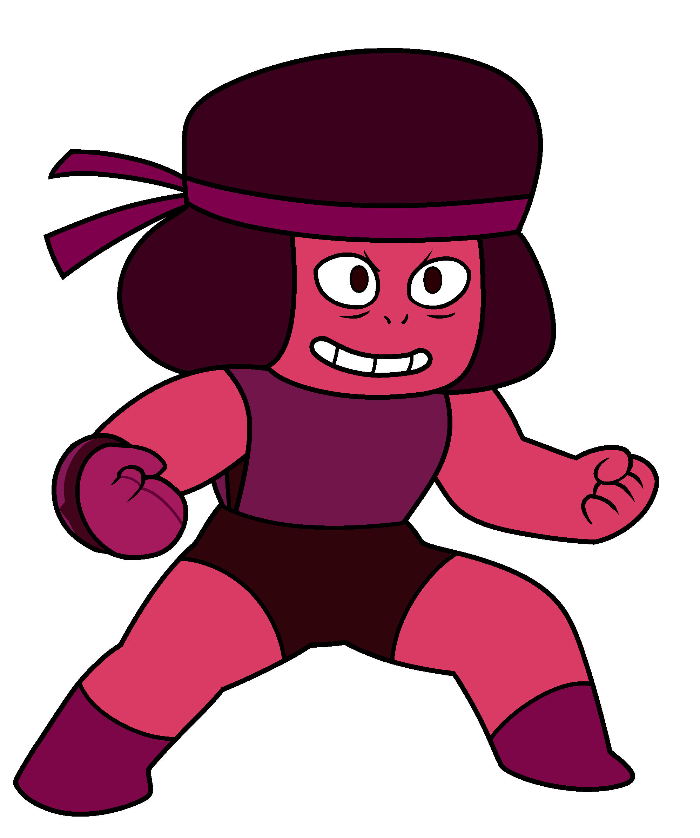
Happy Scraping!

