Slide 1
Connect two teensy4.0
Use I2C

Slide 2
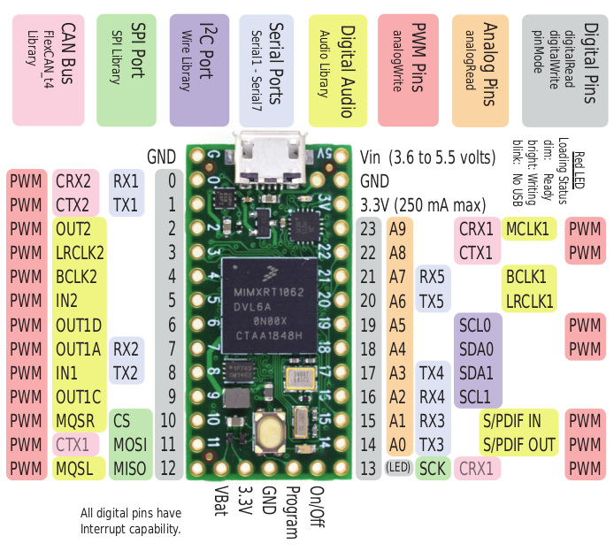

Slide 3
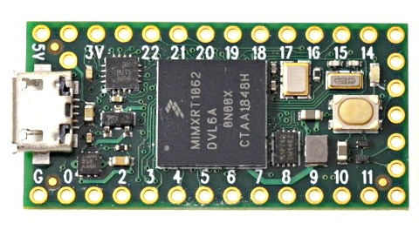
GND
SCL
SDA

Slide 4
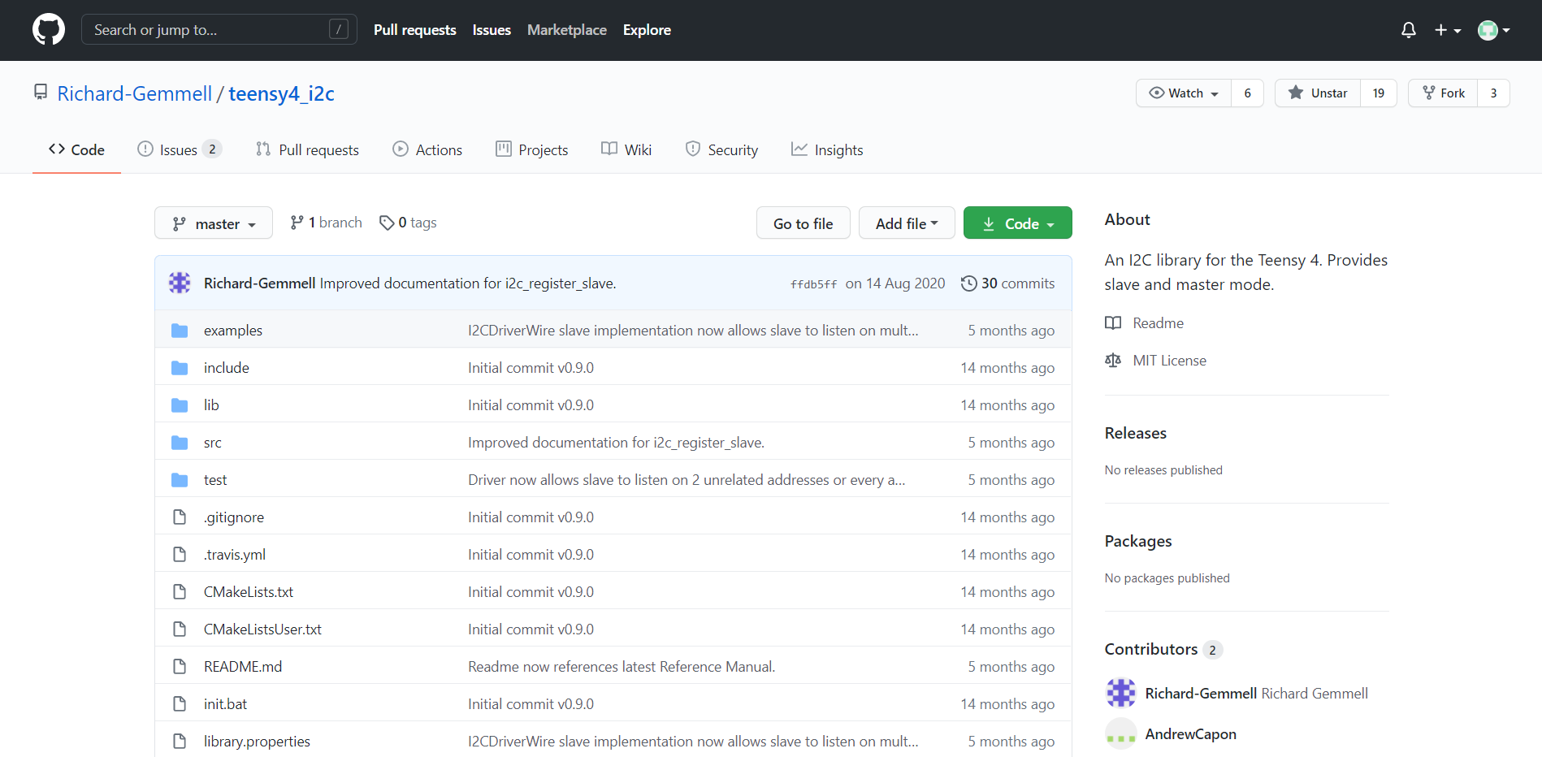
Library:
https://github.com/Richard-Gemmell/teensy4_i2c

Slide 5
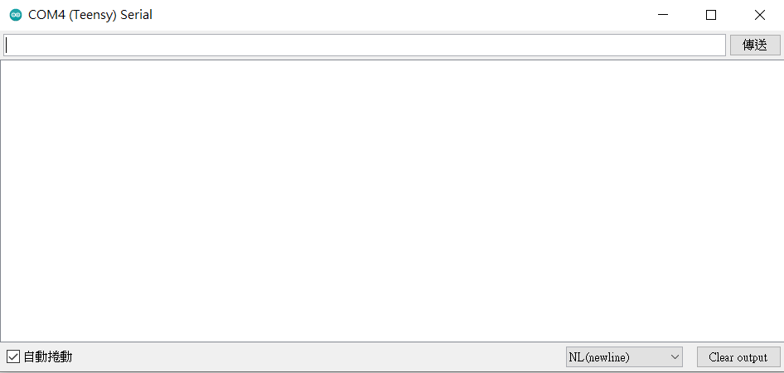
Architecture:
Step1: request data
Slave Board
Master Board
Step2: write data
Step3: read data
Step4: show the result on the screen

Slide 6
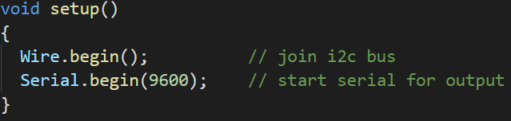
Master Board:
Step1: initialize, master does not need to set address
Step2: request data

Slide 7
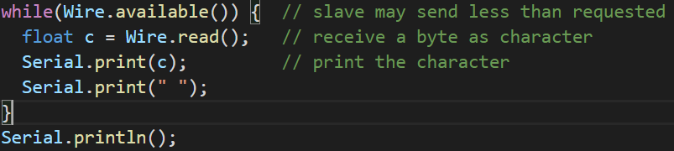
Master Board:
Step3: read the data in the bus

Slide 8
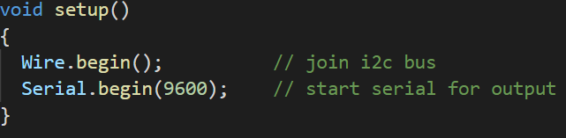
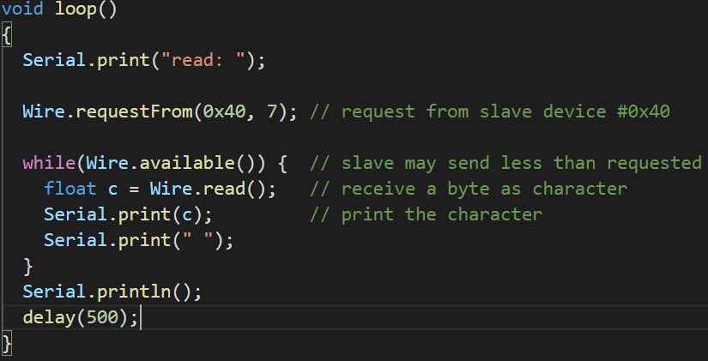
Master Board:

Slide 9
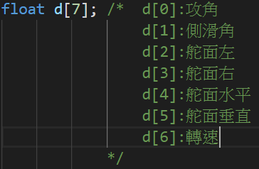
Slave Board:
Step1: Set address, define the request event
Step2: define the structure of data

Slide 10
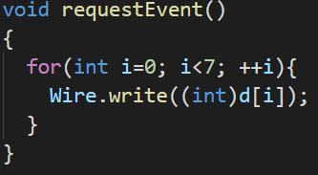
Slave Board:
Step3: send the data to the bus
Note: Wire.write() do not support float,
use cast to convert d[i] to int type.
(Master board use float to get the data)

Slide 11
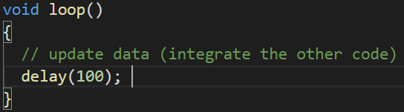
Slave Board:
Step4: update the data of the plane

Slide 12
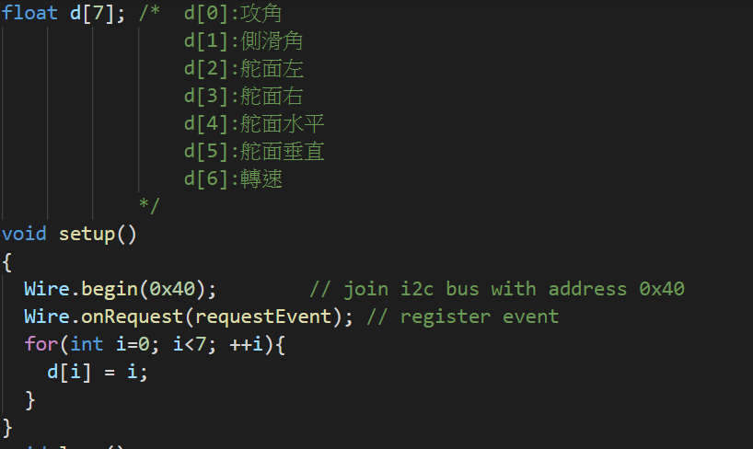
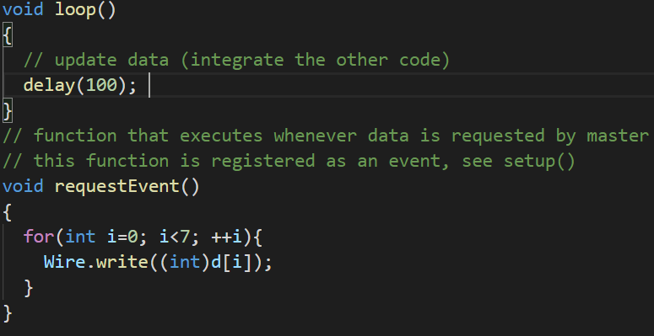
Slave Board:

Slide 13
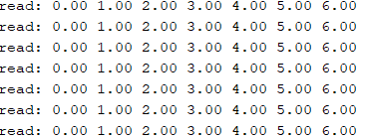
Result:

