Slide 1
Design of an SRAM controller
A design guide

Slide 2
SRAM on the DE2-115 boards
ISSI 1024K x 16 high speed asynchronous CMOS Static RAM with 3.3V supply
High-speed access time: — 8, 10, and 20 ns
Fully static operation: no clock or refresh required
Tristate outputs
Data control for upper and lower bytes

Slide 3
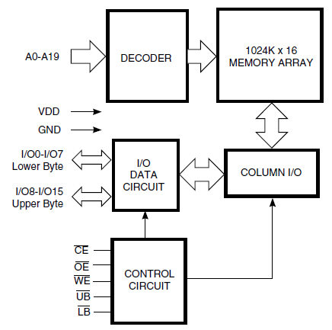
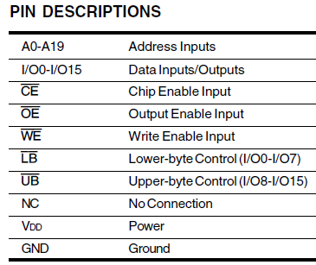
Functional Block diagram of IS61WV102416

Slide 4
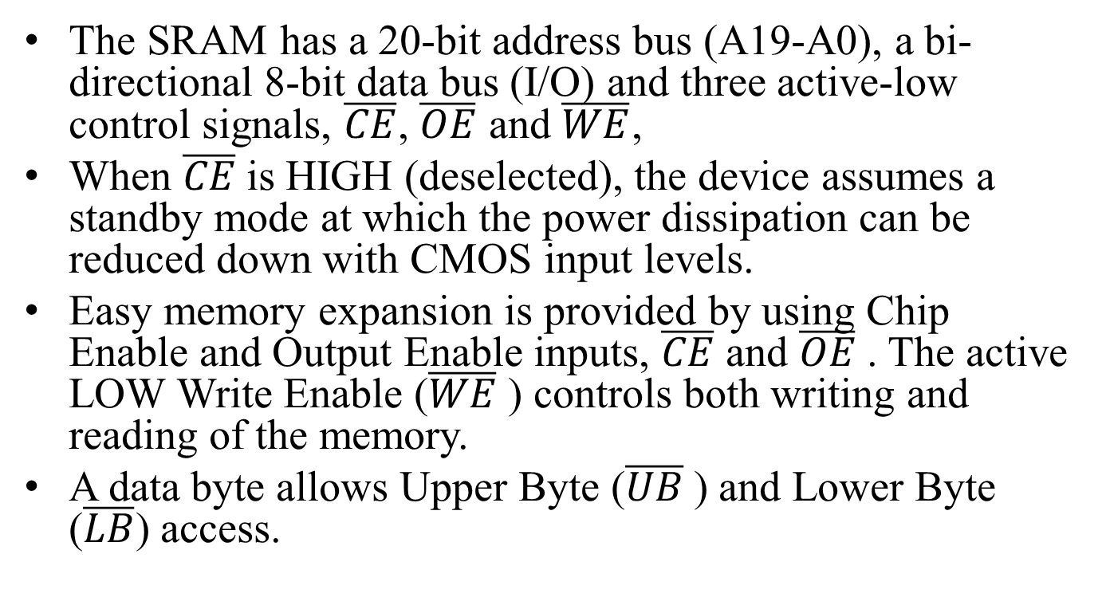
Description
The SRAM has a 20-bit address bus (A19-A0), a bi-directional 8-bit data bus (I/O) and three active-low control signals, $\overline{CE}$, $\overline{OE}$ and $\overline{WE}$,
When $\overline{CE}$is HIGH (deselected), the device assumes a standby mode at which the power dissipation can be reduced down with CMOS input levels.
Easy memory expansion is provided by using Chip Enable and Output Enable inputs, $\overline{CE}$ and $\overline{OE}$. The active LOW Write Enable ($\overline{WE}$) controls both writing and reading of the memory.
A data byte allows Upper Byte ($\overline{UB}$) and Lower Byte ($\overline{LB}$) access.

Slide 5
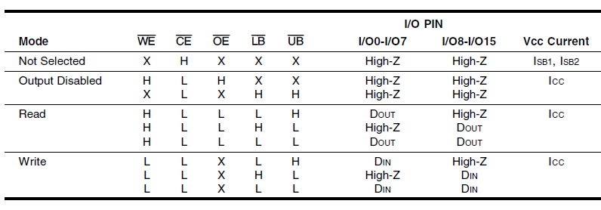
Truth table

Slide 6
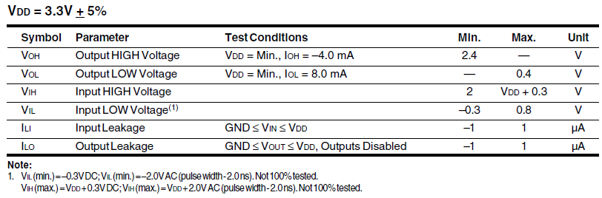
DC Electrical Characteristics

Slide 7
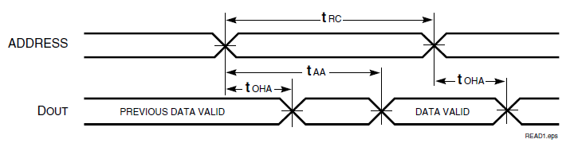
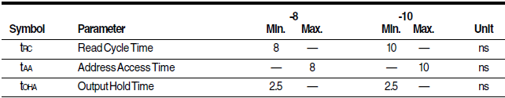
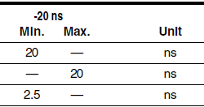
AC timing diagrams Read cycle No. 1

Slide 8
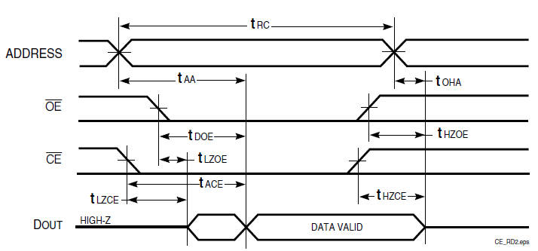

AC timing diagrams- Read cycle No. 2 $\overline{OE}$ controlled

Slide 9
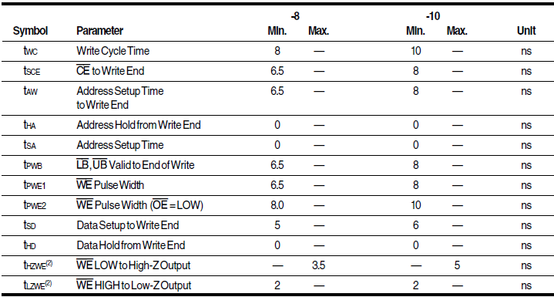
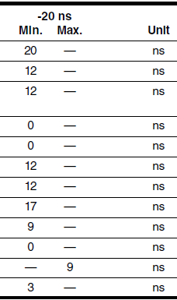
Read cycle switching characteristics use -10 as the speed grade

Slide 10
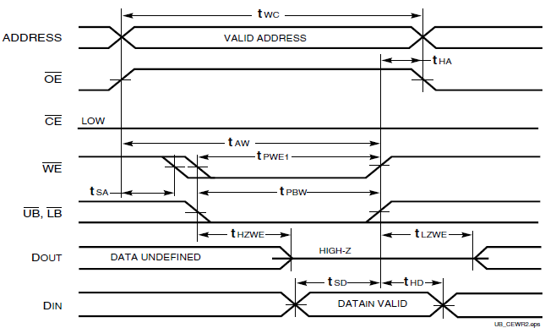
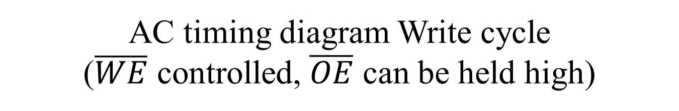
AC timing diagram Write cycle ($\overline{WE}$ controlled, $\overline{OE}$ can be held high)

Slide 11
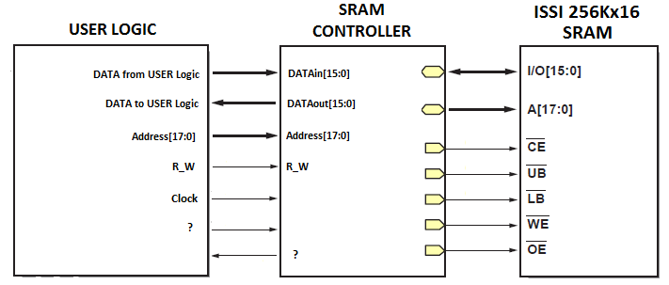
Why and how to design a SRAM controller?
Note, while the SRAM is an asynchronous device, the timing requirements for the read and write require the controller to be synchronous for the user logic to use it properly. What additional user signals and status information would be needed?
1024Kx16
A[19:0]

Slide 12
Can we simplify the waveforms without violating the timing requirements?
If we chose the Read cycle 1, do you need to make sure the data is VALID before you send to the user logic? What data is sent between t_{OHA} and t_{AA}? Does it matter for your project?
Remember, t_{AA} for this device is 8 ns and address changes every one second.
8 ns

Slide 13
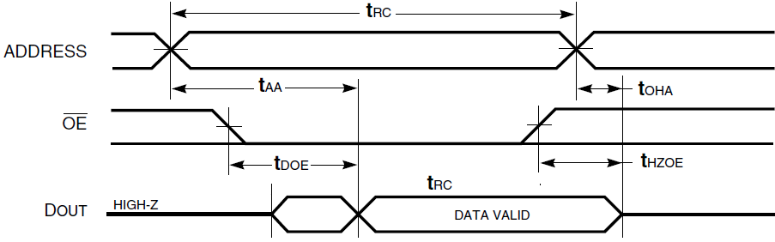
A simplied Read cycle 2
$\overline{OE}$ controlled, $\overline{CE}$ can be held low and $\overline{WE}$ is held high

Slide 14
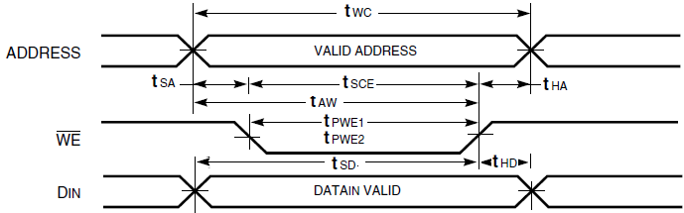
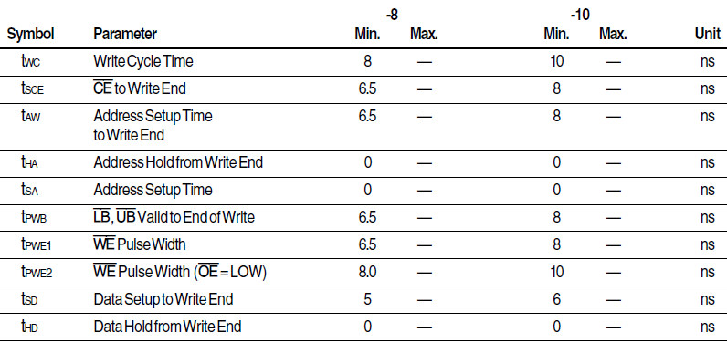
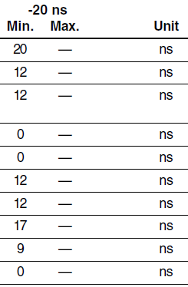
Simplified Write cycle Address and Data input changes at the same time
$\overline{WE}$ controlled, $\overline{CE}$ can be held low and $\overline{OE}$ is held high

Slide 15
Compare the simplified read and write cycles 3 states needed for both!
Read: $\overline{OE}$ controlled, $\overline{CE}$ can be held low and $\overline{WE}$ is held high
Write: $\overline{WE}$ controlled, $\overline{CE}$ can be held low and $\overline{OE}$ is held high

Slide 16
What is needed to design a SRAM controller?
A Finite state machine (FSM)
The FSM controls a Data path contains:
An address register
One Data input register whose output connects to the input of a Tristate buffer
One Data output register that captures the data from the SRAM in the write mode

Slide 17
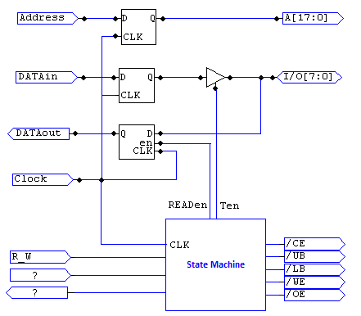
A Simplified SRAM controller Finite State Machine with a Datapath (FSMD)
A[19:0]
Not all inputs and outputs to the State Machine are shown

Slide 18
A partially completed SRAM state diagram
Begin
initialize
Get new address
Get R_W command
Ready
R_W=1
R_W=0
/OE=0
/WE=1
Ten=0
READ1
WRITE1
/WE=0
/OE=1
Ten=1
/OE=1
/WE=1
Ten=0
/WE=1
/OE=1
Ten=1
READ2
WRITE2

Slide 19
What’s left?
You need to decide what input(s) and/or status output(s) may be needed to make sure the user can manipulate the SRAM controller under many circumstances.
You need to modify and complete the suggested partially completed state diagram.
Write the VHDL code.

Slide 20
Reference
IS61WV102416 – data sheet (Moodle, also on the CD-ROM contained in the DE2 Box) SRAM controller design

