Slide 1
Settle My Settle
Lewis Dyer (2299195D)
Luke Gall (2298070G)
Liam Lau (2314991L)
Aidan Randtoul (2323851R)

Slide 2
Overview
SettleMySettle will provide a platform for all kinds of fans of various strategy games (Civilization, Age of Empires, Factorio, etc.) to share, discuss and appreciate cities and starting locations in these games.
Any visitors to the site will be able to view posts by game, however to like, comment, view a customised feed and post themselves, they will have to create an account.
Users will be able to post screenshots of their cities, tagging them with the appropriate game tag as well as any info tags to describe their post. If a particular game tag isn’t available, they will be able to submit a tag to be approved by an admin. They will also be able to like/comment on all posts and select which tags appear on their feed.
Admins will be able to remove screenshots and posts from any users, as well as see a queue of requested tags from users, and create tags accordingly.

Slide 3
User requirements
Guests will be able to view images
Users will be able to login/logout
Users will be to upload pictures with a game tag, optional info tags and an optional short description
Users will be able to comment on their own and others pictures
User must be able to change password and delete their account
Users will be to like other users comments
Users will be able to suggest new game tags for their pictures
User should be able to select their favourite game tags and view a feed only containing screenshots with that tag.
Admins will have all the rights of user plus the able to review and accept new game tag suggestions
Admins will be able to delete pictures and comments if they are inappropriate or poor quality.

Slide 4

Persona 1
Robert is a 2nd year at the university studying Business, he has a large collection of games on his computer and is interested in showing a community of like-minded individuals some of the screen shots from some of the more obscure games in his collection. He is hoping some of his screenshots will get quite popular and help drive interest for some games he feels should have a bigger following. He doesn’t care much for comments but is interested in providing high quality info tags on his screenshot to provide people with an idea of what the games are all about.

Slide 5

Persona 2
This is Andy. He is a 23 year stockbroker. In his space time he likes to wind down with various strategy games. Andy likes to upload his images online in order to get some feedback on his city placement as he doesn’t have a lot of time to practice, he is also interested in viewing other games with similar mechanics and to find out news on the games he is currently viewing. He wants constructive feedback and tips for his play style, so he can learn games better for when he plays them with his friends.

Slide 6

Persona 3
Jessica is a new English lit student from Germany. She has recently joined the Glasgow gaming society, she has gotten friendly with the 4X group of the society and wants a platform in order to communicate with other players and comment on her friends posts. She is an avid civ player and is interested in showing people her strategies, she would be interested in filtering content that only applies to a particular game and it’s related tags. She’s specifically interested in different uses of wonders in the game and would like a way to find pictures easily by features by highlighting the tags on pictures she is interested in. She’s also interested in keeping the site friendly and welcoming to new users as she would like a platform that other new members of the society could use.

Slide 7
Wireframe

Slide 8
Wireframe

Slide 9
Wireframe

Slide 10
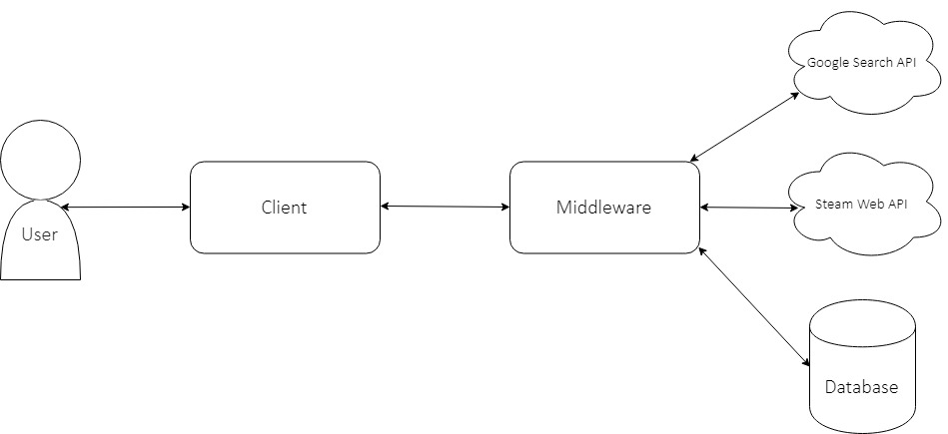
System Architecture

Slide 11
ER Diagram

Slide 12
Site map

Slide 13
Site urls

