Slide 1
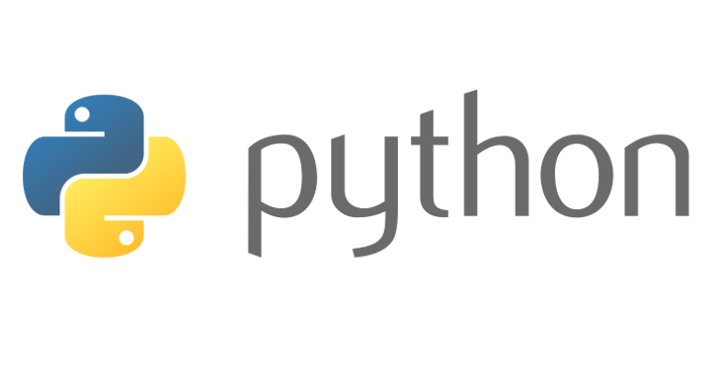
Beginners’ Python - imports
Lewis Gaul
St Edmund Hall
4th year Mathematics

Slide 2
The Standard Library
Modules in the standard library are written in C, so will likely run quicker than if you wrote your own equivalent functions.
time – for getting the current time and manipulating times
math – standard maths constants and functions e.g. pi, sin, sqrt
random – for generating random numbers, shuffling lists etc.
re – ‘regular expression’, match patterns in strings e.g. “.*@gmail.com”
tkinter – GUI library, can be used to make games
os – ‘operating system’ e.g. get path to current folder
Notes:
[First recap functions – see ‘functions summary.py’]

Slide 3
Importing Modules
import [module]
import [module] as [name]
from [module] import [object]
from [module] import *
import math
import time as tm
from math import sqrt
from math import pi as PI
math.sin(0.1)
tm.time()
sqrt(2)
x = PI**2 / 2
Notes:
[Use IDLE to illustrate]

Slide 4
Importing Scripts
Your own scripts can be imported into other scripts
Save a script as [filename].py, e.g. script1.py
You can import from any file which is in the same folder in the same way as importing standard library modules, e.g. import script1
Files must be in same folder, avoid using names of libraries that already exist (time, math etc.)
Useful for splitting up more complex programs

Slide 5
Challenge 4
Go to github.com/LewisGaul/python-tutorial, download challenge4
Work out how the code works (try adding in some print statements)
Write comments with ‘#’ to explain how it works
When you understand it all have a go at the challenge
Try to use sensible variable names
Avoid using too many indented layers or repeating code

