Slide 1
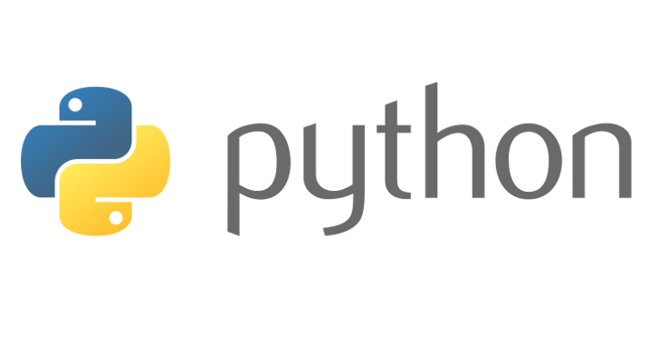
Beginners’ Python
Lewis Gaul
St Edmund Hall
4th year Mathematics
1
2
3
4
5
6
7
8
Notes:
I’m Lewis, I study maths and have been using Python as a hobby for more than 5 years. Can you all now introduce yourselves to the people sitting next to you in the same way. These classes are designed to be interactive, there will be lots of coding on your own laptops, and there are a few of us to help if you get stuck, but to make sure things keep moving at a good pace, I’d like to see everyone helping each other too!

Slide 2
Course Outline
Installation & setup
Introduction to data types
Introduction to if statements and loops
Using built-in functions, defining new functions and using them
Using libraries – time, maths, GUI
Introduction to classes
Creating and using your own classes
Steps to make a game

Slide 3
Characteristics of Python
One of the most widely used languages
Duck Typing – “If it walks like a duck and quacks like a duck, then it must be a duck.”
Object Oriented
High-level language (easier to use than languages like C)
Large and comprehensive standard library
Not particularly fast compared to other languages (often not a problem)
Notes:
Show example of what can be done with Python – minesweeper.

Slide 4
Installation
python.org/downloads
Click ‘Download Python 3.6.x’
Check you have it installed correctly: open a command line…
(Command Prompt on Windows/Terminal on a Mac/Shell on Linux), type in python and hit enter
Notes:
Everyone who doesn’t have Python installed will need to do that now. If anyone’s not sure, ask me. It’s not too important that you have the newest version – Python 2 should be fine.

Slide 5
Which Text Editor?
Python IDLE
Sublime Text
Notepad++
Not TextEdit (Mac)
Notes:
I would strongly advise using IDLE, especially if you’re new to Python, as it will be easier to test out snippets of code which we’ll be doing a lot. If you have some experience and prefer to use something else that’s fine of course, you’ll probably have to execute the code on the command line though.
Has everyone got an editor open? If you do, let’s try running one line of code. [Switch to IDLE] Type in your text editor something like x = 1/7, and on the next line print(x)… [run with IDLE or command line, interactive example e.g. x – 1…] Any object can be assigned to a variable using the equals symbol.

Slide 6
Some Python Data Types
int – integer e.g. 5, -67, 0
float – floating point number (like a decimal) e.g. 1.3, -700.0, 0.03141
str – string/text e.g. “hello”, “5 ducks?!”
boolean – Only examples are True and False
list – e.g. [1, 2, 3], [“hi”, “hello”], [] (empty list)
tuple – more rigid list e.g. (1.0, 0.1, -2.0), (“hi”, “hello”)
dict – dictionary/map containing key-value pairs e.g. {1:“hi”, 2:“hello”}
Notes:
…Throughout these classes, anything in purple is written exactly as you could write it in Python. So you could copy any of these things and type it into the shell to experiment, and I’d recommend doing this. For example, you might see this and wonder if you can have a boolean inside a tuple – if you try it you’ll see that you can.
[Write data types on board]

Slide 7
Basic Operations
Printing:
print(x)
print(“hello”)
print(“value is: ”, value)
Assignment operator is “=” e.g. variable = 3 + 5,
my_string = “yay Python!”
What happens if you add two strings or two lists?
Integer division: 9 // 4 (returns 2)
Modulo (remainder after dividing): x = 5 % 3
Shorthand adding/subtracting etc.: x += 3
Powers: x = 3**(-2 + 5)
Notes:
Mention rules and conventions for variable names.
Like I said, if you’re not sure of anything that’s written on the slides, try typing in the purple code and see what happens when you run it.

Slide 8
Challenge 1
Go to github.com/LewisGaul/python-tutorial, download challenge1.py
Work out how the code works (try adding in some print statements)
Write comments with ‘#’ to explain how it works
Can you think of any other (better?) ways to write it?
When you understand it all, try modifying the code to achieve the challenge
Try to use sensible variable names

Slide 9
If Statements
Remember the colon after the if statement, and that an indent always follows a colon.
Indentation is essential in Python.
if [condition]:
[do this]
elif [condition]: (optional)
[do this]
[and this]
else: (optional)
[do this]
x = 1
if x > 0:
print(“Positive”)
elif x == 0:
print(“Zero”)
x -= 1
else:
print(“Negative”)
Notes:
[First recap data types]

Slide 10
Loops
Use the break keyword to immediately stop the innermost loop.
while [condition]:
[do this]
if [condition]:
break (optional)
for [variable] in [iterable]:
[do this]
x = 1
while True: (infinite loop!)
print(x)
x += 1
if x > 5:
break
for i in [1, 2, “text!”]:
print(i)

Slide 11
Challenge 2
Work out how the code works (try adding in some print statements)
Write comments with ‘#’ to explain how it works
Can you think of any other (better?) ways to write it?
When you understand it all, try to modify the code to achieve the challenge
Try to use sensible variable names
Avoid using too many indented layers or repeating code

