Slide 1
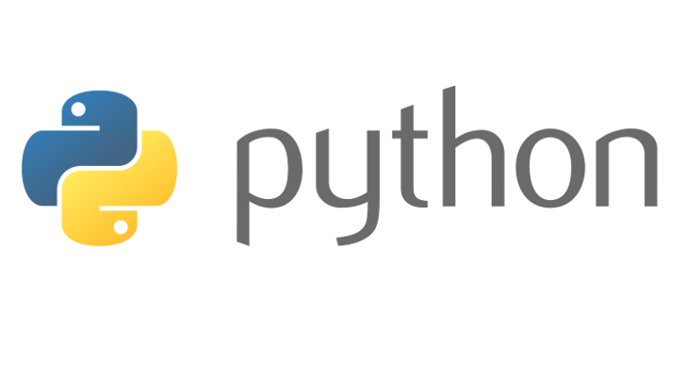
Beginners’ Python – Classes and Inheritance
Lewis Gaul
St Edmund Hall
4th year Mathematics
Notes:
I’m Lewis, I study maths and have been using Python as a hobby for more than 5 years. Can you all now introduce yourselves to the people sitting next to you in the same way. These classes are designed to be interactive, there will be lots of coding on your own laptops, and there are a few of us to help if you get stuck, but to make sure things keep moving at a good pace, I’d like to see everyone helping each other too!

Slide 2
Inheriting from classes
class [name]([other class]):
def __init__(self, [args]):
super().__init__([args])
[do stuff]
[other functions] (optional)
class Student(Person):
def __init__(self, name):
super().__init__(name)
self.deadlines = 0
def work(self):
self.deadlines -= 1

Slide 3
GUI library - tkinter
import tkinter as tk
class MyGui(tk.Tk):
def __init__(self, [args]):
super().__init__()
gui = MyGui([args])
gui.mainloop()

Slide 4
Challenge 6
Go to github.com/LewisGaul/python-tutorial, download challenge6.py
Work out how the code works (try adding in some print statements)
Write comments with ‘#’ to explain how it works
When you understand it all have a go at the challenge
Try to use sensible variable names
Avoid using too many indented layers or repeating code

