Slide 1
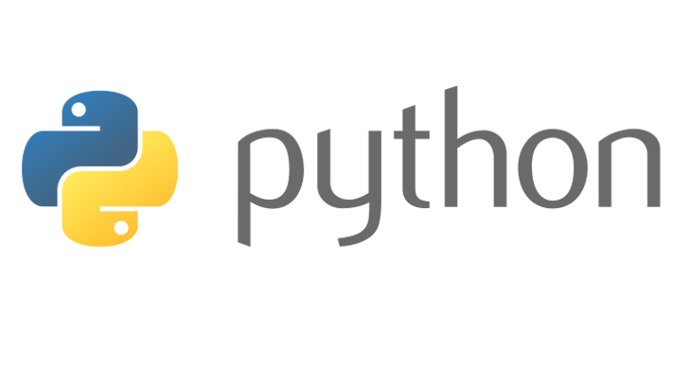
Beginners’ Python – GUI Programming
Lewis Gaul
St Edmund Hall
4th year Mathematics

Slide 2
Inheriting from classes – recap
class Student(Person):
def __init__(self, name):
super().__init__(name)
self.deadlines = 0
def work(self):
self.deadlines -= 1
class ShoppingList(list):
def __init__(self, L=[]):
super().__init__(L)
def __str__(self):
[define how to print a ShoppingList]
def add(self, item, num):
self.append([item, num])

Slide 3
GUI Basics - tkinter
import tkinter as tk
window = tk.Tk()
button = tk.Button(window)
button.pack()
button.config(text=‘hi’)
window.mainloop()
class MyGui(tk.Tk):
def __init__(self
super().__init__()
self.button = tk.Button(
self, text=‘hi’)
self.button.pack()
gui = MyGui([args])
gui.mainloop()

Slide 4
Challenge 7
Go to github.com/LewisGaul/python-tutorial, download challenge7.py
Work out how the code works (try adding in some print statements)
Write comments with ‘#’ to explain how it works
When you understand it all have a go at the challenge
Try to use sensible variable names
Avoid using too many indented layers or repeating code

