Slide 1
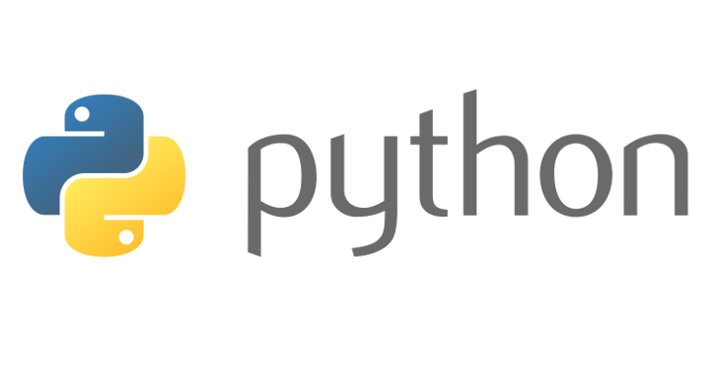
Beginners’ Python - Classes
Lewis Gaul
St Edmund Hall
4th year Mathematics
Notes:
I’m Lewis, I study maths and have been using Python as a hobby for more than 5 years. Can you all now introduce yourselves to the people sitting next to you in the same way. These classes are designed to be interactive, there will be lots of coding on your own laptops, and there are a few of us to help if you get stuck, but to make sure things keep moving at a good pace, I’d like to see everyone helping each other too!

Slide 2
What is a class?
Characteristic feature of object oriented programming languages
The class of an object is equivalent to its type, e.g. [1,2] is a list
Everything is an object – everything belongs to a class (has a type)
You can define your own object types by writing classes
This allows you to define methods e.g. my_list.append(2)
If an object x has class A, we say x is an instance of the A class, e.g. [1,2] is an instance of the list class
Notes:
[First recap imports] Last week we saw how you can use the standard library using the ‘import’ keyword at the top of a script. You can also import your own scripts in this way.
On whiteboard: list class: has methods… (use dir(list))… We can create a list by doing list(‘123’), which I said was a function converting a string to a list. This is kind of true, but a better explanation is that we’re creating an instance of the list class with the arguments (unlike len(‘123’) which just returns an output).
Use example on whiteboard: Everyone in here is a student – you all belong to a ‘Student’ class, and all have attributes such as the number of deadlines you have, and functions such as attend lectures. We might create student objects with this class by student1=Student(‘John’, year=2).
You’re also part of a bigger class which we might call ‘Person’. A person will have attributes such as name, height etc. So the Student class is a subclass of the Person class, and it inherits everything from that class. This is a concept used a lot in object oriented programming.
Another example: ‘Cat’, ‘Dog’ has function ‘bark’, both subclasses of ‘Animal’ class which has ‘num_of_legs’ etc. We’ll come back to inheritance next week.

Slide 3
Creating classes
Create an instance of a class in the same way you call a function – the __init__ method will be called.
lewis = Student(2)
lewis.work()
print(lewis.deadlines)
lewis.join_society(“CodeSoc”)
class [name]:
def __init__(self, [args]):
[do this]
[other functions] (optional)
class Student:
def __init__(self, dlines):
self.deadlines = dlines
self.societies = []
def work(self):
self.deadlines -= 1
def join_society(self, soc):
self.societies.append(soc)
Notes:
[Mention the capitalisation of class names and conventions for variables/functions]
When you’re coding it might be hard to tell when writing your own classes is going to be useful at first. One of the advantages is that it groups code together into behaviours which can be attributed to a specific ‘object’. For example when I made minesweeper I used a class for the graphical user interface, which I only ever create one instance of, and also have a class for a minesweeper board. The GUI has behaviours such as changing the display, checking for mouse clicks, whereas the Board class has behaviours such as checking if it has been solved. The GUI will contain an instance of the Board class but not vice versa.

Slide 4
Challenge 5
Go to github.com/LewisGaul/python-tutorial, download challenge5.py
Work out how the code works (try adding in some print statements)
Write comments with ‘#’ to explain how it works
When you understand it all have a go at the challenge
Try to use sensible variable names
Avoid using too many indented layers or repeating code

