Slide 1
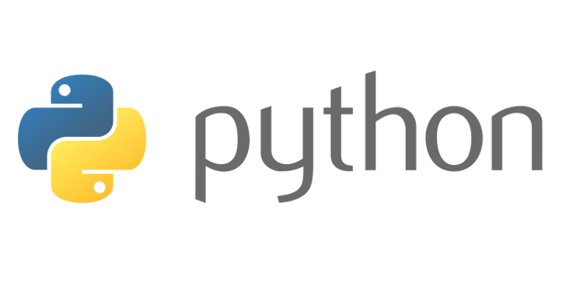
Beginners’ Python - Functions
Lewis Gaul
St Edmund Hall
4th year Mathematics

Slide 2
List Comprehensions
Simple way to construct lists using one or more conditions.
Useful for ‘flattening’ lists.
e.g. [num for num in range(10) if num**2 < 50],
[i**0.5 for i in range(6)],
[i for row in [[1, 2], [3, 4]] for i in row]
Notes:
Everyone quickly introduce themselves to the people next to them so that everyone can help each other if they get stuck.
[First recap if statements and loops in IDLE] – is_hungry = True; eaten = 0; while is_hungry: print(‘Eat’); eaten += 1; if eaten > 4: is_hungry = False

Slide 3
Introduction to Functions
Called using parentheses, often with arguments inside
Can be defined to take a fixed number of arguments
Arguments can be any data type (any object)
Arguments can be made optional by giving default values
Can alternatively be defined to take any number of arguments
Notes:
In Python everything is an object – integers, strings, lists, and functions are no exception. Functions can also be stored in variable names, which is what happens when you define a new one, as I’ll show in a few slides.

Slide 4
Some useful Functions
len(list/str)
sorted(list)
reversed(list)
sum(list)
max/min(list)
range([start],stop,[step])
round(float)
int(str/float) e.g. int(‘3’)
Methods:
list.sort()
list.append(object) list.pop(index)
list.extend(list) list/str.count(object) list/str.index(object)
str.join([list of strings])
Notes:
[Point out functions with 0 args, multiple args, optional args, and the fact that multiple data types are valid args]

Slide 5
Defining your own functions
Try calling the functions below, e.g. my_func(2, 5)
e.g. cube(1.2)
def [function name]([arguments]):
[do this]
return [something] (optional)
[name] = lambda [args]: [do this]
def my_func(x, y):
result = x + y // x
return result
cube = lambda x: x**3
Notes:
[Discuss use-cases of lambda functions]
For example, we could define a function that always returns the number 3 in both ways. Now writing x = 3 is the same as writing x = get3(). Or a function that returns the argument you give it, so y = 2 is equivalent to y = get_arg(2), but it can also be used to get a string or a list: get_arg([‘hello’]).

Slide 6
Function arguments
def get_max(arg1, arg2=0, arg3=1):
print(arg1, arg2, arg3)
func(3); func([]); func(arg1=‘hello’)
func(5, 6);
func(-1, arg2=0); func(0.5, arg3=-3)
func(3, 2, 1); func(1, arg3=False, arg2=0)

Slide 7
Challenge 3
Go to github.com/LewisGaul/python-tutorial, download challenge3.py
Work out how the code works (try adding in some print statements)
Write comments with ‘#’ to explain how it works
Can you improve the code?
When you understand it all have a go at the challenge
Try to use sensible variable names
Avoid using too many indented layers or repeating code

