Slide 1
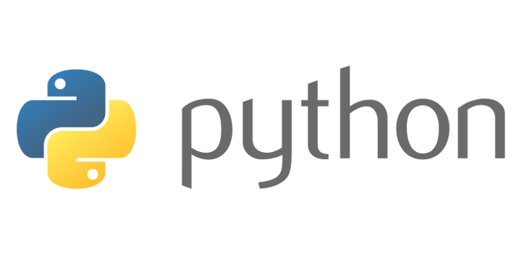
Beginners’ Python - dictionaries
Lewis Gaul
St Edmund Hall
4th year Mathematics
Notes:
I’m Lewis, I study maths and have been using Python as a hobby for more than 5 years. Can you all now introduce yourselves to the people sitting next to you in the same way. These classes are designed to be interactive, there will be lots of coding on your own laptops, and there are a few of us to help if you get stuck, but to make sure things keep moving at a good pace, I’d like to see everyone helping each other too!

Slide 2
Dictionaries
The class name for a dictionary is dict – create an empty one with dict()
They are used to look up objects using a key – the items inside dictionaries come in key-value pairs.
Create a dictionary using {}, e.g. d={‘a’:’apple’,’b’:’bye’}
Access values using the key, e.g. d[‘a’] -> ‘apple’
Assign new values using the same syntax, e.g. d[‘c’]=‘cross’
Notes:
[Also show tuples, maps, lambdas… then give quiz on data types (circle inherits from ellipse), before showing how functions can be passed as arguments.]

Slide 3
Challenge 8
Go to github.com/LewisGaul/python-tutorial, download challenge8.py
Work out how the code works (try adding in some print statements)
Write comments with ‘#’ to explain how it works
When you understand it all have a go at the challenge
Try to use sensible variable names
Avoid using too many indented layers or repeating code

