Slide 1
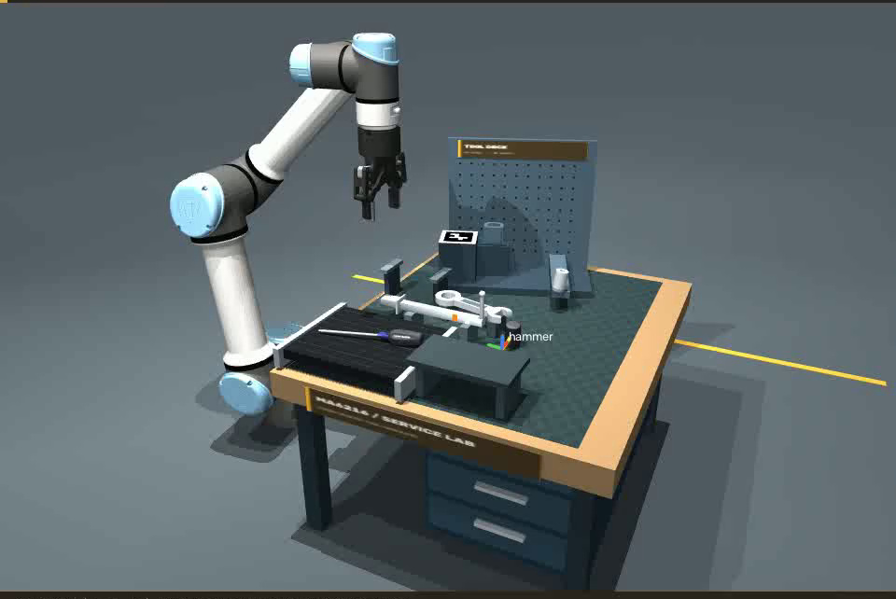
Calibrated 6D vision for sequential tool manipulation
01
Problem & scope
One continuous tool-service task
01 Hammer return
02 Moving screwdriver insertion
03 Independent rack installation
04 Spanner regrasp and hanging
Study question
Can execution-period pose feedback improve complete-task reliability?
MuJoCo · UR5e · Robotiq 2F-85
RGB-D + reconstructed references
MA6216 · Vision-guided robotic manipulation · simulation evidence
Notes:
We study vision-guided manipulation in a simulated maintenance workcell. The system integrates independently estimated camera calibration, image-based localization, reconstructed object references, FoundationPose, and physical robot control. Four dependent operations are executed in one continuous scene. The research question is whether additional execution-period pose feedback improves complete-sequence success, rather than merely improving a local alignment residual. The contribution is independent engineering integration and critical evaluation, not a new neural algorithm.
The central question is whether more visual feedback improves a sequential task when calibration, pose estimation and contact all contribute errors. Translation alone is insufficient: shaft-to-socket and hole-to-pin relationships constrain orientation. Rack installation changes the next task fixture, while spanner regrasp changes the object-to-gripper relationship. We therefore distinguish local pose alignment from released whole-sequence success. One successful replay illustrates feasibility; all attempted trials are required for evaluation.
Evidence: UR5e + Robotiq 2F-85 | MuJoCo | Model-free reference reconstruction + FoundationPose | Final calibrated evaluation | 48 paired attempts | original simulation evidence

Slide 2
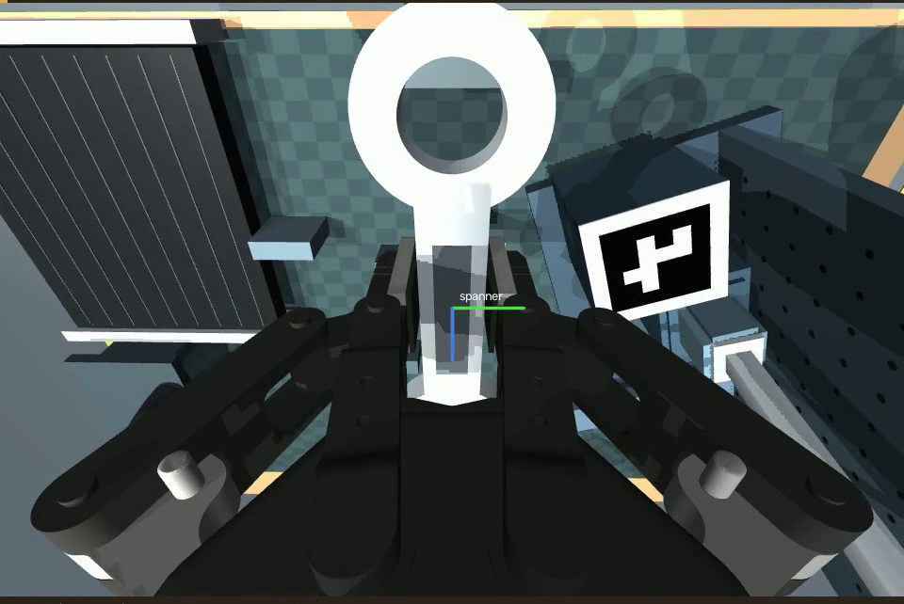
From visual observation to physical manipulation
02
Methods
RGB-D
→
Localization
→
6D pose
→
Robot target
→
Execution
Estimated intrinsics
Depth foreground
FoundationPose
Calibrated chain
IK + control
Workcell observation
Pose-guided grasp and reobservation
24 RGB-D reference views → reconstruction → registration / tracking. MegaPose and GraspNet were reviewed, not benchmarked.
MA6216 · Vision-guided robotic manipulation · simulation evidence
Notes:
The control path starts with RGB-D and estimated calibration. Depth foreground segmentation generates the mask; FoundationPose estimates the object in the camera frame from reconstructed references. Calibrated transforms and robot FK map the pose into a robot target. Checked IK and trajectories, joint control and contact guards execute the operation. Reobservations close a discrete precontact loop. Simulator object truth is downstream evaluation only. Robot FK and contact sensing are legitimate inputs but are not substitutes for visual object localization.
FoundationPose was selected for its few-shot model-free reference route and object-pose output. The tool CAD is not supplied to the pose estimator; calibrated RGB-D scans are reconstructed into an object-specific representation. This still requires references and pretrained networks. MegaPose and GraspNet were reviewed alternatives: the former estimates model-based object pose, while the latter predicts grasp candidates. They were not executed as external experimental baselines. MuJoCo retains the original robot and contact model; OpenCV provides calibration and image operations.
Evidence: Final calibrated evaluation | 48 paired attempts | original simulation evidence | Wen et al., CVPR 2024; Labbé et al., 2022; Fang et al., CVPR 2020; Todorov et al., IROS 2012

Slide 3
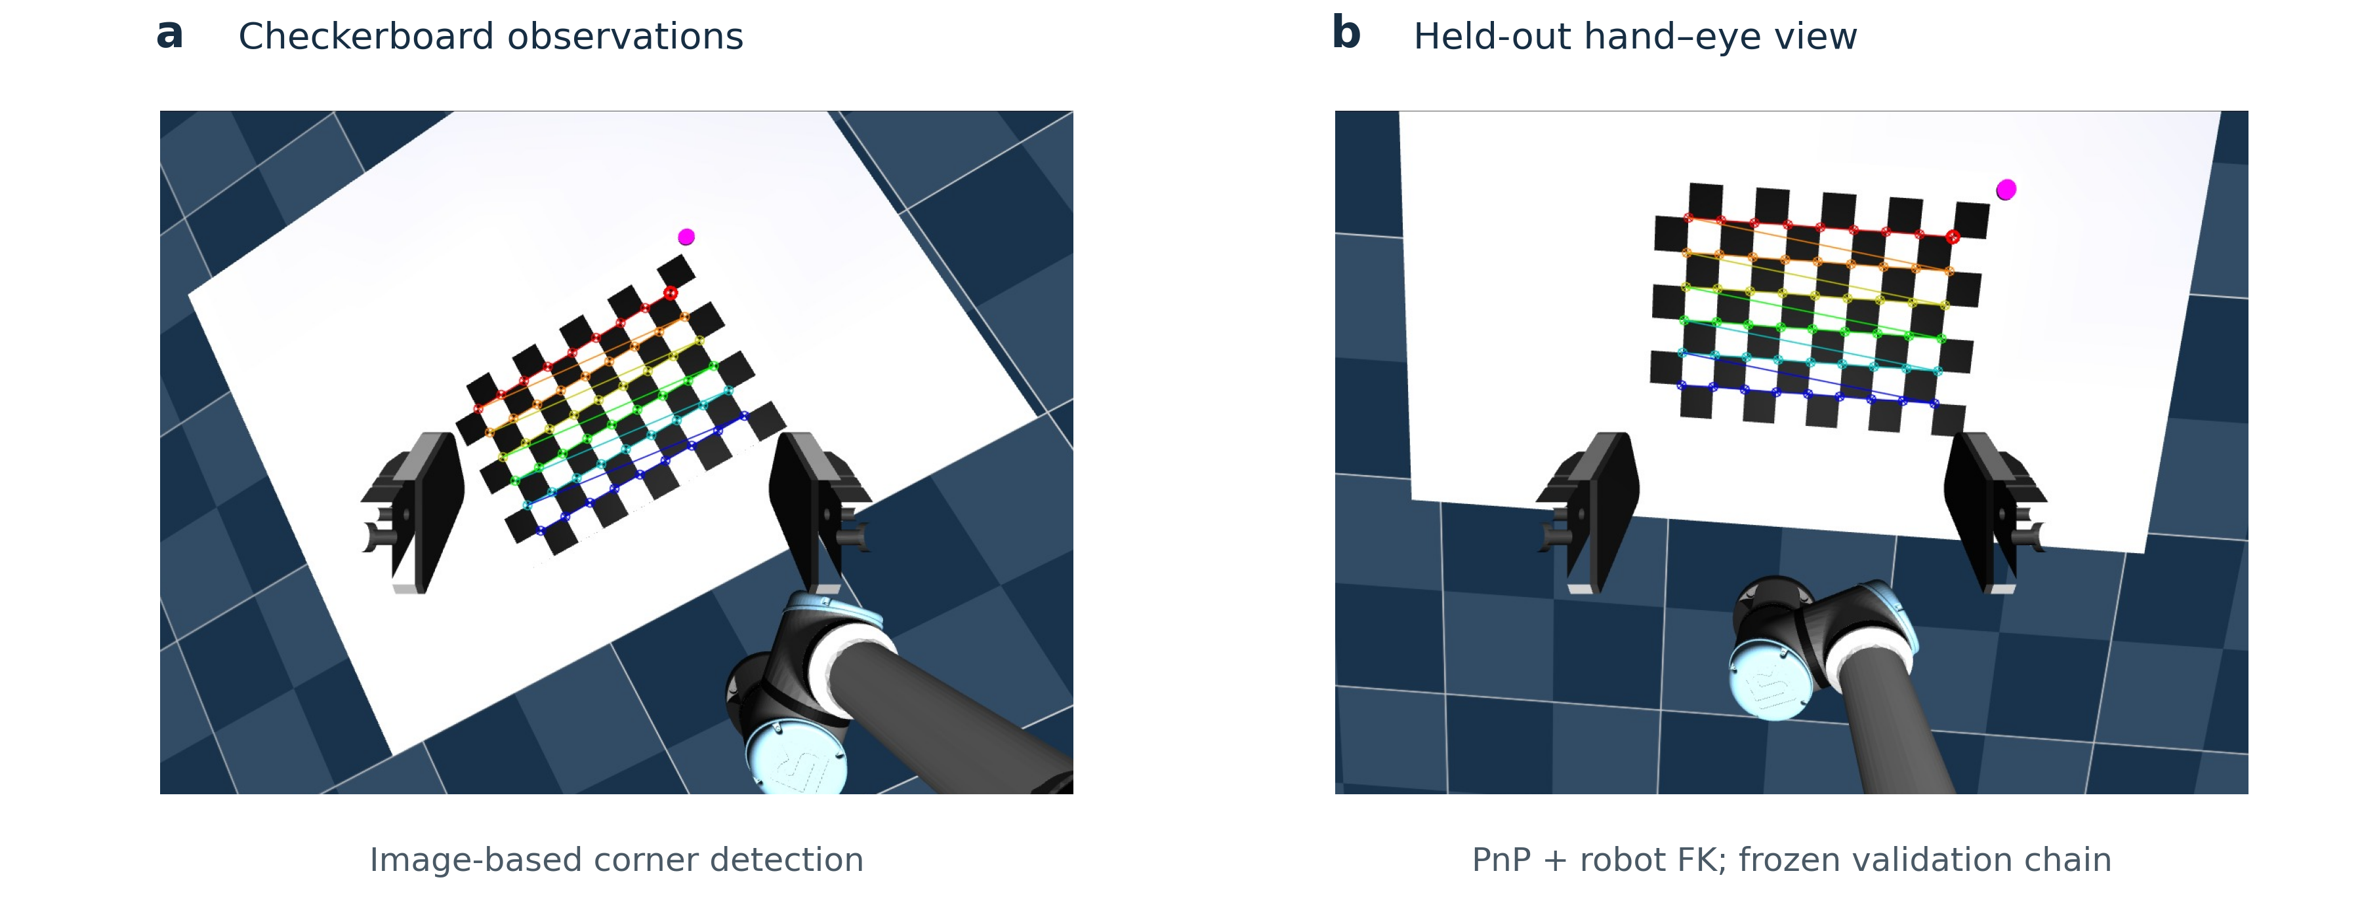
Image-based calibration and held-out validation
03
Methods
Wrist intrinsics | Hand–eye transform | Frozen-chain reprojection
24 / 8 train–validation views | 24 / 10 train–validation views | K and transformations fixed
0.02177 px RMSE | 0.852 mm / 0.0227° | 0.05497 px
Checkerboard detection + image PnP + robot FK. Simulator parameters are validation references; ideal pinhole images limit transfer.
MA6216 · Vision-guided robotic manipulation · simulation evidence
Notes:
Wrist intrinsics use twenty-four accepted training views and eight held-out views. Hand-eye estimation uses image PnP and robot FK, followed by AX equals XB and training-only refinement, with twenty-four training and ten validation views. Validation freezes K, the hand-eye transform and board pose. The simulator provides reference values only after estimation. The very low reprojection residuals reflect synthetic distortion-free images; they are not evidence of equivalent real-camera precision.
Evidence: Actual checkerboard captures | Zhang 2000; OpenCV hand–eye conventions | wrist-calibration-v1

Slide 4
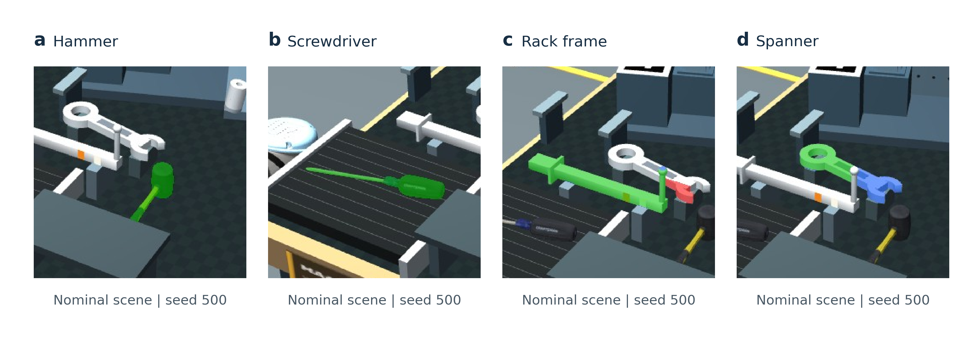
Localization: image masks, evaluation unit and assumptions
04
Methods & validation
Detector | Independent evaluation | Boundary
Depth foreground subtraction Known pickup regions | 50 scenes / 200 queries 10 scenes per tool–condition cell | Matched empty backgrounds Restricted occlusion / noise
Predictions saved first | 160/160 positive queries: IoU ≥ 0.5 0/40 absent-target false positives | Wilson and scene-bootstrap intervals Not 200 robot executions
Nominal seed 500. Green: overlap; blue: missed visible target; red: extra foreground. Crops preserve original overlays.
MA6216 · Vision-guided robotic manipulation · simulation evidence
Notes:
These are crops of original mask overlays for all four tools in nominal seed five hundred. Green marks overlapping prediction and visible target, blue marks missed target and red extra foreground. Known pickup regions associate masks with tools. The fifty-scene audit contains two hundred queries, including one hundred sixty target-present and forty target-absent queries. Predictions are saved before simulator labels are read. All positive queries pass the predefined IoU threshold in this restricted audit, with no absent-target false positives; each tool-condition cell has only ten examples.
Evidence: Localization audit | nominal seed 500 | cropped original overlays | separate from the 48 robot attempts

Slide 5
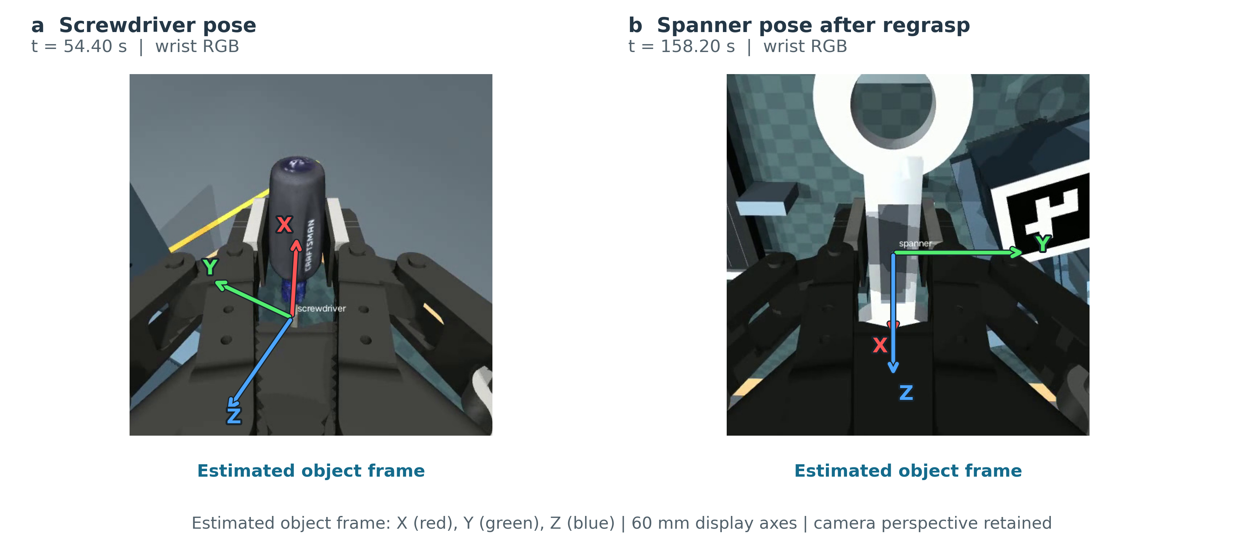
Estimated object frames guide task-specific targets
05
Methods
T_{BO} = T_{BG} · T_{GC} · T_{CO}
FK × hand–eye calibration × visual object pose
Reobserve after regrasp.
MA6216 · Vision-guided robotic manipulation · simulation evidence
Notes:
For the wrist camera, the camera-to-base transform is obtained from robot FK and the independently estimated camera-to-gripper transform. Multiplying by the camera-frame object estimate produces the object pose in the base frame. The notation T sub A B maps coordinates in frame B into frame A. Task-specific geometric offsets then define the desired grasp or insertion target. After a physical regrasp, the object-to-gripper relationship must be observed again; a previous rigid relationship cannot simply be reused.
FoundationPose was selected for its few-shot model-free reference route and object-pose output. The tool CAD is not supplied to the pose estimator; calibrated RGB-D scans are reconstructed into an object-specific representation. This still requires references and pretrained networks. MegaPose and GraspNet were reviewed alternatives: the former estimates model-based object pose, while the latter predicts grasp candidates. They were not executed as external experimental baselines. MuJoCo retains the original robot and contact model; OpenCV provides calibration and image operations.
Evidence: Final calibrated evaluation | 48 paired attempts | original simulation evidence | Wen et al., CVPR 2024; Labbé et al., 2022; Fang et al., CVPR 2020; Todorov et al., IROS 2012

Slide 6
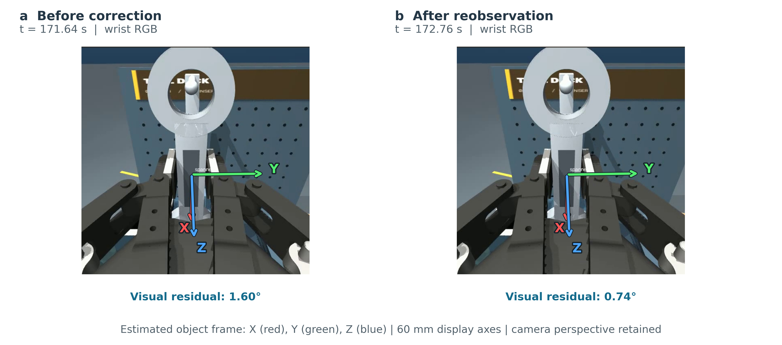
Visual feedback modes and bounded correction
06
Methods
Observation schedule
Open loop
Initial acquisition only
Staged
Task-transition observations
Iterative
Repeated precontact correction
Common control limits
Step cap: 4 mm / 2°
Converged: two observations
within 1.5 mm / 1.5°
Estimated pose residual → bounded correction → reobserve. Same calibration, estimator and guards; discrete precontact control.
MA6216 · Vision-guided robotic manipulation · simulation evidence
Notes:
The implemented controller uses discrete pose-based alignment. Open-loop mode uses initial acquisition and prediction but no execution-period visual correction. Staged mode adds selected reobservations. Iterative mode adds repeated estimates and bounded corrections before contact. Position and orientation residuals are measured from vision, with default correction caps of four millimeters and two degrees. Two consecutive observations within one-point-five millimeters and one-point-five degrees establish convergence. This is not continuous contact impedance control or a claim of formal closed-loop stability.
This example is from a separately archived calibration integration run with an alignment impulse. One spanner correction is logged. The estimated angular residual decreases from 1.60 to 0.74 degrees; those numbers come from original visual observations, not measurements drawn on the images. The visual change is small, so the figure should not be used to estimate a geometric displacement. This run is not an additional attempt in the final forty-eight-trial comparison.
Evidence: Chaumette & Hutchinson, IEEE RAM 2006 | project-specific discrete pose alignment | VISUAL_FEEDBACK.md | Calibrated integration | iterative / alignment impulse / seed 400 | original log + original frames

Slide 7
Visual correction: matched detail views before and after action
07
Separate integration diagnosis
One logged correction in a separate perturbed run. 1.60° and 0.74° are estimated angular residuals, not ground-truth errors.
MA6216 · Vision-guided robotic manipulation · simulation evidence
Notes:
This example is from a separately archived calibration integration run with an alignment impulse. One spanner correction is logged. The estimated angular residual decreases from 1.60 to 0.74 degrees; those numbers come from original visual observations, not measurements drawn on the images. The visual change is small, so the figure should not be used to estimate a geometric displacement. This run is not an additional attempt in the final forty-eight-trial comparison.
Evidence: Calibrated integration | iterative / alignment impulse / seed 400 | original log + original frames

Slide 8
Paired evaluation in the complete workcell
08
Evaluation protocol
48 complete-task attempts
3 feedback modes
× 2 disturbance conditions
× 8 paired seeds
Outcome and uncertainty
All four physical checks must pass.
Wilson 95% intervals
Exact paired tests + Holm
Trial-level continuous summaries
Seeds 400–407 reused.
Paired replication, not a new holdout.
Early failures remain included.
MA6216 · Vision-guided robotic manipulation · simulation evidence
Notes:
The experiment uses three feedback modes, two disturbance conditions and eight seeds per cell: forty-eight complete attempts. Initial physical states are paired by seed. Estimated wrist calibration, pose estimator, control thresholds and physical acceptance remain fixed. The seeds were used previously, making this a paired replication rather than a fresh holdout. Failures before alignment or disturbance delivery stay in the denominator. We report Wilson success intervals, trial-level bootstrap intervals, paired exact tests and Holm correction.
The complete-sequence success rates are low, and uncertainty is wide. Open-loop succeeds zero of eight with and without disturbance. Staged feedback succeeds three of eight without and two of eight with disturbance. Iterative feedback succeeds three of eight in both conditions. All four method comparisons have Holm-adjusted p equal to one. This establishes neither superiority nor equivalence. The images demonstrate feasible behavior but do not override the full attempted-trial results.
Evidence: Final calibrated evaluation | 48 paired attempts | original simulation evidence | n = 8 per mode × condition | Wilson 95% confidence intervals | exact paired tests with Holm correction

Slide 9
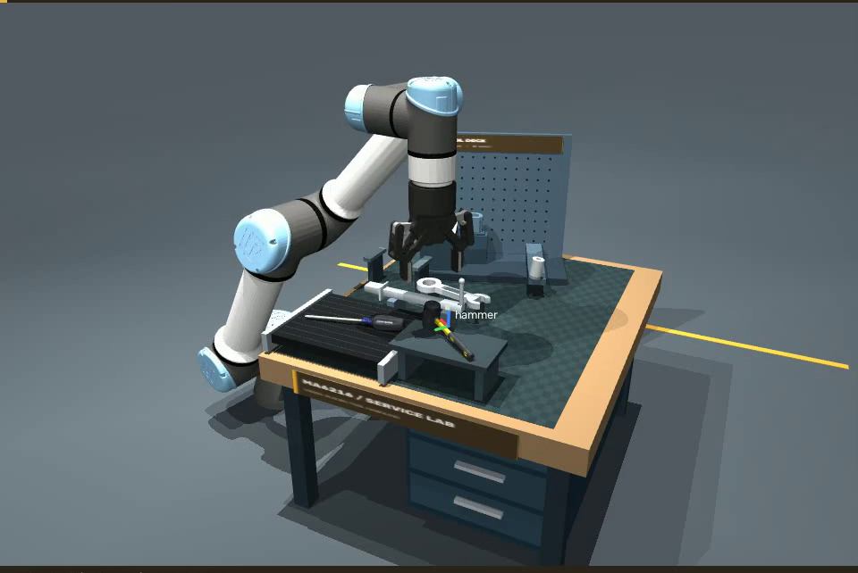
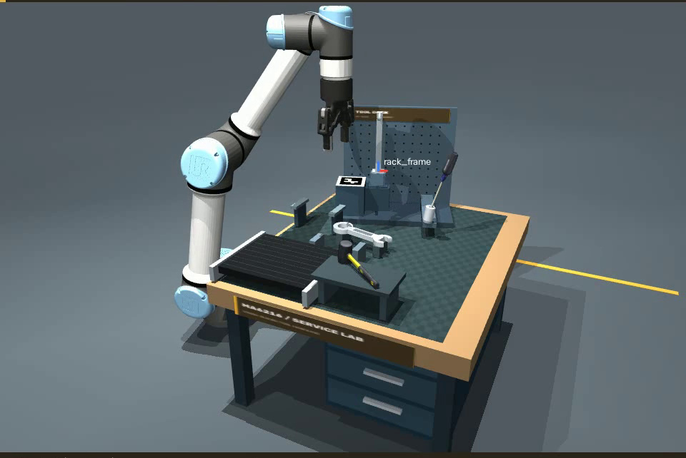
Physical return and independent rack installation
09
Representative successful run
a Released hammer placement · 25.00 s
b Released rack fixture · 134.40 s
One continuous replay. The rack is installed as an independent object; released support and stability determine acceptance.
MA6216 · Vision-guided robotic manipulation · simulation evidence
Notes:
The hammer operation clears tool access before the feed operation. These matched crops show a held tool and the released tray state from the same continuous run. Image-estimated object pose determines the target; checked motion and joint control execute it. Support, geometry and stability determine acceptance. Hammer approach planning failures are retained in the full comparison, rather than treating only reached placements as attempted trials.
The independent frame is picked up and physically seated on its base. Because seating can change the fixture pose, the rack is checked and observed again before the spanner approaches it. The three panels have complementary roles: initial independent object, contact-mediated installation, and released assembled fixture. All prior tools remain in the same scene. The fixture observation is part of the staged and iterative control modes.
Evidence: Representative original run | iterative / no disturbance / seed 400 | playback time

Slide 10
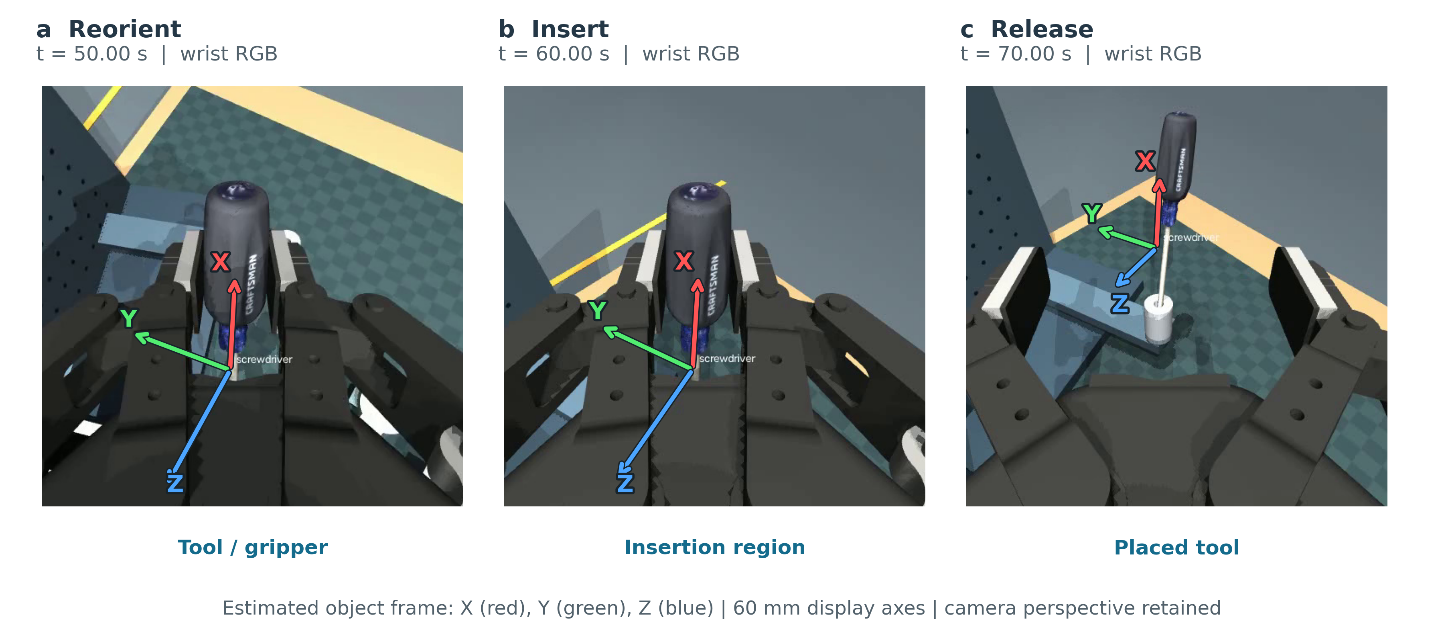
Tilted insertion: orientation, contact and released placement
10
Representative successful run
Enlarged panels use matched pixel windows. Contact is partly occluded; physical acceptance comes from the recorded checks.
MA6216 · Vision-guided robotic manipulation · simulation evidence
Notes:
The screwdriver is first localized on a moving feed and intercepted using prediction. The image sequence begins after acquisition, showing reorientation, guarded insertion and the released screwdriver. Every feedback mode includes initial visual acquisition and moving-target prediction. The comparison concerns execution-period corrections, not vision versus no vision. Frames illustrate the mechanism; the physical acceptance logs establish successful support after release.
Evidence: Representative original run | iterative / no disturbance / seed 400 | playback time

Slide 11
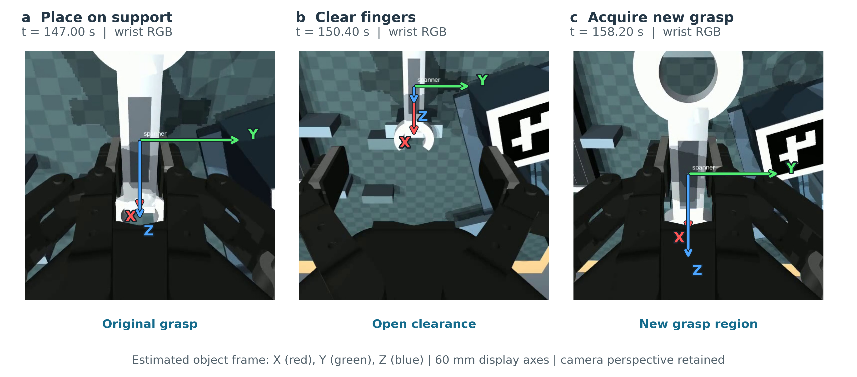
Physical regrasp: support, clearance and grasp reacquisition
11
Representative successful run
One continuous trajectory. Enlarged views expose the grasp interface; new pose observation precedes reacquisition.
MA6216 · Vision-guided robotic manipulation · simulation evidence
Notes:
The sequence documents actual physical regrasp rather than changing a software attachment. The spanner is placed on a support, the fingers open and clear the object, and the robot acquires a new grasp after observation. The common crop makes the change in finger-object relationship visible. The image order and timestamps follow one original trajectory. Contact logs and the recorded regrasp event provide independent evidence for the operation.
Evidence: Representative original run | iterative / no disturbance / seed 400 | playback time

Slide 12
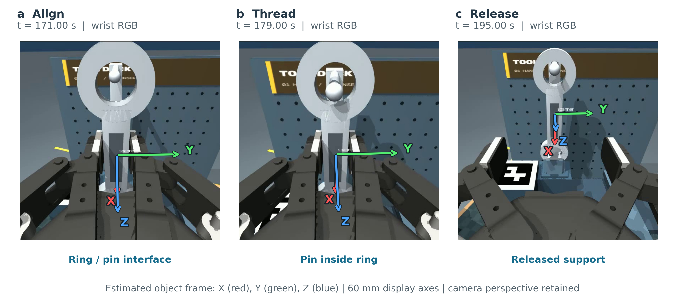
Hole-over-pin placement: local geometry and final support
12
Representative successful run
Four terminal checks passed. Separate passive-stability audit: 30 s. Pose axes are visualization overlays, not measured contact forces.
MA6216 · Vision-guided robotic manipulation · simulation evidence
Notes:
The highlighted region identifies the hole and pin relationship, not a metric error measurement. The images show precontact alignment, threading, and the released final state. No axis or contact force is inferred from the colored annotation. The original trial passes all four terminal checks. A separate thirty-second passive diagnostic retains these outcomes; it does not replace the original score or inspect every five-hundred-hertz physics step.
Evidence: Representative original run | iterative / no disturbance / seed 400 | playback time

Slide 13
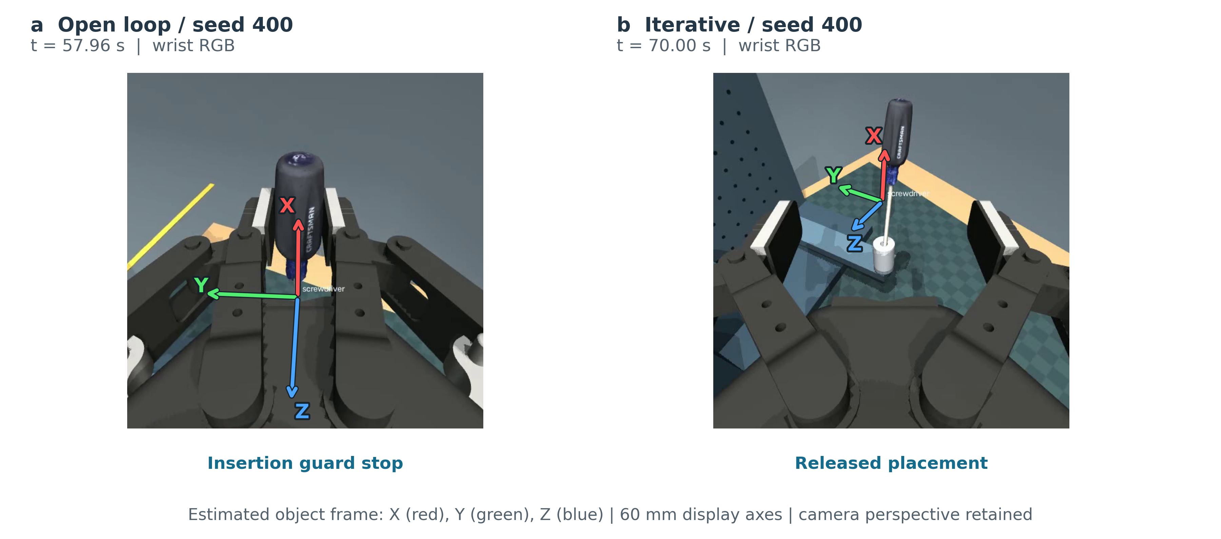
Matched-seed comparison: insertion stop versus released placement
13
Controlled examples
Seed 400, no disturbance; endpoint times differ. A selected paired example does not establish statistical superiority.
MA6216 · Vision-guided robotic manipulation · simulation evidence
Notes:
Both runs share initial seed four hundred without disturbance. The open-loop trial stops at the insertion contact guard, while the iterative trial releases the screwdriver and completes the full sequence. The panels are aligned by task outcome, not by playback time. The failure cause is taken from the recorded guard, since a rendered image alone cannot establish the contact violation. This favorable pair must be interpreted with the full paired statistics.
Evidence: Final 48 attempts | open_loop vs iterative / no disturbance / seed 400

Slide 14
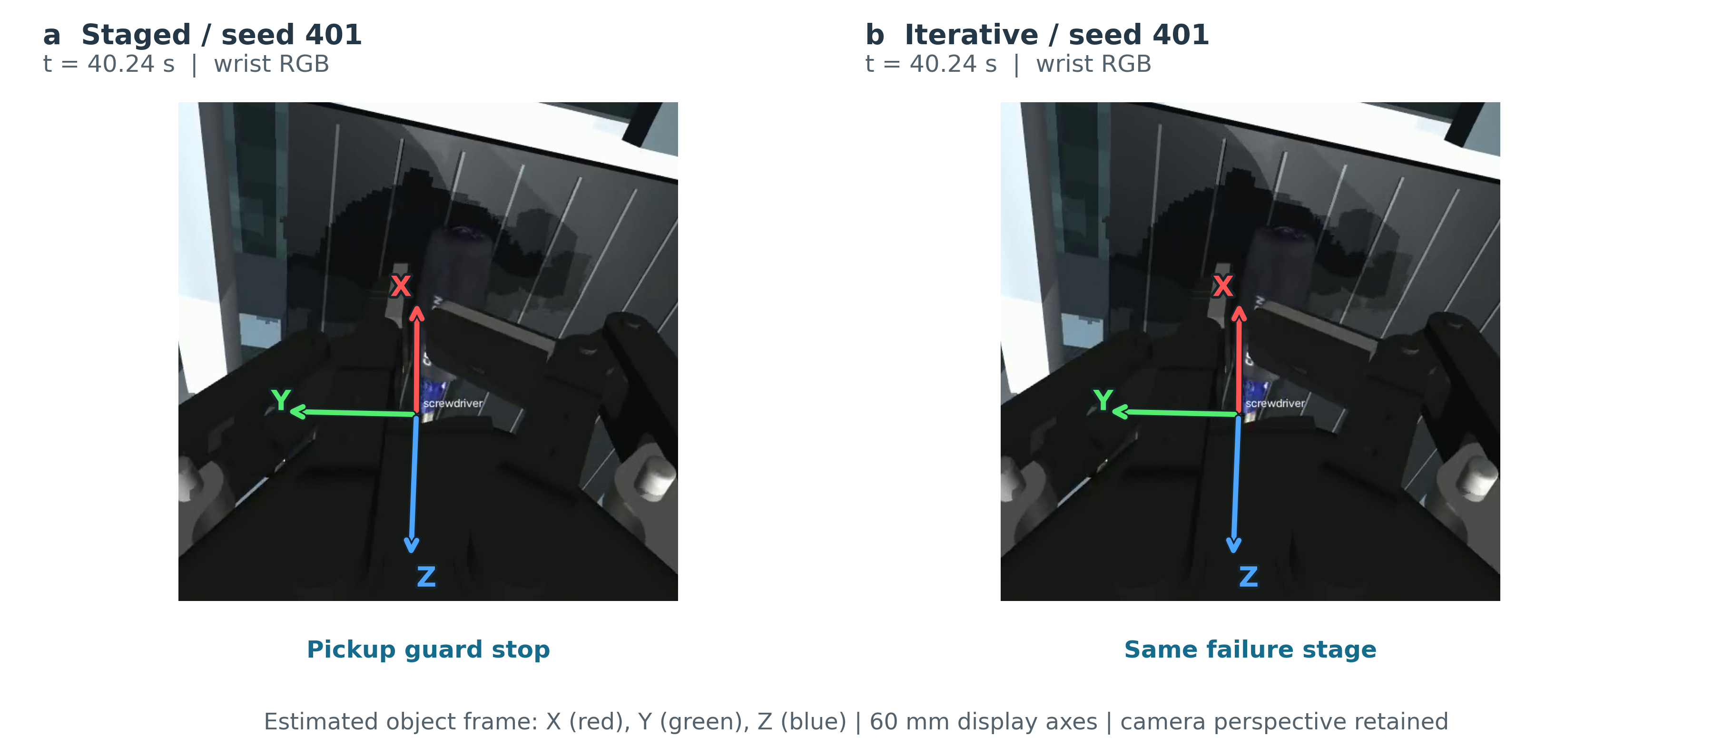
Shared failure boundary: gripper closure before insertion
14
Controlled examples
Seed 401: both modes stop at gripper closure. Stage and guard attribution are from logs; all failed attempts remain in the analysis.
MA6216 · Vision-guided robotic manipulation · simulation evidence
Notes:
Seed four hundred one produces an unexpected robot contact during moving-screwdriver gripper closure in both staged and iterative modes. The iterative failure is shown rather than hidden. The failure occurs before later insertion alignment, so it is a reachability bottleneck for evaluating the feedback loop. The contact violation can be submillimeter and need not look dramatic in a screenshot. Its classification comes from the original controller log.
Evidence: Final 48 attempts | staged vs iterative / no disturbance / seed 401

Slide 15
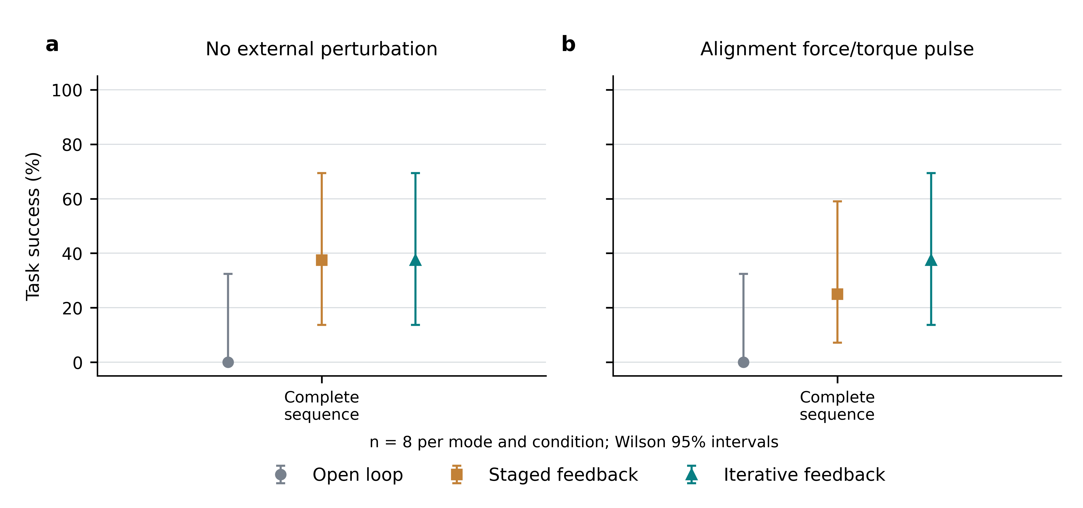
Whole-sequence results and statistical uncertainty
15
Quantitative results
Mode | None | Pulse
Open loop | 0/8 | 0/8
Staged | 3/8 | 2/8
Iterative | 3/8 | 3/8
11/48 complete successes.
All four adjusted paired p-values: 1.0.
No statistically established superiority
or equivalence in this sample.
Interpretation
The selected successful trajectory demonstrates feasibility. Low complete-sequence reliability and wide intervals limit conclusions about feedback benefit. Early failures remain part of the system-level outcome.
MA6216 · Vision-guided robotic manipulation · simulation evidence
Notes:
The complete-sequence success rates are low, and uncertainty is wide. Open-loop succeeds zero of eight with and without disturbance. Staged feedback succeeds three of eight without and two of eight with disturbance. Iterative feedback succeeds three of eight in both conditions. All four method comparisons have Holm-adjusted p equal to one. This establishes neither superiority nor equivalence. The images demonstrate feasible behavior but do not override the full attempted-trial results.
Evidence: n = 8 per mode × condition | Wilson 95% confidence intervals | exact paired tests with Holm correction

Slide 16
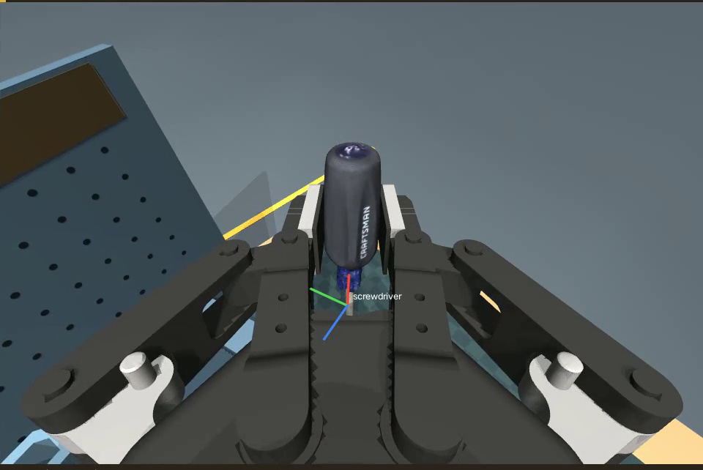
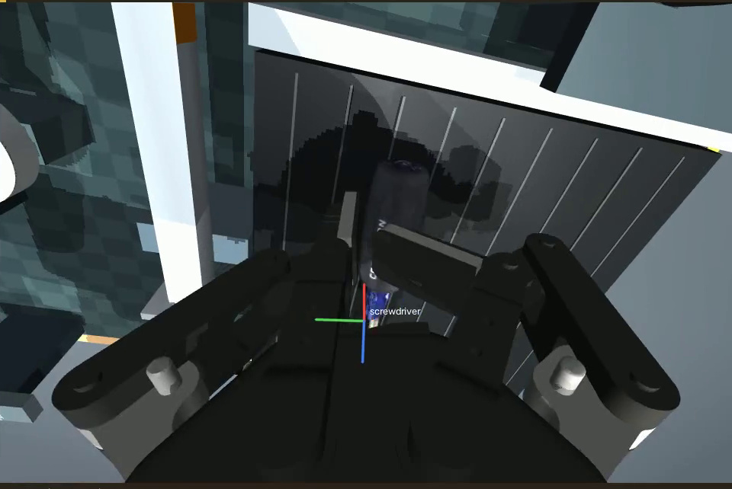
Pose accuracy and the physical failure boundary
16
Error decomposition
Visual pose / initial acquisition
Pickup contact guard
Grasp reliability after reobservation
Initial pose metric | Mean
Translation / rotation | 2.60 mm / 1.44°
ADD / ADD-S | 3.17 / 2.29 mm
Failure category | Attempts
Pickup contact / hammer planning | 24 / 6
Insertion guard / spanner grasp loss | 6 / 1
Initial pose error, TCP tracking and final placement are different endpoints. 500 Hz physics is not visual feedback frequency.
MA6216 · Vision-guided robotic manipulation · simulation evidence
Notes:
The initial fixed-camera pose errors average 2.60 millimeters and 1.44 degrees; ADD and ADD-S are 3.17 and 2.29 millimeters. Those common initial observations do not directly predict whole-sequence success. Of thirty-seven failures, twenty-four stop at moving-pickup closure, six at hammer approach settling, six during open-loop insertion retraction and one after loss of bilateral spanner grasp. This separates perception accuracy, stage reachability and physical reliability. Execution error and visual timing remain in the full report with sample counts.
Evidence: Final calibrated evaluation | 48 paired attempts | original simulation evidence

Slide 17
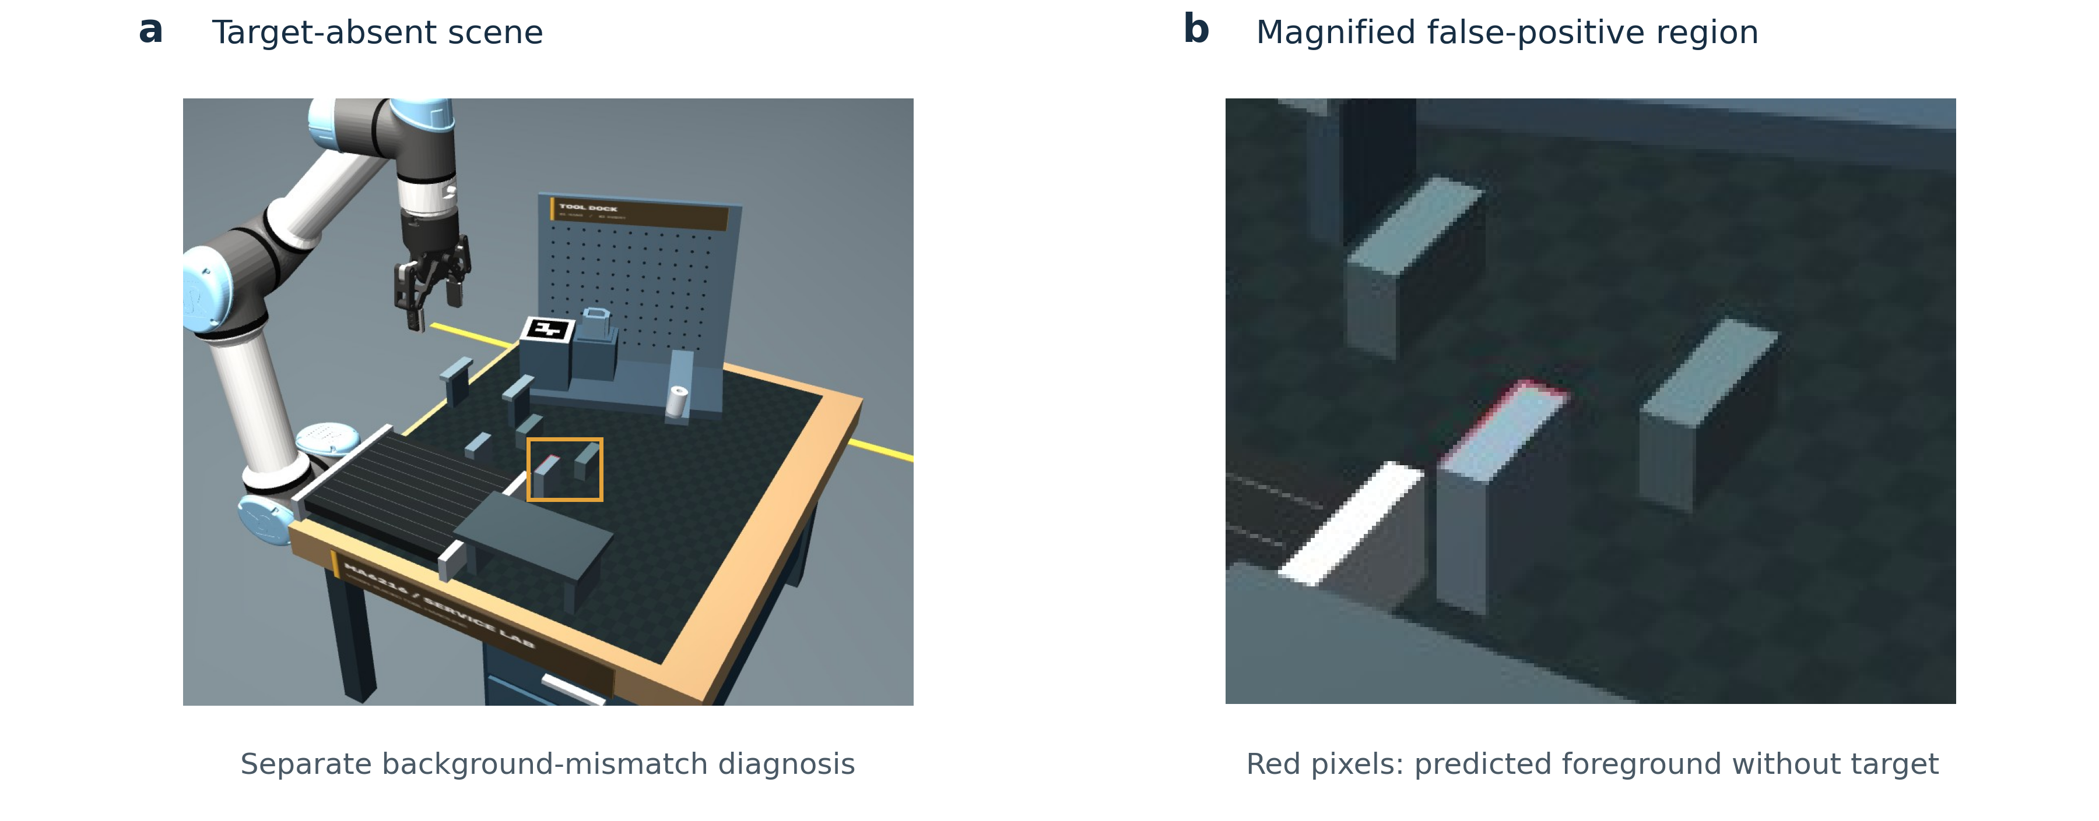
Generalization boundary: background-dependent localization
17
Limitations
Observed limitation
Absent rack target, but mismatched background geometry produces a false-positive region.
The zoom is from the same original image.
Assumption | Impact on interpretation
Known pickup stations and paired backgrounds | Does not establish arbitrary-clutter recognition
Synthetic scans, ideal FK / depth, rigid mounts | Does not establish real-camera or hardware reliability
Small reused-seed sample | Broader unseen-scene trials remain necessary
Separate development diagnosis; not pooled into the 50-scene localization audit or the 48 robot attempts.
MA6216 · Vision-guided robotic manipulation · simulation evidence
Notes:
This separate development diagnosis uses mismatched background geometry. The rack target is absent, but the overlay contains a false-positive red region. The right panel magnifies the region marked on the context image. It is not pooled into the formal fifty-scene localization audit, which uses matched per-scene empty backgrounds. The example exposes a practical limitation: known pickup stations and consistent background references remain assumptions. No artificial failure or scene retouching was introduced.
The project demonstrates a complete calibrated vision-to-action pipeline and a physically released four-operation sequence. The evidence supports feasibility and inspectability, not superior architecture or real-world reliability. The controlled replication has no statistically established feedback gain. Immediate priorities are pickup/contact reliability, background robustness and then feedback scheduling or pose bias. Future validation requires unseen seeds, broader clutter and occlusion, external pose estimators under matched conditions, and eventually hardware. Reference scanning, rigid mounts, FK and basic depth rendering retain ideal assumptions.
Evidence: Separate localization diagnosis | target absent / rack frame / seed 500 | not a robot-trial outcome | Final calibrated evaluation | 48 paired attempts | original simulation evidence

Slide 18
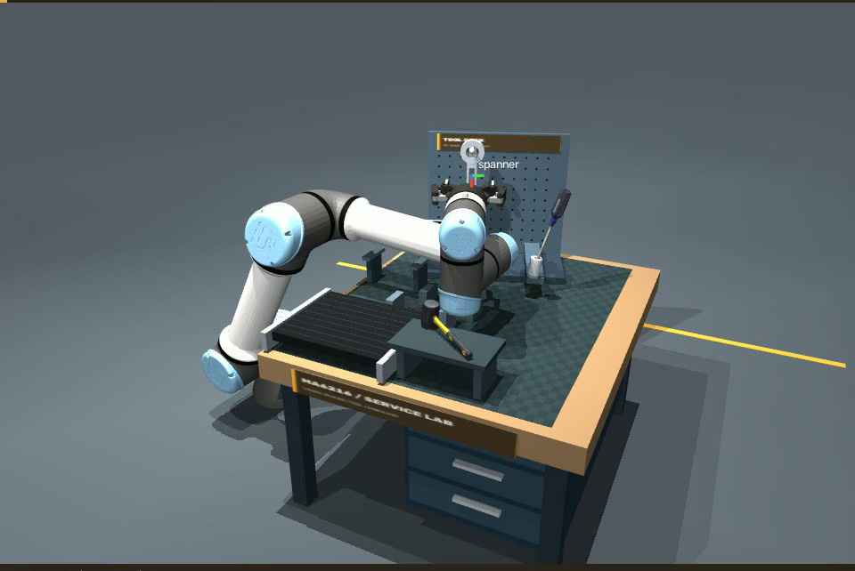
What the integrated system demonstrates
18
Discussion
Demonstrated
Independent calibration
Visual 6D pose integration
Physical regrasp and assembly
Auditable feedback comparison
Next priorities
Improve pickup contacts.
Test changed backgrounds.
Use unseen seeds and external baselines.
Validate on hardware.
High reliability and statistical superiority are not established.
MA6216 · Vision-guided robotic manipulation · simulation evidence
Notes:
The project demonstrates a complete calibrated vision-to-action pipeline and a physically released four-operation sequence. The evidence supports feasibility and inspectability, not superior architecture or real-world reliability. The controlled replication has no statistically established feedback gain. Immediate priorities are pickup/contact reliability, background robustness and then feedback scheduling or pose bias. Future validation requires unseen seeds, broader clutter and occlusion, external pose estimators under matched conditions, and eventually hardware. Reference scanning, rigid mounts, FK and basic depth rendering retain ideal assumptions.
We study vision-guided manipulation in a simulated maintenance workcell. The system integrates independently estimated camera calibration, image-based localization, reconstructed object references, FoundationPose, and physical robot control. Four dependent operations are executed in one continuous scene. The research question is whether additional execution-period pose feedback improves complete-sequence success, rather than merely improving a local alignment residual. The contribution is independent engineering integration and critical evaluation, not a new neural algorithm.
Evidence: Final calibrated evaluation | 48 paired attempts | original simulation evidence | UR5e + Robotiq 2F-85 | MuJoCo | Model-free reference reconstruction + FoundationPose

Slide 19
References and reproducibility
19
Appendix
Selected methods
Wen et al. FoundationPose. CVPR, 2024.
Zhang. A flexible new technique for camera calibration. TPAMI, 2000.
OpenCV. Camera and hand–eye calibration documentation.
Chaumette & Hutchinson. Visual servo control, Part I. RAM, 2006.
Todorov et al. MuJoCo. IROS, 2012.
Reviewed alternatives
Labbé et al. MegaPose. arXiv:2212.06870, 2022.
Fang et al. GraspNet-1Billion. CVPR, 2020.
Repository evidence
Calibration images + robot FK
Predicted and evaluation masks
48 complete trial summaries
Original successful and failed replays
13 annotated image plates (PDF / SVG)
Frame indices, crop boxes and source hashes
Full references: docs/LITERATURE_AND_SELECTION.md
Experiment report: visual-feedback-calibrated-v1
Simulation images illustrate observed behavior; quantitative conclusions use all predefined attempted trials.
MA6216 · Vision-guided robotic manipulation · simulation evidence
Notes:
These references underpin the implemented methods and reviewed alternatives. FoundationPose is the selected pose estimator. Zhang and OpenCV support calibration, Chaumette and Hutchinson provide visual-servoing concepts, and MuJoCo provides the simulator. MegaPose and GraspNet are literature alternatives rather than executed external baselines. The repository retains source code, calibration images and FK, segmentation masks, complete trial summaries, original replays and all image-plate crop manifests.
Evidence: Full citations: docs/LITERATURE_AND_SELECTION.md and docs/references.bib | source manifests included

