Slide 1
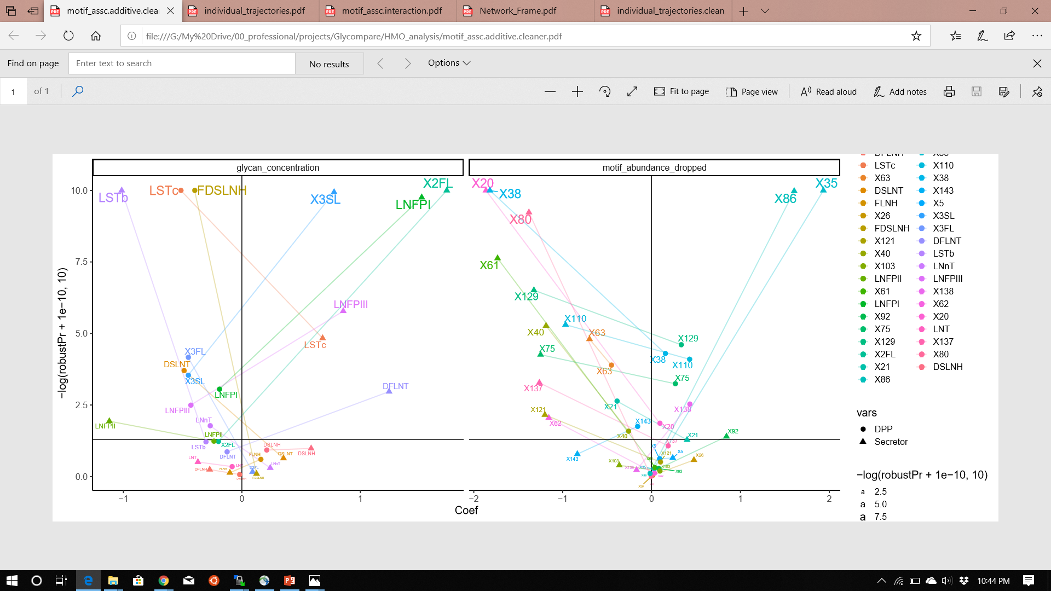
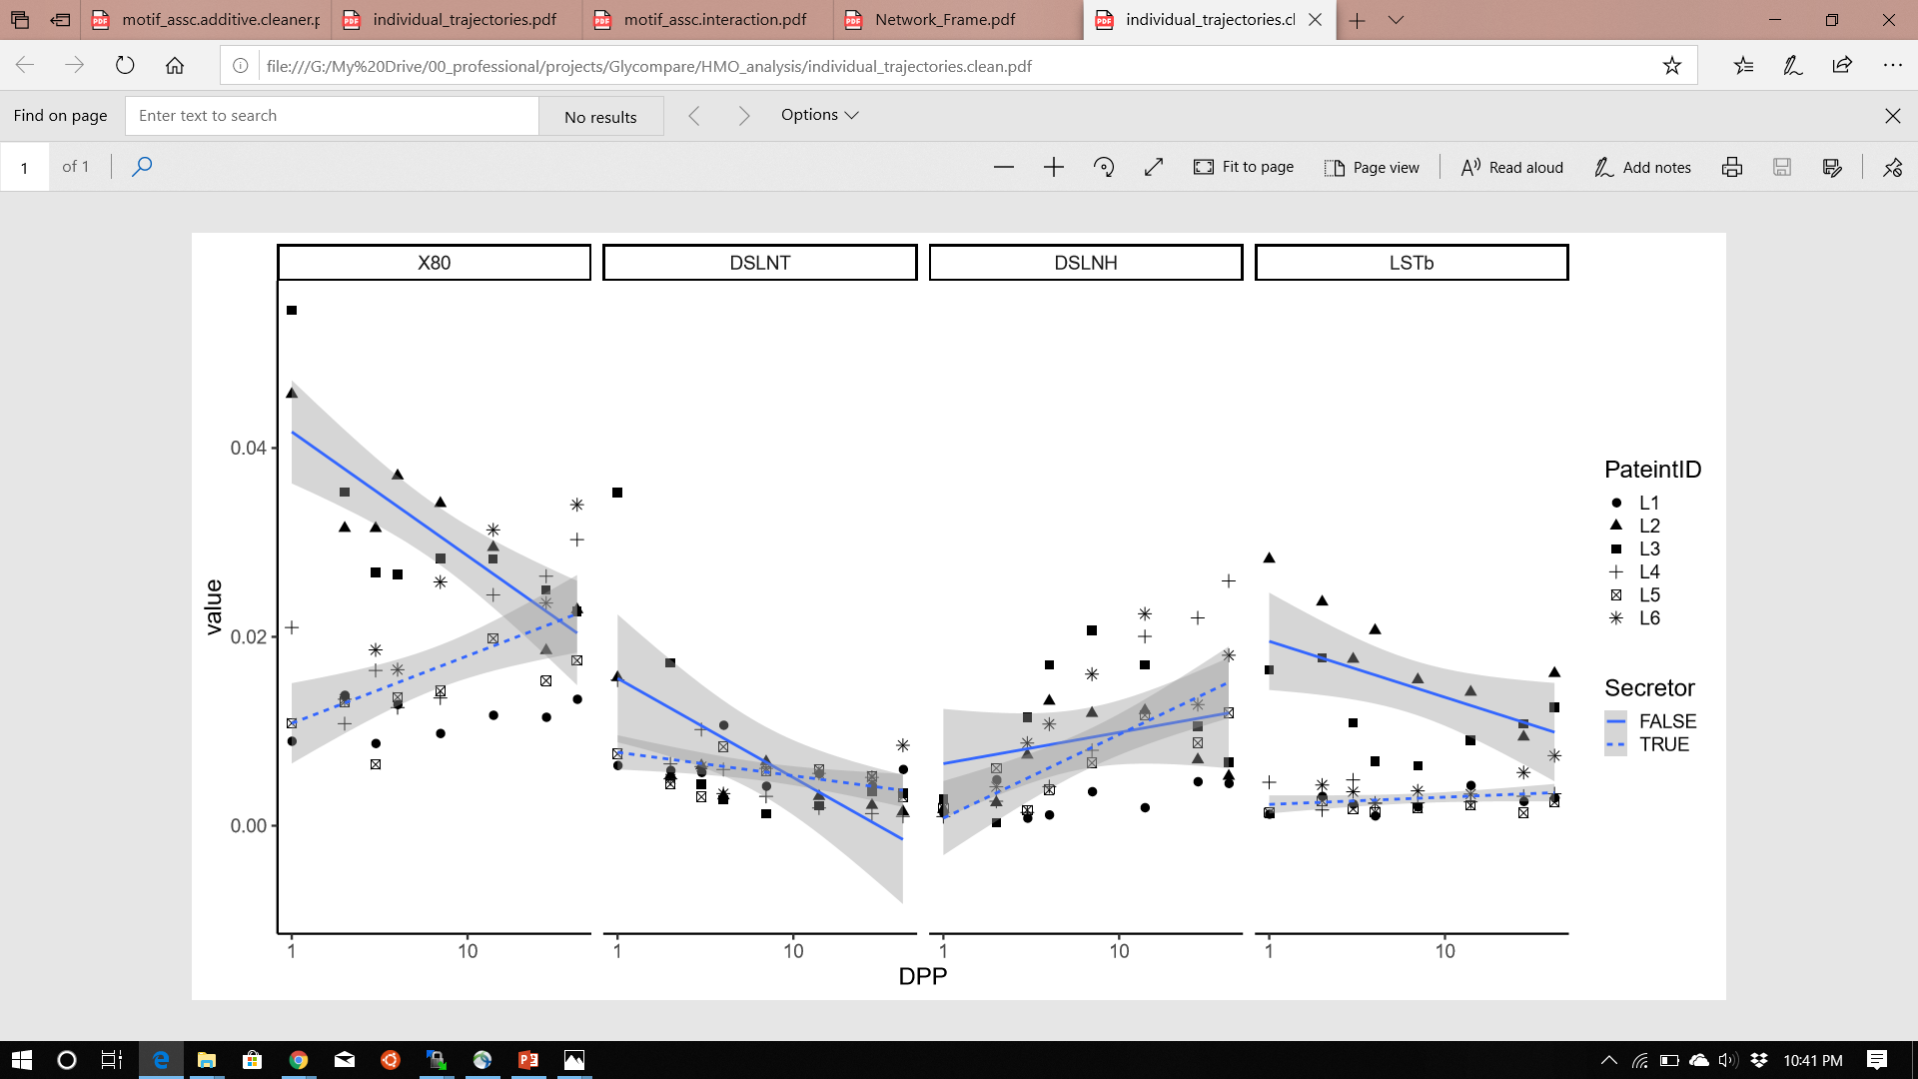
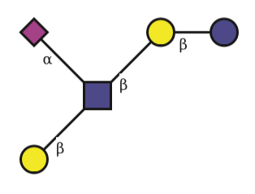
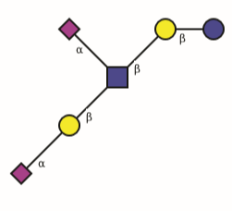
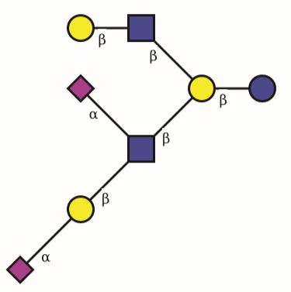
A.
-log10( P coefficient )
Regression Coefficient
Depleted
Enriched
B.
Relative Abundance (%)
Days Postpartum (DPP)

Slide 2
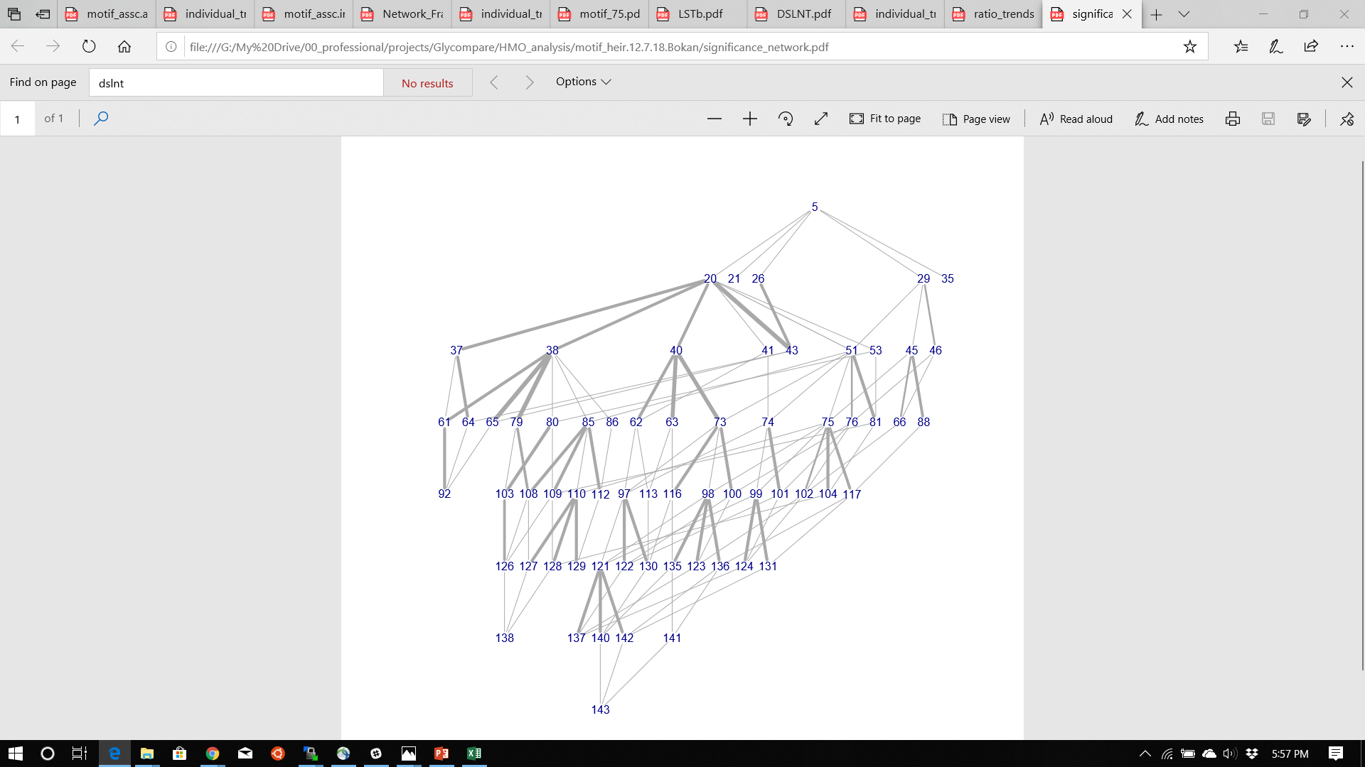
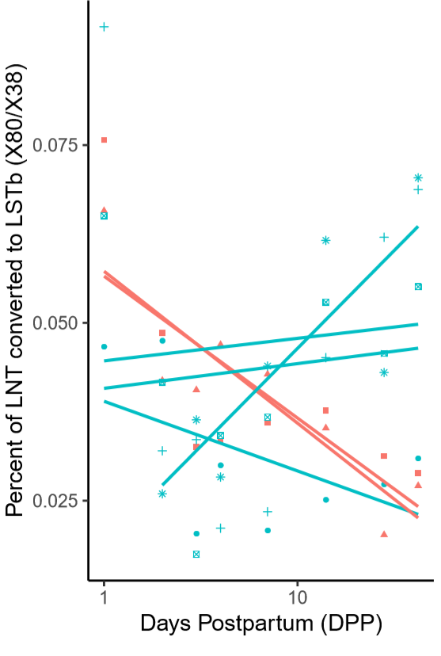
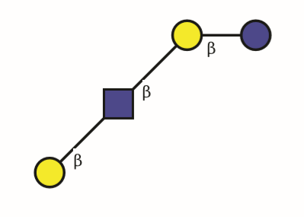
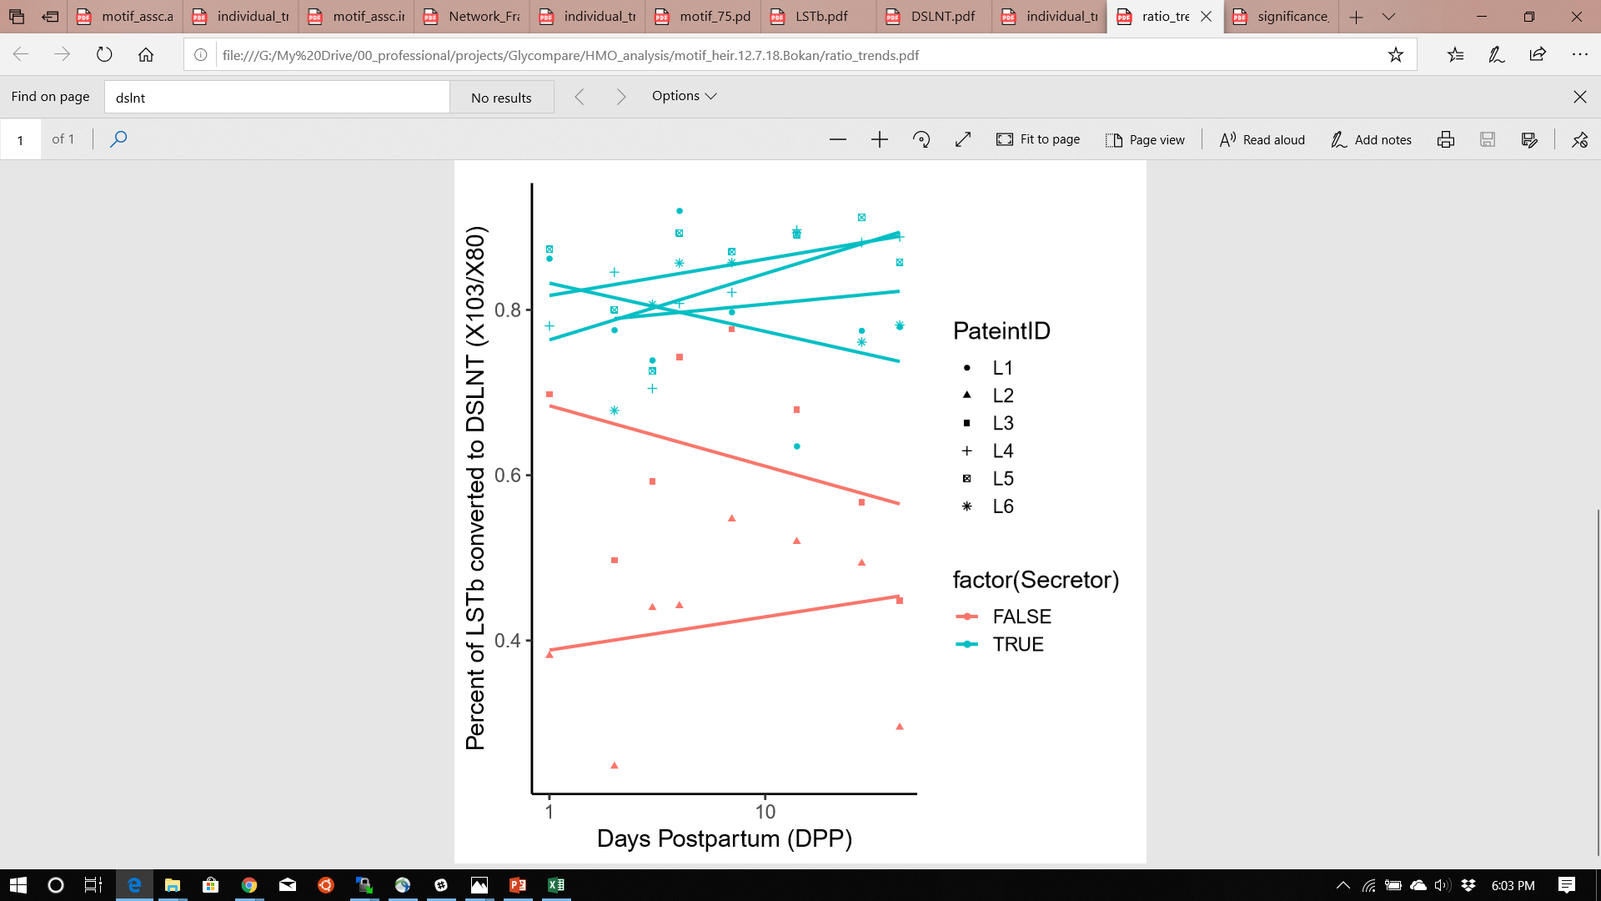
A.
Relative Abundance (%)
Days Postpartum (DPP)
GEE( Secretor ~ log(DPP) + X80/X38 )
Coef. = -0.010 +/- 0.017 (Wald p = 0.55)
B.
C.
GEE( Secretor ~ log(DPP) + X103/X80 )
Coef. = -0.053 +/- 0.02 (Wald p = 0.0183)

