Slide 1
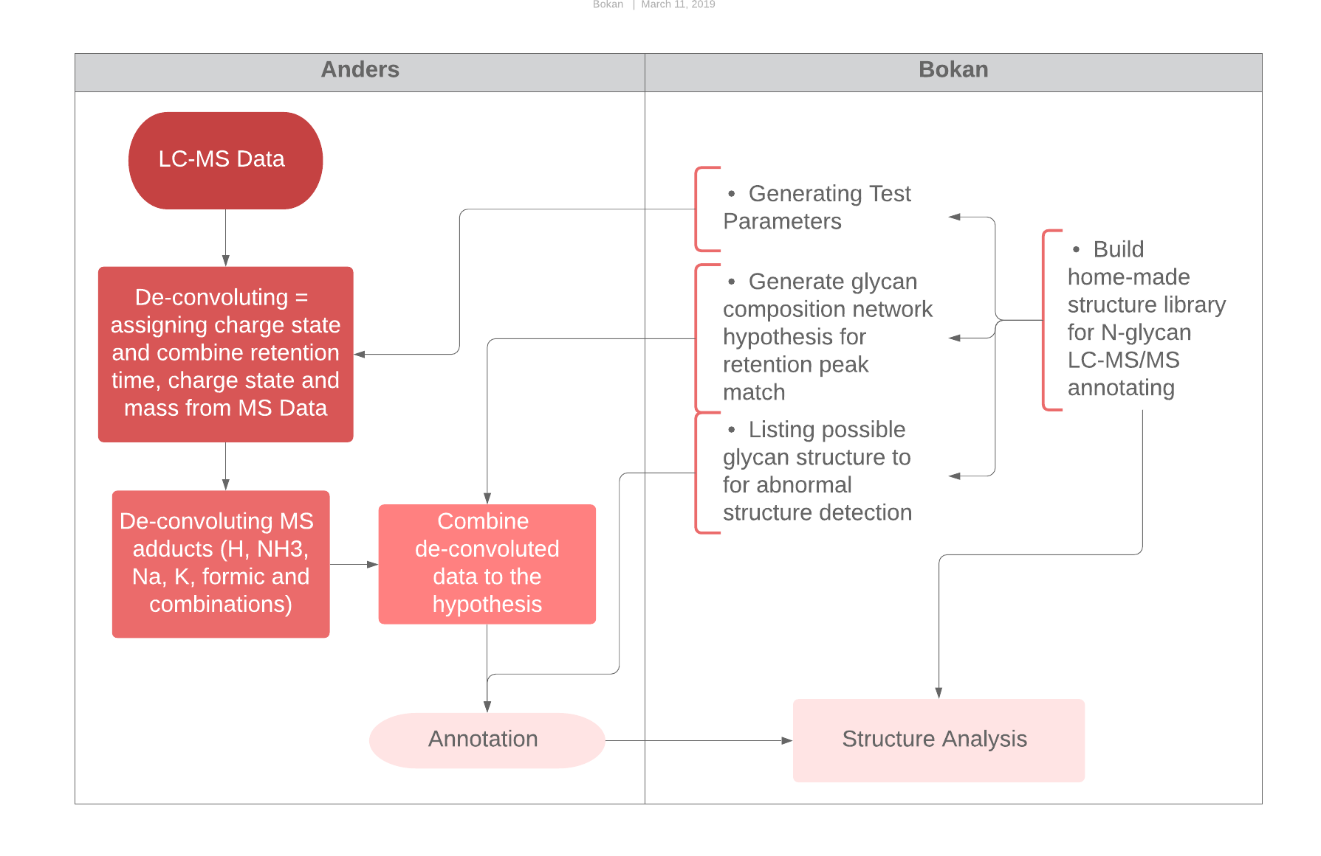
Annotating the CHO glycan with Glycresoft and Glypy
Abnormal retention peak detection
Automatic annotation
Substructure analysis
Rule
Structure
Shorthand
Composition
Mass

Slide 2
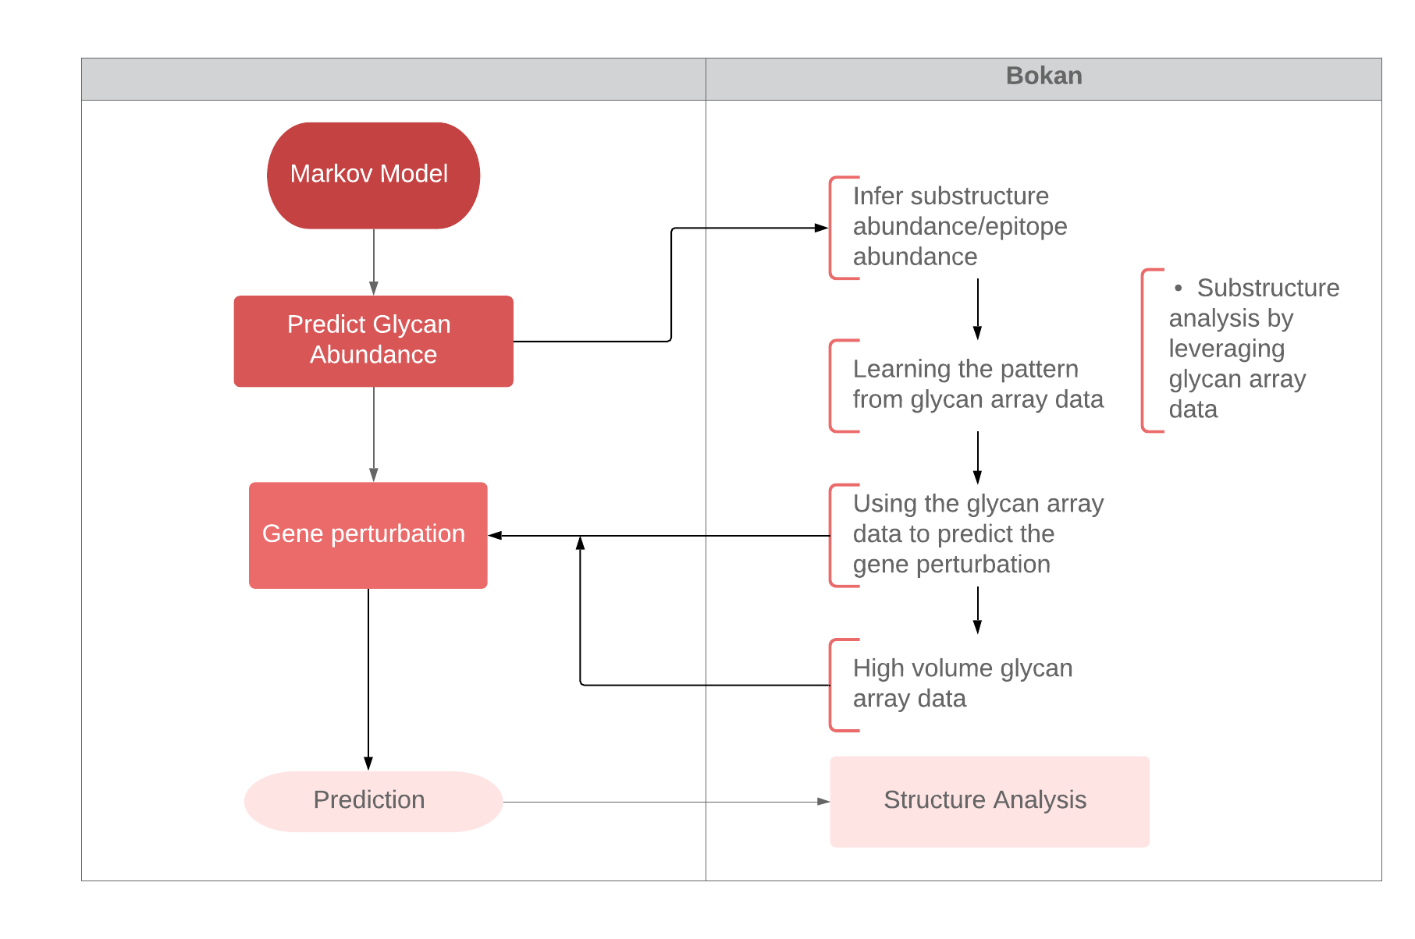
Further substructure analysis

Slide 3
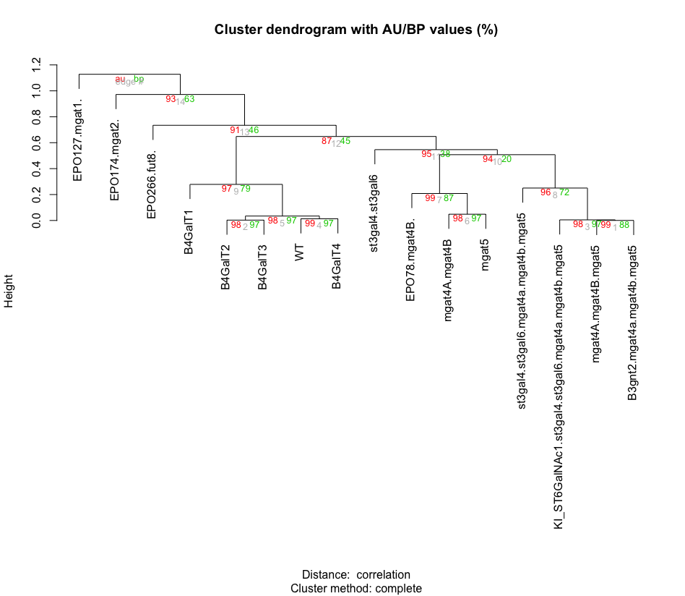
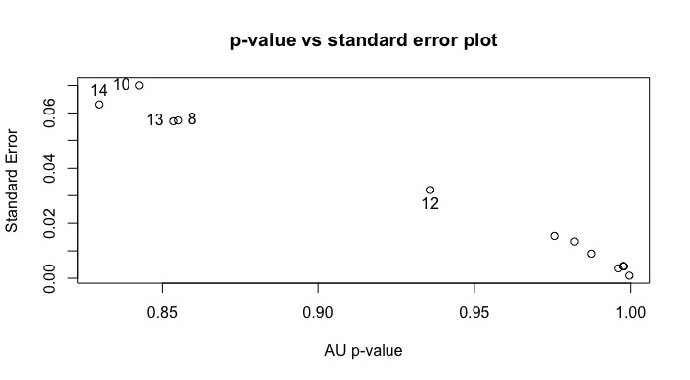
pvclust provides two types of p-values: AU (Approximately Unbiased) p-value and BP(Bootstrap Probability) value. AU p-value, which is computed by multiscale bootstrap resampling, is a better approximation to unbiased p-value than BP value computed by normal bootstrap resampling.For a cluster with AU p-value > 0.95, the hypothesis that "the cluster does not exist" is rejected with significance level 0.05; roughly speaking, we can think that these highlighted clusters does not only "seem to exist" caused by sampling error, but may stably be observed if we increase the number of observation.

Slide 4
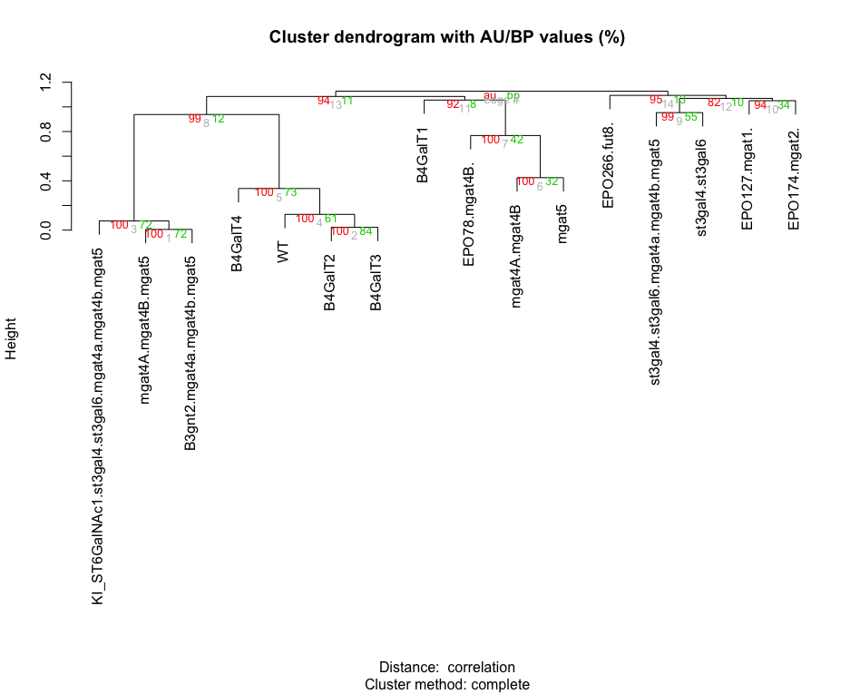

Slide 5
